Slide 1

Greenhouse Monitoring Using GSM
Final Project II

Slide 2
An-najah National University
Faculty of Engineering
Telecommunication Engineering Department
Prepared By :
Maram Hassan Asma Ghannam
Predicted By
Jamal Kharrousheh
1

Slide 3
Contents
Greenhouse Materials Hardware
Greenhouse Materials Software
Building a Greenhouse based on Arduino Software?
Advantages
Disadvantages
Scope to further work
Conclusion
Our model
2

Slide 4
Greenhouse Materials (Hardware)
Arduino Board(AT-Mega)
GSM modem(SM5100B GSM Cellular Shield)
Sensors: - Humidity&Temperature - LDR- Soil Moisture
Housing (based on CubeSat desing) -Screws –fiber glass
Plants -Soil
Water Injection: tank - valves - water hose - minerals
Power Supply -ADC
Cables
Computer
Liquid Crystal Display (16*2 LCD)
Actuators – Relays(6)
Water pump -Motor
Cooler (fan)
Artificial Lights (lamp)
3

Slide 5
Greenhouse Materials (Software)
Arduino Software –Codes
Software Libraries: - for the sensors
Internet (research) :- Temperature& Humidity Sensor-Relays functions-Datasheets for sensors
4

Slide 6
Building a Greenhouse based on Arduino Software?
Greenhouses are controlled-area-environment to grow plants.
In order to control the climate factors and environment autonomously, it is required a computer/software equipment.
The arduino is the heart of the system.It constantly monitor the analogue or digitalized parameters of the various sensors, verifies them and checks if any corrective action is to be taken for the condition at that instant of time.
5

Slide 7
In case such situation arises, It will send an alarm messages to the authorized user and activates the device such as motors,coolers , pumps , sprayers , lights etc.
6

Slide 8
Water pump can be controlled by arduino unit with the soil moisture sensor attached to it. It will turn on the water pump when the soil moisture sensor detects the dry conditions in soil.
7

Slide 9
Temperature sensor can be used with the arduino to measure the temperature in the greenhouse. If the temperature may rises, It would triggers the cooling devices.
Humidity sensor is used for sensing the vapor in the air. The change in RH(relative humidity) of the surroundings would trigger the arduino to activate the sprayers.
8

Slide 10
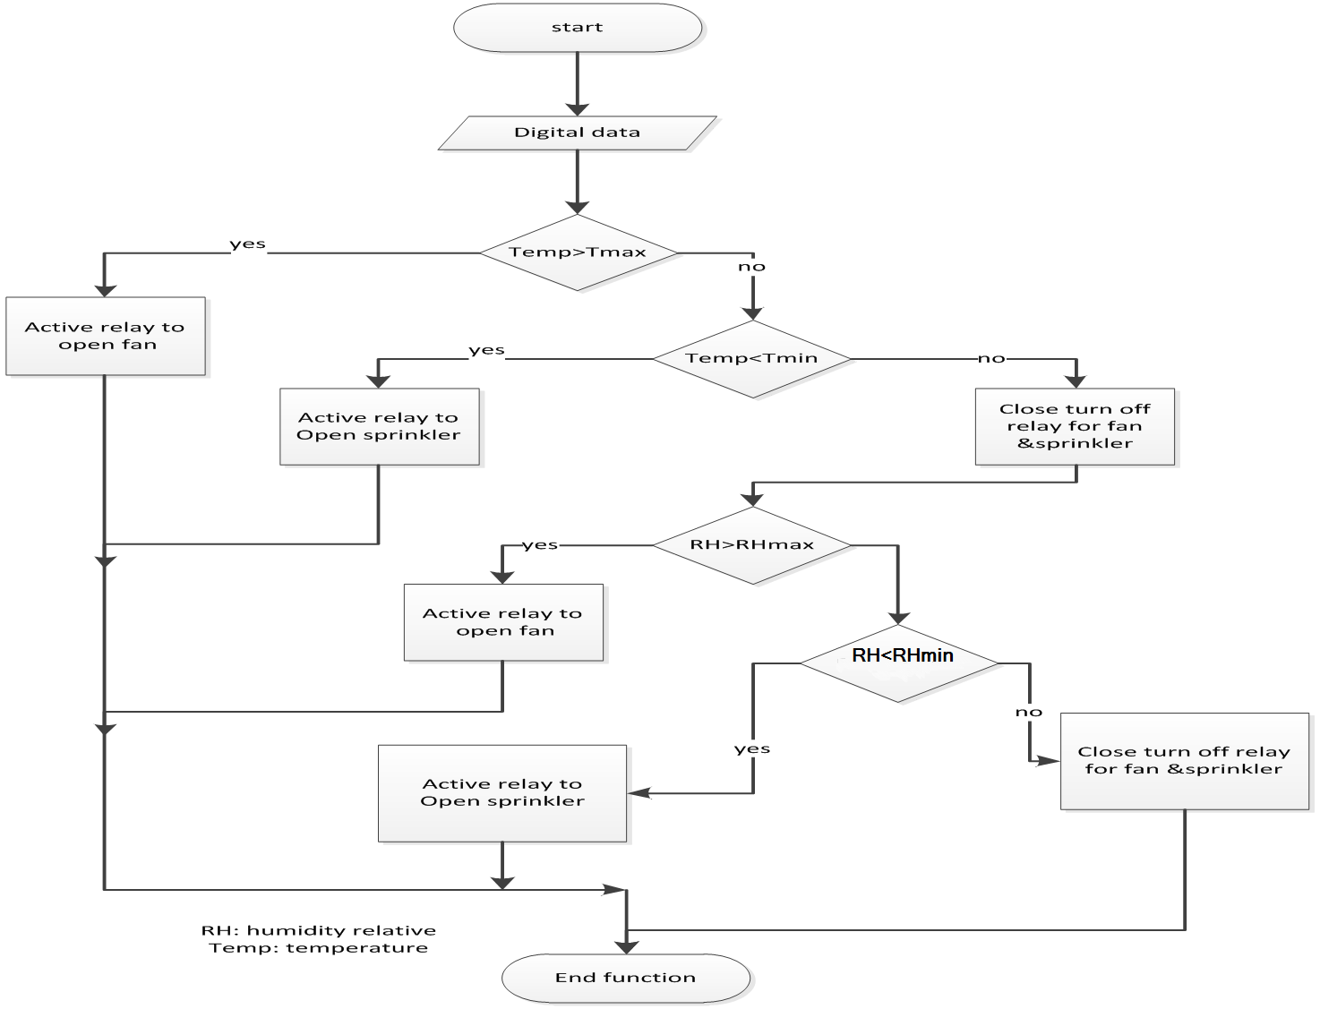
9
9

Slide 11
Growing lights enable cultivators to extend daylight hours – useful for winter and spring growing when levels of natural lights are low, and therefore can improve plants growth. The arduino trigger the artificial lights automatically when the surrounding natural light are low.
10

Slide 12
We used 3- push buttons to improve our system and varying the max or min values indicated in the code to match with the suitable conditions.
11

Slide 13
Note
During the hot summer day , the bright sun may cause the temperature inside the greenhouse rises to an extreme heat. With the arduino , the authorized user can open up the vents to allow the fresh air enter the greenhouse by simply calling the arduino unit.
The authorized user is able to inquire the environment status by sending a text message to the arduino unit.
12

Slide 14
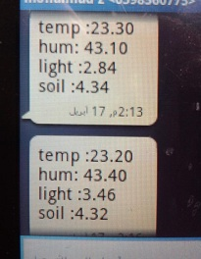
Alarming
Messages to inform operator about operating and error status in the process.
13

Slide 15
Advantages
Low cost system, providing maximum automation
Low maintenance and low power consumption
The system is more compact compared to the existing ones, hence is easily portable.
Labour saving.
Provides a user-friendly interface hence will have a greater acceptance by the technologically unskilled workers.
Closed loop design prevents any chances of disturbing the greenhouse environment.
14

Slide 16
Sensors used have high sensitivity and are easy to handle
In response to the sensors, the system will adjust the heating, fans, lighting, irrigation,irnmediately, hence protect greenhouse from damage.
Malfunctioning of single sensor will not affect the whole system.
User is indicated for changes in actuator state thereby giving an option for manual override.
15

Slide 17
Disadvantages
Complete automation in terms of pest and insect detection and eradication cannot be achieved
No self-test system to detect malfunction of sensors
Requires uninterrupted power supply
Facility to remotely monitor the greenhouse is not possible !
16

Slide 18
Conclusion
We build an automated greenhouse model using Arduino technology.
The system supervise and control the irrigation, light , temperatures, and humidity levels for optimum plant growth.
This automating technology saves time and money by eliminating the need for service personnel to visit each site for inspection.
The system is modified to alert farmers regarding the parameter changes in the greenhouse so that early precaution steps can be taken.
18

Slide 19
Scope for further development
Sending emails or speaking voice could be used when an alarm happens.
The system performance can be modified by providing the power supply with the help of battery source which can be rechargeable or non-rechargeable, to reduce the requirement of main AC power.
In addition to measure the conditions that have been mentioned , other conditions may be included like shade and fire detection .
17

Slide 20
Our model
LCD
1.
"Smart greenhouse“
3.
"Temp="
temp
"Hum="
hum
day..
4.
"wait sendin sms"
Buttons
Button3 | Button2 | Button1
inc | dec | Htemp
inc | dec | Ltemp
inc | dec | Hhum
inc | dec | Lhum
19

Slide 21
Comments?

