Slide 1
Tennis Ball Collector Robot
Hardware Graduation Project
Asala Tibi.
Hala Barqawi.

Slide 2
OutLines
Introduction
Used Tools
Product Design
Feature
Methodology
Constraints and Challenges
Future Work
The End

Slide 3
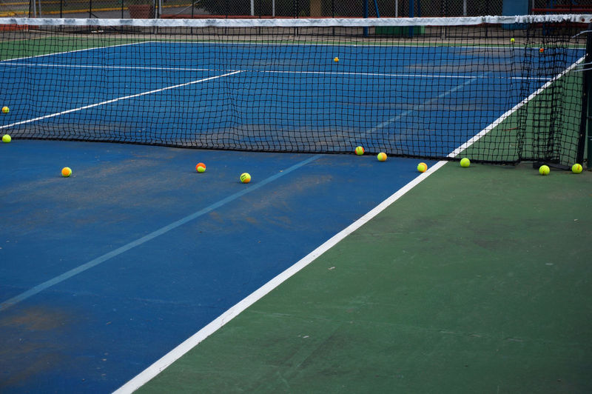
Introduction
1
Problem:
Gathering the tennis balls that have been used and played in various areas of the court can be a wearisome and exhausting task for tennis players during training sessions. And it wastes their energy .
Solution:
This project aims to address the laborious task of manually collecting tennis balls during training sessions by developing an autonomous robotic tennis ball collector.

Slide 4
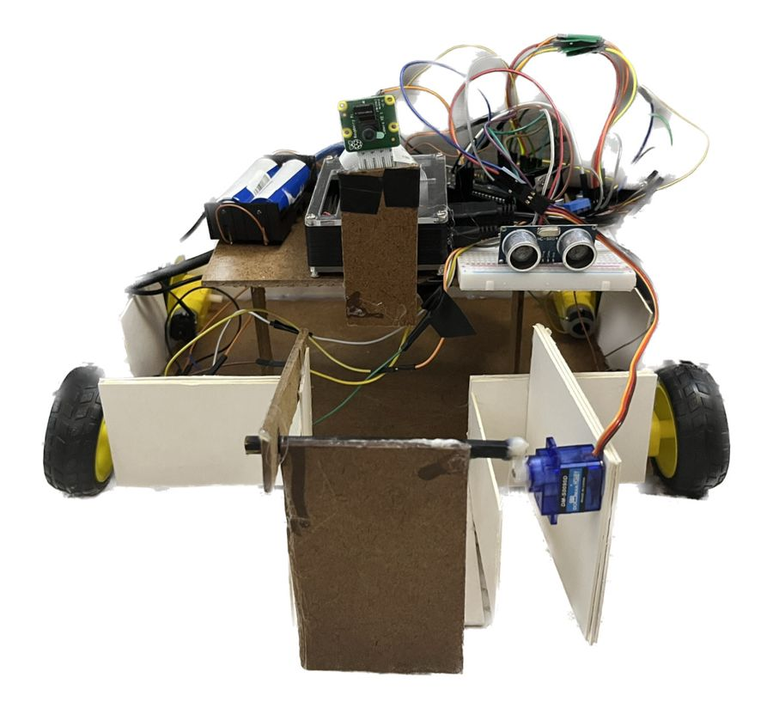
Tennis Ball Collector Robot
The objective of our project is to introduce robotics into the sports field and implement automation to replace humans in performing labor-intensive tasks such as ball collecting.

Slide 5
Used Tools
2
Hardware parts :Electronics ,Power source ,Controller Part and Mechanical Parts.

Slide 6
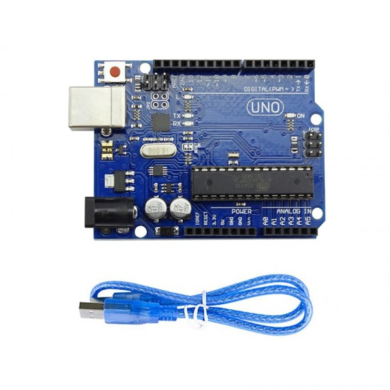
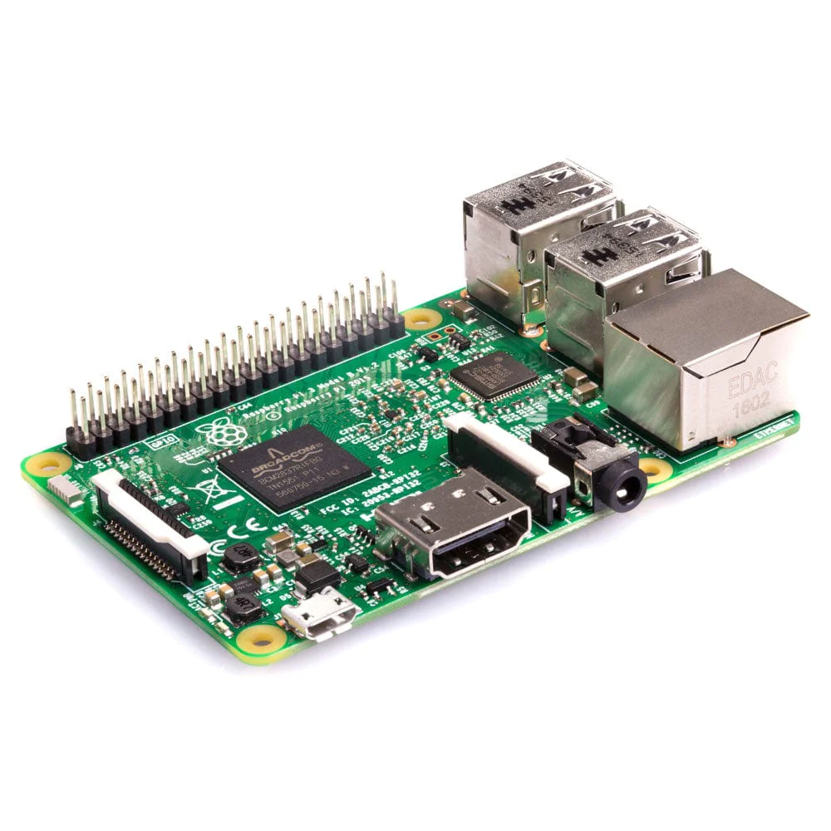
Used Tools
Arduino Uno
Raspberry Pi 3

Slide 7
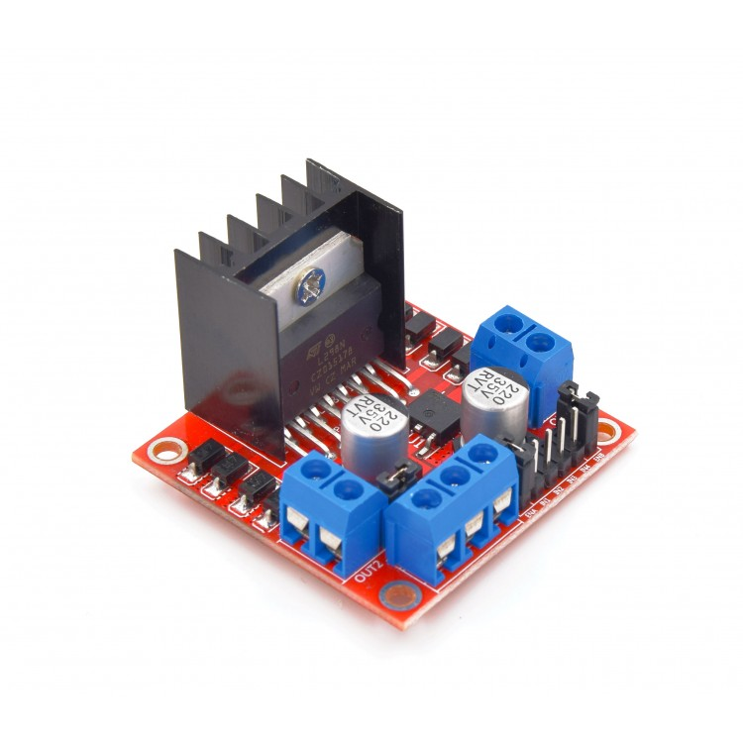
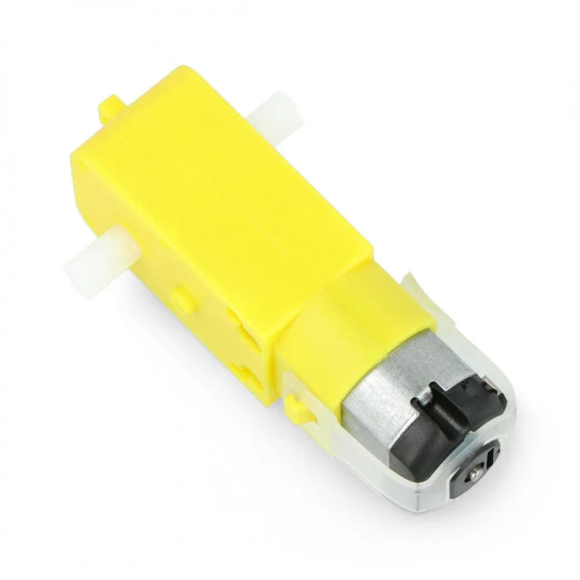
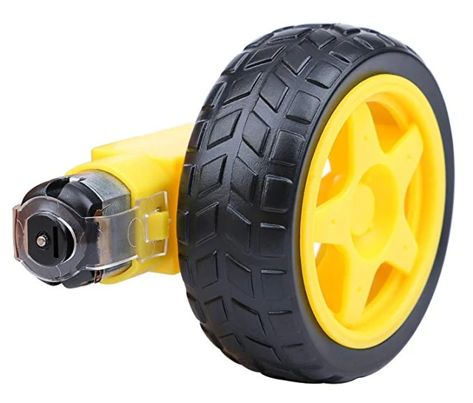
Used Tools Cont.
Dc motor
Wheel Robot
motor driver L298N

Slide 8
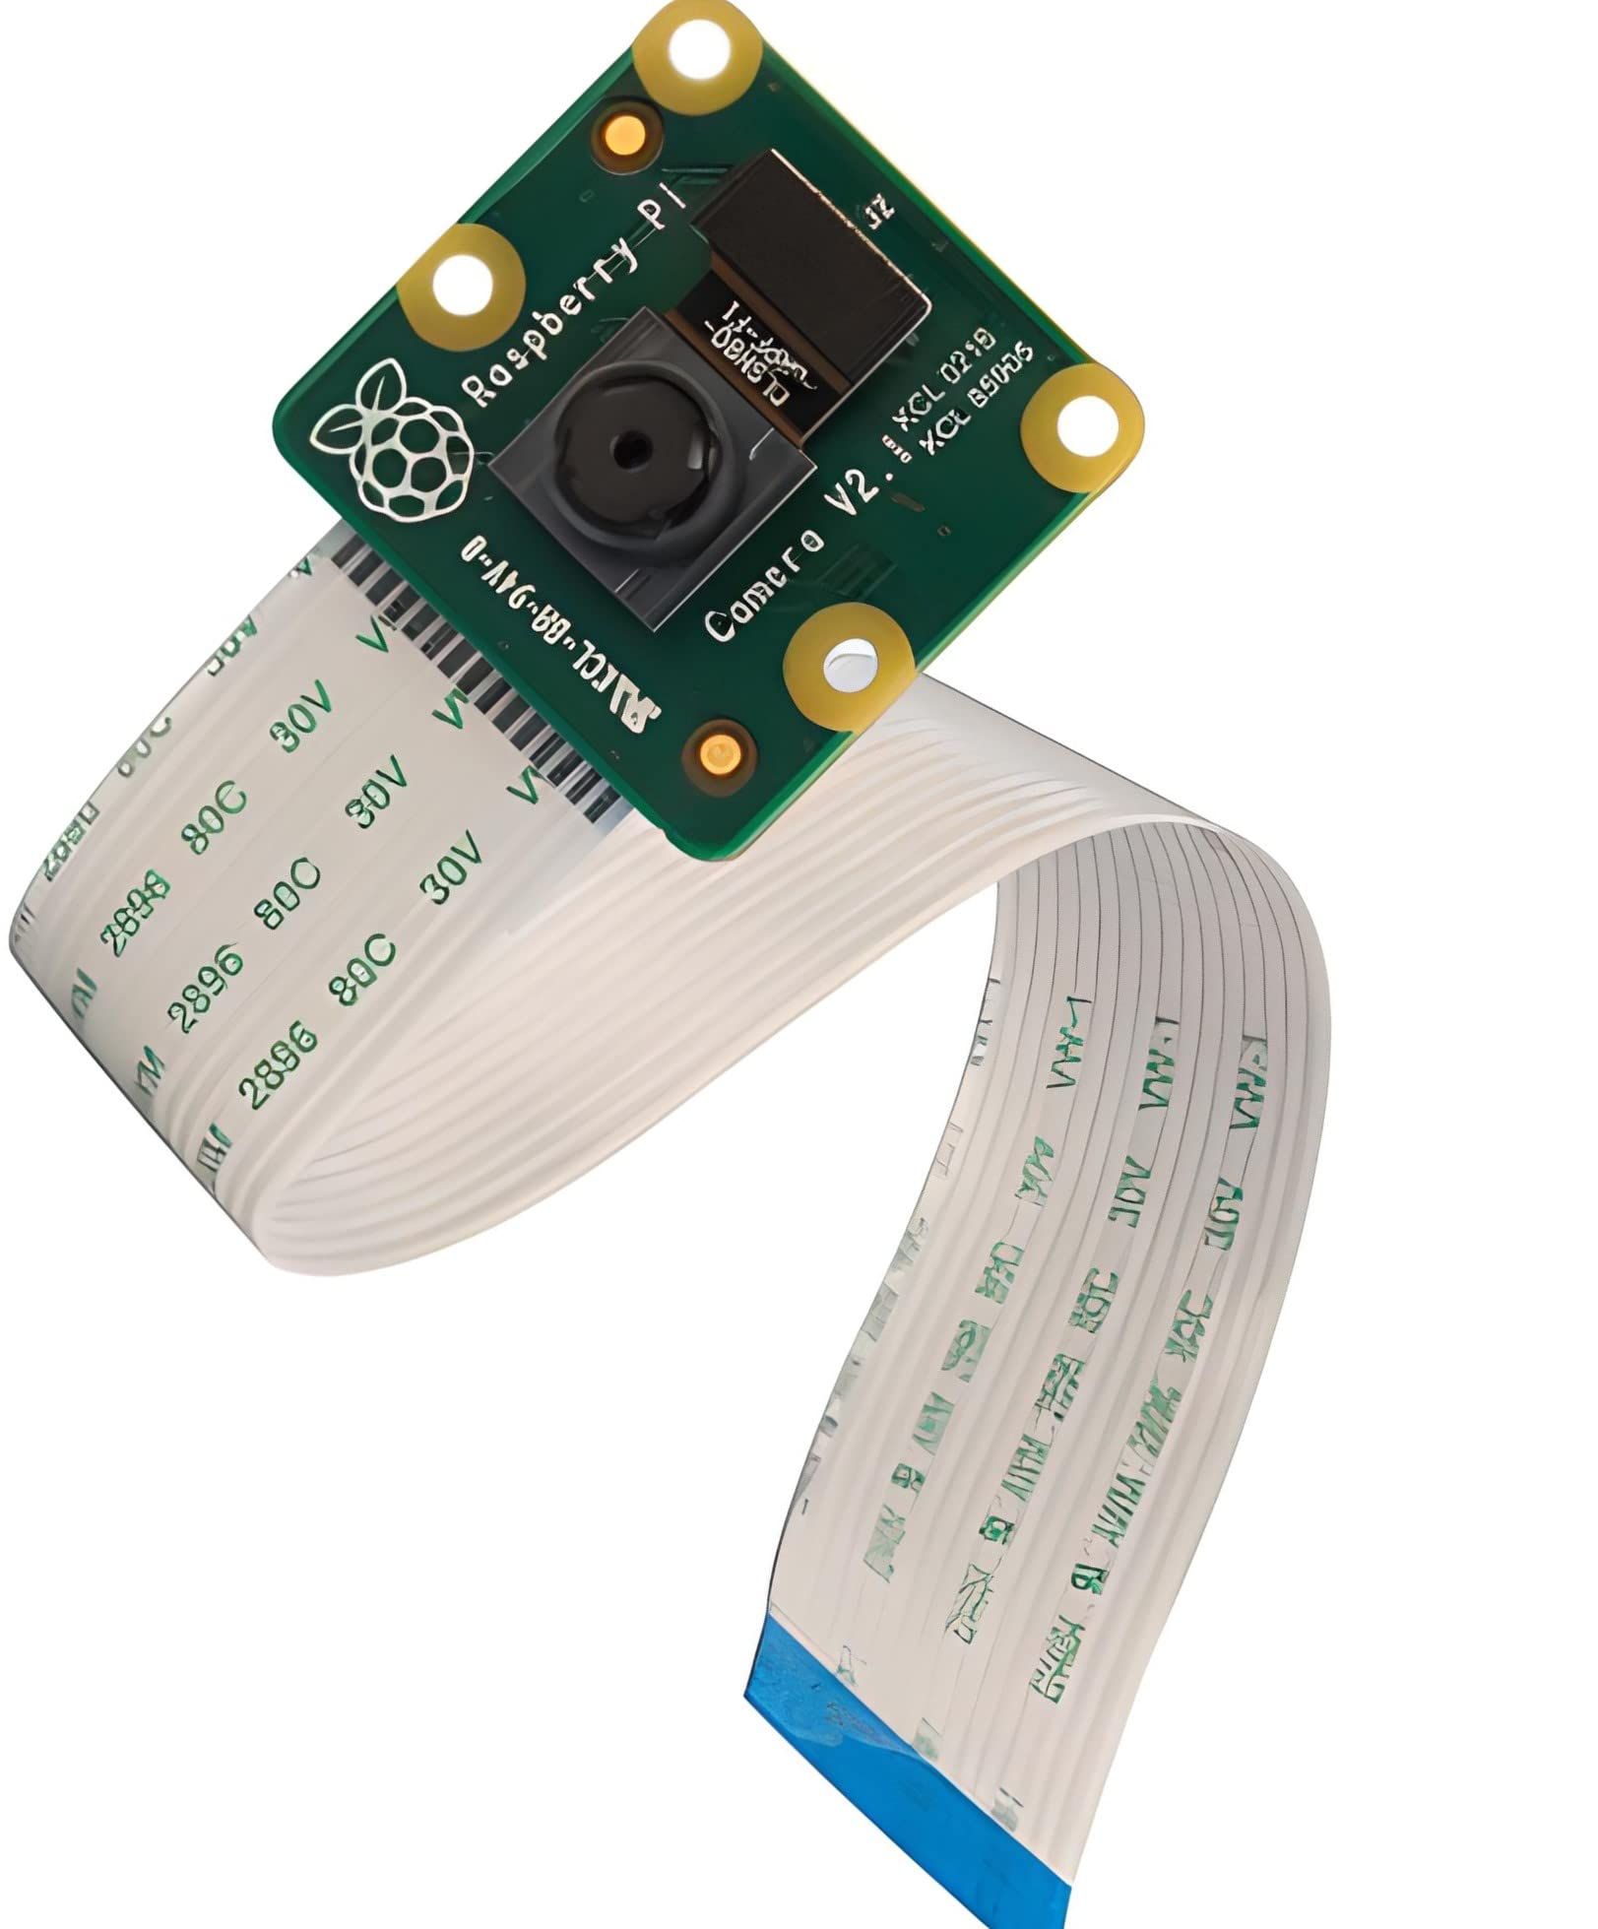
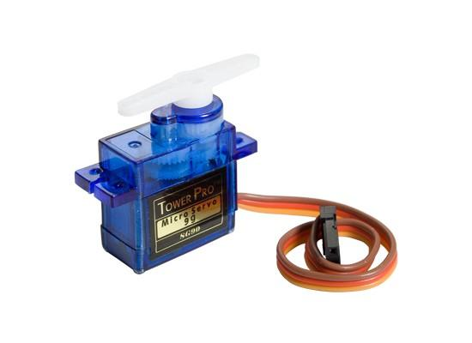
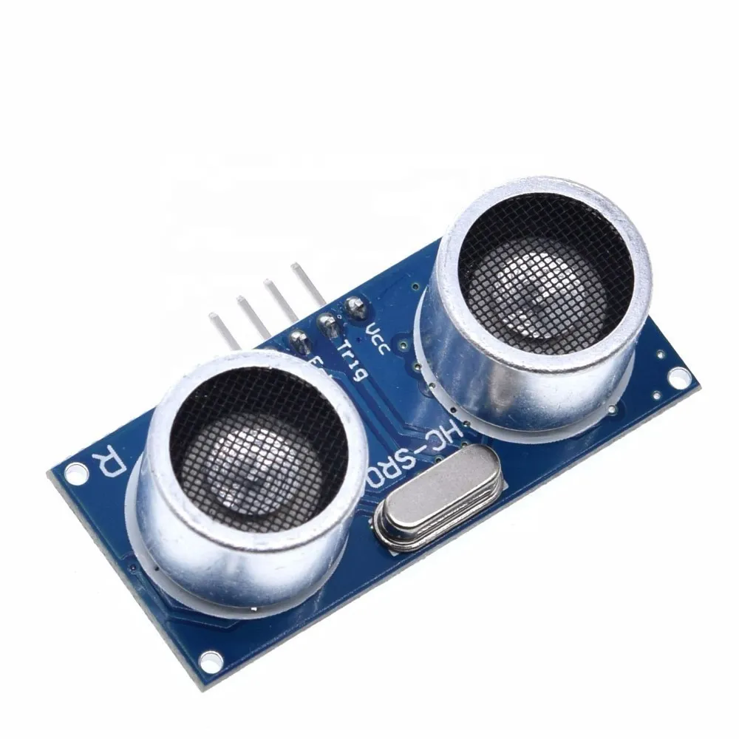
Used Tools Cont.
Raspberry pi camera
Servo motor
Ultrasonic sensor

Slide 9
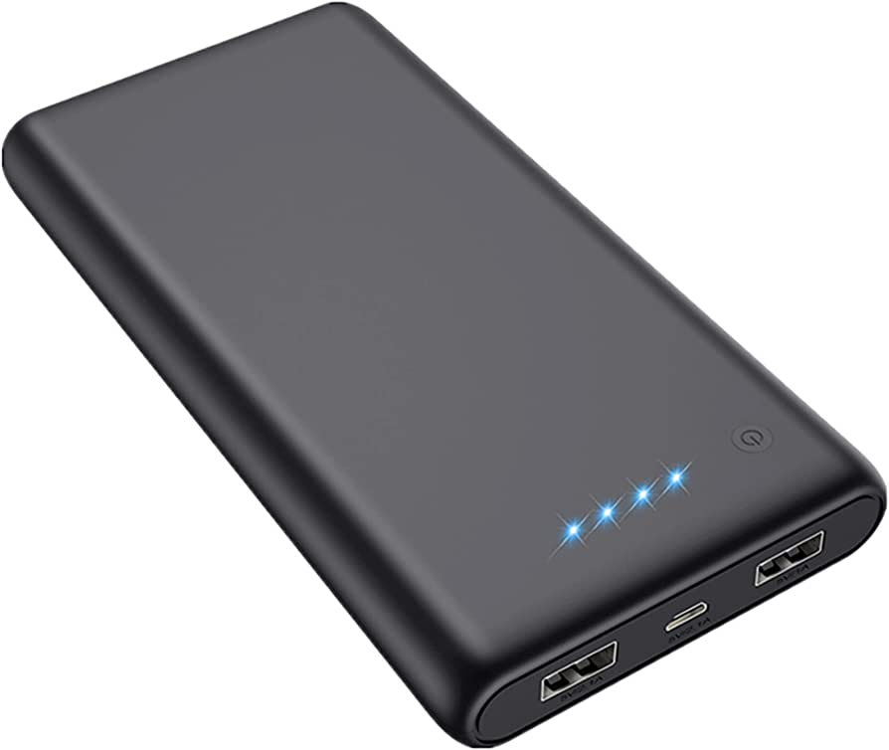
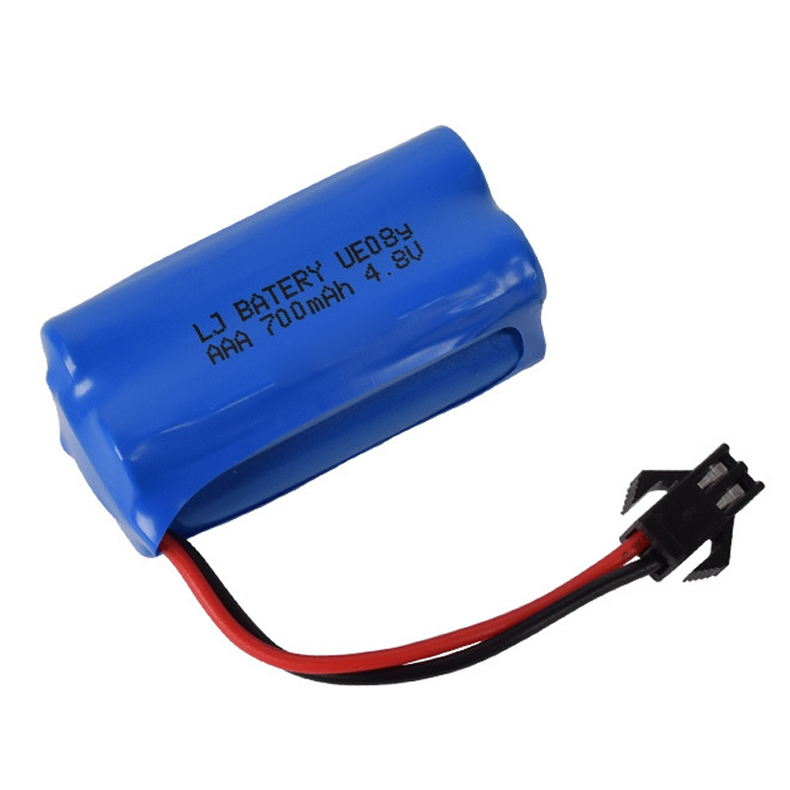
Used Tools Cont.
Power Bank
Lithium battery

Slide 10
Product Design
3
Customize Design -Hand made- .
Storing area: It is placed at the front of the robot so that the balls can enter it immediately without the hassle of going somewhere first.
Effectively tackle the ball.
Lightweight robot -portable- .

Slide 11
Features
Obstacle aِvoidance
Autonomous
Moving
Effectively Collecting balls

Slide 12
Methodology
4
How does it work?.

Slide 13
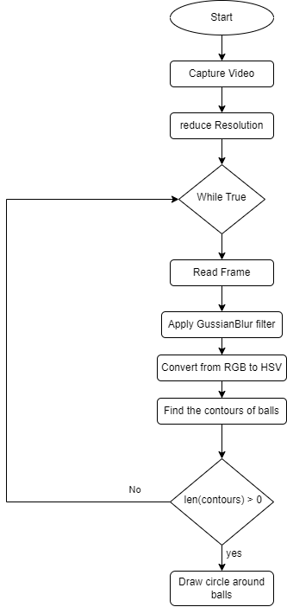
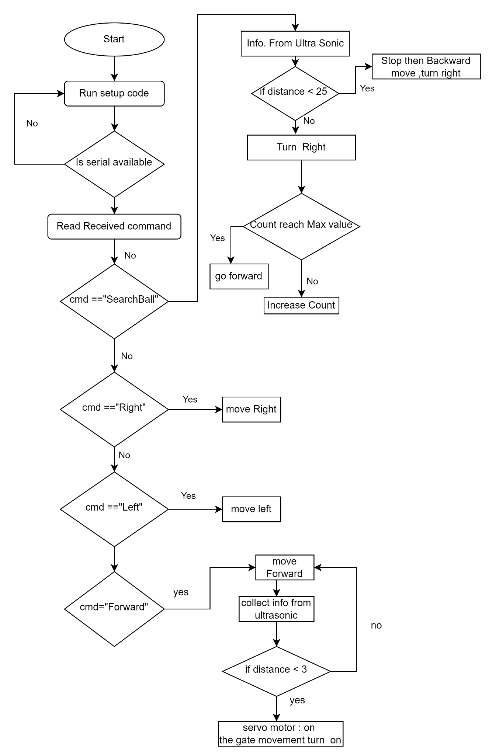
Tennis Ball Collector Robot FLOWCHARTS
For Raspberry pi :
For Arduino:

Slide 14
Challenges
5
Time Limit.
Delay in executing serial commands.
Gate movement while ball is close .

Slide 15
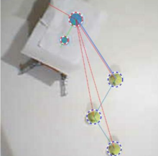
Future Work
6
SMS notification when Robot need to be rechargeable.
When storage become full, Robot will return to the tennis ball container.
Optimal path will be generated by the path planning algorithm

Slide 16
Thanks!
Any questions ?
Supervisor :Asmaa Afeefi
Asala Tibi
Hala Barqawi

