Slide 1


Water Works For Baqa Al-Sharqyah Town
-Analysis And Re/Design
An – Najah National University
Prepared by :
Boraq Ali Raghad Onnab
Supervisor : Dr . Abd Alfttah Almallah

Slide 2
Outline :
Objectives
Study area
WDN Review
WWCN
Results
Conclusion & Recommendations

Slide 3
Objectives:
Analysis the existing water distribution network.
Redesign the existing water distribution network.
Design a wastewater collection network.

Slide 4
Study area:
Location:
Located in the north of Tulkarem governorate
at a distance of about 17km at the north of the
west bank.
2. Surrounded by Apartheid wall from the west,
Wadi Abu Nar from the south and some villages
that surrounds the rest of it.

Slide 5
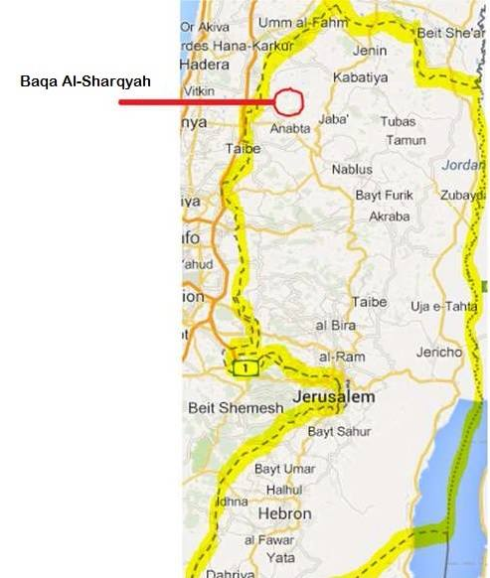
Location:

Slide 6
Study area:
Topography:
The elevation of Baqa ranges from 60 up to 130 meters above sea level.
This town varies in its terrains, it has three mountains at the east, plain from the west and valley from the south.

Slide 7
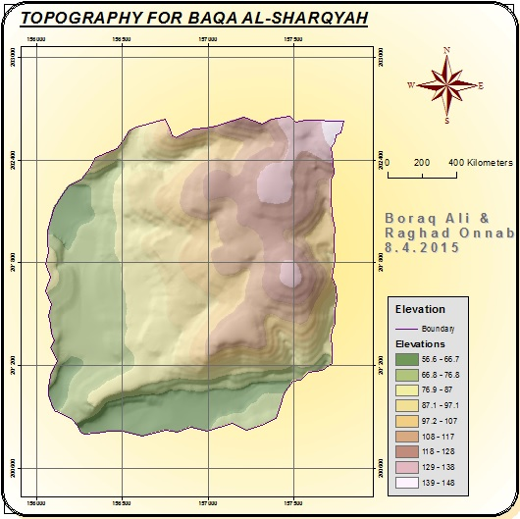

Slide 8
Study area:
Population Calculations
population estimations from the Palestinian Central of Statistics:
Year | 2007 | 2008 | 2009 | 2010 | 2011 | 2012 | 2013 | 2014 | 2015
Pop. | 4064 | 4143 | 4222 | 4304 | 4386 | 4471 | 4555 | 4641 | 4726
The study period is 30 years from now (2015) so depending on these data and using annual compounding method
We predict the population in 2045,
P(2045) = 9674 capita.
Design demand = 4704.6 m³/day.
Design load = 4015 m³/day.

Slide 9
Graduation Project 1 Review
Water Distribution Network

Slide 10
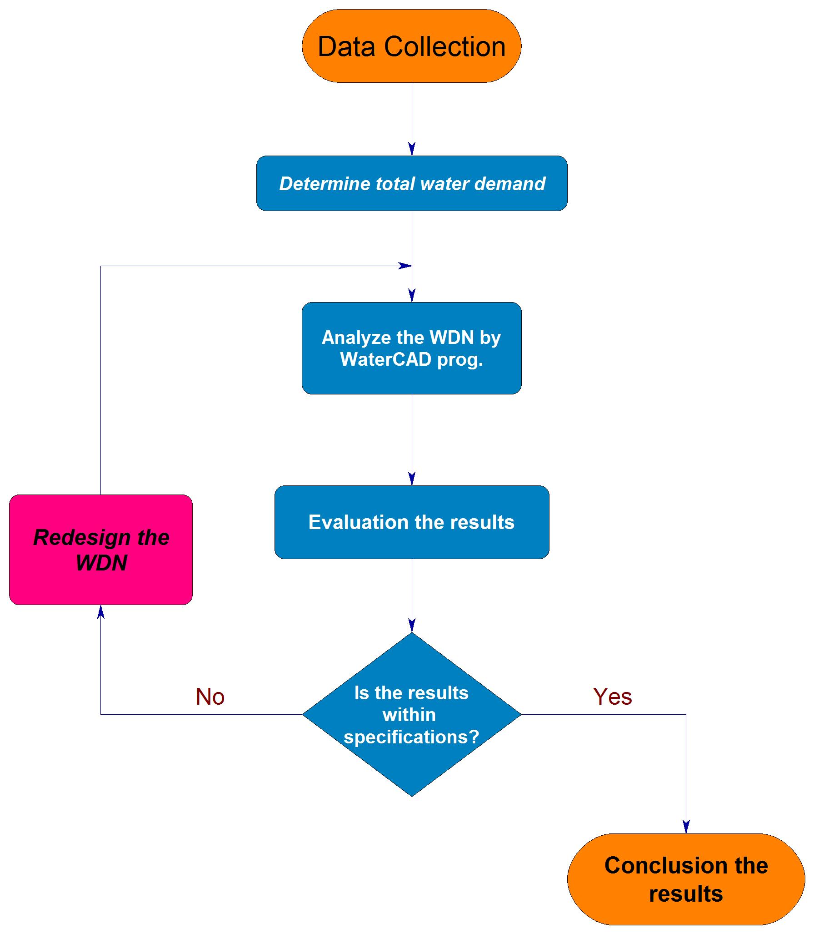
Methodology:

Slide 11
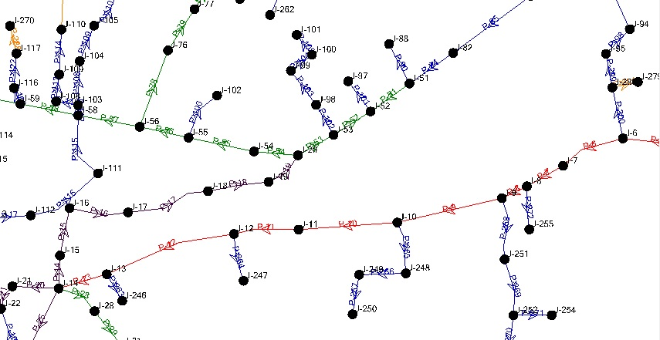
Drawing the existing network

Slide 12
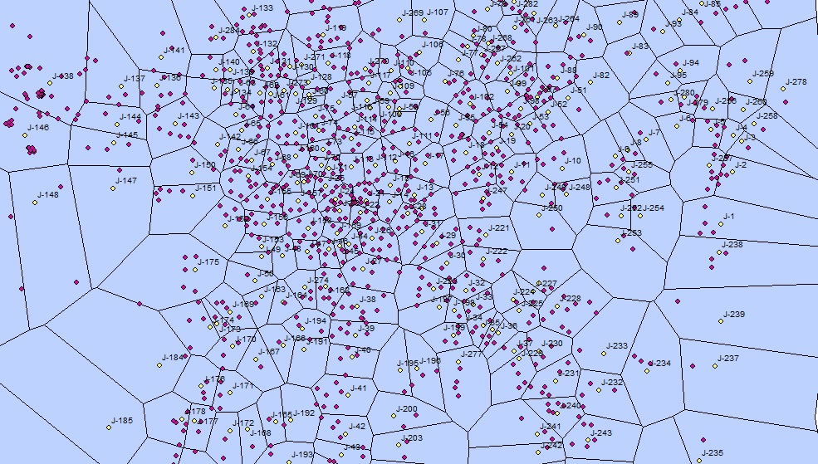
Distribution of houses for each junction in each service area

Slide 13
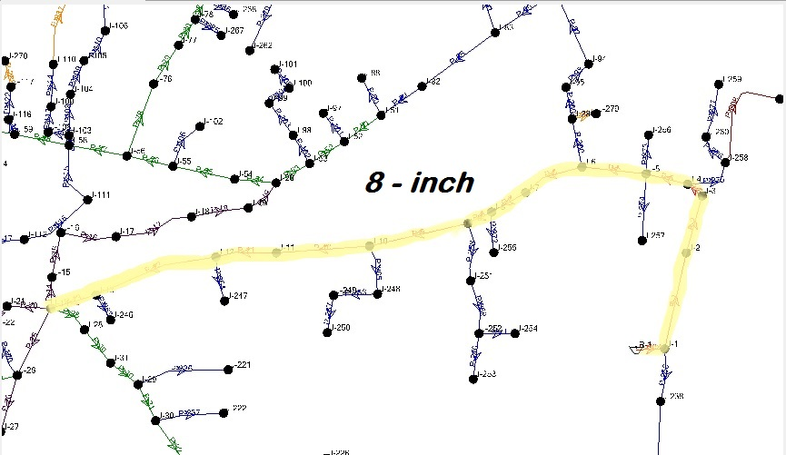
Redesigning and changing the main pipe size

Slide 14
Results:
Pressure
Velocities

Slide 15
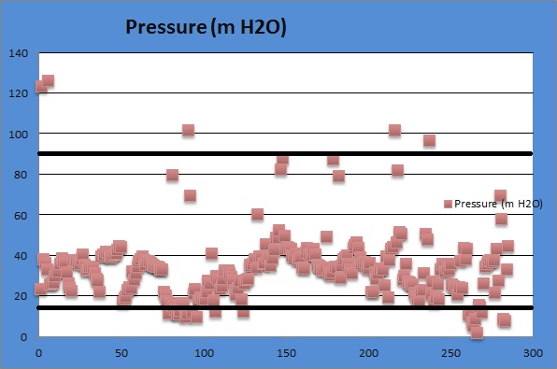
Pressure:

Slide 16
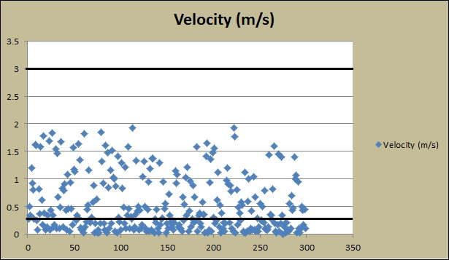
Velocities:

Slide 17
Recommendations:
Pressure reducing valves (PRV) for high pressure.
Internal pumps for low pressure.
Boosters for low velocities.

Slide 18
WasteWater Collection Network

Slide 19
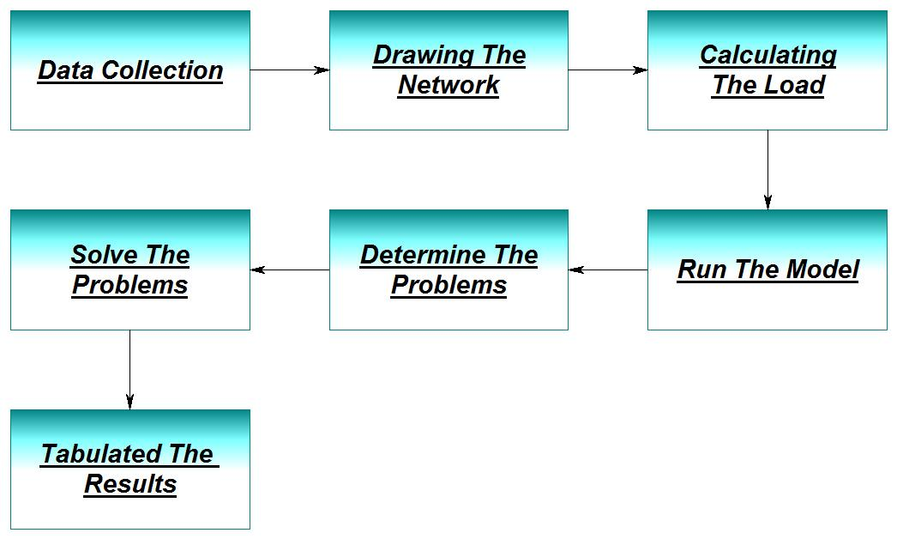
Methodology:

Slide 20
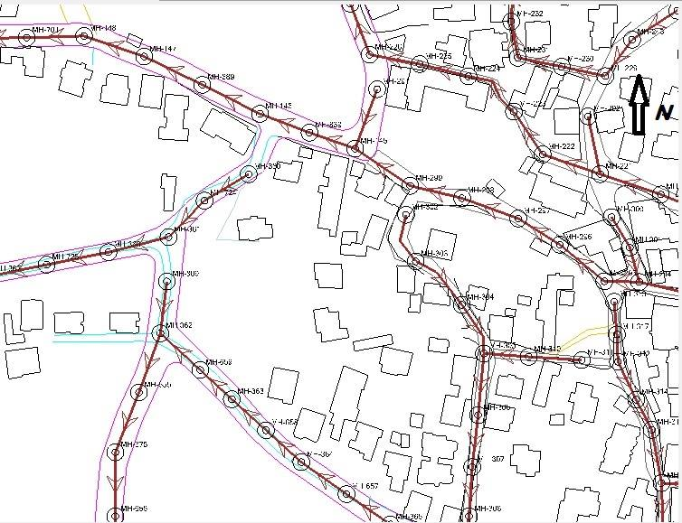
Drawing the Network

Slide 21
Arc-hydro:
Long time
Low accuracy
Shorter time
Medium accuracy
Very short time
High accuracy

Slide 22
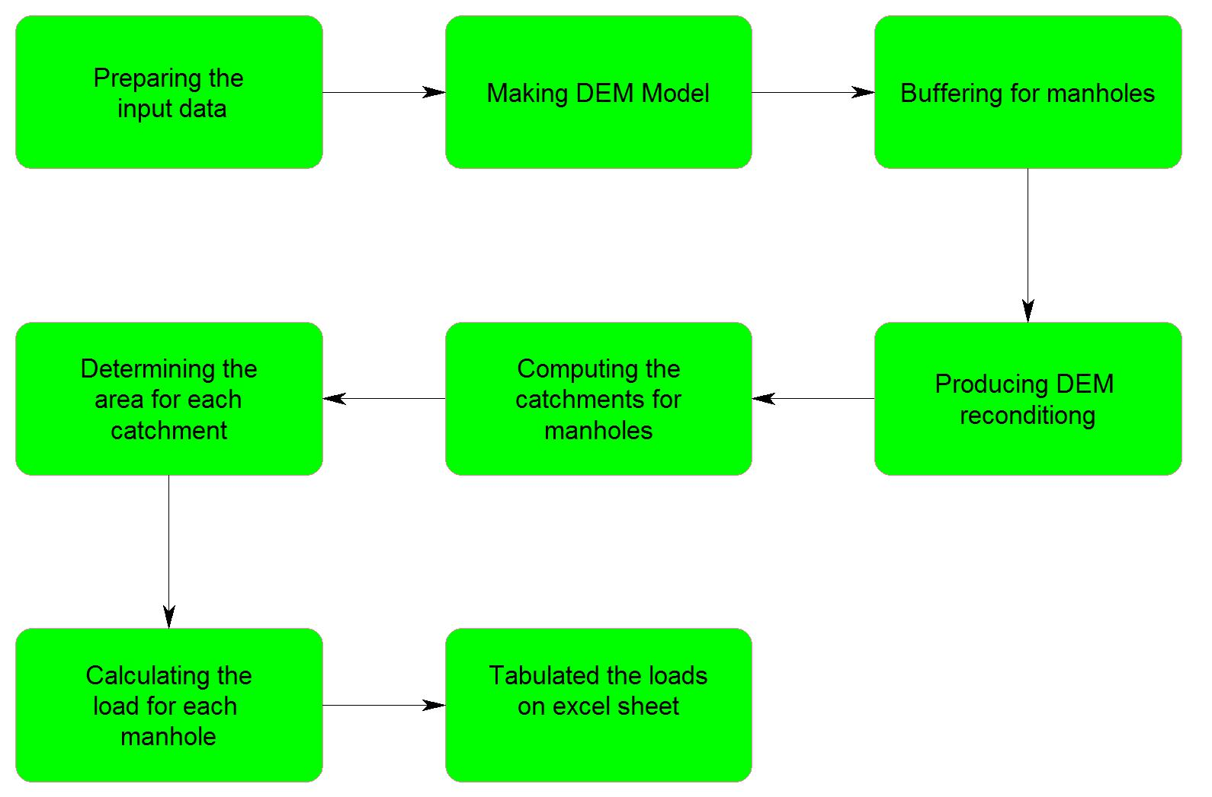
Arc-Hydro Method

Slide 23
Results:
Cover
Slope
Velocity
Length of conduits
Cost

Slide 24
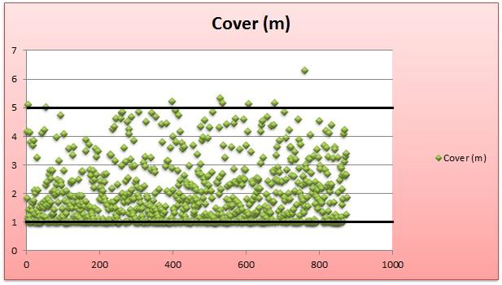
Cover Depth:

Slide 25
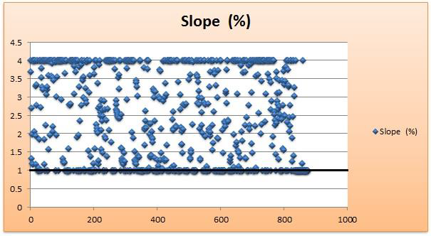
Slope:

Slide 26
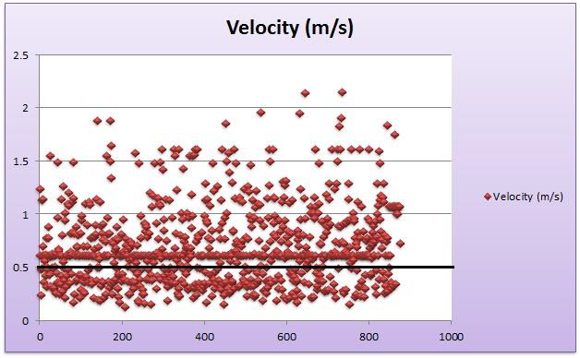
Velocity:

Slide 27
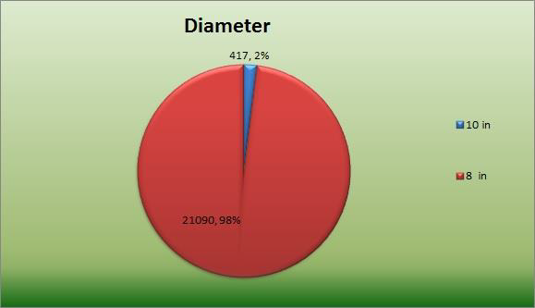
Length of conduits:

Slide 28
Cost Estimations:
Considering the prices in our country,
we estimated the total cost of the wastewater collection network = 1563206$, and the cost per 1km = 72683$.

Slide 29
Conclusion and Recommendations:
Flushing system in the network especially where low velocities occurs.
Implementation of Continuous maintenance to the network.
Constructing a waste water treatment plant to avoid pollution of the environment and to reuse the treated water for agriculture instead of wasting it.

Slide 30
Thank you

