Slide 1

Challenges and strategic obstacles that limit the development of family businesses in the northern West Bank And Developing a framework for strategic planning for family businesses
Prepared by:
Shtha Salah
Raghad Sallam
Tala Darawsheh
Hala Helou
Supervisor Name:
Dr. Muawia Ramadan

Slide 2
Outline
01
introduction
05
02
Al-Arz company
Problem statement
03
06
Objectives
Strategic planning process
04
Methodology

Slide 3

Family businesses
Family companies in Palestine are usually small or medium-sized institutions that play a role in the Palestinian economy and are owned and controlled by family members. Most of these companies are registered as private joint stock companies due to the lack of a legal classification for them in Palestine, and decision-making is concentrated in the hands of a specific person or group. From family members. The management and ownership of these companies are passed from one generation to another through inheritance

Slide 4

Ranging between 90% - 95%
Problem statement
95% collapse after the third generation
reach a clear vision of the reality of family businesses in the northern West Bank from a strategic point of view, and then build strategies for this company.

Slide 5
Objectives
  to reach a clear vision of the reality of family businesses in the northern West Bank from a strategic point of view, and then build strategies for this company.
Develop innovative strategies and create a framework
  Examine the administrative and strategic characteristics
Assess the current reality and working environment of family businesses

Slide 6
Methodology
Study population
Data Collection , Analysis
Developing a framework
Study Approach
Study tool
Case study
1
2
3
4
5
6
68 companies (Nablus - Jenin - Tulkarm)
A questionnaire that includes seven axes
visits to the factories , Data analysis using SPSS
descriptive analytical approach
Al-Arz company
growth and sustainability of family businesses

Slide 7
Al-Arz company
Al-Arz Company was established in 1950
it obtained the Palestinian Quality Certificate and the International Food Safety Certificate
  Registered as a private limited joint stock company with a capital exceeding 1,000,000 Jordanian dinars. The number of its employees exceeds 300, and the number of working family members does not exceed 9 individuals.
Equipped with the most modern production lines in the Middle East

Slide 8

Al-Arz company
The company's management is structured like a private equity firm rather than a family business.
It has internal regulations and policies that all family members adhere to
Strategic planning on a regular basis
Regular market research and analysis
Providing high quality products at competitive prices

Slide 9

Al-Arz company
The company has a clear approach to succession, focusing on individual competencies
Continuous investment in research and development
Working diligently to explore expansion opportunities in global markets
Diversifying and expanding the company's activities to more than one sector
Use of technology(ERP systems and solar cells)

Slide 10
Strategic planning process
determination of long-term goals and objectives of an enterprise and adoption of course of action and allocation of resources necessary to carry out these goals
Strategy implementation
02
01
03
Strategy Formulation
Evaluate and adjust the strategy

Slide 11
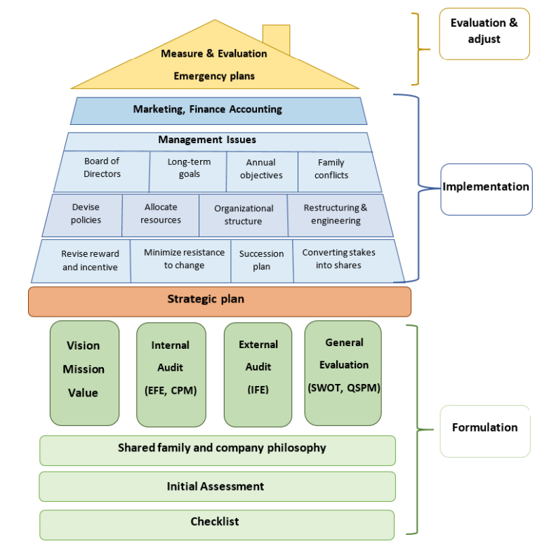
House Model for Strategic Planning in Family Businesses

Slide 12
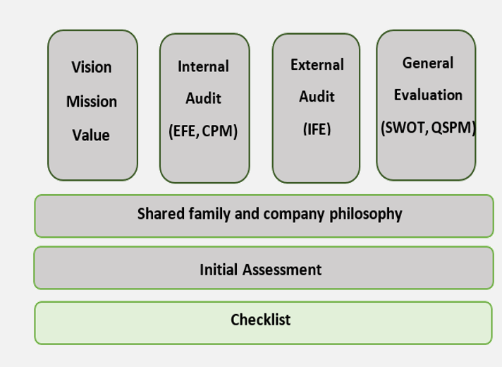
Strategy Formulation

Slide 13
Checklist
It explains the criteria that should be considered when evaluating something
is useful in planning an enterprise, monitoring and guiding its operation, and assessing its outcomes
Checklist
initial component of the strategic framework
aims to verify fundamental elements that should be present in any company

Slide 14
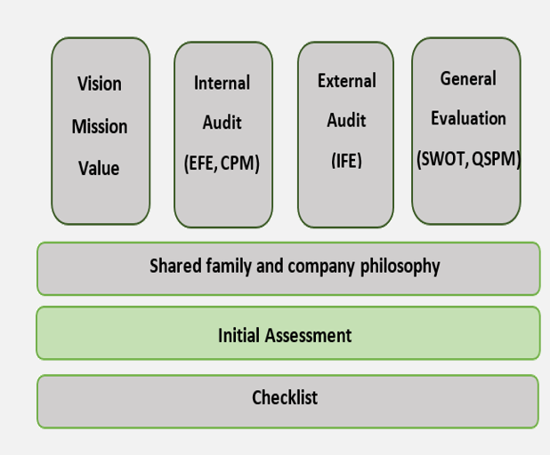
Strategy Formulation

Slide 15
Initial Assessment
it measures various aspects of a business before making important decisions
Initial Assessment
includes general information, an initial survey of the company's situation
Evaluate the company's market position and financial capacity

Slide 16
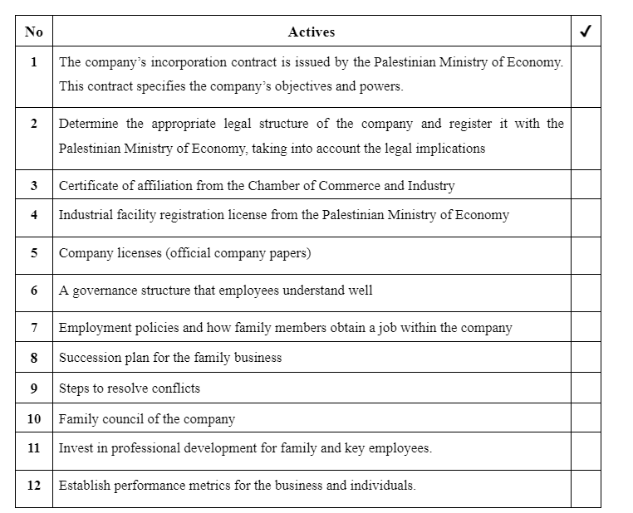
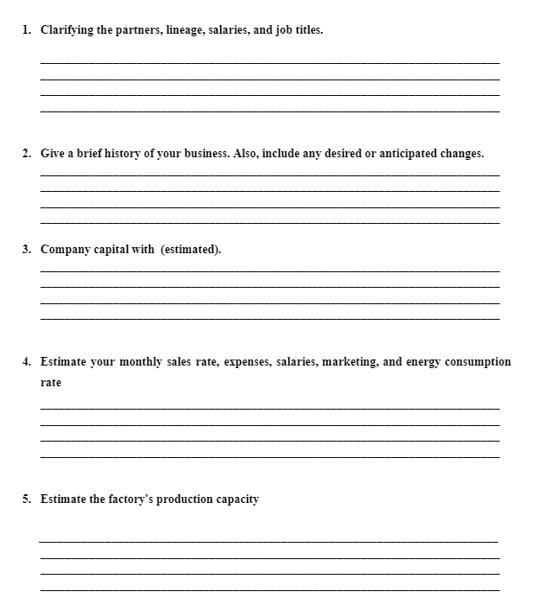
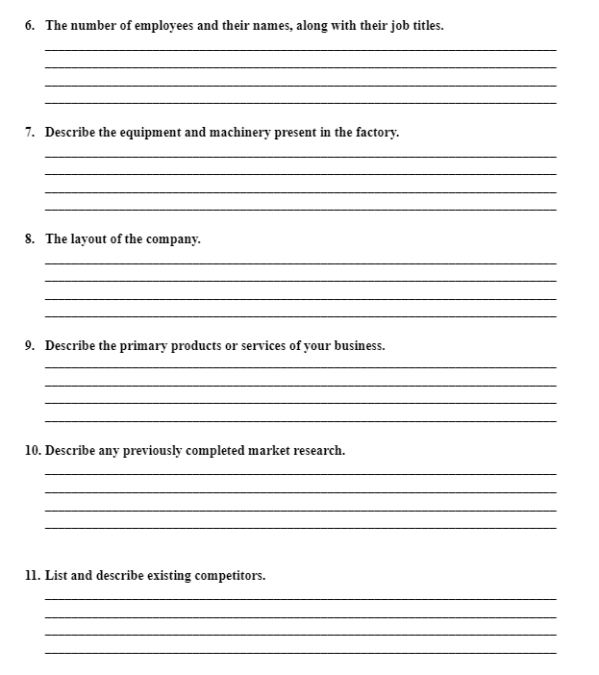
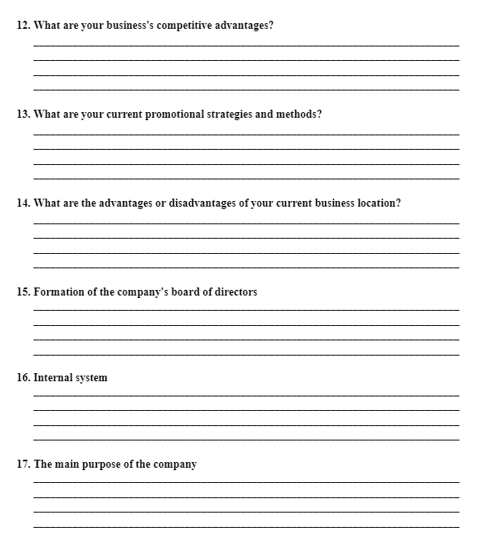
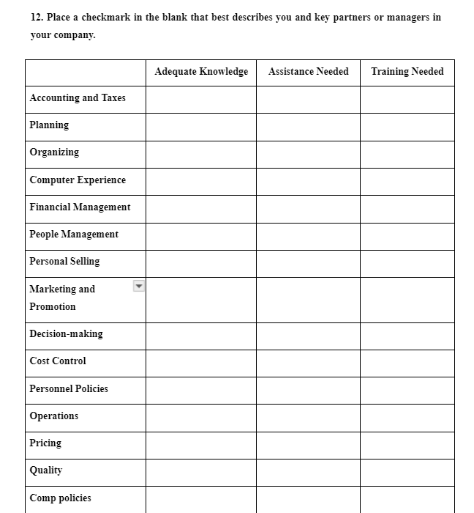
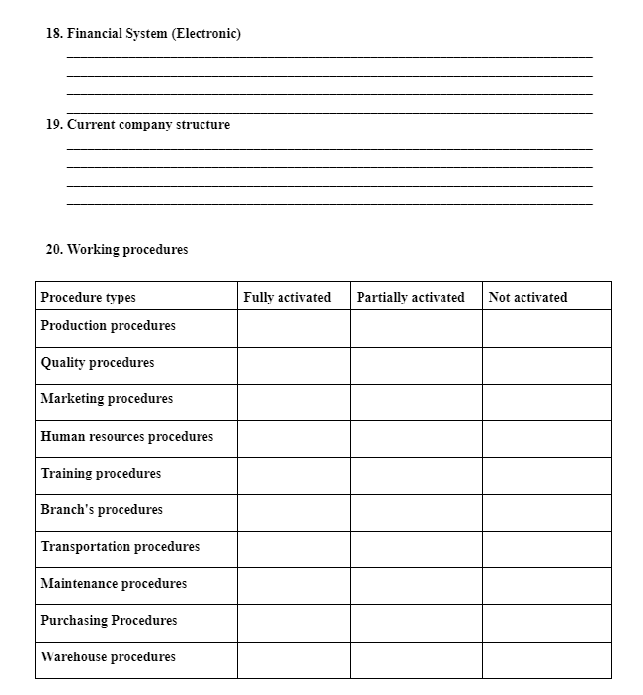

Slide 17
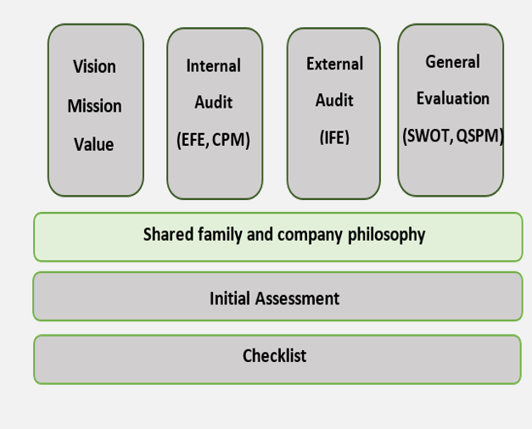
Strategy Formulation

Slide 18

Develop a shared family and company philosophy
The goal of this procedure is to inform family members of the value of their participation in the work
Understanding family values and customs is essential to creating a family business philosophy
To create a balance between the family and the company, a family council was created
Determining the structure of the family business is the next stage

Slide 19
Family Council
Determining Council members through a secret ballot of family members
Determine goals and responsibilities
A
B
Determining the organizational structure
C
Develop a shared family and company philosophy
D
E
Defining the council’s vision and mission

Slide 20
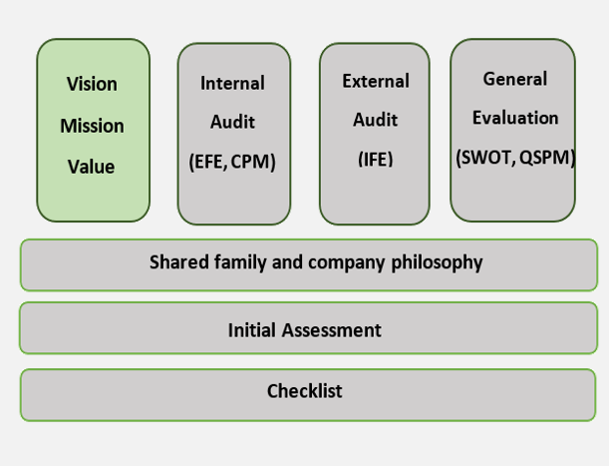
Strategy Formulation

Slide 21
Vision
1
3
The family may reach such a vision through the family council and then document it in the council
5
The first step in strategic planning
Be executable
Ensures family support for the company and helps in setting development plans
Taking into account the company's operations and the external market situation
“What do we want to become?”
2
4
6

Slide 22
Mission
1
Defines the scope of a company's operations in terms of product and market
3
Describes the values and priorities of the organization
5
Explains why the organization exists
Be consistent with the company's vision and long-term goals
"What is our business?"
It must be brief and specific
2
4
6

Slide 23
value
1
define the way that the organization should operate
explains the general direction of the institution
3
communicate the enduring core principles that guide an organization’s strategy
Would these values change with circumstances?
4
2

Slide 24
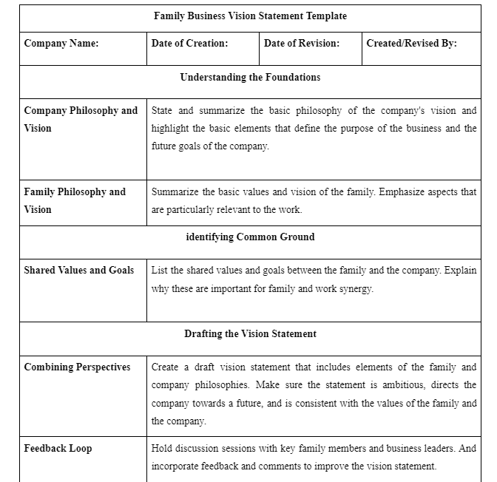
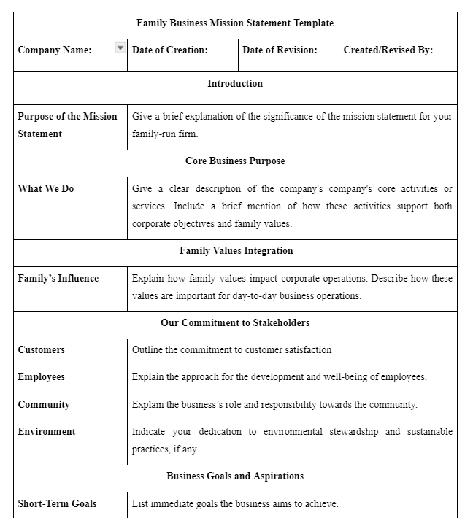
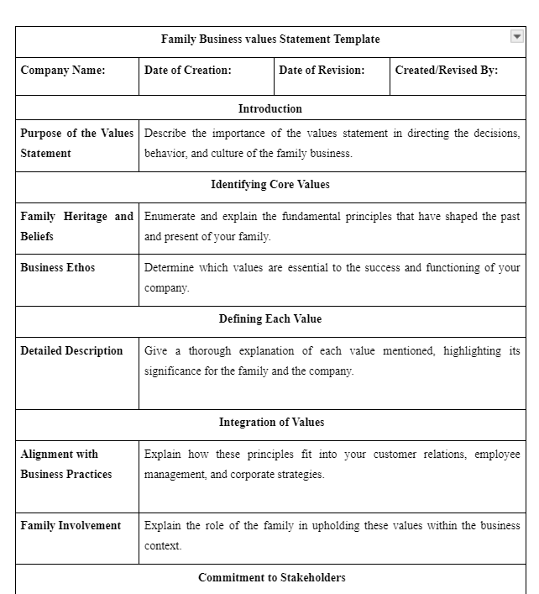
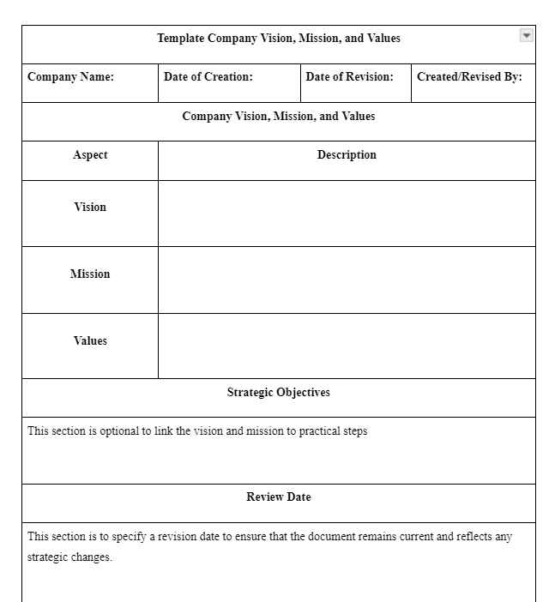

Slide 25
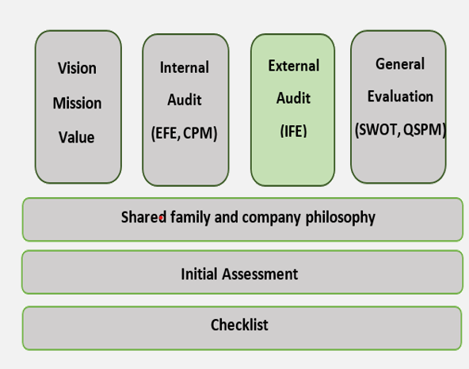
Strategy Formulation

Slide 26

External audit
Aim to identify key variables that provide actionable responses
Develop a limited list of opportunities that could benefit the company and threats that should be avoided
01
02
03
It will make companies able to respond either offensively or defensively to factors
04
important to achieving long-term and annual objectives, measurable, applicable to all competing firms, and hierarchical

Slide 27

External audit
A competitive profile matrix (CPM)
External Factors Evaluation Matrix (EFE)
External audit

Slide 28
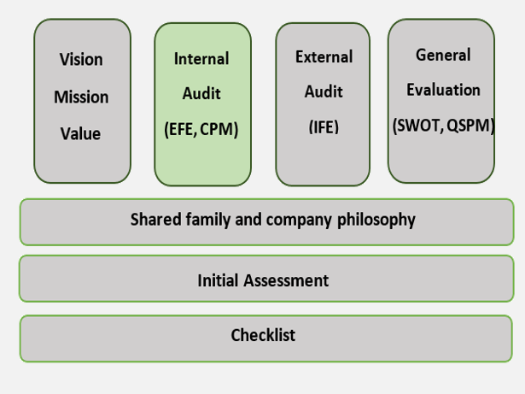
Strategy Formulation

Slide 29
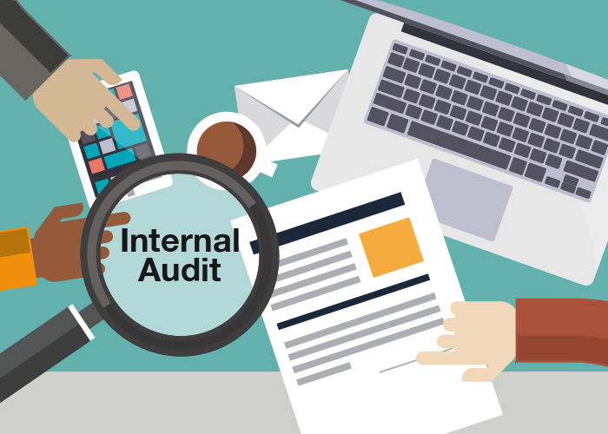
Internal Audit
It refers to the systematic and objective evaluation of an organization's operations
Here the strengths and weaknesses of companies are studied
01
02
03
It shows the extent to which internal controls are compatible with strategic objectives
04
it is considered the basis for setting goals and strategies

Slide 30
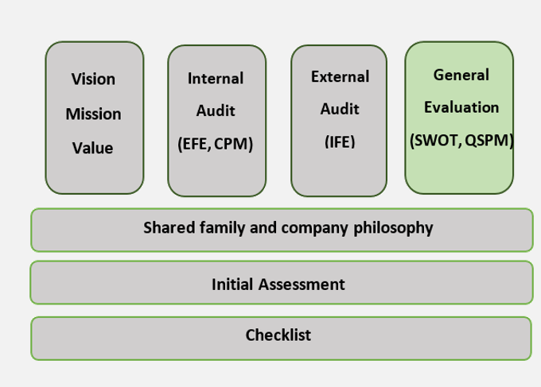
Strategy Formulation

Slide 31
SWOT
(internal)
(internal)
STRENGTHS
WEAKNESS
SWOT
(external)
OPPORTUNITIES
(external)
THREATS

Slide 32
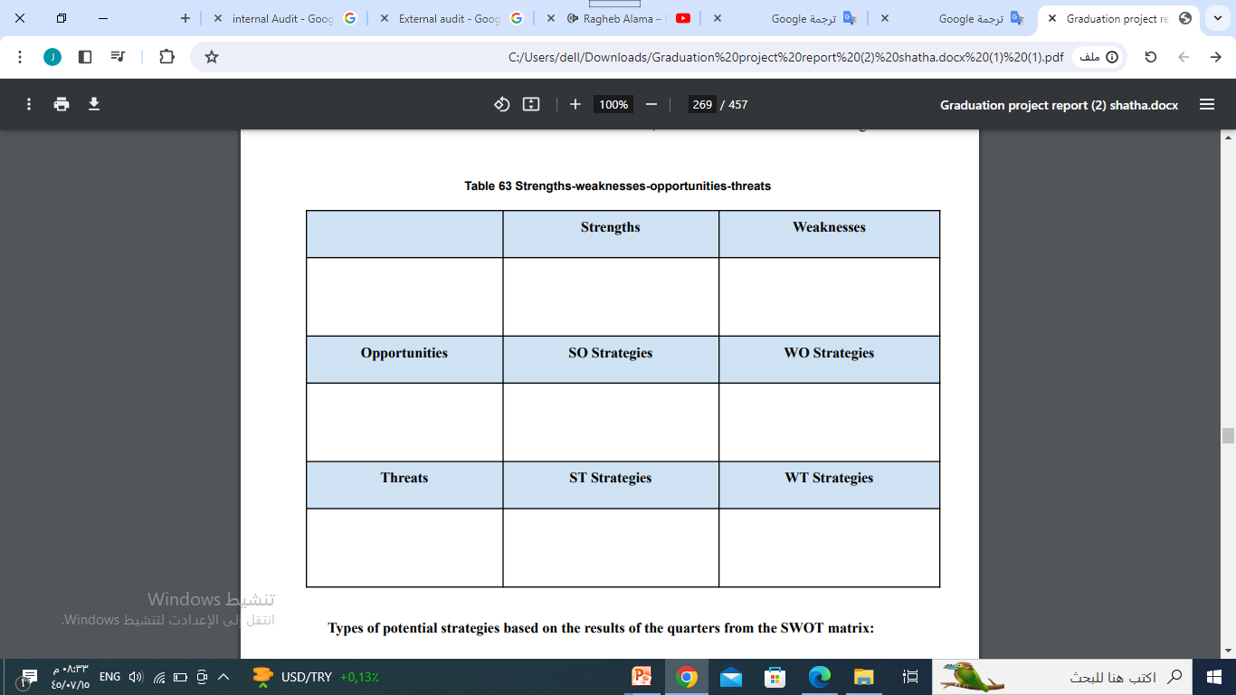
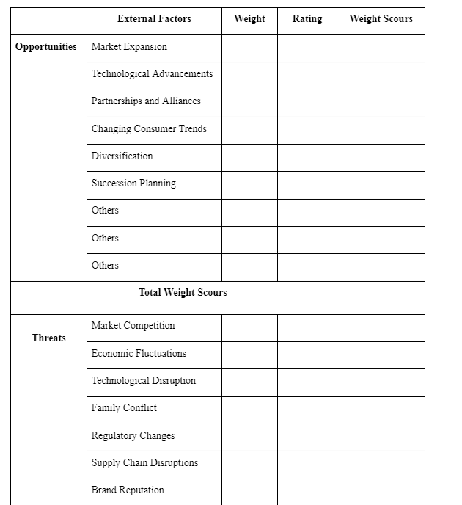
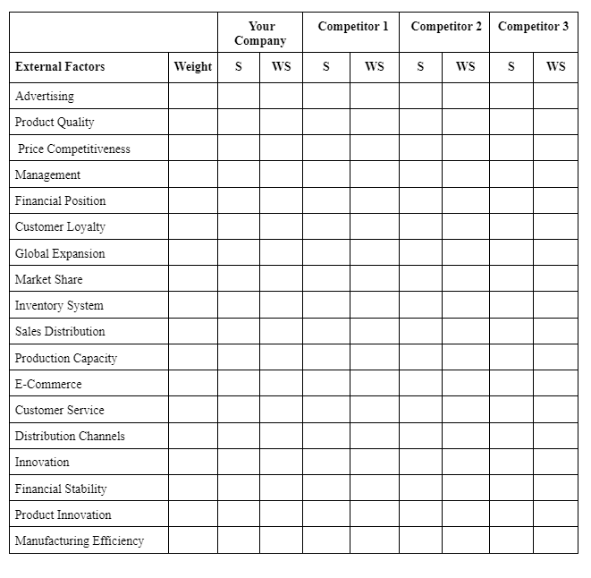
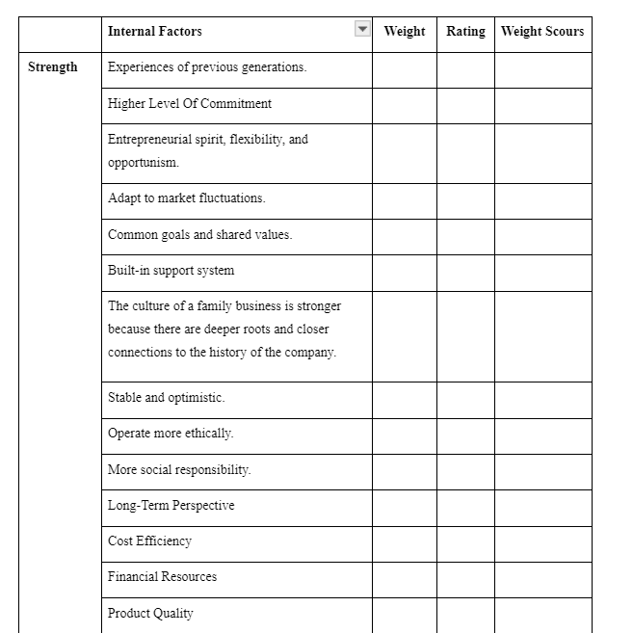
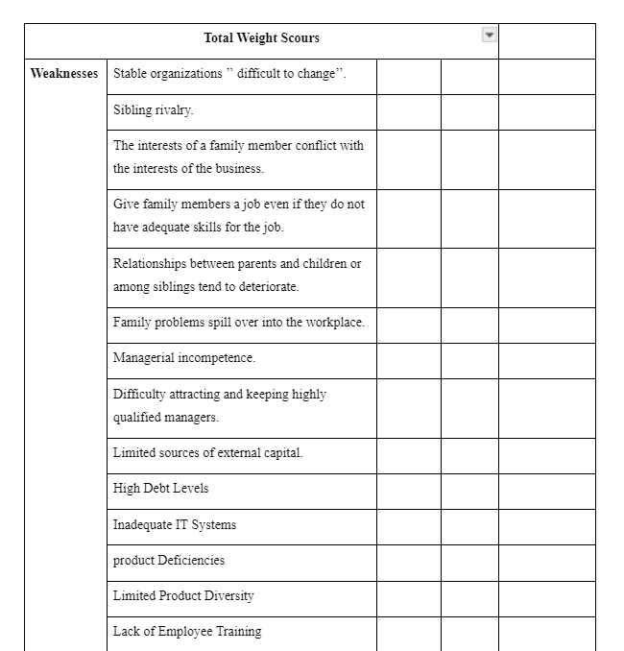

Slide 33
strategies based on the results of the quarters from the SWOT matrix
  Offensive strategy(Using strengths and investing in available opportunities
01
S
01
02
Defensive strategy (using strengths and reducing threats)
02
O
T
strategies
Contractionary strategy (minimizing weaknesses and reducing threats)
03
04
03
W
04
Contractionary strategy (minimizing weaknesses and reducing threats)

Slide 34
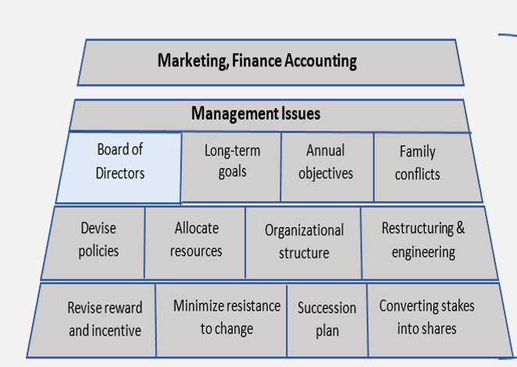
Strategy implementation

Slide 35

Chairperson
CEO or Managing Director
Non-Executive Directors
Executive Directors
Board Committees
Board of Directors
Shareholders
Independent Directors

Slide 36
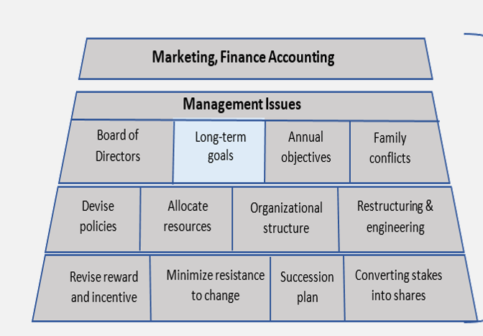
Strategy implementation

Slide 37

Succession planning
Market expansion goals
Enhancing brand reputation
Long-Term Goals
Building an emergency fund
Developing the governance system
    Investing in technology and innovation

Slide 38
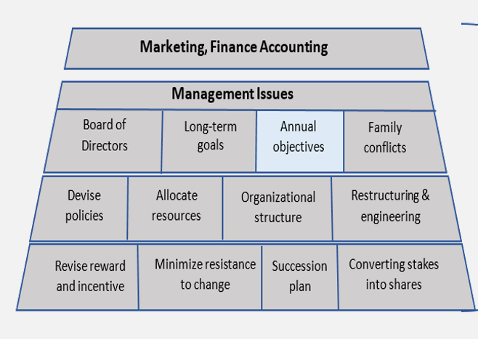
Strategy implementation

Slide 39
Strategy implementation

Slide 40
Annual objectives
1
5
characterized by an appropriate time dimension
measurable
3
reasonable
clear
7
communicated throughout the organization
accompanied by commensurate rewards and sanctions
consistent
challenging
2
4
6
8

Slide 41
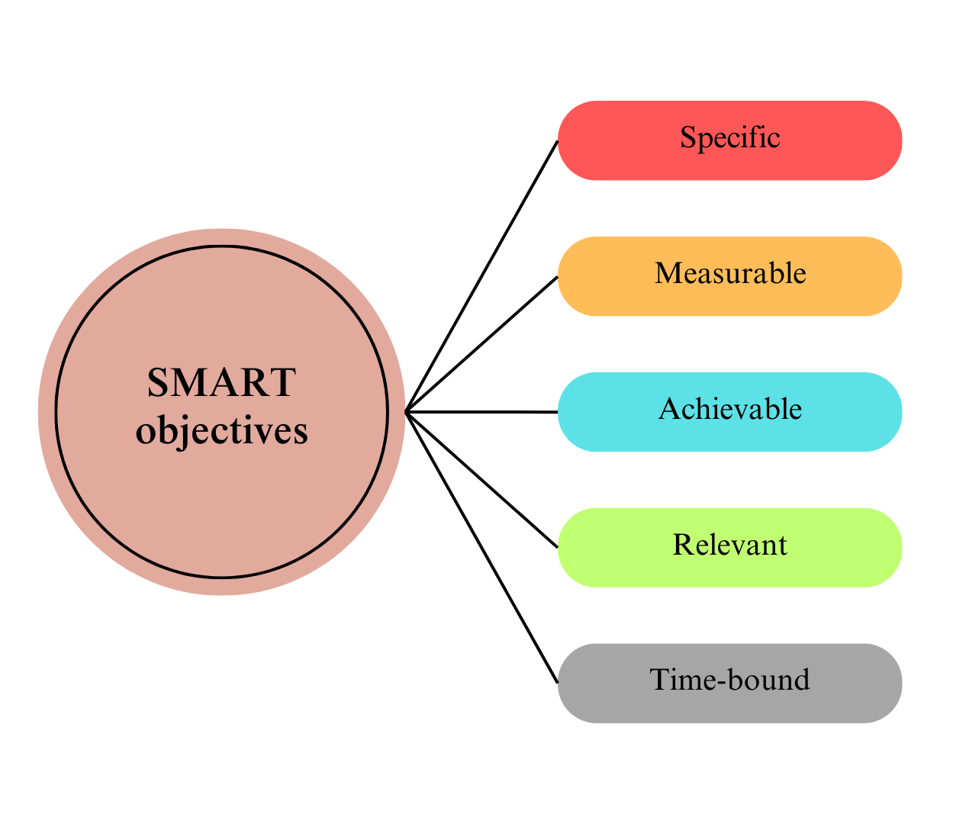

Slide 42
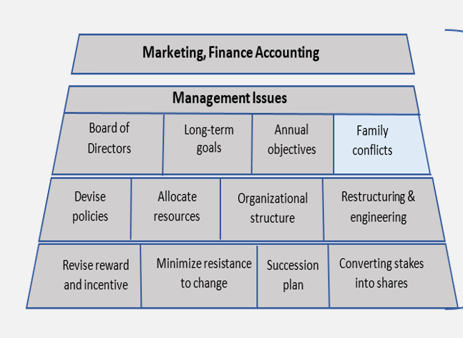
Strategy implementation

Slide 43

Poor communication and leadership
Family conflict
Resistance to change
Weak sense of responsibility
The overlap between the role of the family and the role of the company
Succession

Slide 44
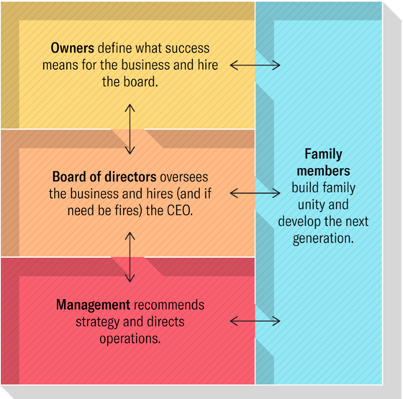
The four-room model

Slide 45
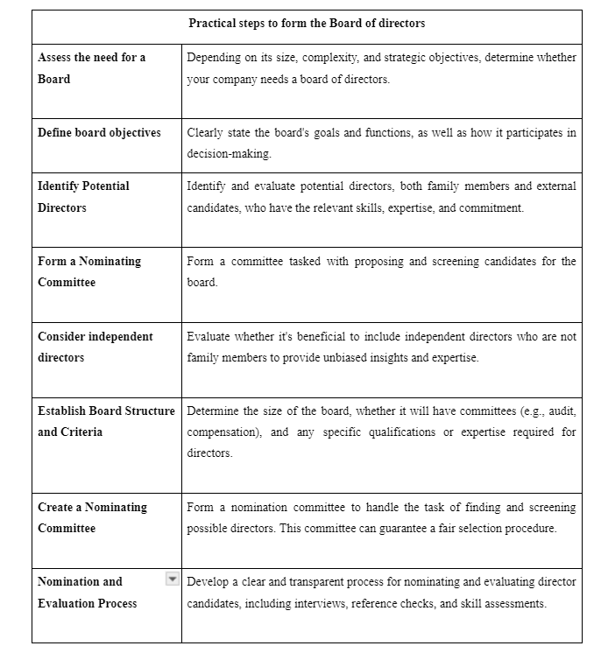
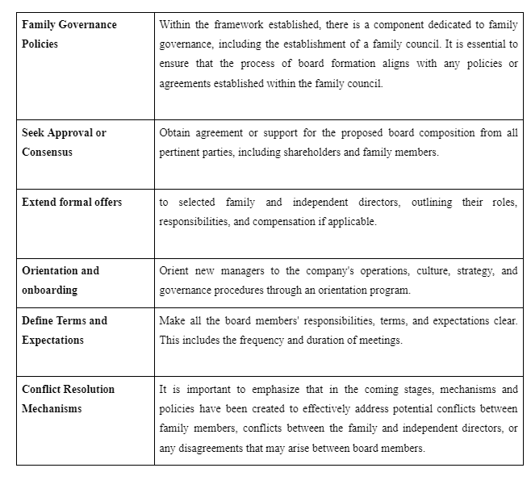
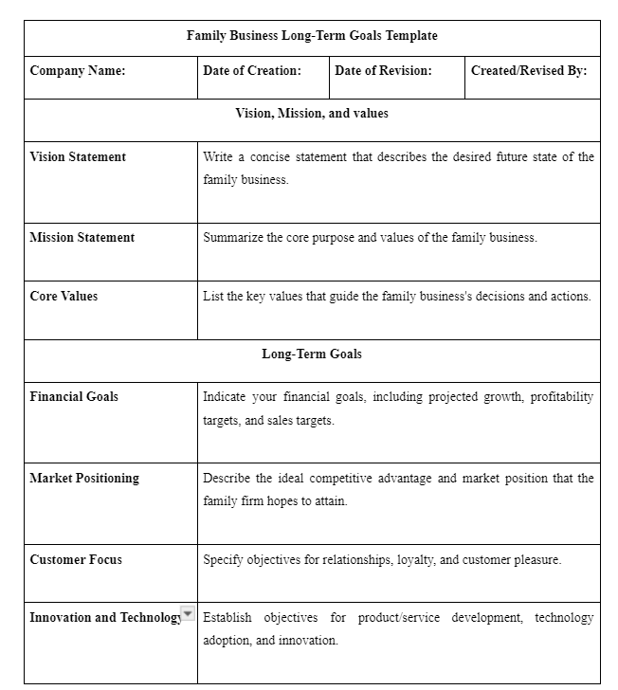
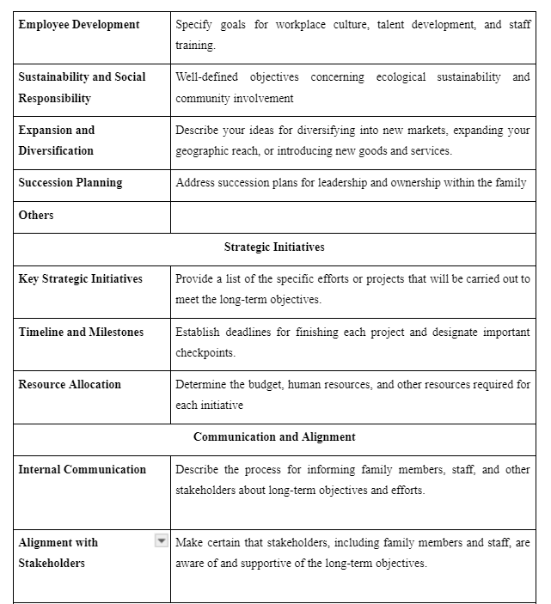
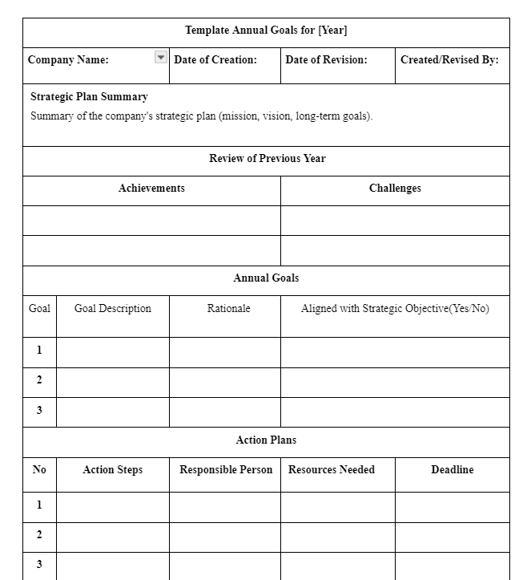
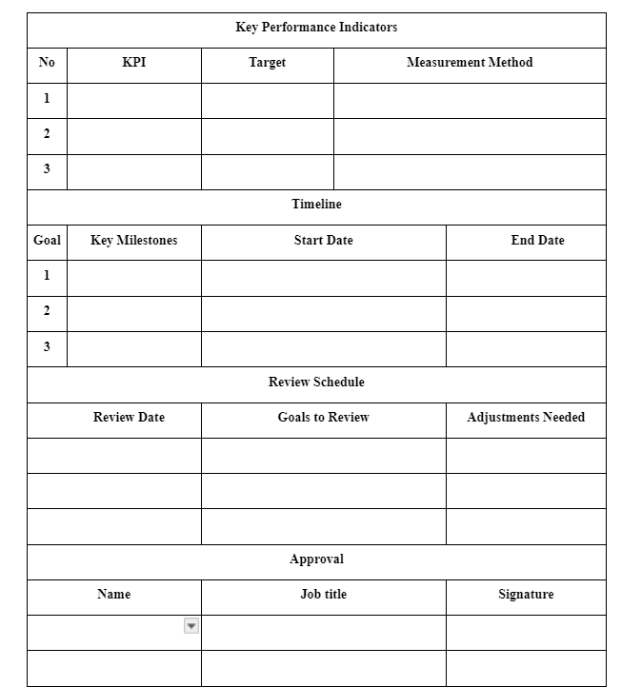

Slide 46
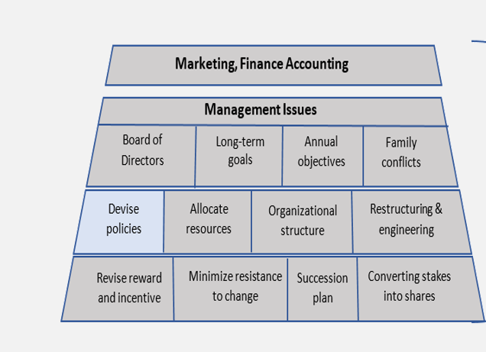
Strategy implementation

Slide 47

Succession Planning Policy
Ownership policies
Entry and Exit Policies
policies
Employment policies

Slide 48
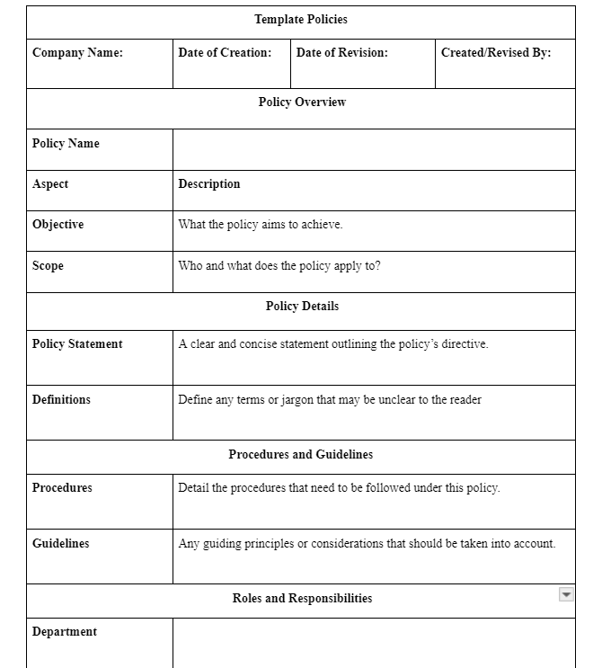
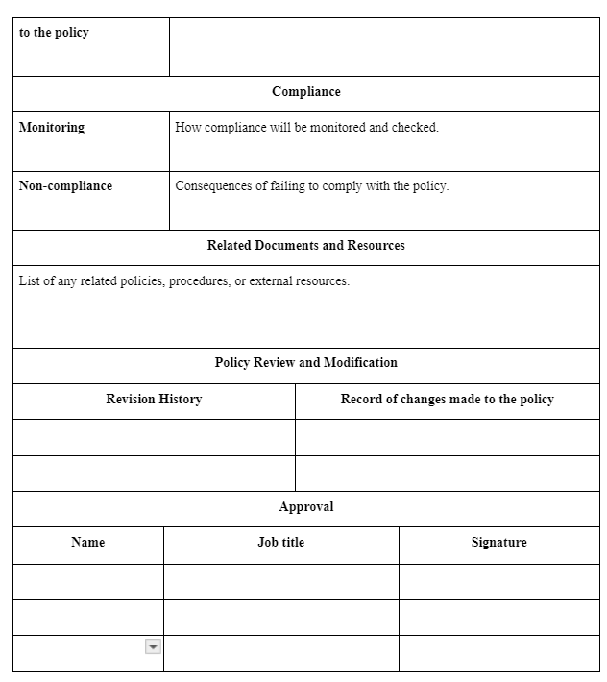
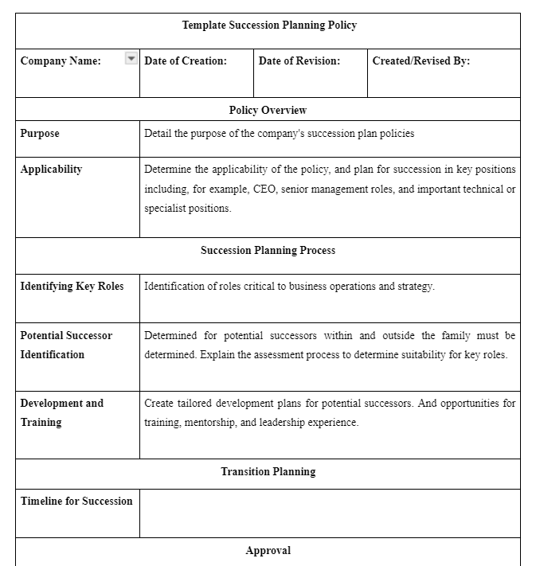
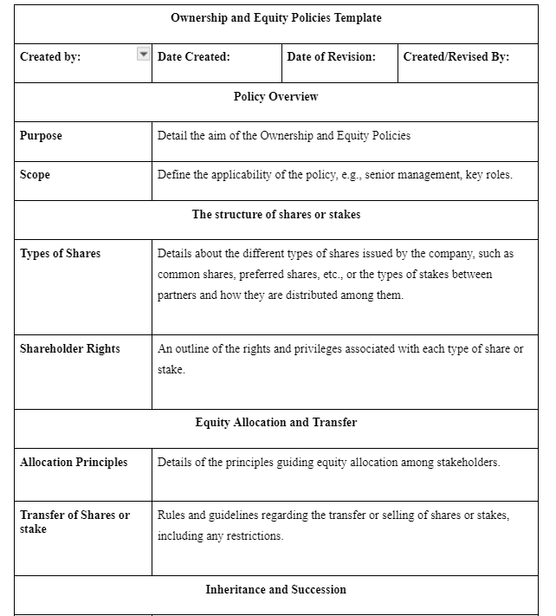
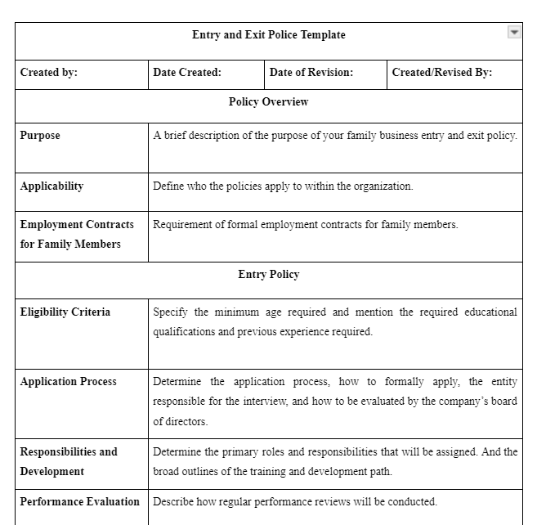
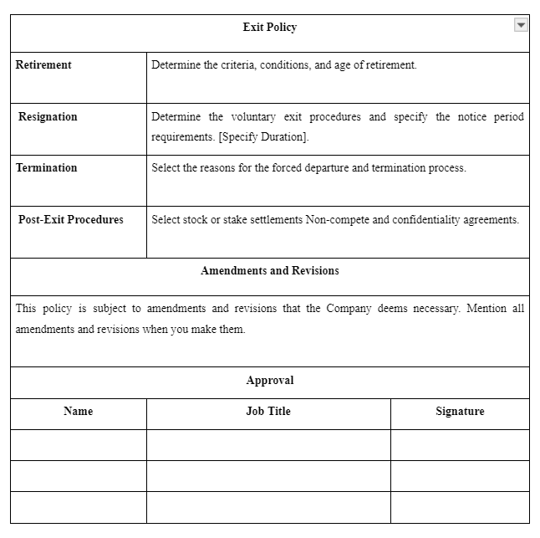
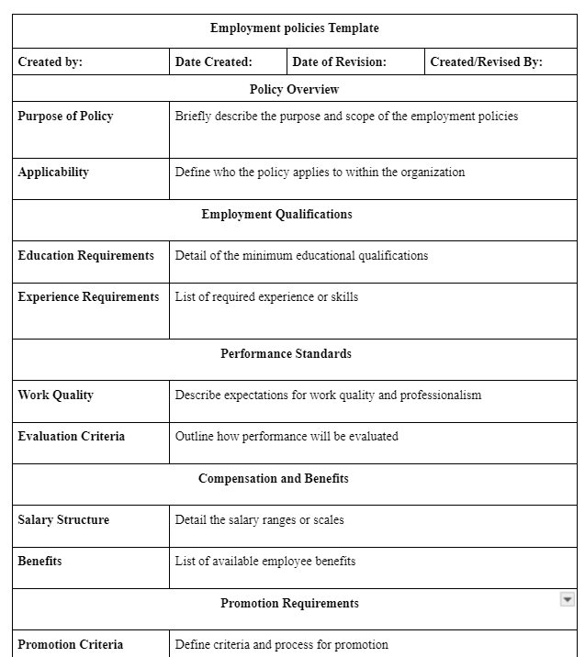

Slide 49
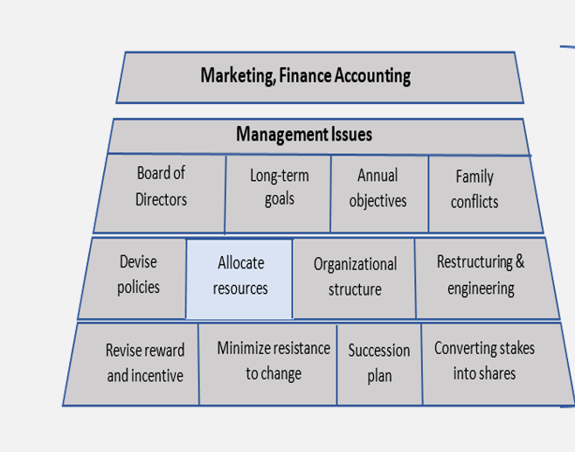
Strategy implementation

Slide 50
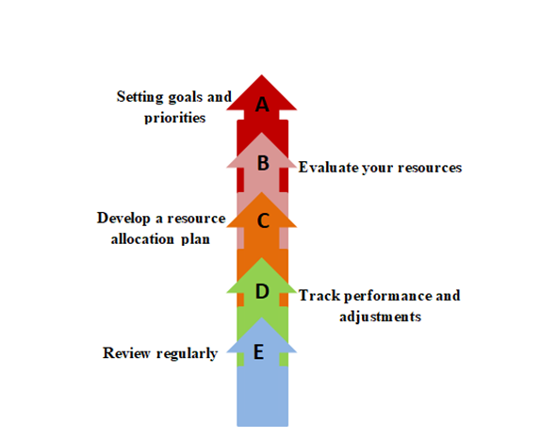
Allocate resources

Slide 51
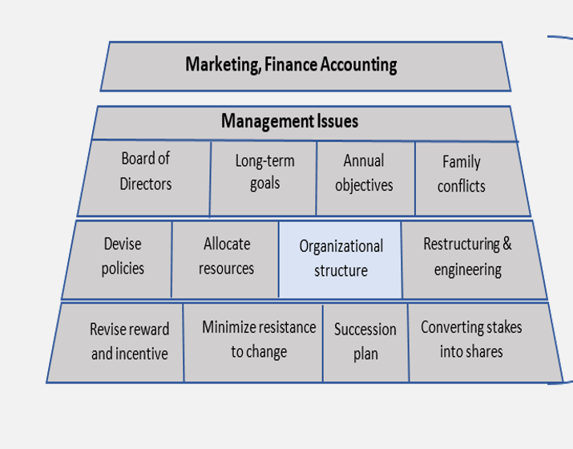
Strategy implementation

Slide 52
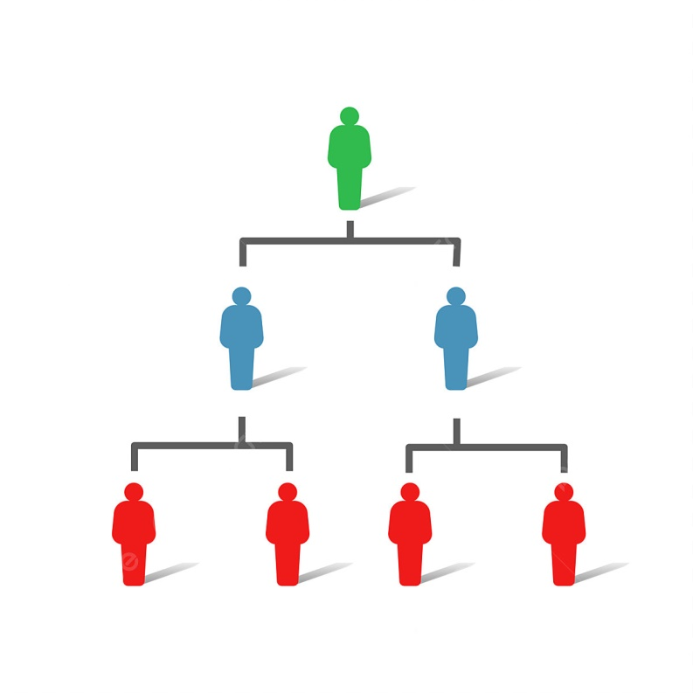
Most family businesses did not have a formal organizational structure
Those who have a structure can modify it
The structure varies depending on the size of the company and the type of industry
An effective structure must align with the company's goals and support its growth and sustainability
Organizational
structure

Slide 53
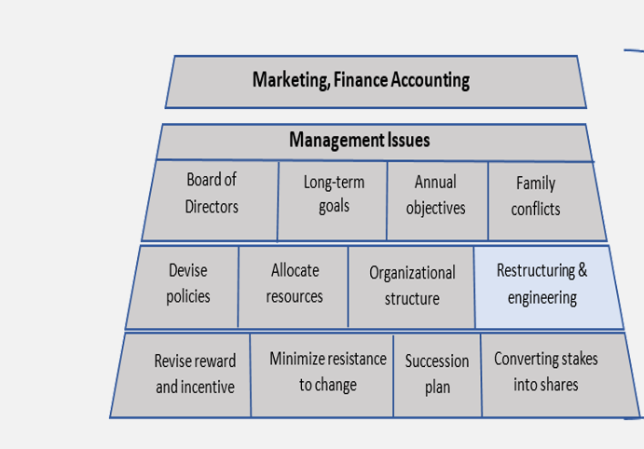
Strategy implementation

Slide 54
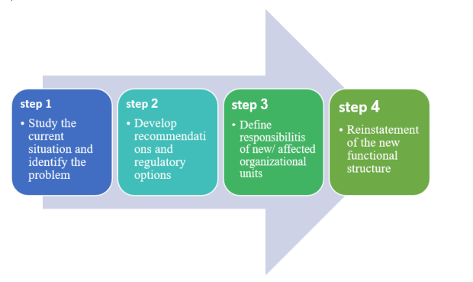
Restructuring

Slide 55

Create a vision
Create a competent team
Entity and understand the current process
Develop/redesign a new process
Implementing the new process/redesigned process
Evaluation
Reengineering

Slide 56

Strategy implementation

Slide 57

Fair among employees
Motivating future generations
Balancing family requirements and company success
Fits with the family culture
Diversity of incentives
Rewards and incentives

Slide 58
Strategy implementation

Slide 59

The reasons:
Adherence to customs and traditions
Fear of the unknown
Relying on traditional experience
Personal interests
Not accepting the entry of new blood
Minimize resistance to change

Slide 60

Conflict Resolution

Slide 61

(Peter Drucker):
“Culture eats strategy for breakfast”
creating a strategy supportive culture

Slide 62







Slide 63

Strategy implementation

Slide 64
Succession plan
Analyze the Work positions and Evaluate Performance
Analyse the Candidates and evaluate Potentials
A
B
Goal Setting
C
D
Management Succession
Ownership Succession and Managing the transition
E

Slide 65






Slide 66

Strategy implementation

Slide 67


Slide 68

Create subgroups of your market based on demographics and needs
Organizations with great market segmentation strategies have a 10% higher market segmentation rate than others
Market segmentation

Slide 69


Slide 70


It is a strategic exercise that defines where your product or service fits in the marketplace and why it is better than alternative solutions.
Product positioning

Slide 71

Acquiring capital to implement strategies
Projected Financial Statements
Preparing financial budgets
Evaluating the Worth of a Business
Finance Accounting

Slide 72

Market Capitalization
Times Revenue Method
Earnings Multiplier
Methods of Valuation

Slide 73
Evaluate and adjust the strategy
The Nature of Strategy Evaluation
01
examining the fundamental foundations of the company's strategy
02
comparing expected results to actual results
03
taking corrective action. Procedures to ensure that performance is consistent with plans

Slide 74

A Strategy-Evaluation Framework
[ Reviewing Bases of Strategy ]:
This table summarizes strategy-evaluation activities in terms of key questions that should be addressed, alternative answers to those questions, and appropriate actions for an organization to take.

Slide 75
A revised EFE Matrix should indicate how effective a firm’s strategies have been in response to key opportunities and threats. This analysis could also address such questions as the following:
How have competitors reacted to our strategies?
How have competitors’ strategies changed?
Why are competitors making certain strategic changes?

Slide 76
Here are some key questions to address in evaluating strategies:
Are our internal strengths still strengths ?
Are our internal weaknesses still weaknesses?
Are our external opportunities still opportunities?
Are our external threats still threats?

Slide 77
[ Measuring Organizational Performance] :
Factor :
Revenues
Profits
ROI
A Sample Framework for Measuring Organizational Performance
several axes:
Corporate
Region
Product
Considering the actual and expected results, variance action , needed.

Slide 78
How well is the firm sustaining and even improving upon its core competencies and
competitive advantages?
How satisfied are the firm’s customers?
[ Balanced Scorecard]:
The company seeks to answer such questions, taking into account the inputs of financial measures to evaluate strategies

Slide 79

These plans include specific actions that must be taken during emergencies, including
Risk identification
Determine emergency objectives
Forming an emergency team
Communication plan
Staff training
Providing equipment and supplies
Damage assessment and restoration
Test the plan
Review and update the plan

Slide 80
We will talk about some of the points that war can cause and how to avoid them:
Economic deterioration
losing important data
Business continuity

Slide 81

"A systematic process of objectively obtaining and evaluating evidence regarding assertions about economic actions and events to ascertain the degree of correspondence between these assertions and established criteria, and communicating the results to interested users"

Slide 82
Conclusion
The strategic framework was built on all the conclusions and recommendations we reached in the first phase of the project
01
Conclusion
Implementing strategic planning will help family businesses grow and survive
02
03
The strategic planning process helps family businesses when they want to convert to publicly traded companies

Slide 83
Recommendations
01
We recommend previous research to apply this framework to family businesses in Palestine to develop it and prove its effectiveness
Recommendations
Developing the framework into software to facilitate the strategic planning process.
02
Family businesses must strive to implement strategic planning steps to achieve their sustainability and this is reflected in the Palestinian economy
03

Slide 84
Thank you

