Slide 1

An-Najah National
University
Graduation Project
3D Dynamic Concrete Design of Al-Isra’a Building
Prepared by:
Imad Qadous
Ali Ismaeel
Ihab Hamayel
Ihab Barakat
Supervisor Name:
Dr. Abdul Razzaq Touqan
Engineering College
Civil Engineering
Department

Slide 2
Contents List
Project Abstract
Chapter One: Introduction
Chapter Two: Preliminary Analysis of Elements
(slabs, Beams, Columns)
Chapter Three: Structural Verification of Model
Chapter Four: Design of Elements
Chapter Five : Dynamic Analysis

Slide 3
Project Abstract
(a)The project is a residential building in Nablus with an area equal to 470 m². It consists of six floors, the first one is used for parking with height of 4m, the other .stories are residential with height of 3.40m
(b) The final analysis and design of building is done using a three dimensional (3D) structural model by the structural analysis and design using sap2000 program.

Slide 4
Chapter one
Introduction

Slide 5
Chapter one: Introduction
1.1 Analysis and Design philosophy
All the structural elements will be analyzed and designed using SAP 2000 v 14.2.2 program.
1.2 Codes
- ACI 318 -08: American concrete institute for reinforced concrete structural design.

Slide 6
Chapter one: Introduction
1.3 Materials
1.3.1 Structural Materials
- Reinforced Concrete with compressive strength
(f’c = 28 Mpa) for concrete, and yield strength of
(fy = 420 Mpa) for steel bars.
- Soil Bearing Capacity = 250KN/m²

Slide 7
Chapter one: Introduction
1.3 Materials
1.3.2 Non Structural Materials
Unit Weight(KN/m³) | Material Name
12 | Block
27 | Tile
27 | Masonry
23 | Plastering
20 | Filling

Slide 8
Chapter one: Introduction
1.4 Loads
1.4.1 Gravity loads
(a) Dead load
(b) Live Load = 3KN/m²
(c) Super Imposed Load = 4.1KN/m²
1.4.2 Load Combination
U = 1.2(dead load) + 1.6(Live Load)

Slide 9
Chapter Two
Preliminary Analysis and Design

Slide 10
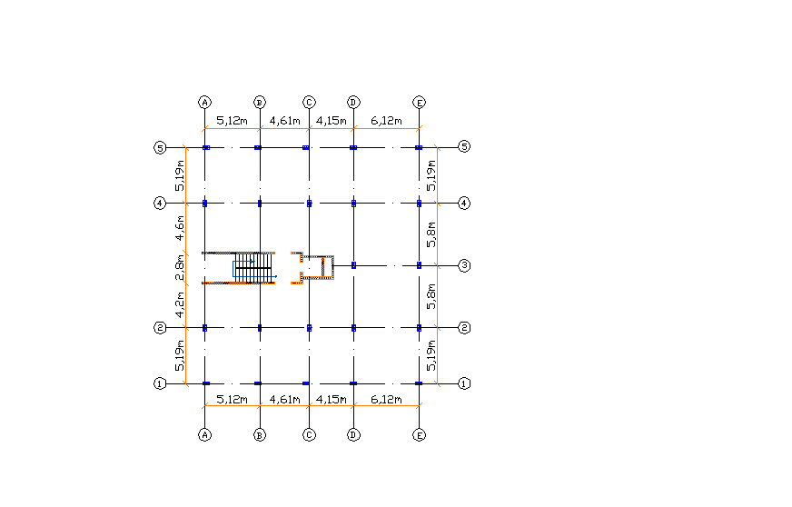
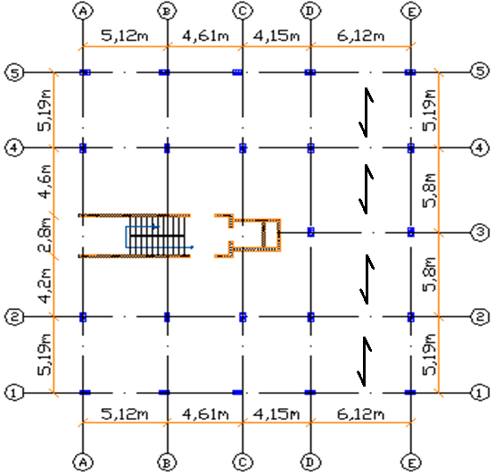
Building plan and Direction of loading:

Slide 11
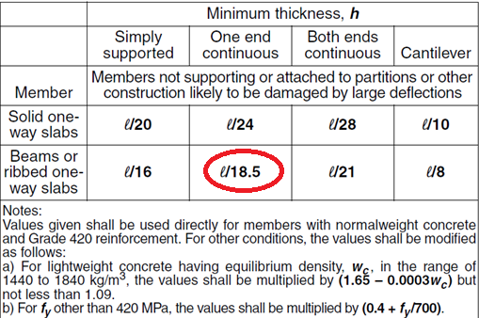
2.1 Analysis of Slabs
- Minimum slab thickness is calculated according to ACI 318-08

Slide 12
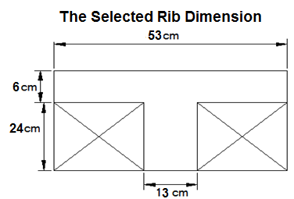
2.1 Analysis of Slabs
The following Rib Dimension are to be used:
- One end continuous h = L / 18.5 = 5.2/18.5 =0.281 m
- Both end continuous h = L / 21 = 5.8/18.5 =0.276 m
Use 0.30m slab thickness

Slide 13
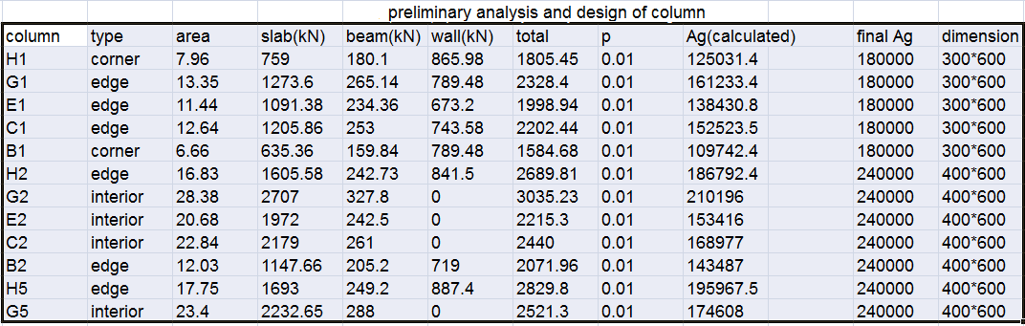
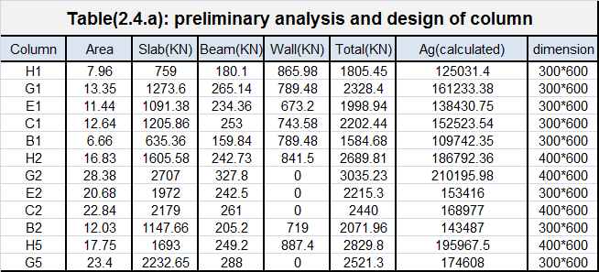
2.2 Analysis of Columns

Slide 14
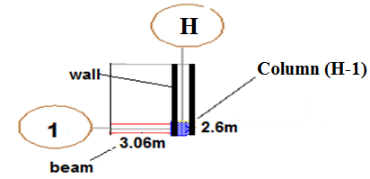
2.2 Analysis of Columns
Take column H1 to check dimension
- Column take from slab(7.96m²) using tributary area.
- Pu1(from slab) = (6*15.9*7.96)=759.38kN
- Pu2(beams)=
[1.2 (0.5*0.45*3.06 + 0.3*0.4*2.6) * 25] * 6 = 180.09 kN
- Pu3(wall) = Pu3 = 6 * (2.6+3.06) * 25.5 = 865.98 kN

Slide 15
2.2 Analysis of Columns
Column H1 to check dimension(sample calculation)
The total ultimate load will be :
Pu = 759.38 + 180.09 + 865.98 = 1805.45 KN
P_{column}=ϕ (0.8) [ 0.85 f/_{c}( A_{g}- A_{s} ) + f_{y} A_{s}]
1805.45x1000=0.65x0.8[ 0.85x28( A_{g}- 0.01A_{g} )
+ 420x 0.01A_{g}]
1805.45 *1000 = 14.44 Ag
Ag = 125031.16 mm² < 180000 mm² ok
Take column dimension(300mm*600mm)

Slide 16
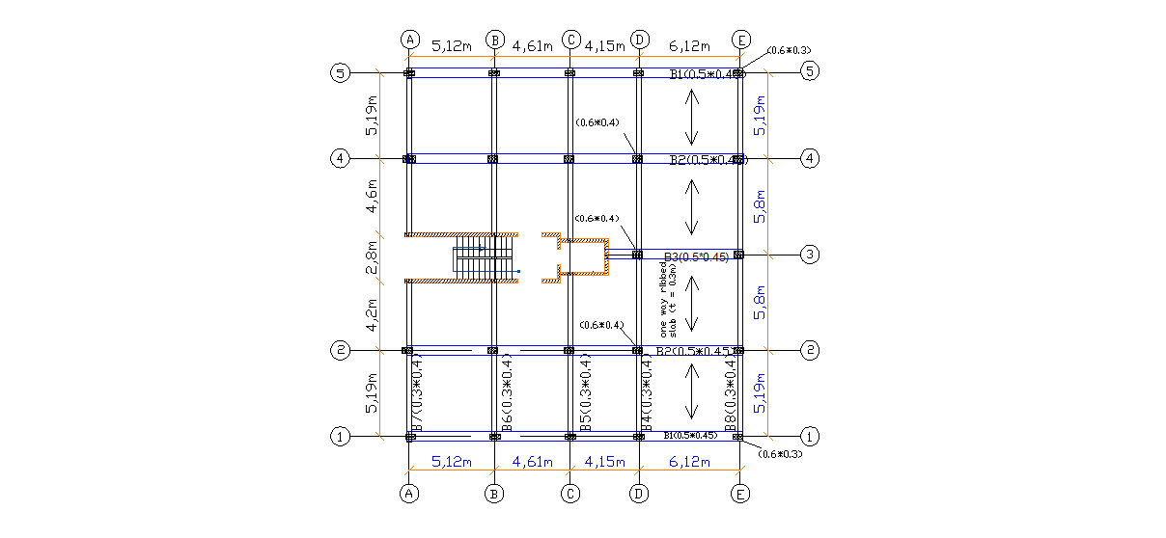
2.3 Analysis of Beams

Slide 17
Chapter Three
Structural verification of model

Slide 18
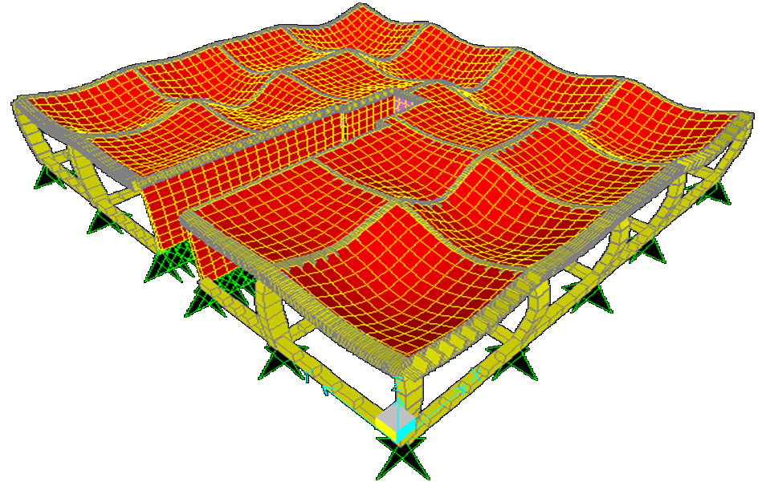
Chapter three: Structural verification of model
3.1 Compatibility for model (One Storey)

Slide 19
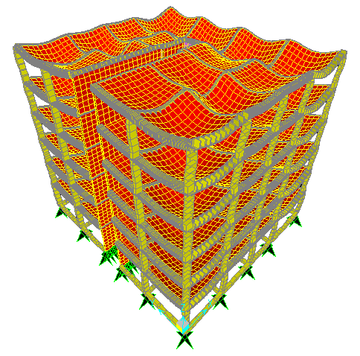
Chapter three: Structural verification of model
3.1 Compatibility for model (Six Storey)

Slide 20
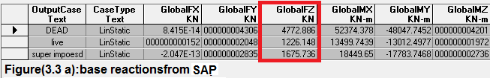
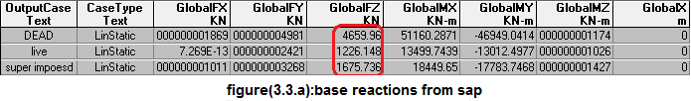
Chapter three: Structural verification of model
3.2 Equilibrium (for one story)
* Values from SAP Program

Slide 21
Chapter three: Structural verification of model
3.2 Equilibrium (for one story)
* Values Manually
- For dead load:
Structural elements | beams | columns | Slab | Shear wall
Weight(KN) | 1531.9 | 486 | 2316.42 | 665
 |  |  |  | Total=4981.32 KN
- For Live Load = (408.9 * 3) = 1226.7KN
- For Super Imposed Dead Load = (408.9 * 4.1 )= 1676.5KN

Slide 22
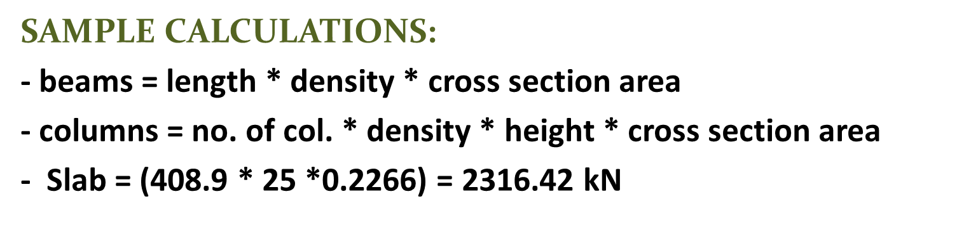
Chapter three: Structural verification of model
3.2 Equilibrium (for one story)
* Values Manually
* Comparison between Sap and Manual:
Load | By sap | manual | Error%
Dead | 4772.88 KN | 4981. 32 KN | 4.3 %
Super imposed | 1675.74 KN | 1676.49 KN | 0.5 %
Live | 1226.15 KN | 1226.7 KN | 0.5 %

Slide 23
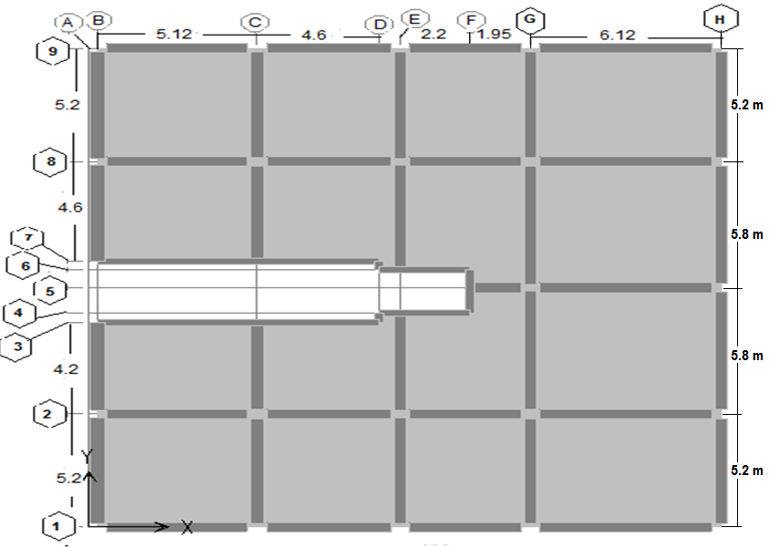
3.3 Stress Strain Relationship (for one story)

Slide 24
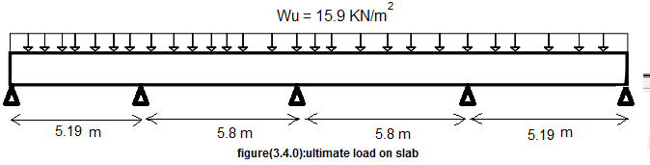
- Manual calculations for slab:
M_{u} = (W_{u} * L²)/8 = (15.9 * 5.8²)/8 = 66.86 KN.m

Slide 25
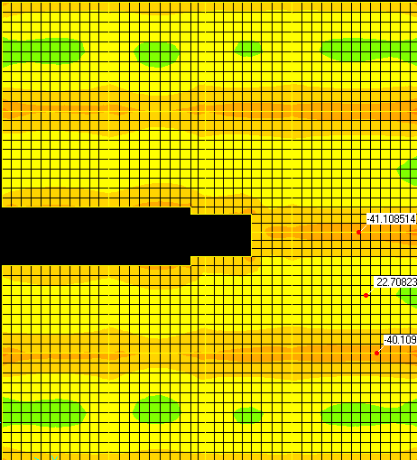
- SAP results for slab :( the following figure shows the moment values for slab from sap)
From SAP: M_{u}_ = 41.1, M_{u}_ = 40.2 , M_{u}⁺ = 22.7
M_{u} = (41.10 + 40.12)/2 + 22.70 = 62.82 kN.m
% Error = {(Manual – SAP)/SAP} *100
= {(66.86 – 62.82)/62.82}*100 = 6.4% < 10%
Stress-strain relationship for slab ………. OK

Slide 26
3.3 Stress Strain Relationship (for one story)
- For Analysis(Take Beam{G5-H5})
- Manual calculations for beam (G5-H5):
W_{u} from slab = 15.9 KN/m²
W_{u} from beam(own weight)
= 1.2 * 25 * 0.27 * 0.45 = 3.55 KN/m
Total load on beam:
W_{u} = 15.9 * (5.8/2 + 5.8/2) + 3.55 = 95.8 KN/m.
M_{u} = (W_{u} * L²)/8 = (95.8 * 6.12²)/8 = 448.5 KN.m.

Slide 27
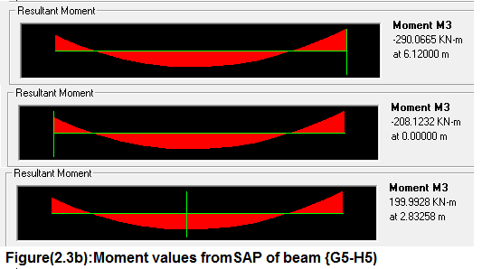
- SAP Values for beam (G5-H5):
% Error = {(Manual – SAP)/SAP} *100
M_{u SAP} = (290 + 208.12)/2 + 200 = 449.06 kN.m.
= {(448.30 – 449.06)/448.30}*100 = 0.16 % < 10%
Stress Strain Relationship for beam is Ok

Slide 28
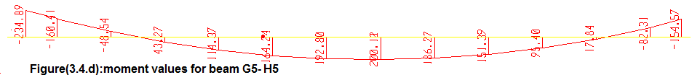

3.3 Stress Strain Relationship (for one story)
- For Design(Take Beam{G5-H5})
f'_{c} = 28 MPa , f_{y} = 420 Mpa , b_{w} = 450 mm d = 440 mm
For M_{u}⁻ = 234.89 KN.m.
ρ = (0.85*28/420)(1-{1-(2.61*234.89*10⁶)/28*450*440²)}^{0.5}) =0.00764
A_{s} = ρ * b_{w} * d = 0.00764 * 450 * 440 = 1512 mm² .
.

Slide 29


3.3 Stress Strain Relationship (for one story)
- For Design(Take Beam{G5-H5)
A_{s} from SAP = 1514 mm².
% Error = (SAP – Manual)/SAP
= (1514 – 1512)/1514 = 0. 15 % < 5%…………… OK.

Slide 30
Chapter Four
Design OF Elements

Slide 31
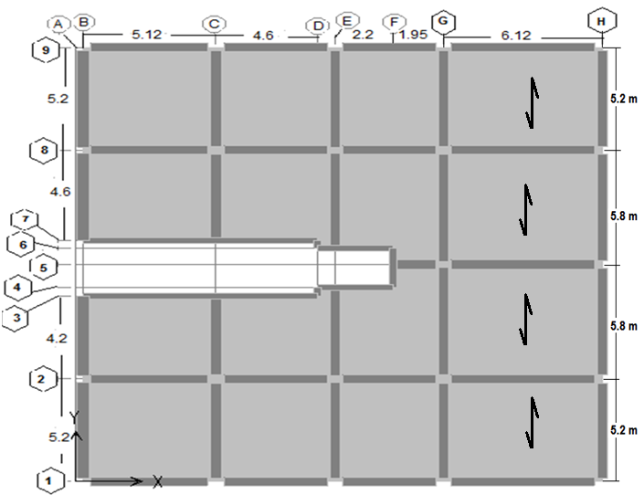
4.1 Design of Slabs:
The following figure shows the direction of loading:

Slide 32
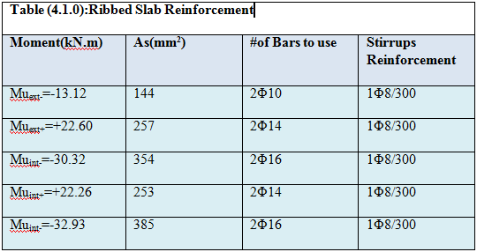
4.1 Design of Slabs:

Slide 33
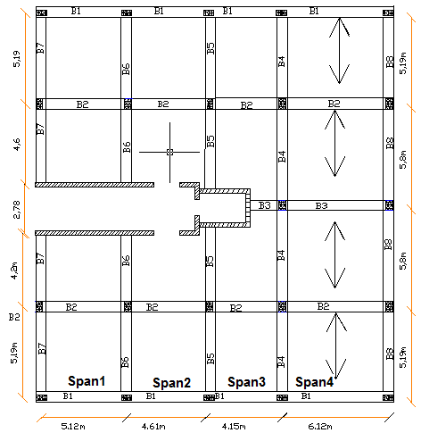
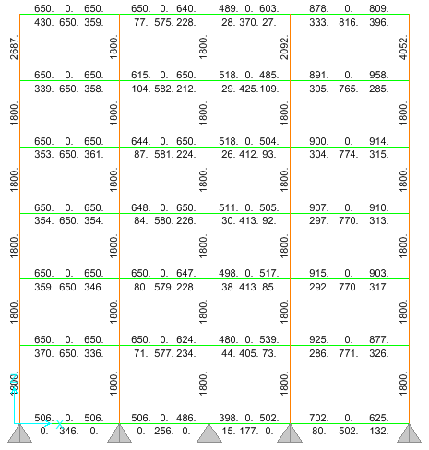
4.2 Design of Beams:(Take Beam B1 as an example)

Slide 34
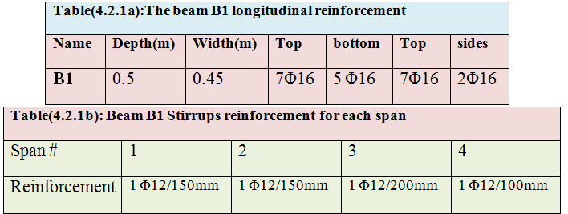
4.2 Design of Beam B1

Slide 35
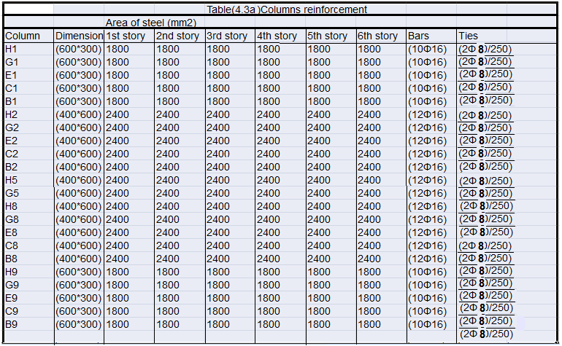
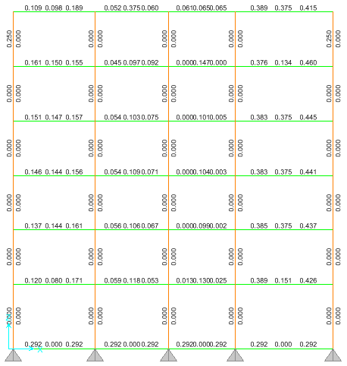
4.3 Design of Columns:

Slide 36
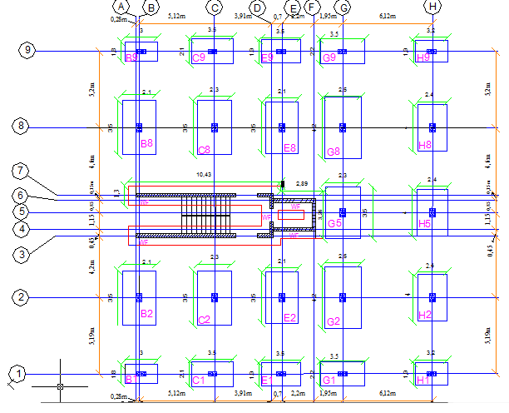
4.4 Design of Footings: (Footings layout)

Slide 37
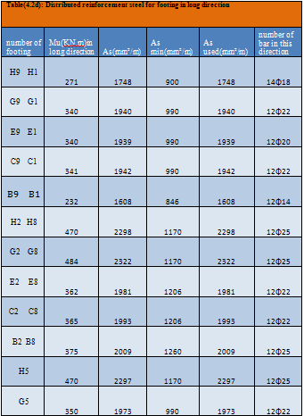
4.4 Design of Footings

Slide 38
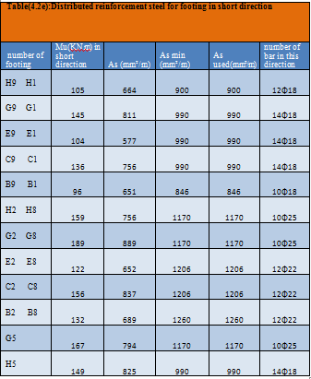
4.4 Design of Footings

Slide 39
CHAPTER FIVE
Dynamic Analysis

Slide 40
Introduction
This chapter will discuss dynamic analysis as a study case for the building, using SAP2000 and some specific hand calculations to insure the program results.
The study aims to analyze the dynamic lateral loads and check if the static design enough to resist the expected earthquake loads and give an explanation for that.

Slide 41
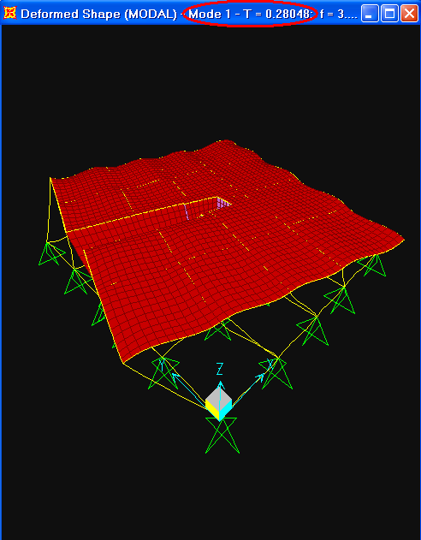
Modes

Slide 42
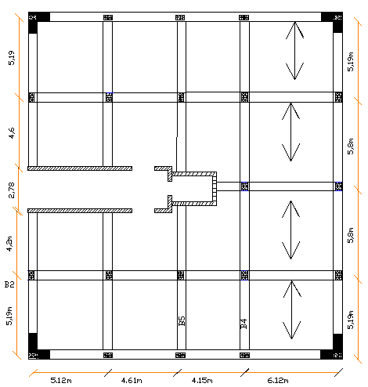
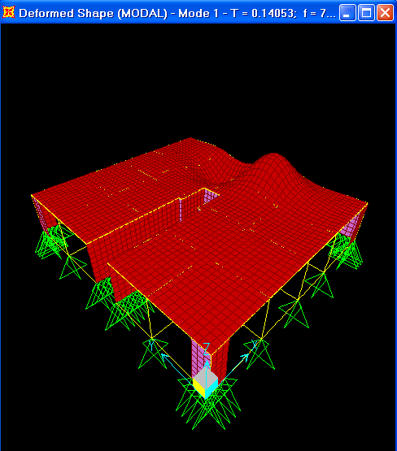
Trials To Solve

Slide 43
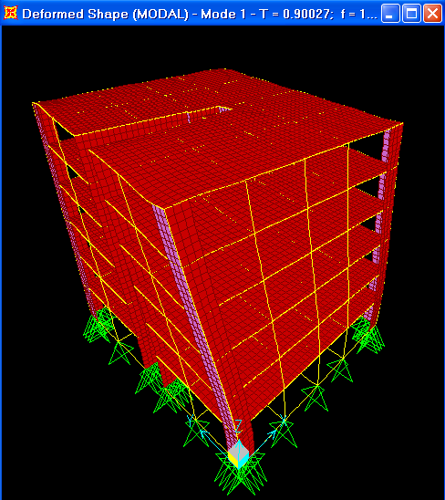
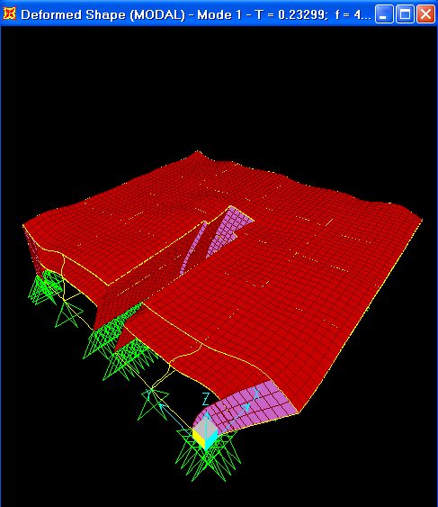
Trials To Solve

Slide 44
Modifications
Because the shear wall affect the behavior of the building, these columns will be instead of it: B3, B7, C3, C7, E4, E6, F4, F5, and F6.
Note: Shear wall in grids (D3-D4) and (D6-D7) stayed as it is (0.45 * 0.25 m).

Slide 45
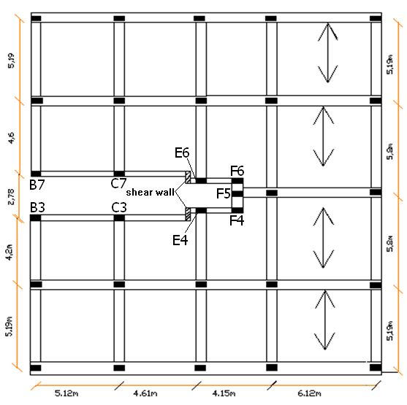
Modified Plan

Slide 46
column ID. | Depth.(cm) | Width.(cm)
B1 | 60 | 30
B2 | 60 | 40
B3 | 60 | 25
B7 | 60 | 25
B8 | 60 | 40
B9 | 60 | 30
C1 | 60 | 30
C2 | 60 | 40
C3 | 60 | 25
C7 | 60 | 25
C8 | 60 | 40
C9 | 60 | 30
E1 | 60 | 30
E2 | 60 | 40
E4 | 50 | 20
E6 | 50 | 20
E8 | 60 | 40
E9 | 60 | 30
F4 | 60 | 25
F5 | 50 | 20
F6 | 60 | 25
G1 | 60 | 30
G2 | 60 | 40
G5 | 60 | 40
G8 | 60 | 40
G9 | 60 | 30
H1 | 60 | 30
H2 | 60 | 40
H5 | 60 | 40
H8 | 60 | 40
H9 | 60 | 30

Slide 47
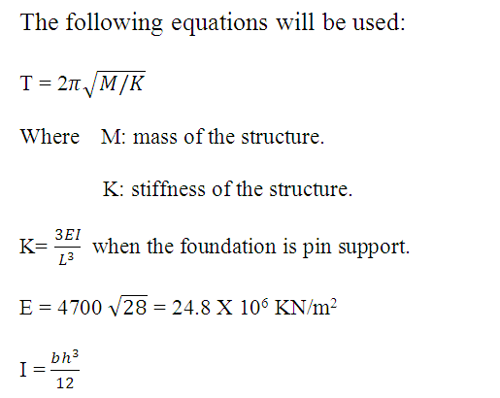
Period Calculations
Period for any structure defined as the time needed for the structure to back to it’s equilibrium-static position.

Slide 48
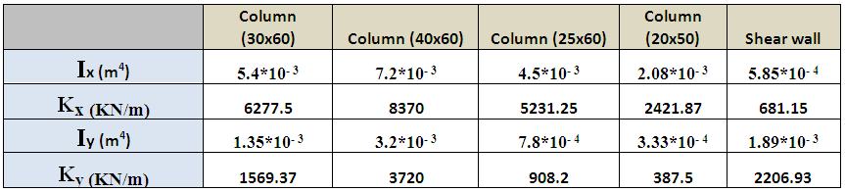
The following table shows moment of inertia and stiffness for all columns:
Total stiffness of structure (K) = no. of column * stiffness of column
* In y-direction:
Total (K_{y}) = 10*1569.37 + 12*3720 + 6*908.2 + 3*387.5 + 2*2206.93
= 71359.31 KN/m.
* In x-direction:
Total (K_{x}) = 10*6277.5 + 12*8370 + 6*5231.25 + 3*2421.87 + 2*681.15
= 203230.41 KN/m.

Slide 49
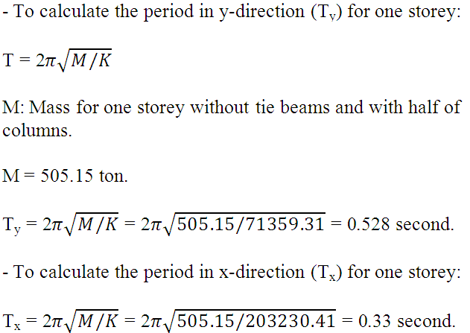
Period Calculations For One-Storey

Slide 50
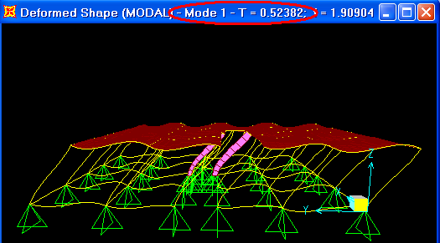
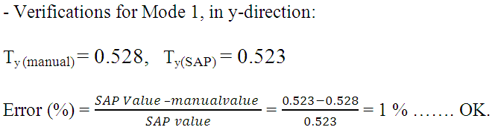
Checks Of Period

Slide 51
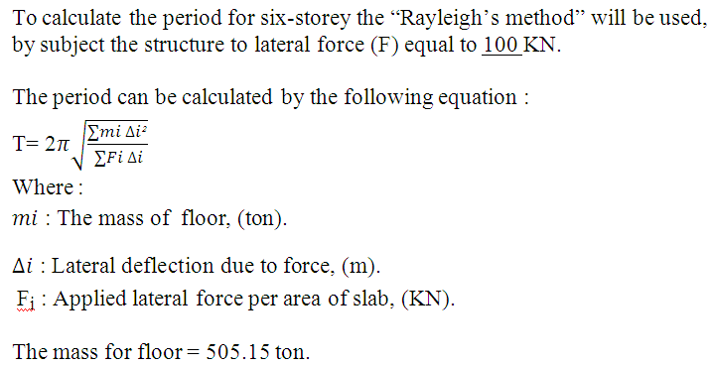
Period Calculations For Six-Storey

Slide 52
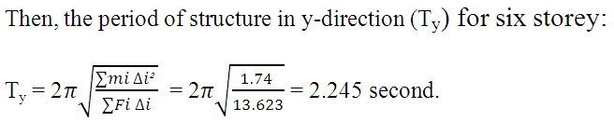
Rayleigh’s Method
Displacement for each floor in y-direction.
Floor No. | Mass of floor (ton) | Force (KN) | ∆ (m) | mass*∆² | Force* ∆
1 | 505.15 | 100 | 0.00941 | 4.47E-02 | 0.941
2 | 505.15 | 100 | 0.01654 | 1.38E-01 | 1.654
3 | 505.15 | 100 | 0.02227 | 2.51E-01 | 2.227
4 | 505.15 | 100 | 0.0266 | 3.57E-01 | 2.66
5 | 505.15 | 100 | 0.02967 | 4.45E-01 | 2.967
6 | 505.15 | 100 | 0.03174 | 5.09E-01 | 3.174
Total |  |  |  | 1.74E+00 | 13.623

Slide 53
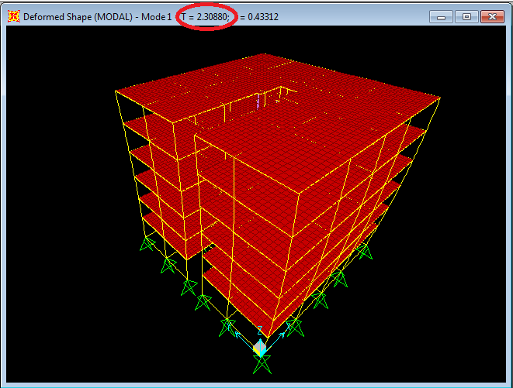
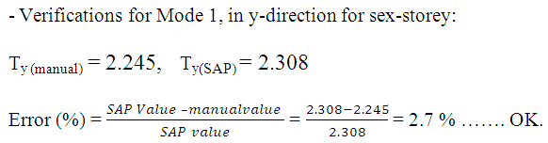
Checks Of Period

Slide 54
Base Shear Calculations
There are three methods to find base shear for the structures:
Equivalent lateral force method and IBC2003 response spectrum.
Response spectrum dynamic analysis method and IBC2003 response spectrum.
Time history analysis method and structure is subjected to “Elcentro” earthquake.

Slide 55
Equivalent Static Method
Since the building is in Nablus city, the seismic zone for this city is (2B).
- The parameters used for equivalent method are:
1. Site of structure: Nablus City.
2. Soil-type (Rock) = B.
3. Peak ground acceleration ( PGA ) = 0.2g.
4. Spectral accelerations for 1-sec.period (S₁)=0.2
5. Spectral accelerations for short-sec. (S_{s}) = 0.5
6. Site coefficients for acceleration (F_{a}) and for velocity (F_{v}) = 1
7. S_{Ds} = 2/3(S_{s} * F_{a}) = 2/3 (0.5*1) = 0.3333
8. S_{D1} = 2/3(S₁* F_{v}) = 2/3 (0.2*1) = 0.13333

Slide 56
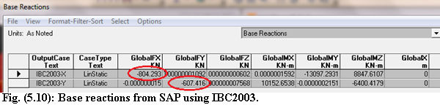

Checks
The following figure shows results of base shear from SAP using IBC2003:
Total weight of structure ( W ) = no. of floors * weight of floor
= 6 * 5255.61= 31533.66 KN.
- Base shear in y-direction (V_{y}):
V_{y} = C_{S y} * W = 0.0193 * 31533.66 = 608.6 KN.
- Base shear in x-direction (V_{x}):
V_{x}= C_{S x} * W = 0.0255 * 31533.66= 804.12 KN.

Slide 57
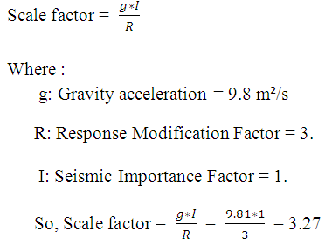
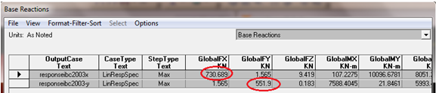
Response Spectrum Method
The following figure shows SAP results of base shear using IBC2003 response spectrum:

Slide 58
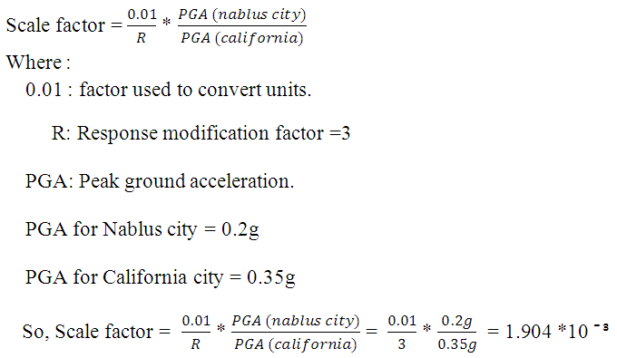
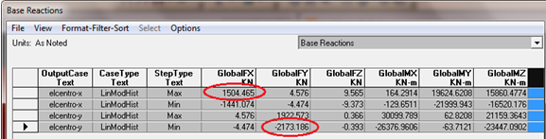
Time History Method
The following figure shows SAP results of base shear using Time History method

Slide 59
Check Of Structure
 | Base shear (KN)
The method | x-direction | y-direction
Equivalent static | 804.29 | 607.42
Response spectrum | 730.69 | 551.9
Time history | 1504.47 | 2173.19
The following combination for gravity load and dynamic load will be used to make check on structure:
1. Combination (1) = 1.2DL + 1.6 LL. (Ultimate Combination).
2. Combination (2) = 1.2DL + 1.0 LL + 1.0EQ. (Earthquake Combination).

Slide 60
Check Of Columns
 | Axial Force(KN)
column ID. | Comb.(1) | Comb.(2) in X-direction | Comb.(2) in y-direction | No. of Govern Comb.
B1 | 1756.9 | 1899.65 | 1932.27 | 2
B2 | 2560.717 | 2618.22 | 2459.35 | 2
B3 | 947.115 | 932.32 | 1182.52 | 2
B7 | 1038.057 | 1018.85 | 1196.48 | 2
B8 | 2659.083 | 2711.75 | 2519.7 | 2
B9 | 1752.595 | 1896.63 | 1957.81 | 2
C1 | 2394.149 | 2292.65 | 2520.37 | 2
C2 | 2903.308 | 2769.22 | 2655.77 | 1
C3 | 989.592 | 915 | 1205.84 | 2
C7 | 1086.277 | 1002.16 | 1220.22 | 2
C8 | 3017.765 | 2873 | 2748.69 | 1
C9 | 2384.958 | 2283.7 | 2549.61 | 2
E1 | 2150.041 | 2082.49 | 2288.93 | 2
E2 | 2577.849 | 2532.754 | 2393.94 | 1
E4 | 427.936 | 529.08 | 733.89 | 2
E6 | 483.06 | 547.02 | 666.98 | 2
E8 | 2671.472 | 2619.04 | 2442.34 | 1
E9 | 2143.441 | 2076.48 | 2317.57 | 2
F4 | 630.219 | 583.56 | 1012.89 | 2
F5 | 382.011 | 708.11 | 414 | 2
F6 | 662.035 | 654.37 | 1194.47 | 2
G1 | 2487.767 | 2498.93 | 2613.31 | 2
G2 | 3328.052 | 3179.46 | 3064.2 | 1
G5 | 2528.619 | 2909.43 | 2308.02 | 2
G8 | 3348.105 | 3197.06 | 3082.75 | 1
G9 | 2486.194 | 2498.29 | 2651.23 | 2
H1 | 1971.447 | 2062.351 | 2112.31 | 2
H2 | 3115.144 | 3090.36 | 2983 | 1
H5 | 3167.091 | 3139.96 | 2974.39 | 1
H8 | 3117.36 | 3093.41 | 2982.22 | 1
H9 | 1972.03 | 2063.51 | 2145.46 | 2

Slide 61
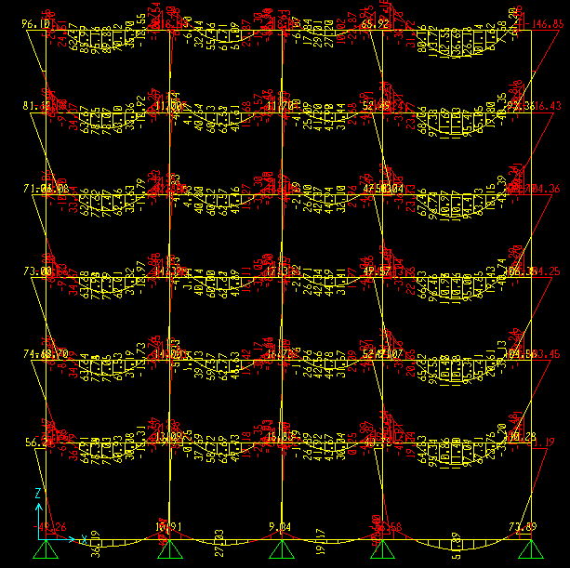
Check Of Beams
The following figures shows moment diagram for Frame (1):

Slide 62
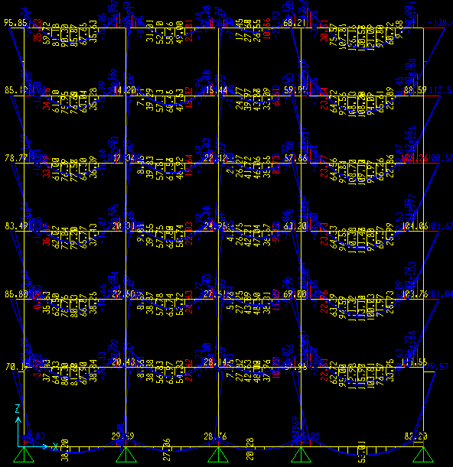
Check Of Beams

Slide 63

Check Of Beams
The following figures shows moment diagram for Frame (2):

Slide 64

Check Of Beams

Slide 65

Check Of Slabs
The following figure shows moment values (M22), for first slab in the structure from ultimate combination:

Slide 66

Check Of Slabs
The following figure shows moment values (M22), for first slab in the structure from earthquake combination:

Slide 67
THANK YOU

