Slide 1

AN-NAJAH NATIONAL UNIVERSITY
ELECTRICAL AND TELECOMMUNICATION ENGINEERING DEPARTMENT
GRADUATION PROJECT 2
SMART CHICKEN FARM
SUPERVISOR: DR. JAMAL KHROUSHEH
PREPARED BY:
AMAL NASER ALJADAA [11612206]
SALI SHAHIR BANIODEH [11611389]
FAYHAA SAMEER KILANI [11612682]
ISRAA NAJEH QARARIAH [11612815]
2020/2021

Slide 2
The idea of the project in general
IOT is an integrated application utilizing current information technologies, involving many technical areas, such as sensor technology, communication, automation, high end computation, information processing and security etc. In the “internet of things”, objects can “communicate” with each other, without human intervening.

Slide 3
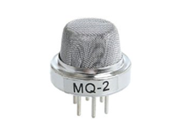
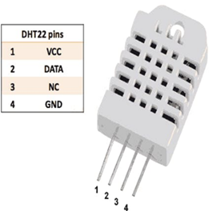
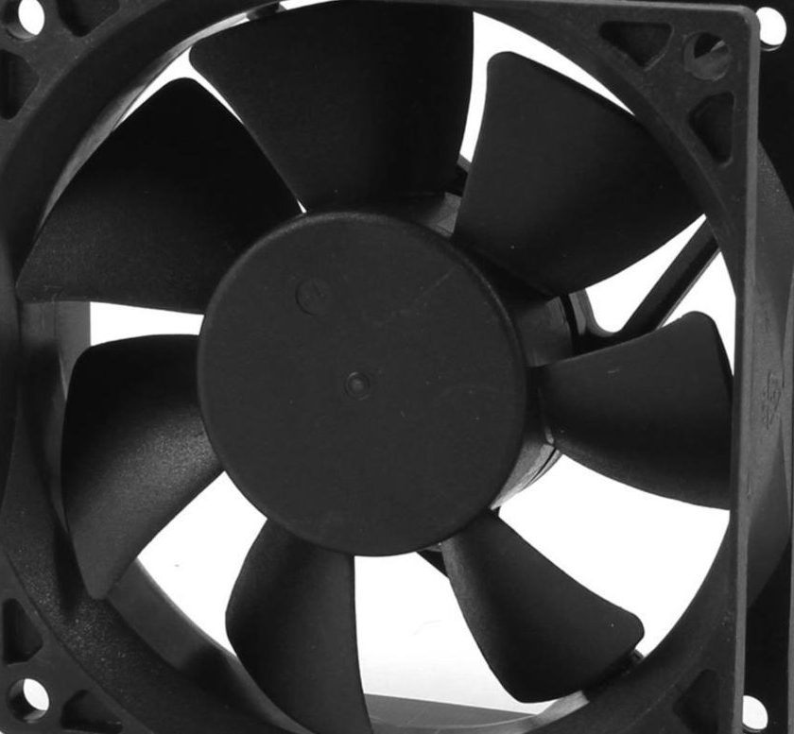
Equipment
DHT temperature-humidity sensor
Gas sensor
80mm 2pins cooling fan dc

Slide 4
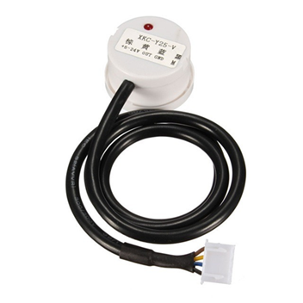
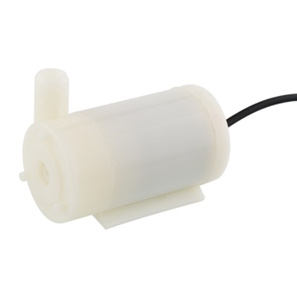
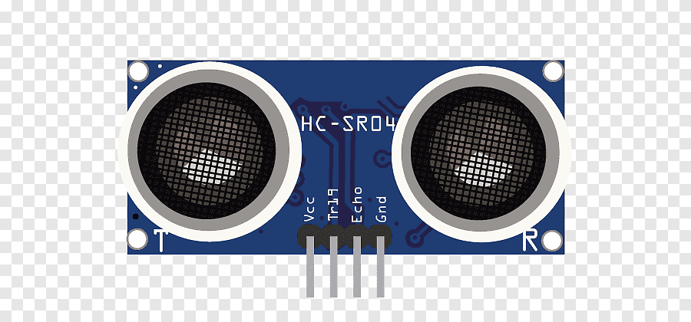
non contact capacitive liquid level sensor
Mini Submersible Water Pump
Ultrasonic distance sensor.

Slide 5
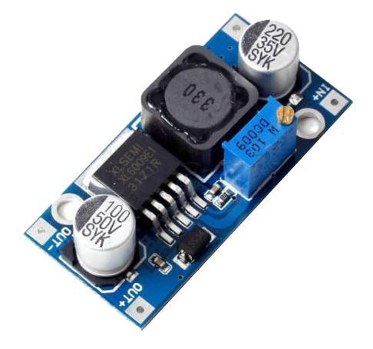
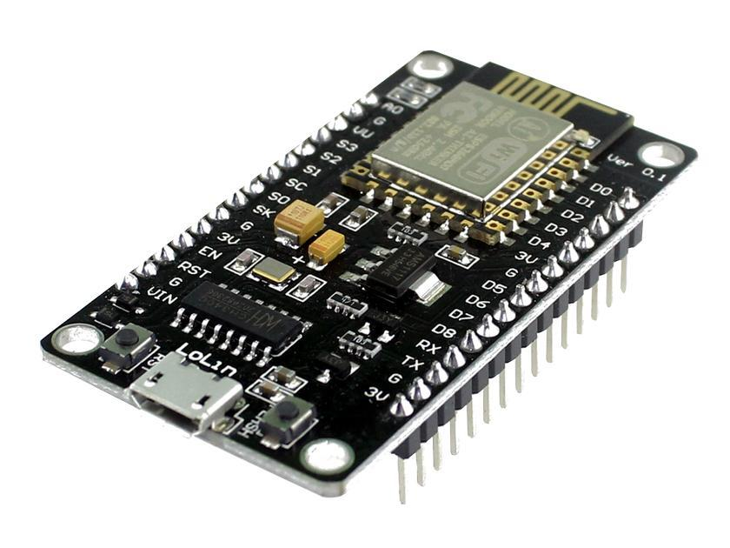
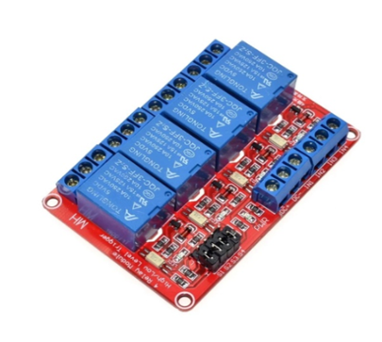
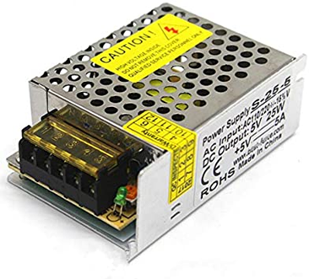
Boost convertor
NODEMCU
Relay
power supply

Slide 6
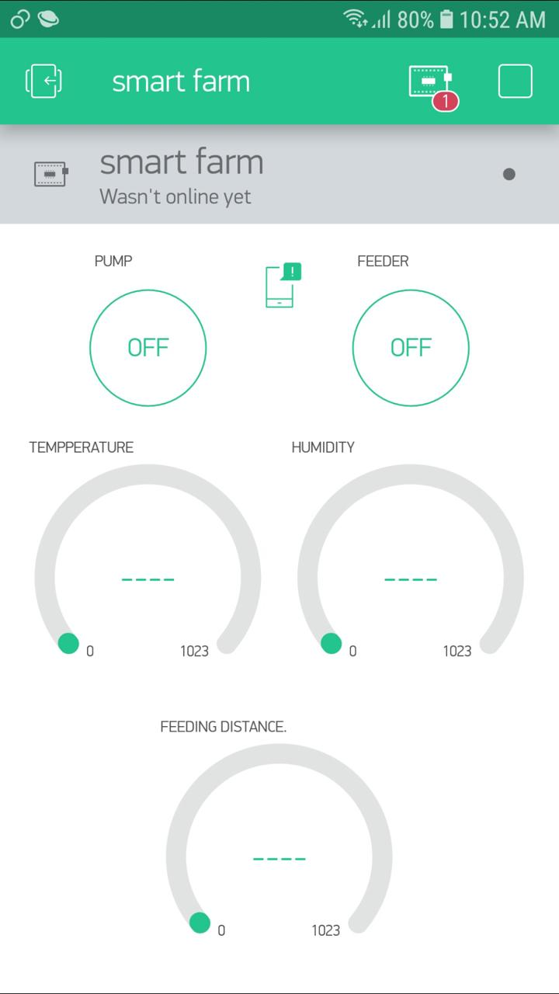
How did we use the Internet of Things in this project?
We worked on the Blynk app .

Slide 7
Difficulties and problems faced us
Each step has challenges, and we had to face and solve them, from these challenges:
Expensive prices for some parts .
At first we started working on plc programming, but this did not work out for several reasons .
Consequently, we lost a lot of time needed to complete the project
Difficulty finding economic alternatives .

