Slide 1
IMPLEMENTING LEAN SIX SIGMA IN THE PALESTINE POULTRY COMPANY
Prepared by :
Huthaifa Abu Shhade
Mohammad Abd Aljaleel
Rema' Bsharat
Shahed Zedan
Leena Alatrash
Supervisor :
Eng. Ahmad Zaid

Slide 2
Outlines:
Introduction.
Production process.
Problem statement.
Objectives.
Methodology (DMAIC Cycle).
Results.
Conclusion.
Recommendation.

Slide 3
Introduction
Lean Six Sigma : is the combination of Lean and Six Sigma.
The fusion of Lean and Six Sigma is required because lean cannot bring process under statistical control, and Six Sigma alone cannot dramatically improve process speed or reduce invested capital.
Benefits from Lean Six Sigma
Increased profits
Fast and dramatic results
Increased revenue
improved quality
Increased customer satisfaction

Slide 4
Problem statement
Mainly, the problem in this factory is at the production rate in mixing console and crunches. In more details, the actual rate of production capacity is 19 tons per hour (where in some varieties to 25 tons / hour).
The difference in capacity rate occurred for many reasons:
The actual production capacity of crusher is smaller than planned.
multiplicity of varieties produced daily where you need to switch between categories

Slide 5
Objectives
The project will achieve the following objectives:
reduce the gap (6 ton) between planned (25 ton) and current (19 ton) production.
increase of revenue.
reduce delay time.

Slide 6
Earlier Course Work
Methods Engineering
Computer Integrated Manufacturing (CIM)
Simulation
Facility Planning and Layout
Laboratory computerized applications

Slide 7
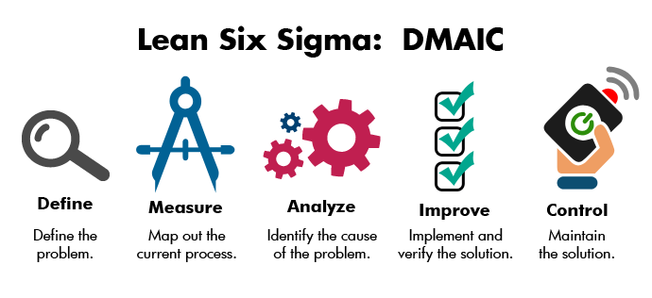
Methodology
In this project we have used the DMAIC cycle as a guideline.

Slide 8

Define
Step 1: Define the problem.
Step 2 : Define the goal.
Step 3 : Define process.
Step 4 : Define and execute a change management strategy .

Slide 9
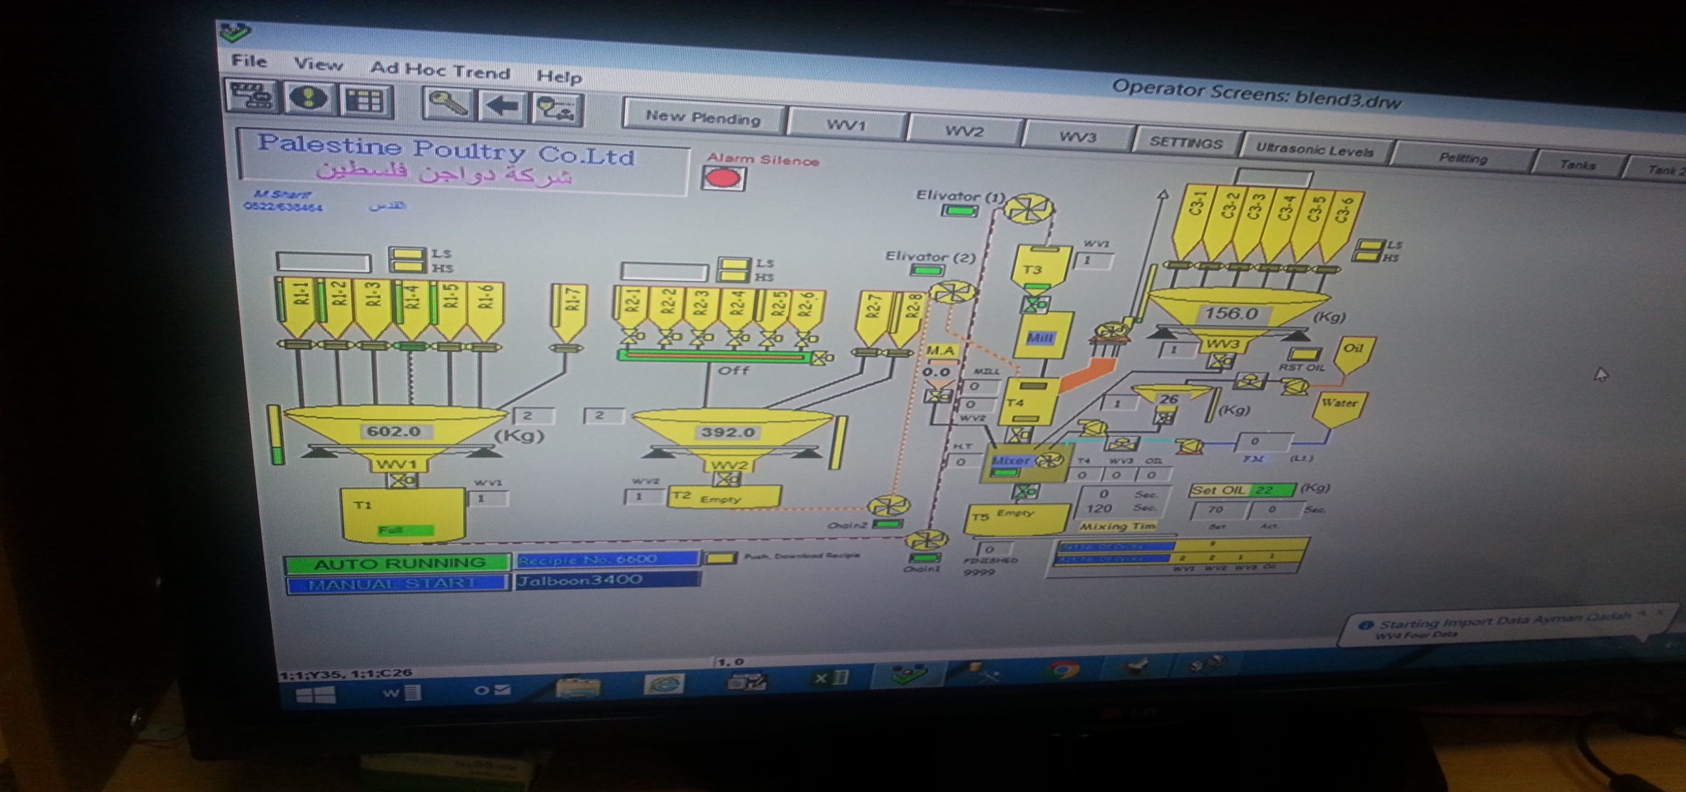
Production process

Slide 10
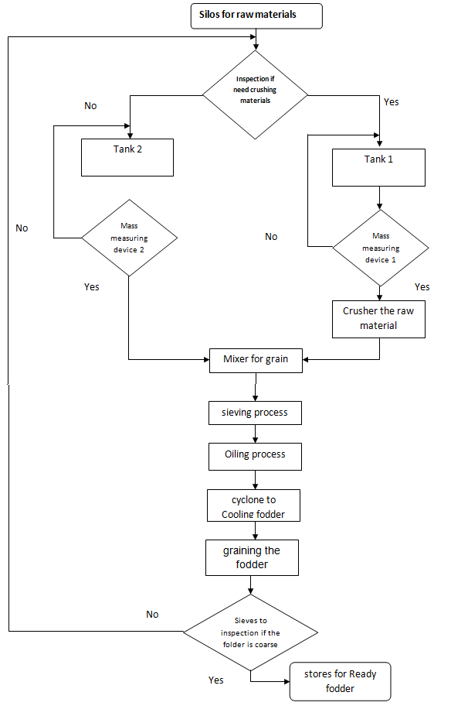
Define
Process Map form.

Slide 11
Measure
At measure phase we use the Lean Six Sigma process improvement strategy.
Tools which is used:
1- Fishbone diagram.
2- FMEA.
3- Data collection plan.

Slide 12
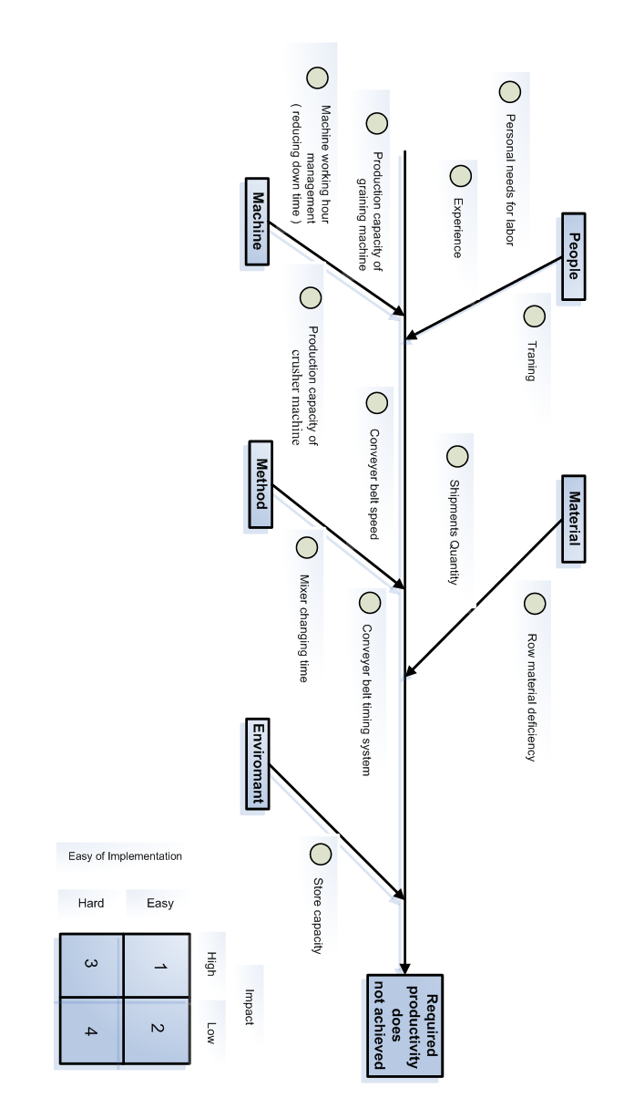
Fishbone diagram
We use fish bone diagram in the measurement phase to find out all the variables occurred in the manufacturing process, where this process depends on people, material, method, environment and machine

Slide 13
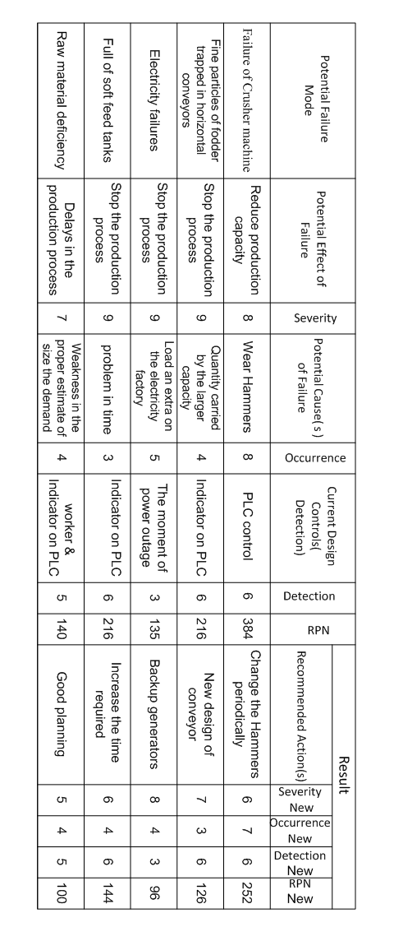
FMEA
RPN = (Severity) x (Occurrence) x (Detection)

Slide 14
FMEA Result
We obtain that the biggest problem that effect on the productivity was Crushing machine. In addition, we study the main three factor:
The handling time.
Safety margin for the gate of crusher.
Effect of the volume of orders on production capacity.

Slide 15
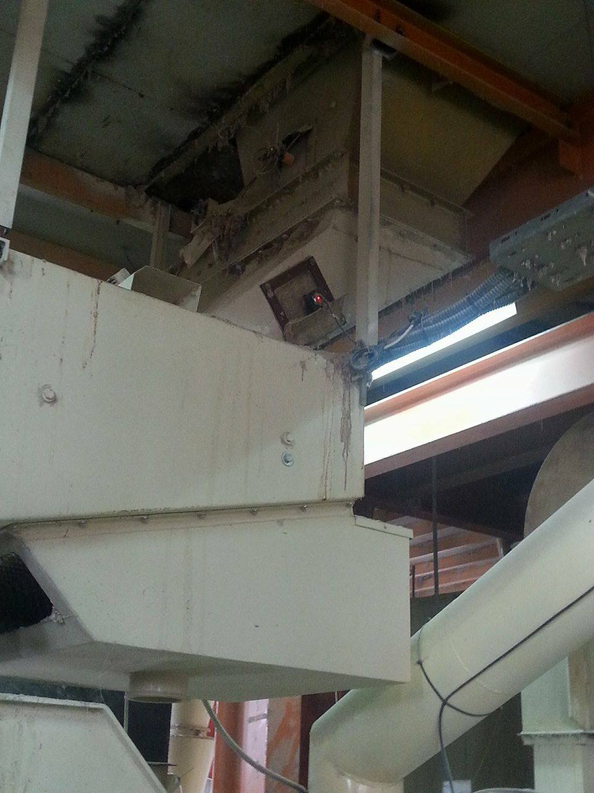
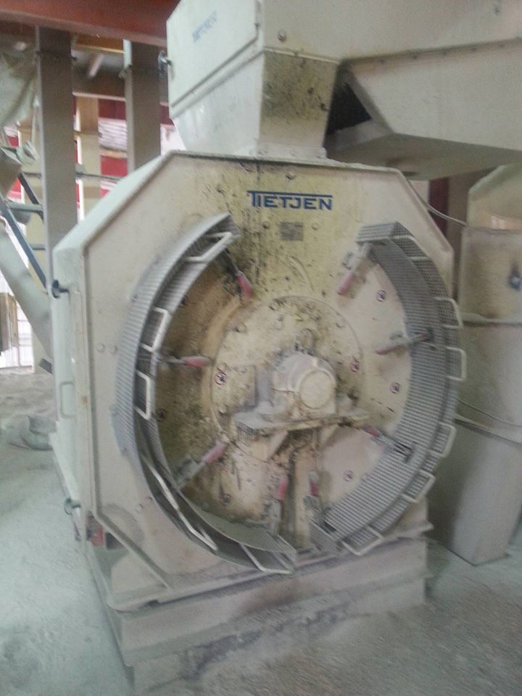
Crushing machine
Two laser sensors.
Ammeter :
Empty | Material inside crusher
120 ampere | (200-250) ampere

Slide 16
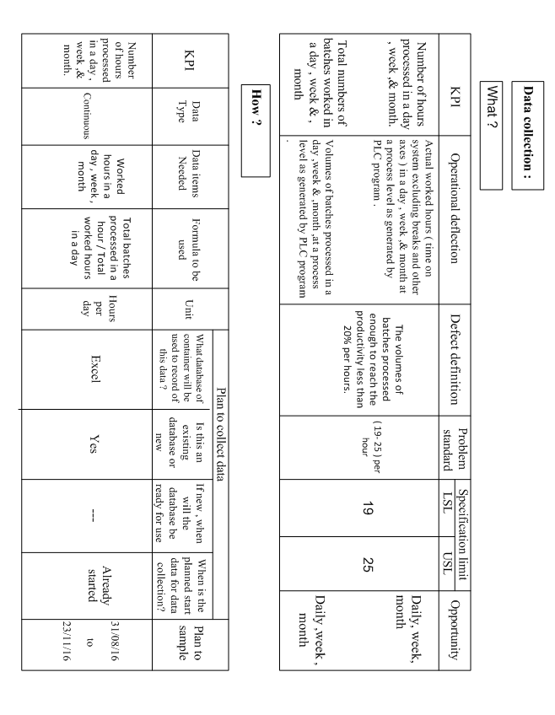
Data collection plan

Slide 17

Analyze
Analyze phase is the beginning of statistical analysis of the problem, the practical problem was defined earlier
Analyze tools :
Histogram .
Run chart .
Box plot.
Pareto analysis.

Slide 18
The handling time
The handling time between PLC and real time on the crushing machine.
The handling time is ideal and it can’t be changed or modified.
Time on PLC control (Minute) | Actual time on crushing machine (Minute)
4.47 | 4.49
4.45 | 4.46
4.41 | 4.45
4.45 | 4.44
4.54 | 4.53
4.49 | 4.50
4.46 | 4.46
4.42 | 4.43
4.50 | 4.49
4.52 | 4.51

Slide 19
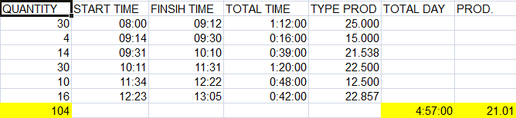
The production capacity in Crusher machine
How calculated the production capacity in Crusher machine ?

Slide 20
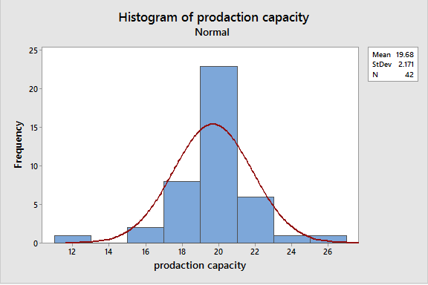
The production capacity in Crusher machine
The samples were taken from the date 31/08/2016 to date 15/10/2016.
Histogram :

Slide 21
Run Chart
Run Chart

Slide 22
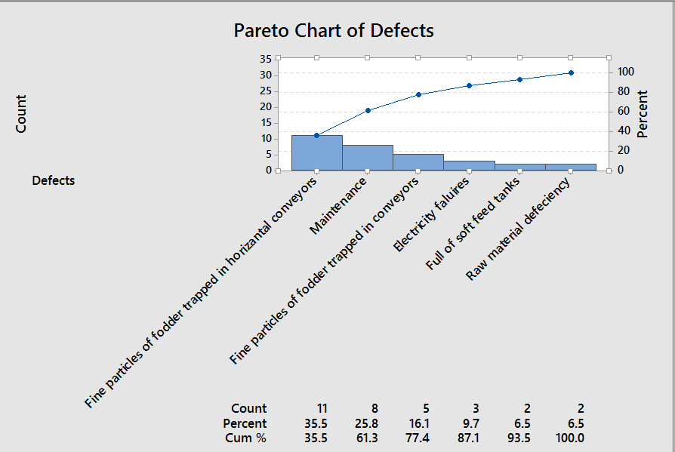
Pareto Analysis

Slide 23
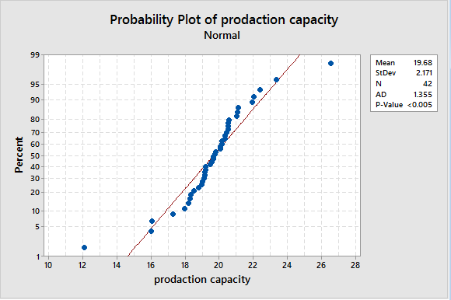
Normality

Slide 24
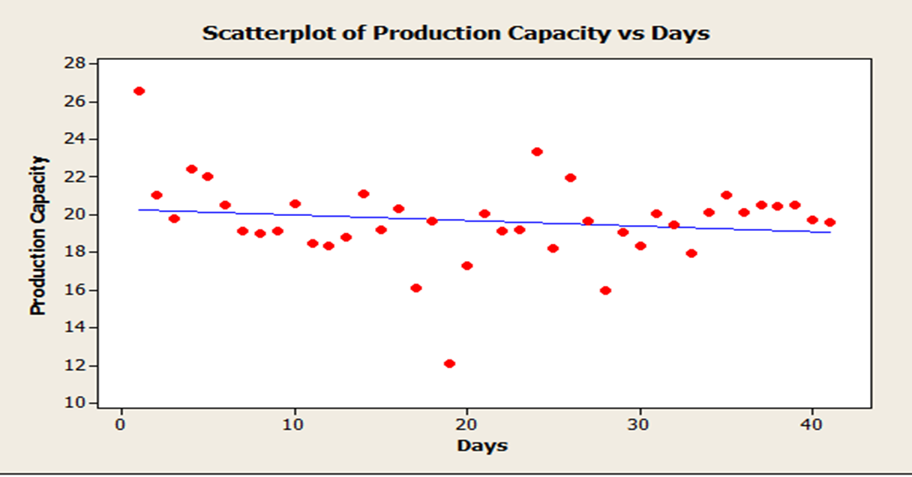
Scatter plot

Slide 25
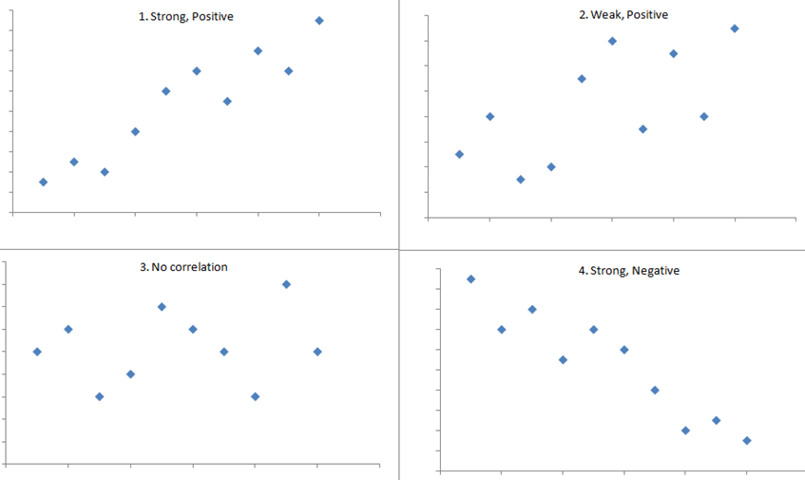
Correlation
Is a statistical measure that indicates the extent to which two or more variables fluctuate together.

Slide 26
Correlation
Correlations: between days and Production capacity before improvement.
Pearson correlation of Days and Production capacity before improvement | -0.162
P-Value | 0.311

Slide 27
Improve
The Improve phase focused on selecting the improvement ideas that were either identifies generated potential solutions or Select and test solution.
Kaizen is a lean tool which is used here.
Kaizen objectives:
1-Reduce non-value-adding activities or waste.
2- Productivity increase.

Slide 28
Reduce non-value-adding activities or waste
Crushing machine system

Slide 29
Reduce non-value-adding activities or waste
 | Before | After
Safety margin for the gate of crusher. | 20 sec | 10 sec
Conveyor time | 20 sec | 10 sec
Total time required for each batch | 4.5 min | 4.16 min
Total time for 12 batch | 54 min | 50 min
32 min /8 hr | 4 min/hr | Saving time
15.38 ton/8 hr | 7.69 batches/8 hr | Quantity

Slide 30
Productivity increase
By doing necessary maintenance for hammers and filters.
The main goal was increasing the productivity of crusher.
Starting from 16/10/2016 to 23/11/2016.

Slide 31
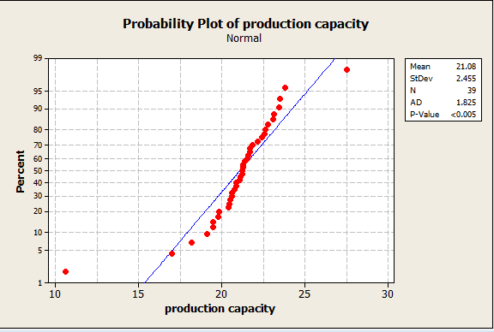
Normality

Slide 32
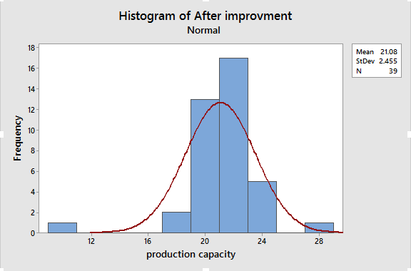
Histogram

Slide 33
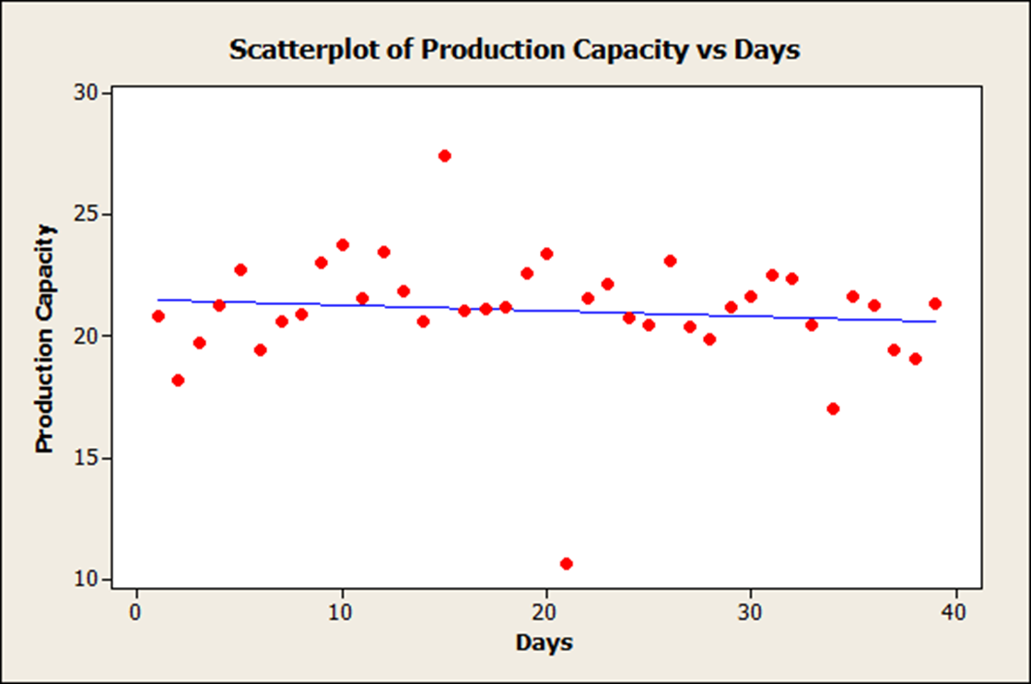
Scatterplot

Slide 34
Correlation
Pearson correlation of Days and Production capacity after improvement | -0.105
P-Value | 0.527

Slide 35
Hypothesis
We use the 2 sample – T test
 | Before improvement | After improvement
Sample | 42 | 39
Median | 19.74 | 21.23
St.Dev | 2.17 | 2.46
SE Mean | 0.33 | 0.39
Difference | Mean (1) – Mean (2)
Estimate for difference | -1.49
95% CI for difference | (-2.520, -0.460)
T-Test of difference | 0
T-Value | -2.88
P-Value | 0.005
Degree of freedom | 75

Slide 36
Box plot
Is a graphical rendition of statistical data based on the minimum, first quartile, median, third quartile, and maximum

Slide 37
Results from Box plot
N | Median | Q1 | Q3 | IQ Range
42 | 19.74 | 18.76 | 20.515 | 1.755 | Before Improvement
39 | 21.23 | 20.45 | 22.38 | 1.93 | After Improvement

Slide 38
Effect of the volume of orders on production capacity
We take 9 days sample containing small size orders and comparing them with high-volume orders, analyzed using the MINITAB program, and results were as follows:
Production capacity with high volume of order | Production capacity with small volume of order
21.35 | 18.17
21.64 | 19.61
21.32 | 19.66
23.13 | 18.99
21.55 | 21.12
27.48 | 19.91
20.45 | 18.19
23.49 | 20.05
23.44 | 19.47

Slide 39
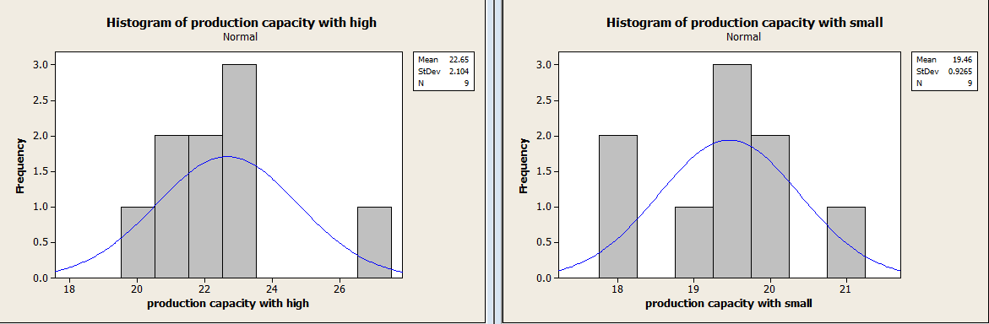
Histogram of production capacity before & after remove small quantities

Slide 40
Control
Once the improvements have been implemented, we need to ensure that the project goals have been attained and the required measures for sustainability are in place.
The appropriate technique for developing a process control system is SPC.
We divided the period by weeks, and counted the defects per weeks.

Slide 41
Data table for SPC chart before improvement
Week | Count of defects
1 | 10
2 | 12
3 | 6
4 | 8
5 | 5
6 | 4
Total defects | 45

Slide 42
U chart count of defects before improvement

Slide 43
Data table for SPC chart after improvement
Week | Count of defects
1 | 4
2 | 1
3 | 7
4 | 9
5 | 0
6 | 3
Total defects | 24

Slide 44
U chart count of defects after improvement

Slide 45
Results of the difference between before and after improvement
DPMO =[(total count of defects) / (number of units x number of opportunities per unit)] x 1000000.
Before | After
Units = 461 hr | Units = 358 hr
Total number of defects = 45 | Total number of defects = 24
DPMO = (45/461) x 1000000 = 97613 | DPMO = (24/358) x 1000000 = 67039
Z score (using z table) = 2.8 | Z score (using z table) = 3.0

Slide 46
Conclusion
The production capacity was increased from 19.68 to 21.08 ton/hr and this was achieved by focusing on the three stages :
Handling time.
Crusher machine.
Volume of orders.

Slide 47
Recommendation
The quantity of small volume orders shall be reduced.
More studies for other machines (e.g. graining machine).
Provided with electrical power generators.
Doing periodical maintenance for machines.
Scheduling a weekly preventive maintenance and documented for each year.

Slide 48


