Slide 1


Slide 2
OUTLINE
Back ground.
Study area
Project objectives.
Methodology.
Data collection
Data Analysis
Countermeasures
Conclusions

Slide 3
Background
Two-lane highways are the major road network in the West Bank.
The safety condition of this type of roads is not well addressed in the literature.
The influencing factors have an effect on increasing the number of crash .

Slide 4
Study Area
Road number | Road name | Start | End | Length(km)
1 | Tulkarm _Nablus | Dair-Sharaf | Tulkarm | 13
2 | Jenin _Nablus | Dair-Sharaf | Jenin | 25
3 | Al-Bathan _Al-Masaken | Al-Bathan | Nablus | 11
4 | Nablus _Qalqilya | Bait-Wazan | Qalqilya | 27
6 | Za’tara_ Kefl-Hares | Za’tara | Kefl Hares | 10

Slide 5
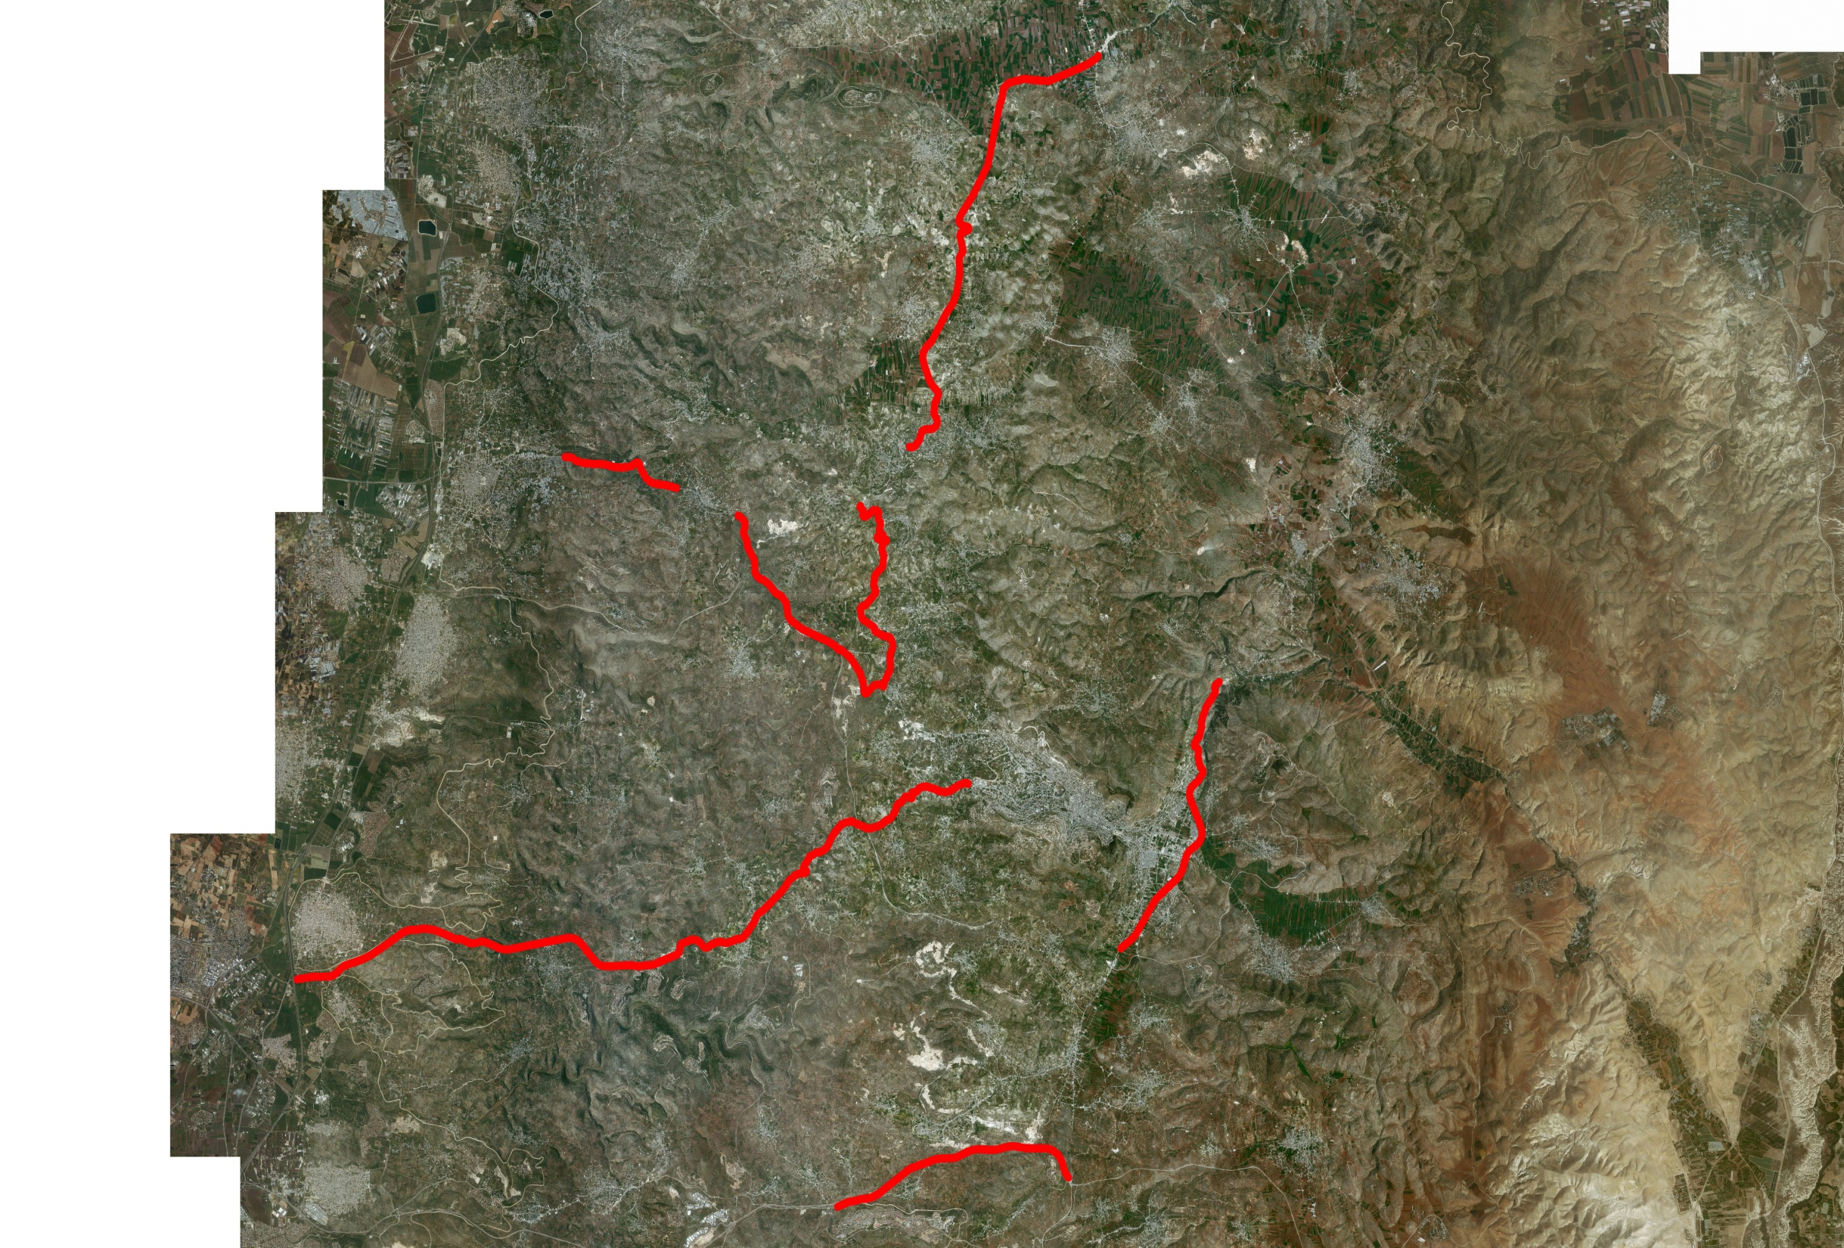

Slide 6
Objective
Analyze the safety performance
Identify the contributing factors to crashes .
Identify the most hazardous locations.
Propose countermeasures on one hazardous location.

Slide 7
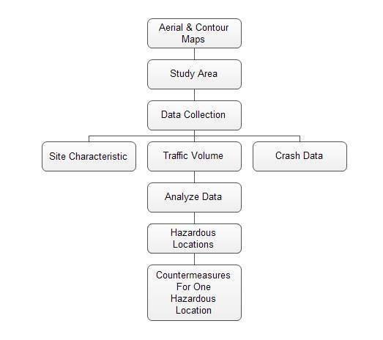
Methodology

Slide 8
Data Collection
Several type of data we required to conduct this project:
Crash data.
Geometric data.
Traffic data

Slide 9
Crash Data
Obtained from:
  traffic police centers and
  Israeli Central Bureau of Statistic through information already available on the internet.
Highway name | No. of crashes | % of injury crashes | % of PDO crashes | % Fatal Crashes
Tulkarm _ Nablus | 78 | 71.8 | 24.4 | 3.8
Nablus _ Jenin | 182 | 64.5 | 31.5 | 3.8
Nablus _Qalqilya | 161 | 22.2 | 76 | 1.8
Al-Bathan | 96 | 64.6 | 33.3 | 2.1
Za’tara_ Kefl-Hares | 17 | 11.8 | 88.2 | 0

Slide 10
Geometric Data
obtained from:
an aerial photograph for the west bank. Photo helped us to draw the highways on AutoCAD and divide each highway to stations

Slide 11
Highway name | NO of highway | NO of segments | NO of curves | NO of Links
Nablus_Jenin | 1 | 62 | 45 | 17
Nablus _Tulkarm | 2 | 47 | 31 | 16
Al-Bathan _ AL-Masaken | 3 | 27 | 21 | 6
Za’tara _Kefl-Hares | 4 | 11 | 6 | 5
Nablus Qalqilya | 5 | 61 | 39 | 22

Slide 12
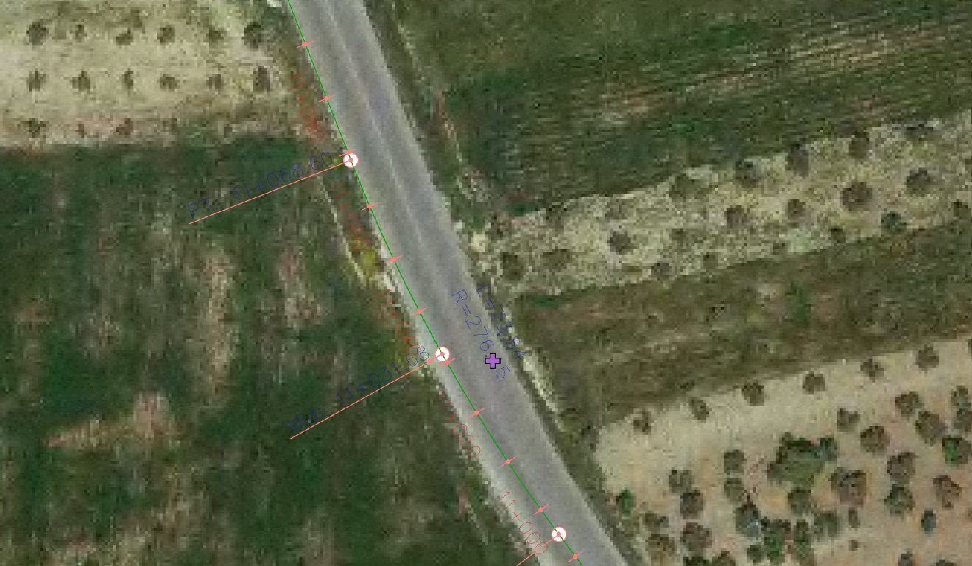
geometry of Nablus _Jenin.

Slide 13
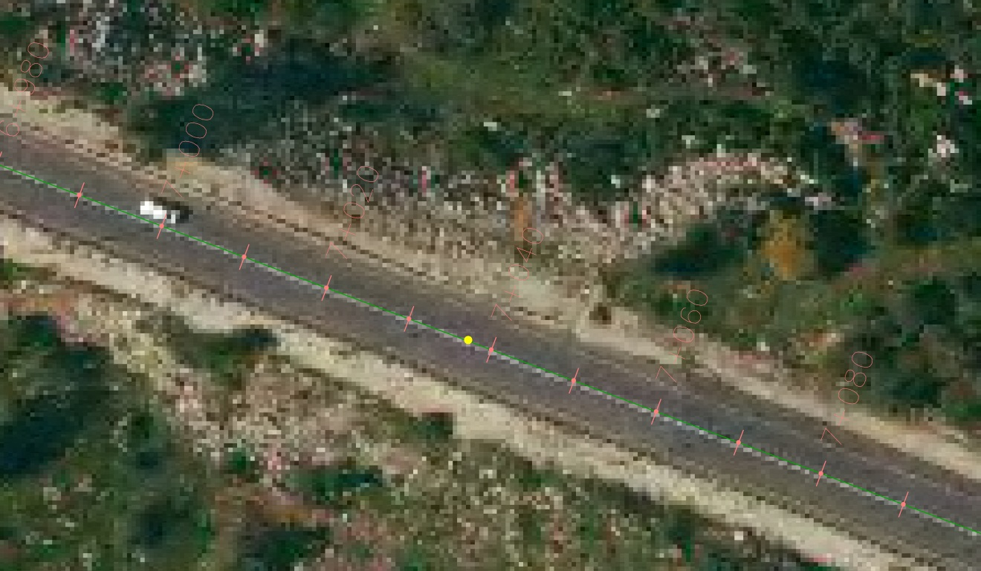
geometry of Nablus_ Qalqilya.

Slide 14
Traffic Data
Field count .
Previous Study .

Slide 15
Highway | PH | PHV | PHF | ADT | %HV
Tulkarm _ Nablus | 7.15-8.15 | 425 | 0.916 | 2729 | 18.20%
Nablus _ Jenin | 4:15-5:15 | 507 | 0.93 | 3206 | 5%
Nablus _Qalqilya | 7:45-8:45 | 463 | 0.95 | 2841 | 13%
Al-Bathan | 2.30-3.30 | 602 | 0.86 | 4118 | 11
Za’tara_ Kefl-Hares | 4.15-5.15 | 494 | 0.818 | 3553 | 10.14%

Slide 16
Data Analysis
ADT:
highway name | PHV | PHF | DHV | K | ADT
Tulkarm _Nablus | 425 | .916 | 464 | 0.17 | 2729
Jenin _Nablus | 507 | 0.93 | 545 | 0.17 | 3206
Al-Bathan _Al-Masaken | 602 | 0.86 | 700 | 0.17 | 4118
Nablus–Qalqilya | 459 | 0.95 | 483 | 0.17 | 2841
Za’tara_ Kefl- Hares | 494 | 0.818 | 604 | 0.17 | 3553

Slide 17
CRASH RATE:
Road name | length(km) | ADT | number of crash | crash rate
Tulkarm _Nablus | 12.96 | 2729 | 78 | 2.013
Jenin _Nablus | 24.933 | 3206 | 182 | 2.08
Al-Bathan _Al-Masaken | 10.85 | 4118 | 96 | 2.09
Nablus _Qalqilya | 27.319 | 2841 | 161 | 1.88
Za’tara_ Kefl Hares | 9.42 | 3553 | 17 | 0.47

Slide 18
Expected value calcuation :
Road name | expected value curve | expected value link | abnormal curve | abnormal link
Tulkarm _Nablus | (-6.3 – 12.5) | (-1.4 – 2.39) | 4+636 - 4+795//519 | 6+105 – 6+326//526 8+505 – 10+443//539
Jenin _Nablus | (9.01 - 15.98) | (-2.56 - 5.2) | 6+253-6+408//121 8+078 - 8+182//128 9+771- 9+968//133 18+792 -19+094//152 | 21+108–21+326// 155
Al-Bathan _Al-Masaken | (-5.31- 11.77) | (-1.12- 2.94) | 2+215 - 2+391//311 2+391 - 2+517//312 | 0
Nablus _Qalqilya | (-4.98-9.56) | (-2.72- 6.16) | 3+429 - 3+980.5//25 25+732 -26+002//255 | 5+835- 6+008//29
Za'tara_ Kefl-Hares | ( -0.17- 0.26 ) | ( 0.006- 1.54 ) | 7+955- 8+950 // 410 | 0

Slide 19
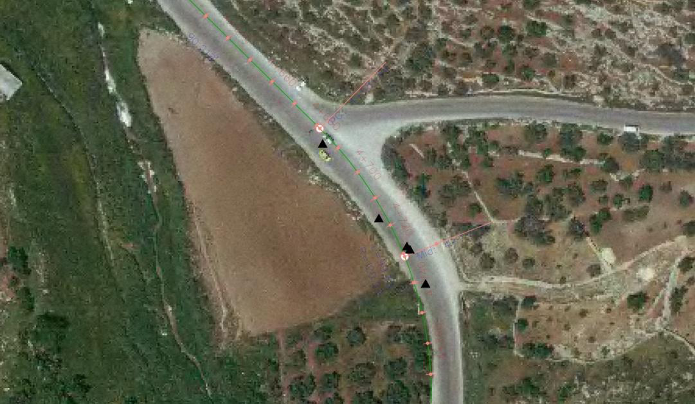
curve no. 519 on Tulkarm_ Nablus highway.

Slide 20
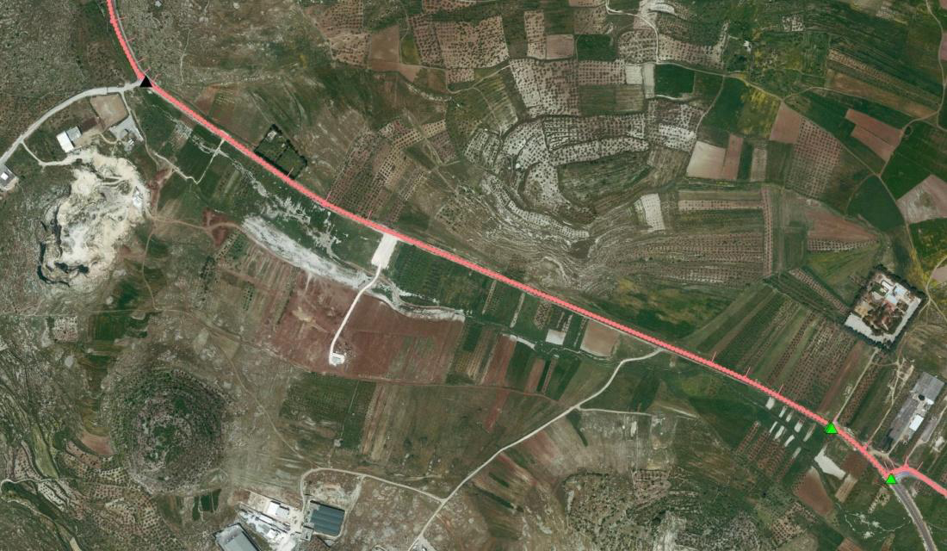
link no 539 on Tulkarm_ Nablus highway

Slide 21
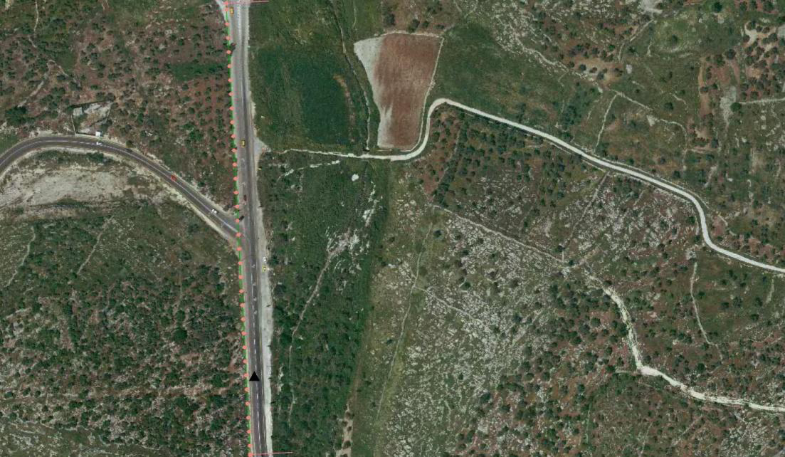
link no 526 on Tulkarm_ Nablus highway.

Slide 22
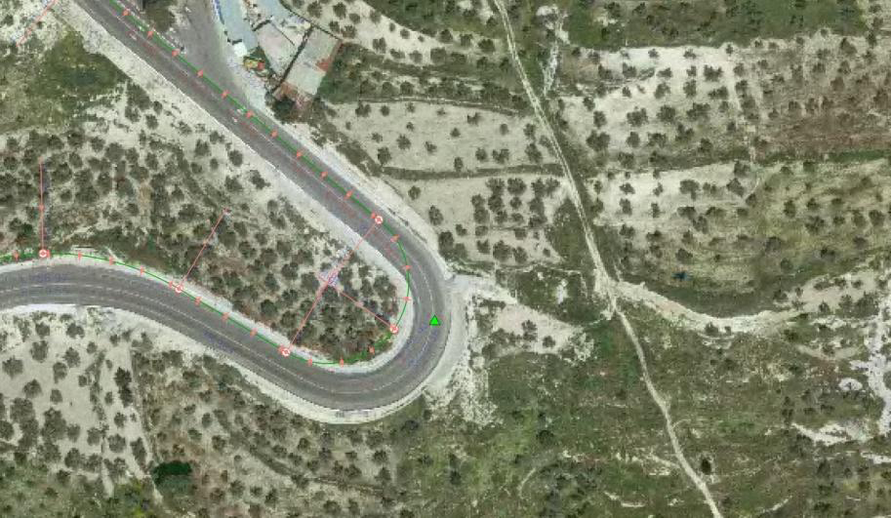
curve no. 121 on Nablus_ Jinen highway

Slide 23
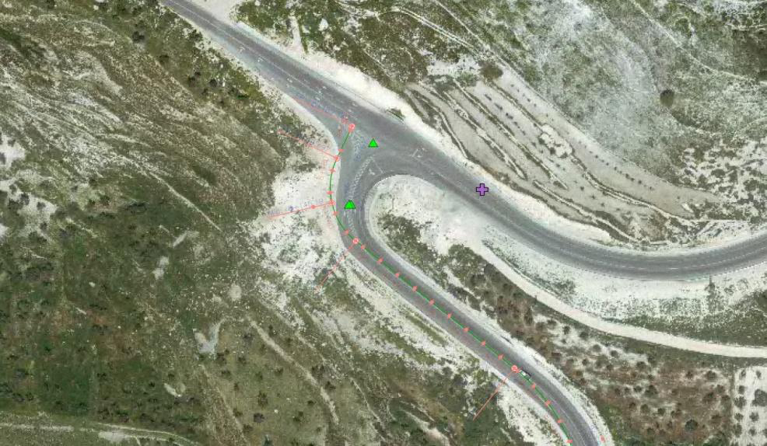
curve no. 128 on Nablus_ Jinen highway.

Slide 24
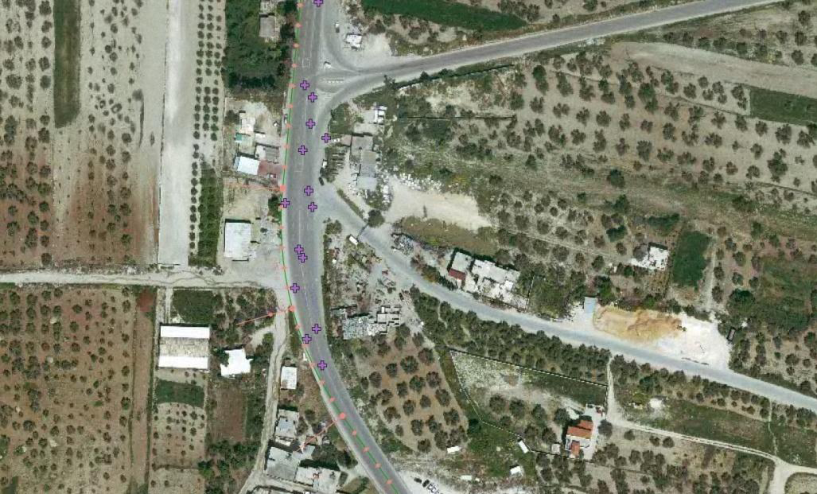
curve no. 133 on Nablus_ Jinen highway.

Slide 25
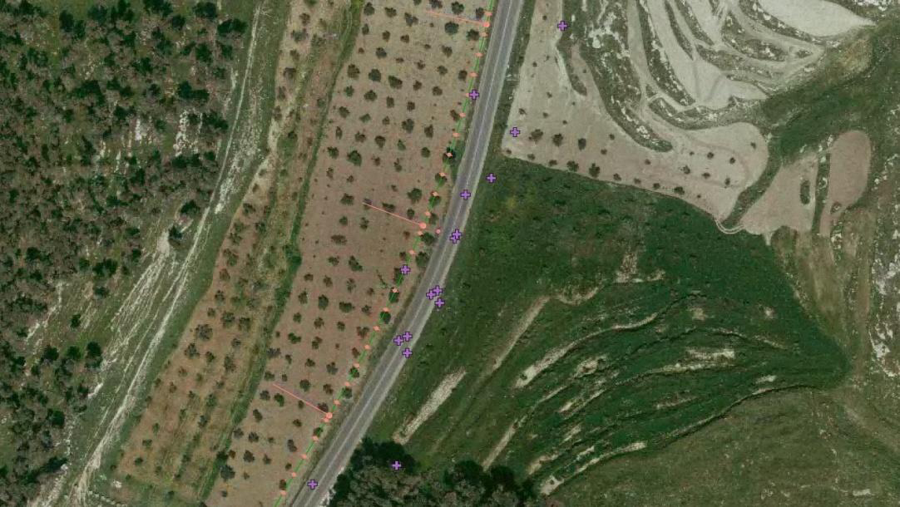
curve no. 152 on Nablus_ Jinen highway.

Slide 26
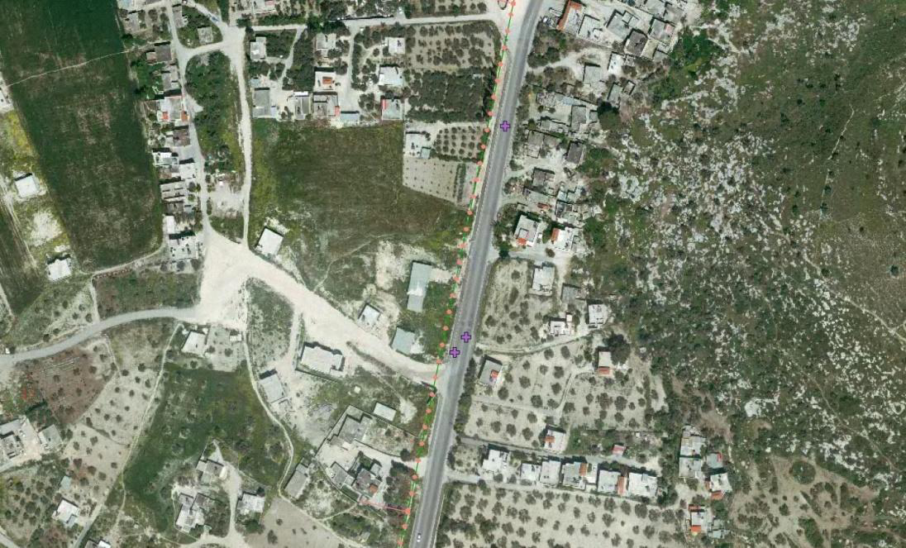
link no. 155 on Nablus_ Jinen highway

Slide 27
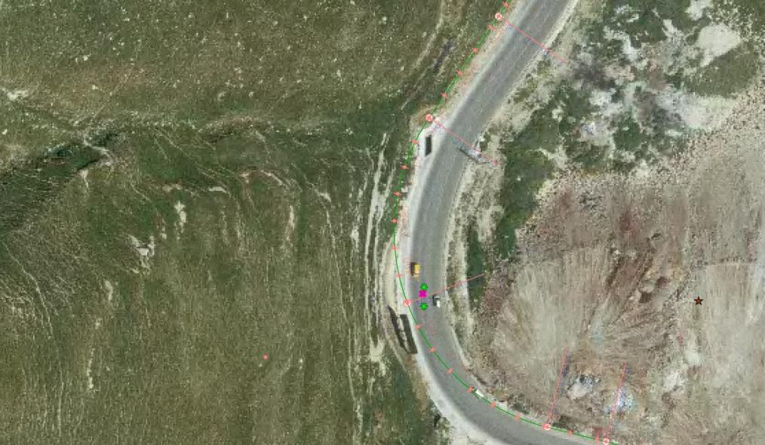
curve no. 311 on Al-Bathan_ Al-Masaken highway.

Slide 28
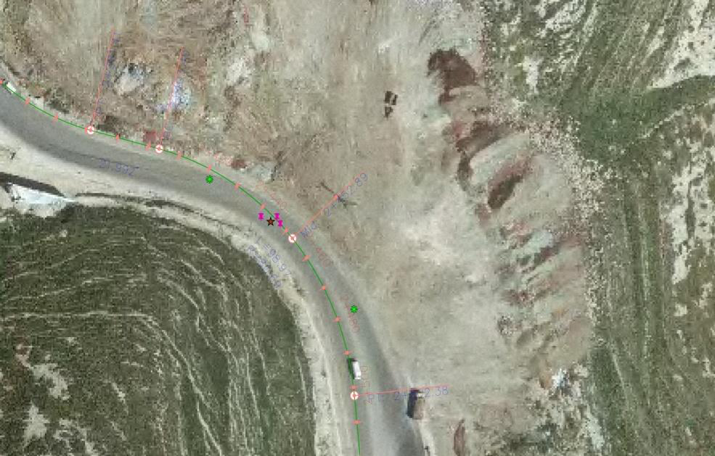
curve no. 312 on Al-Bathan_ Al-Masaken highway

Slide 29
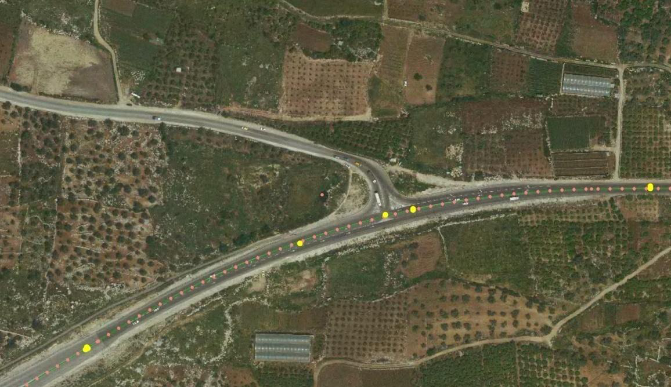
curve no. 25 on Nablus_ Qalqilya highway.

Slide 30
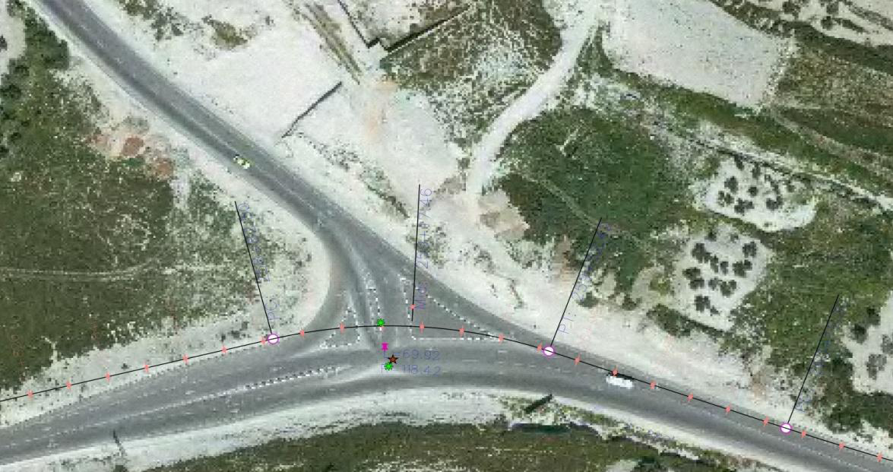
curve no. 255 on Nablus_ Qalqilya highway

Slide 31
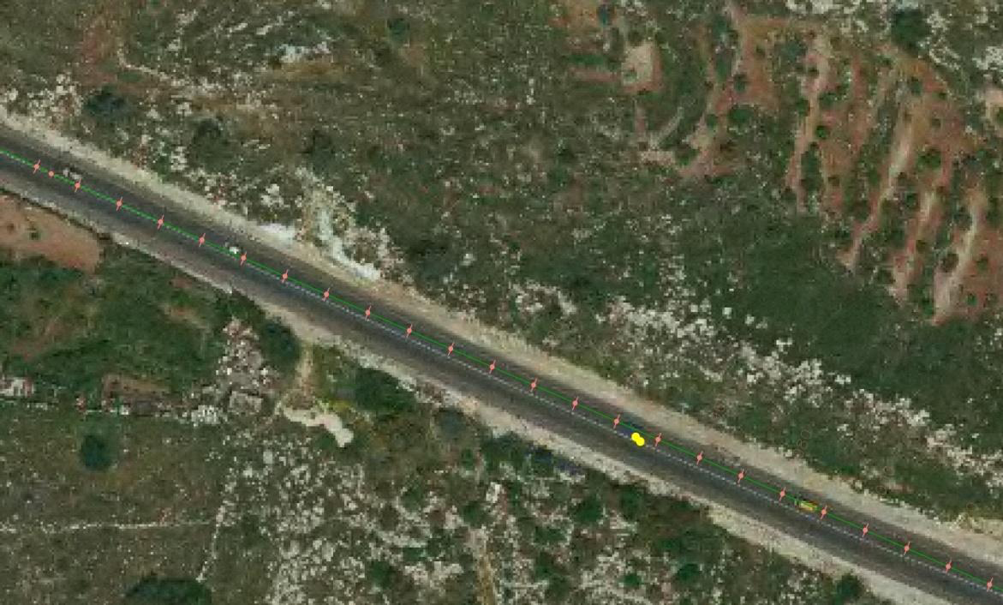
link no. 29 on Nablus_ Qalqilya highway

Slide 32
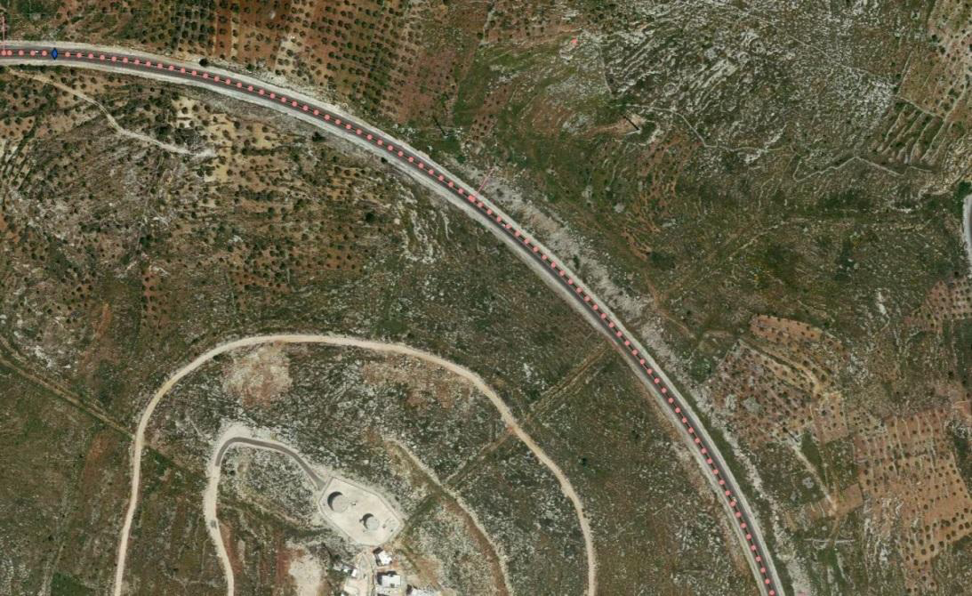
curve no. 410 on Za’tara_ Kefl-Hares highway

Slide 33
Counter measure
After the previous data analysis,The curve no 311considered an example for the hazardous locations on Al_Bathan – AL_Masaken highway

Slide 34
Why Al_Bathan – AL_Masaken highway ??
-Its location
- The most hazardous highway according to the crash rate values.

Slide 35
Data collection
super elevation 5.7%
85% of percentile speed equal 59.4 kph.
R_{min}=radius of this curve = 73 m
f_{s}=0.2

Slide 36
R_{min}=U^2/127(e+F_{s})
The velocity according to this equation equal 48 kph is lower than the driver velocity on this location

Slide 37
The velocity is the main reason for the crashing on this location.

Slide 38
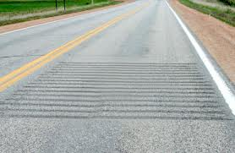
Countermeasure to reduce speed:
Roadway Related Countermeasures:
Install rumble strips in all paved lane

Slide 39


advance warrant sign
warrant sign used to lower the speed limit to 40kph.

Slide 40
Non_ Roadway Related Countermeasures
increased speed Enforcement
strength existing graduating license law
Traffic control devices
Flushing Picon
Dynamic message sign for speed reduction

Slide 41
Conclusions
many crashed were occurred at several location .These crashes were occurred at curves.
The mainly causes for the crashes were focused on the driver behavior.
crashes were concentrates on PDO or PI. But the fatalities were seldom to happen

Slide 42
Recommendations
Search about the hazardous locations for urban highways. and rural highways that not studied.
Introduce the systematic approaches to develop a safety program to minimize the occurrence of potential accidents.
Study deeply for all hazardous locations in rural areas in order to find the effective reminded actions

Slide 43
THANK You

