Slide 1


An – Najah National University
Faculty of Engineering
Civil Engineering Department
Prepared By:
Basel Zakarni
Mohammad Al-khaldi
Mohammad Kmail
Super Visor:
Eng.Emad Al-qasem

Slide 2
Outline
Project description
Philosophy of analysis & design
Design Of Slab
Design Of Beam
3-D Model
Design of column
Design of footing
Dynamic analysis

Slide 3
Project description
Faculty of science building in king Khalid university located in Saudi Arabia.
Area of the part that we take to design = 7250 m²

Slide 4
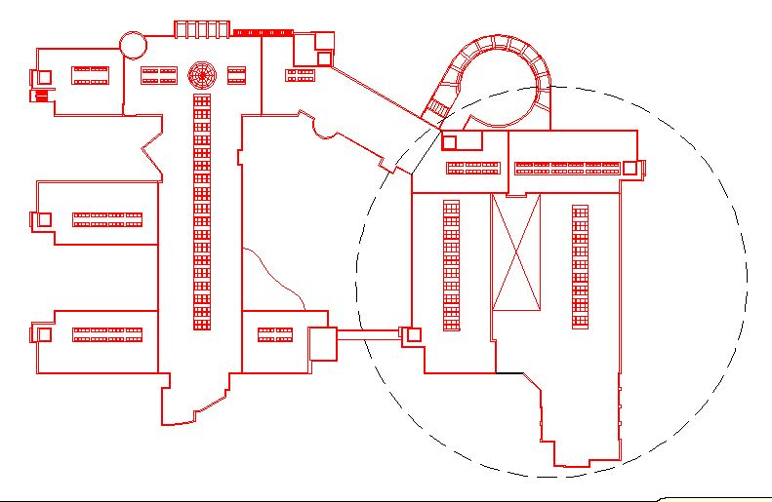

Slide 5
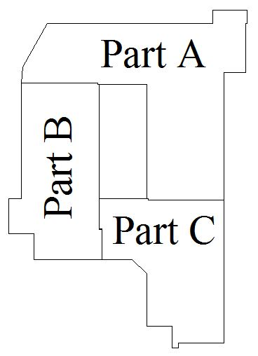

Slide 6
Philosophy of analysis & design
Ultimate design method is used to analysis and design of one way solid slab
the slab are carried over drop beams
Columns carrying an axial loads calculated by tributary area

Slide 7
materials of construction
Reinforced concrete
The unit weight of concrete (ρ) = 25 kN/m³.
The required compressive strength after 28 days is fc = 28 MPa.
The yield steel bars required Fy = 420 MPa.

Slide 8
Code used
American concrete institute code (ACI 318-08)
2009 International Building Code (IBC )

Slide 9
Loads
Dead load:
Own weight for slab = 6.25 kN/m² .
Super imposed load = 3.44 kN/m² .
Live load:
for Garage = 3 KN/m² .
for all the class room = 2.4 KN/m² .
for corridors = 4.8 KN/m².

Slide 10
Load Combination
Ultimate load = 1.2D+1.6L
Where:
D: dead load
L: live load

Slide 11
Design Of Slab

Slide 12
Slab
One way solid slab is used in the building
slab thickness is determined according to deflection control according to ACI code
Minimum thickness = Ln/24 = 22 cm
thickness used = 25 cm

Slide 13
Check shear for slab
Ln max = 6 - 0.4 = 5.6 m
Vu =42.5 kN at distance d from face of column.
φVc =0.75*0.166*(28)^{1/2} *1000*220/1000 = 145 kN
145 > 42.5 ……… OK

Slide 14
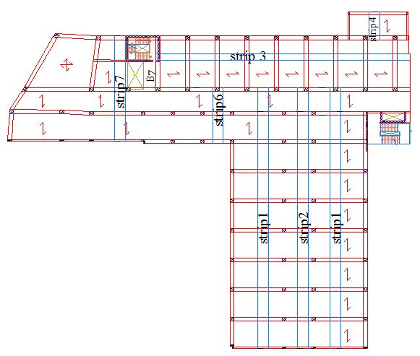
Part A
Strip Distribution of sub terrain floor

Slide 15
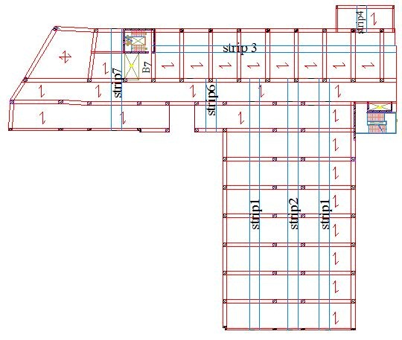
Part A
Strip Distribution of ground , first & second floor

Slide 16
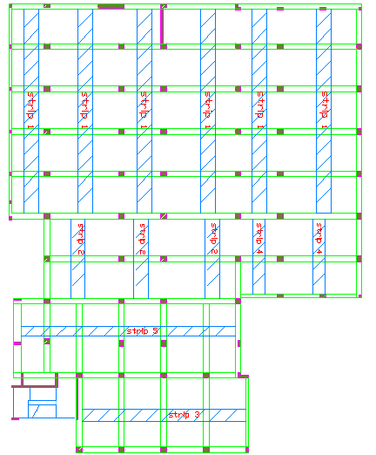
Part B
Strip Distribution of sub terrain floor

Slide 17
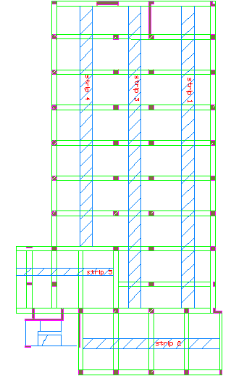
Part B
Strip Distribution of Ground & First floor

Slide 18
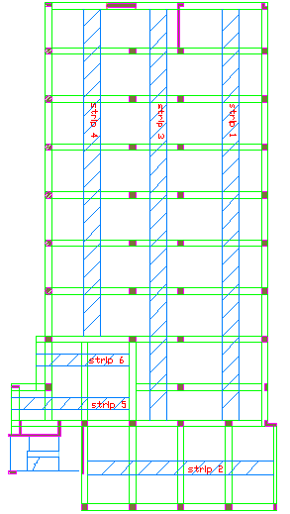
Part B
Strip Distribution of second floor

Slide 19
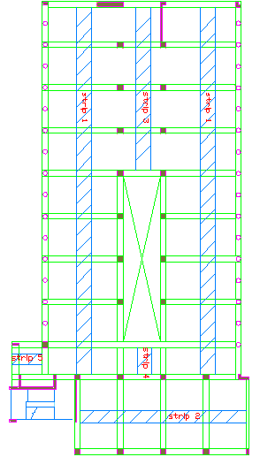
Part B
Strip Distribution of third floor

Slide 20
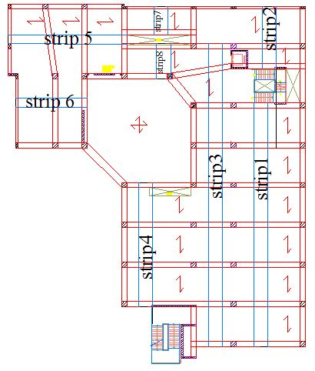
Part C
Strip Distribution of sub terrain floor

Slide 21
Part C
Strip Distribution of Ground , First & second floor

Slide 22
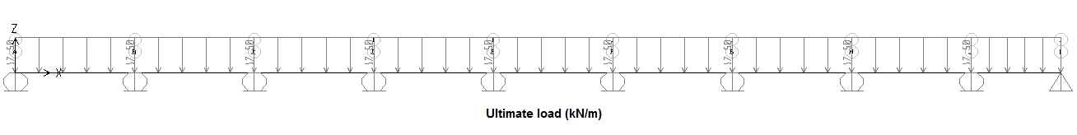
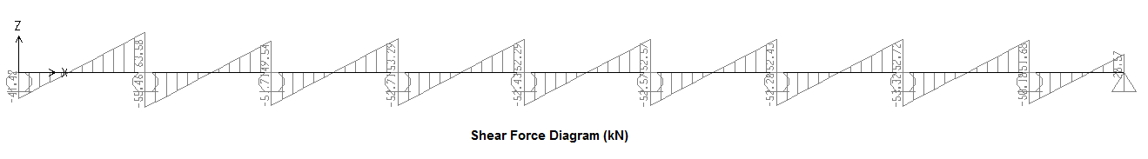
Design of strip 1 of sub terrain floor of part (A)

Slide 23
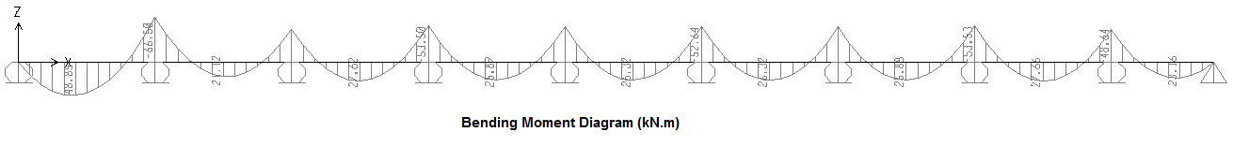
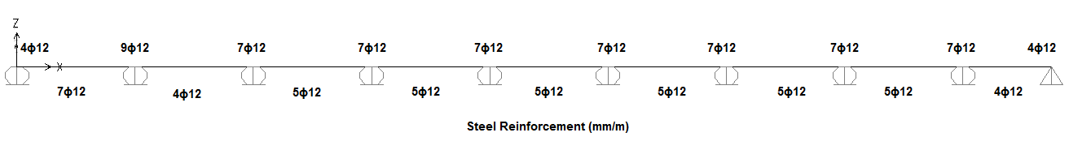

Slide 24
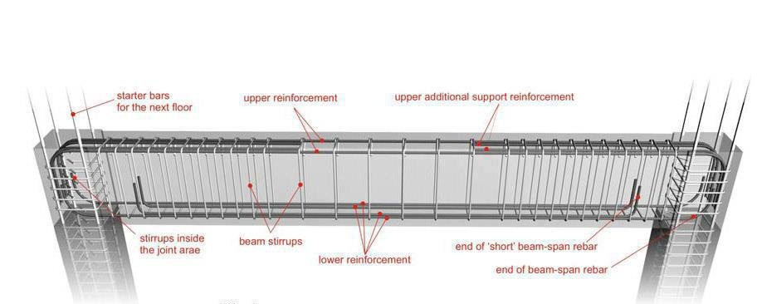
Design Of Beam

Slide 25
Beams designed using tributary area method.
All beams are dropped.
T & L Section used.

Slide 26
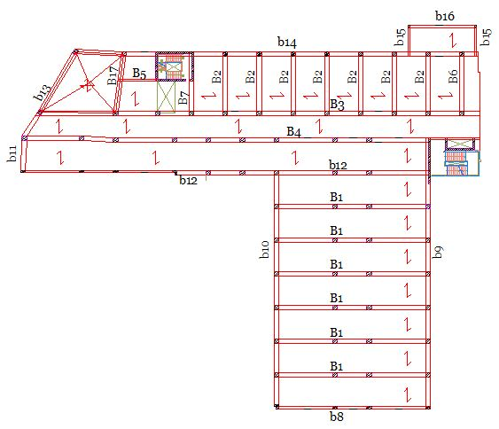
Part A
Beams in sub terrain floor

Slide 27
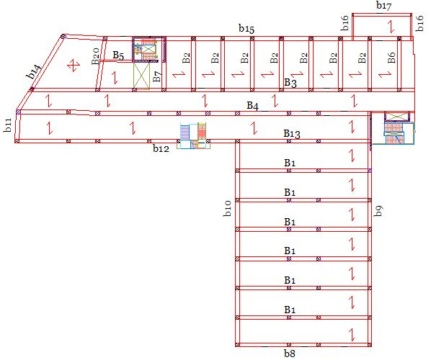
Part A
Beams in ground , first & second floor

Slide 28
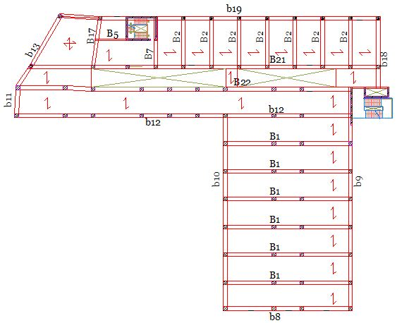
Part A
Beams in third floor

Slide 29
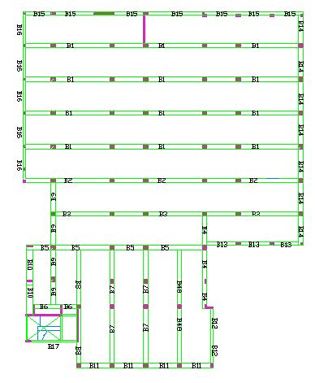
Part B
Beams in sub terrain floor

Slide 30
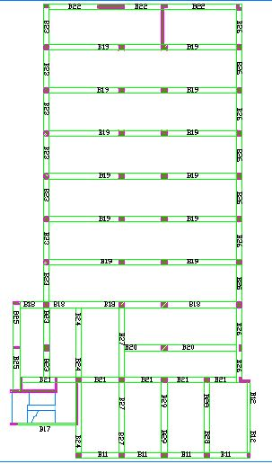
Part B
Beams in ground & first floor

Slide 31
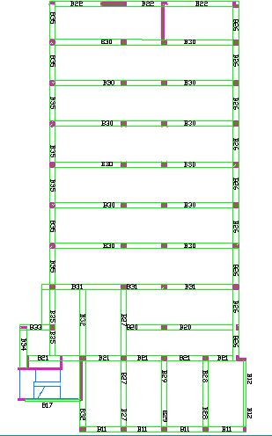
Part B
Beams in second floor

Slide 32
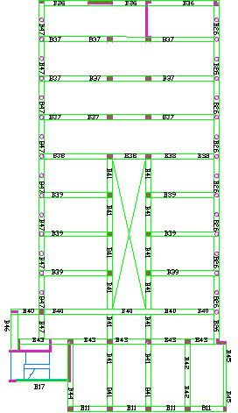
Part B
Beams in third floor

Slide 33
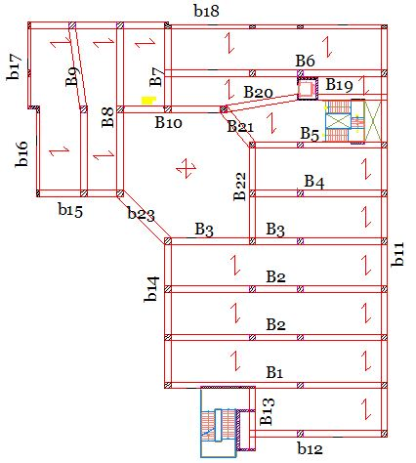
Part C
Beams in sub terrain floor

Slide 34
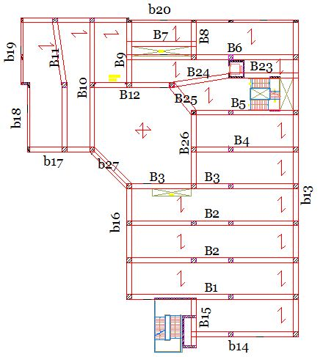
Part C
Beams in ground & first floor

Slide 35
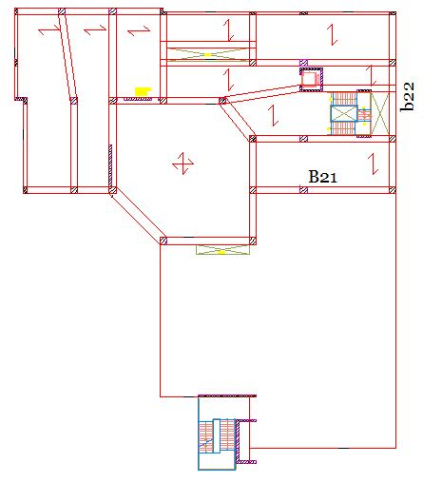
Part C
Beams in second floor

Slide 36
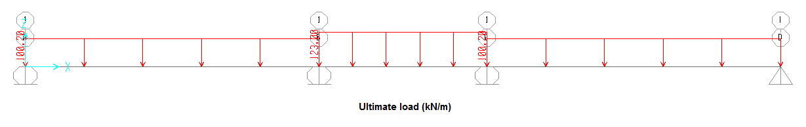
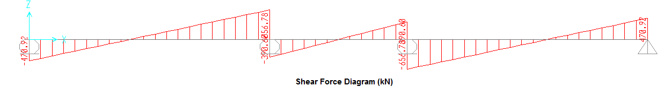
Of part (A) Design beam 1 of ground floor

Slide 37
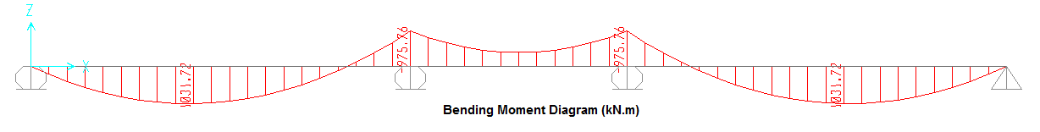
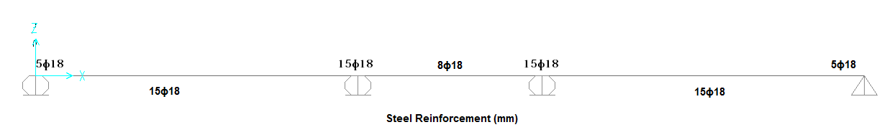
Av/s =1.864
S= 80 mm

Slide 38
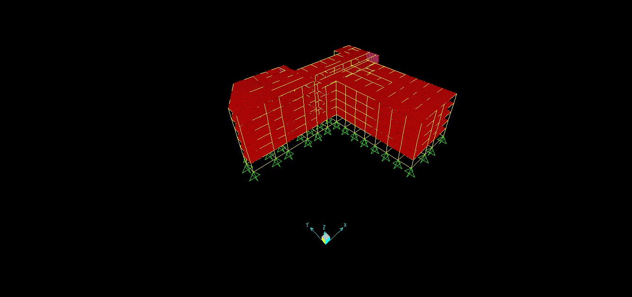
3-D Model
Part A

Slide 39
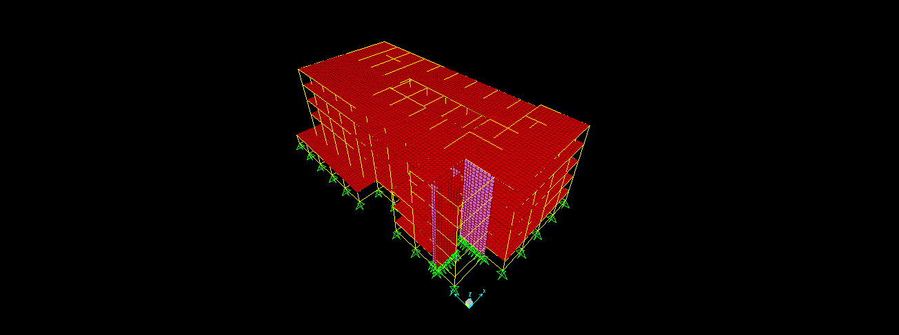
Part B

Slide 40
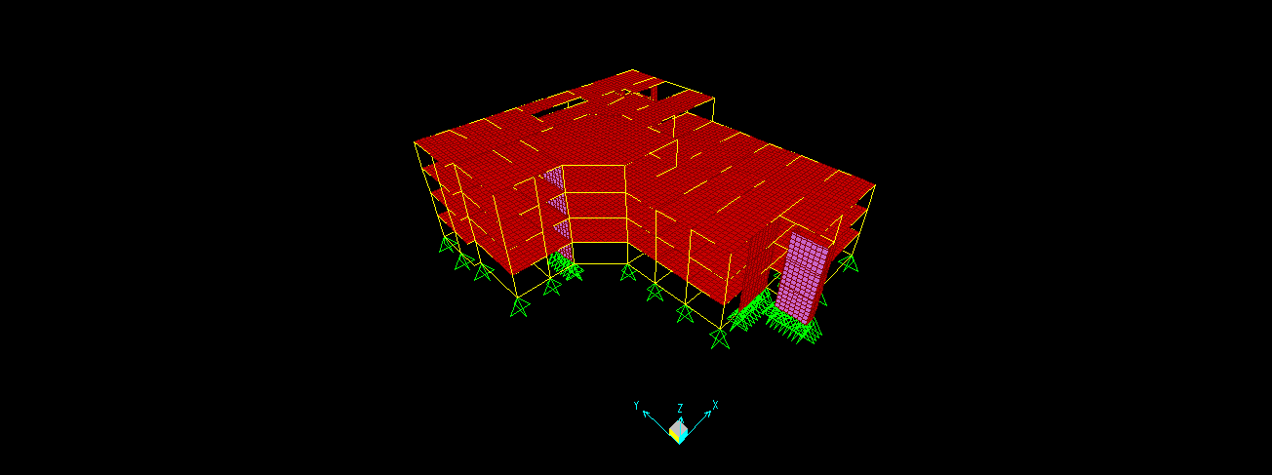
Part C

Slide 41
Required Checks
Compatibility Check
Equilibrium Check
Stress-Strain Relationships

Slide 42
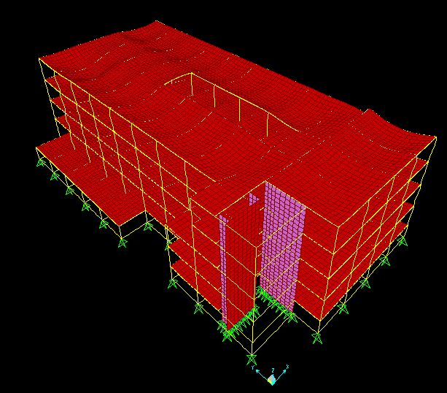
Check compatibility:
This requires that the structure behave as one unit

Slide 43
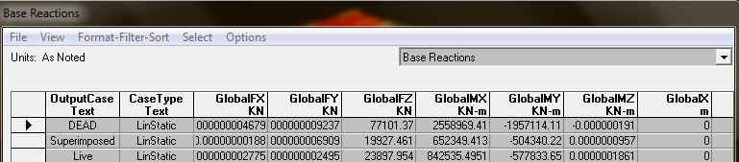
Equilibrium Check
Part C
Load Type | Hand Calculation | From SAP | % of Error
Live Load | 22987.4 | 23898 | 3.9
Superimposed load | 19633 | 19927 | 1.5
Dead Load | 73829 | 77101 | 4.4

Slide 44
Design Of Column

Slide 45
Columns are divided into five groups :
Each group include columns with ultimate axial load :
group1 (800−2500) kN,
group 2 (2500−4000) kN,
group 3 (4000−5500) kN,
group 4 (5500−7000) kN,
and group 5 (7000−8500) kN.

Slide 46
Check buckling
If KL/r ≤ 34-12 (M1/M2) the column is short
KL/r = 1(4.5)/0.3(0.8) = 18.75 < 22
Can be considered as short column

Slide 47
Design of columns in group (1):
ɸP_{n} = ɸλ {0.85 fˋ_{c}(A_{g}-A_{st}) + F_{y}A_{st}}
2500x10³=0.65x0.8{0.85x40(Ag-0.01Ag)+420x0.01Ag}
Ag =1270 Cm²
Use 40*40 ……… Ag =1600 Cm²
A_{st}=0.01x160000=1600mm² (use 4ɸ25mm)

Slide 48
Spacing between stirrups:
At least dimension of the column = 40 cm
S ≤ 16 d_{b} =16x2.5=40 cm
45 d_{s} =45 x1 =45 cm
Ties (1ɸ10mm/40cm)

Slide 49
Design Of Footing

Slide 50
selection of footing
Since the area of all single footings >> 60% the area of building
Then using mat foundation

Slide 51
Mat foundation:
this type of foundation is used when the allowable bearing capacity of soil is very low and very large load on it.

Slide 52
To calculate the effective depth (d) check punching shear has been used
Part A
φV_{C} =0.75(1/3)f`_{C}^{1/2}b_{o}d
Assume d=1.25 m
φV_{C} =0.75(1/3)(28)^{1/2}(4600)(1250)/1000=7607kN>Pu

Slide 53
Part B
Assume d=1.0 m
φV_{C} =0.75(1/3)(28)^{1/2}(6800)(1000)/1000=8995kN>Pu
Part C
Assume d=1.1 m
φV_{C} =0.75(1/3)(28)^{1/2}(4000)(1100)/1000=5820kN>Pu

Slide 54
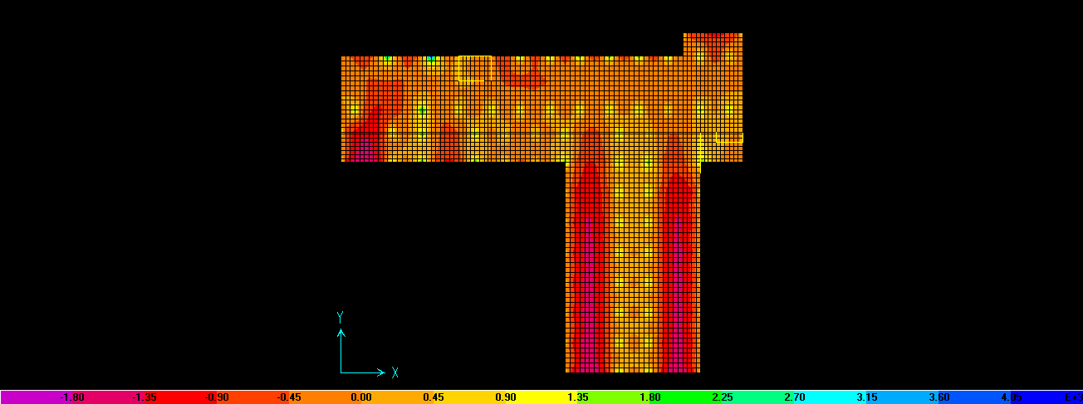
Ultimate bending moment (m11) of part A

Slide 55
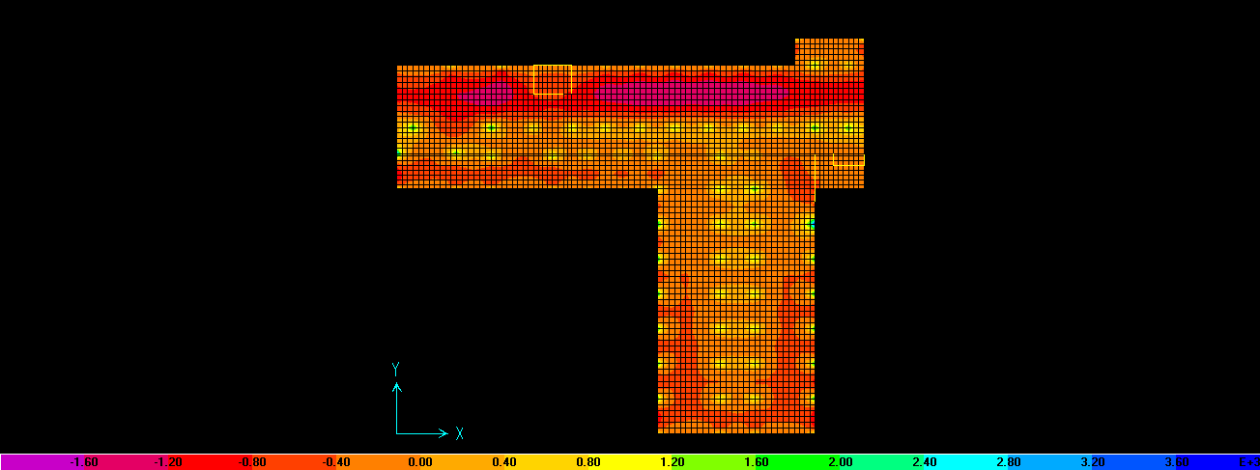
Ultimate bending moment (m22) of part A

Slide 56
Reinforcement for part A
Take the moment from SAP to compute the reinforcement
ρmin= 0.0018 (b*h)/(b*d)
= 0.0018 (1000*1400)/(1000*1250)
= 0.002
Mu using (ρmin = 0.002) = 1162 kN.m > Mu from SAP
Using As min in both direction (1ɸ18/100)

Slide 57
Dynamic Analysis

Slide 58
Dynamic analysis can be used to find dynamic displacements, time history, and modal analysis.
Response spectrum method will be used for seismic analysis as provided in Uniform Building Code for year 97 (UBC 97).

Slide 59
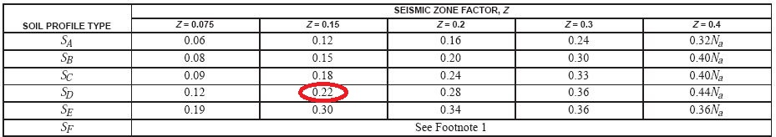
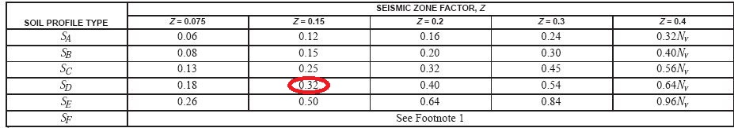
Ca & Cv

Slide 60
Scale factor
Scale factor = g I / Rp
= 9.81 *1.25 /3
= 4

Slide 61
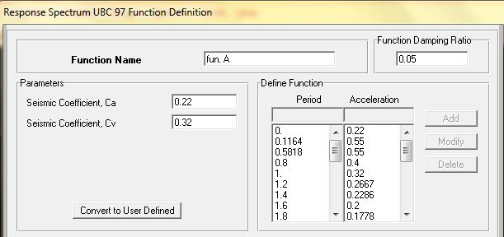

Slide 62
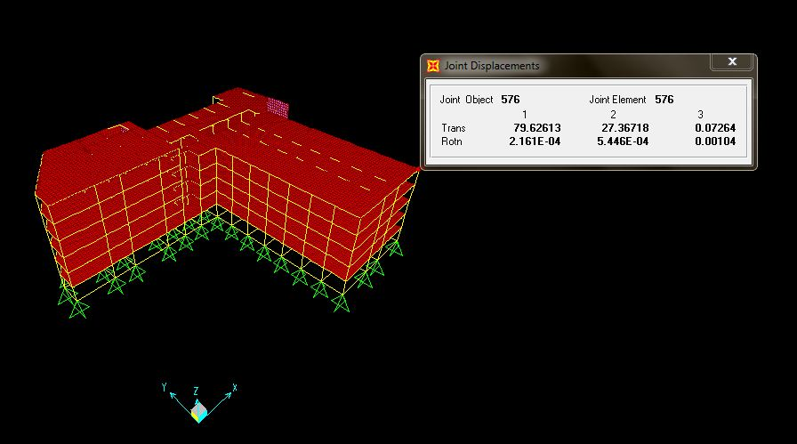
Maximum displacement:
From seismic load: (e_{x}) part (A)

Slide 63
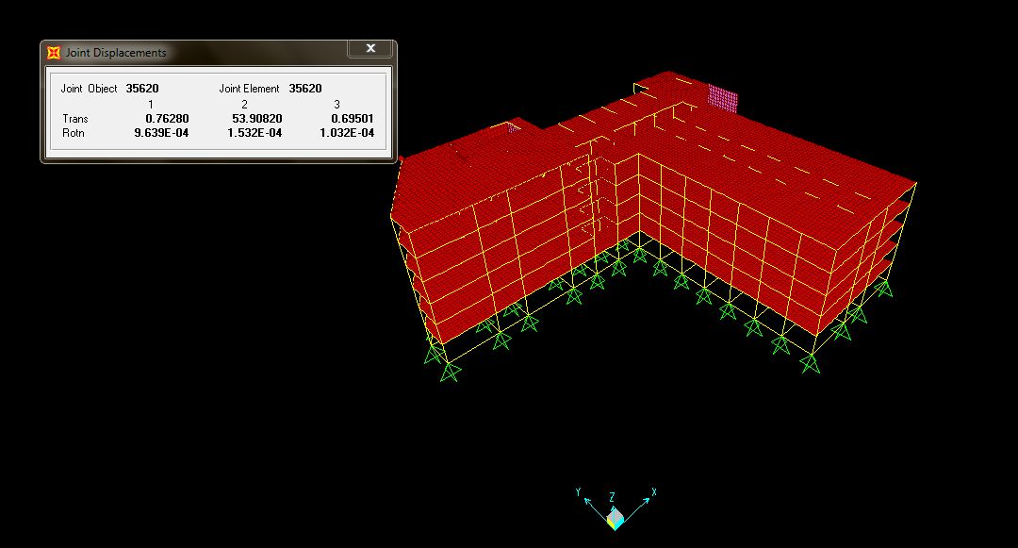
Maximum displacement:
From seismic load: (e_{Y}) part (A)

Slide 64
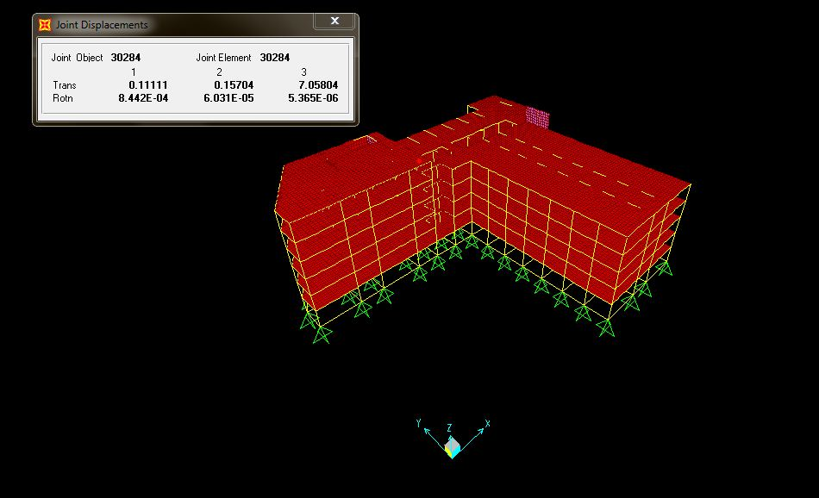
Maximum displacement:
From seismic load: (e_{z}) part (A)

Slide 65
Thanks For Listening

