Slide 1

The Design of Water and Waste Water Networks for Issa and Farsh Al-Hawa Regions Network
Prepared by Under Supervision of
Yazan Ibrahim / Alaa Jubeh Dr. Numan Mizyed
Yousef Sherif / Khaled Yaseen

Slide 2
Outline
Study Area & GP1 Review
Objectives
Design Methodology
Sewer Network Layout
Waste Water Collection System Design
Design Results

Slide 3
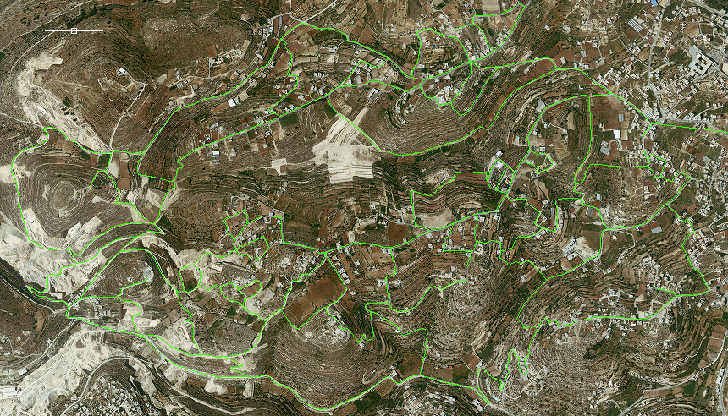
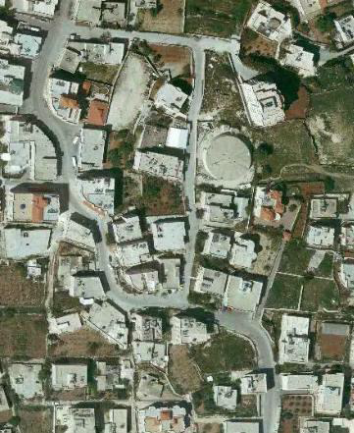
Study Area and First Project Review
The first region which is called Farsh Al-Hawa.

Slide 4
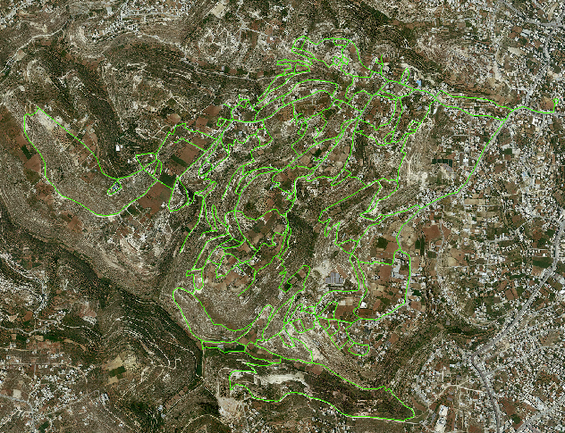
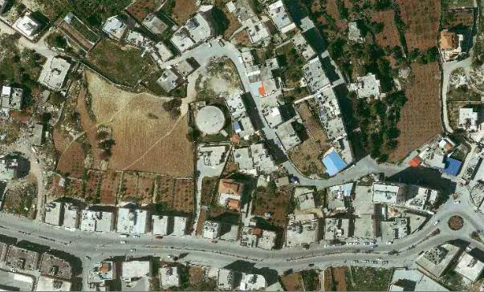
The second region which is called Issa.

Slide 5
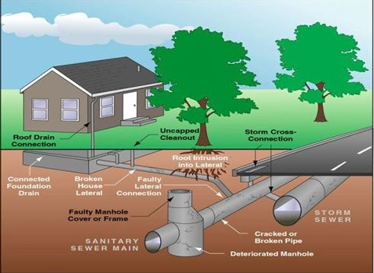

Slide 6
Objectives
Design a reliable Waste Water Collection System.
Provide the adequate drainage of the waste water.
Meet the PWA design standards
Make sure that the Sewer network will function under capacity for the intended design period.

Slide 7
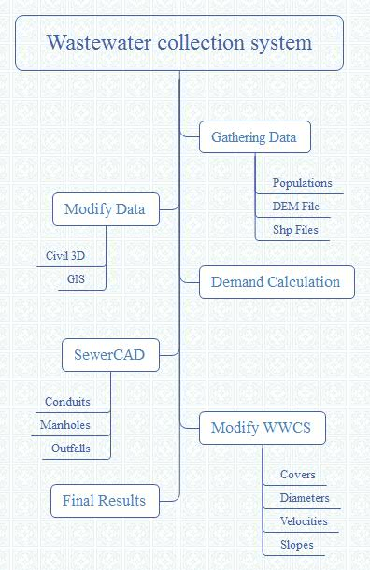
Design Methodology

Slide 8
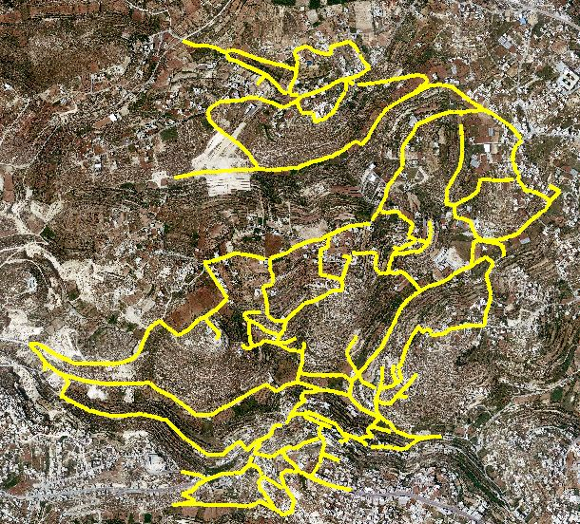
Sewer Network Layout
The first region which is called Farsh Al-Hawa.

Slide 9
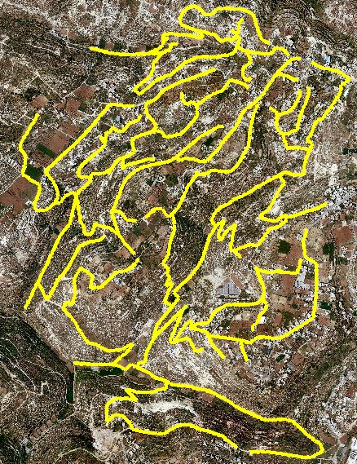
The second region which is called Issa.

Slide 10
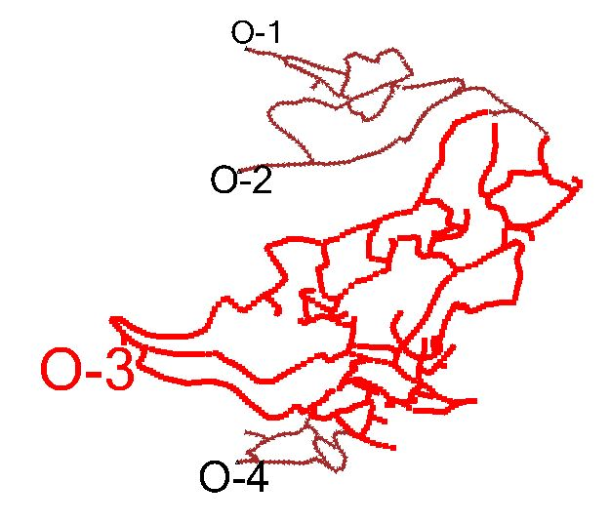
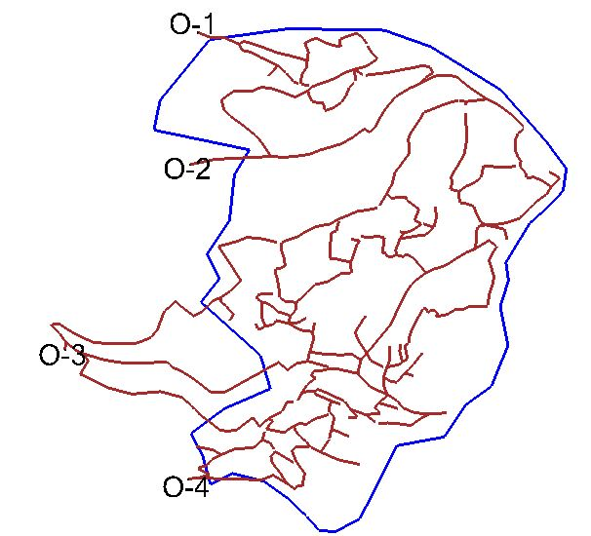
Waste Water System Design
Sewer Network layout for the first region ( Farsh Al Hawa )

Slide 11
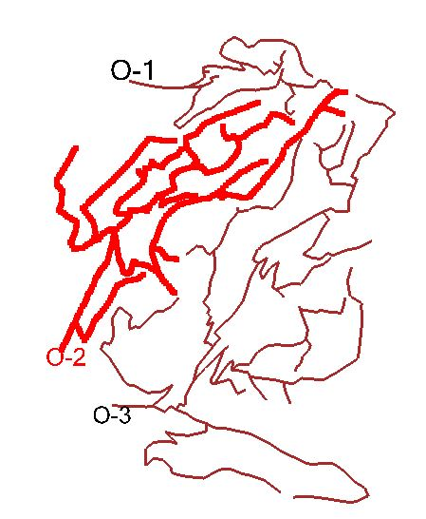
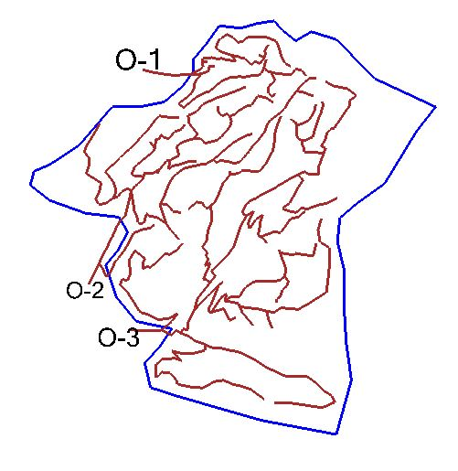
Sewer network layout for the second region ( Issa )

Slide 12
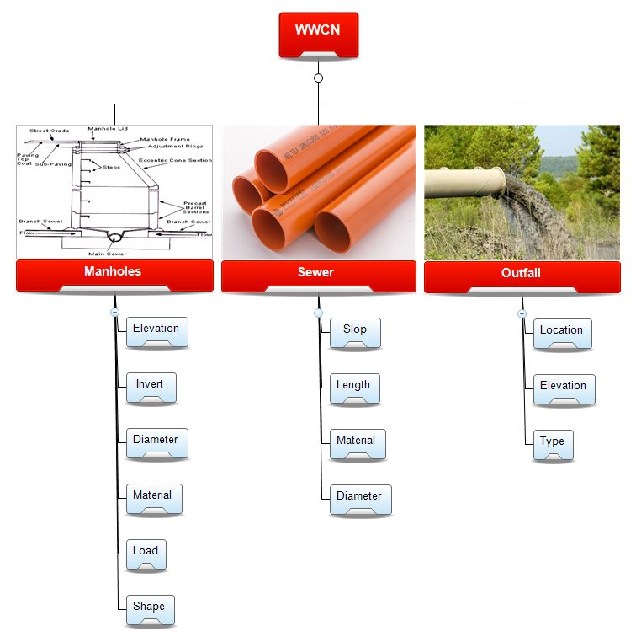
Network Component and Material Used

Slide 13
Design Constrains
PWA Design Constrains
Velocities range (0.6-3.0 m/s)
Cover range (1-5 m)
Slope range (0.5-15 %)

Slide 14
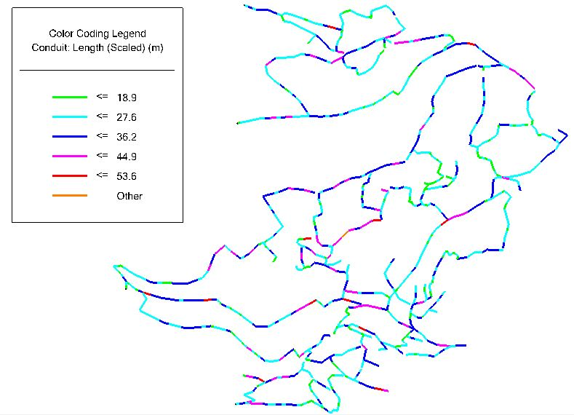
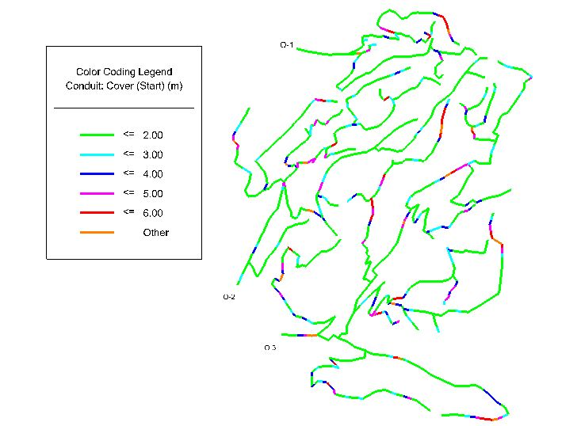
Design Results
First Region ( Farsh Al Hawa )
Conduits Lengths Conduits Covers

Slide 15
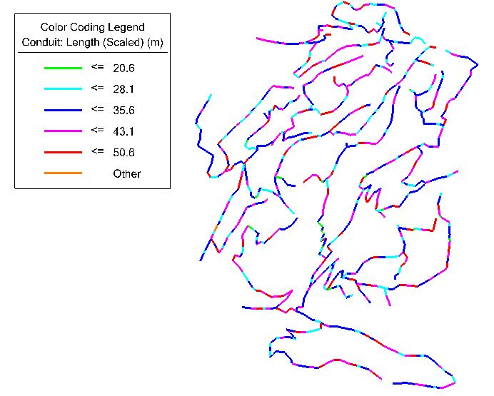
Second Region ( Isaa )
Conduits Lengths Conduits Covers

Slide 16
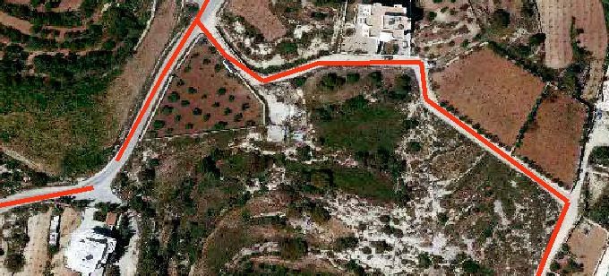
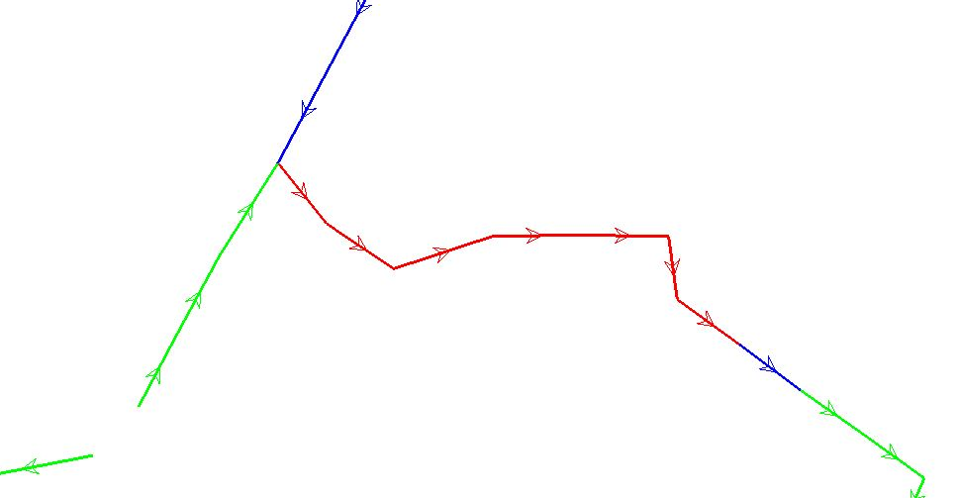
High Cover Example

Slide 17
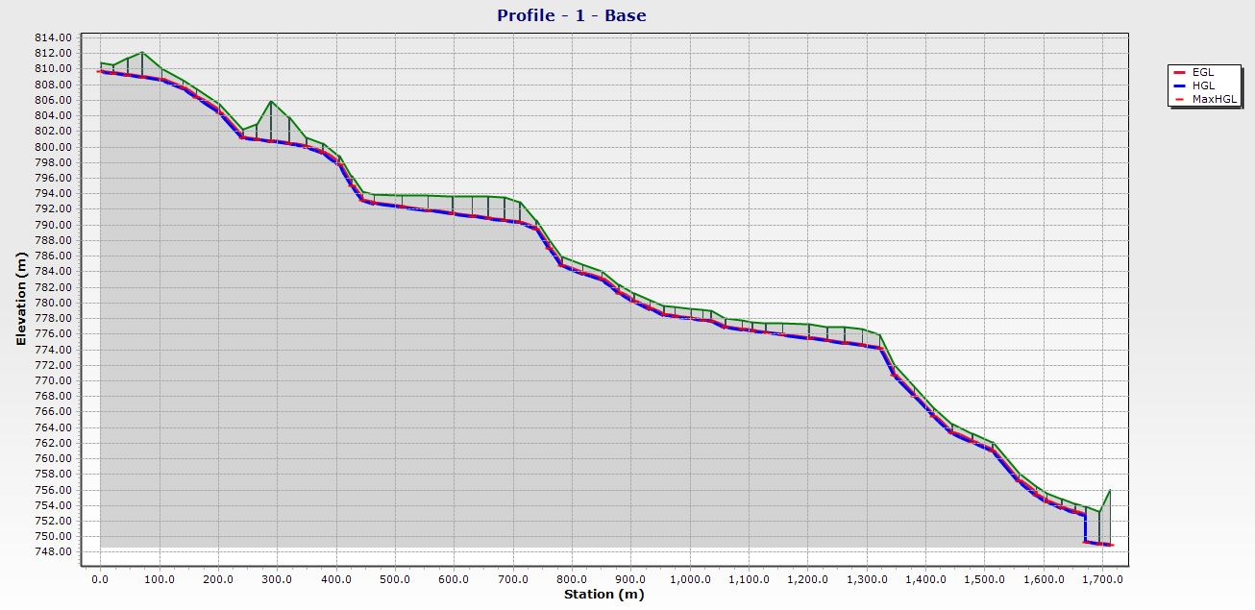
First Region ( Farsh Al Hawa )
Main Line Profile

Slide 18
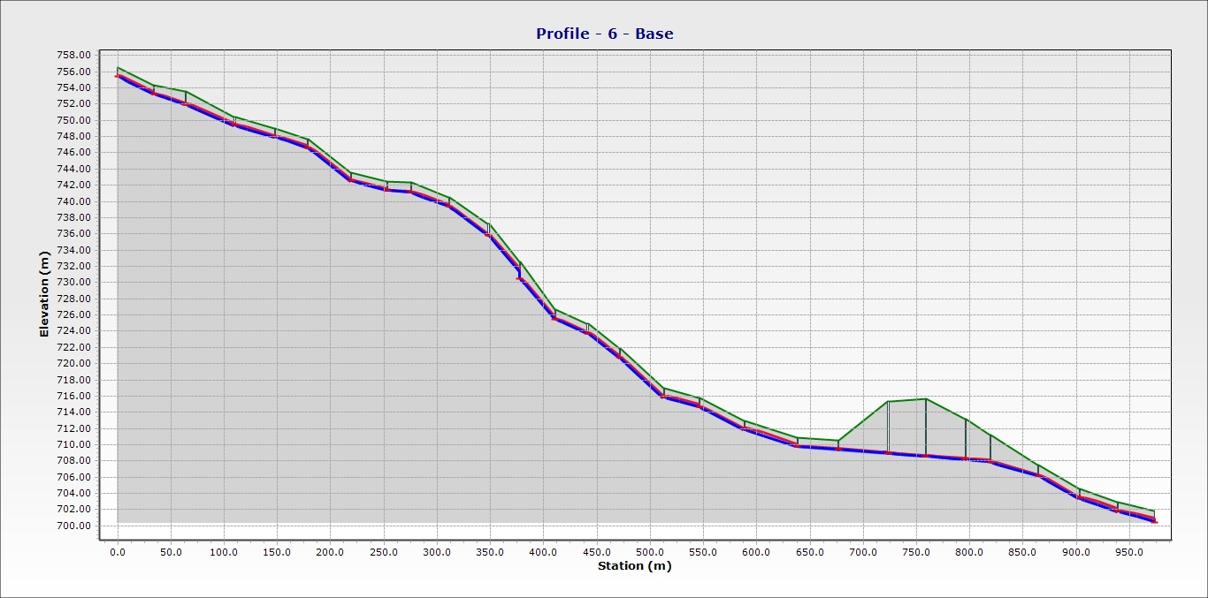
Second Region ( Isaa )
Main Line Profile

Slide 19
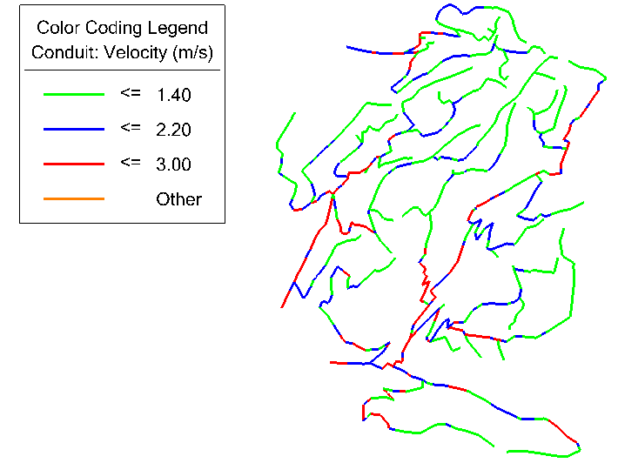
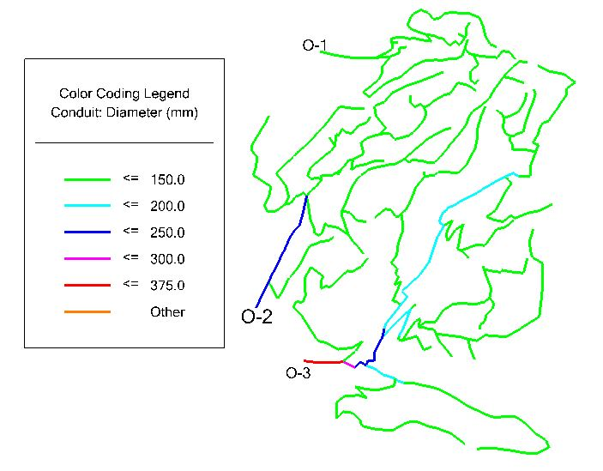
First Region ( Farsh Al Hawa )
Conduits Diameters and Velocities

Slide 20
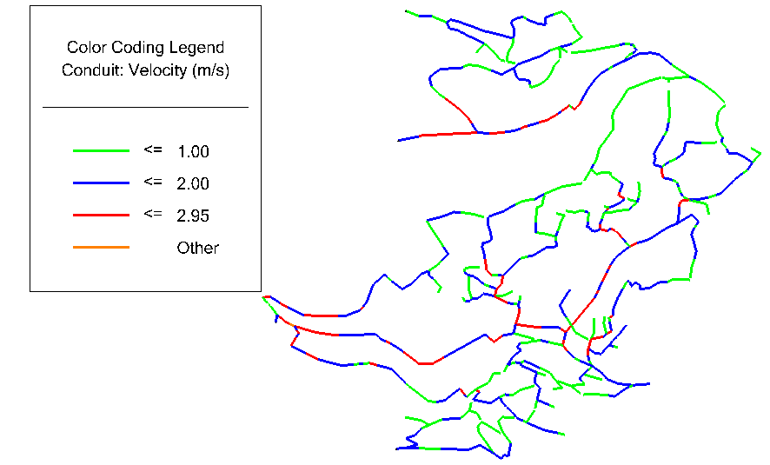
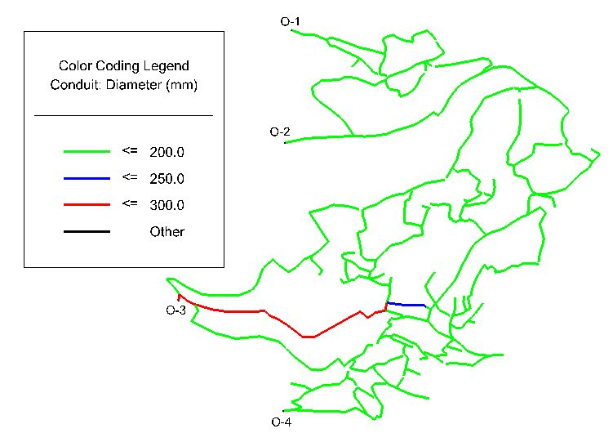
Second Region ( Isaa )
Conduits Diameters and Velocities

Slide 21
Summary & Conclusion
First Region Conduit Diameters
300mm | 250mm | 200mm | 150mm | Conduit Diameter
53 | 8 | 27 | 992 | Number of Conduit
1472 | 241 | 616 | 25080 | Conduit Lengths
Second Region Conduit Diameters
375mm | 300mm | 250mm | 200mm | 150mm | Conduit Diameter
6 | 2 | 36 | 68 | 848 | Number of Conduit
103 | 35 | 732 | 1640 | 29486 | Conduit Lengths (m)
First Region Manholes
1000 mm | Manhole Diameter
1079 | Number of Manholes
Second Region Manholes
1000 mm | Manhole Diameter
959 | Number of Manholes

Slide 22
Thank You

