Slide 1


Slide 2


Slide 3
Outlines:
Introduction
Motivation & Importance
Technologies
Features
Methodology
Future Work

Slide 4
What is Give?
Give is a donation platform that help the needy people to ask for help , and help the donors to find the people who need help.

Slide 5
Motivation and Importance
Life has become easier with the presence of mobile applications. People start to prefer doing all their jobs online without any effort or wasting of time.
There is a lot of people who are ready to give donation but don’t know needy people. And there is people who need help and don’t know how to ask !

Slide 6
Technologies
Programming Languages :
Flutter
Php
Dart
Paython
Programs used:
Android studio
VSC
Pycharm
Webhost server

Slide 7
Features
Know information about every orphanage on Palestine like location,
Number of kids ,needs ..
Donate to orphanages with money or things from the online store
that gives low prices .
Donate to orphanages with the specific things they need.
Donate to students and give them these money depend on
their information using AI system that predict the amount
of percentage of their Premium.
Book a day to visit any orphanage .

Slide 8
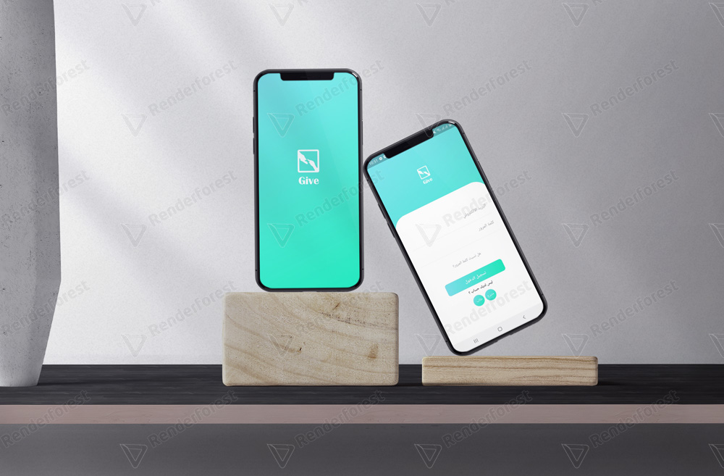
Log in
Methodology
Donor , student , seller, orphanage official and student official can log in from here.

Slide 9
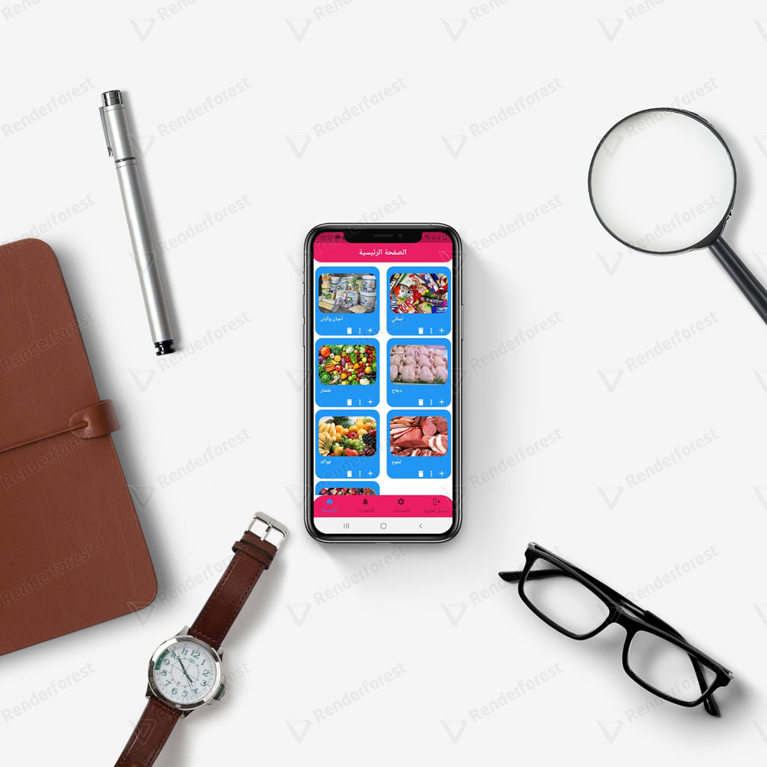
1.seller:
First user of app is the seller.
The seller cant sign up ,the app deal with specific sellers who give low price .
We have four types :
1) food seller

Slide 10

2(Household tools seller
Any one of them can add goods,
Delete it , add every item diesels
And after the donor bye from him ,
He send the order to the chosen
Orphanage.

Slide 11
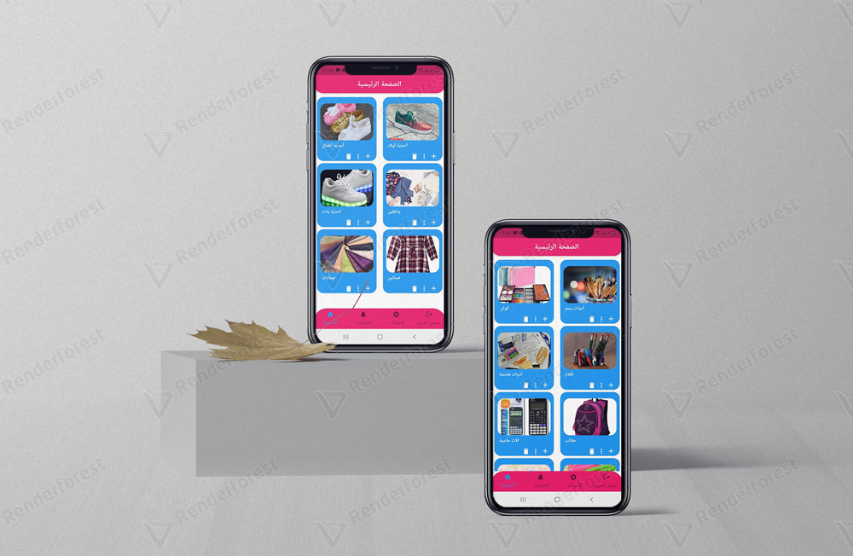
3) Clothes seller
4) Stationery

Slide 12
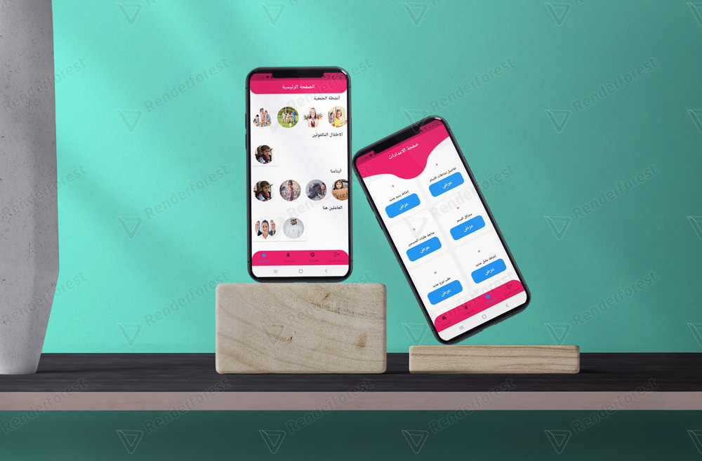
2.Orphanage
official
Orphanage officer can log in using the username and password ewe give .
He can put all orphanage data to make it easier for them to return to any detail they want.

Slide 13
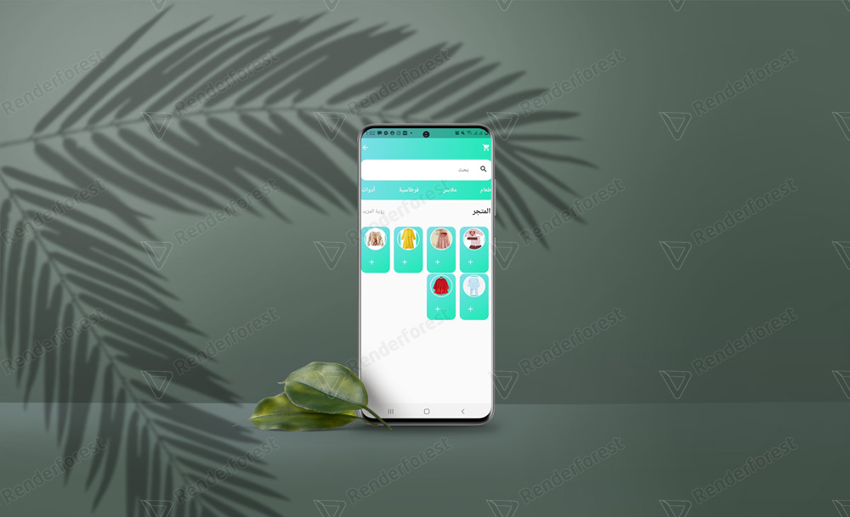
They can add
issues of The orphanage,
events they make
access the online store to ask for
Donation from the
donor.

Slide 14
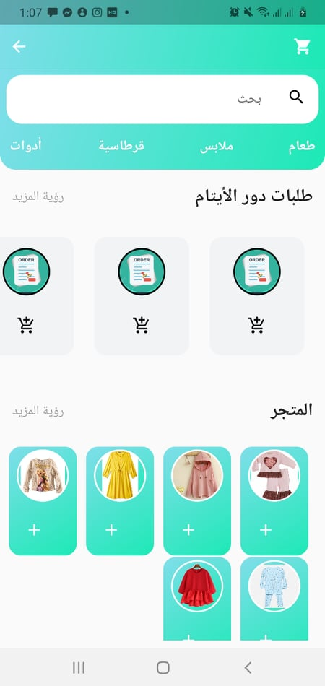
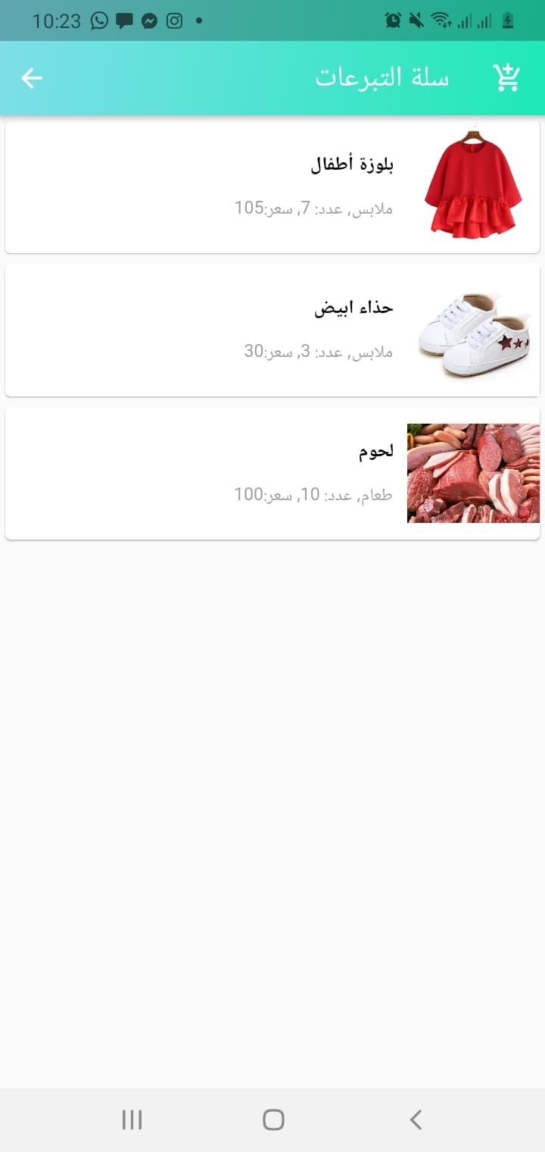
It shown here in the donor page
The orphanage official order this
They can choose items like that .
So it shown in the donor page so he can pay for it for them

Slide 15

3.Students admin
No student can sign in
On the app without the
Approval of the admin
Any donation from
Donor to students
Come first to the
Admin so he can accept
Or not
Any student can
can ask for donation for
one time every 4 months
and the admin can
transfer money for his
account.

Slide 16

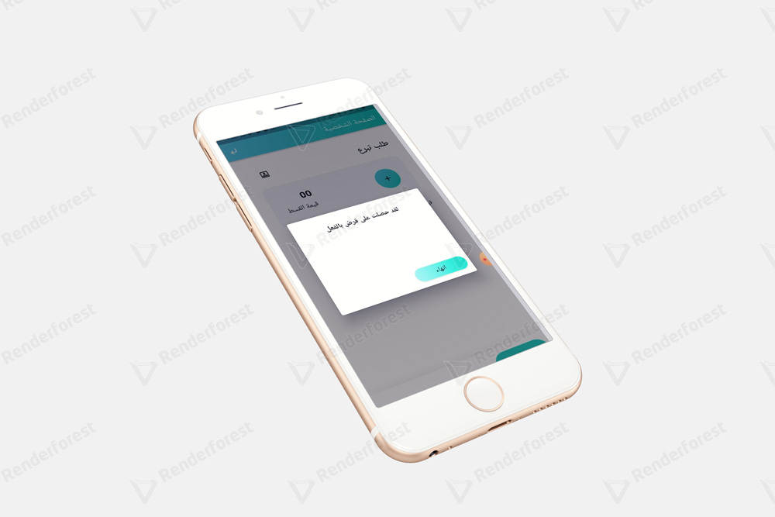
4.Student
When the student be accepted
In the app,
He can ask for donation for one
Time every 4 months.
He get a notification when his
Order of donation is accepted.

Slide 17
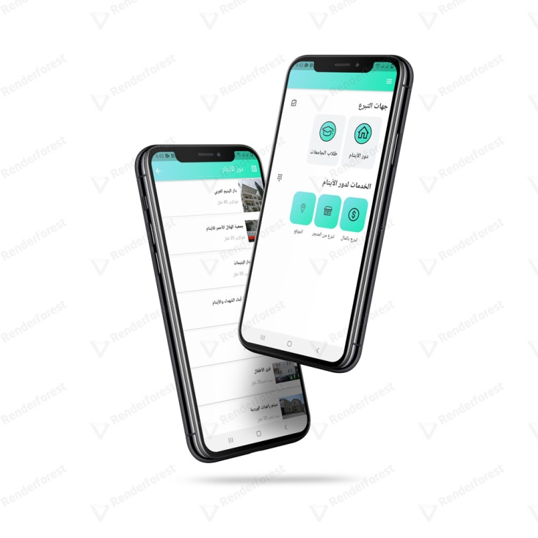
5.Donor
The Donor can sign up
Then he can have an account
On Give .
He can see all orphanages
On Palestine , their needs
And their location
He can book a day to visit them
And he can buy thing for them

Slide 18
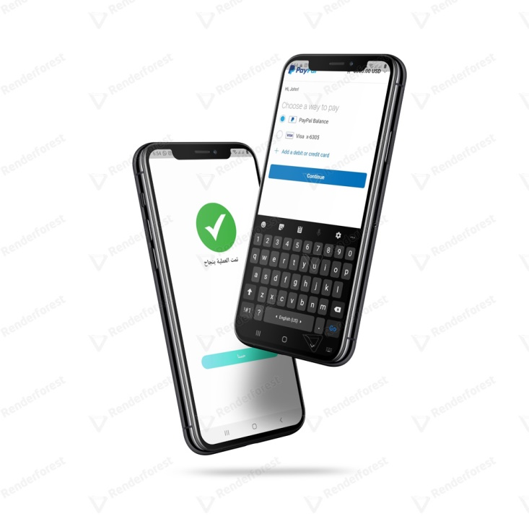
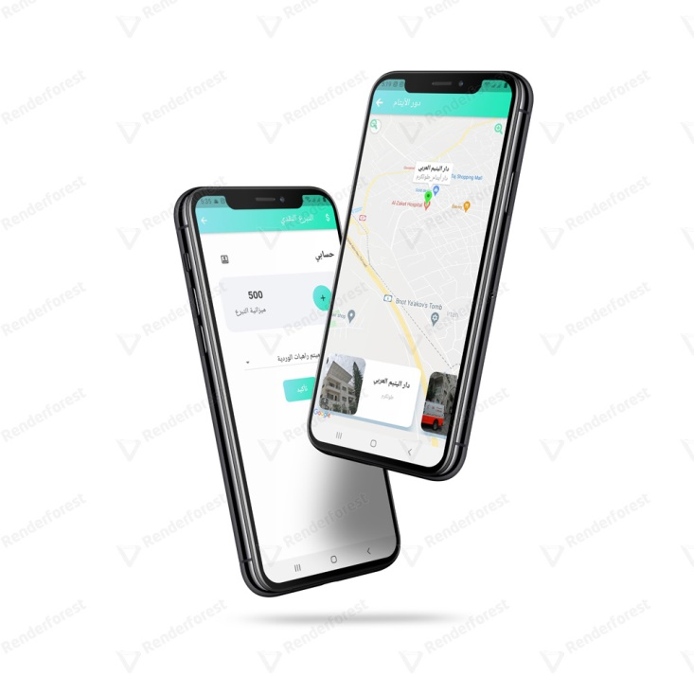
He cane also donate with money for any orphanage or for the students using paypal.

Slide 19
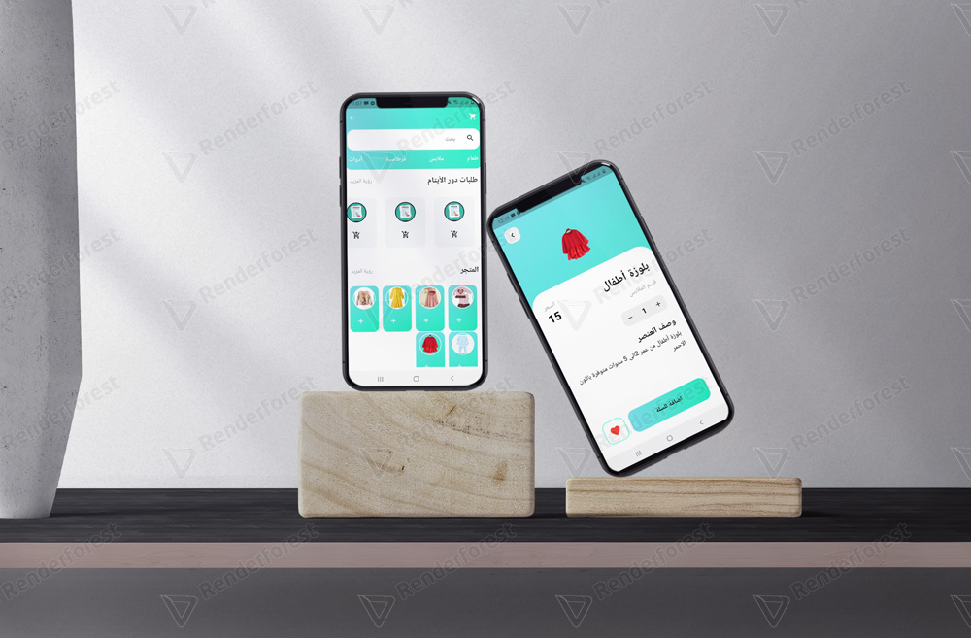
He can access an online store , he can buy anything he wants for orphans , he can also see orphans needs and buy them.

Slide 20
Future Work
Include more types of needy people in the app
Include banks in the process
AI system that help you choose the best one to donate to

