Slide 1
Smart POV Display
Presented By:
Hala Jabr
Noor Zakaria
Supervised By:
Dr. Raed Al-Qadi

Slide 2
Overview
Introduction
Motivation
Components
Methodology
Challenges
Future work
Demo

Slide 3
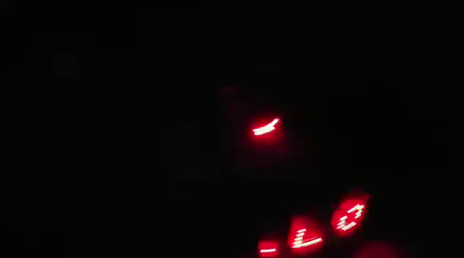
Introduction
What is POV (persistence of vision)?
Why “Smart” POV Display?

Slide 4
Motivation
Use new technologies like POV display and MQTT Protocol
Display real inputs on the LEDs
Make new type for advertisements.

Slide 5
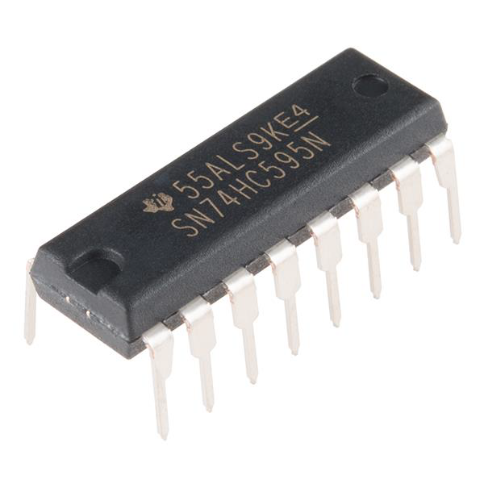
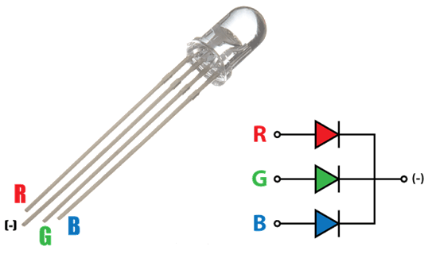
Components
RGB LEDs (16,8)
Shift Register (6,3)

Slide 6
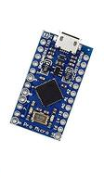
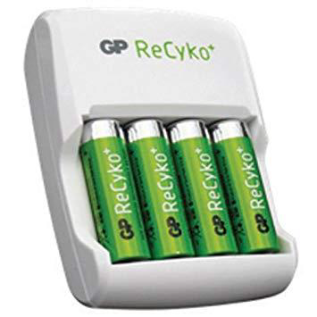
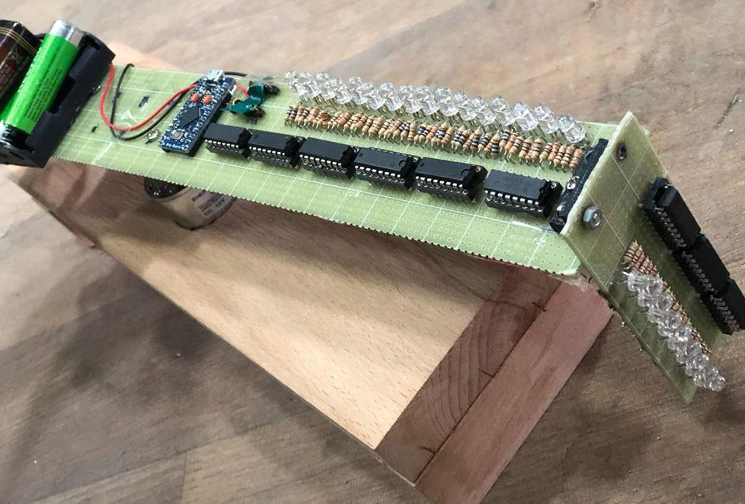
Component
Arduino pro-micro
Rechargeable Butteries

Slide 7
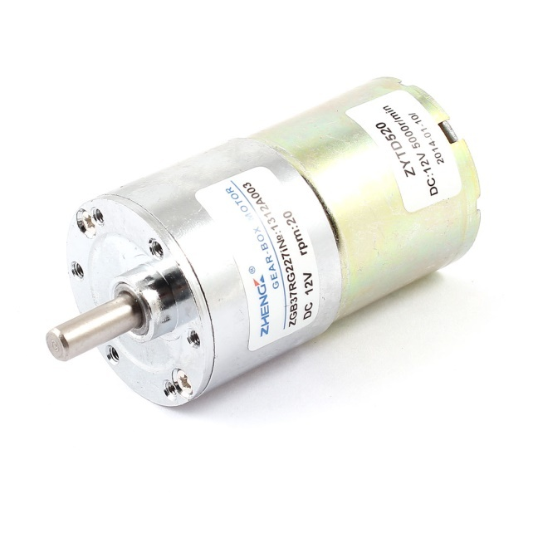
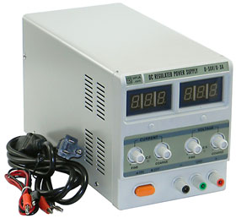
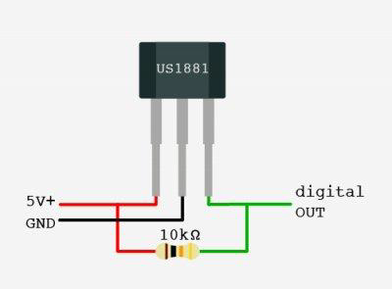
Components
DC Motor
Hall Effect Sensor
Power Supply

Slide 8
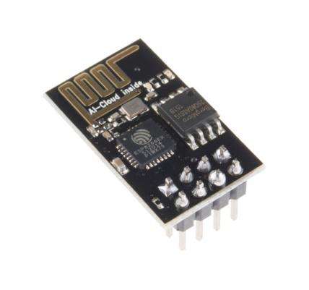
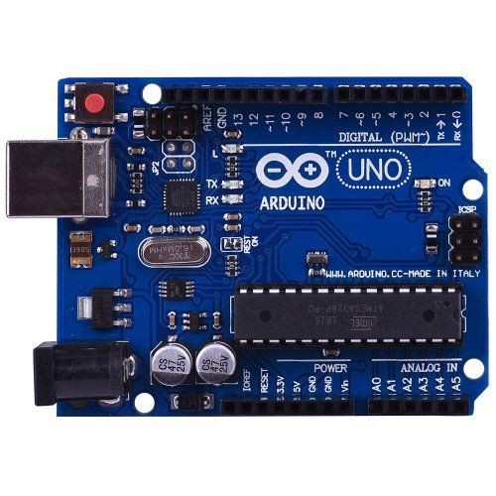
Components
ESP8266 Module
Arduino UNO

Slide 9
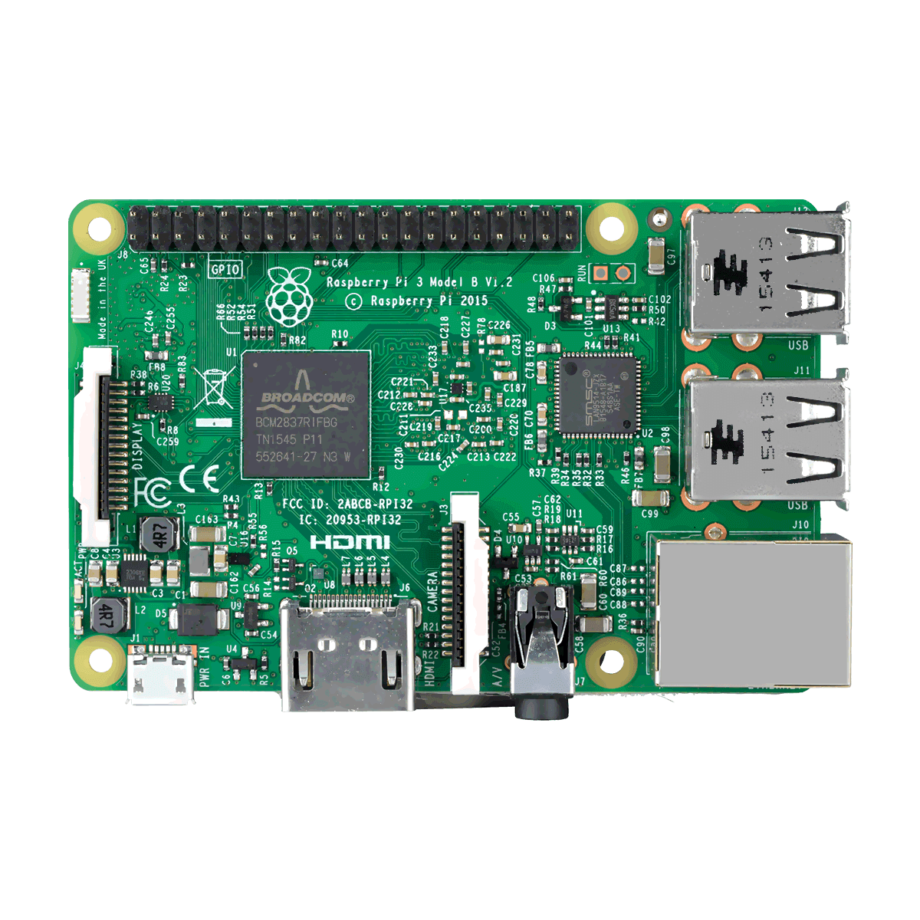
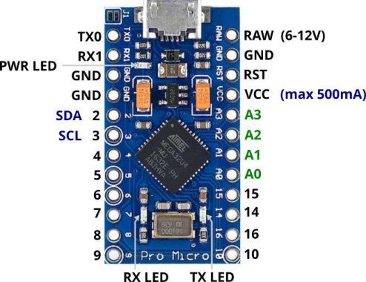
Components
WI-FI
MQTT Protocol
Serial

Slide 10
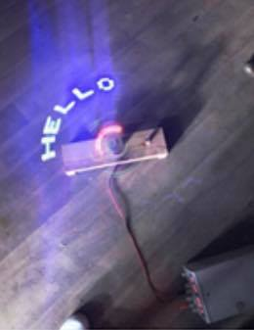
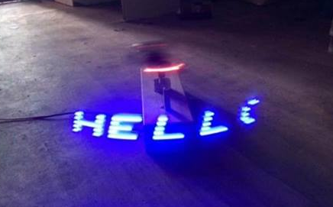
Methodology
Sending data using MQTT protocol
Displaying data on LEDs

Slide 11
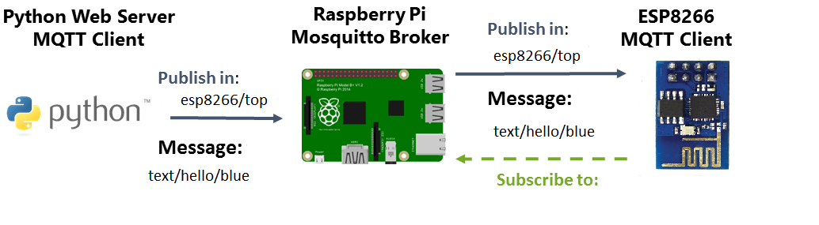
Sending data using MQTT protocol
What is MQTT?

Slide 12
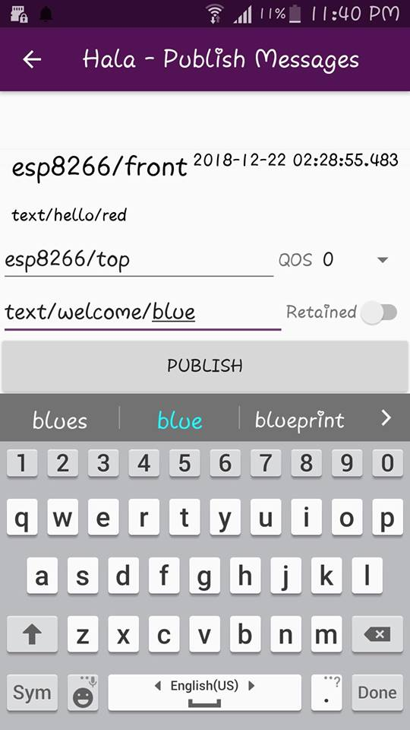
Sending data using MQTT protocol
MQTT Client

Slide 13
////video

Slide 14

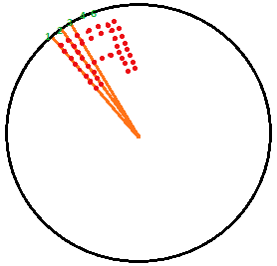
Displaying data on LEDs
Eye can recognize one second before led disappear.
Array of the characters want to display (font) represented by binary bits.

Slide 15
Challenges
Sensor
Clock
number of letters

Slide 16
Future work
Increasing number of LEDs
Using image processing to get the input(text or photo)
Use wireless buttery charger.

Slide 17
Demo
///video

