Slide 1
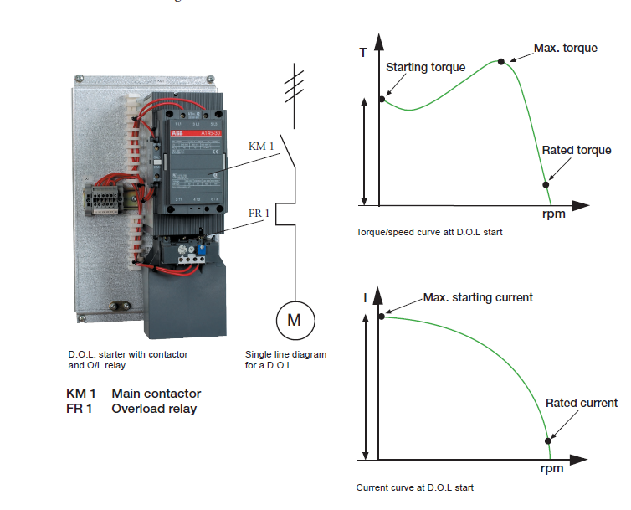
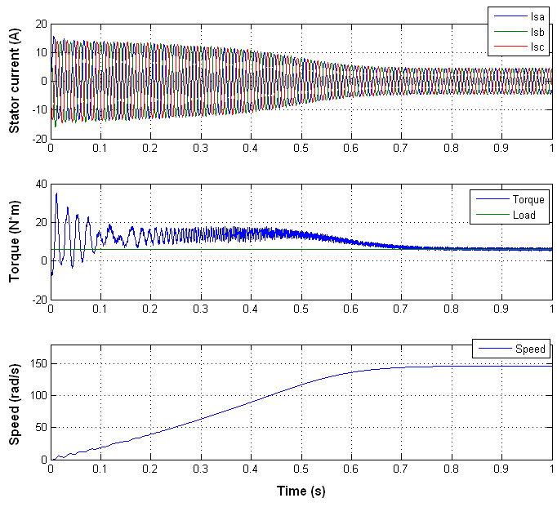
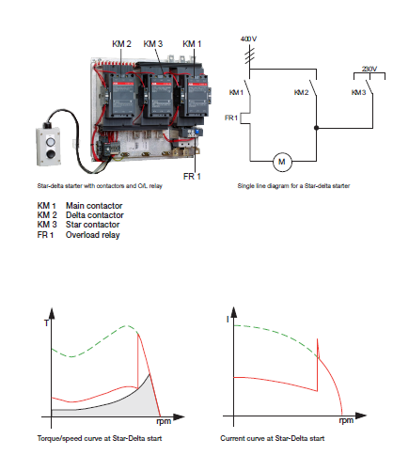
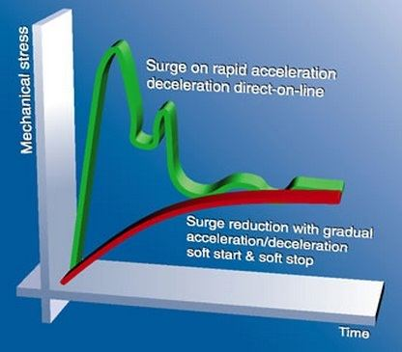
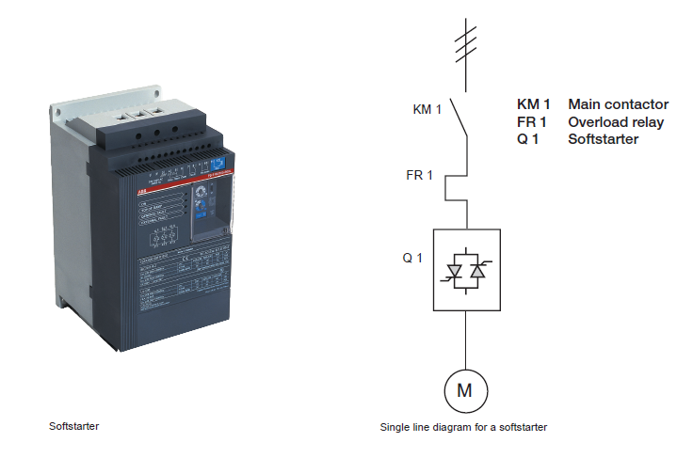
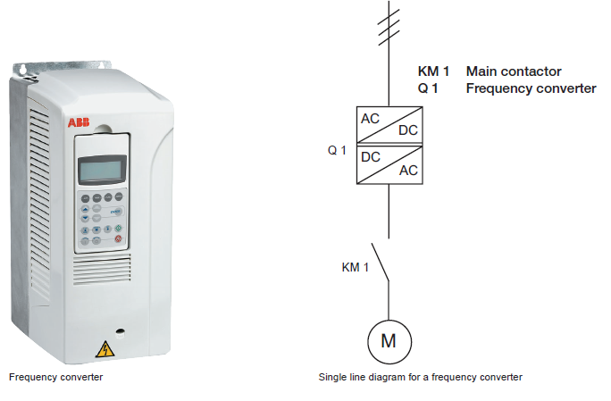
Soft Starter For Three Phase Induction Motor
Lama Khatib , Dina Omran
Dr.Samer Mayaleh
AL-NAJAH NATIONAL UNIVERSITY
Electrical Engineering Department
Frequency Converter ( VFD )
Introduction
Motor Starting Methods
Our project will provide a soft and smooth start to a 3-phase induction motor. The three-phase induction motor during the initial starting condition draws up much higher current than its capacity and the motor instantly reaches the full speed. This results in a mechanical jerk and high electrical stress on the windings of the motor. Sometimes the windings may get burnt. The induction motor should start smoothly and gradually catch up the speed for a safer operation.
Direct on-line start D.O.L
Induction motor startup
Star-Delta start
Soft starter
Objectives
1- A comparison between soft starters and VFD
2- Implement soft starter for three phase induction motor
3- Providing a soft starter with competitive price and high quality
Frequency converter VFD

Slide 2
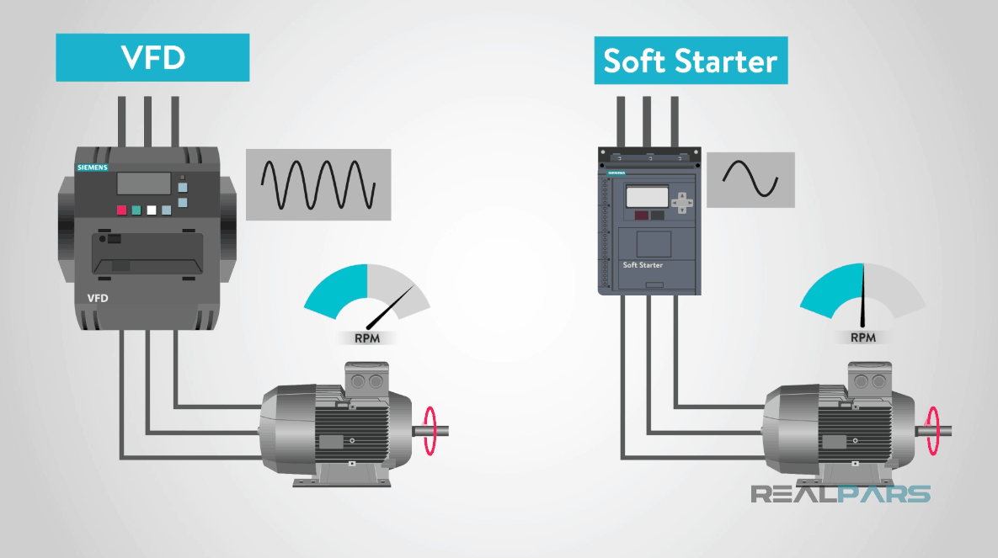
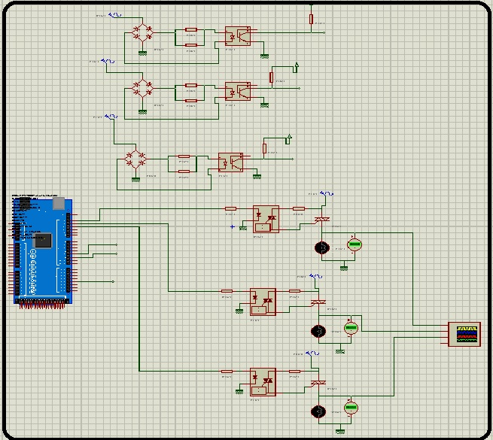
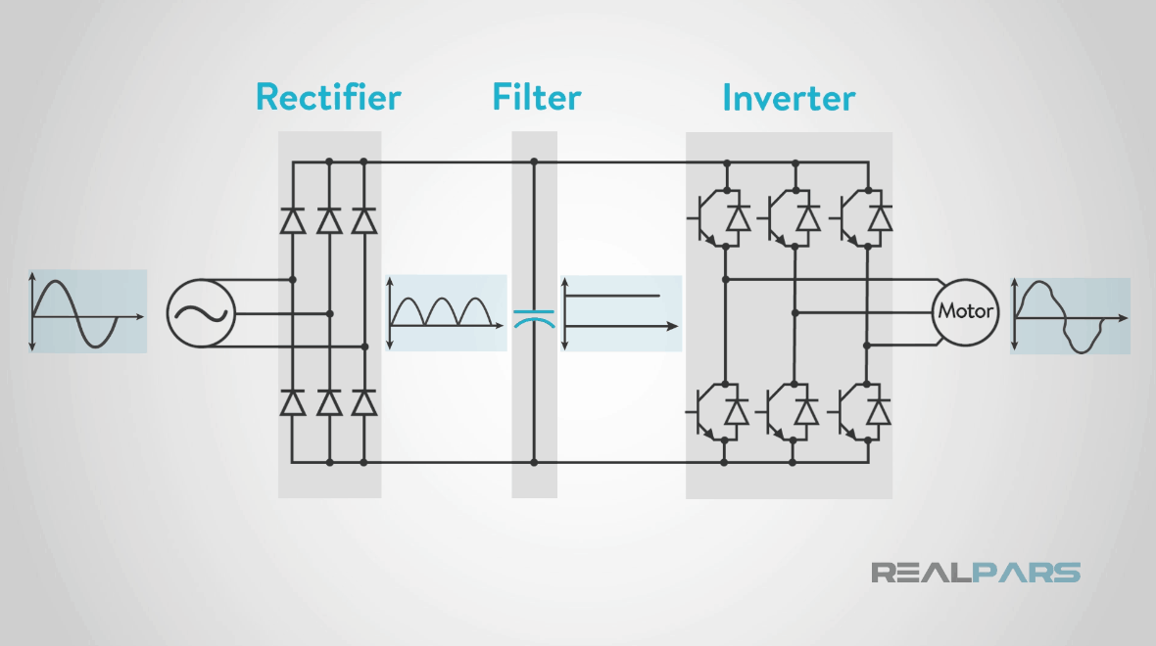
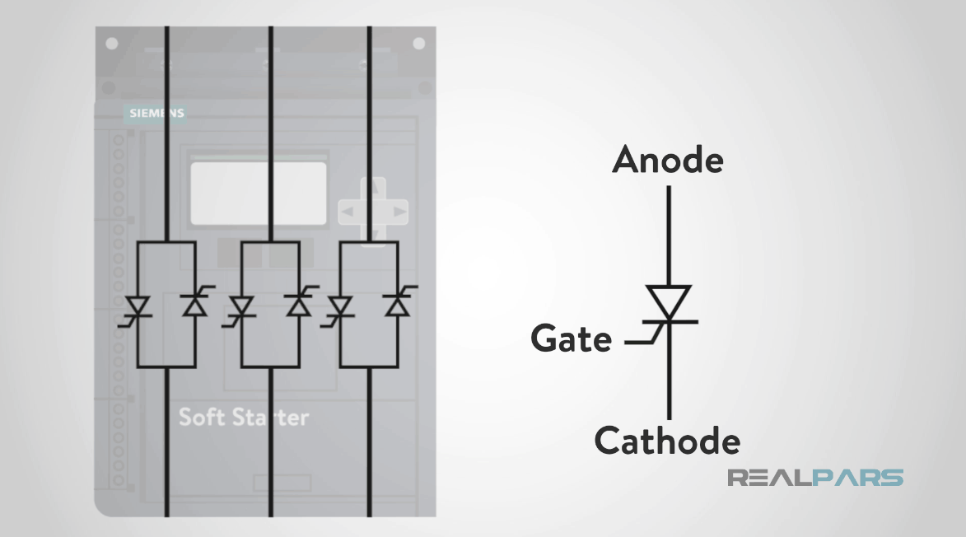
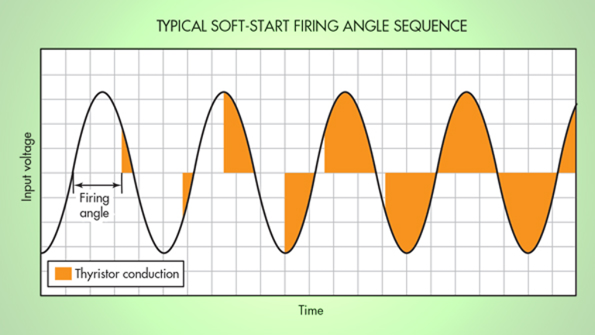
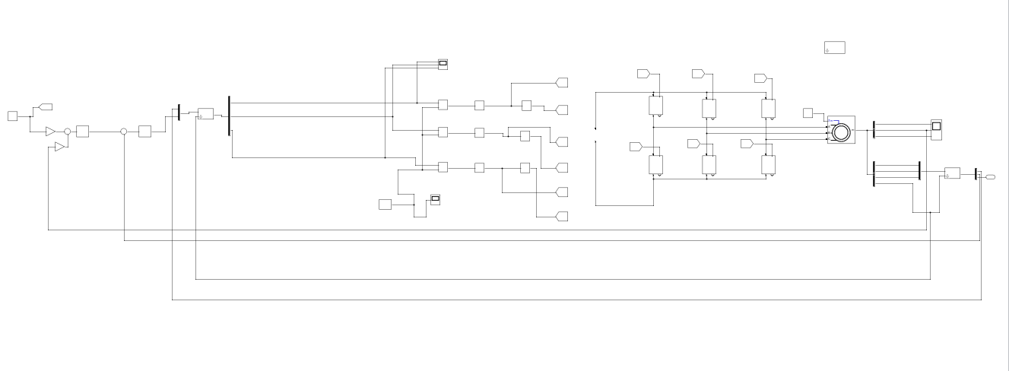
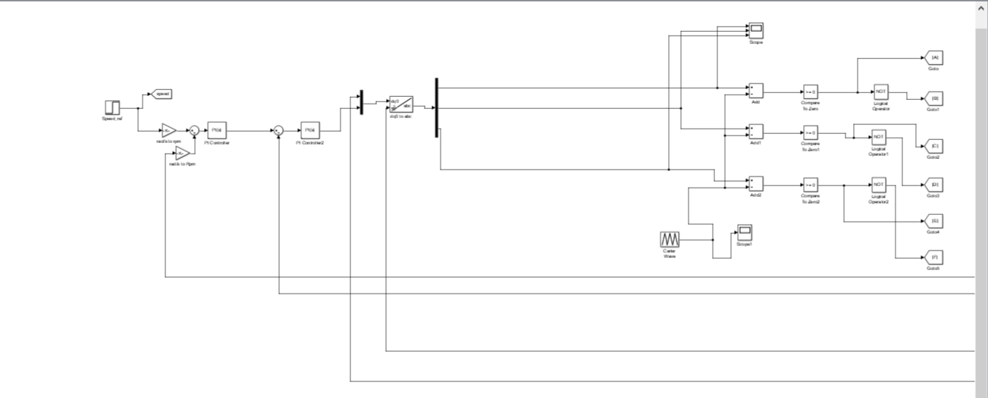
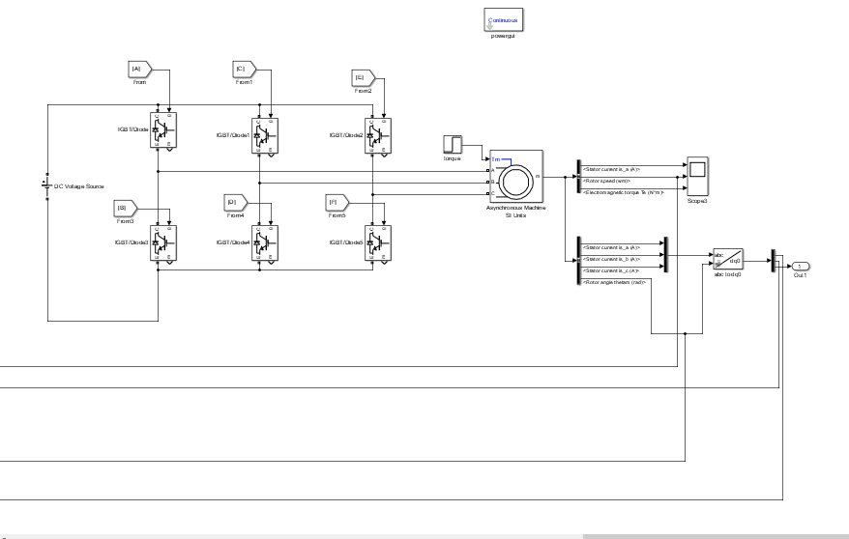
Soft Starter vs VFD
Methodology
Circuit diagram soft starter for three phase induction motor using Arduino
VFD Internal Circuit
Soft Starter Internal Circuit
Circuit components :
1- Arduino Mega2560
2- Zero crossing detection circuits (rectifier and optocoupler)
3- Triac and diac
a VFD and a Soft Starter can do similar functions when it comes to ramp up or down a motor.
The main difference between the two is that a VFD can vary the speed of a motor while a soft starter only controls the starting and stopping of that motor.
When faced with an application, price and size are in the favor of a soft starter. A VFD is the better choice if speed control is required.
Methodology
Future work
Our next step is to implement this project practically using the circuit we have chosen, and our aim is to make a soft starter machine with good quality and with a cost less than the commercial ones, and with a range power between ( 4 - 9 HP ) .

