Slide 1
Metal Detector
Prepared by :
Dyana Alshaer
Yusra Salameh
Supervised by :
Falah Mohammed

Slide 2
Out line :
1. Over view
2. Problems it solves
3. Technologies used in metal detectors
4. The design of the project
5. Conclusion
6. Discussion

Slide 3
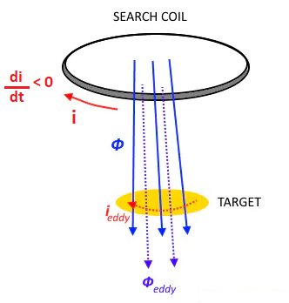
Over view:
Our graduation project is a metal detector, which works to detect and locate metals, by sending magnetic field pulses by passing an electrical current in a coil consisting of a circular wire, if the device is close to a specific metal, the value of the current passing through the coil will change due to the change in the intensity of the magnetic field surrounding the coil because of its proximity to that metal, then the device will make a sound indicating the presence of a nearby metal.

Slide 4
Problem it solves:
We designed this device to eliminate complexity problems and difficulty in dealing with metal detectors.
We designed it also to get rid of the problem of high prices of metal detectors.

Slide 5
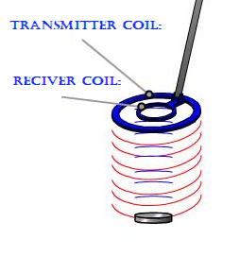
Technologies used in metal detectors:
Very Low frequency technique :
This technology uses two coils: the transmitter coil -which sends the magnetic field to the surrounding objects.
And the receiver coil -which receives the signal reflected from surrounding metallic objects.

Slide 6
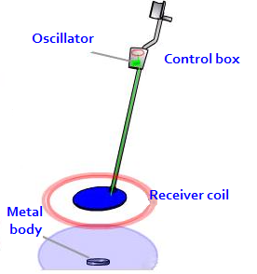
2. Beat frequency oscillation technique:
This technique uses a large file at the end of the search and a smaller file located inside the control box.
The coil sends radio waves received by a receiver in the control box and turns it into an audio signal that we hear in the form of pulses resulting from the frequency difference with the two coils when there is a metallic object nearby.

Slide 7

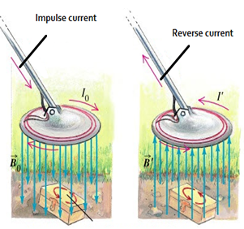
This technique uses a single file that uses as a transmitter and a receiver file at the same time. The idea of ​​this technique is based on sending an electric current in the form of short and strong pulses in a circular wire coil. Each of these pulses generates a magnetic field.
When there is a metal near the coil this electrical field produces a magnetic field in the metal body. And then the magnetic field fades and causes a reflected pulse, which creates a weak electrical current that flows into the coil. This weak current represents a sign of a metal object near the coil.

Slide 8
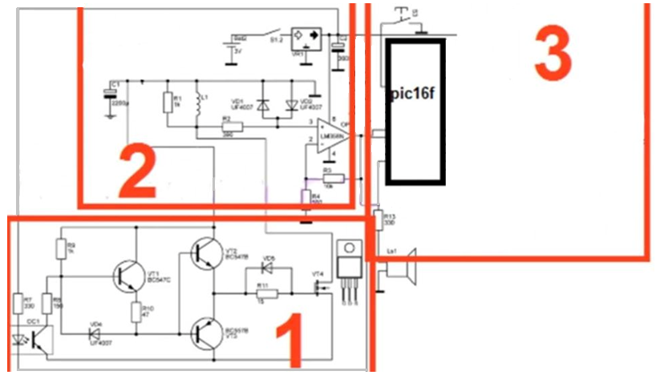
The design of the project:
The device consists mainly of three circuits which are : pulse transmission circuit, pulse amplifier circuit, and control circuit.

Slide 9
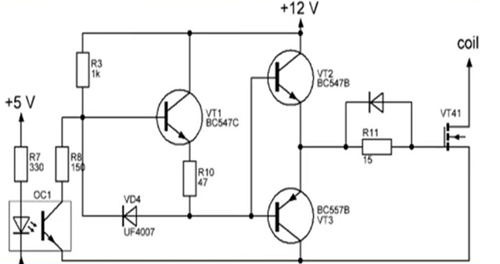
1) pulse transmission circuit:

Slide 10
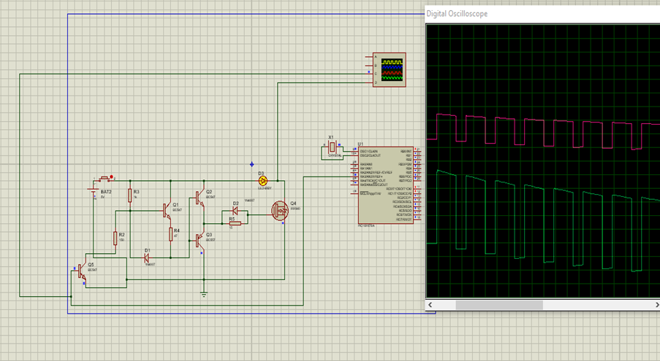
Software results:

Slide 11
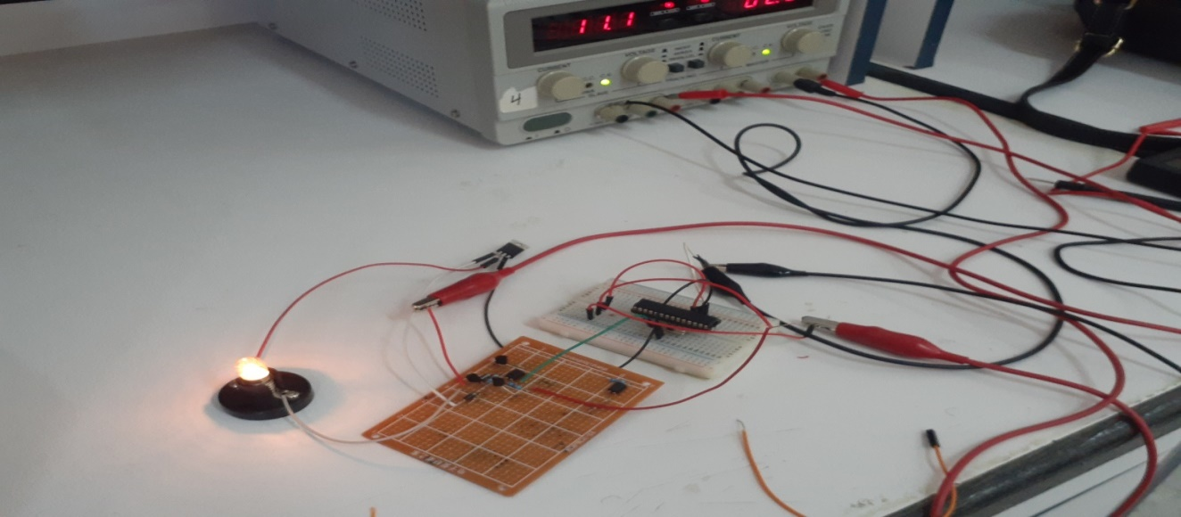
Practical results:

Slide 12
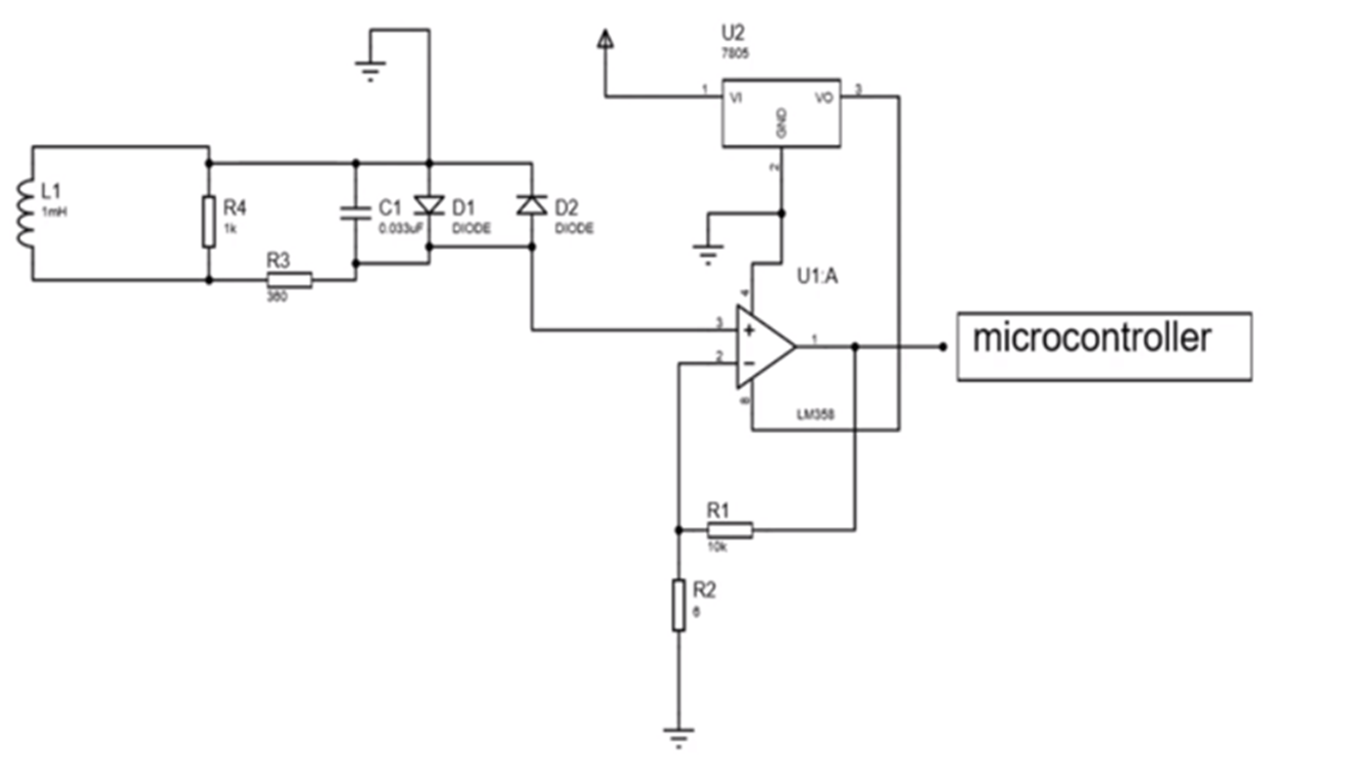
2) pulse amplifier circuit:

Slide 13
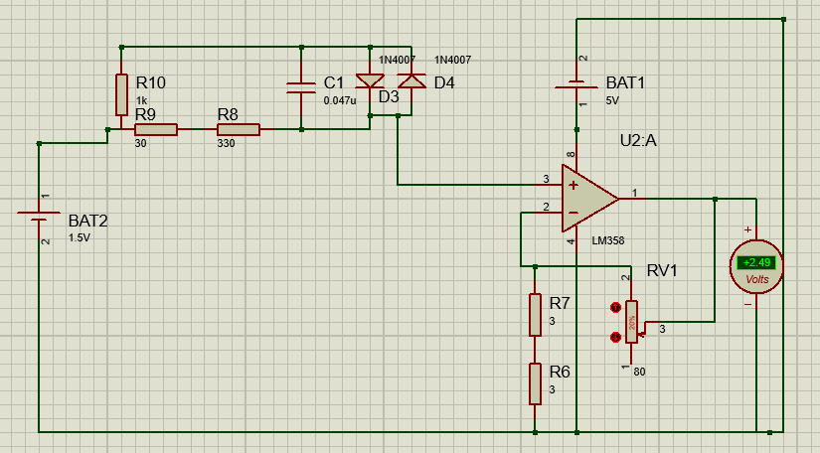
Software results:

Slide 14
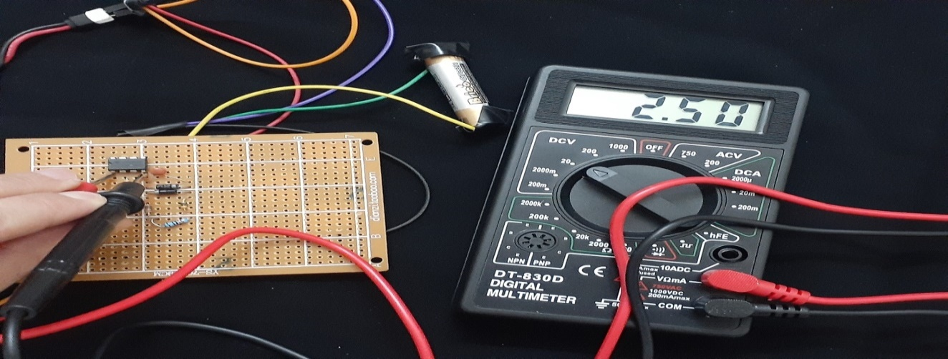
Practical results:

Slide 15
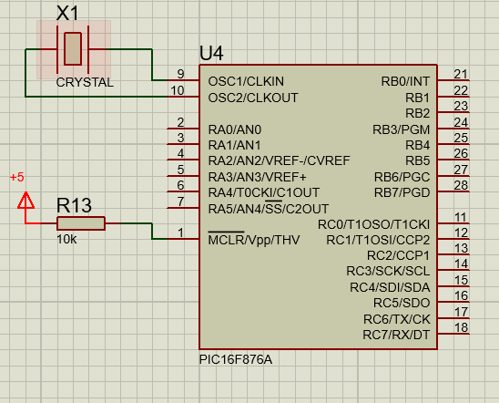
3) Control circuit:

Slide 16
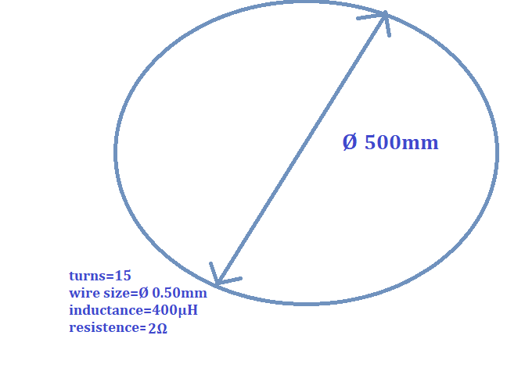
4) The coil :
a)

Slide 17

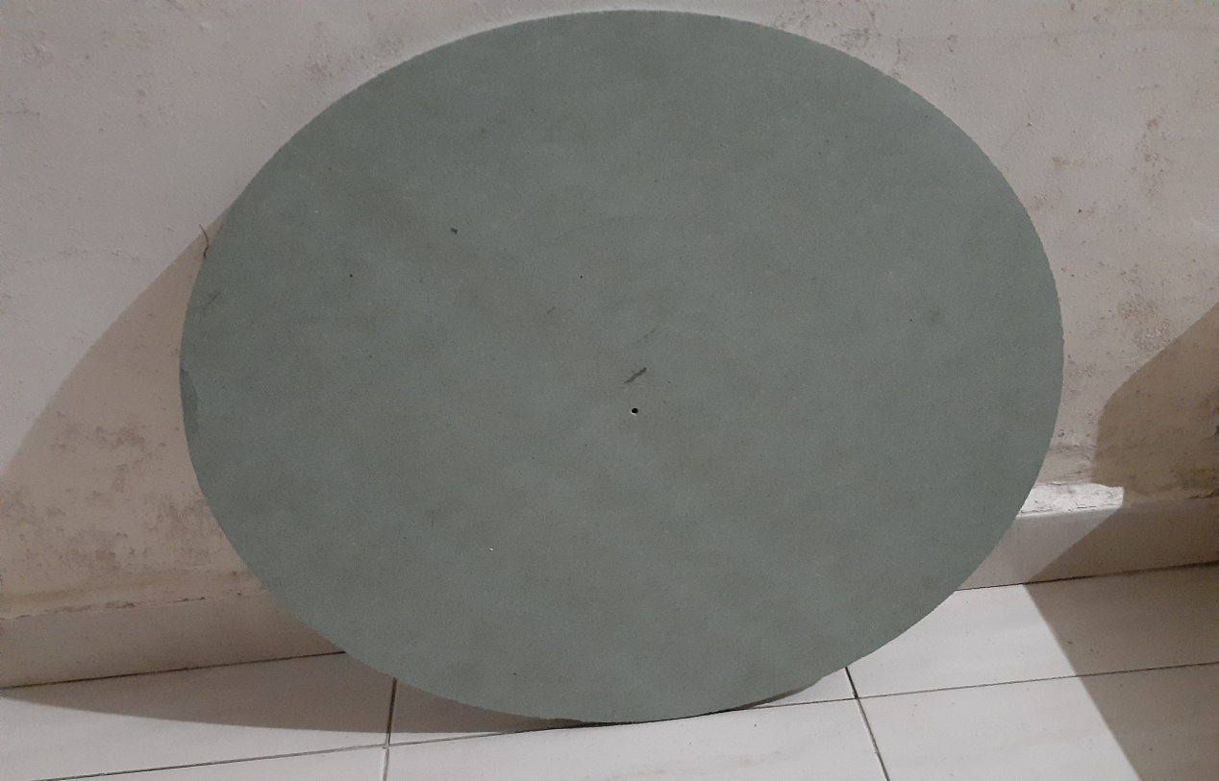

Slide 18
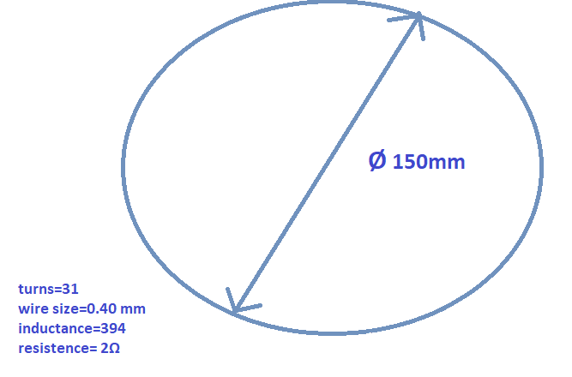
b)

Slide 19
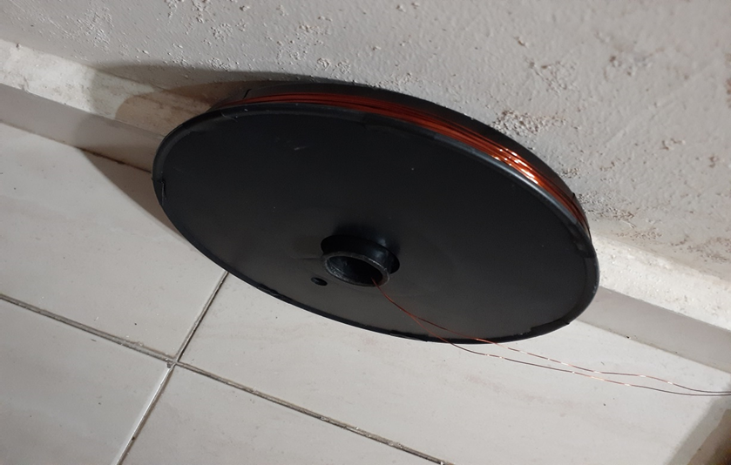
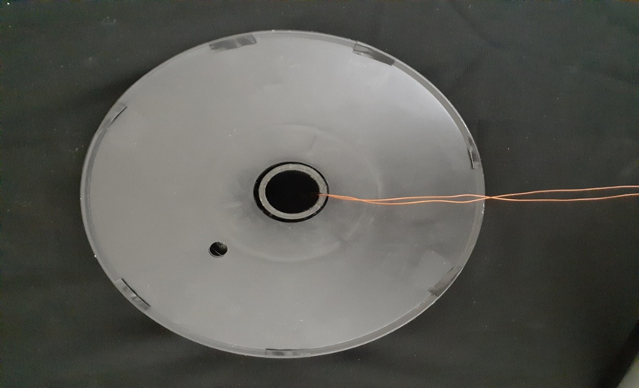

Slide 20
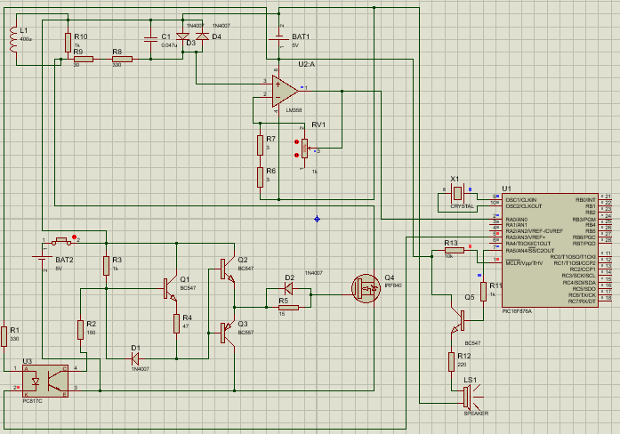
5) Connecting electronic circuits to each others:
Software connection:

Slide 21
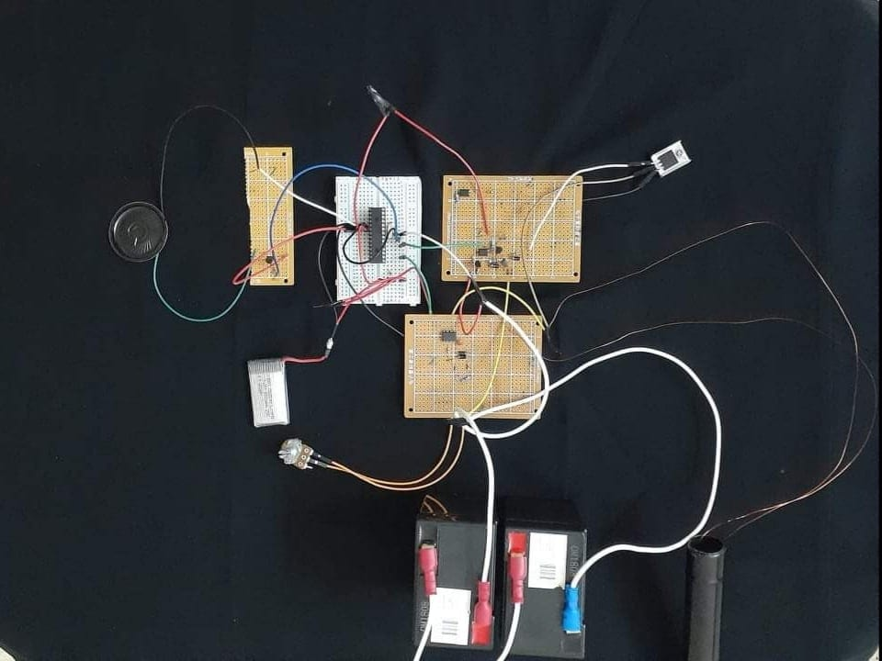
Practical connection:

Slide 22
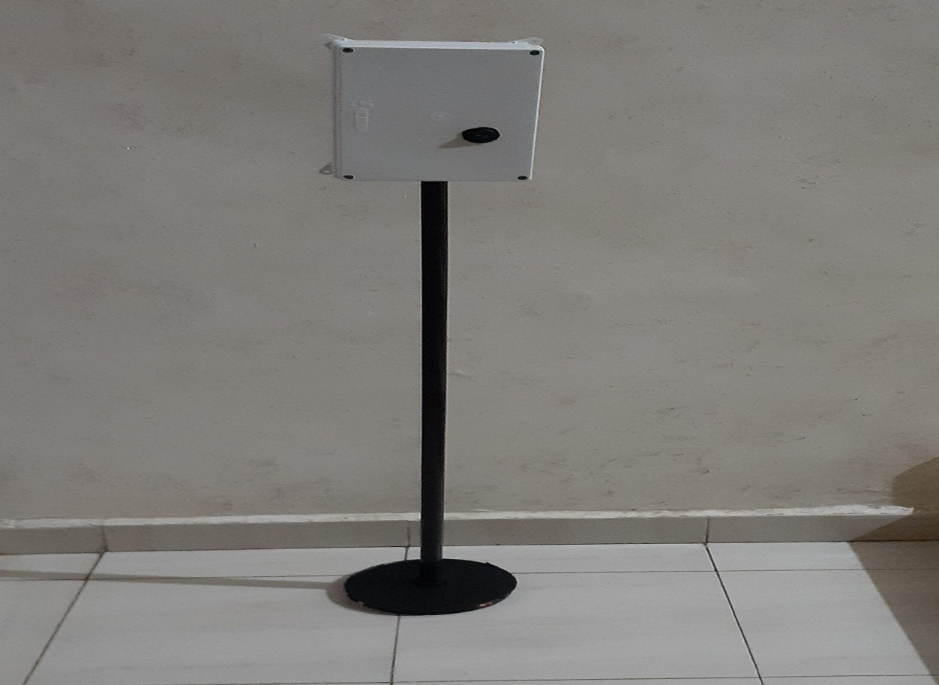
6. The Final design :

Slide 23
Conclusion:
After connecting all the circuits to each other, we tested the device with several sizes of coils, calibrated the variable resistance and rebuilt the circuit several times, but the device did not work.

Slide 24
Discussion :
We expect that the main reason for the failure of the device is the correct calibration of the coil, which is one of the most difficulties that we encountered during the manufacture of the device, as metal detectors are among the devices that need a correct calibration of the coils. Also, the calibration of the variable resistance and capacitor values must be appropriate in order for the device to work and failure to properly calibrate one of them will result in the device not working.

Slide 25


