Slide 1

An-Najah National University
Facility Of Engineering And Information Technology
Department of Building Engineering
Graduation Project II
Integrated Redesign of Hebron municipality
Performed by : Bana Salhi
Dalal Hanani
Tariq Salameh
Under the supervision of Eng.Hitham sawalha

Slide 2
Contents:
Architectural Aspect
Introduction
Environmental Aspects
Structural Aspects

Slide 3
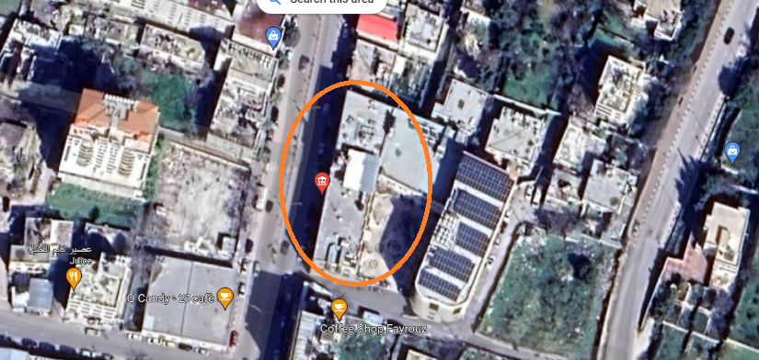
Introduction
The municipality is loaded in the city of Hebron.
It consists of six floors including two basements and a roof.
Total area of floors above ground = 4507 SM.
Basements total area = 5540 SM

Slide 4
Architectural Aspects

Slide 5
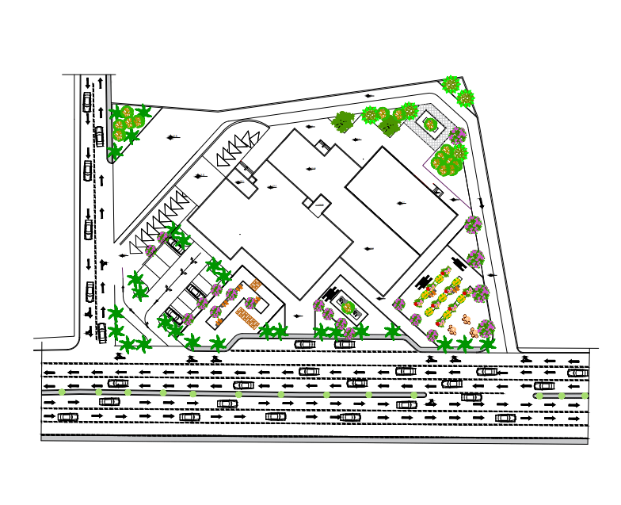
Site Plan:

Slide 6
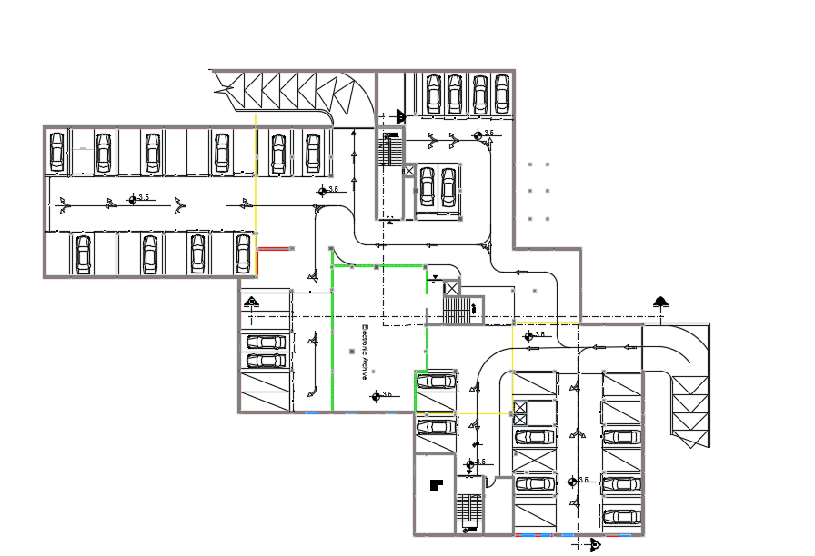
Parking before modification :

Slide 7
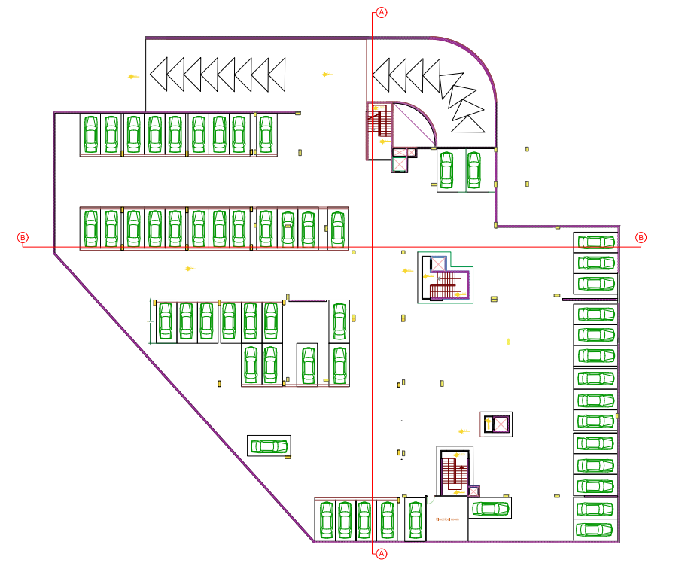
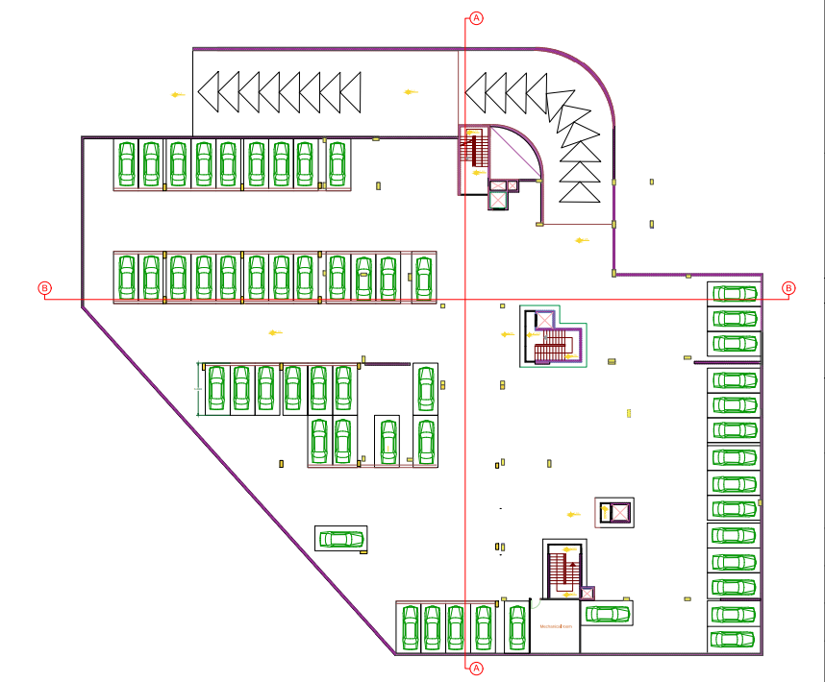
Parkings after modification :

Slide 8
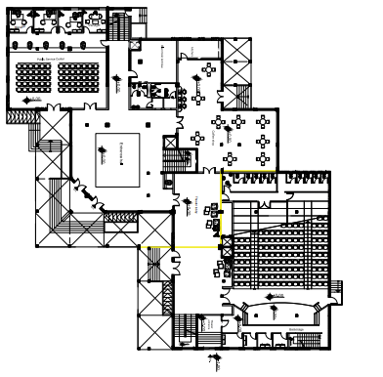
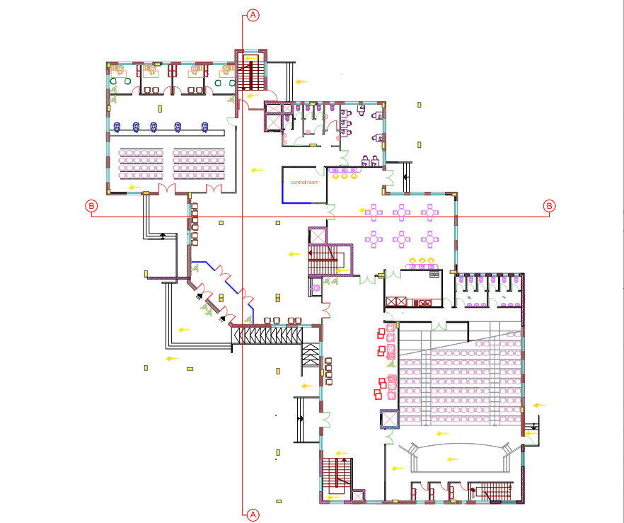
Ground floor before and after modification:
before modification:
before modification:

Slide 9
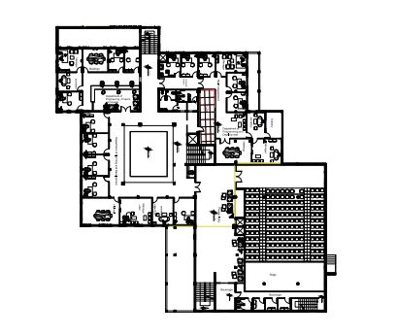
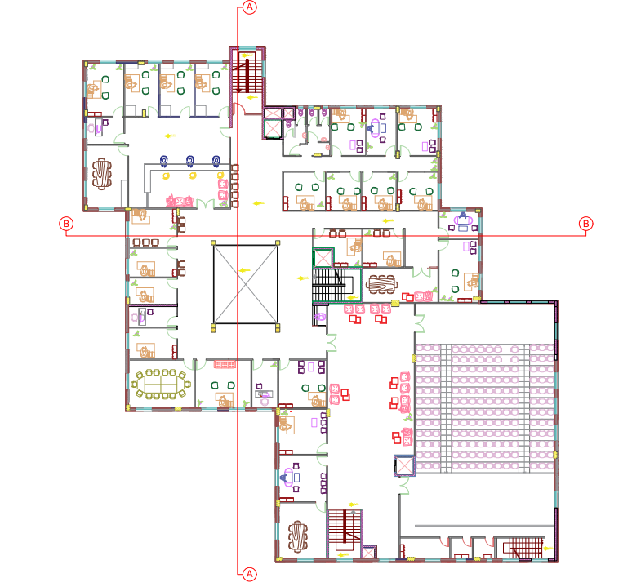
First floor before and after modification:

Slide 10
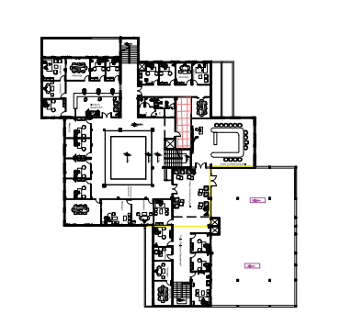
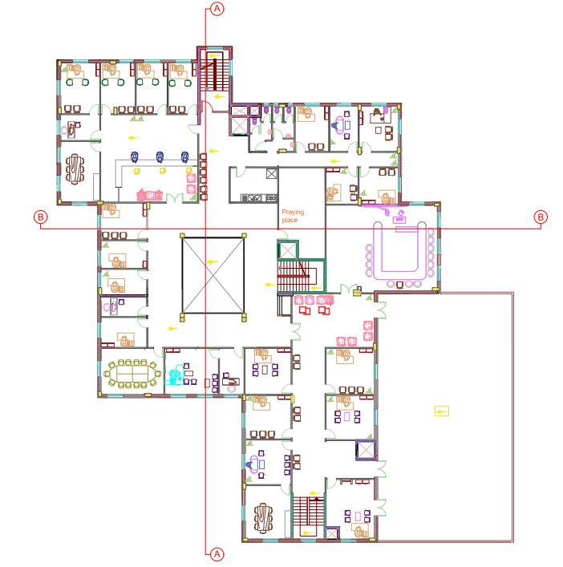
Second floor before and after modification:

Slide 11
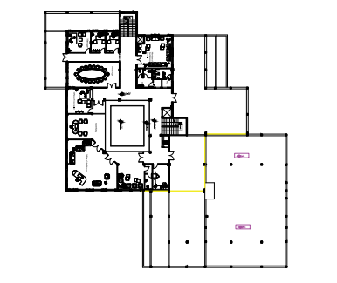
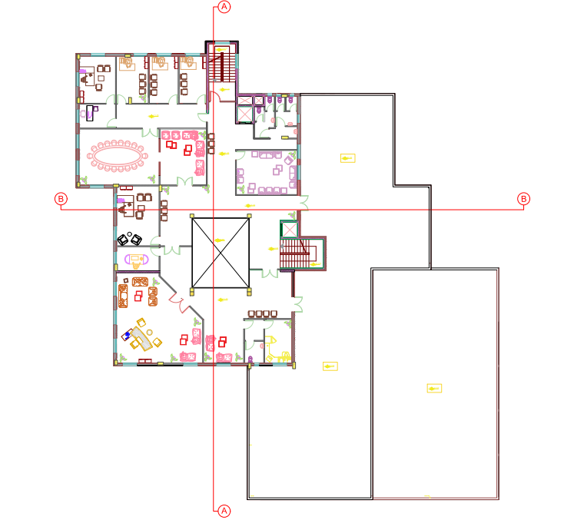
Roof before and after modification:

Slide 12
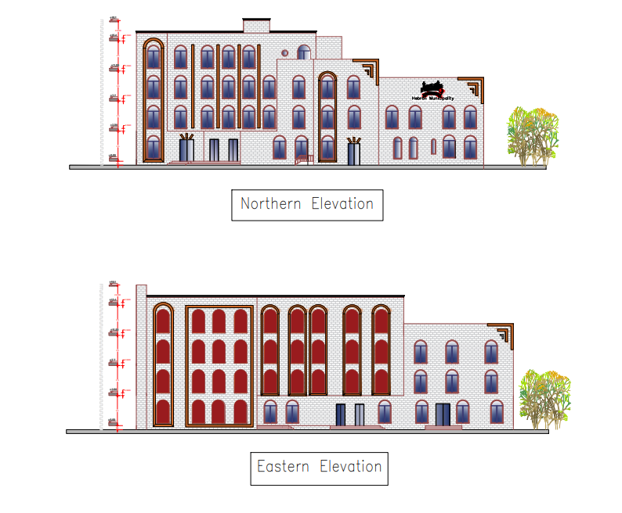
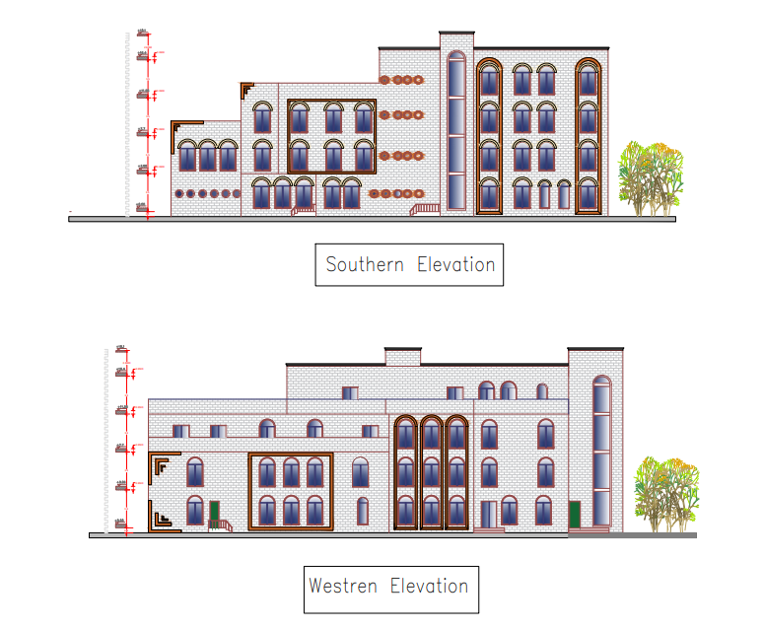
Elevations:
North elevation

Slide 13
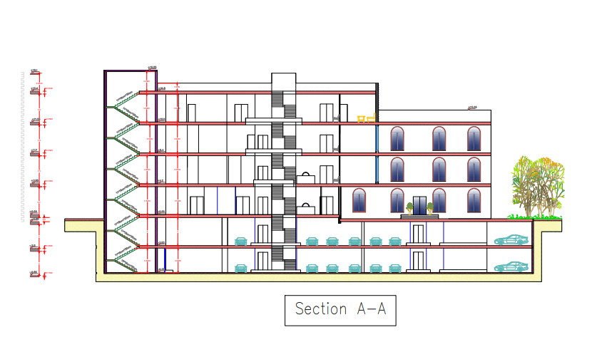
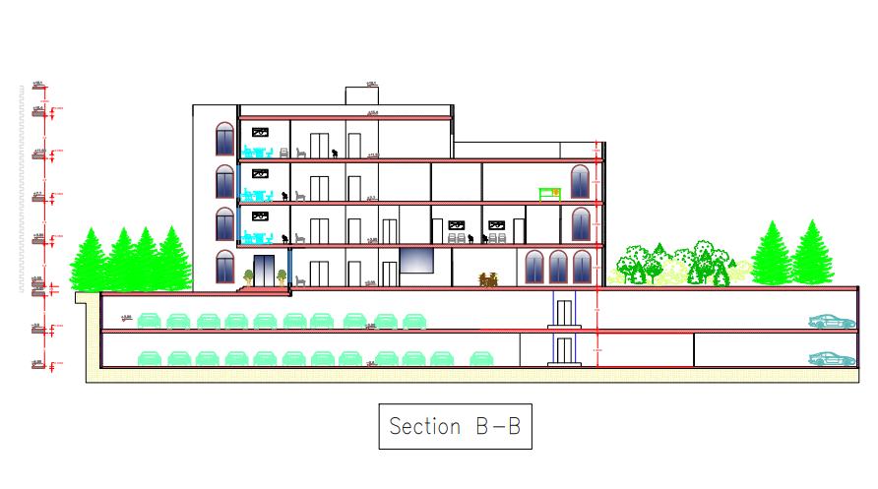
Sections:

Slide 14
Environmental Aspects

Slide 15
Environmental design program:
Put insulation in roof.
Use double type of glass with 60% lighting,26% solar, good insulation.
Put vertical louvers and cantilever.
The working hours in the building are from 8:00 am-2:00pm.
Photovoltaics.

Slide 16
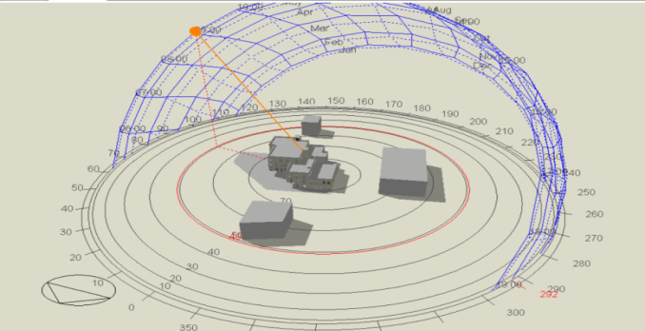
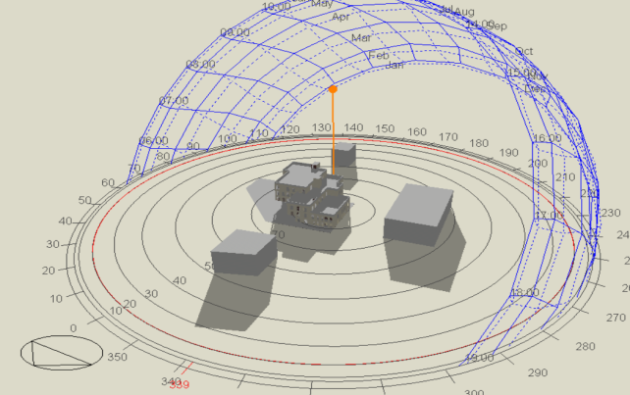
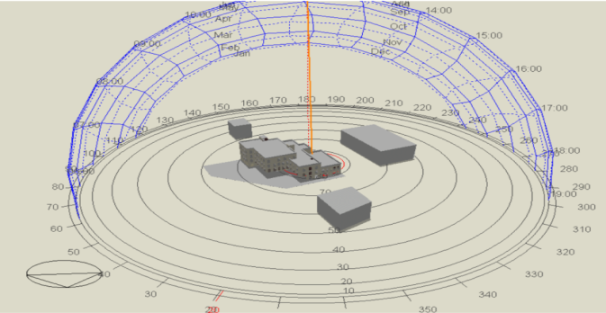
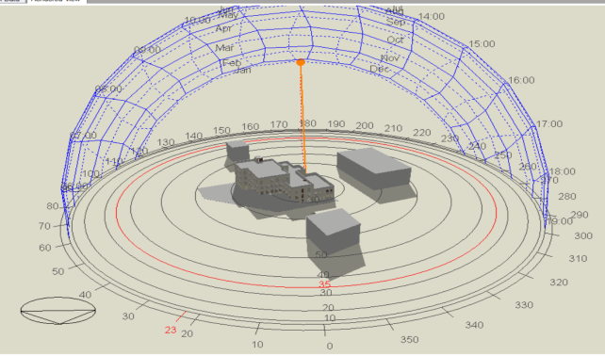
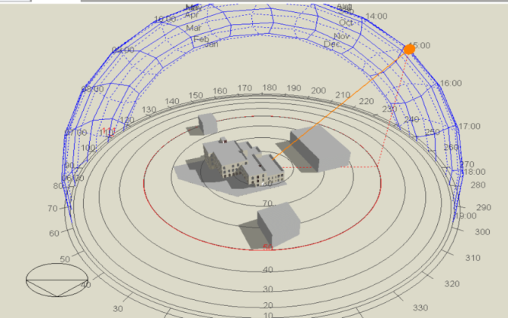
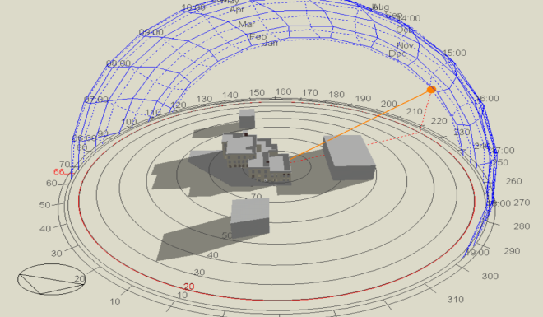
Environmental Analysis:
Summer 9 Am
Winter 9 Am
.
Summer 12 Am
Winter 12Am
Summer 3 Pm
Winter3Pm

Slide 17
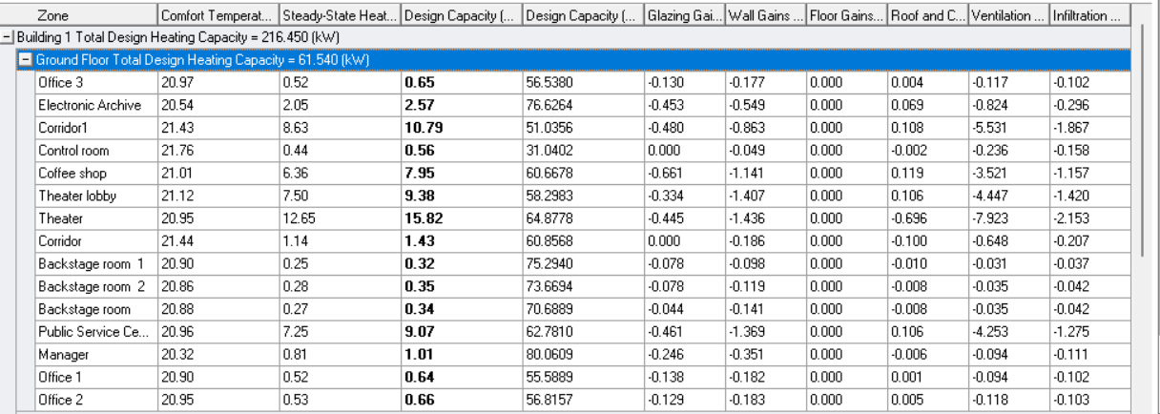
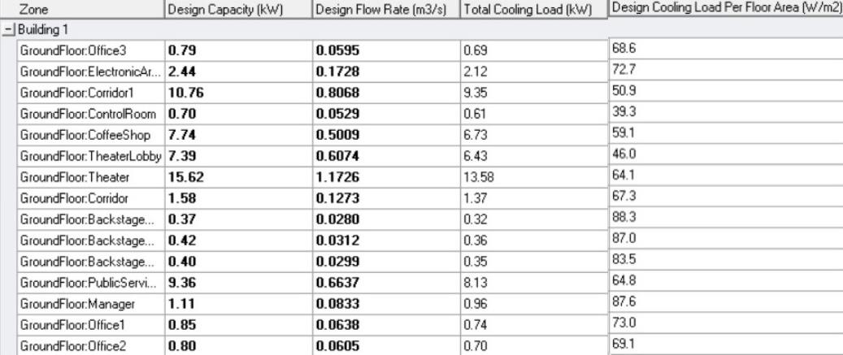
Heating and cooling load:
Heating Load: Total heating load capacity=216.45 kW
--→61.54 ton .
Cooling Load: Total cooling load capacity=229.42 kW
--→65.23 ton .

Slide 18
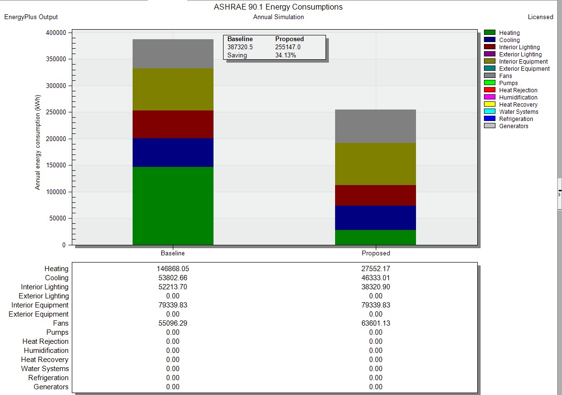
Beseline energy building analysis:

Slide 19
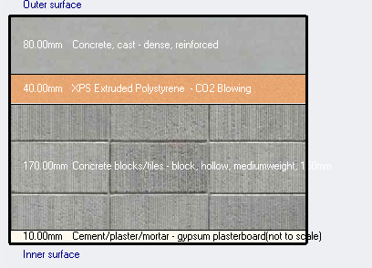
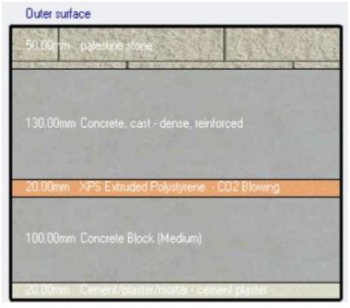
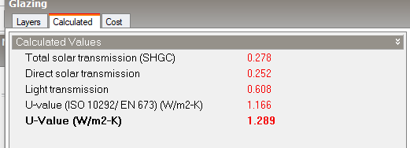
Thermal analysis:
U = 0.458(w/m2.k)
Roof layers
External wall layers
U =1.289 (w/m2.k)
U =0.91 (w/m2.k)
Glass layers

Slide 20
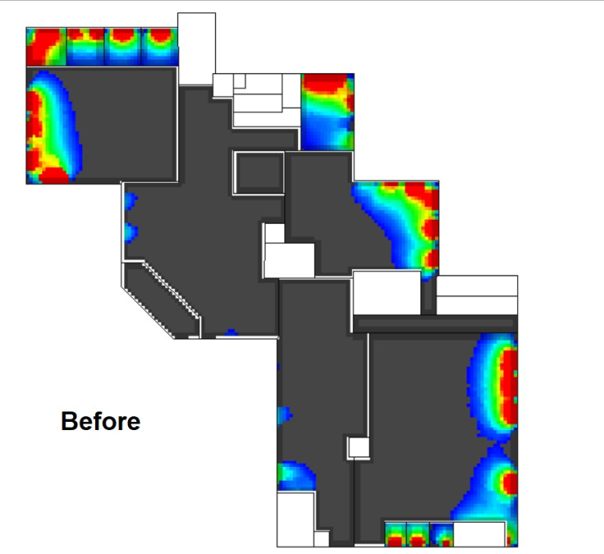
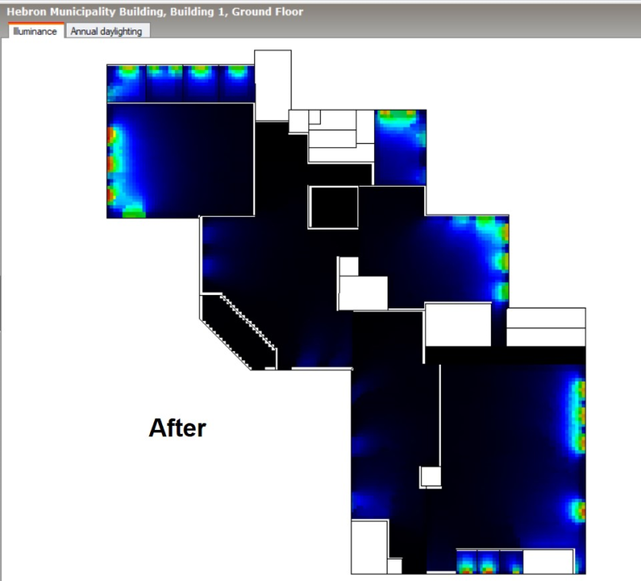
Daylight factor:
Ground Floor:

Slide 21
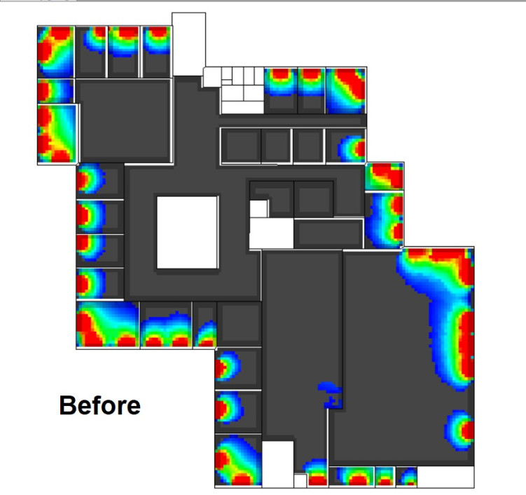
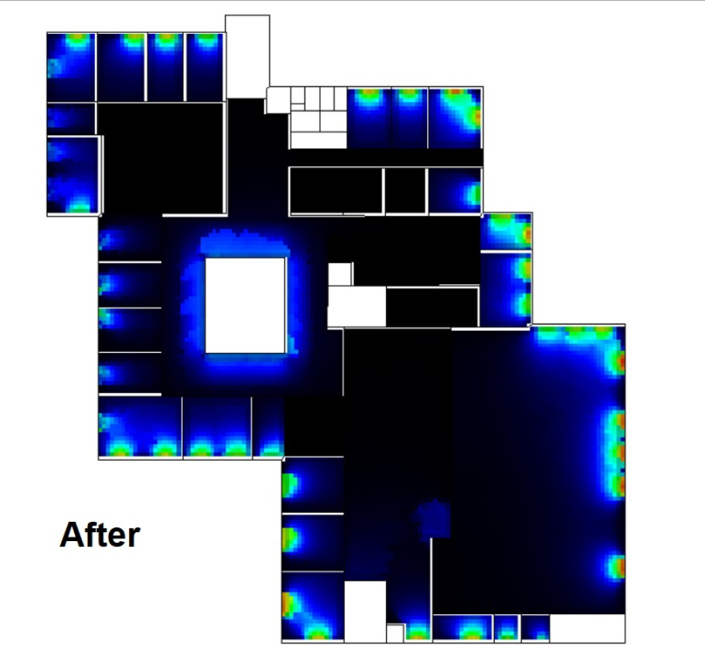
First Floor:

Slide 22
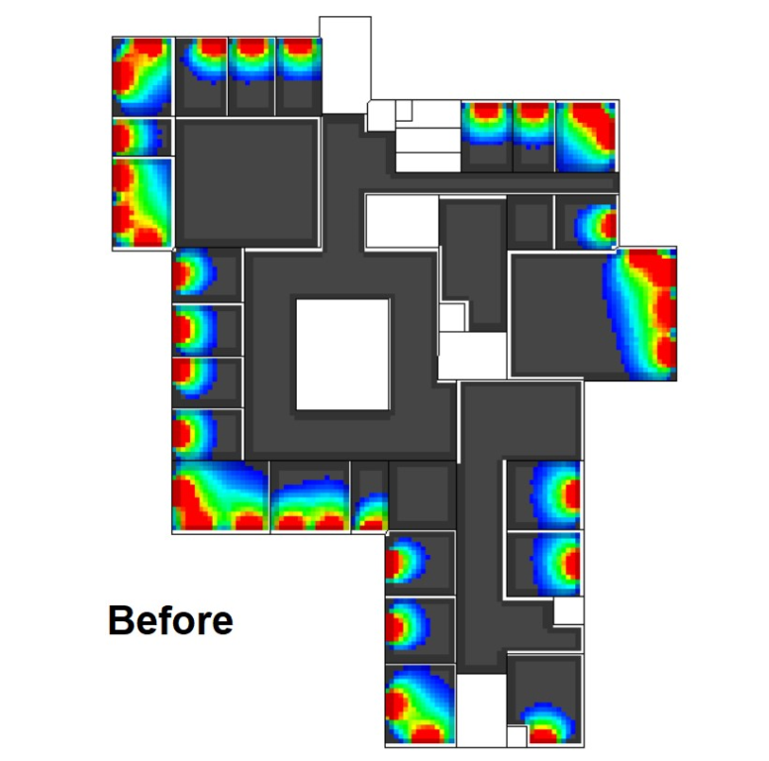
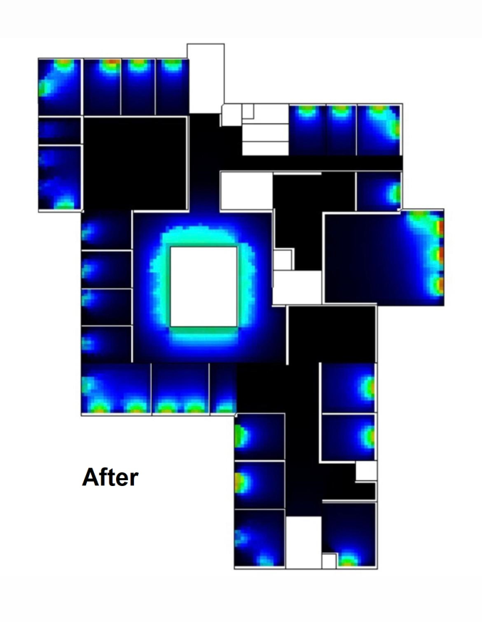
Second Floor:

Slide 23
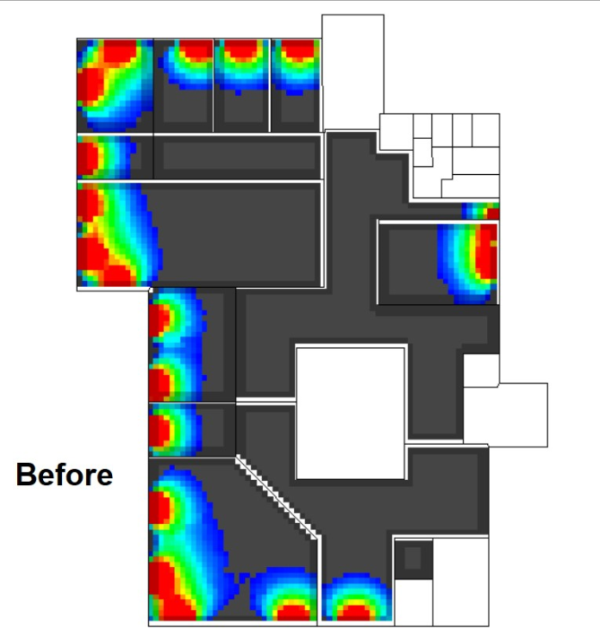
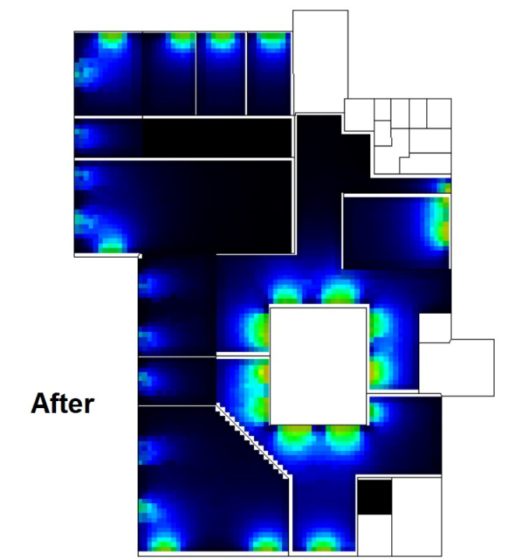
Roof Floor:

Slide 24
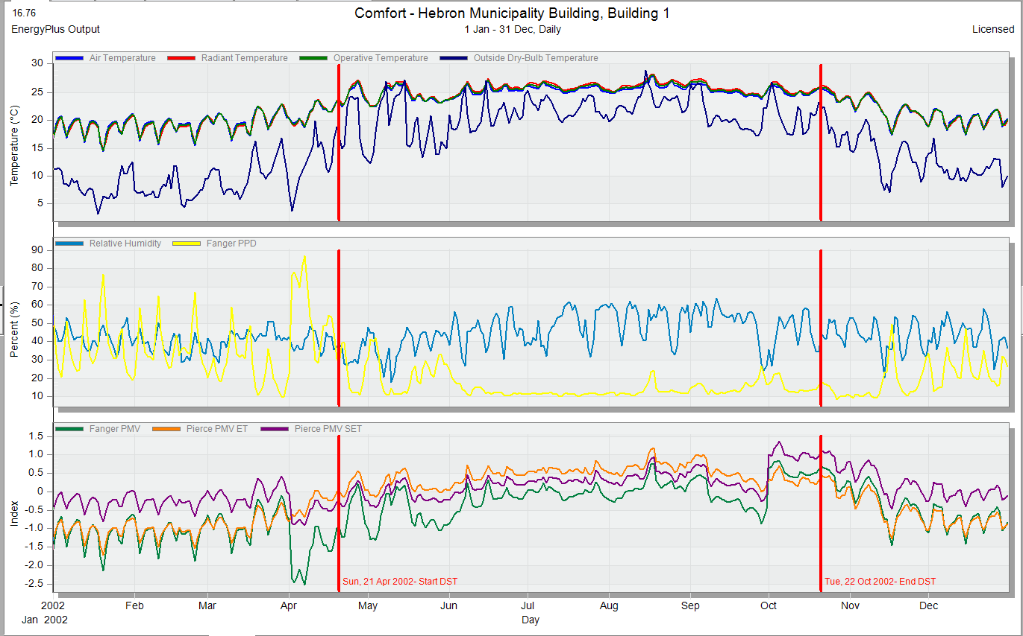
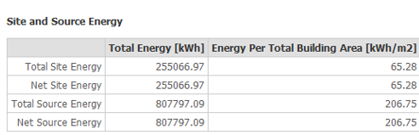
Thermal comfort:
PMV between (-0.7 to 0.7)
The total site energy is 65.28 kwh/m2

Slide 25
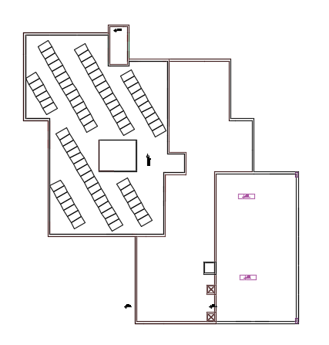
Photovoltaic design:
Number of modules =75
Number of inverter =3

Slide 26
Electro-mechanical aspects

Slide 27
Electro-mechanical aspects
Water supply
Drainage Design
Firefighting system
Artificial lighting
HVAC design
Acoustic
Electrical design
27

Slide 28
Acoustical design
Two component should be taken into consideration :
Architectural side
Electro- acoustic side
Component that was studied:
Spaces designed by using insul, ease ,ease address and ecotect programs:
Reverberation time (RT60)
Sound transmission loss
amphitheater
Sound pressure level
cafeteria
Sound transmission class (STC)
public service room
Articulation loss (AL)
28

Slide 29
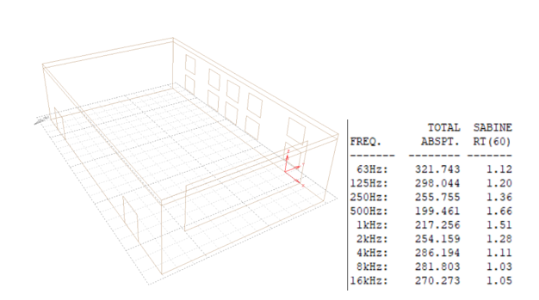
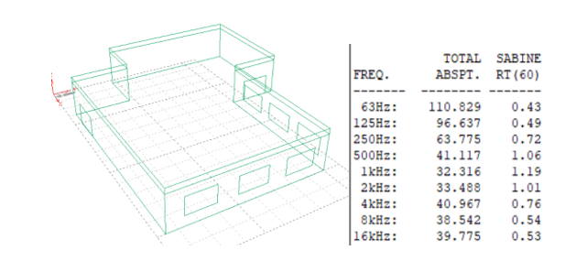
Reverberation time (RT60):
By using ecotect program the following results for reverberation time is conducted:
Amphitheater reverberation time
is in the range of (1-1.6) which is within standards.
Cafeteria reverberation time
is less than (1) which is within standards.
29

Slide 30
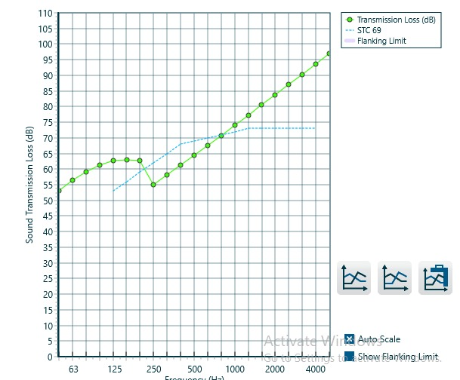
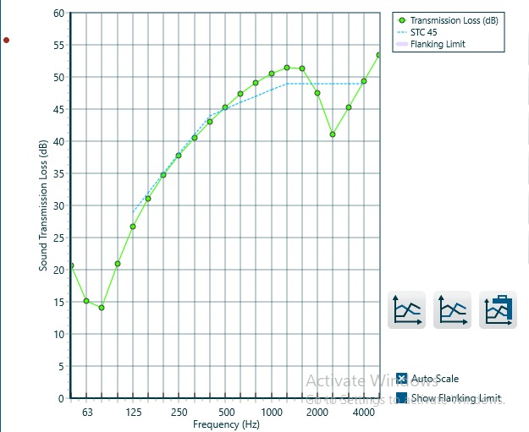
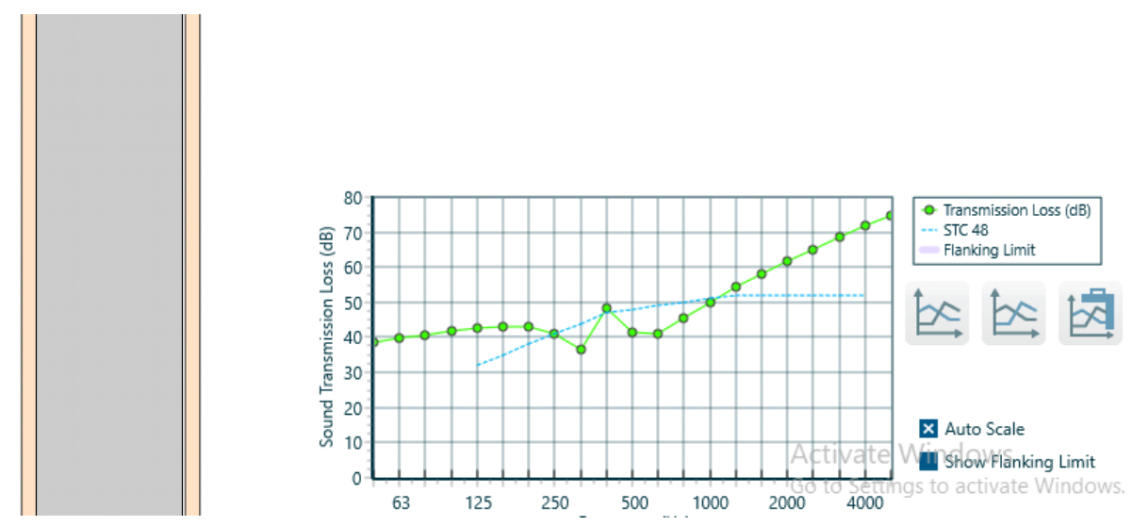
Sound transmission class (STC)
By using Insul program the following results for sound transmission class is conducted:
External wall
Glazing
Internal wall
30

Slide 31
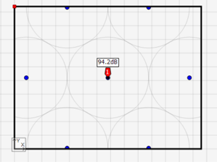
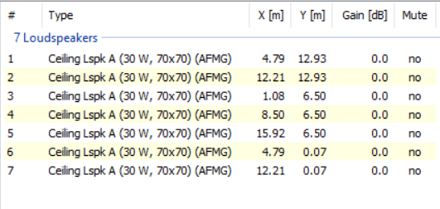
Sound pressure level (SPL) ( loud speakers design )
By using Ease address program the following results for SPL is conducted:
31

Slide 32
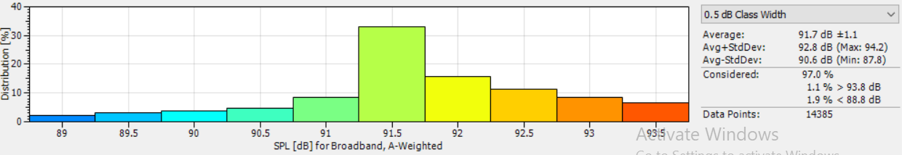
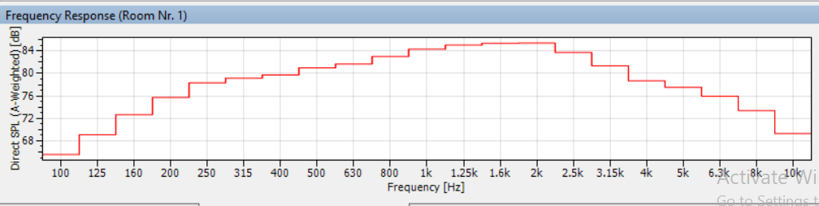
Sound pressure level (SPL) ( loud speakers design )

Slide 33
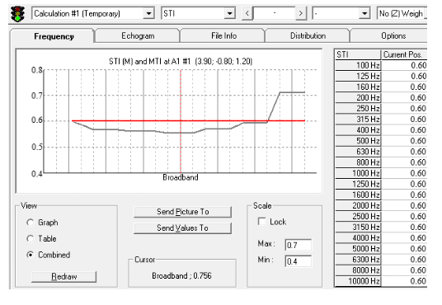

Articulation loss (AL) and Sound transmission loss (STL)
AL value of the amphitheater = 7
STL value of the amphitheater =0.6
33

Slide 34



Water supply
distribution pipes on the ground floor
34

Slide 35
Diameter design for pipes and calculation loss for ground floor
Table 1: Diameter of the vertical pipe(steel).
Flow= 41gpm
Table 4: Diameter of the vertical &horizontal pipe in floors.
Dim | 4" | 3" | 2.5" | ”2 | 1.5”
loss/100ft | .16 | .45 | 1.5 | 3.3 | 13
loss/91.3ft | .14 | .4 | 1.3 | 3 | 11.8
 | vertical design |  | Horizontal design
floor | Steel pipes | Loss/eq.length | PVC pipes diameter | Loss/eq. length
G.F | 2” | 3 | 1” | 11.8
F.F | 2.5” | 2.9 | 1 .25” | 1.4
S.F | 2.5” | 1.4 | 1 .25” | . 3
R.F | 3” | .47 | 1 .25” | .53
Table 2: Diameter of the horizontal pipe.
Flow = 24gpm
Dim | 3” | 2.5” | 2" | 1.5” | 1”
loss/100ft | .19 | .5 | 1.5 | 4.6 | 9
loss/14.1ft | .02 | .07 | .21 | . 63 | 1.2
Table 3: Diameter of the branch pipe.
Flow=5.2gpm
Dim | 1 ¼ " | 1" | ¾ " | .5"
loss/100ft | .6 | 2.2 | 8 | 36
loss/29.5ft | .17 | .64 | 2.36 | 10.2
35

Slide 36


Draining
36

Slide 37



Artificial lighting design :
Indoor lighting design is simulated on DIAlux evo software
37

Slide 38

Public services center:
38

Slide 39



547 lux > 500 lux ok.
Uniformity = 0.59 == 0.6 ok.
Maximum glare permeated =19.
39

Slide 40

Amphitheater
40

Slide 41



audience area
Stage area
glare result
41

Slide 42

Meeting room

Slide 43


571 lux > 500 lux ok
Uniformity = 0.65 > 0.6 ok
Maximum glare permeated =19.
43

Slide 44
Firefighting system:
Requirements:
A sprinkler system was used in the cafeteria and the two basements , while other floors cannot be provided with fire sprinklers due to it’s space function.
Automatic extinguishing systems must be linked to the automatic alarm system in order for these systems to operate at the same time.
Each floor is provided of fire extinguishers , hose stations and fire bells.
44

Slide 45




Fire system
Sprinkler and Heat detectors arrangement in the cafeteria
Fire extinguishers , hose stations and fire bell arrangement in the ground floor

Slide 46



As long as providing exist signs for the escape path

Slide 47

HVAC design
Total heating load capacity = 216kW
Total cooling load capacity = 229 kW
The system used for HVAC design is (VRF system)
Outdoor unit:
Outdoor unit model name (AM220FXVAGH/TK) and type (DVM S).
We need four units .

Slide 48


Indoor unit :
Fan coil unit:
Cassette unit:
Indoor unit model flow rate equal 0.28m³/s.
We used a diffuser model with airflow =0.09:

Slide 49


HVAC design
HVAC plan for ground floor.

Slide 50


Electrical design

Slide 51

Electrical design
After designing wire for the worst case each floor:

Slide 52
Structural Aspects

Slide 53

General information
Design codes are ACI 318, ASCE , UBC-97
Slab system is a Two-way Ribbed Slab.
Subjected loads are as follows:
Live load = 4.79 KN/m
Live load in basements = 6 KN/m
Dead load = 5.64 KN/SM
SID = 5.14 KN/SM
Concrete brick wall =18 KN/SM
Materials used:
Concrete B350 kg/Cm² (f'c=28 Mpa).
Steel fy=420 Mpa.

Slide 54



Structural system
Slab thickness equals to 350 mm

Slide 55



Beams and Columns dimensions
Dimensions (cm)
width | depth | beam name
100 | 35 | Main Hidden beam
90 | 95 | Dropped Beam 1 (60 cm under floor)
90 | 90 | Dropped Beam 2 (55 cm under floor)
30 | 35 | Edge beam

Slide 56





3D Etabs model
Due to different heights in the building, dissimilar shape and large dimensions it needed structural separates so the building is separated into three parts:

Slide 57
ETABS Checks
To ensure that the calculation is done correctly and to adopt the design results from ETABS; some checks are required:
compatibility check
Equilibrium check
Stress-strain check
deflection check
Seismic loads check

Slide 58



Compatibility check

Slide 59
Equilibrium check
 | Etabs | Hand | Error%
live load | 33820.18 | 34974.05 | 3.29
Dead load | 110233.5 | 104341.7 | 5.65
SID external walls | 11727.21 | 11930.4 | 1.70
SID slabs | 34743.85 | 34915.7 | 0.49

Slide 60


Stress-strain check
% Error | Etabs result | Total | Pu | Wall weight | Beam weight | Own weight | Column type
20.50 | 986.55 | 1240.876 | 701.096 | 235.08 | 223.7 | 81 | Edge
3.57 | 1131.07 | 1092.113 | 624.6128 | 288 | 112 | 67.5 | Corner
11.46 | 2477.35 | 2797.971 | 2294.496 |  | 382.2 | 121.275 | Middle
For the separated area:
Total | Pu | beam weight | column weight
1032.51 | 618.11 | 382.9 | 31.5
$\%Error=\frac{944.25−1032.51}{1032.51}∗100\%$ = 8.55 %
$\%Error=\frac{Etabs−Hand}{Hand}∗100\%$ $=\frac{67.2−65.47}{65.47}∗100\%$ = 2.64 %

Slide 61



Deflection check
Deflection = $\frac{L}{240}$ =$\frac{13.2}{240}$ = 0.055 m

Slide 62

Seismic loads checks
Response spectrum function factors are as follows:
Seismic zone is 2A (Z=0.15)
Soil profiles in the project is (SD)
Acceleration-dependent seismic coefficient, Ca =0.22
Velocity dependent seismic coefficient, Cv = 0.32
Ductility factor, R 5.5
Importance factor I =1
Four checks will be performed:
Time period check.
Model participation check.
Minimum force checks.
Drift check.

Slide 63
Time period check
T of the building = 0.7
Building part | Time period result | Time period of the building
Upper part | 0.64 | 0.7 | ok
Lower part | 0.42 | 0.7 | ok
Separated part | 0.17 | 0.7 | ok

Slide 64



model participation checks.
Lower part
Upper part
Separated part

Slide 65


Minimum force checks
Lower part
Upper part
Separated part

Slide 66


Drift check
Story | Height(mm) | Dis-X | Dis-Y | Drift-X | Drift-Y | Δm X | Δm Y | Δ M allow
0 | 0 | 0 | 0 | 0 | 0 | 0 | 0 | 0
B2 | 3000 | 7.2 | 6.7 | 0.864 | 2.492 | 3.3264 | 9.5942 | 75
B1 | 3000 | 4.9 | 5.1 | -2.3 | -1.6 | -8.855 | -6.16 | 75
GF | 3500 | 12 | 12.9 | 7.1 | 9.4 | 27.335 | 36.19 | 87.5
F1 | 3500 | 22 | 17 | 10 | 4.1 | 38.5 | 15.785 | 87.5
F2 | 3500 | 23 | 17.2 | 1 | 0.2 | 3.85 | 0.77 | 87.5
Roof | 3500 | 22 | 11 | -1 | -6.2 | -3.85 | -23.87 | 87.5
Height (mm) | Dis-X | Dis-Y | Drift-X | Drift-Y | Δm X | Δm Y | Δ M allow
0 | 0 | 0 | 0 | 0 | 0 | 0 | 0
3000 | 1.65 | 1.65 | 0.864 | 2.49 | 3.33 | 9.59 | 75
3000 | 3.5 | 3.3 | 1.85 | 1.65 | 7.12 | 6.35 | 75
3500 | 8.1 | 4.4 | 4.6 | 2.75 | 17.71 | 10.59 | 87.5
3500 | 10.8 | 6.1 | 2.7 | 1.70 | 10.40 | 6.55 | 87.5
3500 | 16.3 | 8.5 | 5.5 | 2.40 | 21.18 | 9.24 | 87.5
3500 | 34 | 19 | 17.7 | 10.50 | 68.15 | 40.43 | 87.5
Lower part
Story | Height(mm) | Dis-X | Dis-Y | Drift-X | Drift-Y | Δm X | Δm Y | Δ M allow
0 | 0 | 0 | 0 | 0 | 0 | 0 | 0 | 0
B2 | 3000 | 0.125 | 0.388 | 0.864 | 2.49 | 3.33 | 9.59 | 75
B1 | 3000 | 3.3 | 3.33 | 3.175 | 2.94 | 12.22 | 11.33 | 75

Slide 67


Columns detailing

Slide 68


Slab detailing

Slide 69

Stair detailing

Slide 70



Shear wall detailing

Slide 71


Beam detailing

Slide 72



Ramp detailing

Slide 73

Mat Footing detailing

Slide 74

Mat Footing detailing

Slide 75

Cost estimation and Quantity Surveying
Total cost of building = 15,000,000 NIS
Cost per square meter = 1500 NIS/SM

Slide 76
Thank you for your attention
The End

