Slide 1
Assessment of Level of Implementation of Green Manufacturing Practices in the Palestinian Concrete-Mixing Industry

Slide 2


Hello!
Prepared by:
Ashraf Nazzal
Ali Bani-Odeh
Abd-alruhman Abudiak
Ahmad Abd-alrarzeq
Supervisor: Dr. Ahmad Ramahi
Date: 19 May 2018

Slide 3

Outline
Introduction
Methodology
Results and Analysis
Discussion
Conclusions and Recommendations

Slide 4

Introduction
Ch1

Slide 5
Review
Problems
Social
Economic
Environmental
Literature review about the green manufacturing philosophy and concrete mixing industry.
Identify the most important problems facing the industry.
Develop a customized model for green manufacturing.
Develop an assessment tool.

Slide 6
Design and planning
Control/tools
Identify the green level
Assess the current conditions of the industry from a green manufacturing perspective.
Quantitative analysis
- Assessment tool ( survey ) - Green stream mapping
Green Manufacturing Model
Identify the development plan
In order to identify weaknesses and areas of improvement.
Consumption analysis
Water/energy/natural resources.
Going green
Apply green manufacturing principles to improve the green level.
Efficiency/Performance
Cost and time savings, Eco impact, quality improvement.
Maintaining a high level of green manufacturing
Maintain the green level and develop other green improvement plans for continuous improvement.
Sustainability tools
- Monitoring procedures.

Slide 7
  Problem Statement
The industry of ready mix concrete is one of the important industrial sectors in Palestine, but it faces many environmental, social and economic problems, such as :
  Gaseous emissions resulting from the transfer of materials
  The problem of child labor.
  Lack of control over workers' practices.
  Environmental pollution caused by dust in the atmosphere.

Slide 8
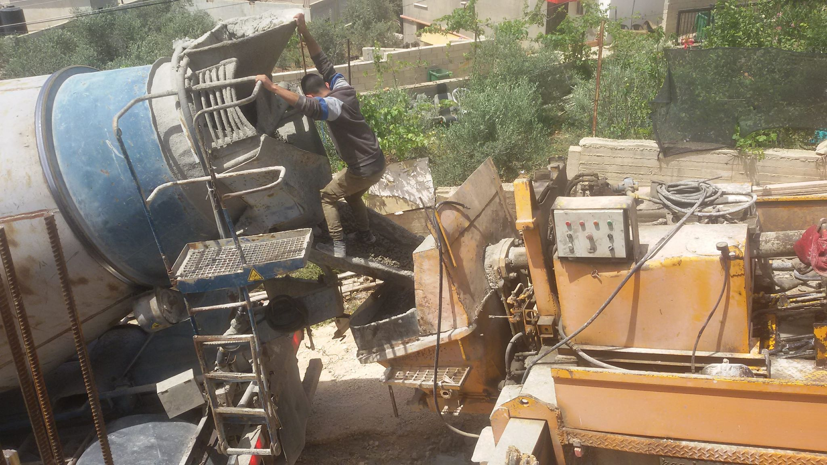

Slide 9
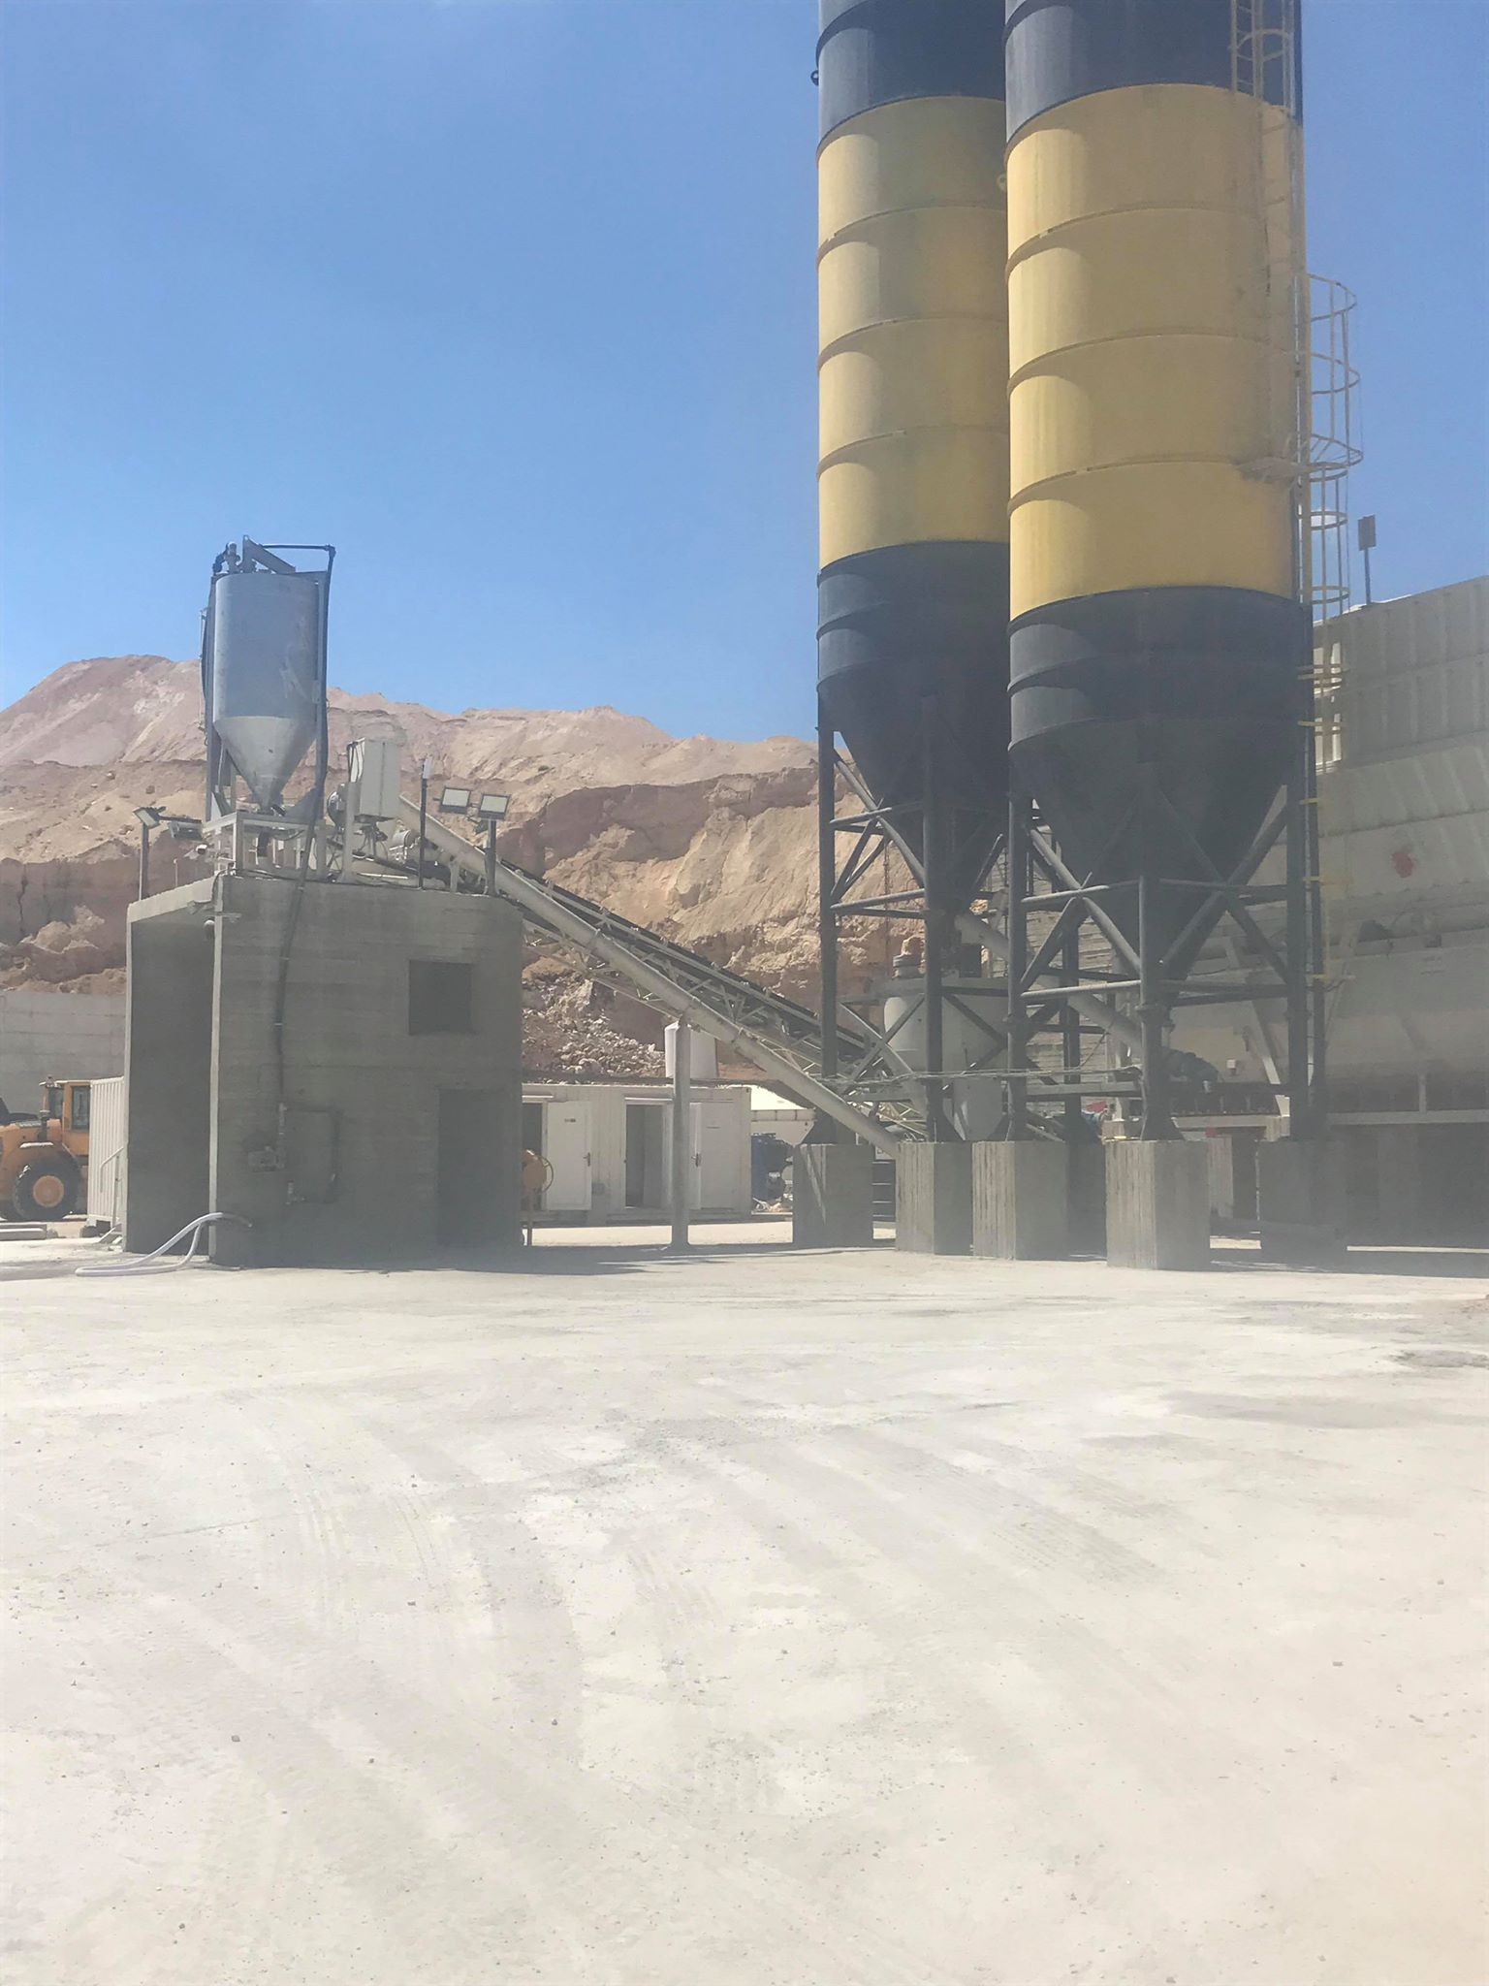
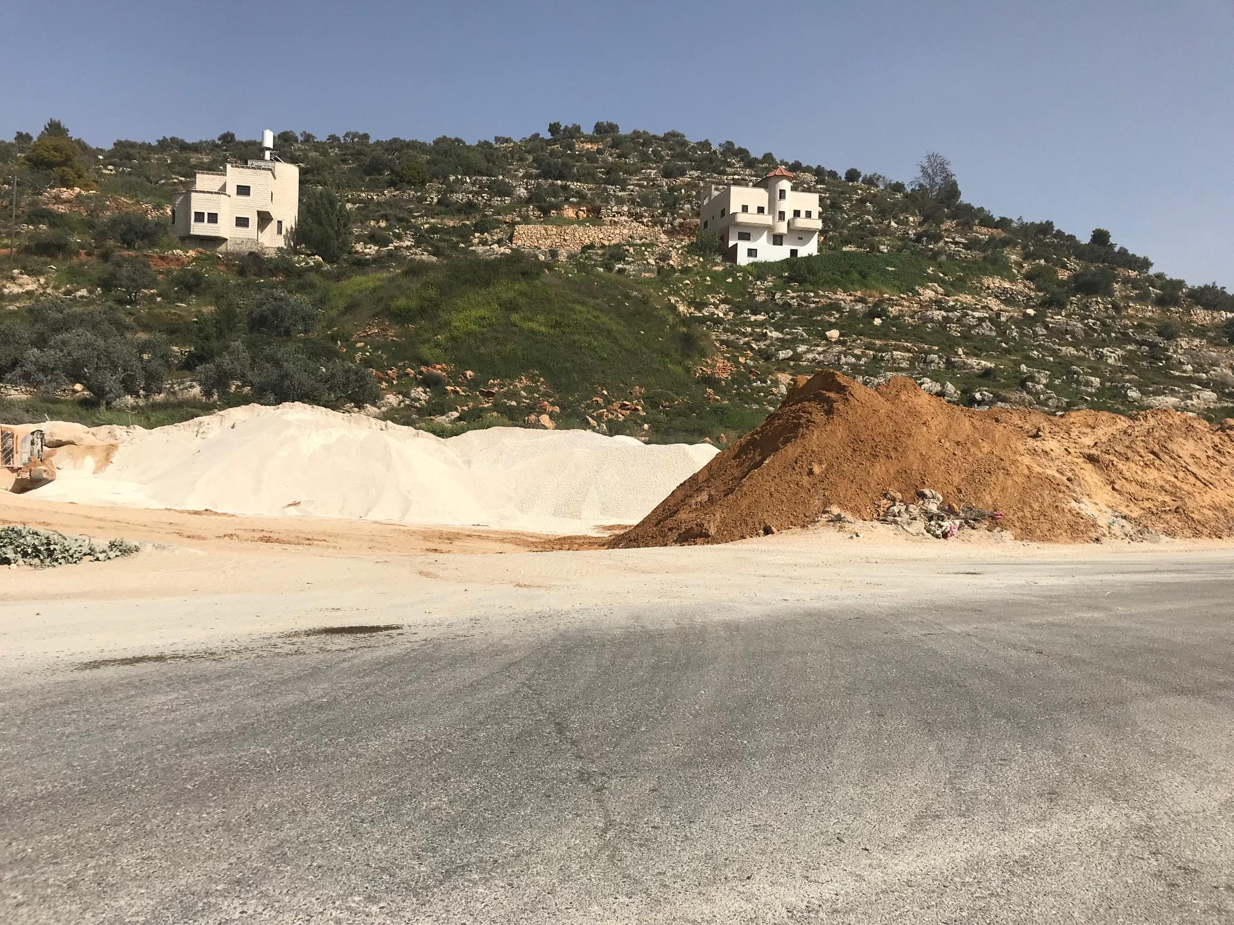

Slide 10
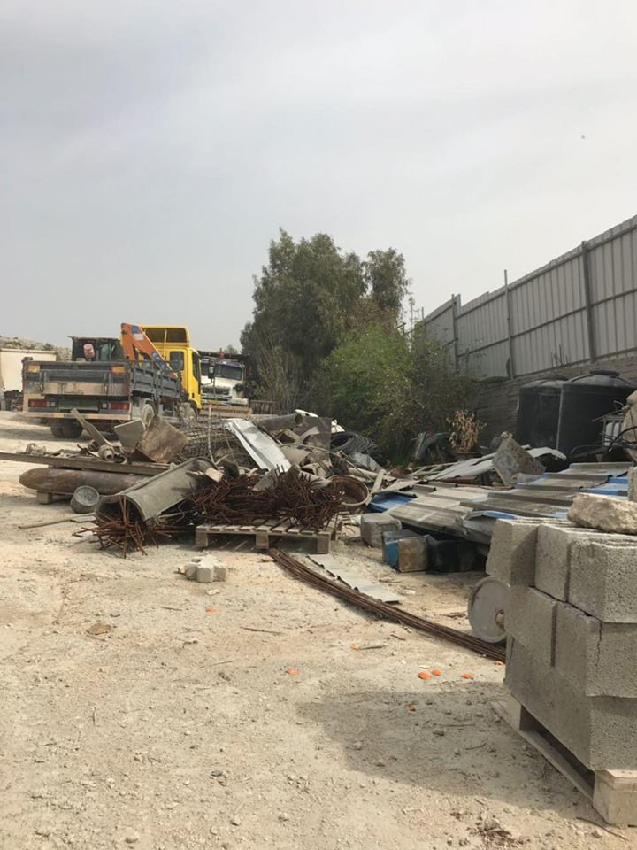
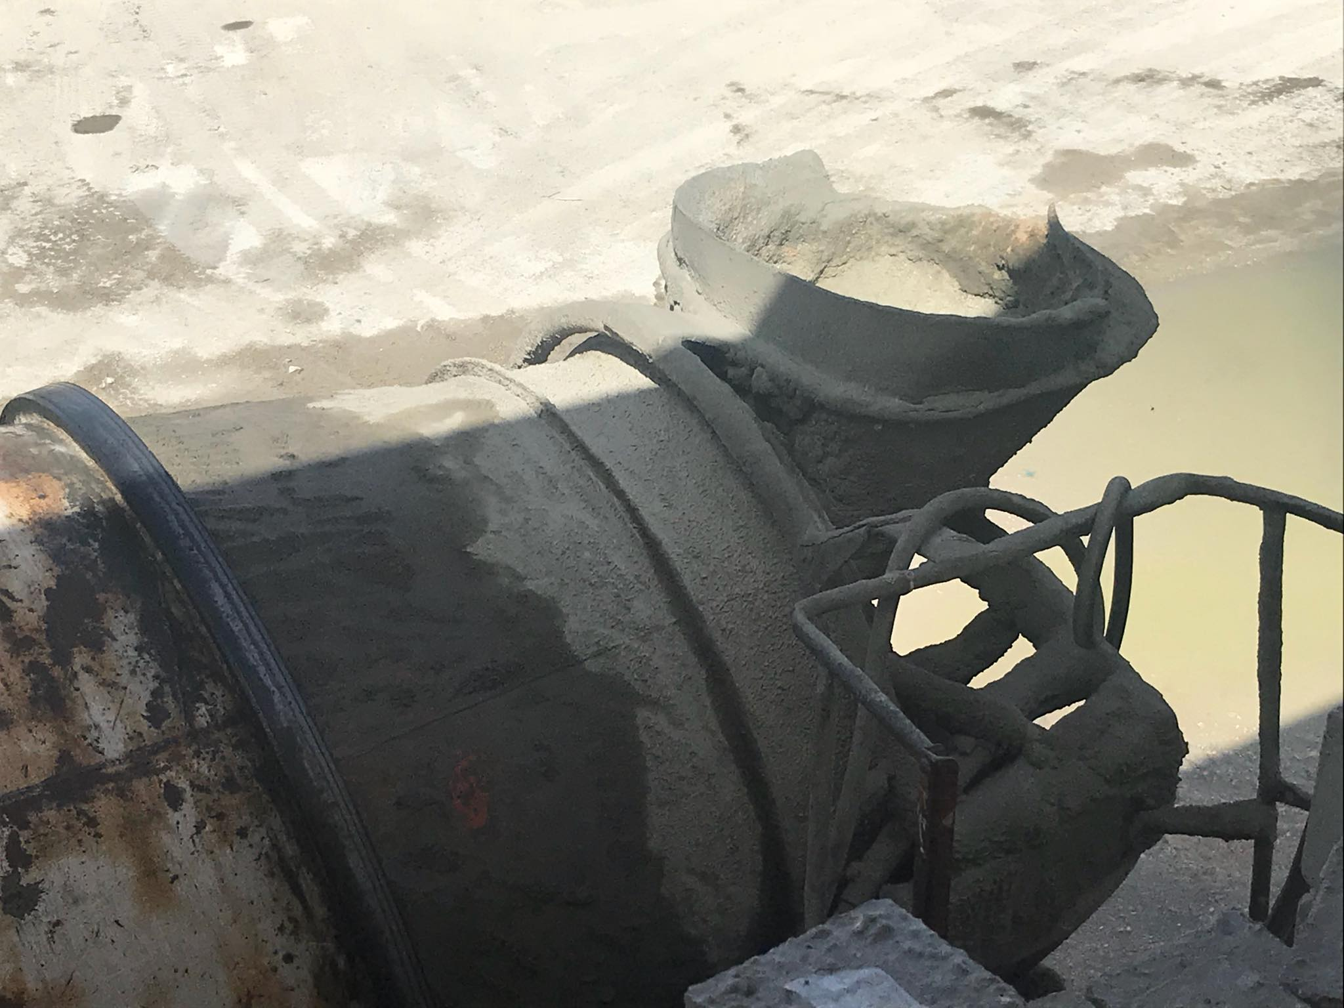

Slide 11
Project objectives
Identify the most important problems faced by ready-mix concrete industry.
Develop an assessment tool used to detect the gaps in this industry.
Develop a framework that demonstrates assessment and development steps.
Develop the necessary development procedures to improve the industry.

Slide 12

Methodology
Ch2

Slide 13

Data collection
Data analysis
Develop a Framework
Prepare To do lists
Designing an Assessment tool

Slide 14

Results and Analysis
Ch3

Slide 15
Data collection

Slide 16

Assessment tool

Slide 17
Aspect No.1: Environmental
Weight = 54%
# | Indicators | Weight | Score (1 or 2 or 3) | Weighted score
1. 1 | Assessment of the disposal system of plant waste and excess solids | 14%
1. 2 | Gases affecting the ozone layer | 11%
1. 3 | General impact on the environment | 11%
1. 4 | Impact of dust on surrounding area | 11%
1. 5 | Vehicle Status Assessment | 11%
1. 6 | Assessment of water reuse system | 6%
1. 7 | Watersupply mechanism | 5%
1. 8 | Assessment of the vehicle wash system - inside and outside the plants | 5%
1. 9 | Assessment of the material storage mechanism in the plants | 5%
1. 10 | Assessment of plant's area and land management status | 4%
1. 11 | Assessment of materials storage and prevention of volatilization , moisturizing and covering the materials | 4%
1. 12 | System for collecting rainwater | 4%
1. 13 | Floor of the plants status (paved / unpaved) | 3%
1. 14 | Road to the plants status (paved / unpaved) | 3%
1. 15 | Energy saving | 3%
 |  | 100%
Total |  |  |  | %
 |  |  |  | %

Slide 18
Aspect No.2: Social
Weight = 30%
# | Indicators | Weight | Score (1 or 2 or 3) | Weighted score
2.1 | Safety of workers in the plants | 31%
2.2 | Accident Insurance (Depends on the number and types of insurance) | 19%
2.3 | Accident Documentation | 17%
2.4 | Customer protection | 11%
2.5 | Dealing with workers according to the Labor Law | 8%
2.6 | Training system within the plants | 6%
2.7 | Child labor | 5%
2.8 | Future development projects | 3%
 |  | 100%
Total |  |  |  | %
 |  |  |  | %

Slide 19
Aspect No.3: Economic
weight = 16%
# | Indicators | Weight | Score (1 or 2 or 3) | Weighted score
3. 1 | Amount of the Annual sales | 22%
3. 2 | Assessment of the plant system to reduce consumption of raw materials - creative ideas | 21%
3. 3 | Amount of annual water consumption | 17%
3. 4 | Amount of annual electricity consumption | 17%
3. 5 | Assessment of the taxes payment system | 8%
3. 6 | Providing job opportunities - administrative and non-administrative - | 6%
3. 7 | Contribution to charitable and social work | 5%
3. 8 | Monthly employee wages and benefits | 4%
 |  | 100%
Total |  |  |  | %
 |  |  |  | %

Slide 20
Plants green levels

Slide 21
Data analysis

Slide 29

Discussion
Ch4

Slide 30

Framework for assess and improve the ready-mix concrete plants

Slide 31
Assessment
Start
Level 1
To do list 1
Yes
Identify the aspects
No
Level 2
Yes
To do list 2
Environmental
Social
Economical
No
Level 3
Yes
To do list 3
Indicators
Indicators
Indicators
No
Level 4
To do list 4
Yes
No
Continuous improvement
Level 5

Slide 32

To-do lists

Slide 33
To-do list 1 for level 1
Use filters on cement silo.
Paving roadways and vehicle paths to minimize the dust which released to the air.
When a raw material leakage occurs, it must be cleaned quickly before it becomes airborne.
Minimize number of material transfer points.
Ensure proper maintenance of firefighting equipment .
Moisturizing raw materials to save from volatilization.
Use a guidance and warning signs of risk.
Ensure that concrete and raw materials will not leaking on public roads during transportation.
Avoid washing vehicles outside the plant.
Provide first aid, fire extinguishing equipment and tools, and train employees to use them.
Separate and cover the material.
Use a renewable energy sources.
supply the raw materials from nearby sources to minimize transportation costs and minimize environmental impact.

Slide 34
To-do list 2 for level 2
Covered or enclose transfer points.
Collect, treat, and recycle washout wastewater, including concrete and cement.
Set a labels for chemicals, and provide material safety data sheet for each chemical.
Provide appropriate personal protective equipment for employees and ensure that the safety procedures are followed .
Use appropriate ways to enhance energy conservation.
Use the best ways and means to reduce water consumption.
Surrounding the plant with walls 1.5 meters high at least.
Addition material to fuel to reduce the emission of gases (Urea).
Cover the mixer nozzle.
Use alternative materials have the same quality with lower costs
Establish laboratory to ensure quality control within the plant.

Slide 35
To-do list 3 for level 3
Maintain the cleanliness of surfaces and floors through the wiping, rinsing and periodically cleaning.
Perform truck washout activities in a concrete pit to take advantage of washing water when they are not discharged into the ground.
Hazardous waste disposal in proper ways, taking into consideration the regulations of the ministry of environment.
Create an emergency response plan and train staff on possible emergencies.
Staff training in spill prevention and control, refueling procedures, safety, personal protective equipment.
Providing containers for industrial waste.
Regulating the traffic inside and outside the plant with the necessary traffic instructions and signs.
Use a municipal line as a source of water.

Slide 36
To-do list 4 for level 4
Use dust collection systems, such as filters.
Monitor noise generated from operations.
Provide vegetative barriers to reduce the spread of dust
Provide an integrated environmental health and safety management system for the site, plant operations and delivery process.
The plant must have a mechanism to collect rain water.
Reuse of damaged equipment, such as using mixer as a reservoir to collect water.
Take advantage of the use of excess concrete to produce concrete cubes.

Slide 37

Conclusions and Recommendations
Ch5

Slide 38
Conclusions
Green manufacturing are not fully applied in most of the plants that have been assessed
Novelty of this concept
lack of management awareness of the importance of strategies
Clear gap between the existing system in the ready-mix concrete plants and the requirements of green manufacturing
partial application of some activities and requirements of green manufacturing philosophy

Slide 39
Recommendations
Increasing the public awareness among the owners of the ready-mix concrete plants with the importance of green manufacturing philosophy, by definition them to the concepts, requirements and benefits of this philosophy.
The philosophy of new factory.

Slide 40
Attention to the activities and means that aims to reduce the environmental impact of dust caused by manufacturing activities.
Safety procedures should be followed by the presence of safety equipment, warning signs and instructions.

Slide 41
THANKS!
Any questions?
رمضان كريم

