Slide 1

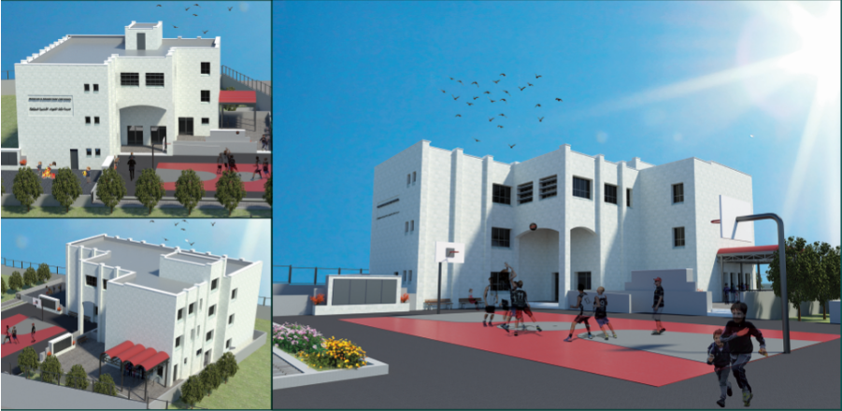

Quantity surveying for Muthalath Al Shuhada School
1

Slide 2
Outlines
Introduction
GP1 Review
3D Model Utilizing Revit
Managing Project Using Primavira
Navisworks Software
Assessment
2

Slide 3
Introduction
The construction sector is a very important economic sector in Palestine. It’s providing the necessary housing structures and economic activity.
3

Slide 4
Introduction
  Study objective
Importance
  Limitation
4

Slide 5
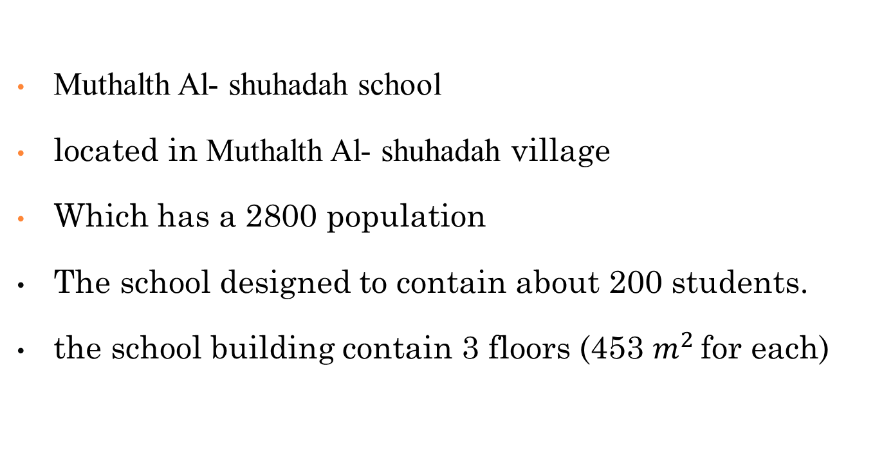
GP 1 Review
Muthalth Al- shuhadah school
located in Muthalth Al- shuhadah village
Which has a 2800 population
The school designed to contain about 200 students.
the school building contain 3 floors (453 $m^{2}$ for each)
5

Slide 6
Building Information Modeling (BIM)
Definition
Importance
Uses of BIM
6

Slide 7
Software Programs Used
Revit
Primavera
Navisworks
7

Slide 8

3D Model Utilizing Revit
8

Slide 9
Architectural Model
9

Slide 10
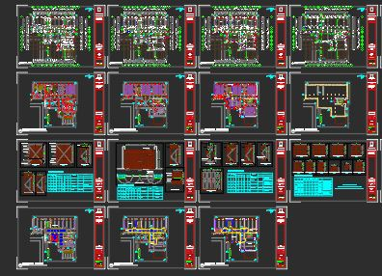
Insert CAD
10

Slide 11
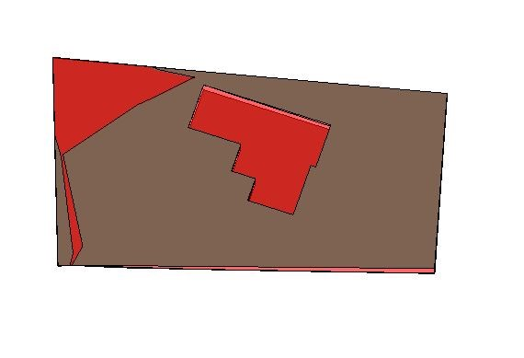
Site features
Select the optimum reduce level
Estimated the net cut/fill
11

Slide 12
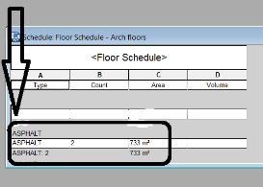
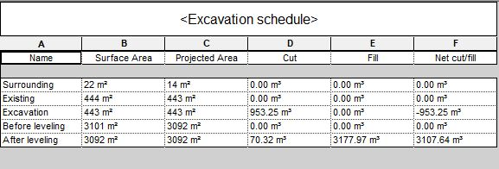
quantities result
12

Slide 13
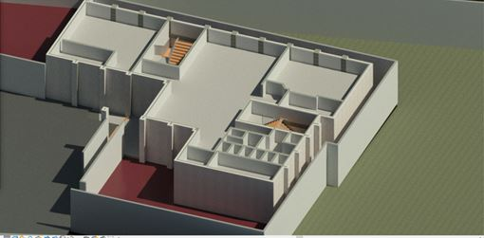
Architectural Wall
aid to protect the building from any external factors
improve the appearance form.
Interior walls
13

Slide 14
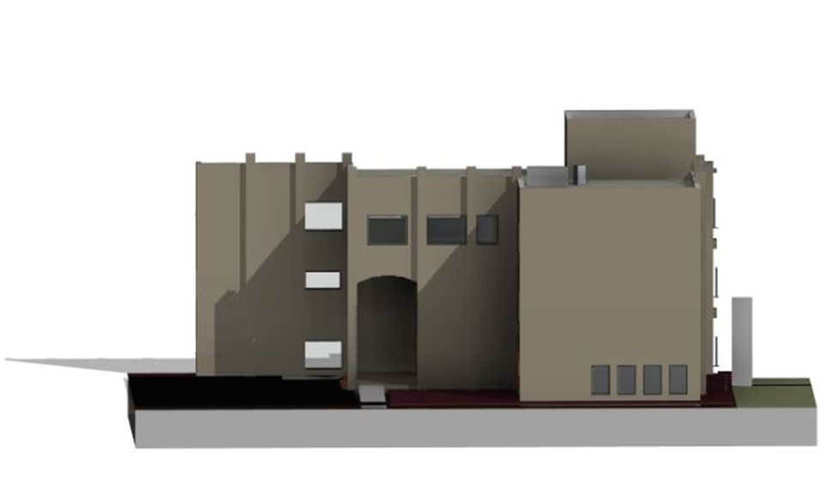
Architectural Wall
External walls
14

Slide 15
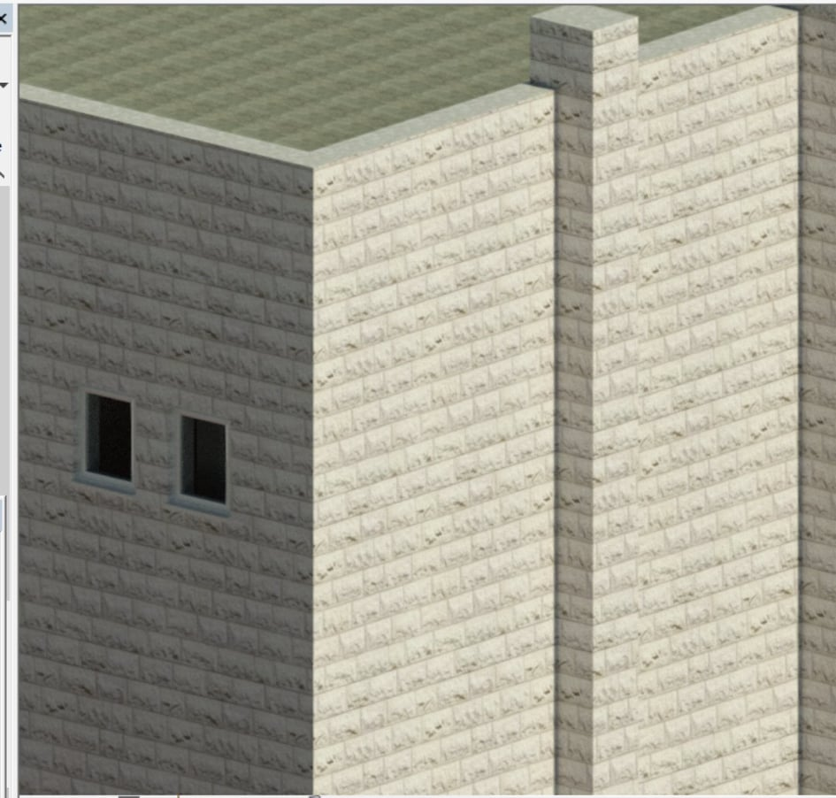
Architectural Wall
External wall Stone
15

Slide 16
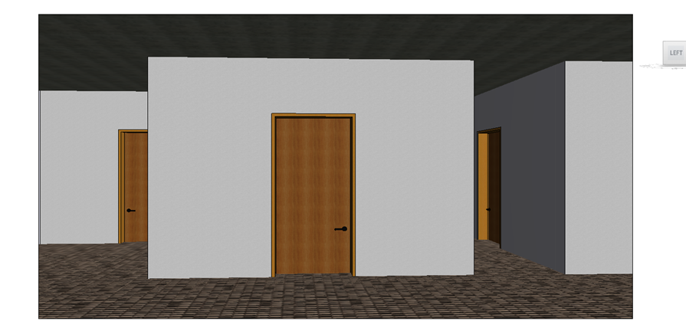
Doors
There are many shapes of doors
Can selecting particular proprieties of doors
16

Slide 17
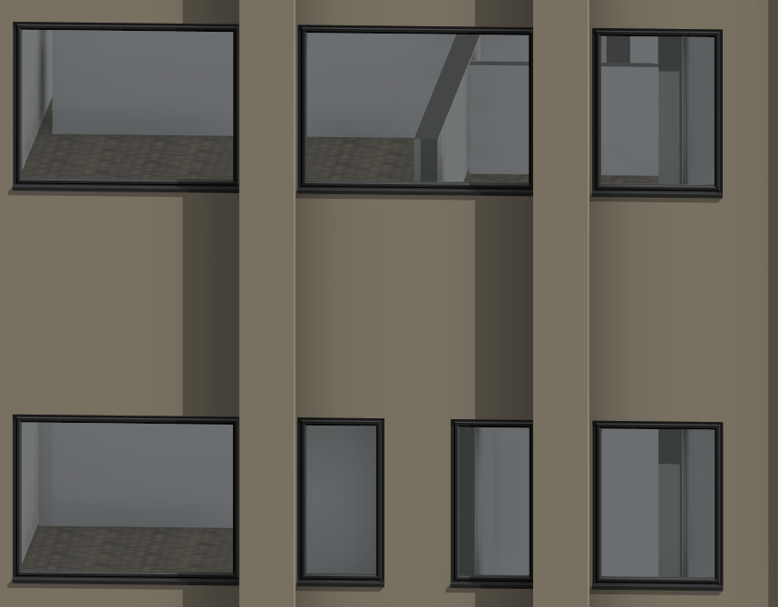
Windows
There are many shapes of Windows
Can selecting particular proprieties of Windows
External windows
17

Slide 18
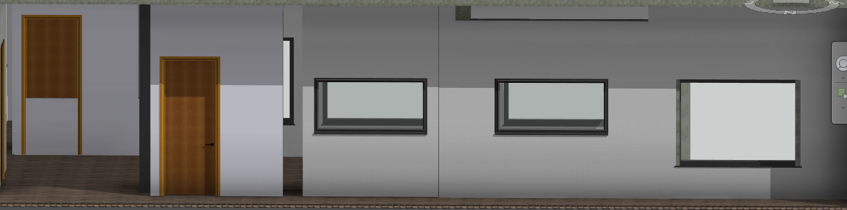
Windows
Internal windows
18

Slide 19
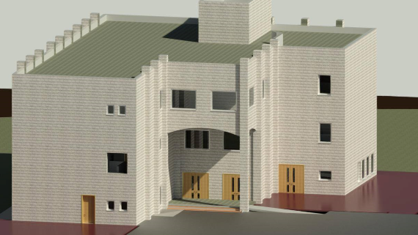
Render
19

Slide 20
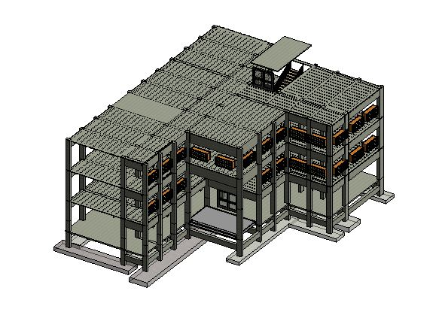
Structural model
Contain Structural Elements
Satisfy the SAFE of the Building
20

Slide 21
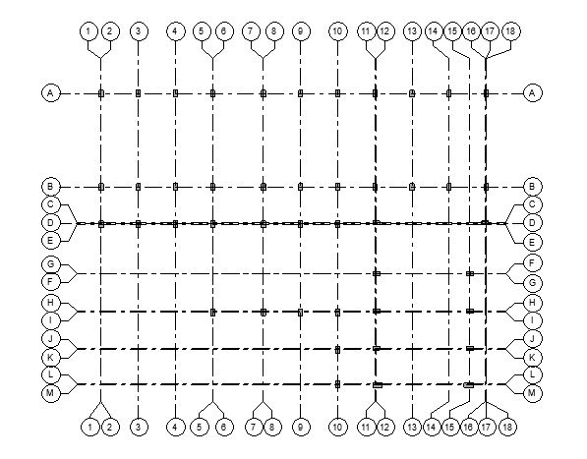
Grid System
Aid to ensure the boundaries of building
columns centerlines.
21

Slide 22
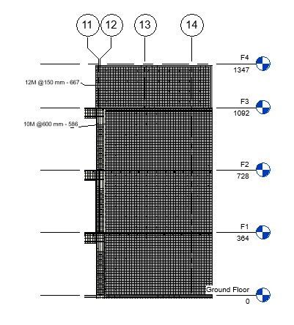
Structural Walls
Walls that carrying the load (Load-bearing walls)
Ability to reinforced
part of shear walls
22

Slide 23
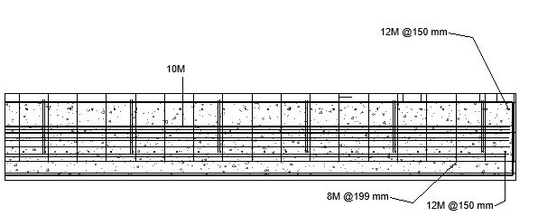
Cross section in shear wall
23

Slide 24
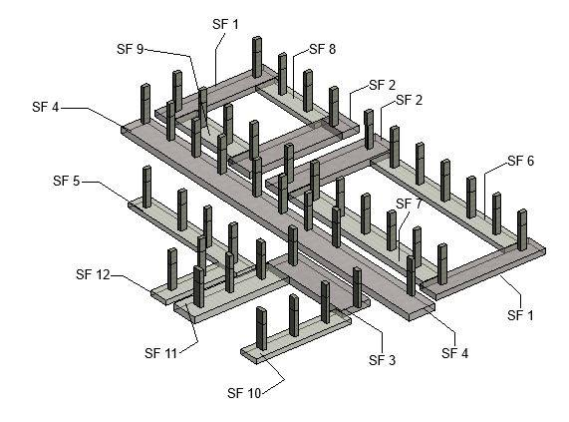
Footing
There are many different type of footing
Footing used in project:
Strip footing
Wall footing
24
Structural footing

Slide 25
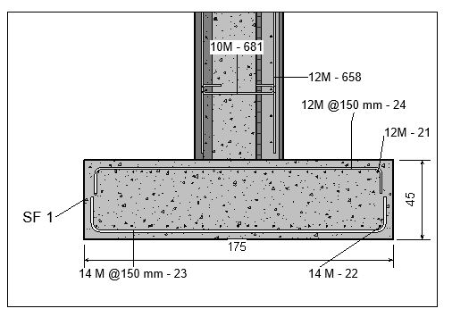
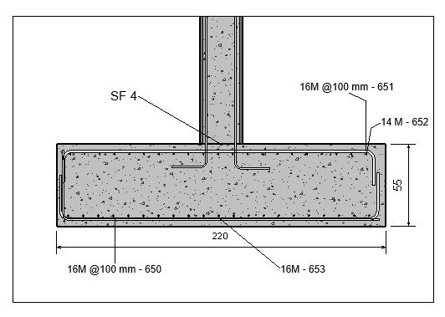
Cross section of footings
25

Slide 26
Columns
Making the different type of columns.
Ability to reinforced
Columns used in project:
C1 30x50
C2 30x50
C3 30x70
26

Slide 27
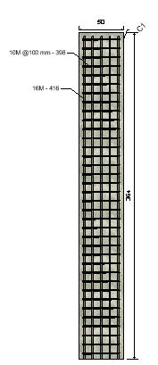
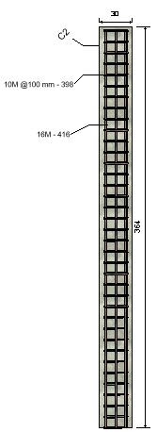
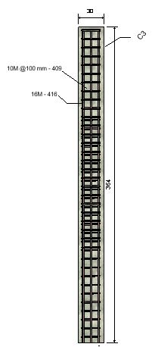
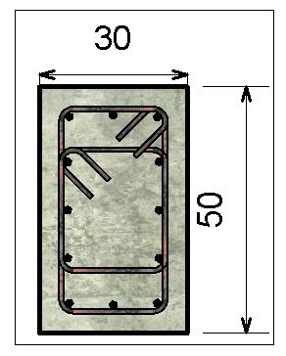
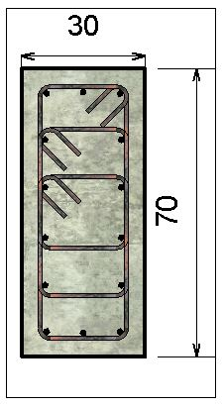
Columns types
27

Slide 28
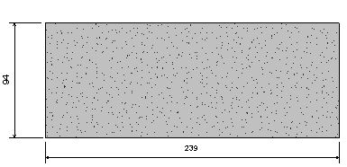
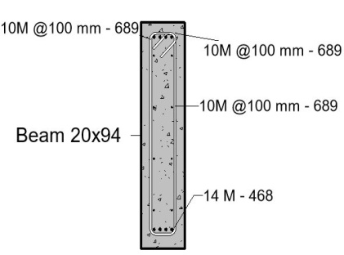
Beams
Making the different type of columns.
Ability to reinforced
Beams Details
28

Slide 29
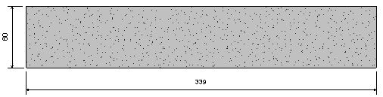
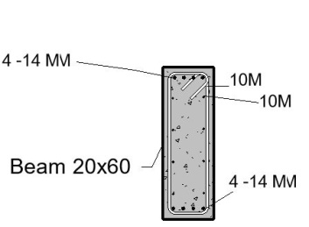
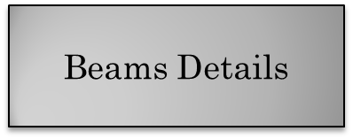
29

Slide 30
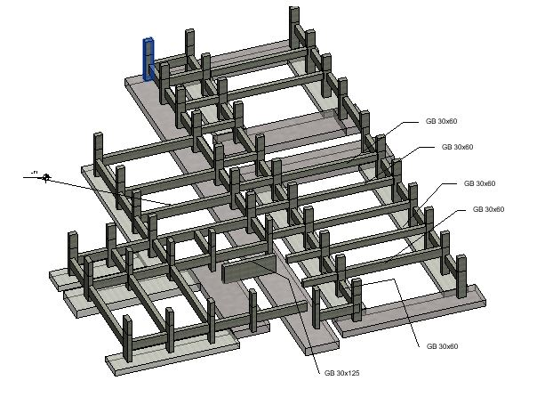
Ground Beams and Neck Columns
30

Slide 31
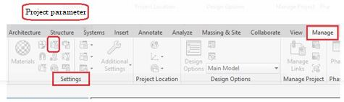
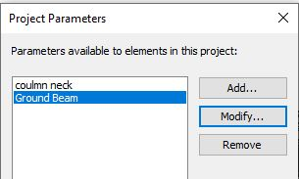
Ground Beams and neck columns
For more specified and sorting elements to achieve the exact quantities we are doing the following:
From manage bars >> Setting list >> project parameters
31
add new elements

Slide 32
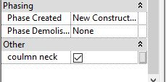
Ground Beams and neck columns
Then select the element and checked the parameter to take encounter
32

Slide 33
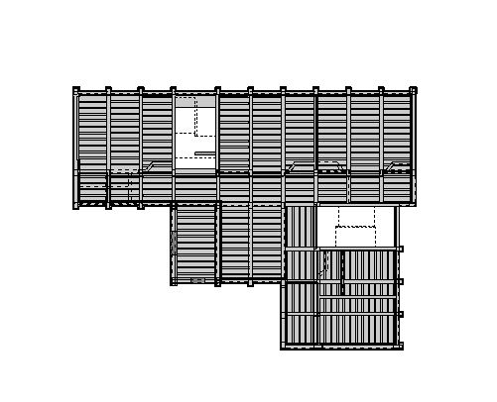
Slabs
Slab used in the project:
Solid slab
One way Ribbed Slab
One way ribbed Slab
33

Slide 34
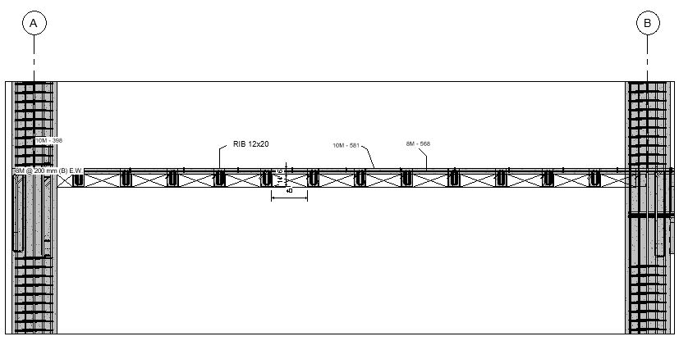
Ribbed slab Section
34

Slide 35
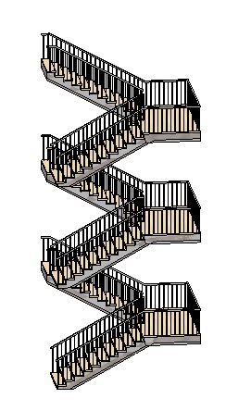
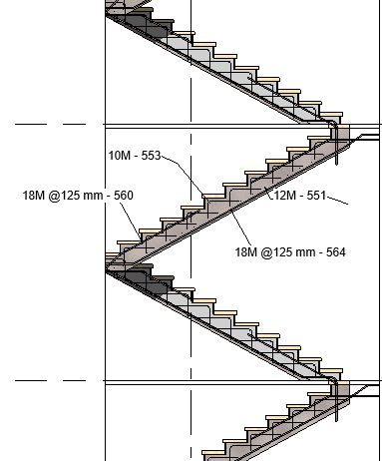
Stairs
Stairs Details
35

Slide 36
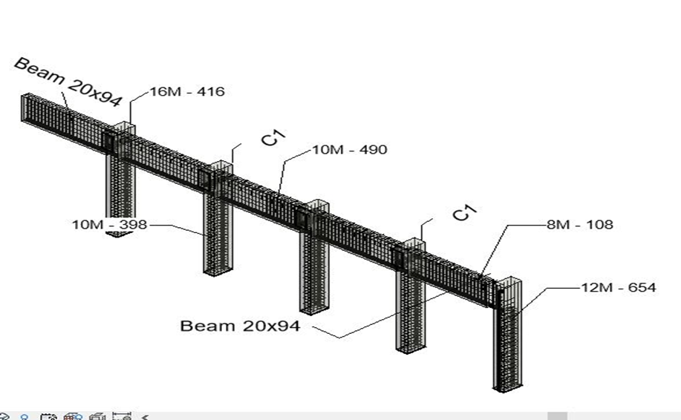
Structural Rebar
Structural rebar used to reinforce all structural elements to enhance reality simulation.
36

Slide 37
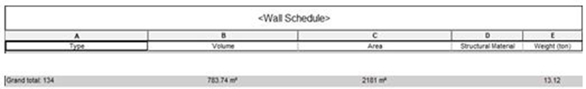
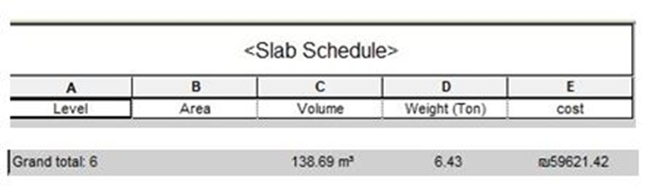
Revit output
The main output that obtained from Revit is quantity surveying as shown:
37

Slide 38
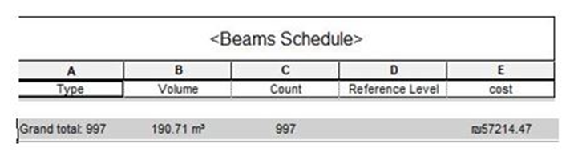
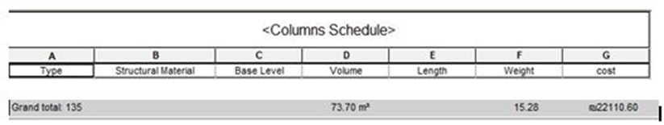
38

Slide 39
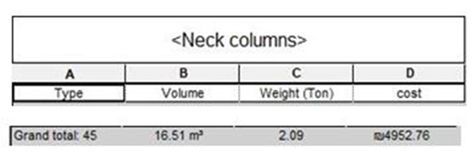
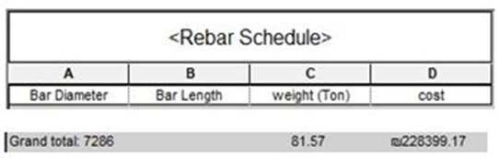
39

Slide 40

MANAGING PROJECT USING PRIMAVERA
40

Slide 41
Primavera Software
Objectives
Input
Output
41

Slide 42
Primavera Objectives
Enhance the management and controlling the project
Time schedule estimate
Budgeted cost estimate
Earned value analysis
42

Slide 43
Primavera input
Activity of project
Activity relation
Expenses
43

Slide 44
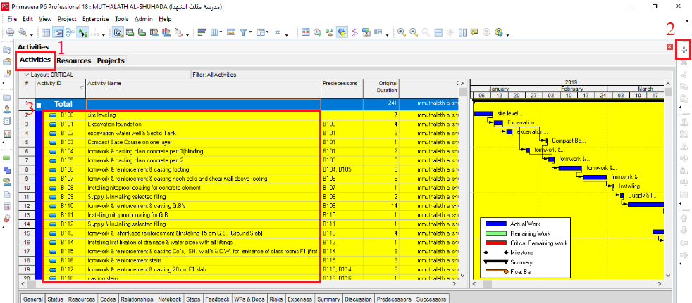
Activity of project
44

Slide 45
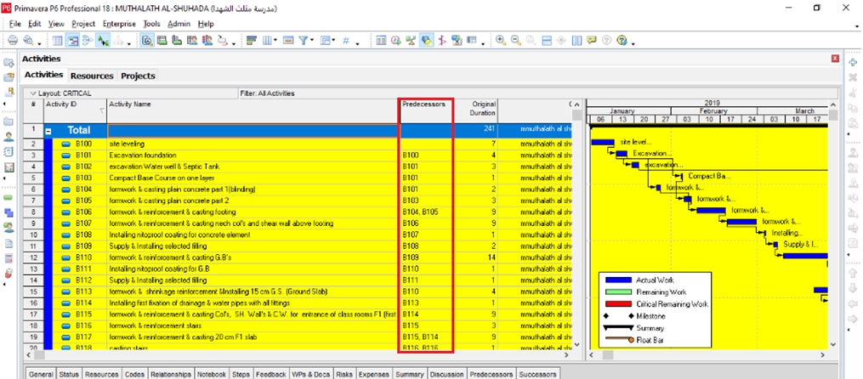
Activity Relation
45

Slide 46
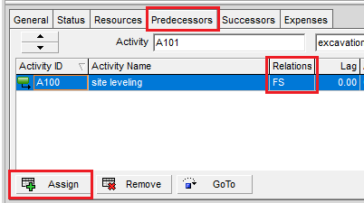
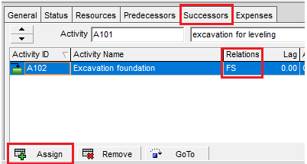
Activity Relation
46

Slide 47
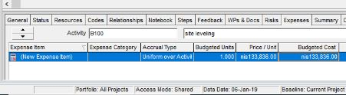
Expenses
      Expenses are the cost incurred in or required for something.
      Aid to facilitate and quickly estimation
.
      Expenses for site leveling
47

Slide 48

Expenses
the total cost was estimated for site leveling = 47650 + 86186 = 133838 ₪ as shown:
Part of sheet excel estimation list
48

Slide 49
Primavera Output
Bar Chart
Time schedule
Budgeted cost
S-curve
49

Slide 50

Primavera Output
Bart chart
50

Slide 51

Primavera Output
Sec C-C
51

Slide 52

Primavera Output
Time schedule
The total duration of project is 241 working days.
52

Slide 53

Primavera Output
      Budgeted Cost
The total budgeted cost of the project is 2,123,273 ₪
53

Slide 54

Primavera Output
      S-Curve
54

Slide 55

naviswork
55

Slide 56
Navisworks Software
Navisworks Software
Objective
Input
Output
56

Slide 57
Navisworks objective
Navisworks allows users to open and combine 3D models, navigate around them in real-time
Review the model using a set of tools including comments, redlining, viewpoint, measurements.
A selection of plug-ins enhances the package adding interference detection, 4D time simulation
57

Slide 58

Navisworks Input
58

Slide 59

59

Slide 60

Navisworks Input
60

Slide 61

Navisworks Output
61

Slide 62

62

Slide 63

ASSESSMENT
      A comparison has been achieved between the total cost and duration that estimated by the contractor and the budgeted total cost and duration that estimated by this study.
      .
      :
As shown above there was an over budget cost about 244,874 ₪
63

Slide 64

ASSESSMENT
There was a delay of 125 working days which gives an indicator that the most important reason for the over budget occurred in the total budget cost during the executing of the project.
64

Slide 65


Slide 66


