Slide 1
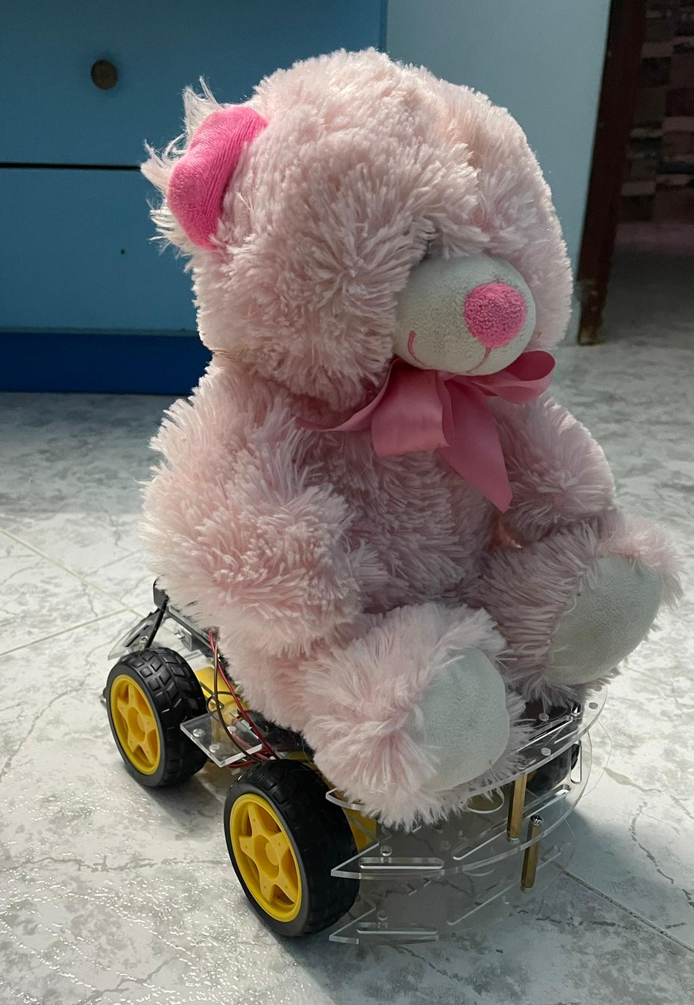
Smart
Doll

Slide 2
Our Team
Reem Dalab
Ali Yaseen

Slide 3
Table of Contents
01
02
03
04
05
06
07
Our Team
Motivation
Project Details & Hardware
Project Development Stages
Demo
Conclusion and Future Work
Constraints and Challenges

Slide 4
Motivation
In today's fast-paced world, maintaining a strong relationship between parents and their children is extremely important, especially for children with autism. However, busy schedules and physical separation can often present greater challenges to this vital bond for individuals with autism. Hence the idea of ​​the smart doll, which aims to bridge the gap between parents and their children

Slide 5
Project Details
The doll will have four main features:
Doll Movement
Voice Recording
The doll moves in four directions and is controlled through the website .
The child will speak to the doll and she will in turn repeat his words.

Slide 6
Project Details
Video Streaming
Moving Hands
The web page displays the video that is being filmed through the camera on the doll, so the web page is the client that communicates with the server, which in turn displays the video on the web
The doll moves its hands in sync with its repetition of the sound as a kind of interaction with the child.

Slide 7
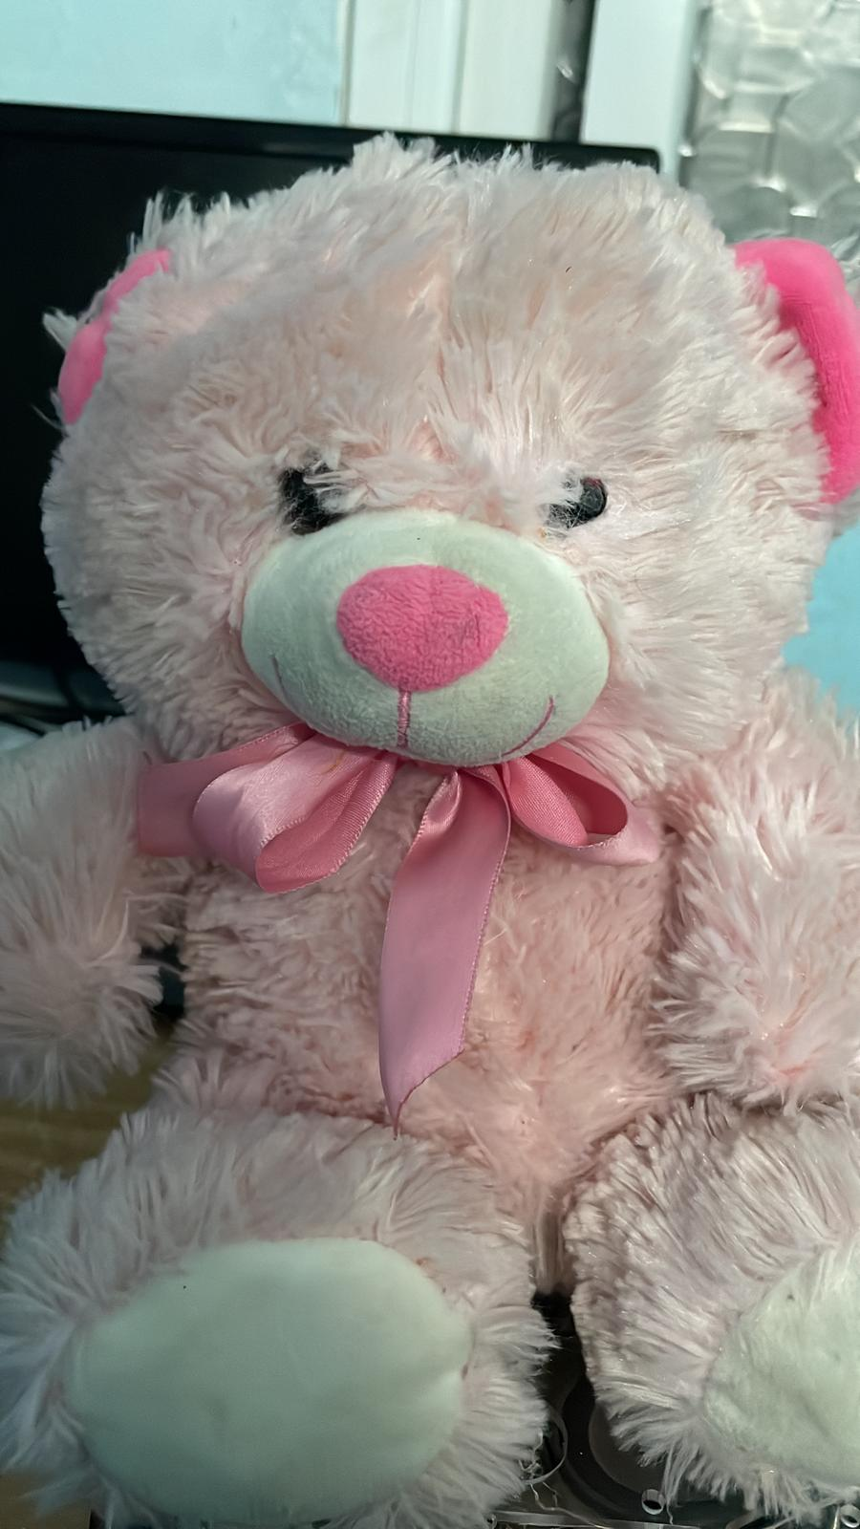
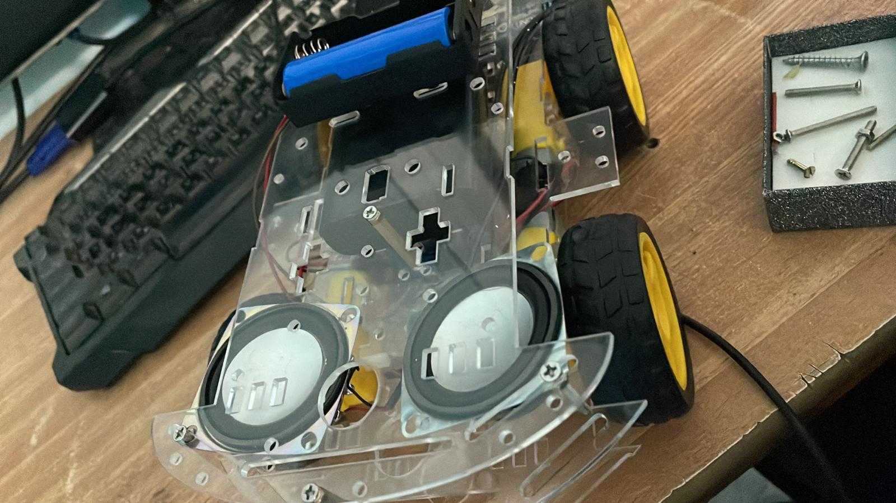
Project Details Cont.

Slide 8
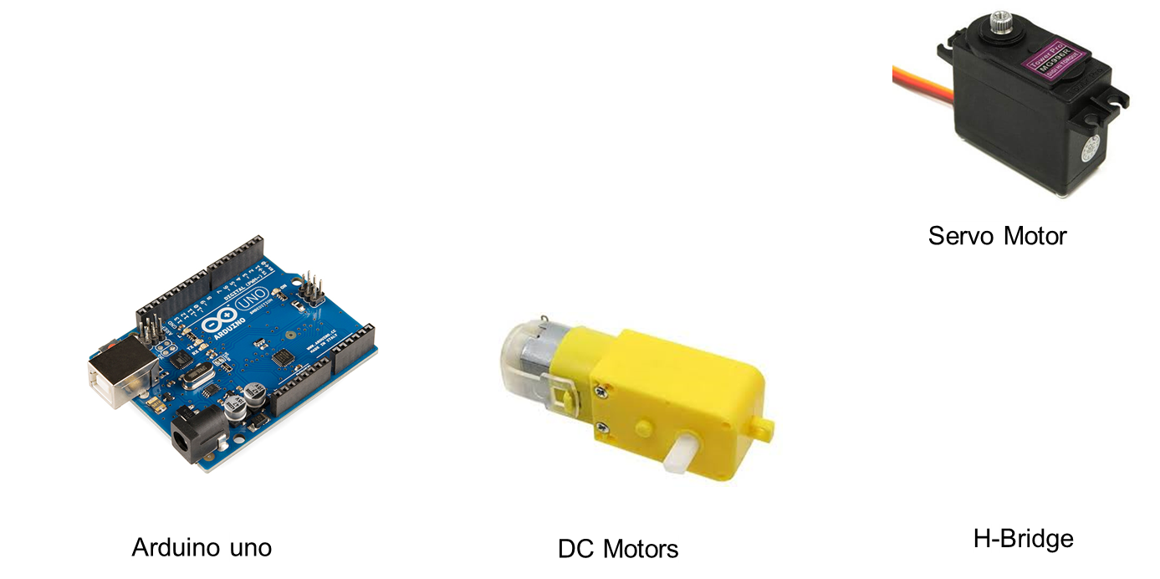
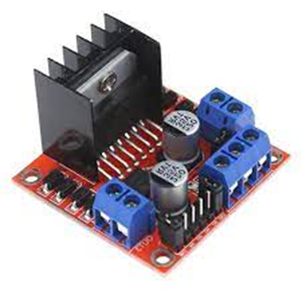
Hardware Structure
Car Structure
H-bridge

Slide 9
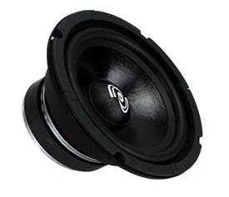
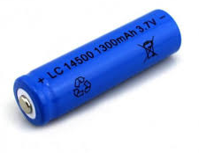
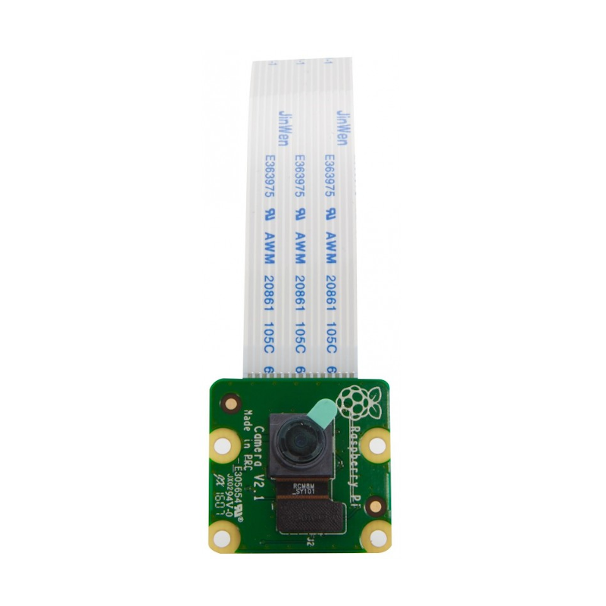
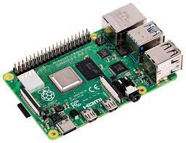
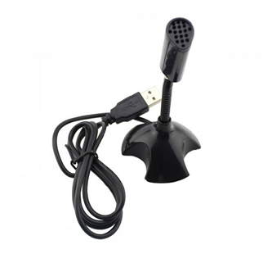
Hardware Structure Cont.
Car Structure
Lithium Batteries
Speaker
Raspberry Pi 3
Voice Recognition
Pi Camera V2

Slide 10
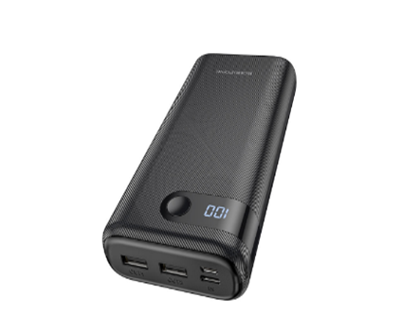
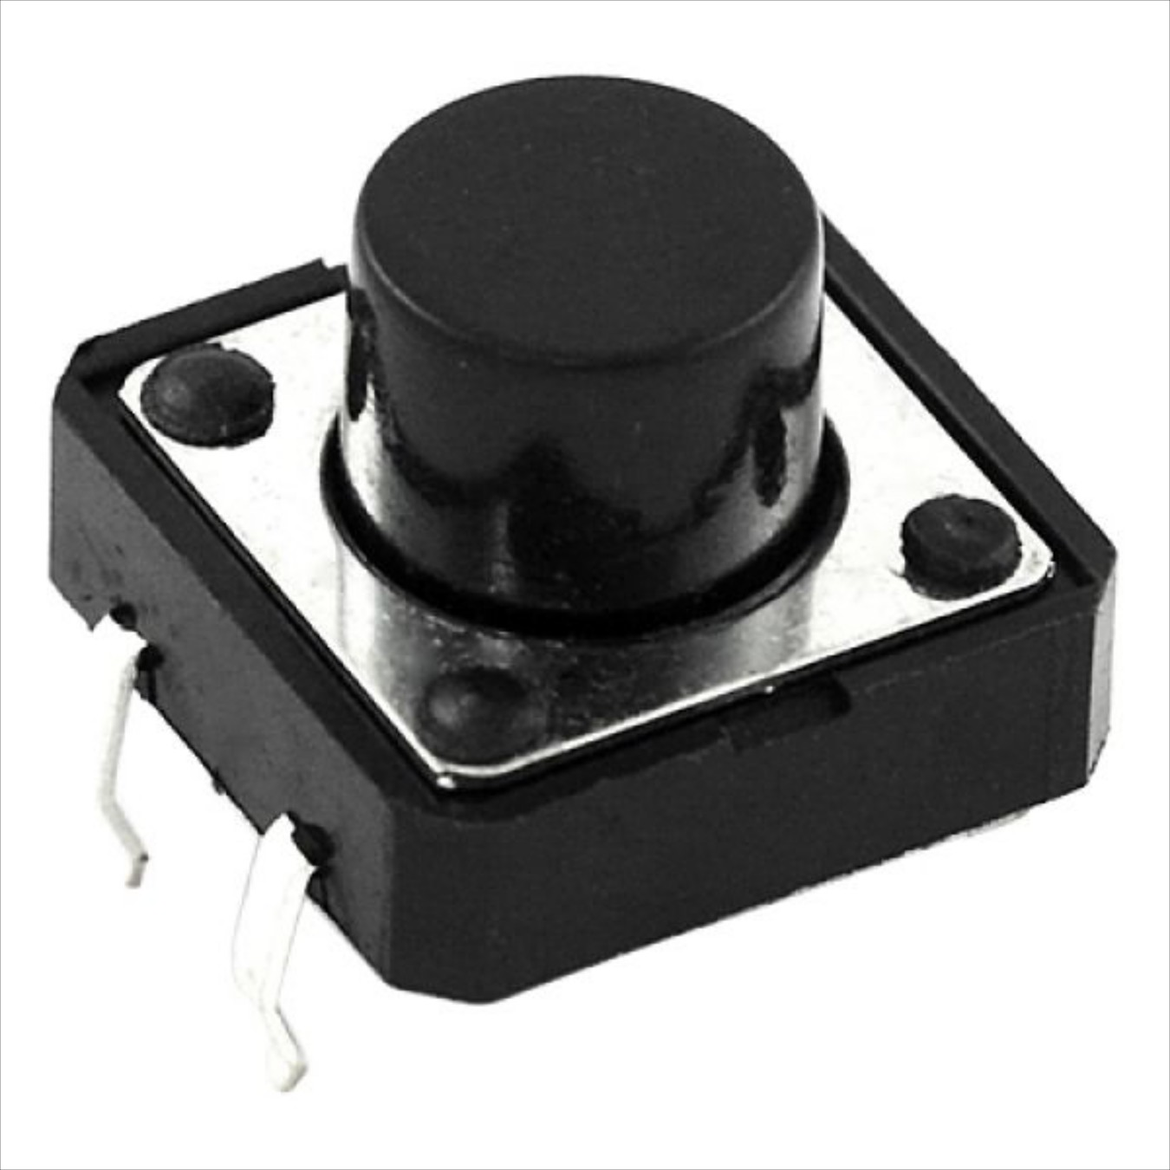
Hardware Structure Cont.
Push button
Power bank

Slide 11
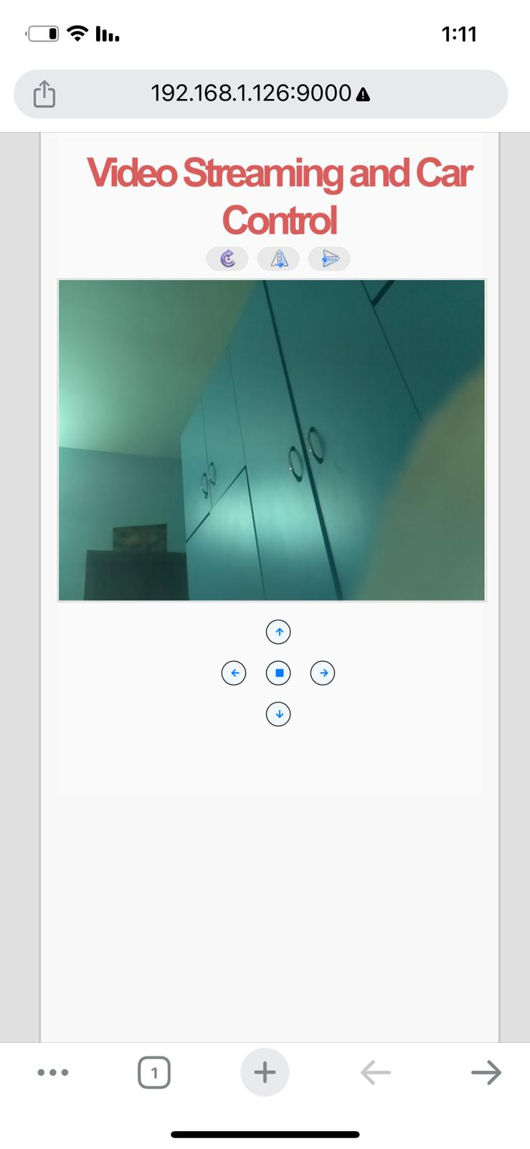
Website
We built a webpage in html and css, the page contains a screen showing a live video of what is being filmed through the camera on the doll, and it also contains 5 buttons to control the movement of the doll in all directions (forward, behind, right, left, stop button)

Slide 12
Project Development Stages
Building & Developing Car Movement
Developing Voice Recognition
01
02
03
04
Developing Camera module
Developing Hand movement

Slide 13
Conclusion and Future Work
Future work includes the ability to ask the doll many questions that will be able to answer, with the aim of benefiting from it in teaching children, developing their languages, and social communication.

Slide 14
Constraints and Challenges
Hardware problems: Servo Motors.
Raspberry Pi availability .
Limited weight on the robot.
Time.
Integration Challenges:Connecting the Raspberry Pi with the Arduino posed technical difficulties.

Slide 15
Demo

Slide 16
Thanks for listening
Any questions?

