Slide 1

ML
STORE
BOX
Layan Othman&Muna khwaireh

Slide 2
Introduction
1
Project Execution
  2
AGENDA
  3
Hardware Component
Mobile Application
  4
  Constraints
  5
  Future Works
  5
  6

Slide 3
1
INTRODUCTION
AN-Najah University | 2024

Slide 4
2
PROBLEM
First Problem
Third Problem
The street system in Palestine is unclear and undefined.
The customers are not present at the time of delivery at their homes.
Second Problem
Efforts to contact customers via phone calls.

Slide 5
3
OBJECTIVES
  Accuracy.
  Time saving.
  24/7 availability.
  Efficient route planning.
  Environmental impact.
  Secure storage.

Slide 6
2
PROJECT EXECUTION
First idea
second idea
1.Stepper motor with gear box
2. 3d printed gears same size
3. 4*4 the size of the machine
  wiper motor
2. wiper motor
3. iron gears , one different size
4. 3*3 the size of the machine
AN-Najah University | 2024

Slide 7
5
HARDWARE COMPONENT
AN-Najah University | 2024

Slide 8
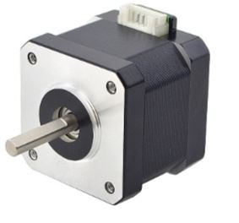
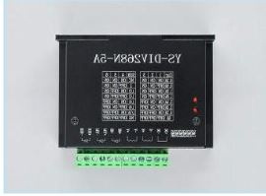
Motors and drivers:

Slide 9
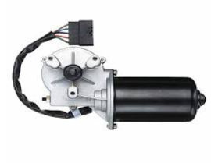
Motors and drivers:

Slide 10
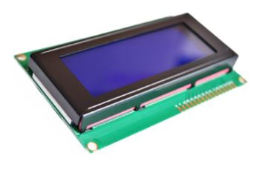
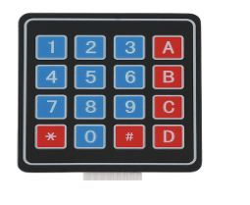
Input/Output Components:

Slide 11
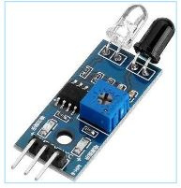
Input/Output Components:

Slide 12
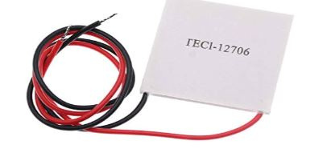
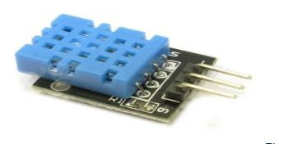
Input/Output Components:

Slide 13
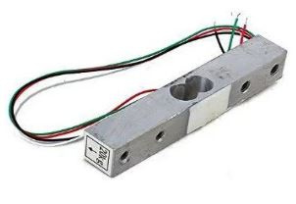
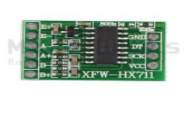
Input/Output Components:

Slide 14
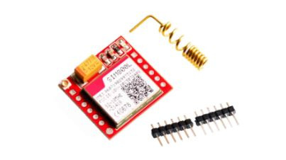
Input/Output Components:

Slide 15
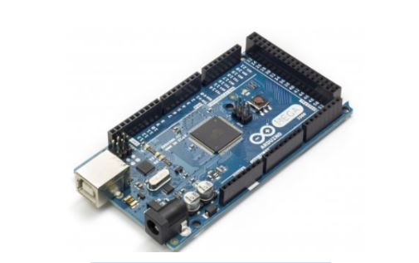
Microcontrollers

Slide 16
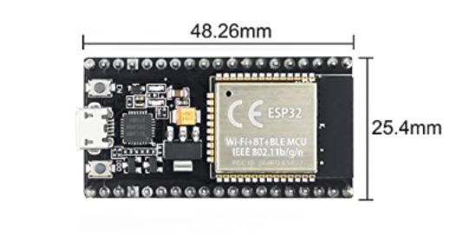
Microcontrollers

Slide 17


4
MOBILE APPLICATION
AN-Najah University | 2024

Slide 18
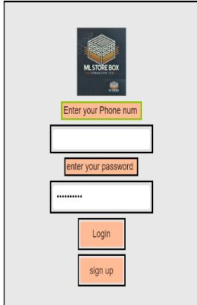
ADMIN PAGE:

Slide 19
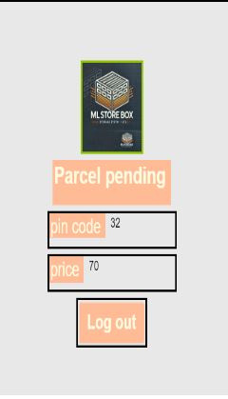
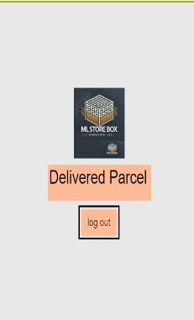
USER
PAGE:

Slide 20
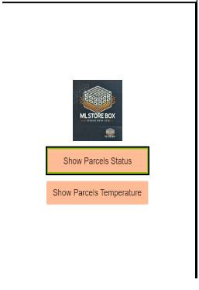
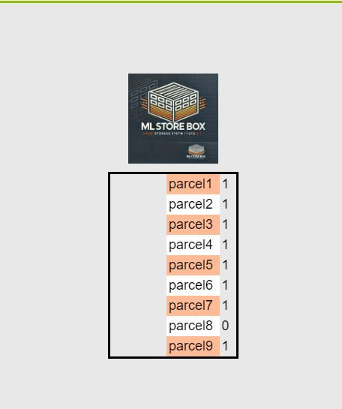
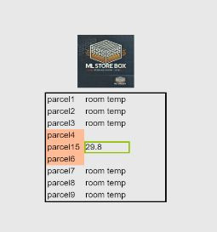

Slide 21
CONSTRAINS

Slide 22
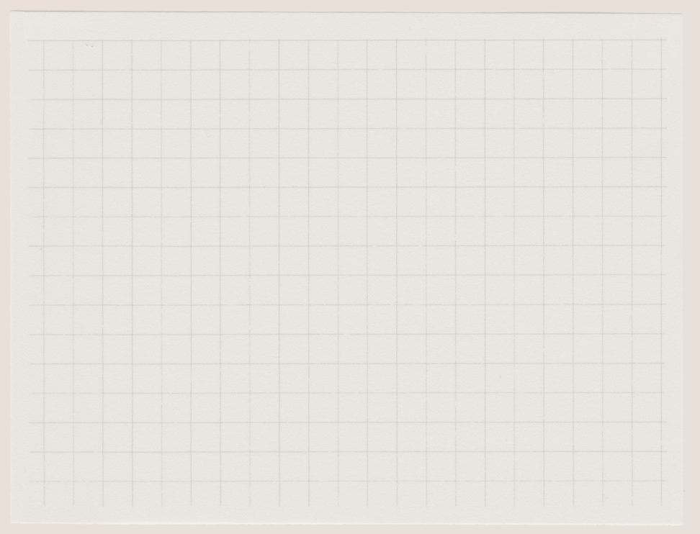







  constrains
01
02
03
04
Balance and weight calculations.
Low signal problem with the GSM.
Providing power to the various components.
.
app inventor with firebase.

Slide 23
FUTURE WORK

Slide 24
FUTURE WORK
1
Use material stronger than wood for more security.
2
Adding frozen parcels
AN-Najah University | 2024
3
credit card and cash payment system.
4
Barcode scanner

Slide 25
AN-Najah University | 2024
THANK YOU
Presented By : Muna khwaireh
Layan Othman

