Slide 1

AN-NAJAH
NATIONAL UNIVERSITY
Abed EL Ruhman Badwan
Sharief Mohammed
Ahmad Shtaya

Slide 2
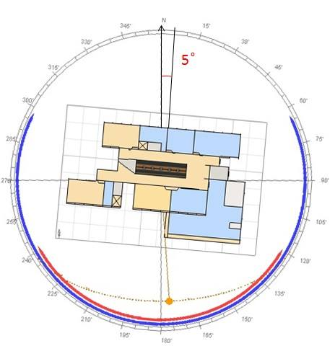
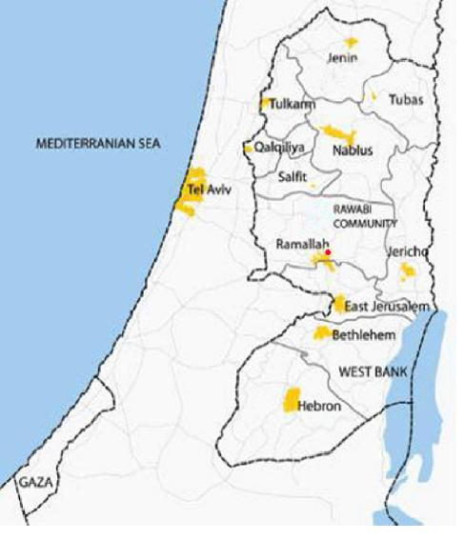
Project Information

Slide 3
Contents
Design Concept
Functional Distribution
Structural Elements and loads
Thermal Properties
Natural Ventilation
Daylight Analysis
Acoustical Design
Water supply and Drainage system
Fire exists
Artificial Lighting

Slide 4
Architectural
Design

Slide 5
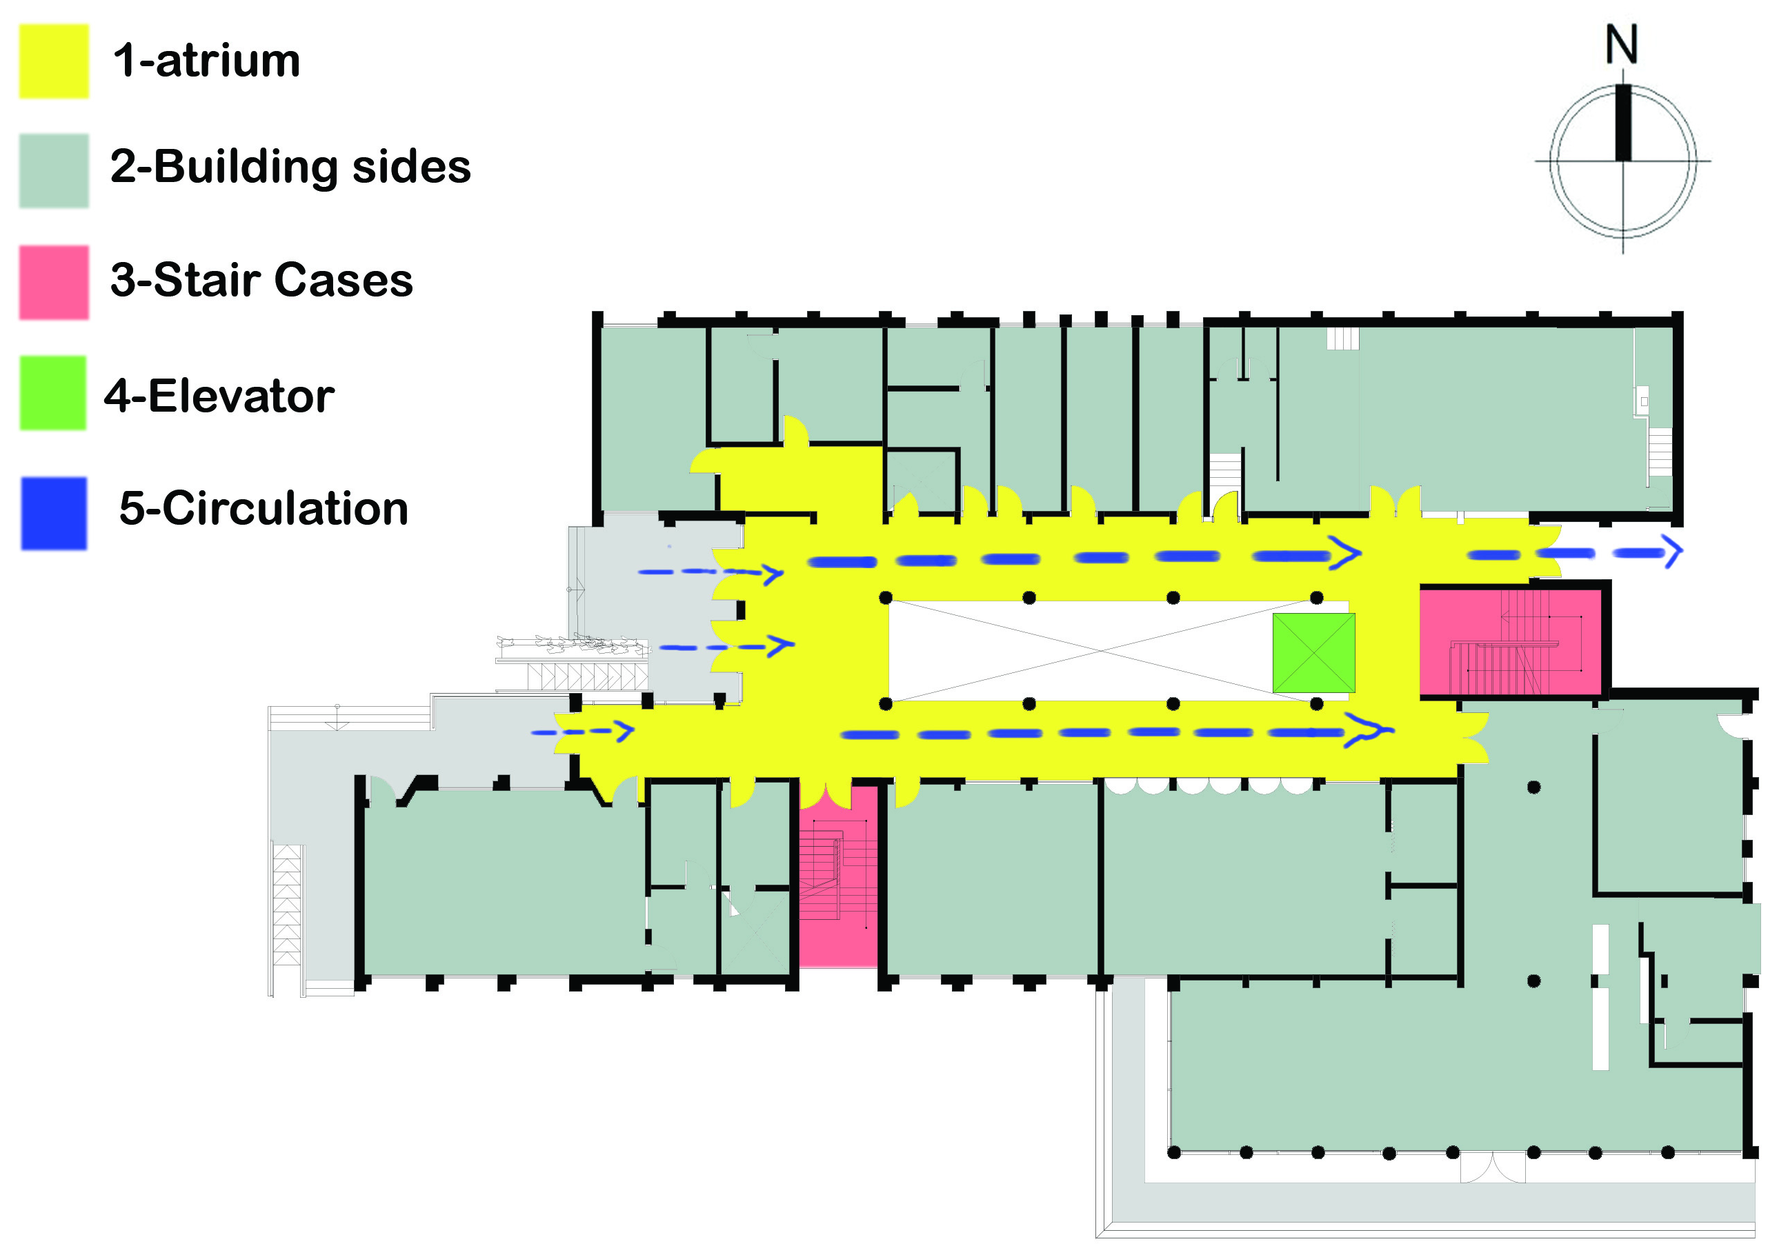
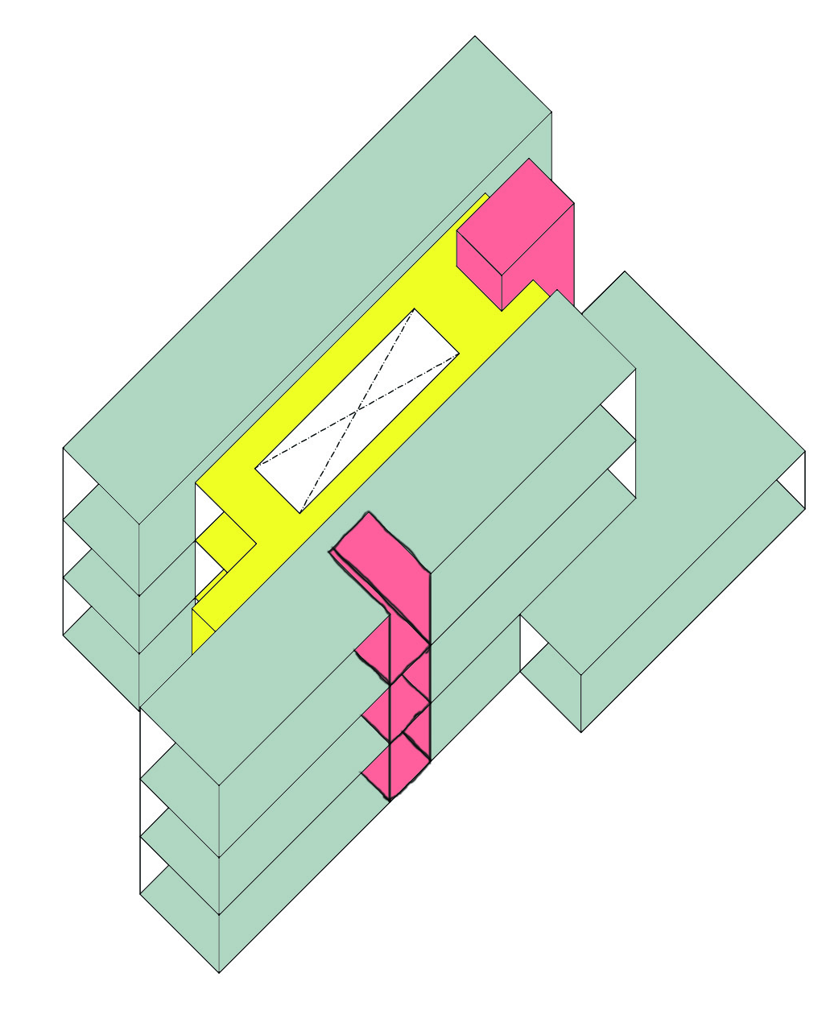
Design Concept
The design based on :
1- The best orientation
2- Circulation
3- Ventilation

Slide 6
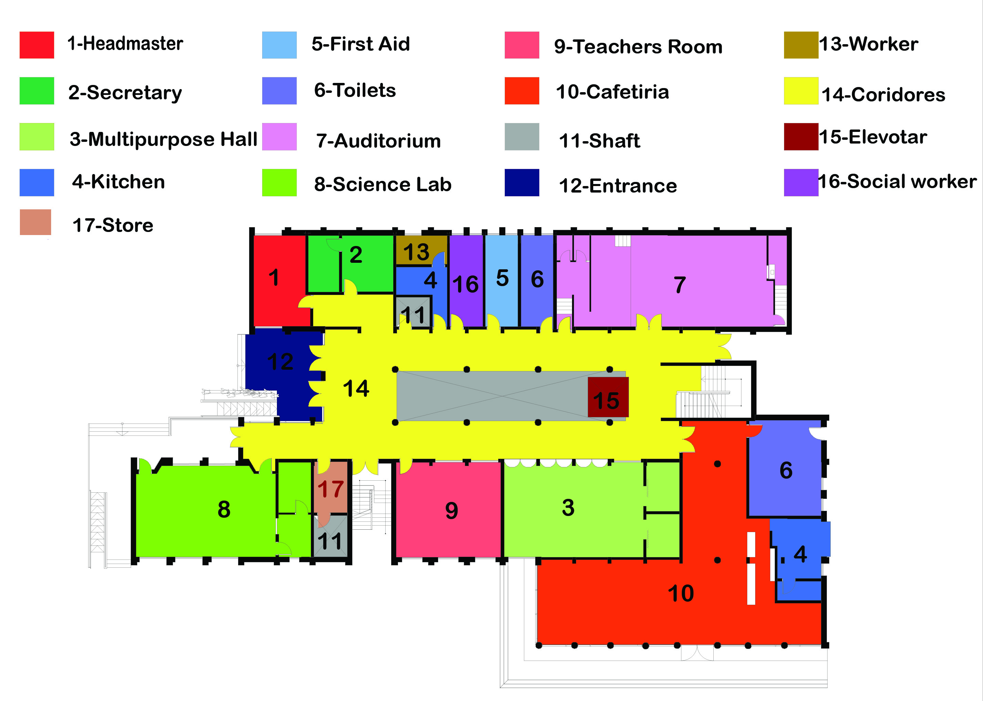
Functional Distributions
Ground Floor

Slide 7
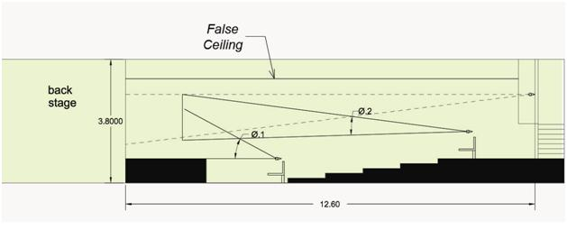
Auditorium
Side View

Slide 8
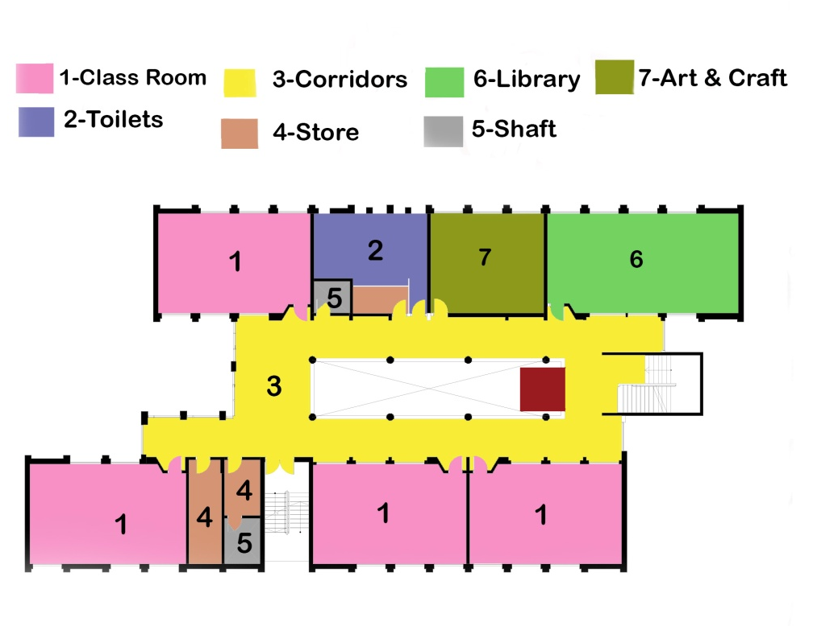

Functional Distribution
First Floor
Second Floor

Slide 9
Structural
Design

Slide 10
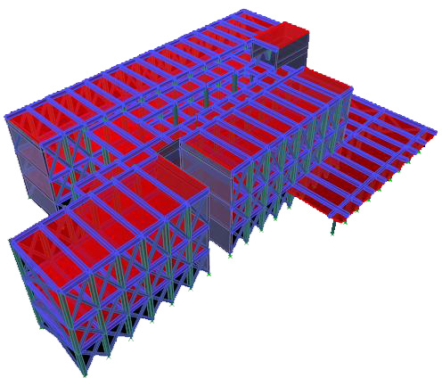
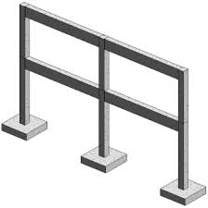
General Notes
ƒc= 300 Kg/cm2
Fy=4200 Kg/cm2

Slide 11
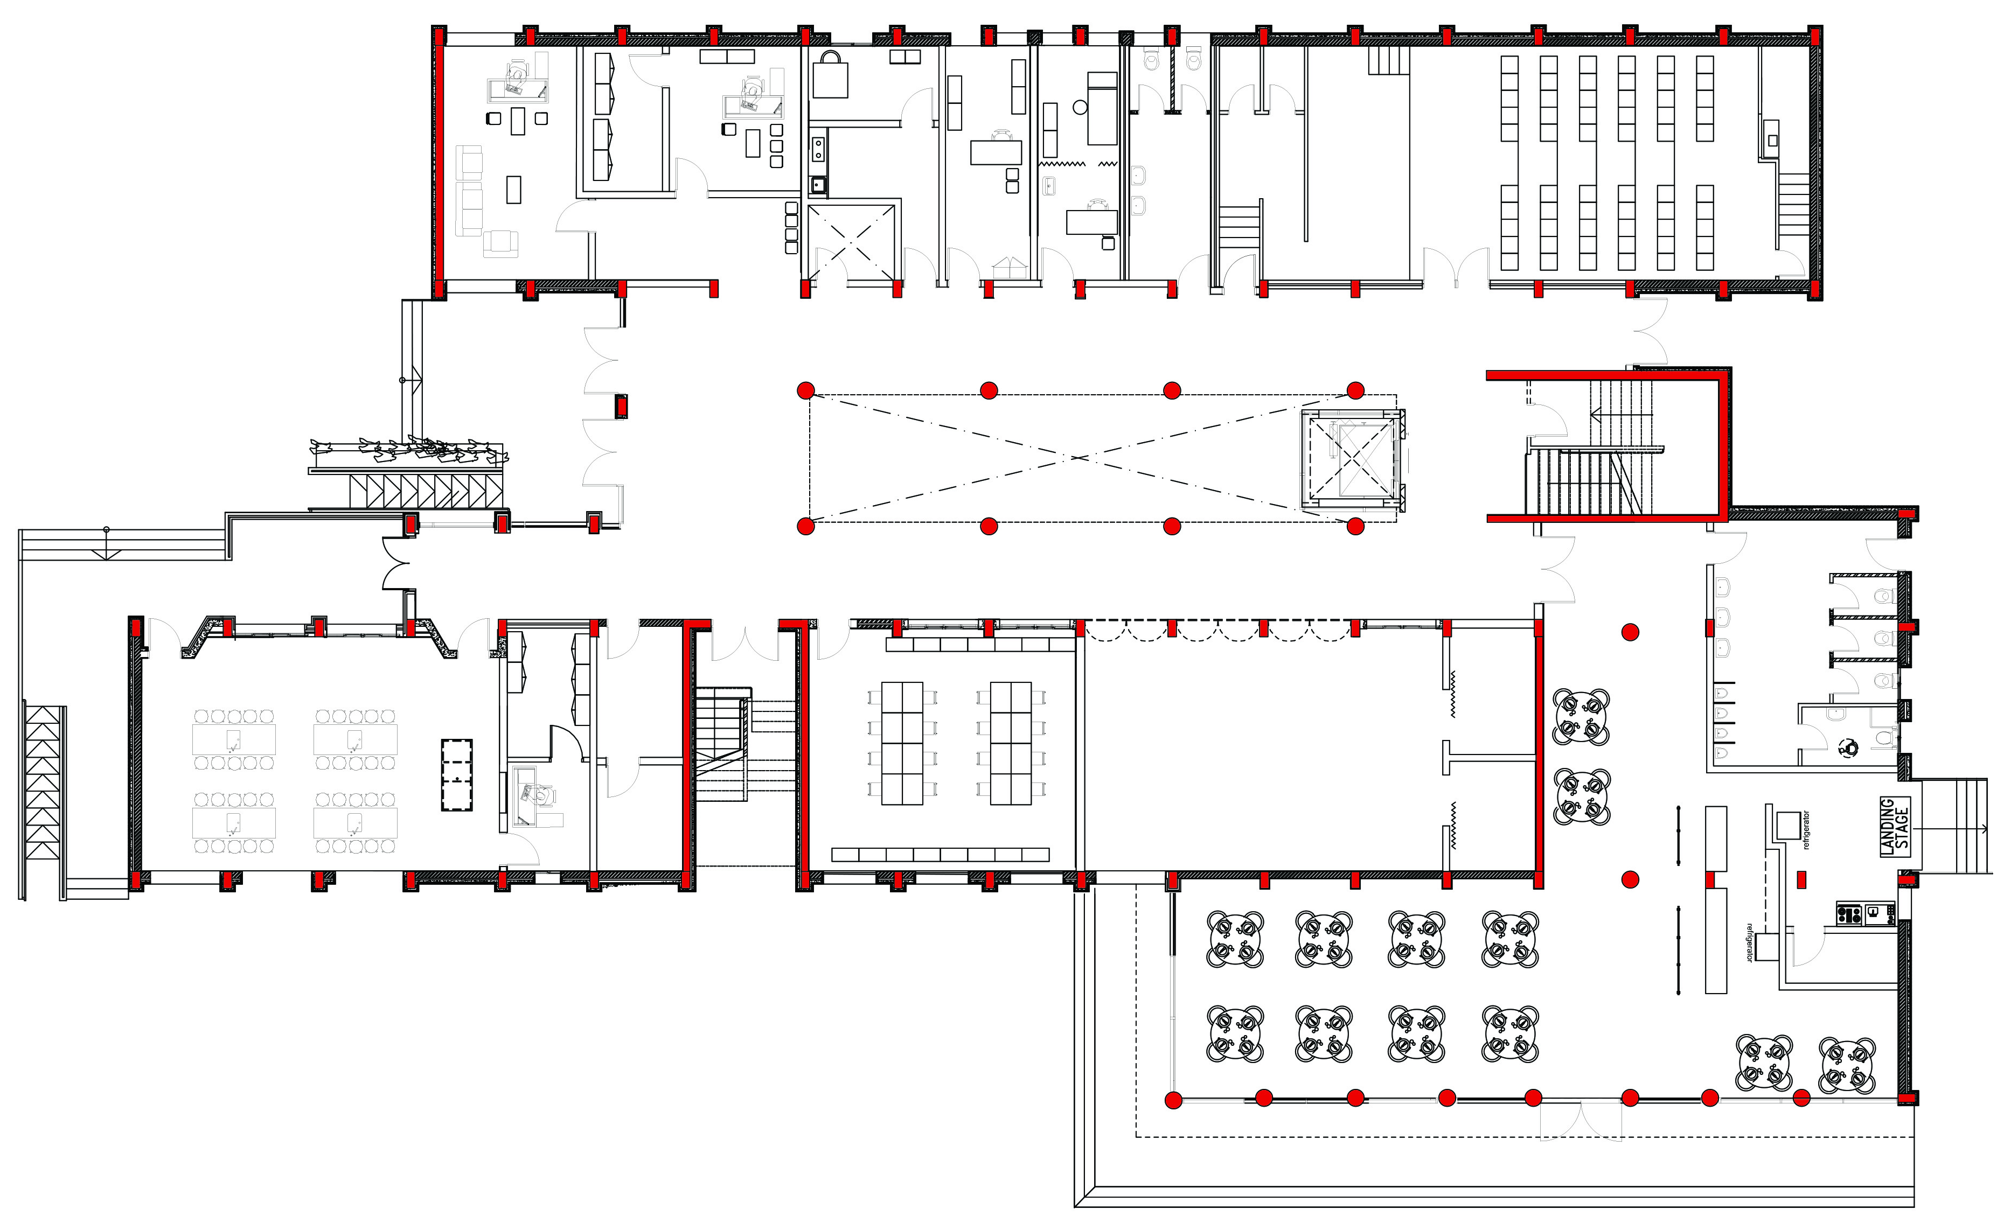
Structural-Elements

Slide 12
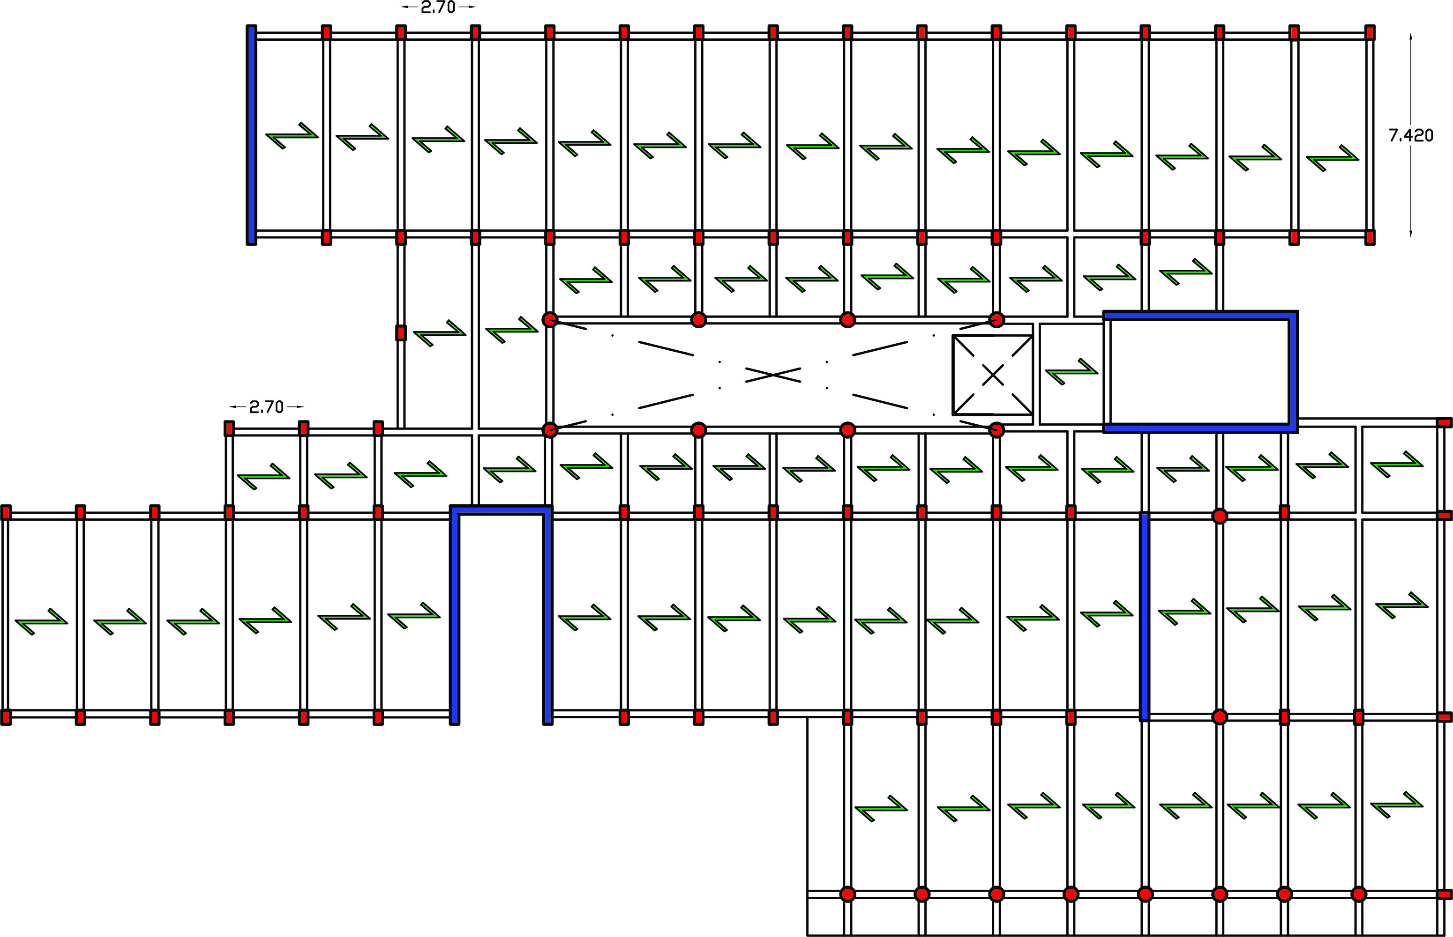
Load Distributions

Slide 13
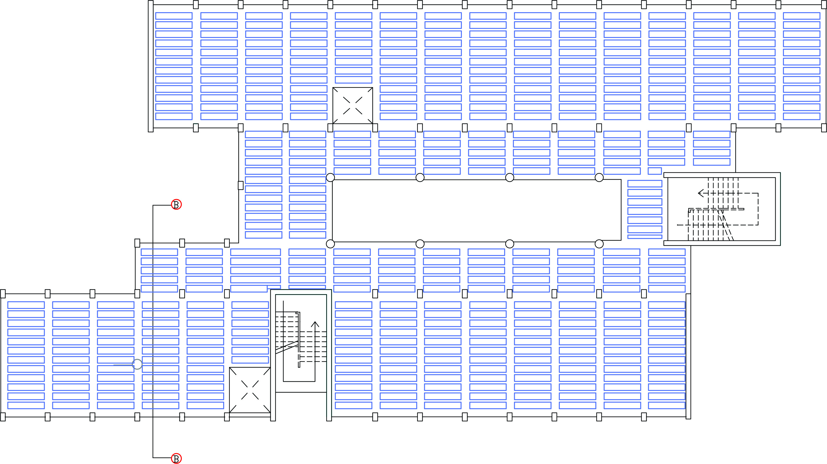
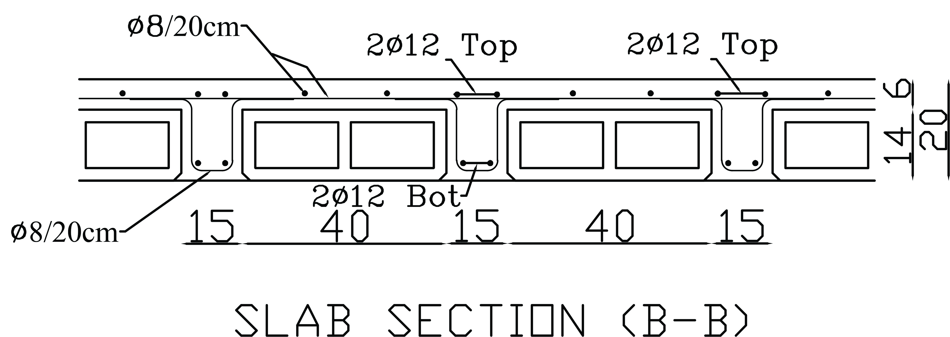
Slab Systems

Slide 14
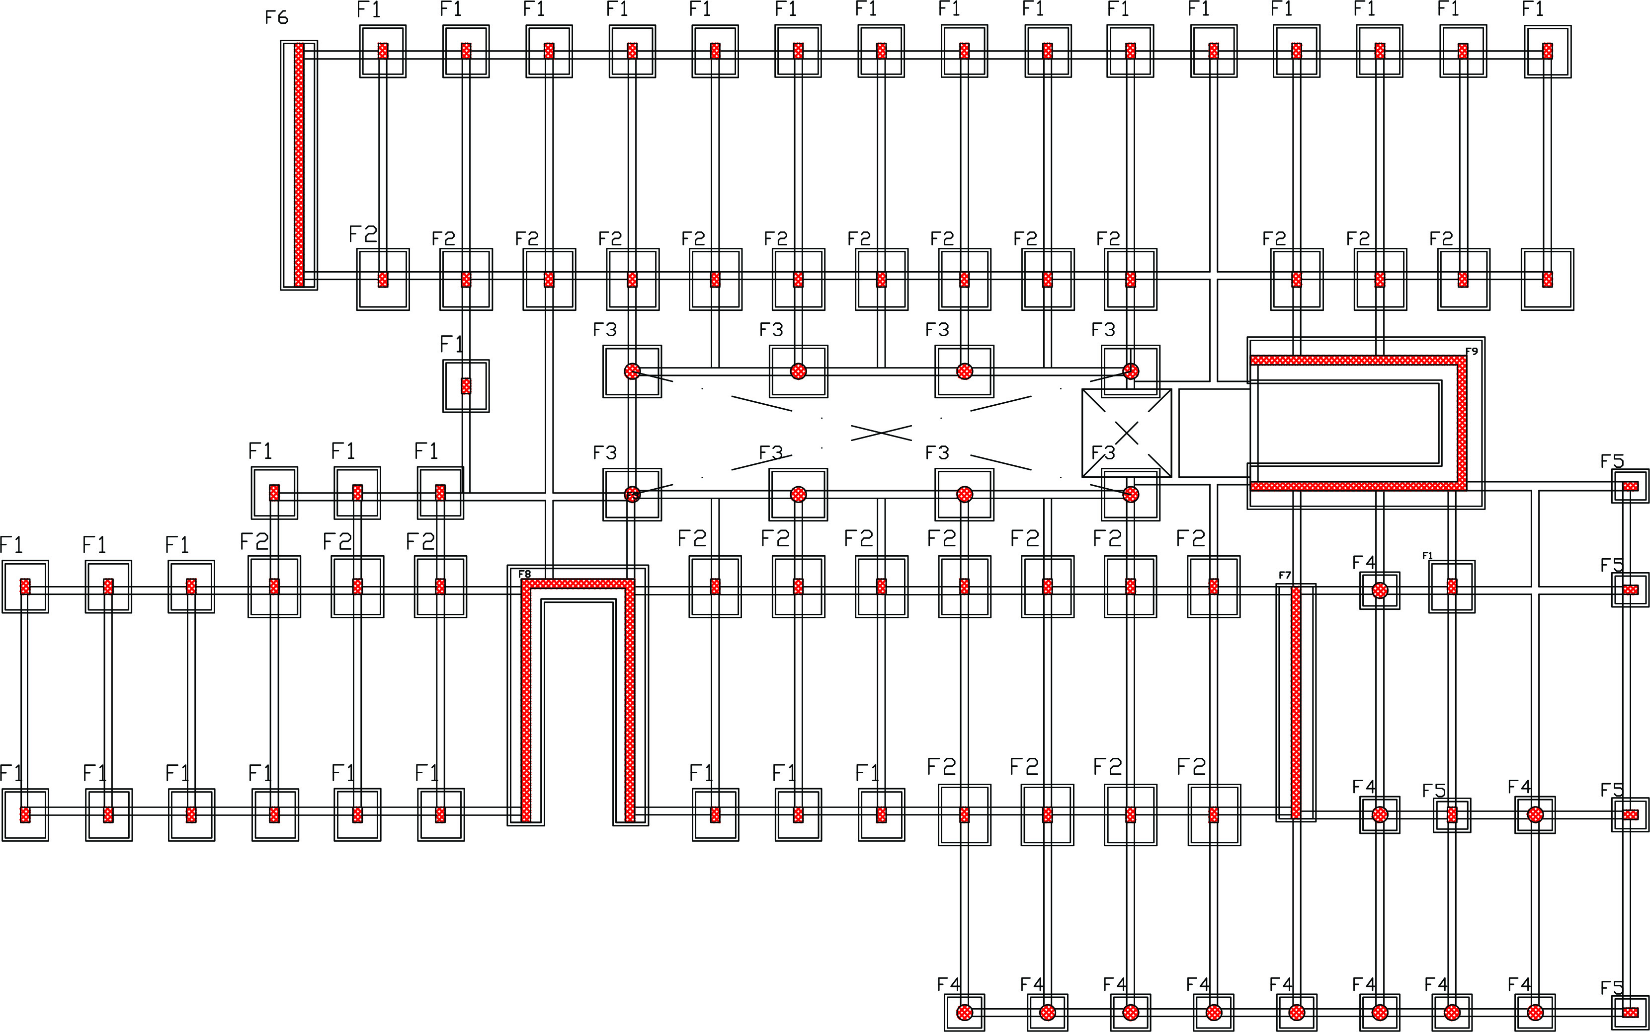
Footing Layout
q all= 200 KN/m2
Soil Profile : very denies soil

Slide 15
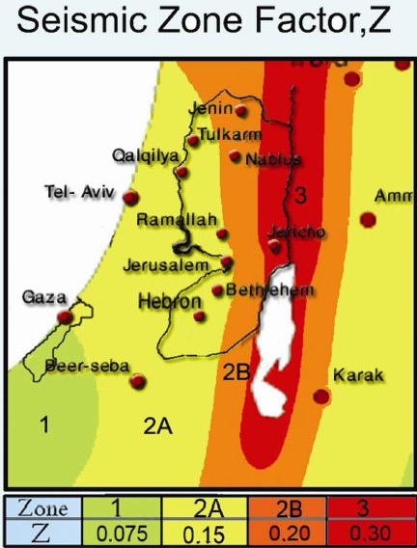
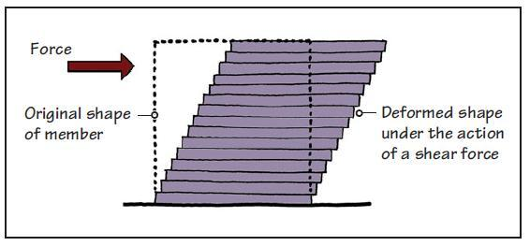
Seismic Design
Factor affects seismic design :
-Location and ground motion
-Soil Type
-Building occupancy’s risk category
-Building’s mass and ductility of the structural frame
-Building shape and dimensions

Slide 16
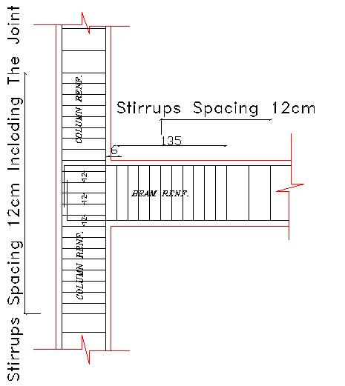
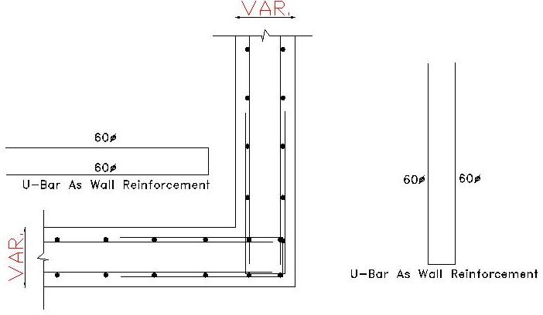
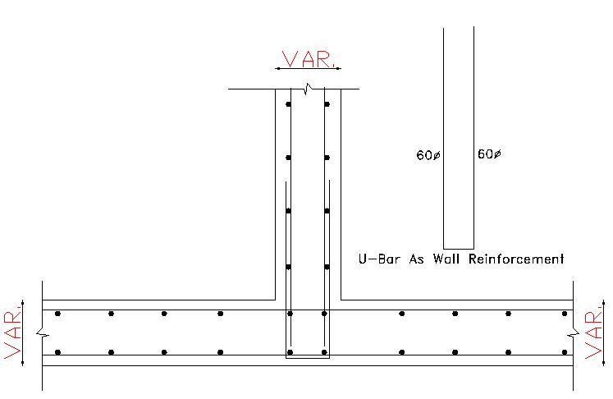
Details Notes

Slide 17
Environmental Design

Slide 18
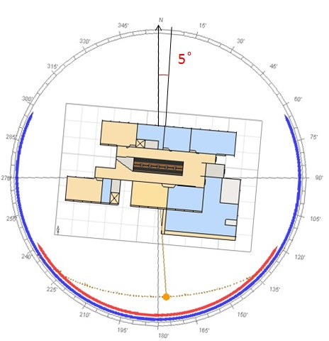
Qalqelia
latitude 32.1
longitude 34.7

Slide 19
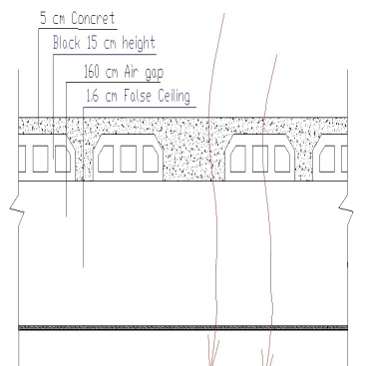
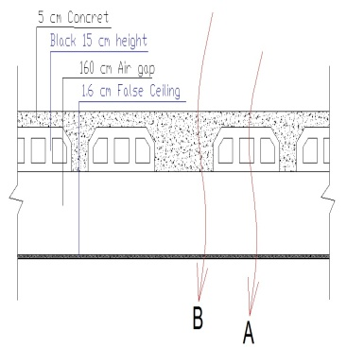
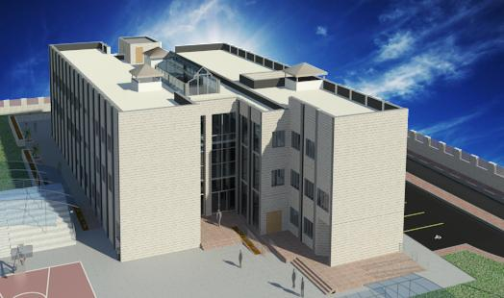
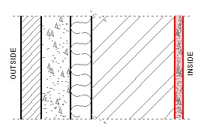
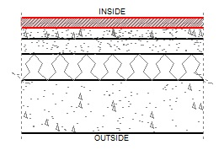
Single Glass
U = 6
LT = 75%
`
External Roof 2
U=0.3
External Roof 1
U=0.32
`
Light Gold
U = 2.6
LT = 30%
External Wall
U=0.33
Double Glass
U = 2.4
LT = 61%
`
`
External Floor
U=0.37

Slide 20
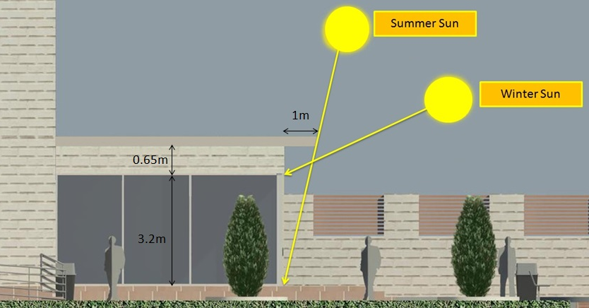
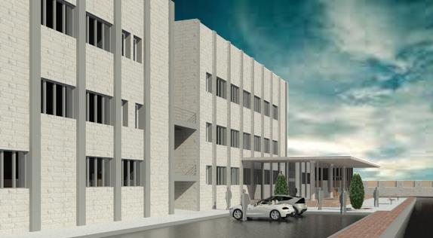
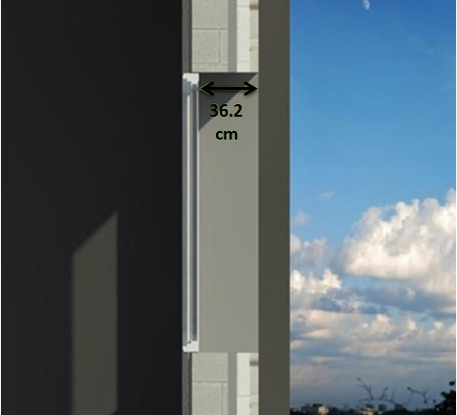
Shading
1- Horizontal Sun Shine
Breaker
No need for southern Window
`

Slide 21
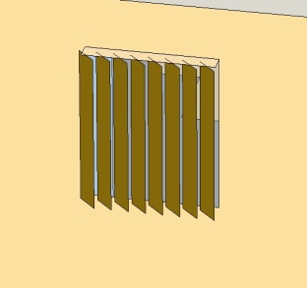
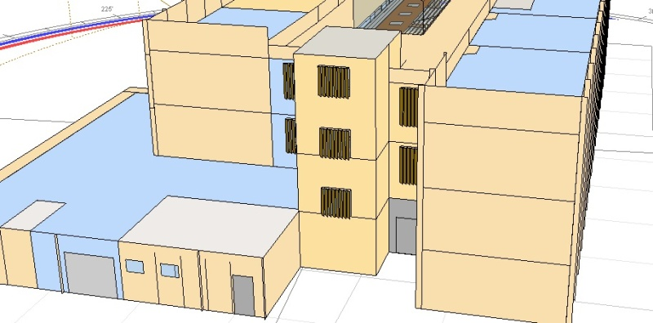
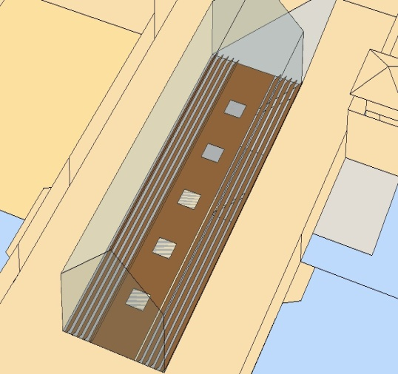
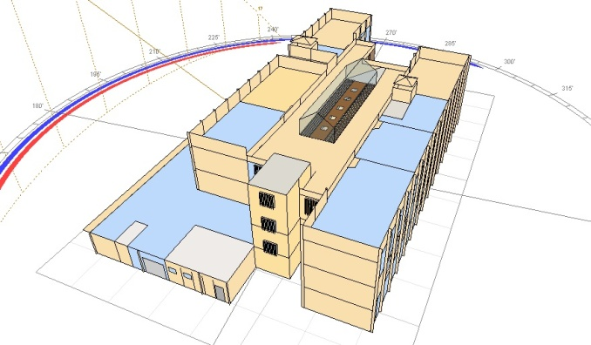
Shading
2- Vertical Louvers
3- Horizontal Louvers

Slide 22
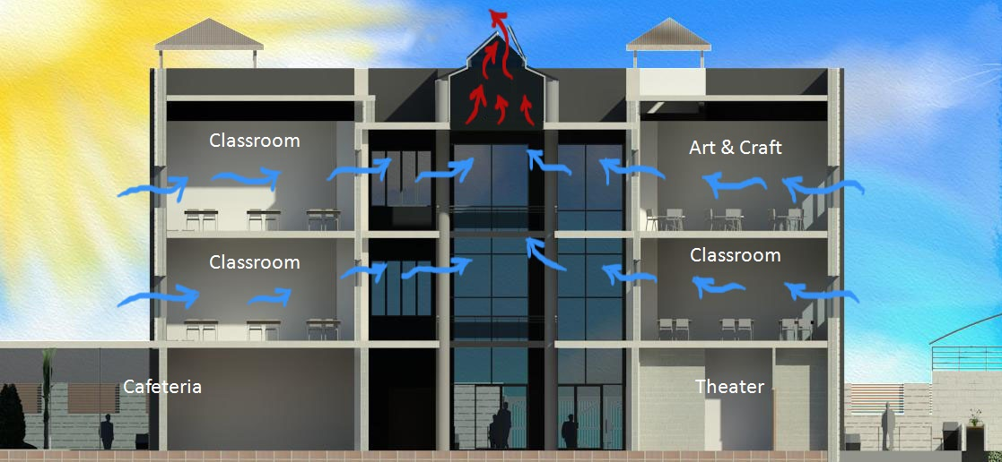
Natural Ventilation

Slide 23
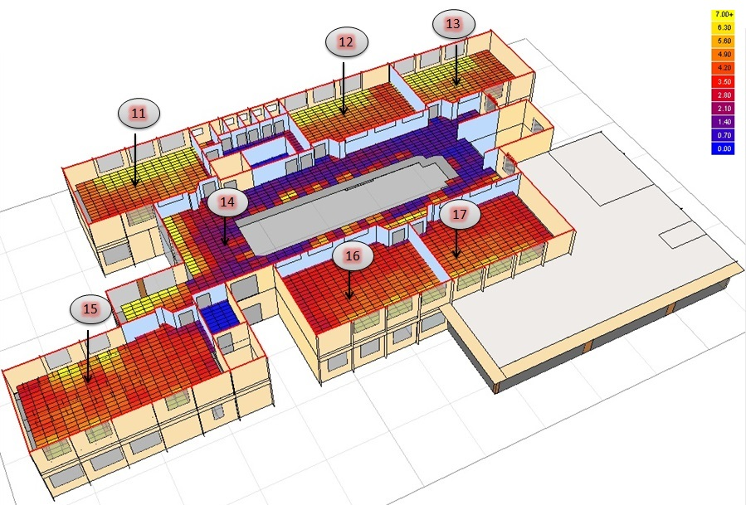
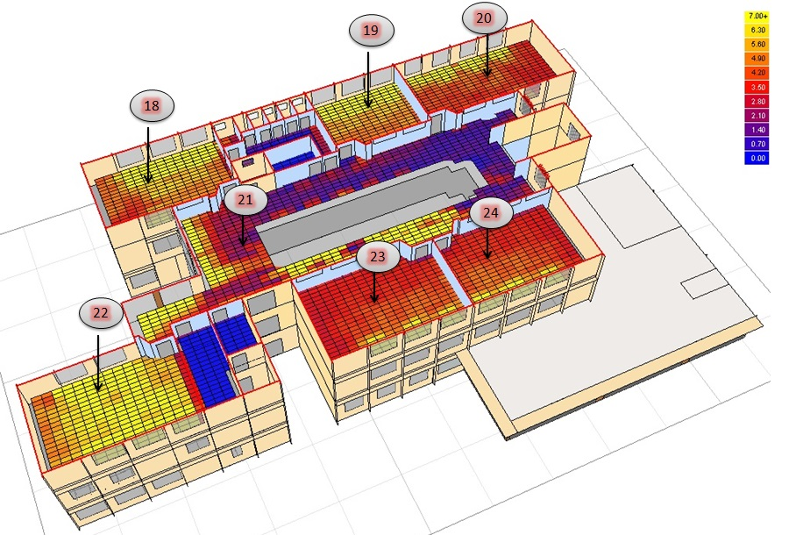
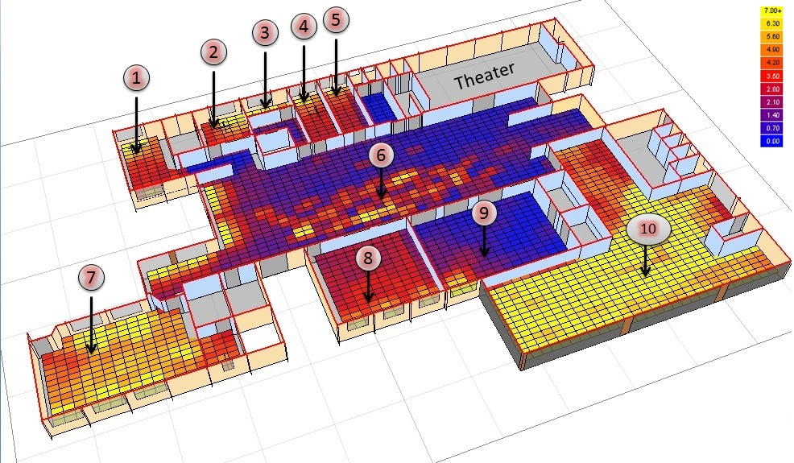
Daylight Analysis
3.5
GF
First Floor
Second Floor
Good light distribution
Light level conforms to specifications and criteria

Slide 24
Thermal Loads
35 < 78 < 85 (KW.H/m²)
Low heating and cooling loads
Energy conservation and low running cost for HVAC System

Slide 25
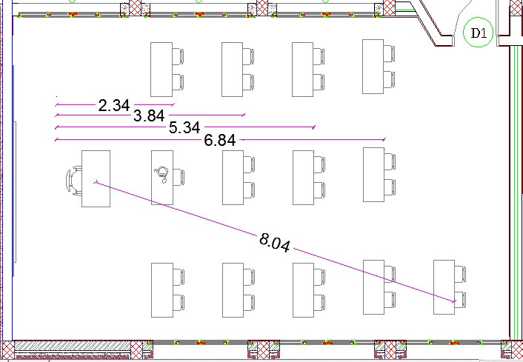
Acoustical Design
Classroom
Lw = 65 dB
Inside Noise = 35 dB
Standards
Measured
Empty
Fully occupied
RT60 :
0.6 - 0.8 s
0.6
0.78
S/N :
10 - 30 dB
Good
Alcons% :
7 - 15 %
Acceptable

Slide 26
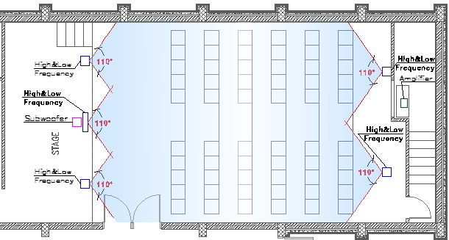
Theater
Lw = 85 dB
Windows Glass
9.1 Speakers
system
(Double glass low E , STC = 28 dB
SGG reflectasol light gold , STC = 30 dB
Partitions
Standards
Measured
Empty
Fully occupied
RT60 :
0.45 - 1 s
0.6
0.78
Internal Ceiling
S/N :
> 30 dB
STC = 55 db
Excellent
Alcons% :
3 – 7 %
Good

Slide 27
Mechanical Design

Slide 28
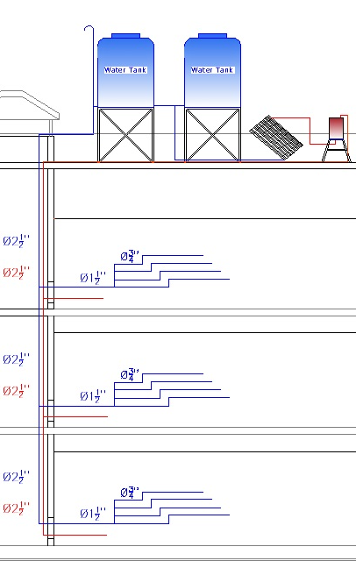
Water Supply System
Vertical galvanized Steel Pipe
Ø2.5’’
Horizontal galvanized Steel Pipe Ø1.5’’
PVC tube for Branch Ø 0.75’’
Hose real: Vertical Ø2’’
Horizontal Ø1’’

Slide 29
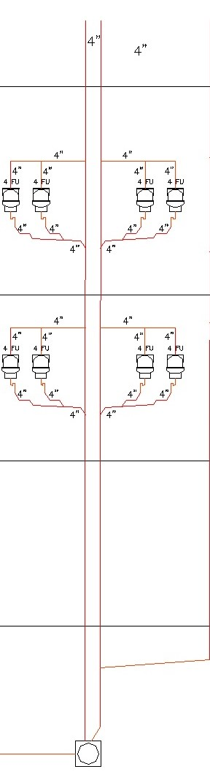
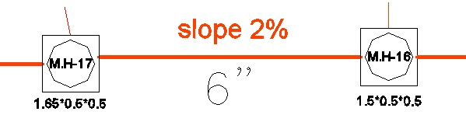
Drainage System
Suitable PVC pipes size
Vent stack Ø 4’’
Ø 6’’ UPVC pipes between
manholes

Slide 30
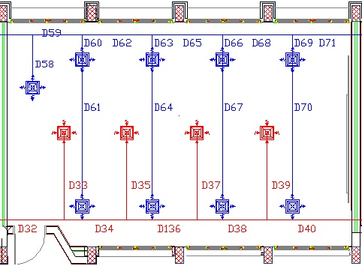
HVAC System
Duct system
T_{s}=12 ºc
T_{i}=24 ºc
Equal drop pressure method
∆P/EL= 0.58 pa/m (Supply)
∆P/EL= 1.1 pa/m (Return)

Slide 31
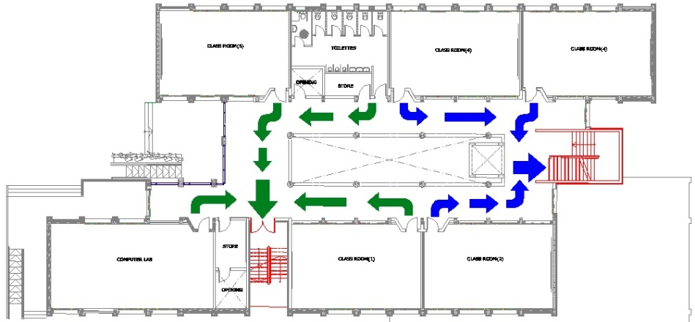
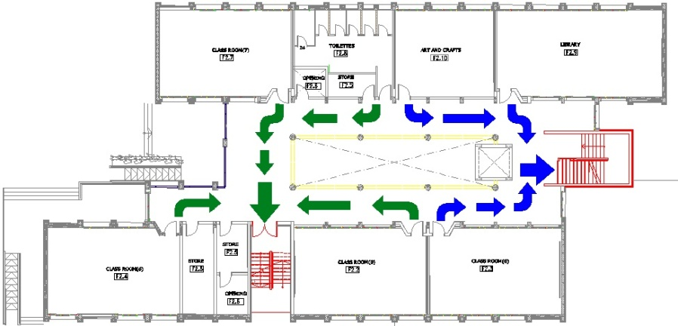
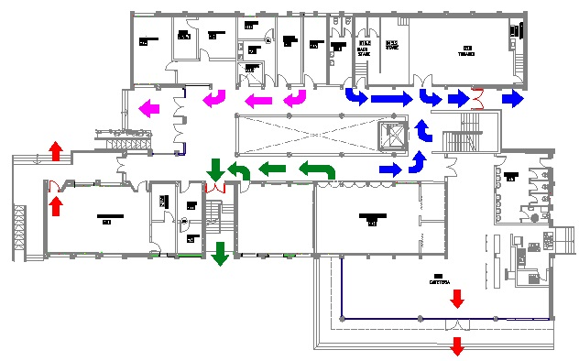
Emergency Exits
Second Floor
First Floor
Ground Floor

Slide 32
Electrical Design

Slide 33
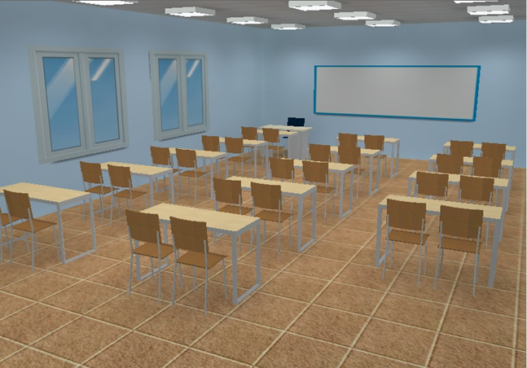
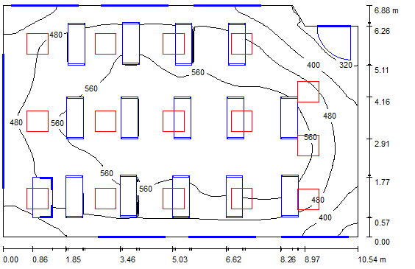
Lighting distribution to some areas in the school.
Classroom no. 1, 6 and 9

Slide 34
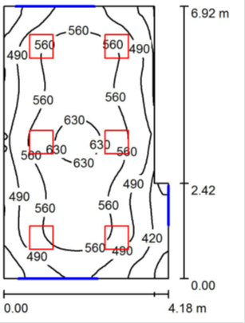
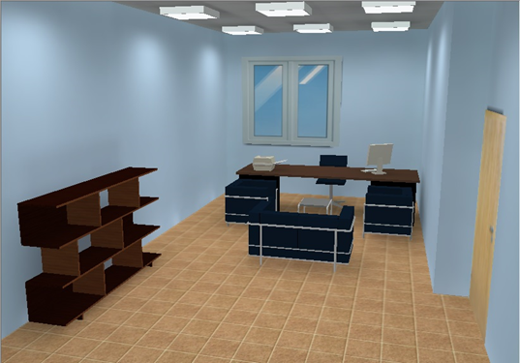
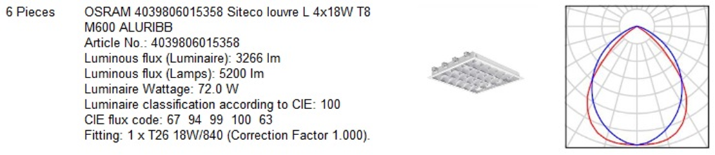
Head Master Room

Slide 35

Lighting distribution in the GF

Slide 36

Lighting distribution in the 1st floor

Slide 37

Lighting distribution in the 2nd floor

Slide 38

Sockets distribution in the GF

Slide 39

Sockets distribution in the 1st floor

Slide 40

sockets distribution in the 2nd floor

Slide 41

Fire alarm distribution in GF

Slide 42

Fire alarm distribution in the 1st floor

Slide 43

Fire alarm distribution in the 2nd floor

Slide 44

The main board
160Amp
//////////
//////////
//////////
//////////
32Amp
42Amp
42Amp
42Amp

Slide 45

Earthing system
Earthing system is a very important
system and school must provide it.

Slide 46
Quantities and Costs
Total cost | Unit price | Quantity | Material
125600 $ | 100 $ | 1256 m3 | Concrete
65450 $ | 700 $ | 93.5 ton | Steel
16710 $ |  | 33500 unit | Masonry
27200 $ | 16 $ | 1700 m2 | Stone

