Slide 1
An-Najah National University
Faculty of Engineering
Civil Engineering Department
Structural analysis and design of Dr. Ziad Sinan mall-Jenin
Prepared By:
Osaid Ayman
Dunia Sabra
Salsabeel Hamdi
Supervisor: : Dr. Mohammad Samaaneh

Slide 2
Outline :
Background information
Analysis and design inputs
Conceptual design
ETABs modeling & checks.
Design.

Slide 3
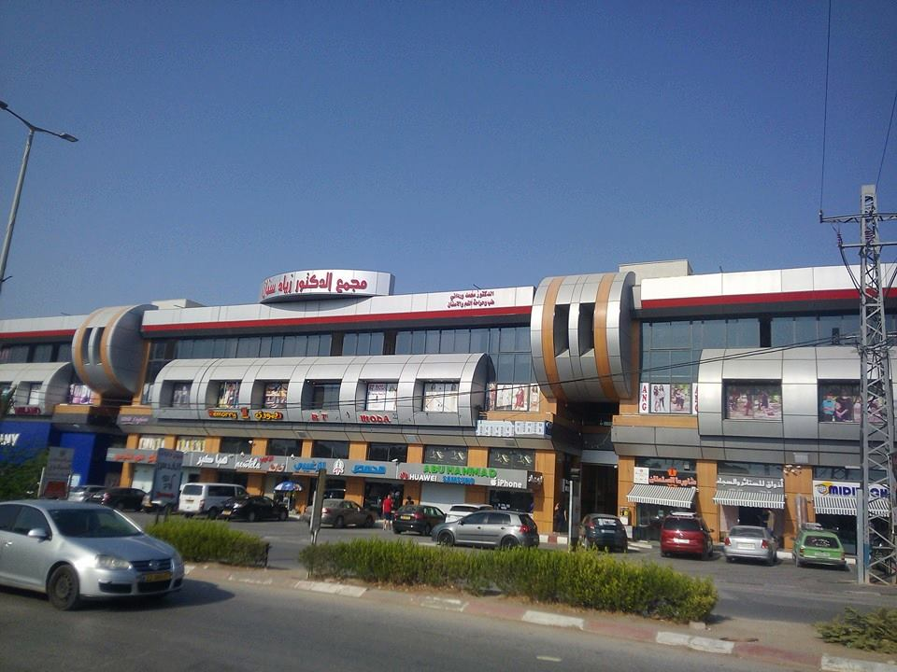

Slide 4
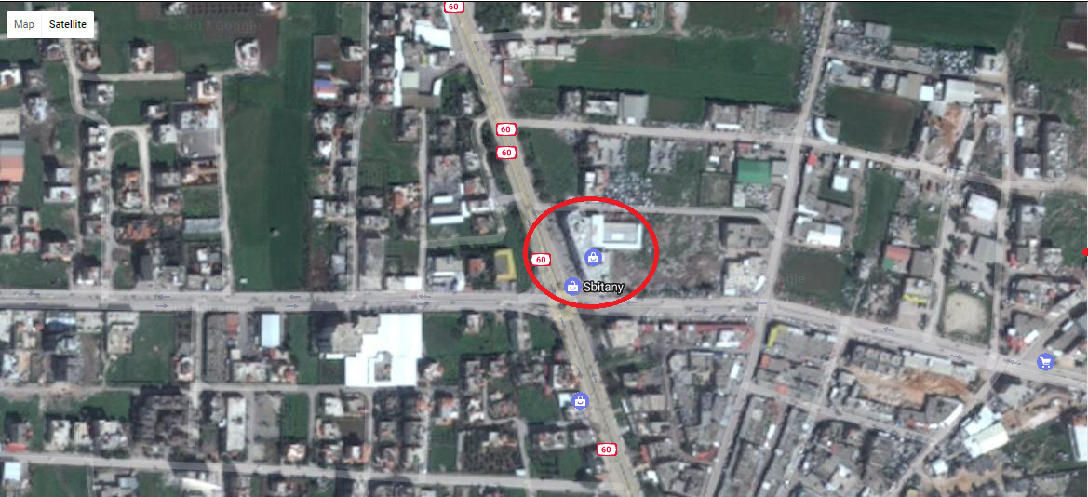
Location:
The project addresses is the analysis and design of Dr. Ziad Sinan mall (7683.5 m²) located in Jenin .

Slide 5
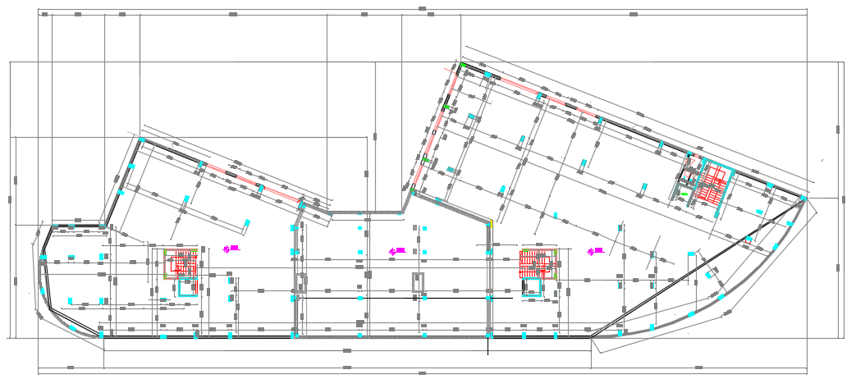
Basement floor

Slide 6
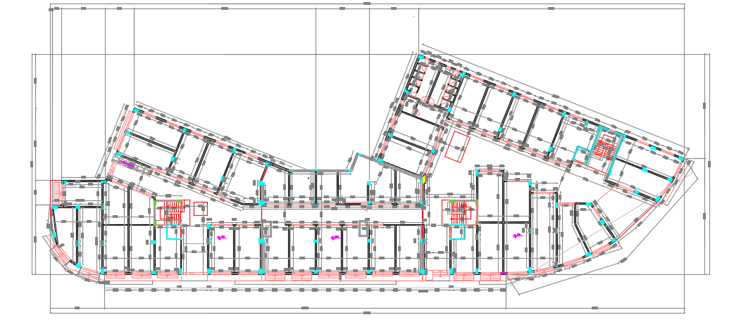
Ground floor

Slide 7
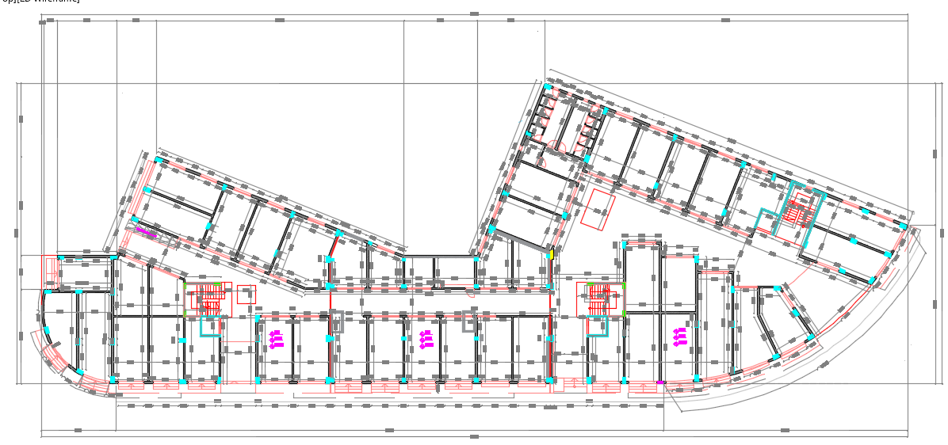
1st,2nd and 3rd floor

Slide 8
Floors, functions areas and heights
Floor number | Function | Area (m2) | Height(m)
Basement (B1) | Parking | 1922 | 4.40
Ground floor (GF) | Shops | 1922 | 5.10
First floor (F1) | Offices&Shops | 1916.3 | 3.50
Second floor (F2) | Offices& Shops | 1923.2 | 3.50
Third floor(F3) | offices&Shops | 1923.2 | 3.50

Slide 9

This project consists of three blocks that are shown in figure and the structural system used for whole project is two way solid slab.

Slide 10
    Concrete:
Unit weight of reinforced concrete = 25 kN/m³
Materials:
Structural element | Fc` (MPs) | Concrete type | Modulus of elasticity(MPs)
Beams, slabs , stairs | 24 | B300 | 23025
Footings, columns, shear walls | 28 | B350 | 24870
Reinforcement steel:
Yielding strength (Fy) = 420MPa.
Modulus of elasticity (Es) = 200GP

Slide 11
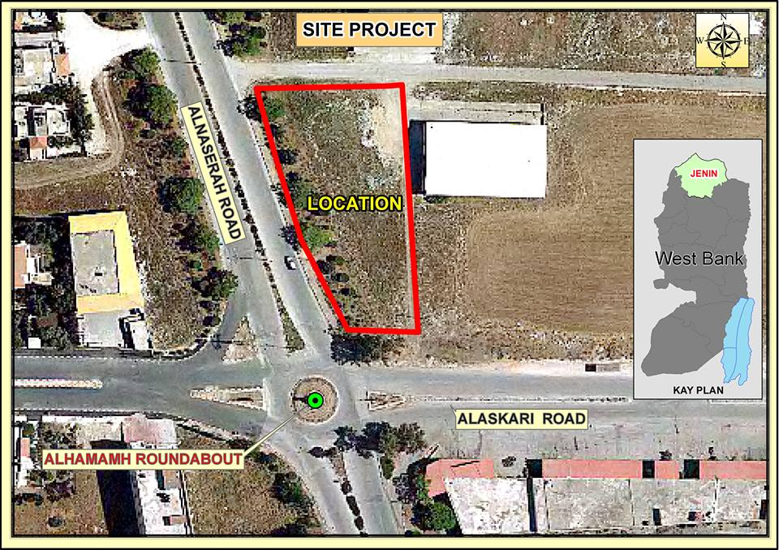
The bearing capacity of the soil in the region of the mall is estimated to be (180) kN/m².
Soil properties:

Slide 12
Loads :
Loads
Gravity
Lateral
Dead
Live
Earthquake

Slide 13
  Load:
13
Dead Load:
Slab own weight for solid= 5 KN/m²
Superimposed dead load=3.6 KN/m2
Wall load= 6.64 kN /m2
Live load:
In this project, a live load of 4.8 kN/m² will be used for whole structure, according to ASCE.

Slide 14
    Lateral loads data:
Inputs of design
Site class | D
Risk category | II
Seismic force resisting frame | Special reinforced concrete shear walls
R | 6
Ss | 0.325g
S1 | 0.075g
Fa | 1.54
Fv | 2.4
Sms=Ss×Fa | 0.5005
Sm1=S1×Fv | 0.18

Slide 15
Seismic design risk category at Sds =0.5005 | D
Seismic design risk category at Sd1=0.18 | C
The design seismic category | D
Redundancy factor (ρ) | 1.3

Slide 16
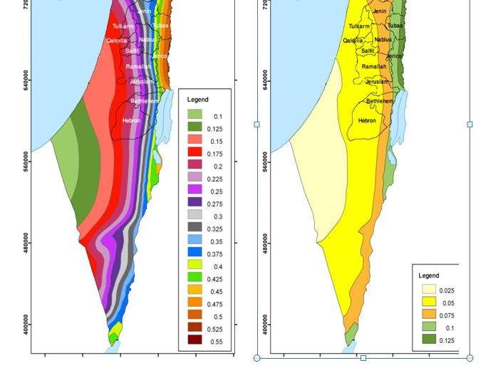
Hazard map of Israel:

Slide 17
  Load combinations:
  According to the "ACI 318-2011 and ASCE7-10, the load factors that are used in the analysis and design are:
Ultimate combinations:
a) 1.4 D
b) 1.2D + 1.6 L
c) 1.2D+E+L
d) 0.9D +E
Service combinations:
a) D +L
b) D +0.75L
c) D +0.7E
d) D +0.75L +0.75(0.7E) e) 0.6D+0.7E

Slide 18
  Computer programs:
  1) ETABS 2016: is used to analyze and design the structural elements.
  2) SAFE 2016
  3) CSiCOL 9
  4) AutoCAD: is used for plans and draw structural detailing.
  5) Other programs such as Excel and word.

Slide 19

Preliminary design for block A:

Slide 20
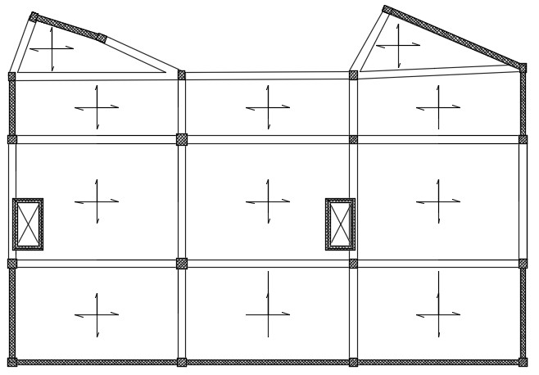
Slab :

Slide 21
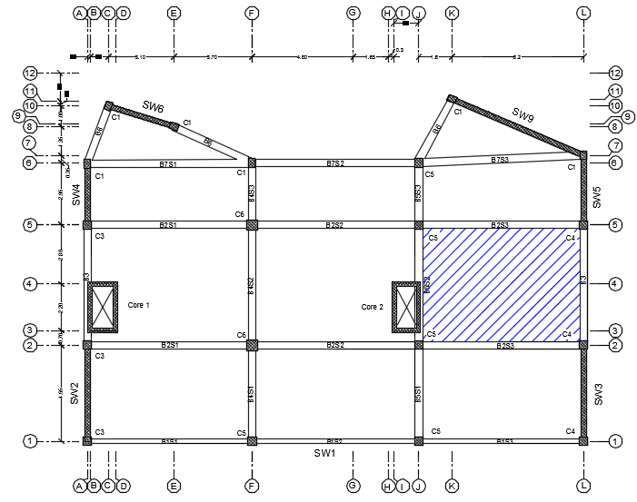
The Critical Panel (7.8m x 5.7m) as shown in the figure:

Slide 22
The minimum thickness of the slab was calculated using “Direct Design Method ".
Check the validity of ACI Coefficients requirements:
1- There are two or more spans in each direction. (OK)
2- Spans are approximately equal. (OK)
3- Loads are uniformly distributed.
4- Panels are rectangular with L/B less than two. (OK)
5-Successive spans length C/C of supports in each direction do not differ by more than 1/3. (OK)
6-All loads are gravity with WL/WD Less than two. (OK)
The minimum slab thickness was calculated equal 0.167 m.
So use h = 0.2 m

Slide 23
Check slab thickness for shear
𝛷𝑉𝑐=105.83 KN
Vu=64.62 KN
Since ΦVc ˃> Vu, Slab thickness is adequate for resisting shear (OK). So there is no need for shear reinforcement.

Slide 24
2. Beam Dimensions :
After making checks, the final beam dimensions are shown in this table:
Beam | Dimensions(mm2)
B1 | 350×700
B2 | 350×700
B3 | 350×700
B4 | 350×700
B5 | 350×700
B6 | 350×500
B7 | 350×500

Slide 25
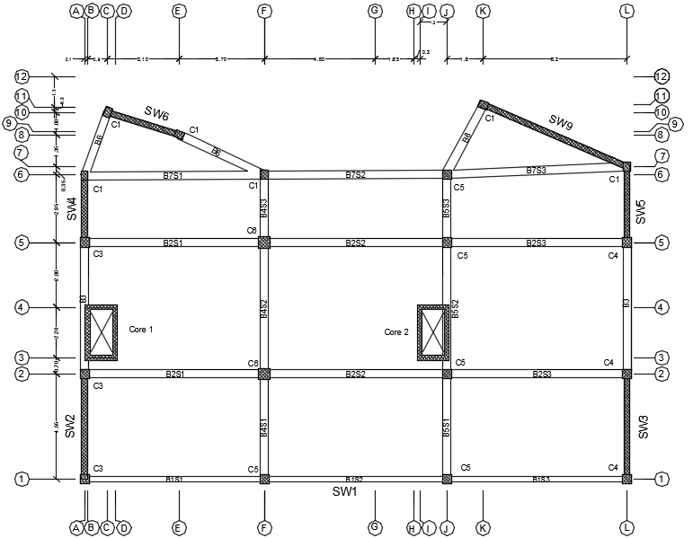
Beams layout F1,F2 and F3

Slide 26
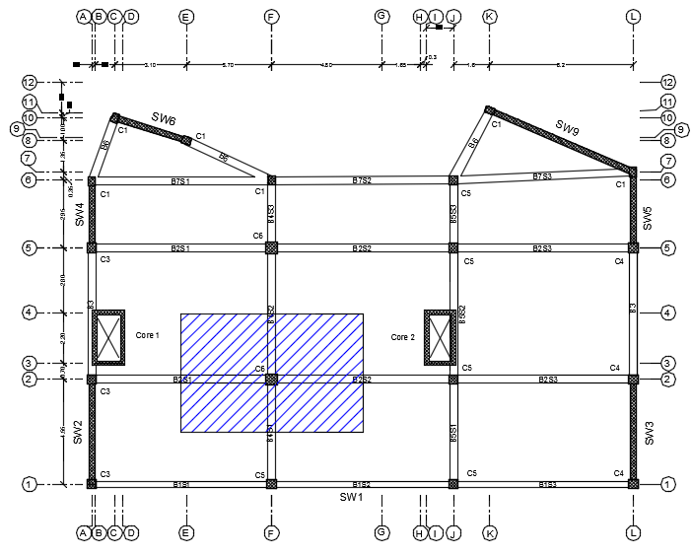
3. Column Dimensions :
Critical column is shown below in figure below:

Slide 27
By using tributary area method, we found the ultimate load on the critical columns=2898kN.
ØPn = δ×Ø (0.85𝑓𝑐 ′Ac + As×fy)
Ag = 200744.79 mm2.
Use h = 500 mm & b = 500 mm.
As = 0.01x500x500
= 2500 𝑚𝑚2.
so the columns dimensions are shown in table
Columns | Dimensions(mm2)
C1,C2 | 400×300
C3,C4,C5 | 400×400
C6 | 500×500

Slide 28
Columns layout F1,F2 and F3

Slide 29
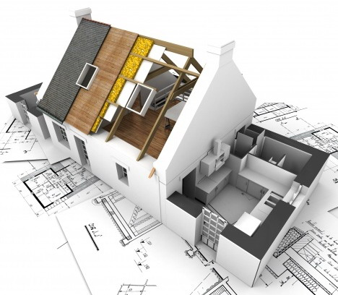
SEISMIC ANALYSIS AND CHECKS FOR BLOCK A:

Slide 30
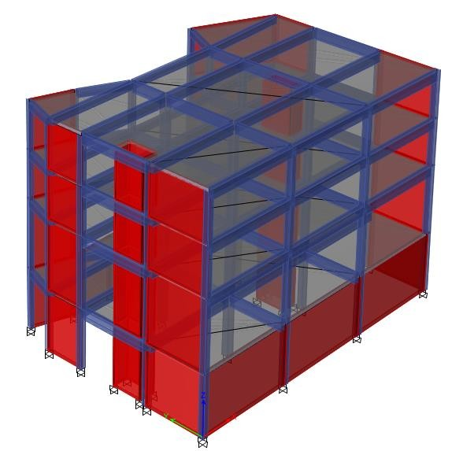
3D modal for block A:

Slide 31
Modifiers for structural element of block A:
Modifiers/Section | B0.35×0.7 | B0.35×0.5 | Col0.4×0.4 | Col0.5×0.5 | Col0.4×0.3 | Shear wall | Slab0.2
Cross section (axial) Area | 1 | 1 | 1 | 1 | 1 | 1 | 1
Shear Area in 2 direction | 1 | 1 | 1 | 1 | 1 | 1 | 1
Shear Area in 3 direction | 1 | 1 | 1 | 1 | 1 | 1 | 1
Torsional constant | 0.35 | 0.35 | 0.7 | 0.7 | 0.7 | 0.35 | 0.3
Moment of inertia bout 2 direction | 0.35 | 0.35 | 0.7 | 0.7 | 0.7 | 0.35 | 0.3
Moment of inertia bout 2 direction | 0.35 | 0.35 | 0.7 | 0.7 | 0.7 | 0.35 | 0.3
Mass | 1 | 1 | 1 | 1 | 1 | 1 | 1
Weight | 1 | 1 | 1 | 1 | 1 | 1 | 1
Meshing size =0.5×0.5 m2.

Slide 32
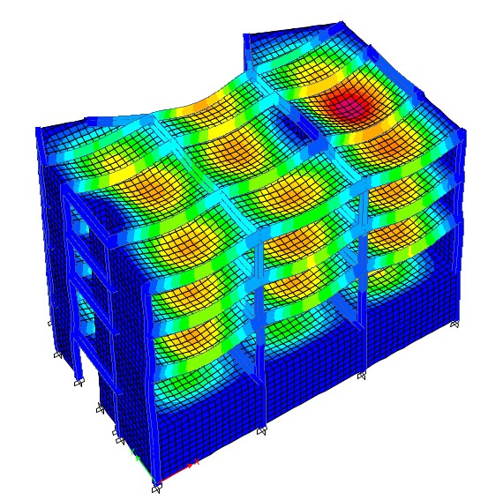
  Block A-checks:
    Compatibility check:

Slide 33
    Equilibrium check:
Load type | Hand results kN | ETABS results kN | Difference %
Dead | 15895.24 | 15886.8 | 0.05
SD | 4837.82 | 4835.2 | 0.05
LL | 6450.42 | 6446.9 | 0.05
wall | 2633.35 | 2631.1 | 0.085

Slide 34
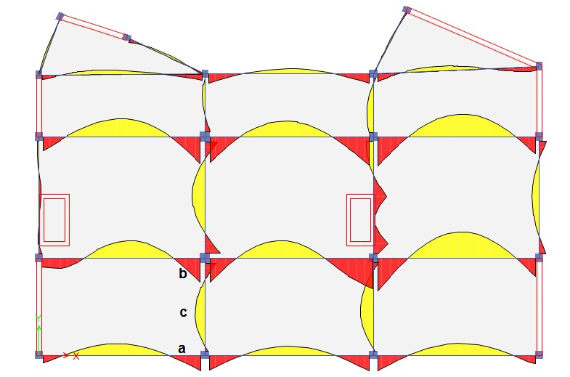


    Stress - strain check:
By using live load in this check on beam 4 span 1, so Wu=4.8𝐾𝑁/𝑚3:
. Ma =-5.9 kN.m
. Mb =-24.9 kN.m
. Mc = 22.94kN.m
$$\frac{Ma+Mb}{2 }+Mc=\text{38}\text{.}\text{34 }KN.m$$
MU_{Hand} =37.68 KN.m
% Difference = 1.72 % < 10 %,
so it is OK.

Slide 35
    Deflection check:
Δ_{long term} =25.97mm Δ_{allawable}= 32.5mm
25.97mm < 32.5 ,so it is OK.

Slide 36
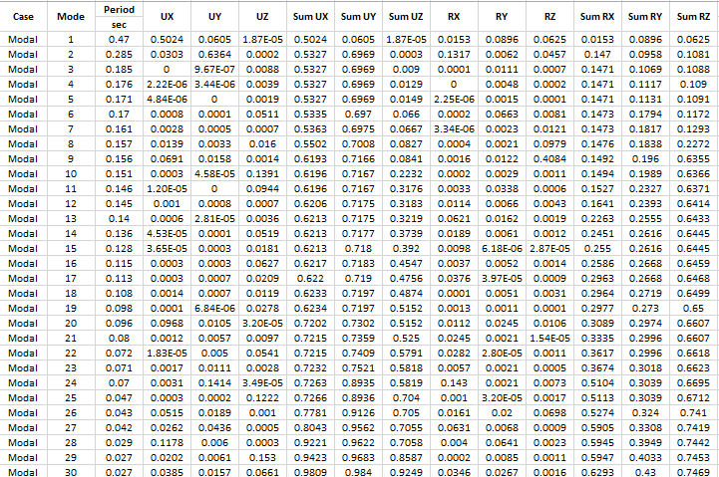
  Modal mass participation ratio:

Slide 37
Period:
Method | Ta(sec) | Error in comparison with Method A
Method A (approximate) | 0.3995 | -
Method B (Rayleigh) | 0.435845 | 8.33% < 30%
Period for mode 1 from ETABS | 0.47 | Is less than 1.3Tn method A

Slide 38
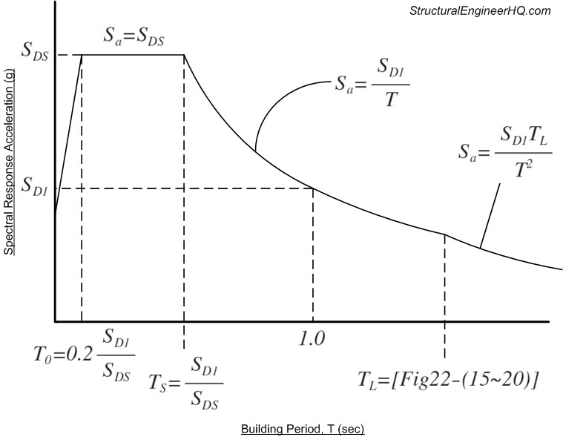
      Response spectrum curve:
In (sec) | inputs
0.5005 | SDS
0.18 | SD1
0.3995 | T
0.072 | To
0.36 | TS
8 | TL

Slide 39
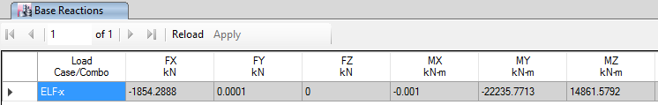
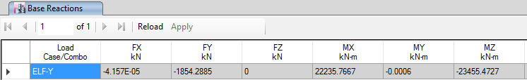
Base Shear:
        ETABS result for base shear (ELF) in X &Y direction :
Hand results for base shear =1873.425kN
The errors =1% less than the allowable (15%) so it is Ok.

Slide 40
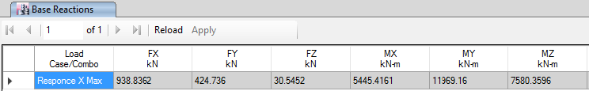
        ETABS result for base shear (Response) in X-direction :
So to reach 0.85 of ELF-X it was multiplied with scale factor.

Slide 41
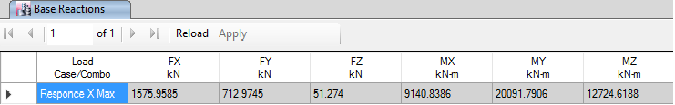
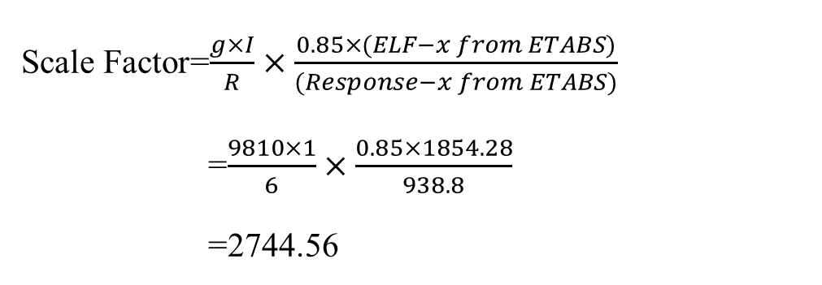
Scale Factor=$\frac{g×I}{R}×\frac{0.85×(ELF−x from ETABS)}{(Response−x from ETABS)}$
=$\frac{9810×1}{6}×\frac{0.85×1854.28}{938.8}$
=2744.56
Base shear due to Response-X after multiplying with scaling factor

Slide 42

        ETABS result for base shear (Response) in Y-direction :
So to reach 0.85 of ELF-Y it was multiplied with scale factor.

Slide 43
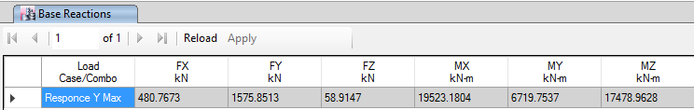
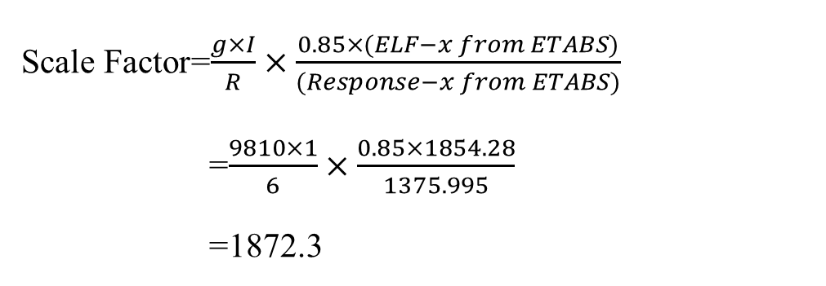
Scale Factor=$\frac{g×I}{R}×\frac{0.85×(ELF−x from ETABS)}{(Response−x from ETABS)}$
=$\frac{9810×1}{6}×\frac{0.85×1854.28}{1375.995}$
=1872.3
Base shear due to Response-Y after multiplying with scaling factor

Slide 44
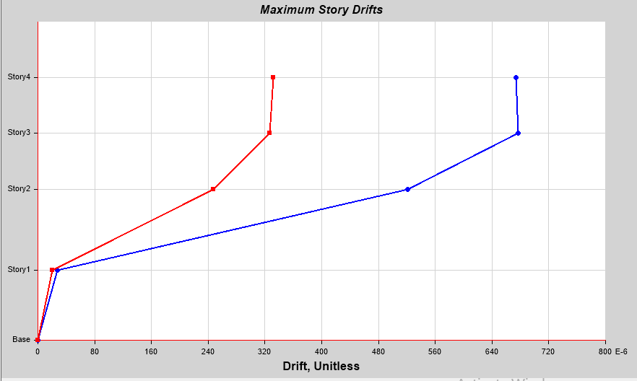
Drift:
Drift in X-Direction
Floor | Drift
F3 | 0.000674
F2 | 0.000677
F1 | 0.000521
G | 0.000028
All values of drift are less than 0.02hx, so it is OK.

Slide 45
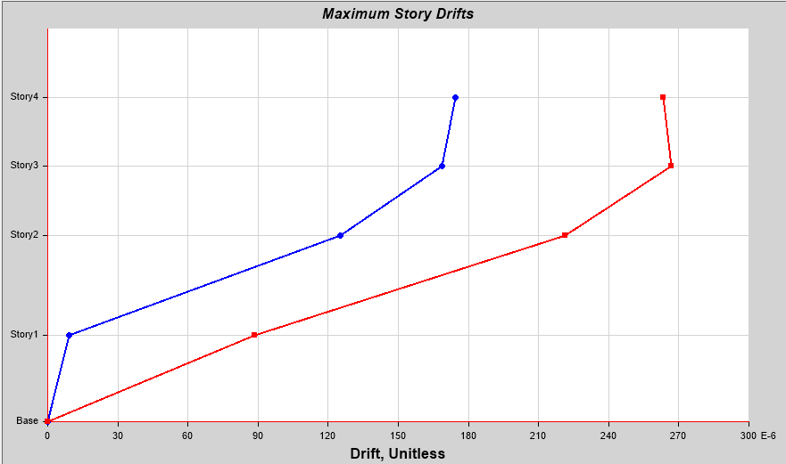
Drift in Y-Direction
Floor | Drift
F3 | 0.000263
F2 | 0.000267
F1 | 0.000089
G | 0.00000
All values of drift are less than 0.02hx, so it is OK

Slide 46
Irregularity Checks:
Horizontal Irregularity
Torsional irregularity
Torsional horizontal irregularity check in X-Direction.
Floor | U1 | U2 | Δ1 | Δ2 | Δ avg | Ratio
F3 | 7.451 | 4.853 | 2.34 | 1.502 | 1.921 | 1.218116(4)
F2 | 5.111 | 3.351 | 2.316 | 1.523 | 1.9195 | 1.206564
F1 | 2.795 | 1.828 | 2.672 | 1.736 | 2.204 | 1.212341
G | 0.123 | 0.092 | 0.123 | 0.092 | 0.1075 | 1.144186
All ratios around ≈1.2 , So there is no torsional irregularity

Slide 47
Torsional horizontal irregularity check in Y-Direction.
Floor | U1 | U2 | Δ1 | Δ2 | Δ avg | Ratio
F3 | 3.336 | 2.534 | 0.917 | 0.599 | 0.758 | 1.209763
F2 | 2.419 | 1.935 | 0.93 | 0.654 | 0.792 | 1.174242
F1 | 1.489 | 1.281 | 1.124 | 0.894 | 1.009 | 1.113974
G | 0.365 | 0.387 | 0.365 | 0.387 | 0.376 | 1.029255
All ratios around ≈1.2 , So there is no torsional irregularity

Slide 48
Horizontal Irregularity
Re-entrant corners | does not exist
Diaphragm discontinuity | does not exist
Out –of-plane offsets | does not exist
Nonparallel systems | does not exist

Slide 49
Vertical Irregularity
Stiffness irregularity –soft story | does not exist
Weight (mass) irregularity | does not exist
Vertical geometry irregularity | does not exist
In-plane discontinuity in vertical lateral –force-resisting element | does not exist
Discontinuity in capacity –weak story | does not exist

Slide 50
Foundation:

Slide 51
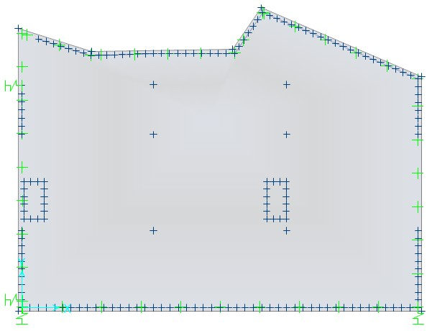
In our project we have mat footing and we design it by safe program.

Slide 52
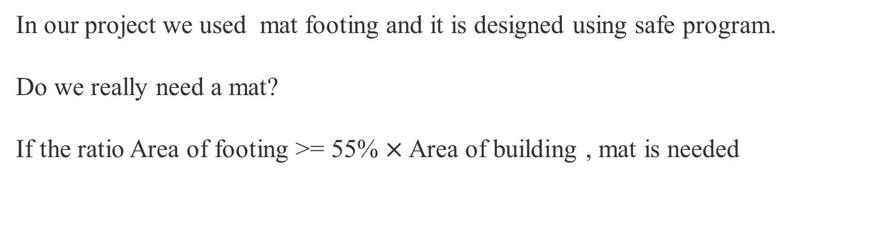
In our project we used mat footing and it is designed using safe program.
Do we really need a mat?
If the ratio Area of footing >= 55% $×$ Area of building , mat is needed
After check the area of footing needed for the structure by dividing the total envelope service earth quick by soil capacity which equal =224.836 m²
Area of footing to area of basement ratio =0.623
Which is greater than 0.55 of basement area so the type of footing will be mat foundation.
The total area of mat foundation =378.6m2

Slide 53
Checks of mat foundation

Slide 54
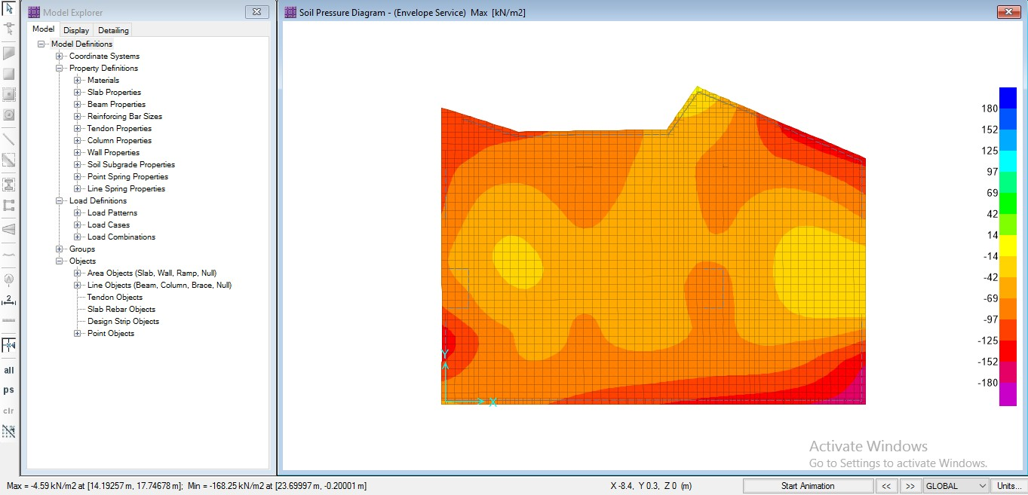
Bearing capacity of soil:
The maximum soil pressure is less than 180 so it is OK

Slide 55
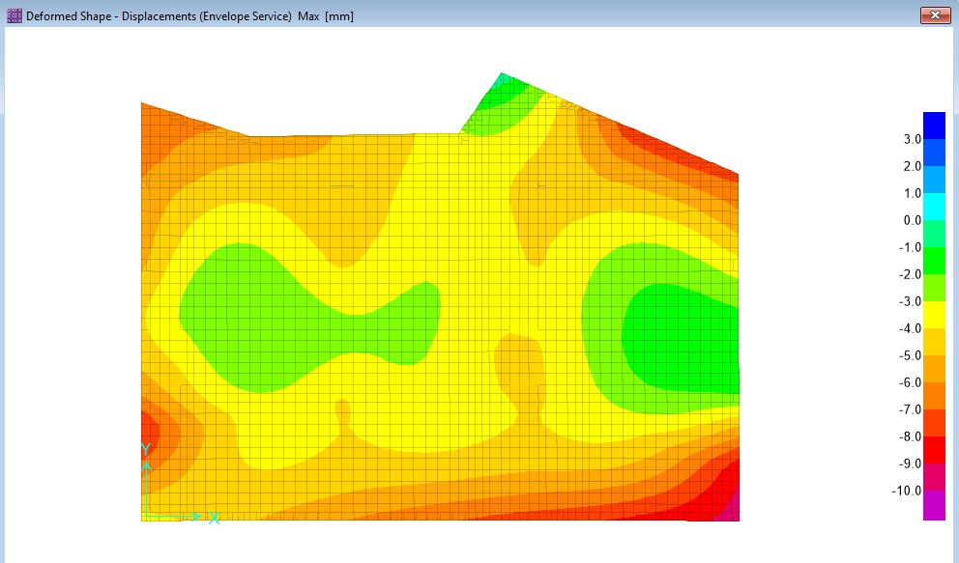
        Deflection check:
        The allowable relative deflection is less than 10 mm so this check is OK.

Slide 56
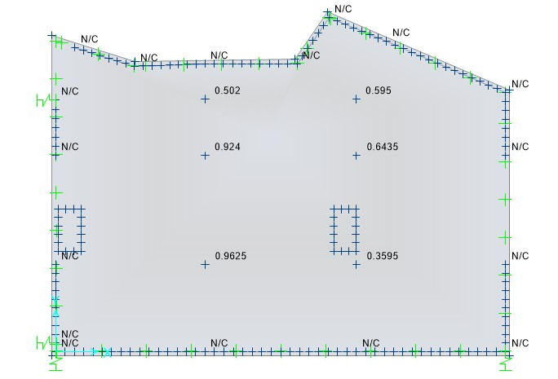
        Shear capacity check(punching): the maximum ratio is less than 1 so the dimension of mat foundation is ok.

Slide 57

SEISMIC DESIGN

Slide 58
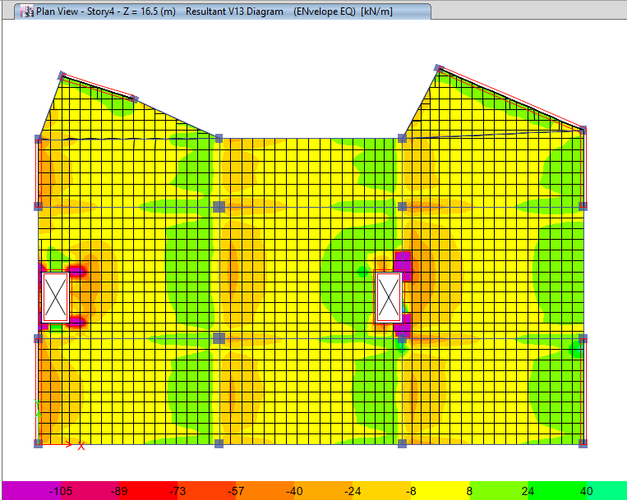
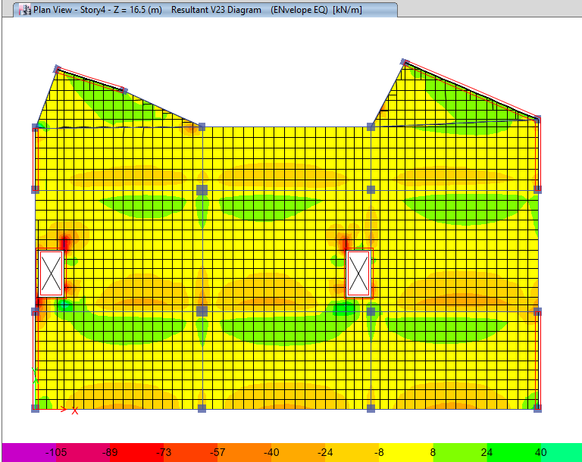
Slab design:
Shear:

Slide 59
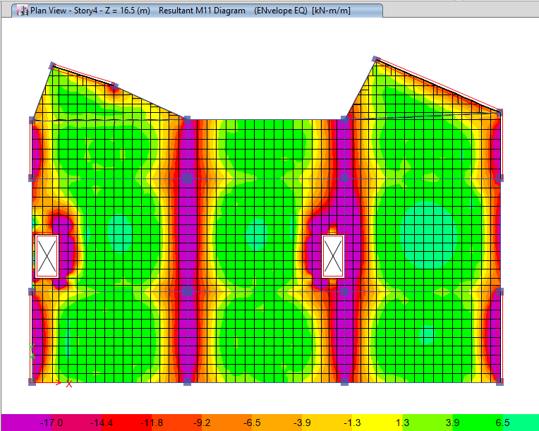
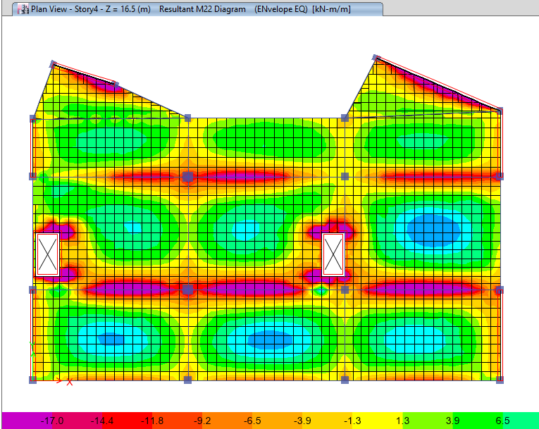
Flexure:

Slide 60
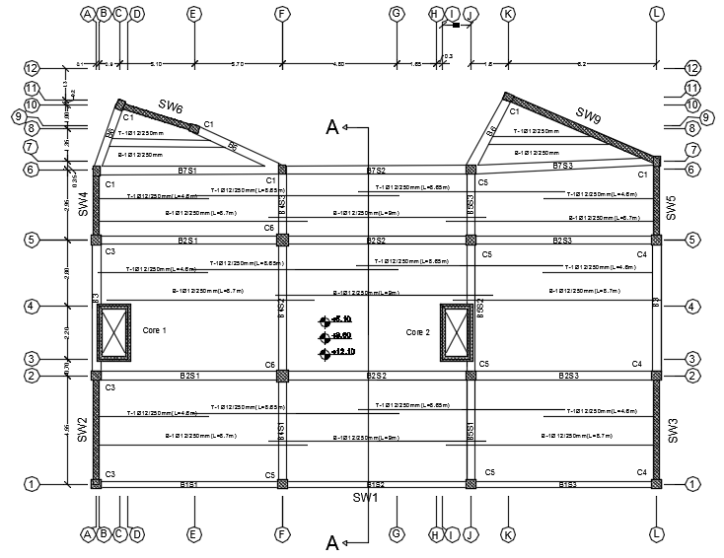

Slide 61
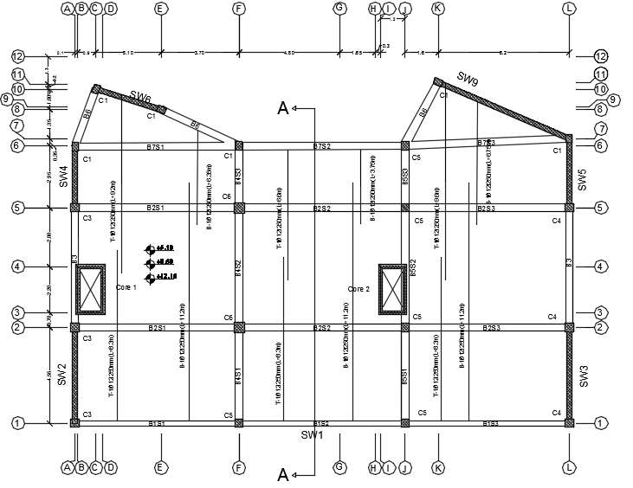

Slide 62
Beams reinforcement:
Group | SPAN | A | C | E | F | G | Al in the middle of the beam | S1 | S2 | Stirrups
B1 | 1 | 5Ø20 | - | 3Ø20 | 3Ø20 | 2 | 2 Ø12 | 10cm | 20cm | 1 Ø10
 | 2 | - | 6Ø20 | 3Ø20 | 3Ø20 | 2 | 2 Ø12 | 10cm | 20cm | 1 Ø10
 | 3 | 6Ø20 | 6Ø20 | 3Ø20 | 3Ø20 | 2 | 2 Ø12 | 10cm | 20cm | 1 Ø10
B2 | 1 | 4Ø20 | - | 3Ø20 | 3Ø20 | 2 | 2 Ø12 | 10cm | 25cm | 1 Ø10
 | 2 | - | 6Ø20 | 3Ø20 | 3Ø20 | 2 | 2 Ø12 | 10cm | 25cm | 1 Ø10
 | 3 | 6Ø20 | 6Ø20 | 3Ø20 | 4Ø20 | 2 | 2 Ø12 | 10cm | 25cm | 1 Ø10
B3 | 1 | 4Ø20 | 4Ø20 | 4Ø20 | 4Ø20 | - | 2 Ø12 | 10cm | 25cm | 1 Ø10
B4 | 1 | 3Ø20 | - | 2Ø20 | 3Ø20 | - | 2 Ø12 | 10cm | 25cm | 1 Ø10
 | 2 | - | 3Ø20 | 2Ø20 | 3Ø20 | - | 2 Ø12 | 10cm | 25cm | 1 Ø10
 | 3 | 3Ø20 | 3Ø20 | 2Ø20 | 3Ø20 | - | 2 Ø12 | 10cm | 25cm | 1 Ø10
B5 | 1 | 3Ø20 | - | 2Ø20 | 4Ø20 | - | 2 Ø12 | 10cm | 25cm | 1 Ø10
 | 2 | - | 5Ø20 | 5Ø20 | 4Ø20 | - | 2 Ø12 | 10cm | 25cm | 1 Ø10
 | 3 | - | 5Ø20 | 5Ø20 | 4Ø20 | - | 2 Ø12 | 10cm | 25cm | 1 Ø10
 | 4 | 3Ø20 | 3Ø20 | 2Ø20 | 3Ø20 | - | 2 Ø12 | 10cm | 25cm | 1 Ø10
B6 | 1 | 3Ø20 | 3Ø20 | 2Ø20 | 3Ø18 | - | 2 Ø12 | 10cm | 20cm | 1 Ø10
B7 | 1 | 5Ø20 | - | 3Ø20 | 3Ø20 | 2 | 2 Ø12 | 10cm | 20cm | 1 Ø10
 | 2 | - | 6Ø20 | 3Ø20 | 3Ø20 | 2 | 2 Ø12 | 10cm | 20cm | 1 Ø10
 | 3 | 6Ø20 | 6Ø20 | 3Ø20 | 3Ø20 | 2 | 2 Ø12 | 10cm | 20cm | 1 Ø10

Slide 63
Beams layout F1,F2 and F3

Slide 64
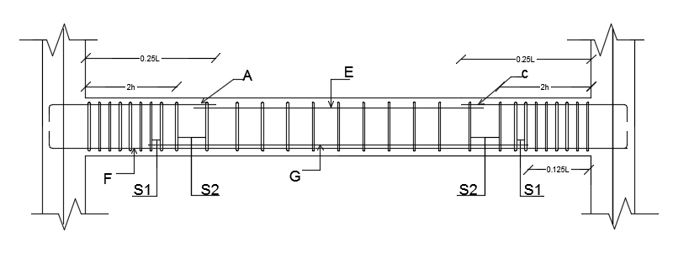

Slide 65
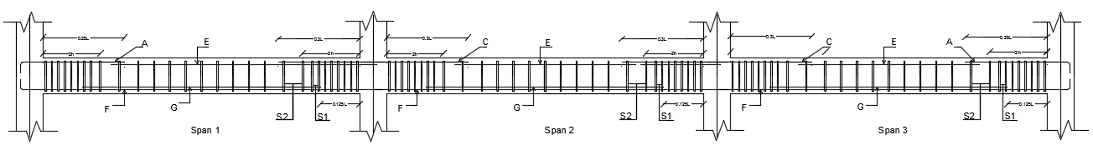

Slide 66
Columns reinforcement:
Group No. | Floor No. | Dimension mm² | Height m | No. of bars | S₀ | S₁ | Ties
C1 | G | 400×300 | 4.4 | 10Ø18 | 100 | 100 | 1 Ø 10
 | F1 | 400×300 | 5.1 | 10Ø18 | 100 | 100 | 1 Ø 10
 | F2 | 400×300 | 3.5 | 10Ø18 | 100 | 100 | 1 Ø 10
 | F3 | 400×300 | 3.5 | 10Ø18 | 100 | 100 | 1 Ø 10
C2 | G | 400×300 | 4.4 | 10Ø14 | 100 | 100 | 1 Ø 10
 | F1 | 400×300 | 5.1 | 10Ø14 | 100 | 100 | 1 Ø 10
 | F2 | 400×300 | 3.5 | 10Ø14 | 100 | 100 | 1 Ø 10
 | F3 | 400×300 | 3.5 | 10Ø14 | 100 | 100 | 1 Ø 10
C3 | G | 400×400 | 4.4 | 12Ø16 | 100 | 100 | 1 Ø 10
 | F1 | 400×400 | 5.1 | 12Ø16 | 100 | 100 | 1 Ø 10
 | F2 | 400×400 | 3.5 | 12Ø16 | 100 | 100 | 1 Ø 10
 | F3 | 400×400 | 3.5 | 12Ø16 | 100 | 100 | 1 Ø 10
C4 | G | 400×400 | 4.4 | 12Ø22 | 100 | 100 | 1 Ø 10
 | F1 | 400×400 | 5.1 | 12Ø22 | 100 | 100 | 1 Ø 10
 | F2 | 400×400 | 3.5 | 12Ø22 | 100 | 100 | 1 Ø 10
 | F3 | 400×400 | 3.5 | 12Ø22 | 100 | 100 | 1 Ø 10
C5 | G | 400×400 | 4.4 | 12Ø14 | 100 | 100 | 1 Ø 10
 | F1 | 400×400 | 5.1 | 12Ø14 | 100 | 100 | 1 Ø 10
 | F2 | 400×400 | 3.5 | 12Ø14 | 100 | 100 | 1 Ø 10
 | F3 | 400×400 | 3.5 | 12Ø14 | 100 | 100 | 1 Ø 10
C6 | G | 500×500 | 4.4 | 12Ø16 | 100 | 100 | 1 Ø 10
 | F1 | 500×500 | 5.1 | 12Ø16 | 100 | 100 | 1 Ø 10
 | F2 | 500×500 | 3.5 | 12Ø16 | 100 | 100 | 1 Ø 10
 | F3 | 500×500 | 3.5 | 12Ø16 | 100 | 100 | 1 Ø 10

Slide 67
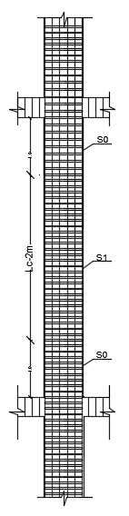
The key of columns:

Slide 68
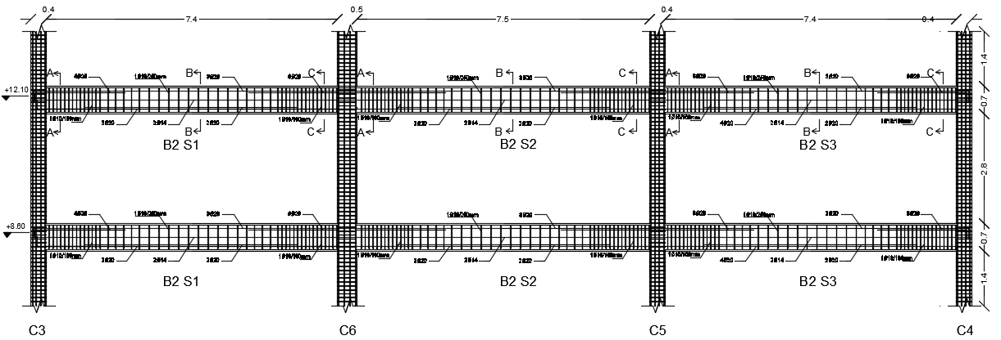

Slide 69
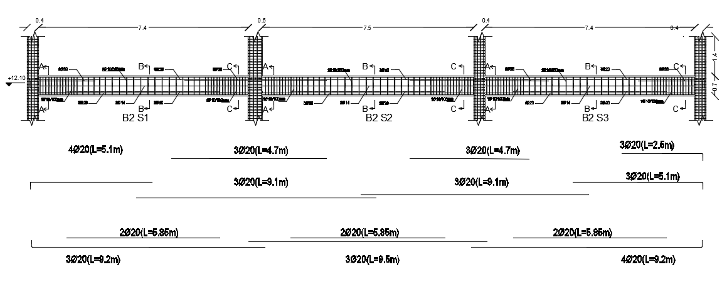

Slide 70
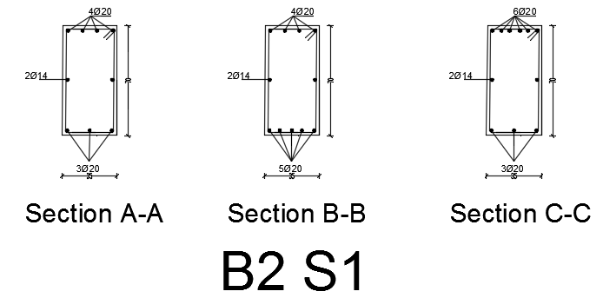
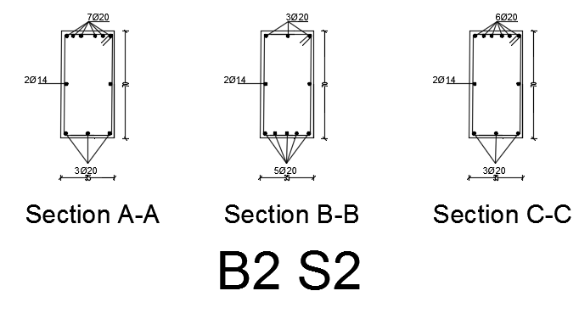
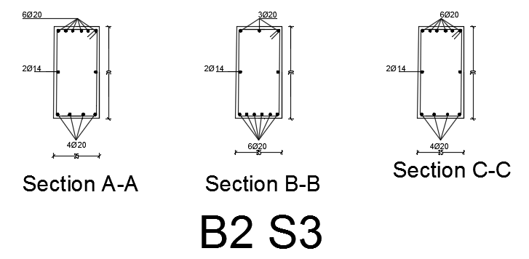

Slide 71
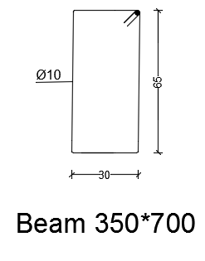
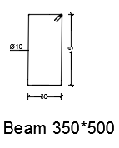

Slide 72
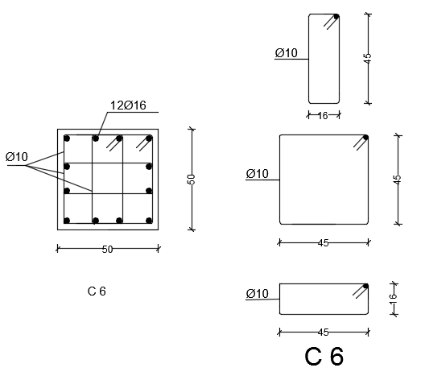
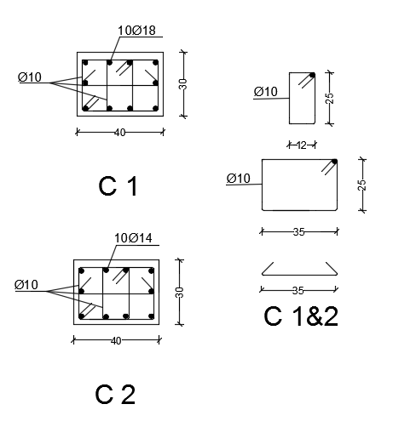
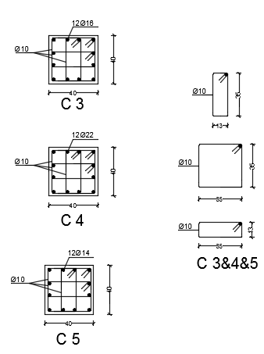

Slide 73



Shear wall reinforcement:

Slide 74


Slide 75


Mat reinforcement:
Moment m11 top in X-direction
Fig. ‎6.29 M22 top in Y-direction.

Slide 76


Moment m22 bottom in x-direction
Moment m11 bottom in Y-direction.

Slide 77


Slide 78


Slide 79

Stairs reinforcement:

Slide 80


Slide 81
Thank You ^^

