Slide 1
Authorship Identification
By: Shadi Asmar & Mohammad Barakat
Supervisors: Loai Malhis

Slide 2
Author Identification
Presented with writing sample (txt, articles, email, blogs,…)
Determine who wrote them
Examples:
  Who wrote the Federalist Papers
  Who wrote Edward III
Notes:
During the time of their publication (Oct 1787 – Aug 1788), their authors‘ identities were not widely revealed

Slide 3
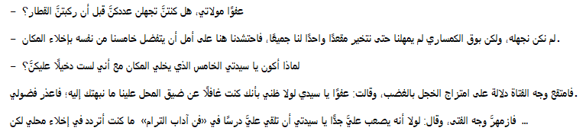
Sample Data

Slide 4
Goals
Given works by an author will I be able to verify that the specific document(s) is written by that author or not.

Slide 5
Methods
Authors:
  Charles Dickens
  George Eliot
  William Makepeace Thackeray
  - At least 10 books per authors
  All from same time period.
  Why?

Slide 6
Methods -
For Authorship Identification
  Focused on Binary Classification
    Word Frequency
  Clustering
    K-means

Slide 7
Methods – Tools
Preprocessing of data
Remove common words using with stopList
Stemming – reduce derived words to base or root
  Cornell University

Slide 8
Classifier & Testing
Implemented training and testing set
  ~70% for training
  ~30% for testing
    Cross Validation
    Naives Bayes
  Each Test contain ~ 3000 attributes

Slide 9
Classifer Analysis
Confusion Matrix
TP Rate
FP Rate

Slide 10
Classifier - Testing
Data Set
  Comparison between pairs of authors
    Charles Dickens & George Eliot
    Charles Dickens & William Makepeace Thackeray
    George Eliot & Charles Dickens

Slide 11

Classifer – Testing
After Preprocess
  Applied TF*IDF for baseline
  Normalize Document Length
    Longer Document may contain higher frequency of same word

Slide 12
Classifer – Performed Task
Cross Validation N=10
  Classifer: Naïve Bayes
    3000 attributes
  Train the Dataset and perform on Test Data
  Retest Using Attribute Selection in Weka
    Test using top 500 attributes
    Train the Dataset and perform on Test Data

Slide 13
Results
TPR = TP/(TP + FN)
    Is the fraction of positive example predicted correctly by the model
FPR = FP/(TN + FP)
  The fraction of negative example predicted as positive class

Slide 14
Results
Time taken to build model: 0.27 seconds
=== Stratified cross-validation ===
=== Summary ===
Correctly Classified Instances 12 70.5882 %
Incorrectly Classified Instances 5 29.4118 %
Kappa statistic 0.3511
Mean absolute error 0.2941
Root mean squared error 0.5423
Relative absolute error 60 %
Root relative squared error 109.0883 %
Total Number of Instances 17
=== Detailed Accuracy By Class ===
TP Rate FP Rate Precision Recall F-Measure ROC Area Class
0.9 0.571 0.692 0.9 0.783 0.664 CD
0.429 0.1 0.75 0.429 0.545 0.664 GE
Weighted Avg. 0.706 0.377 0.716 0.706 0.685 0.664
=== Confusion Matrix ===
a b <-- classified as
9 1 | a = CD
4 3 | b = GE

Slide 15
Results
Time taken to build model: 0.8 seconds
=== Stratified cross-validation ===
=== Summary ===
Correctly Classified Instances 14 82.3529 %
Incorrectly Classified Instances 3 17.6471 %
Kappa statistic 0.6107
Mean absolute error 0.1765
Root mean squared error 0.4201
Relative absolute error 36 %
Root relative squared error 84.4994 %
Total Number of Instances 17
=== Detailed Accuracy By Class ===
TP Rate FP Rate Precision Recall F-Measure ROC Area Class
1 0.429 0.769 1 0.87 0.786 CD
0.571 0 1 0.571 0.727 0.786 GE
Weighted Avg. 0.824 0.252 0.864 0.824 0.811 0.786
=== Confusion Matrix ===
a b <-- classified as
10 0 | a = CD
3 4 | b = GE

Slide 16
Results – Training & Testing
=== Re-evaluation on test set ===
=== Summary ===
Correctly Classified Instances 6 85.7143 %
Incorrectly Classified Instances 1 14.2857 %
Kappa statistic 0.6957
Mean absolute error 0.1429
Root mean squared error 0.378
Total Number of Instances 7
=== Detailed Accuracy By Class ===
TP Rate FP Rate Precision Recall F-Measure ROC Area Class
1 0.333 0.8 1 0.889 0.833 CD
0.667 0 1 0.667 0.8 0.833 GE
Weighted Avg. 0.857 0.19 0.886 0.857 0.851 0.833
=== Confusion Matrix ===
a b <-- classified as
4 0 | a = CD
1 2 | b = GE

Slide 17
Results - Naives Bayes

Slide 18
Clustering K-means
Test on author pairs
Selected < 15 attributes
K = 2 (2 authors)
From the attributes I chose 2

Slide 19
Clustering K-means
Cluster#
Attribute Full Data 0 1
(19) (13) (6)
============================================
abroad 0.1032 0.0889 0.1343
absurd 0.0749 0.067 0.0919
accord 0.1207 0.0992 0.1671
confes 0.1166 0.092 0.17
confus 0.1705 0.2134 0.0776
embrac 0.0829 0.0777 0.0942
england 0.1239 0.0958 0.1846
enorm 0.0778 0.0611 0.114
report 0.0839 0.0744 0.1044
reput 0.0832 0.073 0.1054
restor 0.0912 0.0947 0.0834
sal 0.0907 0.0809 0.112
school 0.1074 0.0877 0.15
seal 0.0756 0.066 0.0964
worn 0.085 0.0853 0.0841

Slide 20
Clustering K-means
kMeans
======
Number of iterations: 6
Within cluster sum of squared errors: 10.743242464527551
=== Model and evaluation on training set ===
Clustered Instances
0 13 ( 68%)
1 6 ( 32%)
Class attribute: @@class@@
Classes to Clusters:
0 1 <-- assigned to cluster
10 0 | CD
3 6 | WT
Cluster 0 <-- CD
Cluster 1 <-- WT
Incorrectly clustered instances : 3.0 15.7895 %

Slide 21
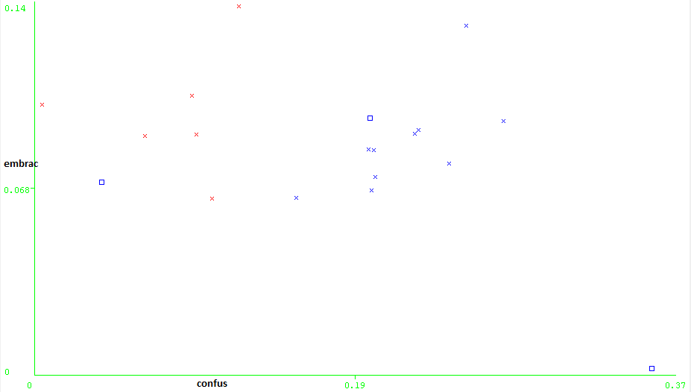

Slide 22
Conclusion
Word Frequency can be use in authorship verification.
Using select attributes with high frequency may be use for clustering but does present high intra and inter class similarity (quality clusters)

