Slide 1

DropPal
Your Local E-commerce Solution
Explore Now

Slide 2
Table Of Contents:
  Introduction
  Features
  Technologies
  Future Work
Explore Now

Slide 3
Introduction
  Overview of DropPal:
    The DropPal e-commerce platform is a comprehensive graduation project that revolutionizes how merchants establish their online presence and sell products to customers. The platform offers merchants two flexible options: they can either list and sell their products directly through the main DropPal application, or utilize our innovative app generation service to create their own customized e-commerce applications.
  Key Features:
    Multi-Merchants platform
    Generate your own store
    Customizable store designs

Slide 4




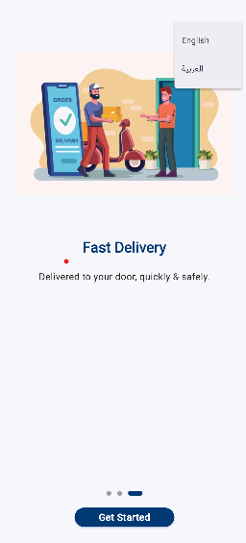
Featrues
  Splash Screen
onboarding

Slide 5

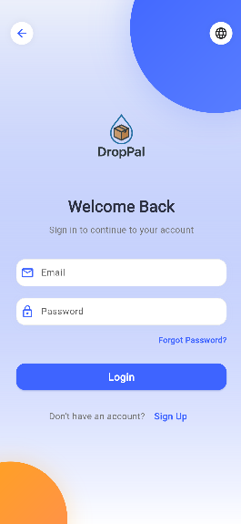
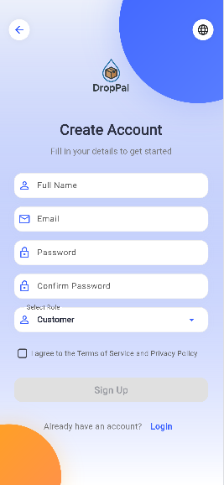
  Start Page & Login & Sign Up

Slide 6
Guest Side

Slide 7
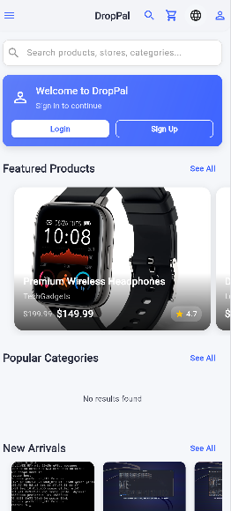
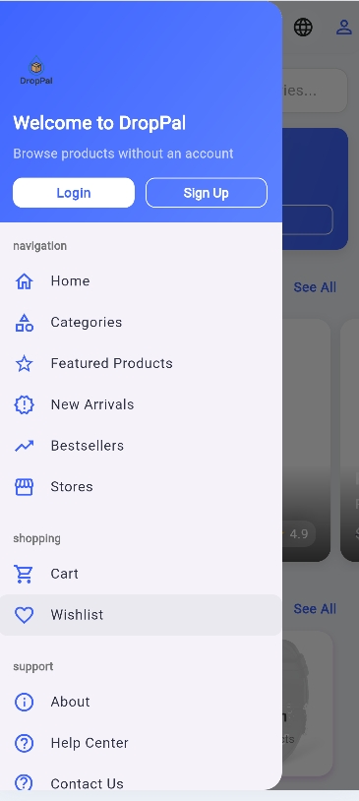
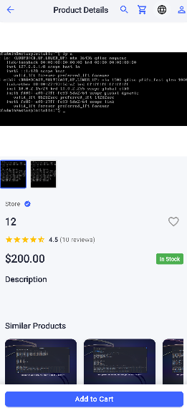
  Guest views

Slide 8
Customer Side

Slide 9
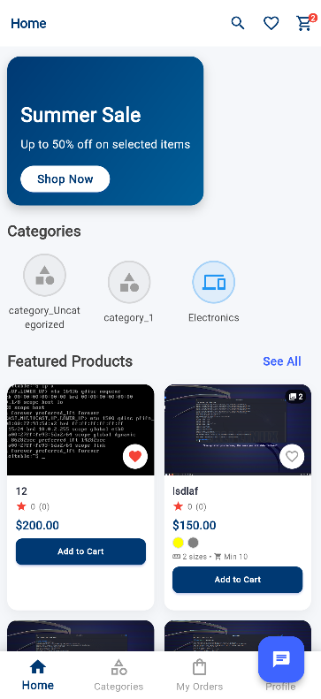
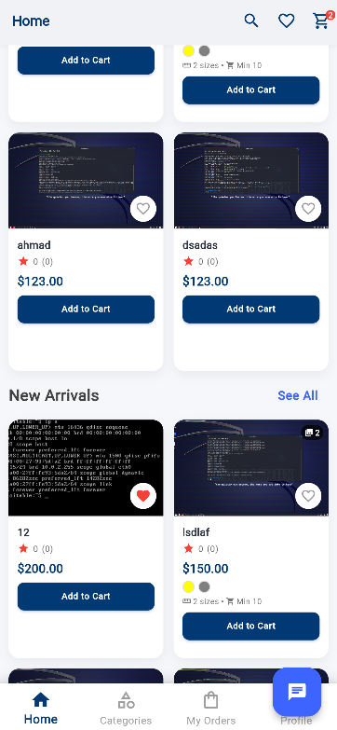
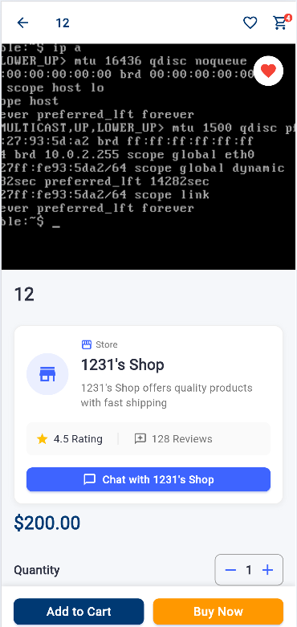
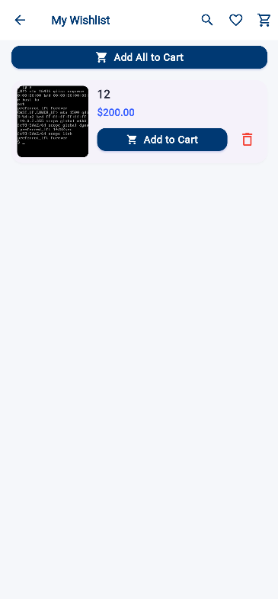
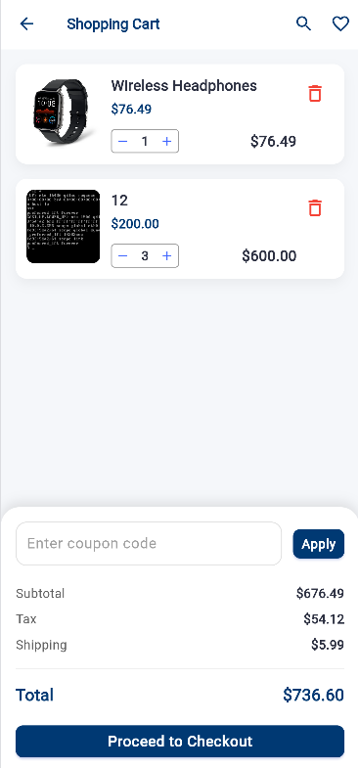
  Customer Home page

Slide 10
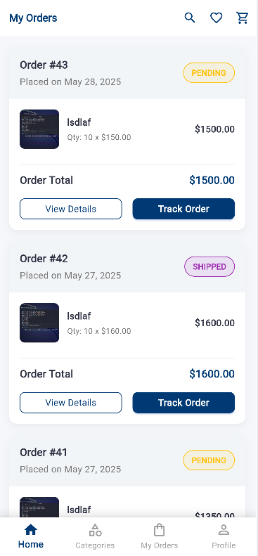
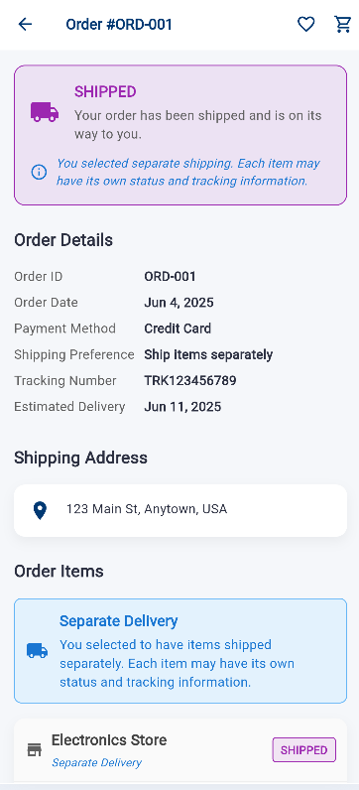
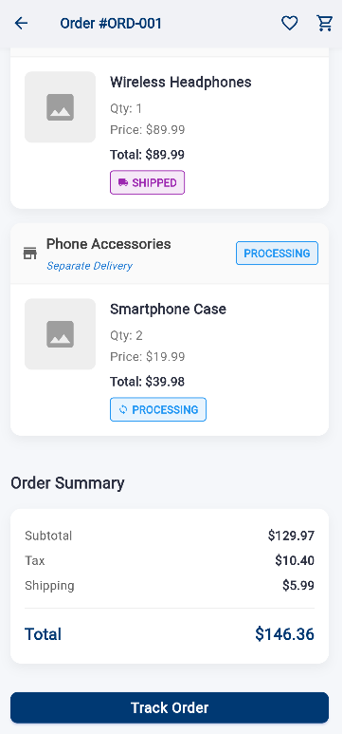
  Customer Orders

Slide 11
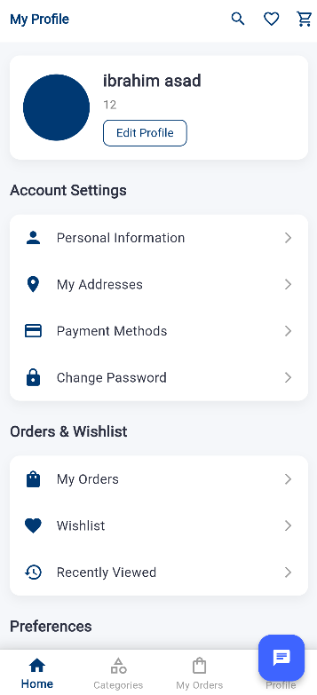
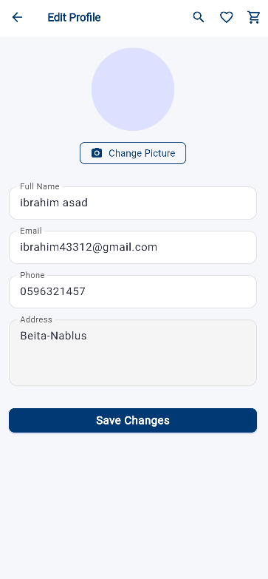
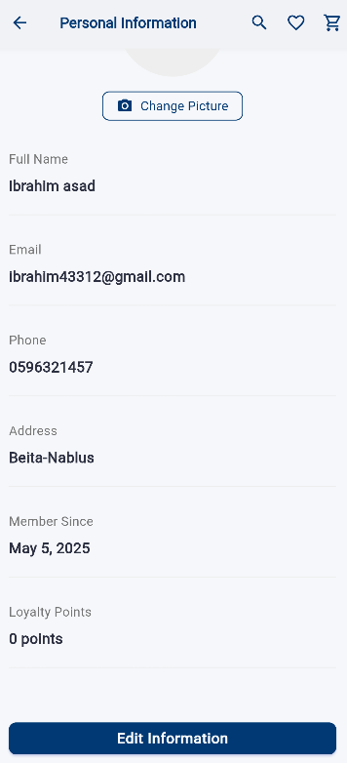
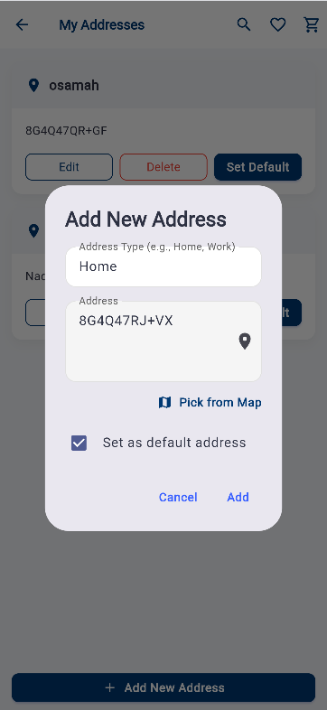
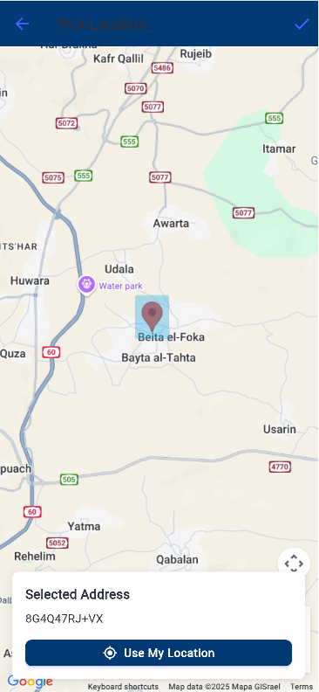
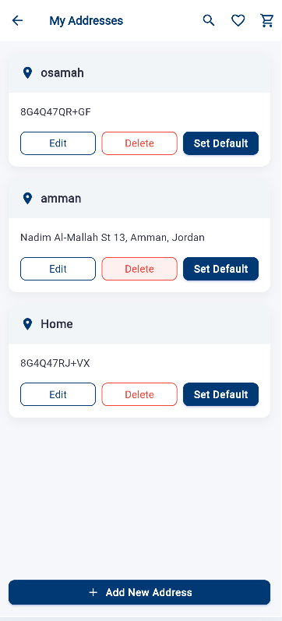
  My profile, Personal Information & My Address

Slide 12
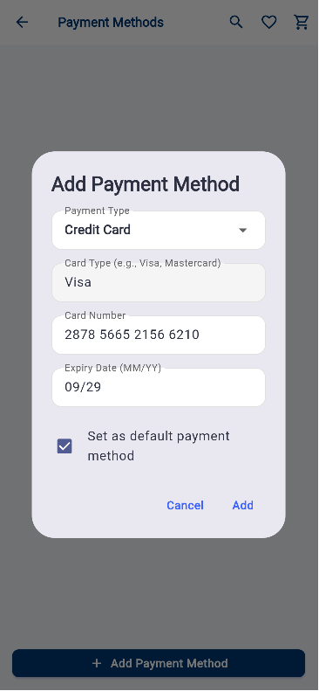
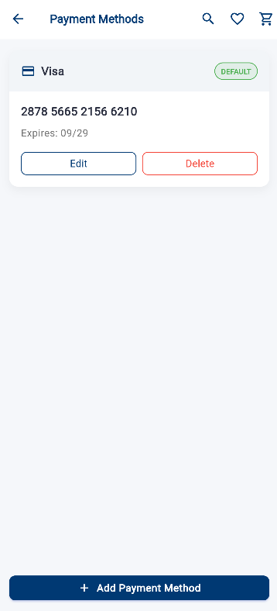
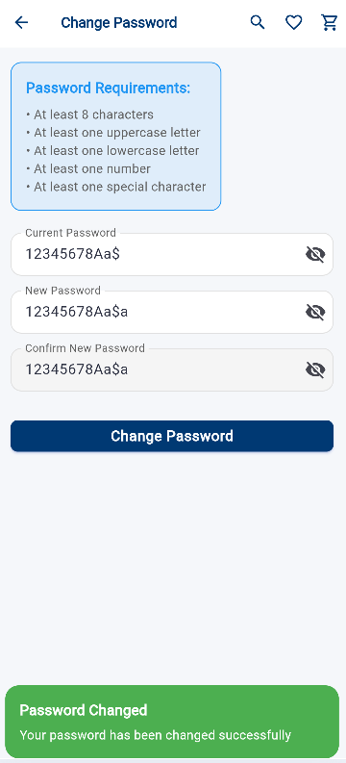
  Payment Method & Change Password

Slide 13
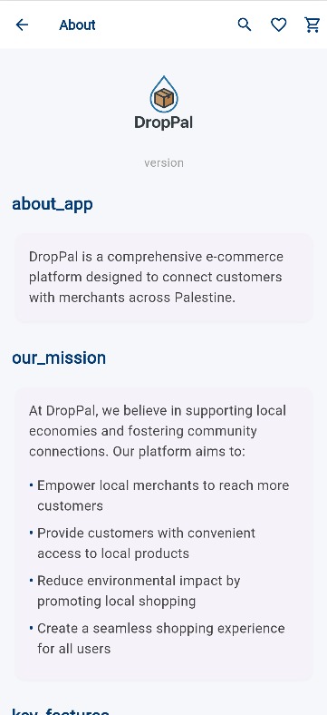
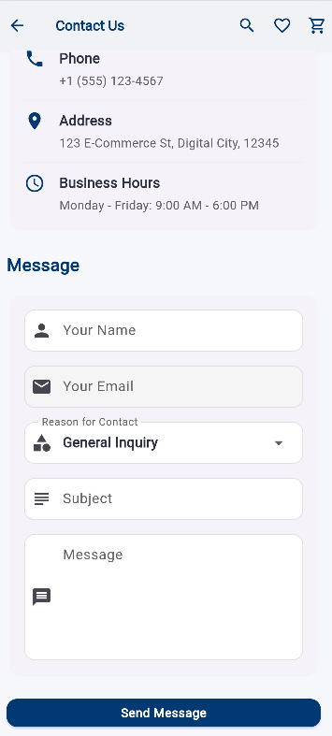
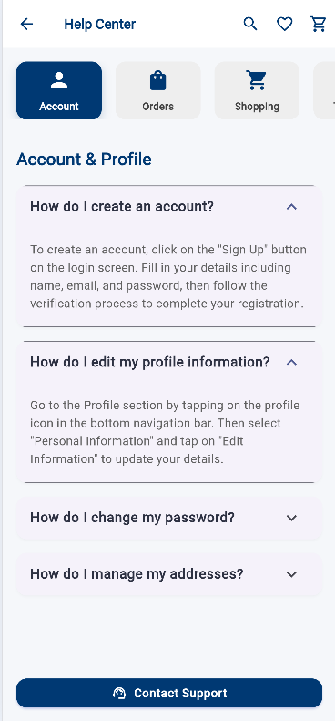
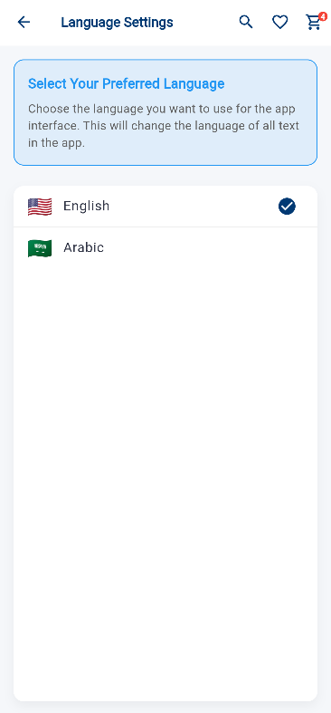
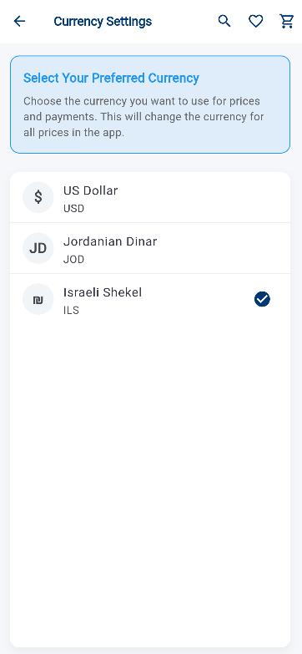
  Support & Setting

Slide 14
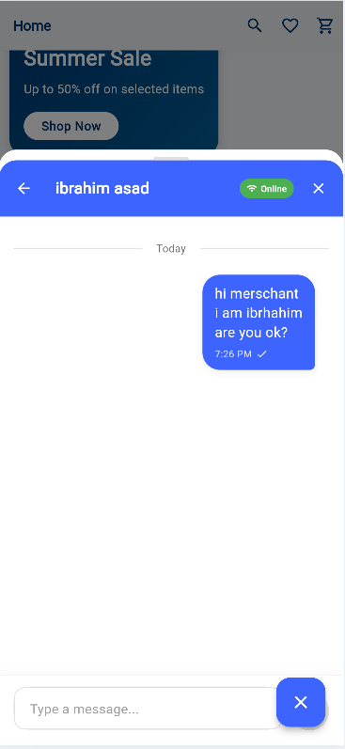
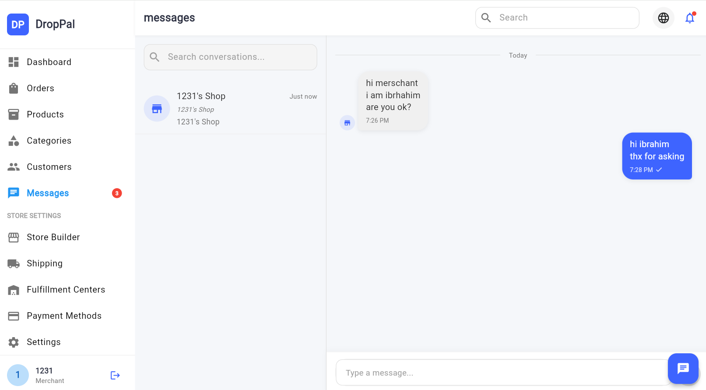
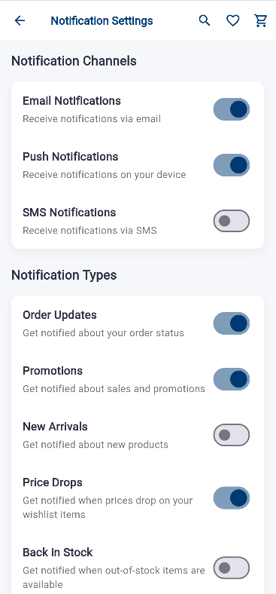
  Chatting System And Notification

Slide 15
Merchant Side

Slide 16
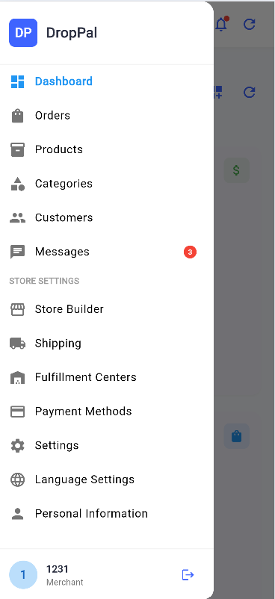
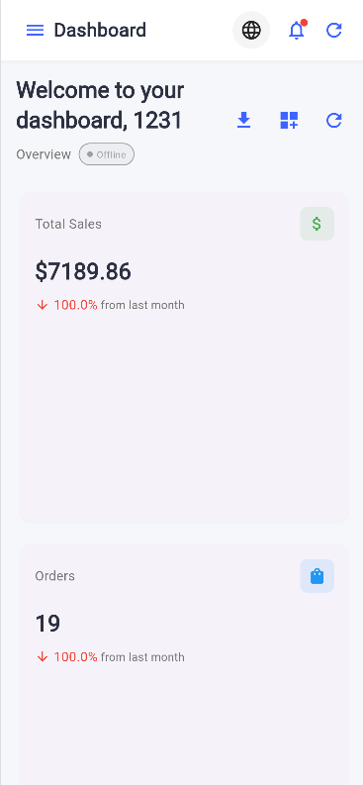
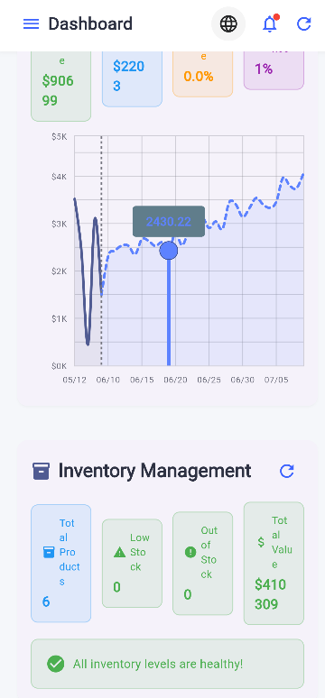
  Merchant Dashboard

Slide 17
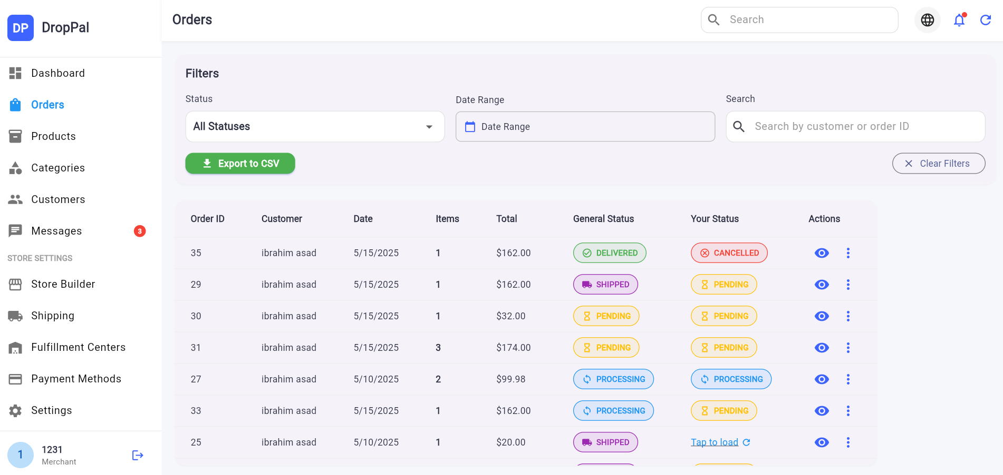
  Orders

Slide 18
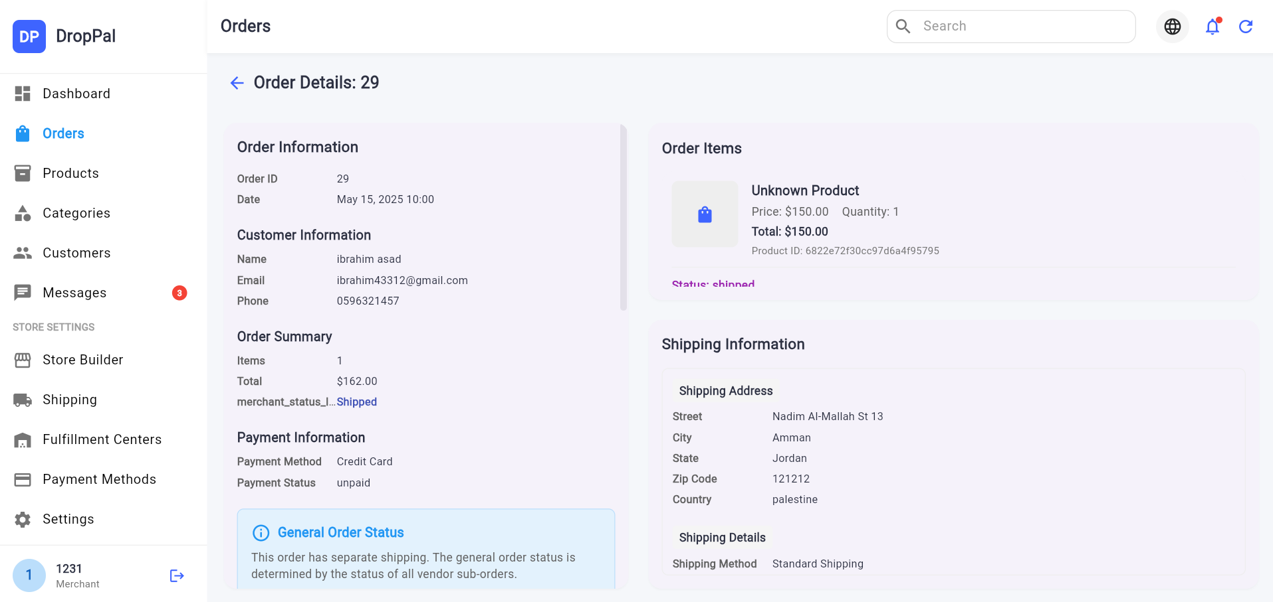
Orders Details

Slide 19
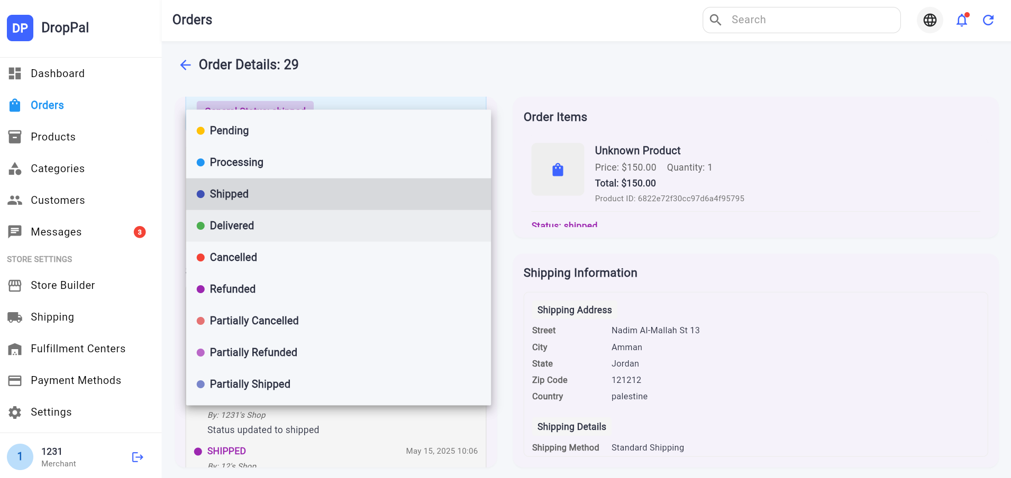
Orders Details

Slide 20
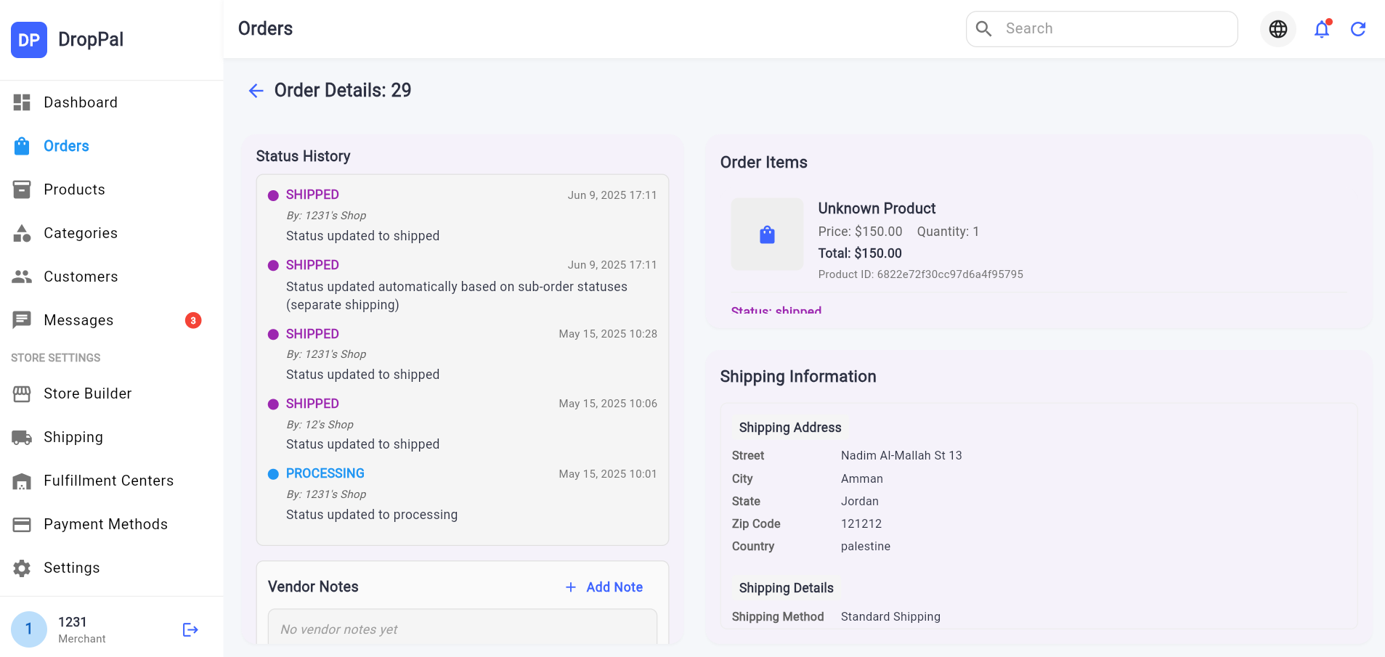
Orders Details

Slide 21
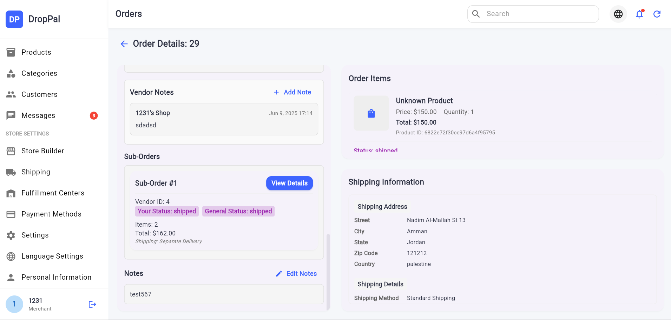
Orders Details

Slide 22
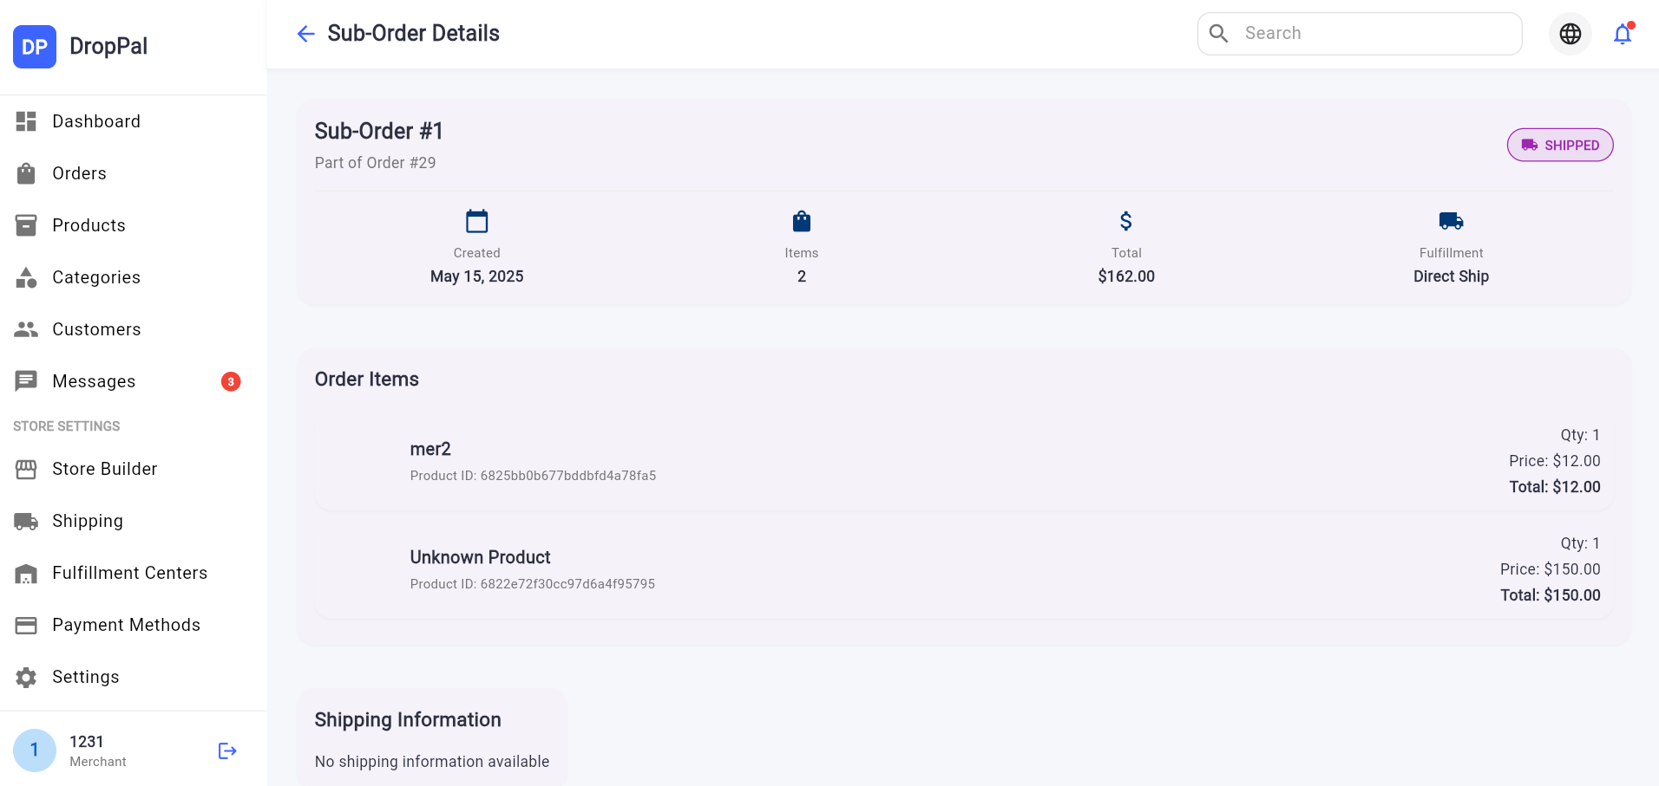
SubOrders Details

Slide 23
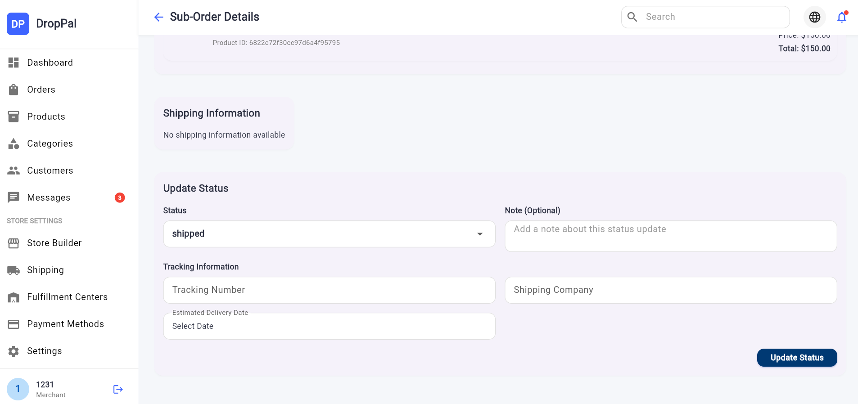
SubOrders Details

Slide 24
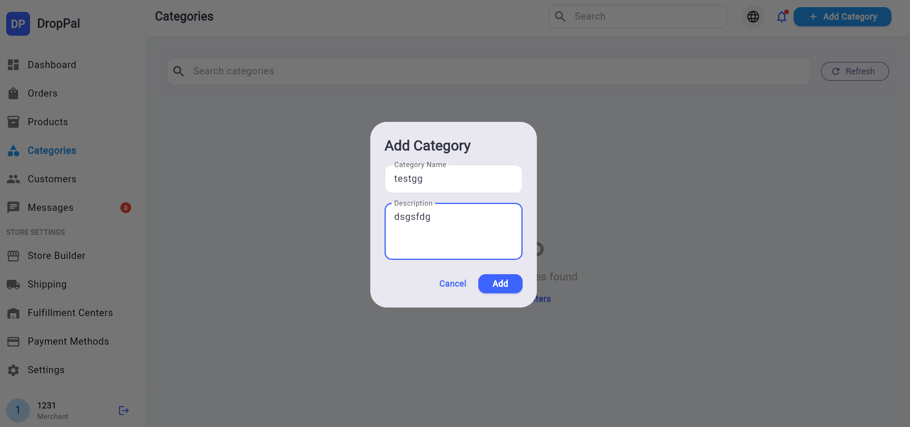
Categorys

Slide 25
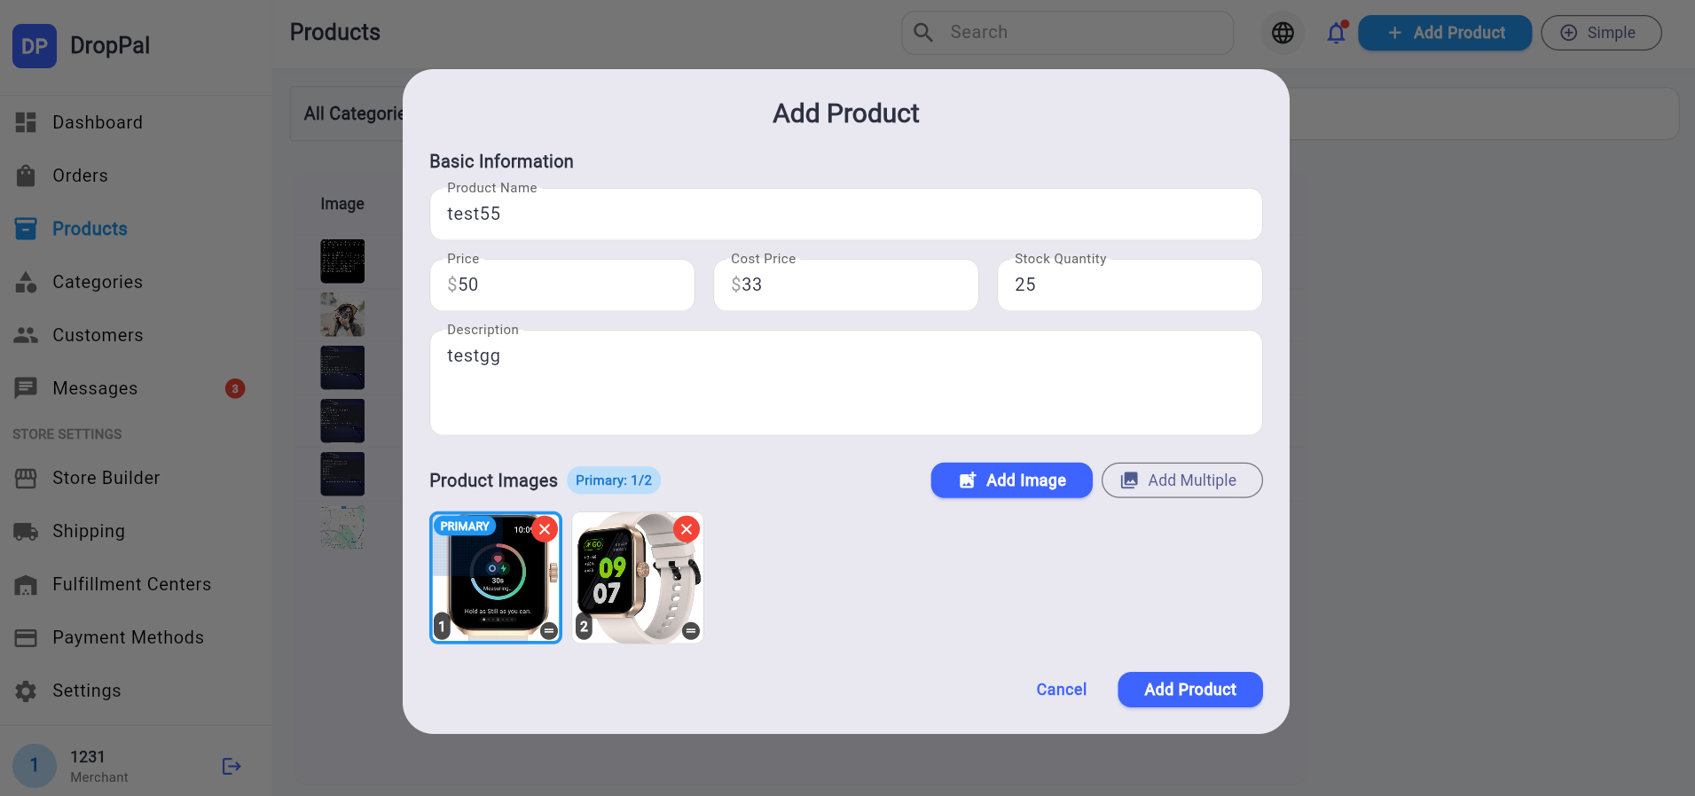
Add Product

Slide 26
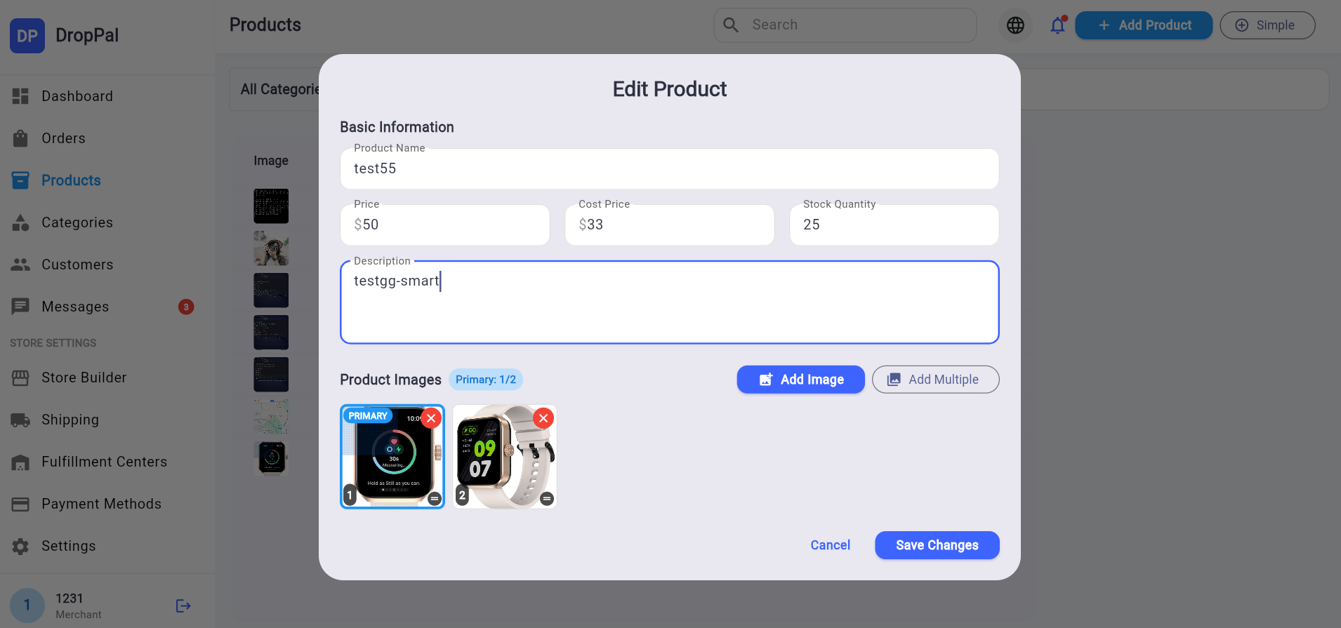
Edit Product

Slide 27
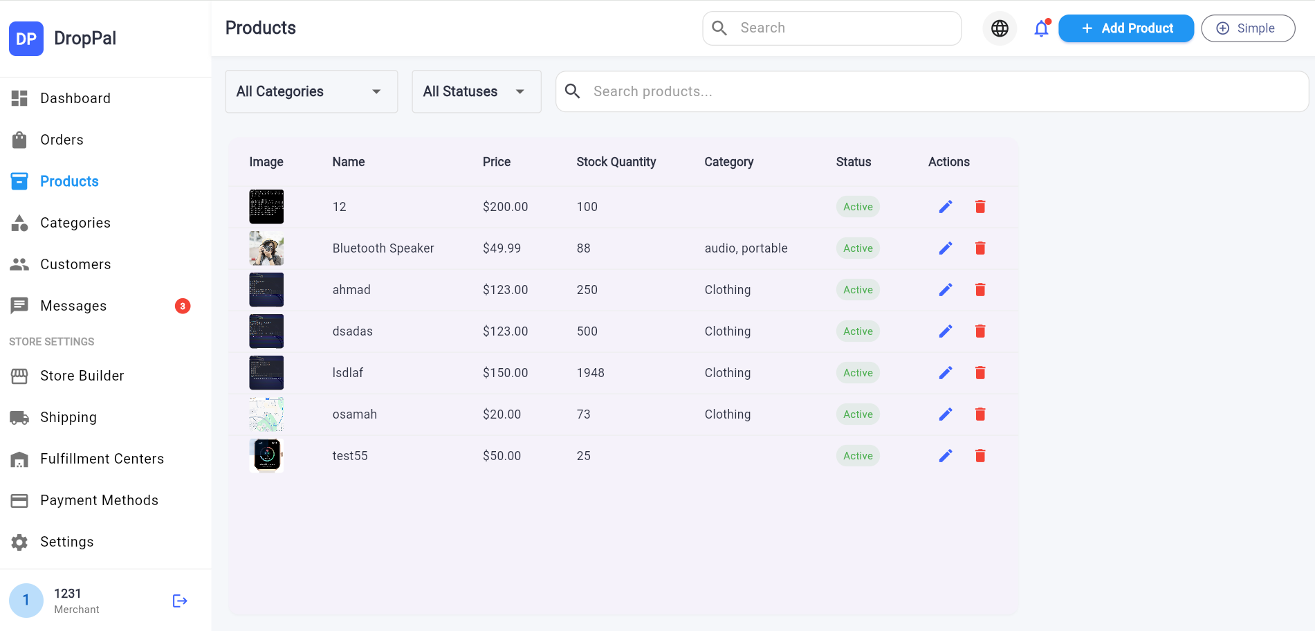
Products

Slide 28
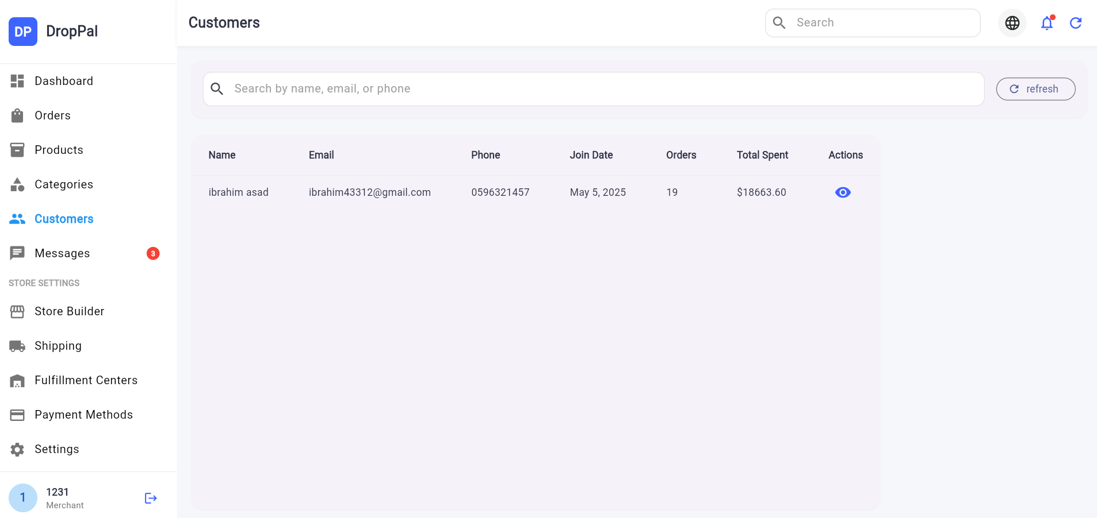
Customers

Slide 29
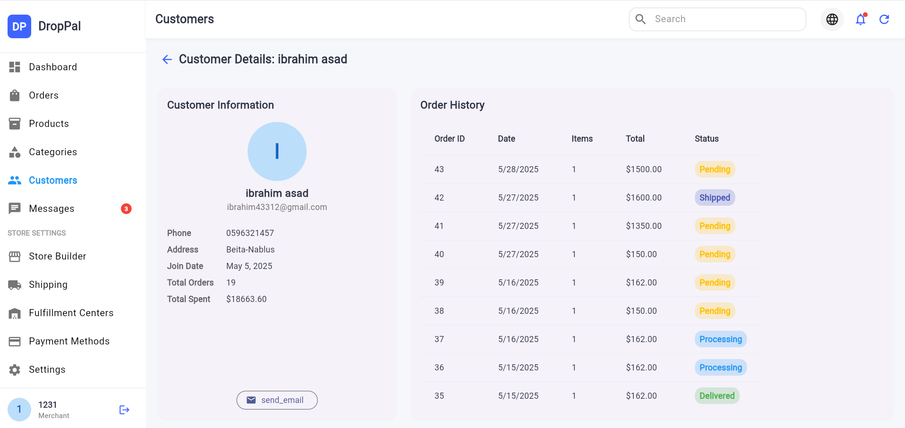
Customers Details

Slide 30
Generate your store

Slide 31
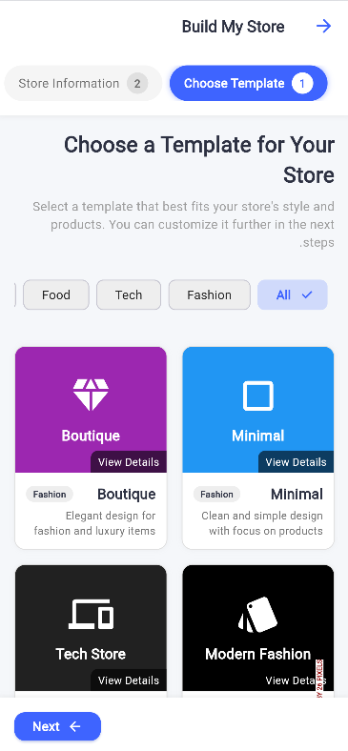
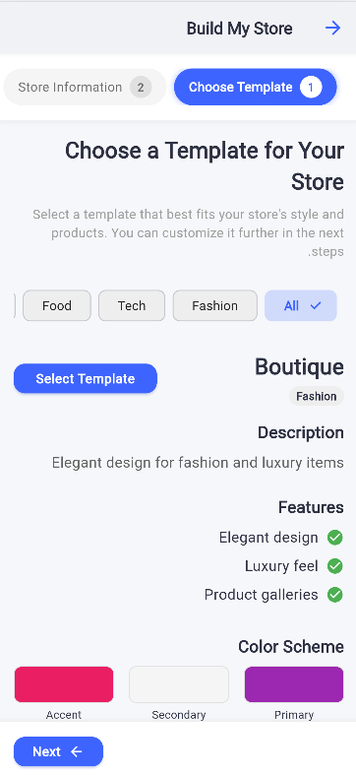
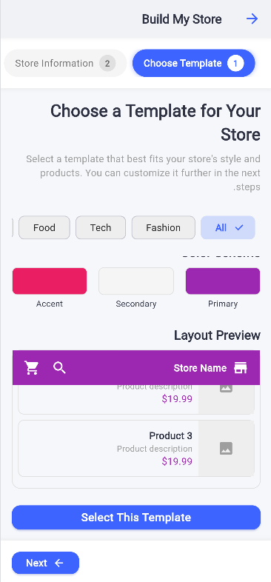


Slide 32





Slide 33

Home Page For Generated store

Slide 34

Admin Dashboard For Generated store

Slide 35









Technologies
Backend
Database
Frontend

Slide 36
Localization

Slide 37





Slide 38




Slide 39
Admin Dashboard

Slide 40


Slide 41


Slide 42


Slide 43
Future Work
  Notification System
  Payment System
  Enhance the UI of some pages.
  Enhance chat page.
  Publish app to app store.

Slide 44
Any Questions?
Explore Now

Slide 45
Thank you for
Listening

