Slide 1
Smart Home
Presented by:-
Aseel Fuad Khaseeb
Noor Fathallah Deek
Supervisor:-
Dr.mohannad al-jabi

Slide 2
Outline
Objective of the project.
Main Features.
Literature Review.
System Model .
Tools.
Constrains.
Conclusion.
Future Work.

Slide 3
objective of the project
The main objective of the project is to provide protection, safety and rationalization of electricity consumption

Slide 4
Main Features
We use Mobile application to control many things in home like fan, door lock, water pump and led.
The application also alerts home owners in the event of a fire or theft.
The app shows temperature and humidity.

Slide 5
Literature Review
Node MCU VS (Arduino + wifi)
Node MCU VS (Arduino + Bluetooth)

Slide 6

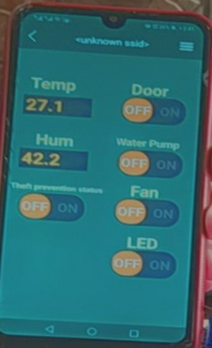

System Model

Slide 7
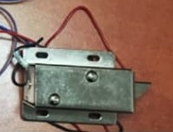
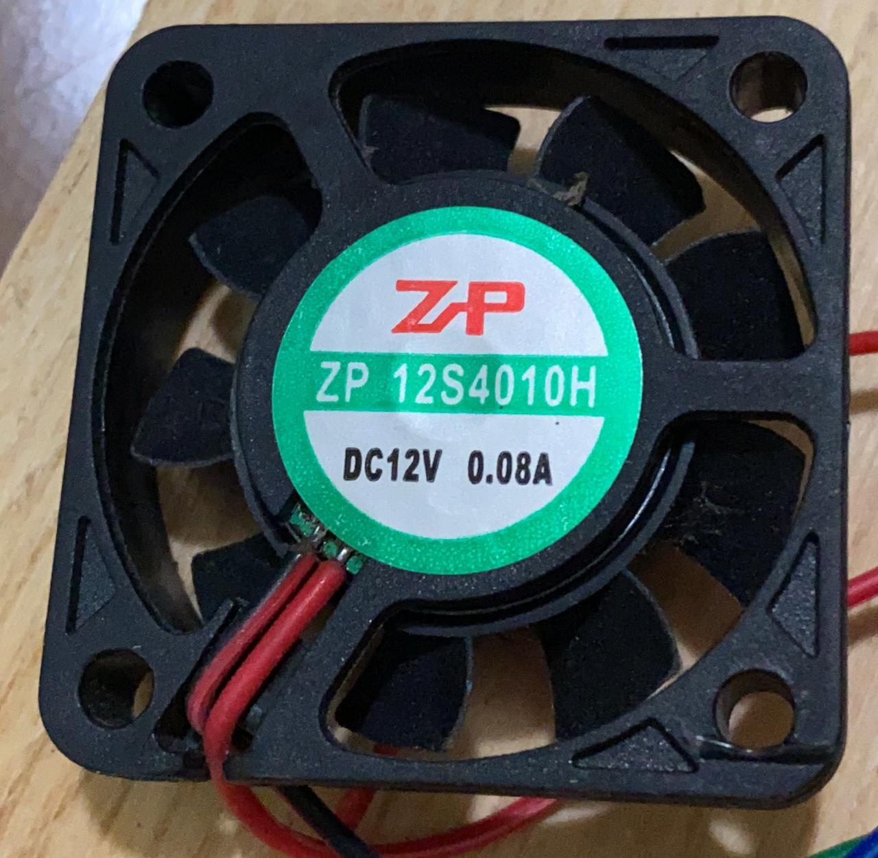
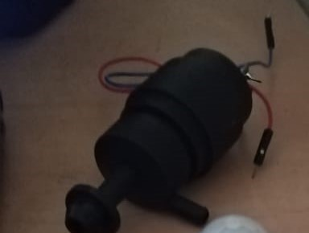

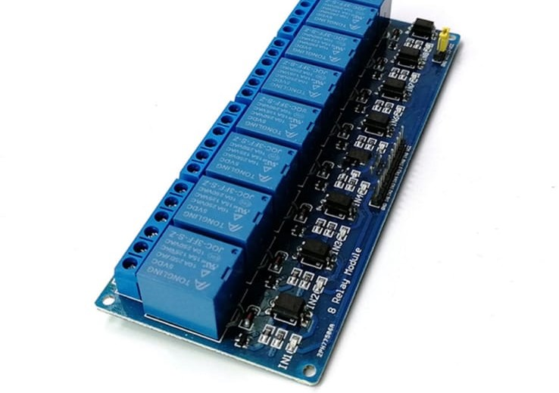
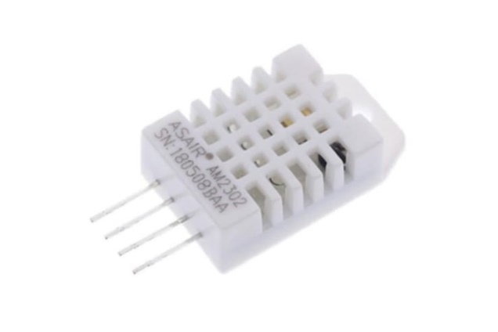
Tools
Door lock
Fan
Water pump
Led
Relay
DHT

Slide 8
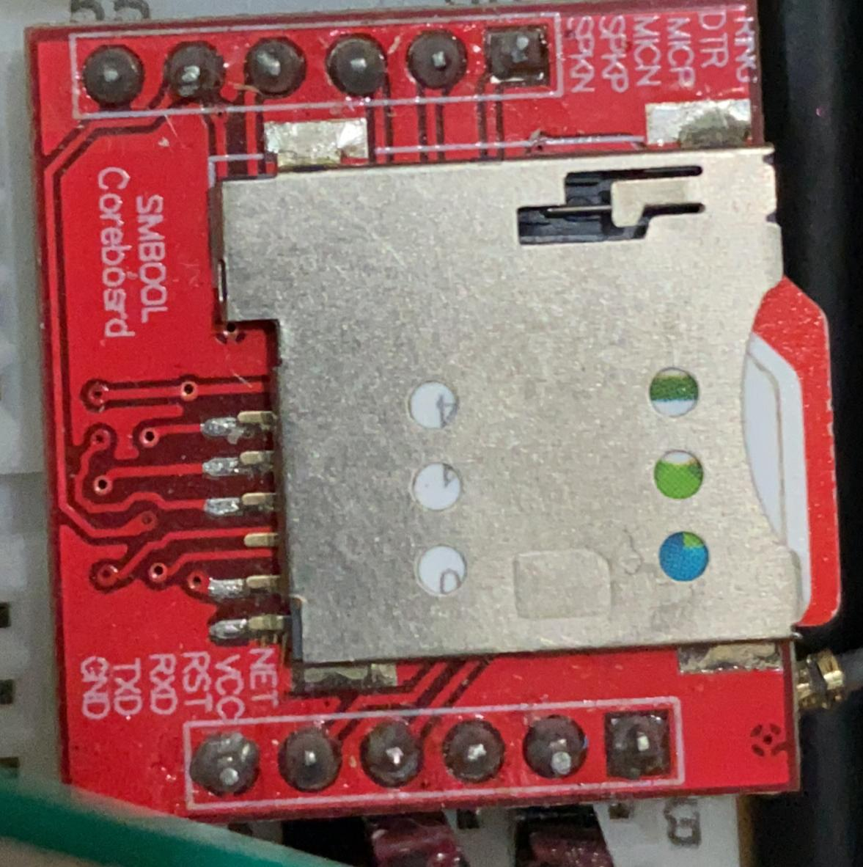
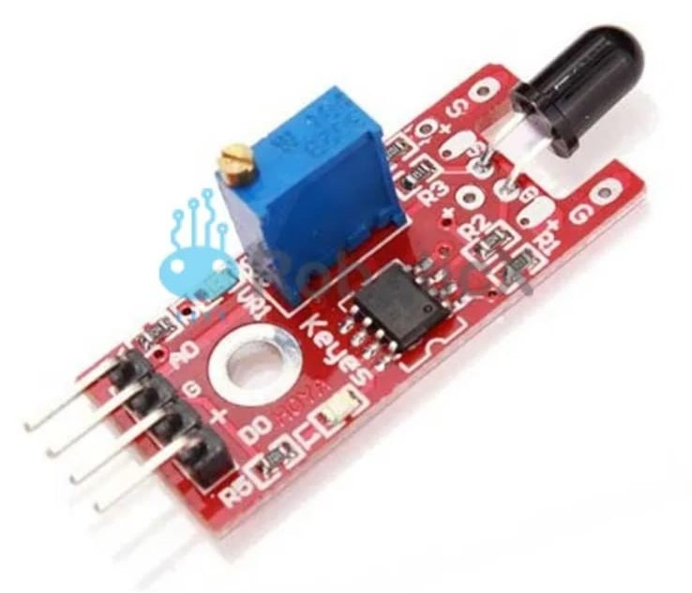
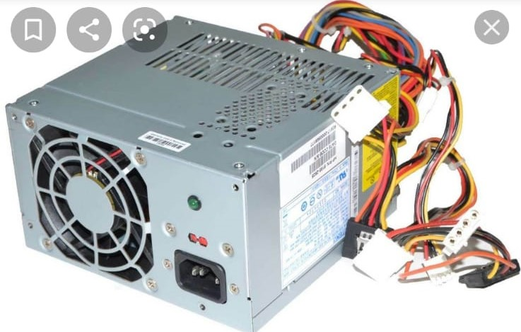
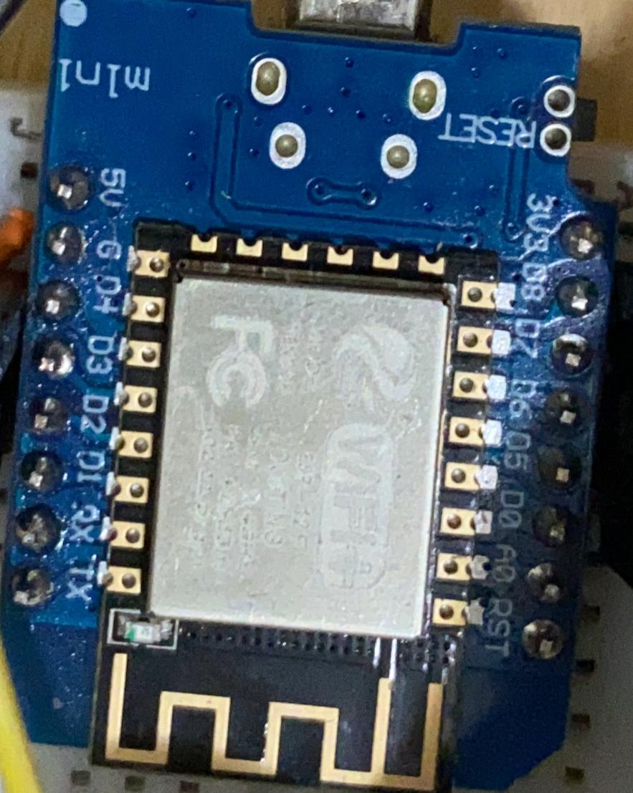
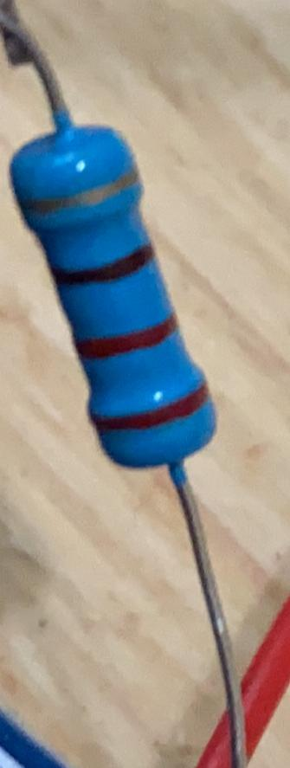
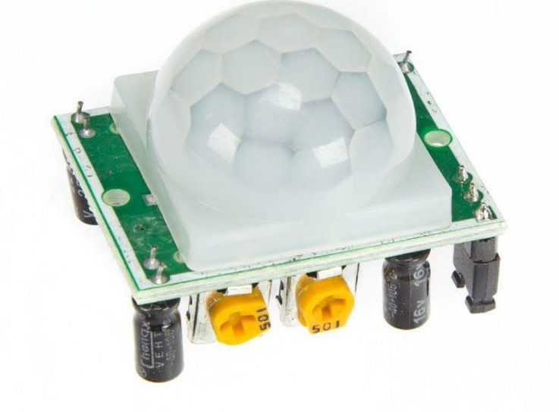
Tools
GSM
Flame Sensor
Power Supply
Node MCU
Resistor
PIR

Slide 9
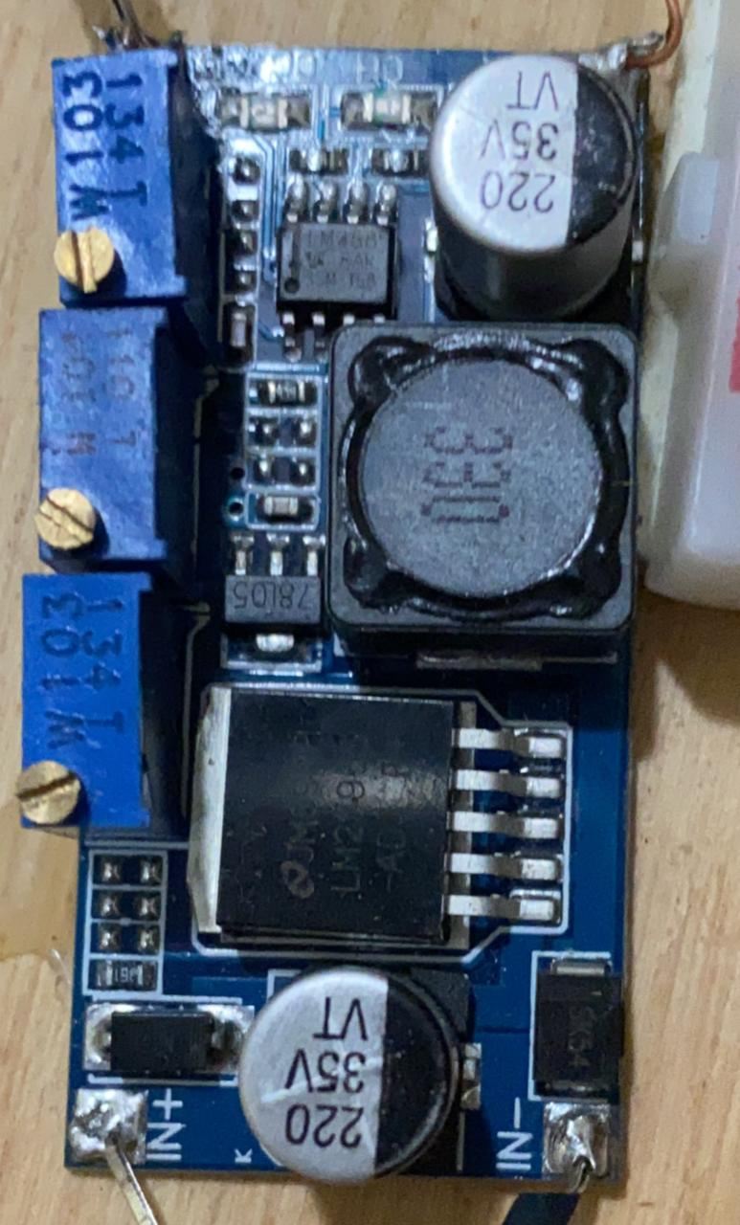
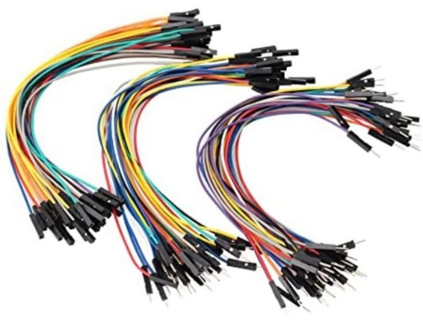
Tools
Regulator
Wires

Slide 10
Constrains
Hardware problem:
When we wired the circuit, the GND side of each block was wired alone with the power supply, the problem was that the GND must be unified between the parts, the Node MCU and the power supply.
Software Problem:
We encountered a problem when programming the Theft button to reconcile and distinguish between two things. When the off button is on a specific command related to lighting must work, and when it is On a movement related command in the event of theft must work.

Slide 11
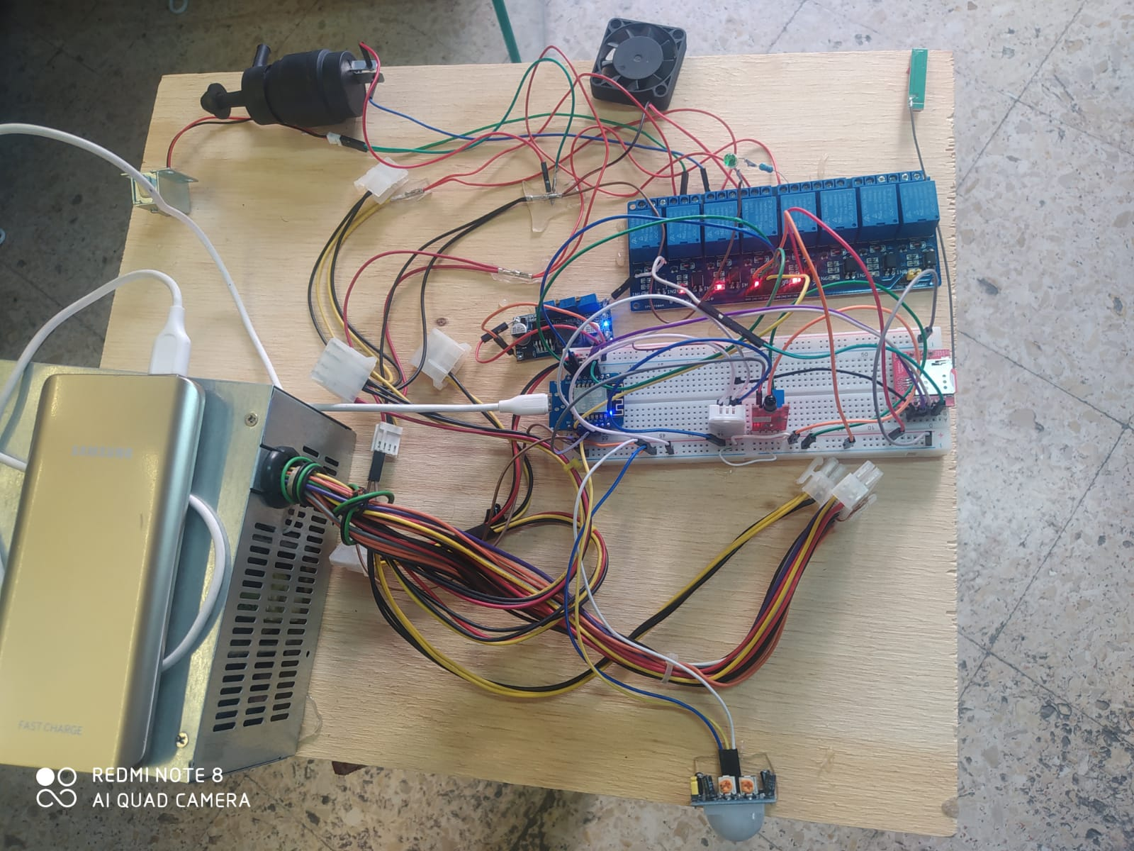
Conclusion
In conclusion, our project benefits the provision of protection for homes, as well as alerting in the event of a fire or attempts to steal homes, so an alarm sounds, and a phone call is made to a family member, ​so that the owner of the house is reassured while he is outside his home

Slide 12
Future Work
In the future, we can use a special sensor to detect a gas leak
Controlling closing and opening windows

Slide 13
Thank you

