Slide 1
Graduation Project 2
Bag Plus
Suhaib Hamdallah and Mohammad Abu-Qasedo

Slide 2
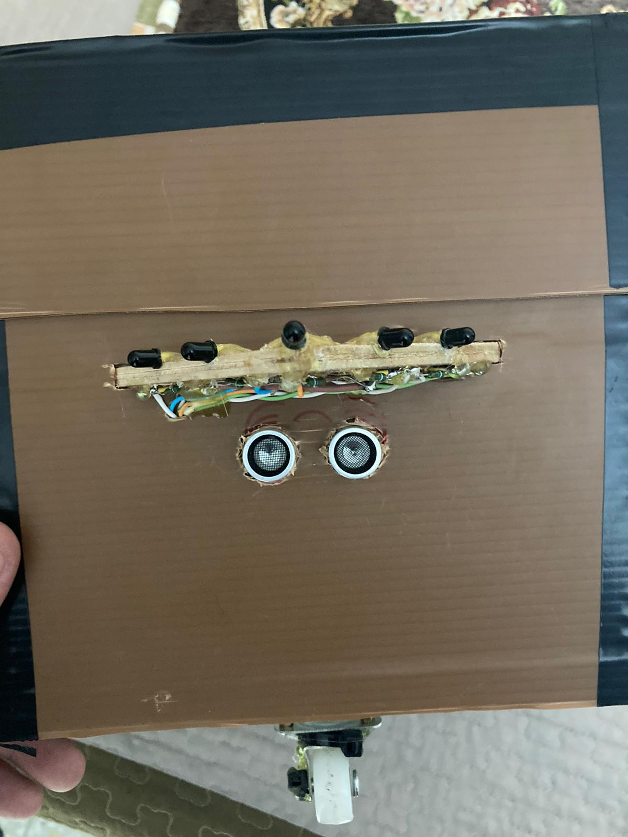
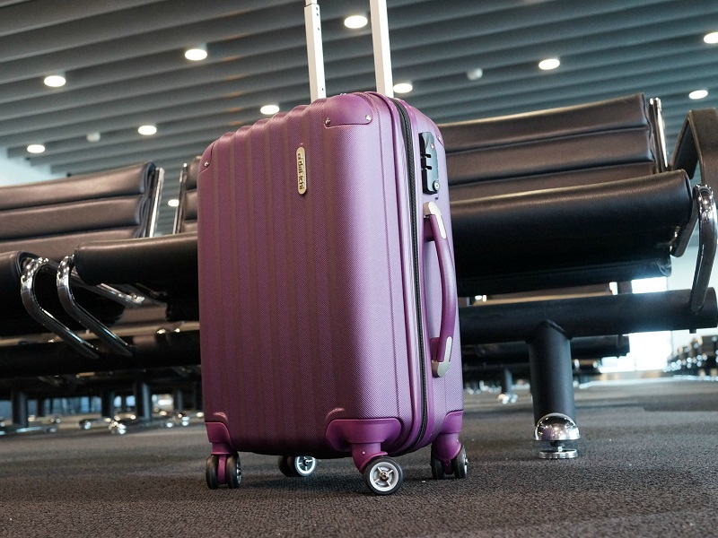
The idea:
Annoying
Can’t be abandoned

Slide 3

Objectives:
Smart, easy and secure. That’s all.

Slide 4
Technical Choices:
Arduino Mage 2560
L298N Dual H-Bridge Motor Controller
GPS Module NEO-6M
A6 GSM Module
HC-05 Bluetooth
RFID
Ultrasonic sensor
Servo Motor
Buzzer
DC Motor
Infrared Sensors
20 1.5 volt batteries

Slide 5
Results
In the demo video.

Slide 6
Thanks!

