Slide 1

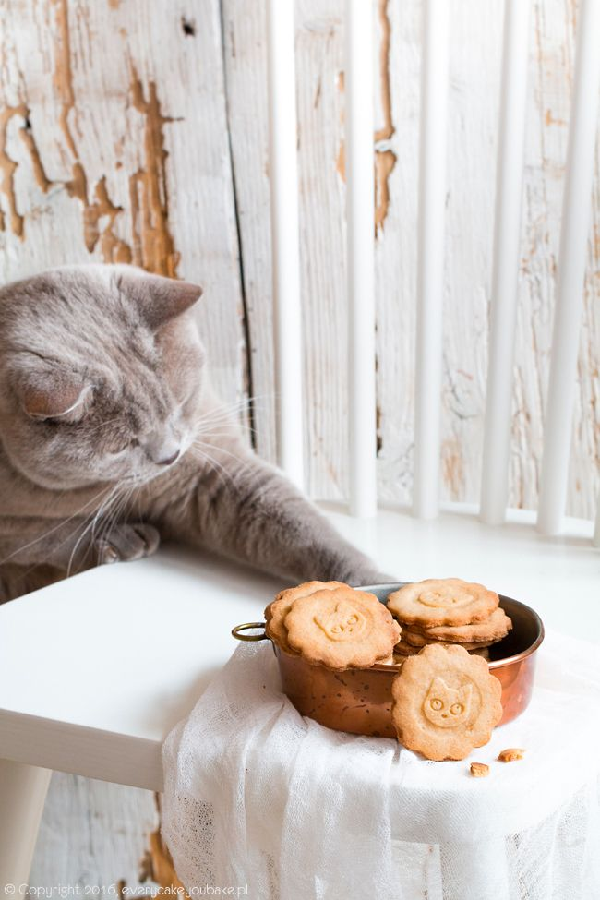















Cat Automatic Feeder
&
Litter Box Cleaner
By:
Ileen Shaar
Manar Mayyaleh
Supervisor:
Dr.Manar Qamhieh

Slide 2
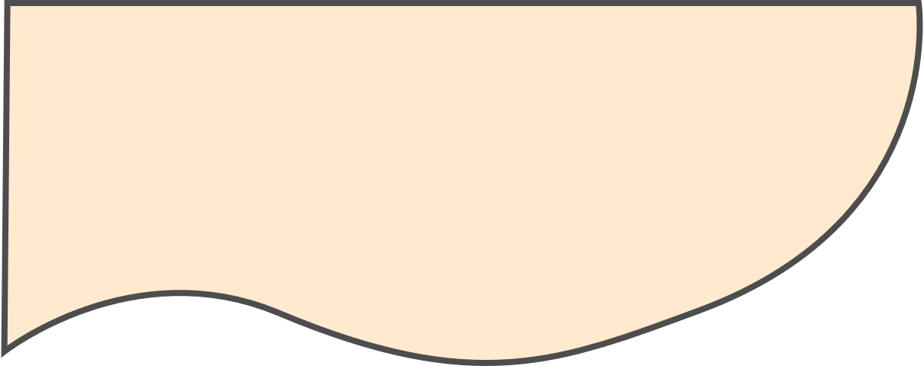


Table Of Contents
01
About Us
What is our project about?
02
Design
How we manage to design our project
03
Features & Methods
How it stands-out?
04
Components
Components used to make our project
05
Constraints
Problems & limitations
06
Future Work
Improvements on our project

Slide 3
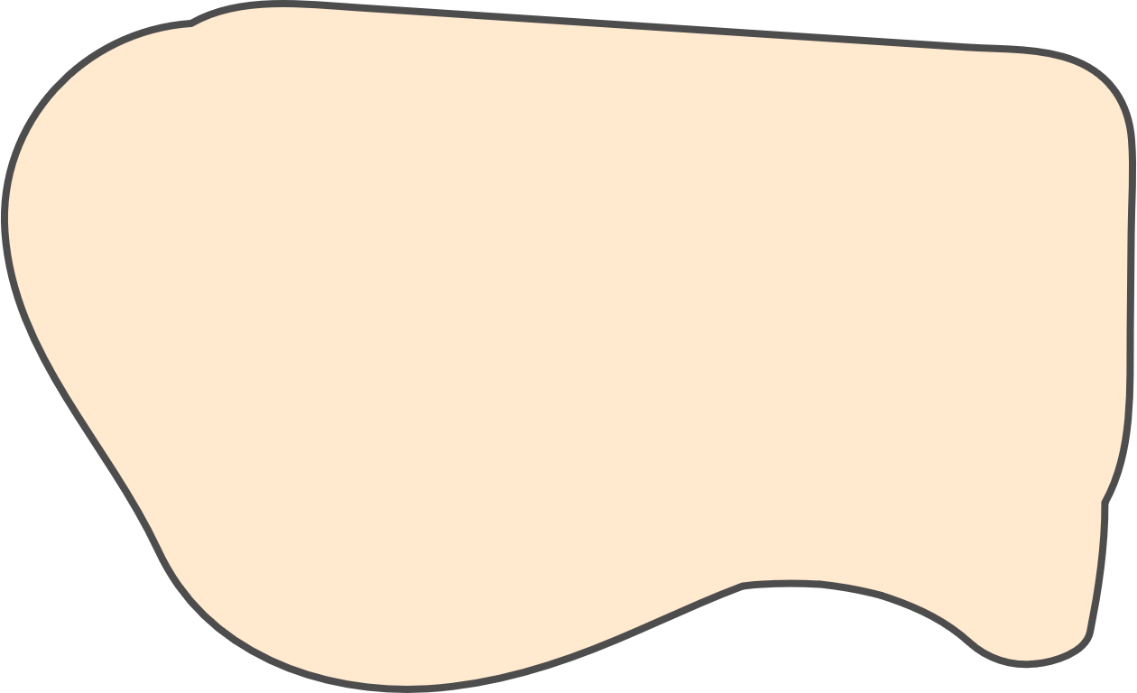



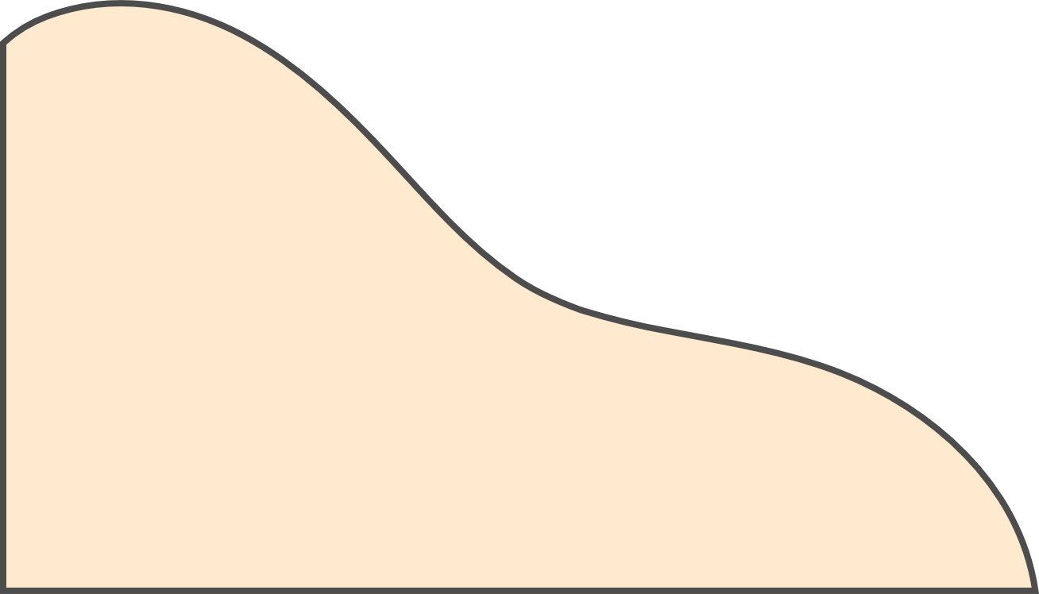

What is Cat Automatic Feeder and Litter Box Cleaner?

Slide 4



Parts of Cat Automatic Feeder and Litter Box Cleaner
Cat Feeder
Schedule meals and set portions.
Water Supply
Automated process of providing water.
Self-Cleaning Litter Box
Automatic litter box can help by removing waste more frequently.

Slide 5
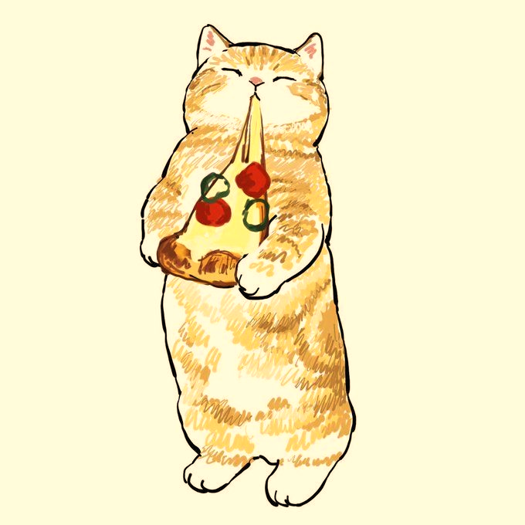
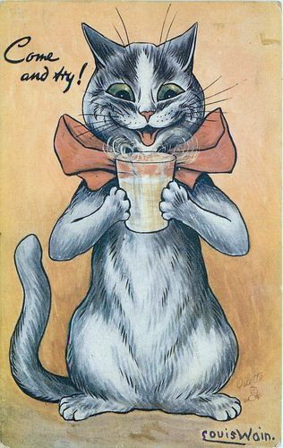
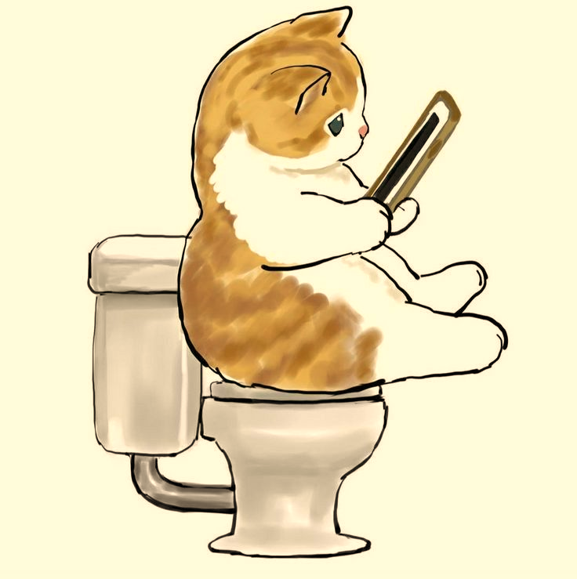



Motivation
Cat Feeder
Water Supply
Litter Box
Make sure the cat has clean and constant access to water
Owners don't have to worry about cleaning the litter box as much
Less responsibilities on the owner, regular schedules for the cat

Slide 6
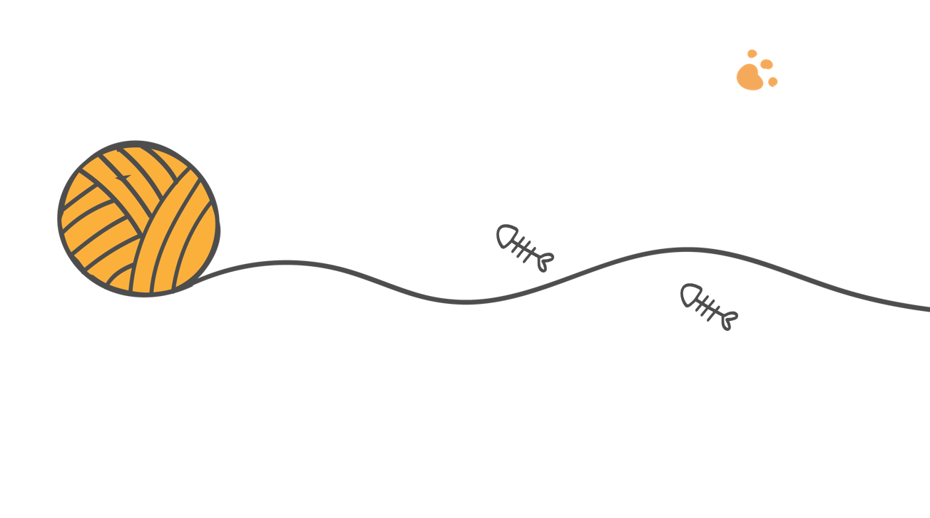

Features
When the water level drops below a certain limit, the bowl is filled. then emptied at the end of the day .
Water supply
Unity
PlayFab
Verbal and visual
C# is the programming language.
Microsoft Visual Studio is the IDE used for coding.
We used platform
-
specific authentication.
Parents have the option to track their child’s performance.
The data that is stored in the database provides information about the student’s knowledge.
Used to decide whether the student should progress or go back.
All of the food portions, drop numbers, start and end hours are determined by the owner.
Litter box
The litter box is self-cleaning.
Cat Feeder

Slide 7
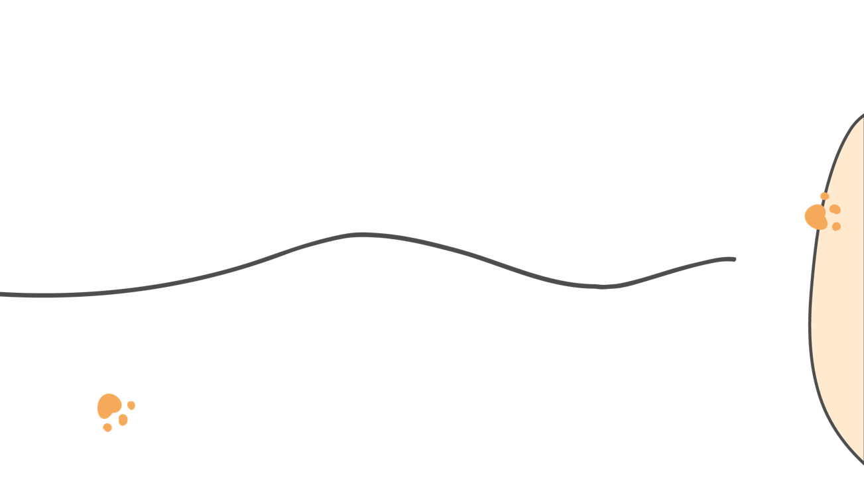
Features
On the project's website, owners can drop food or let the litter box clean itself at any time.
control
Verbal and visual
The data that is stored in the database provides information about the student’s knowledge.
Used to decide whether the student should progress or go back.
Alerting messages
Sends notifications via WhatsApp whenever the food container or water tank is near empty, as well as when an error occurs.

Slide 8
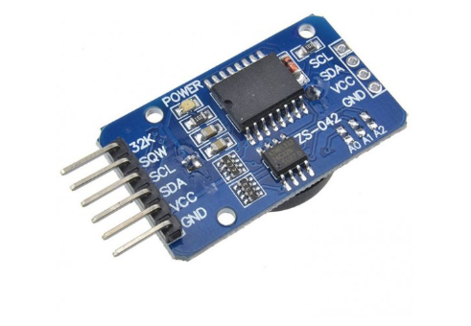
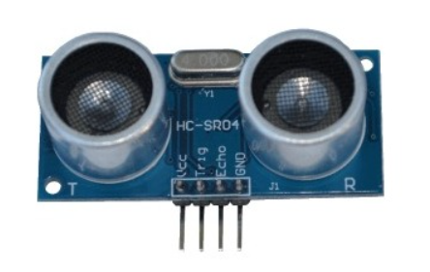
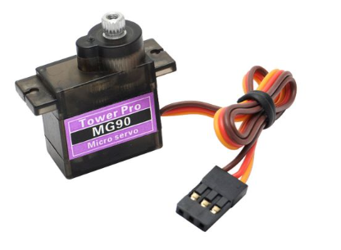
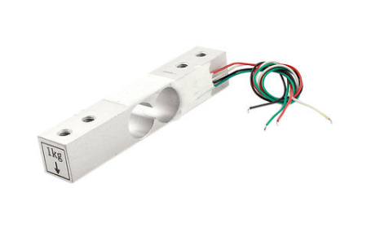
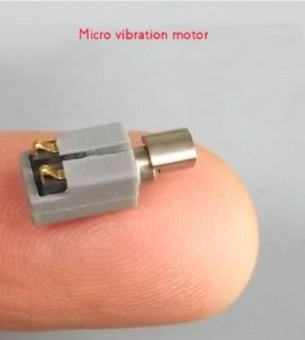
Feeder’s Components
DS3231 RTC
Ultrasonic sensor
Servo motor
Load Cell sensor 1KG
Vibrating Micro Motor

Slide 9
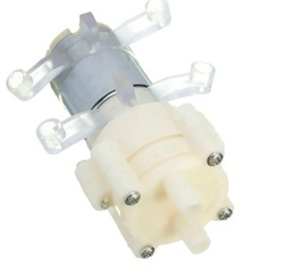
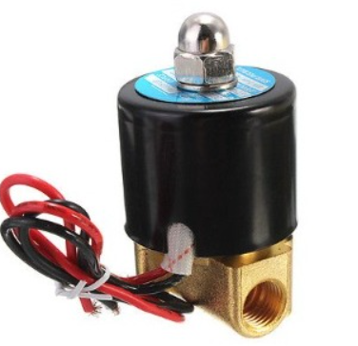
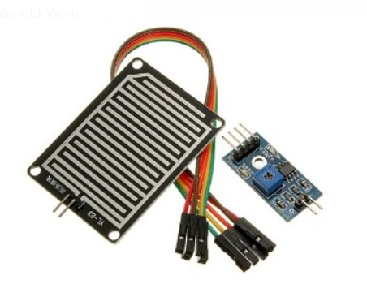
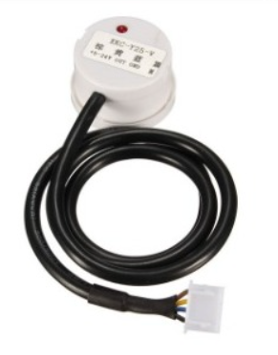
Water Supplier’s Components
Pump For Water
Solenoid Valve
Rain Drops Detection
Liquid Level Capacitive Sensor

Slide 10
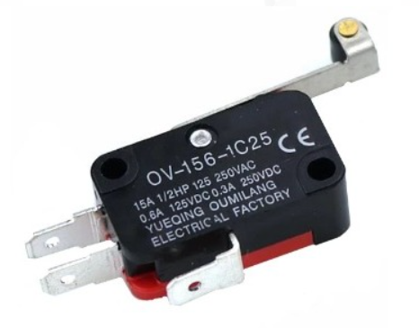
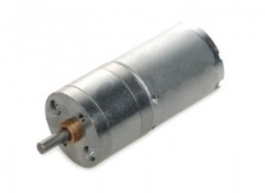
Litter box’s Components
Servo motor
Limit Switch Roller
DC Gear Motor

Slide 11

Constraints
Litter Box
Cat Feeder
Determine food amount
RTC
Budget

Slide 12
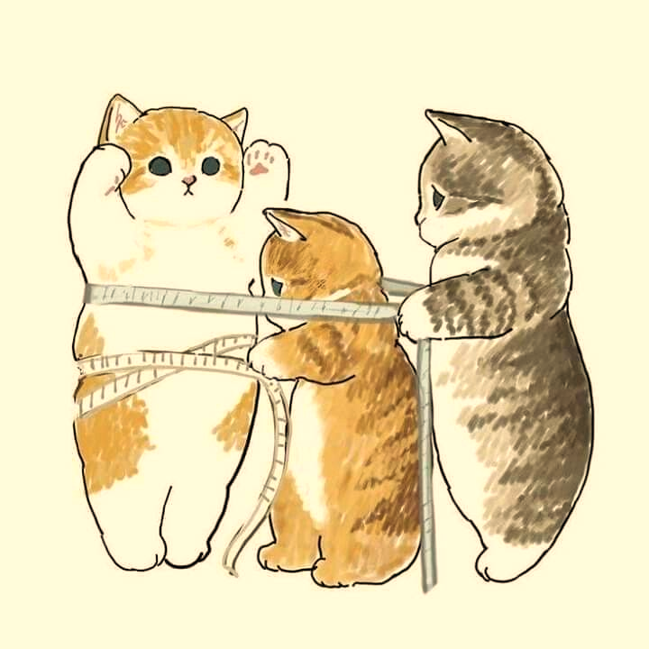
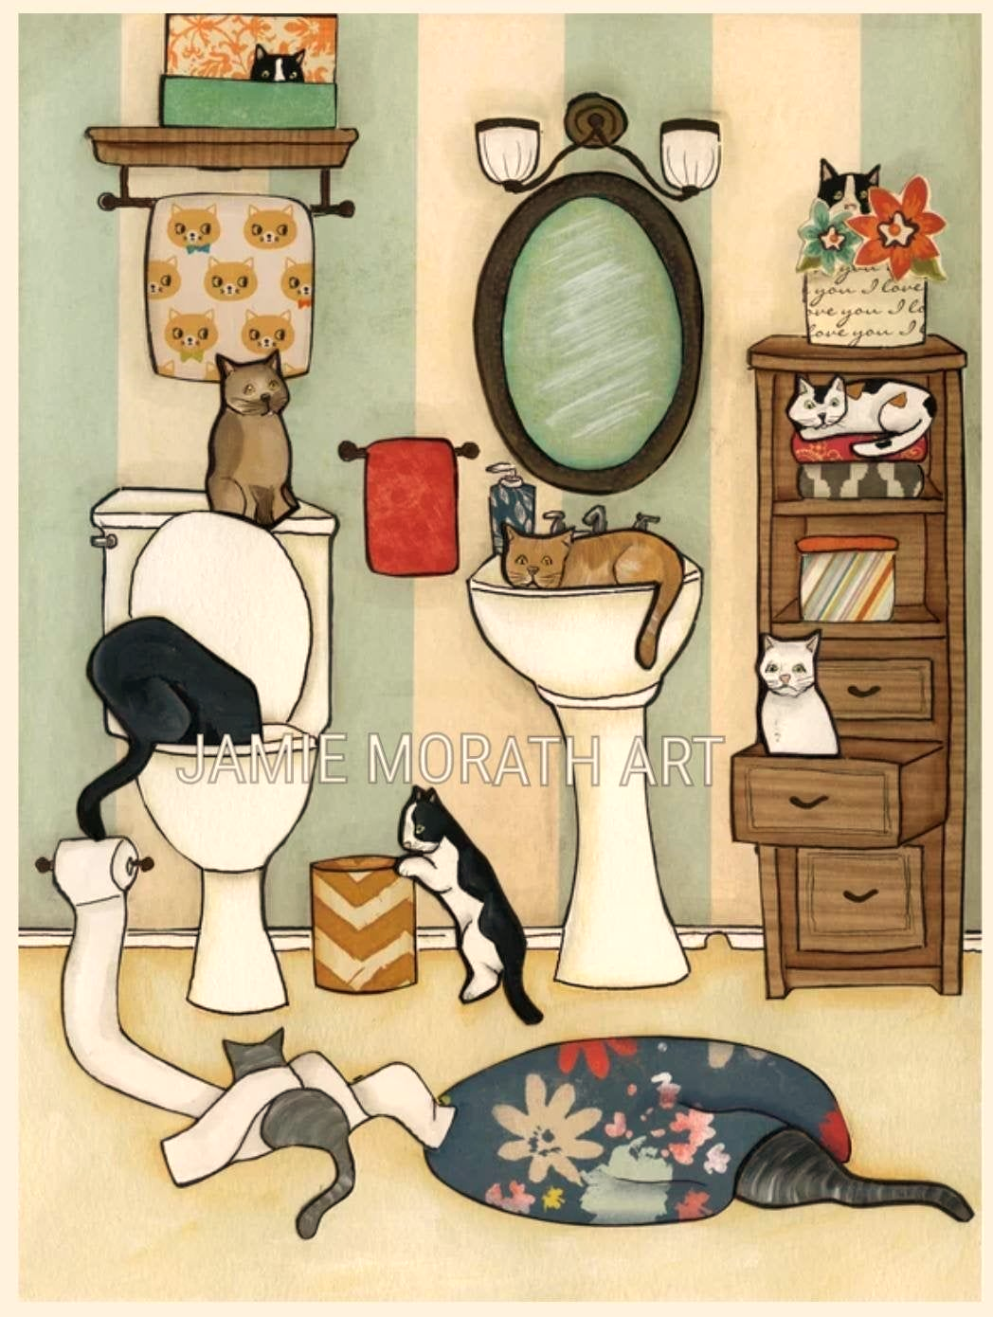

Future Work
It was noticed that the preschoolers got bored from playing the same games after reaching the ninth level and unlocking all the levels as the proposed game contains only 13 activities. This stage is an early research stage only to test the impact of the application, the game will be further developed.
Suitable for multiple cats
Litter box with a more convenient design
Tracking System
Automatic Toy

Slide 13
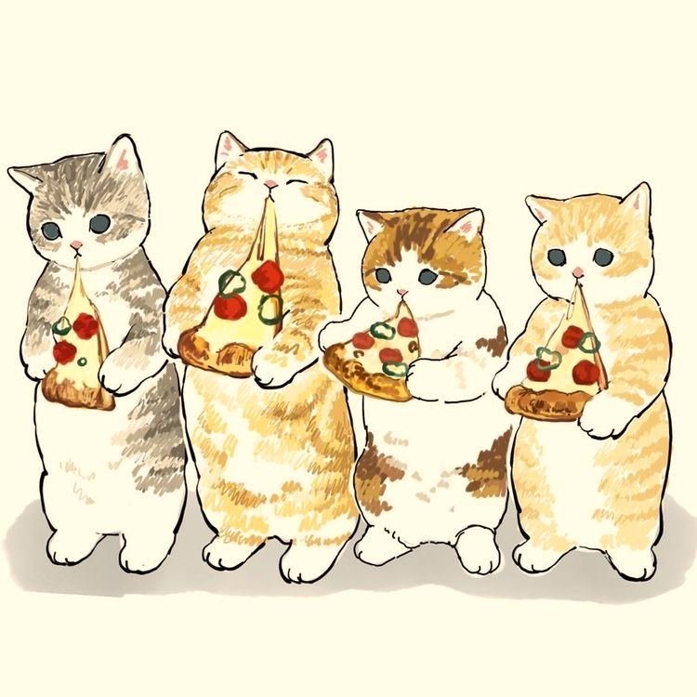
Thank You

