Slide 1
Sales Expert
System

Slide 2

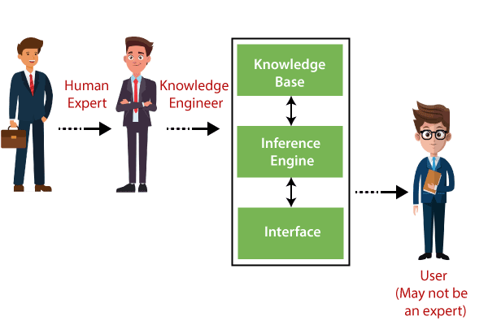
Details
Masa Younes
Yasmeen Marmash
Dr Ahmad Shraideh

Slide 3

Overview
Sales Expert system
AI application
Developed to store expert knowledge and don’t rely on him in every sale transaction accurse.
Tool we use

Slide 4
Sbitany Problem Sales E-S Solve
Branches Joint & Team Joint
Sales person not know about his section only
Always asking the expert

Slide 5
Goals
    Not reliance on expert .
    Assisting sales team .
    Predicting best product and advising customers.
    Justifying the conclusion.
    Suggesting alternative options.

Slide 6
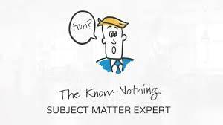
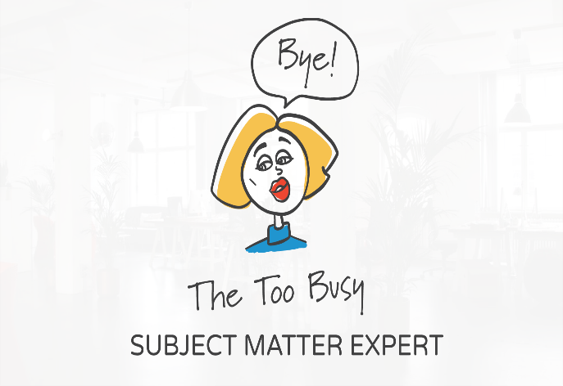
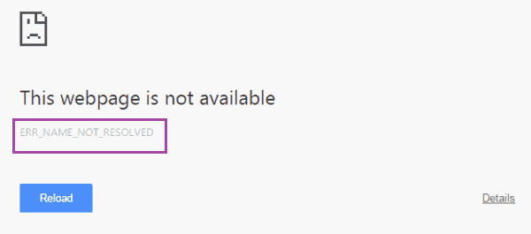
Problem in Building
Get the Knowledge directly and easily from expert.
Sbitany Website disability.
No central database

Slide 7


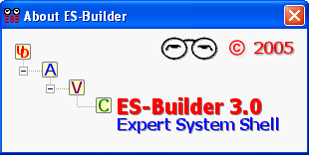
Problem in Tools
Main problem : All Expert system Software are paid and expensive
Days
Nodes
Device setting
Storge
Paid
Inference Engine.
Meta Rule.
Editable User Interface.

Slide 8

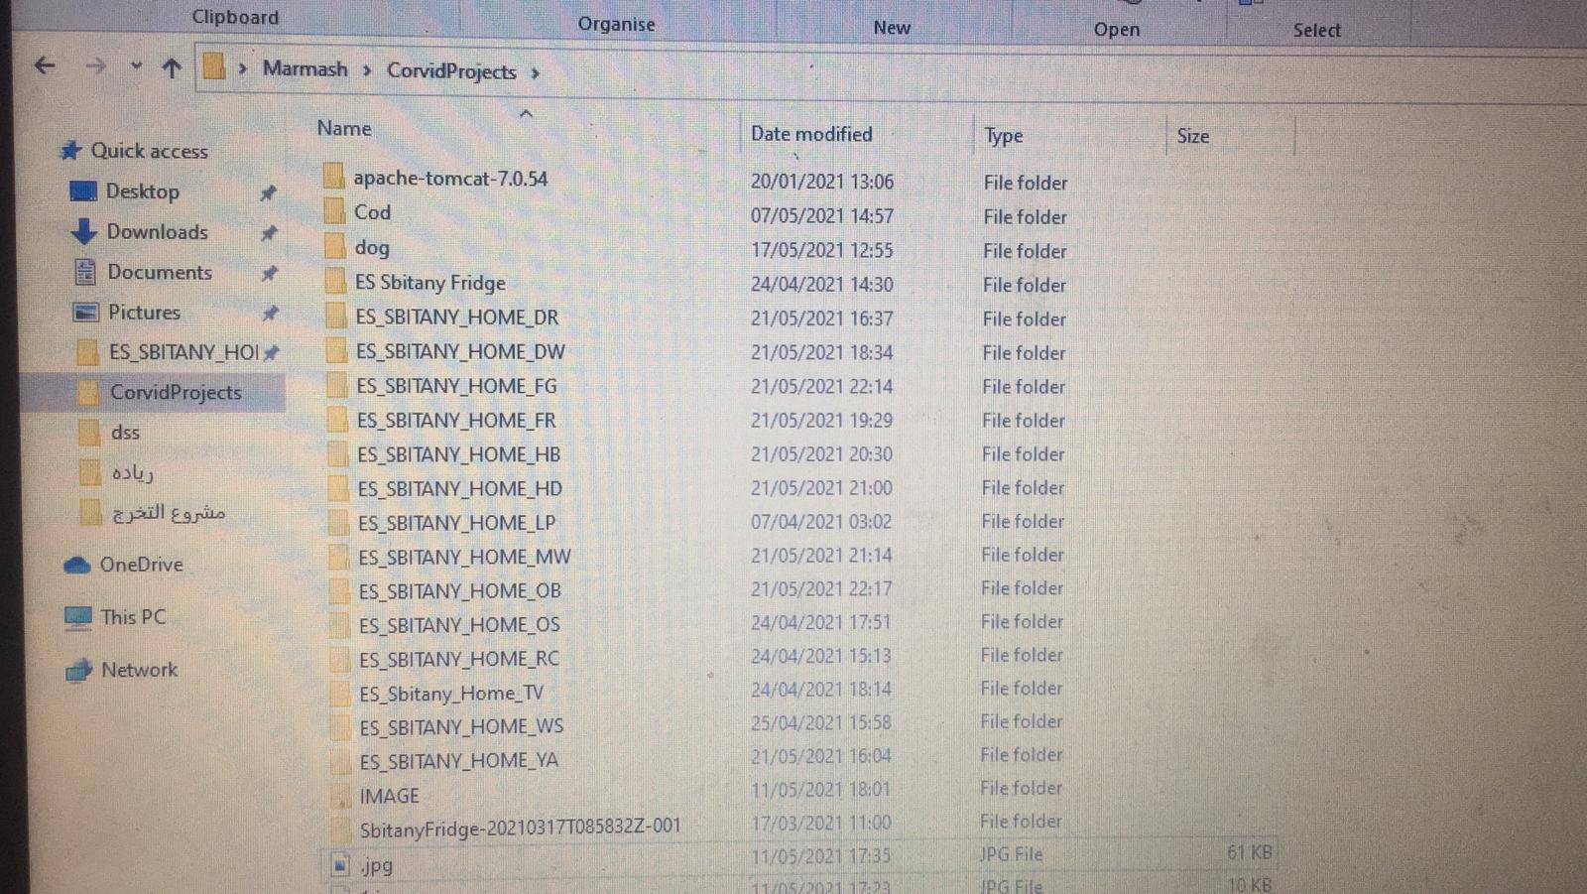
Solution
Single Project for each product.

Slide 9
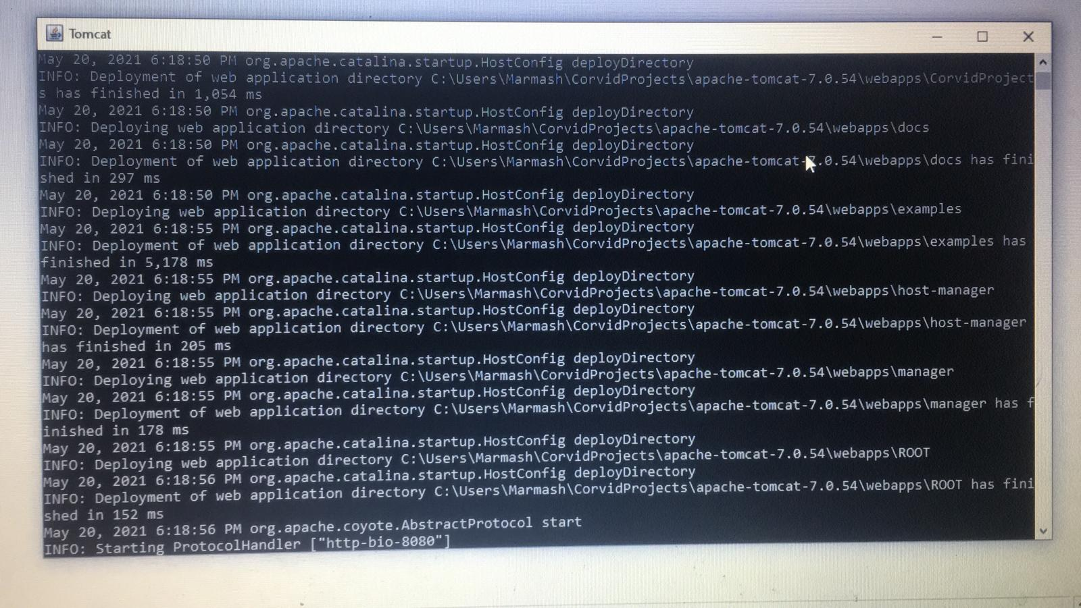
Solution
Stand alone web server Tomcat.

Slide 10
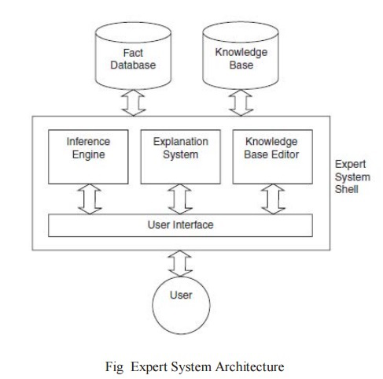
Achievements

Slide 11

Achievements
Obtain Explicit Knowledge from documents
Extract implicit Knowledge from expert
Categorize Knowledge and convert it into a form that the Corvid can understand

Slide 12
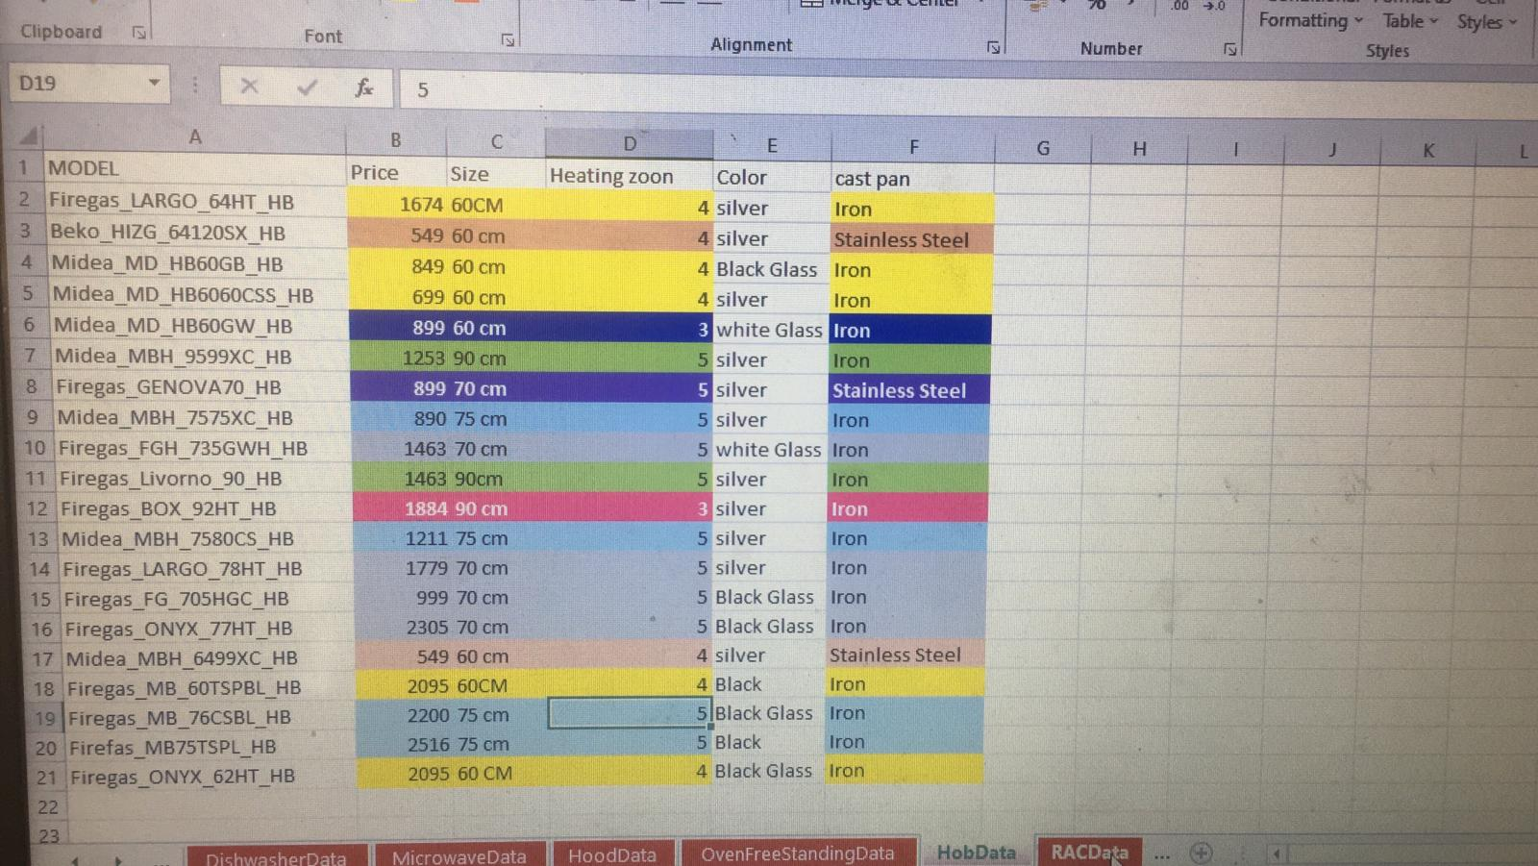
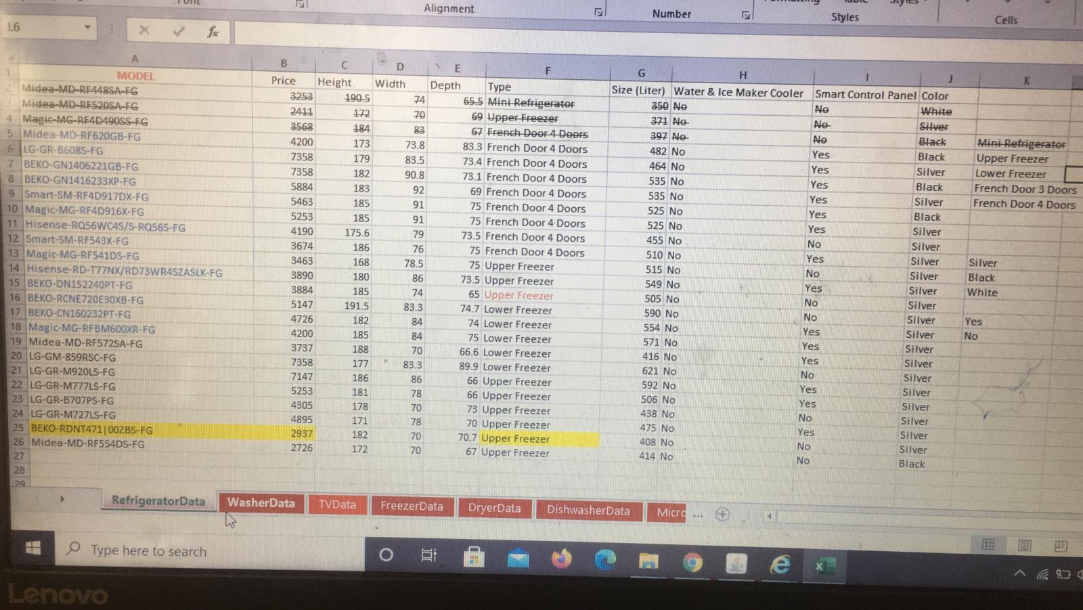
Achievements
Insert product information(Name and specification ) in database (Excel sheets )

Slide 13
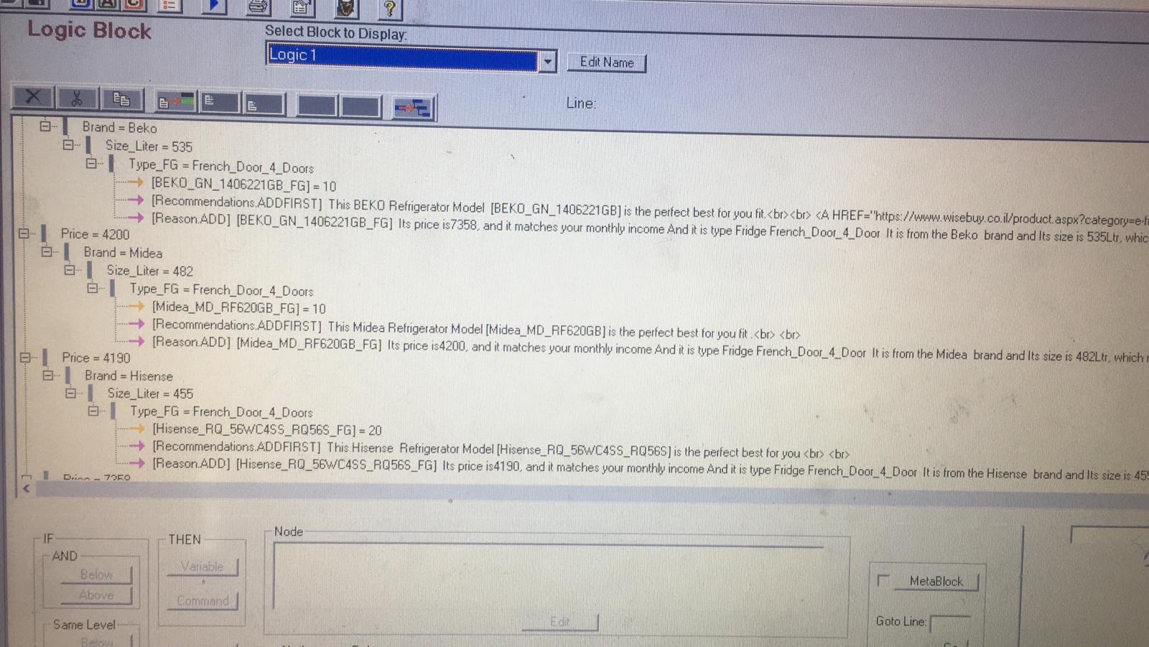
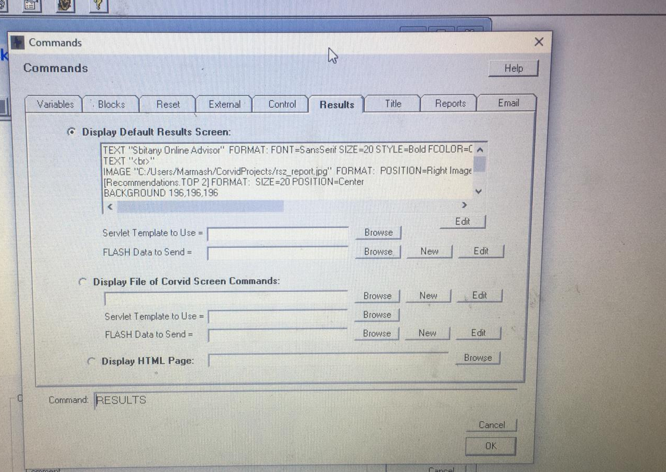
Achievements
Build Knowledge base(Logic Block that store rules)
Procedures (command leads inference engine )

Slide 14
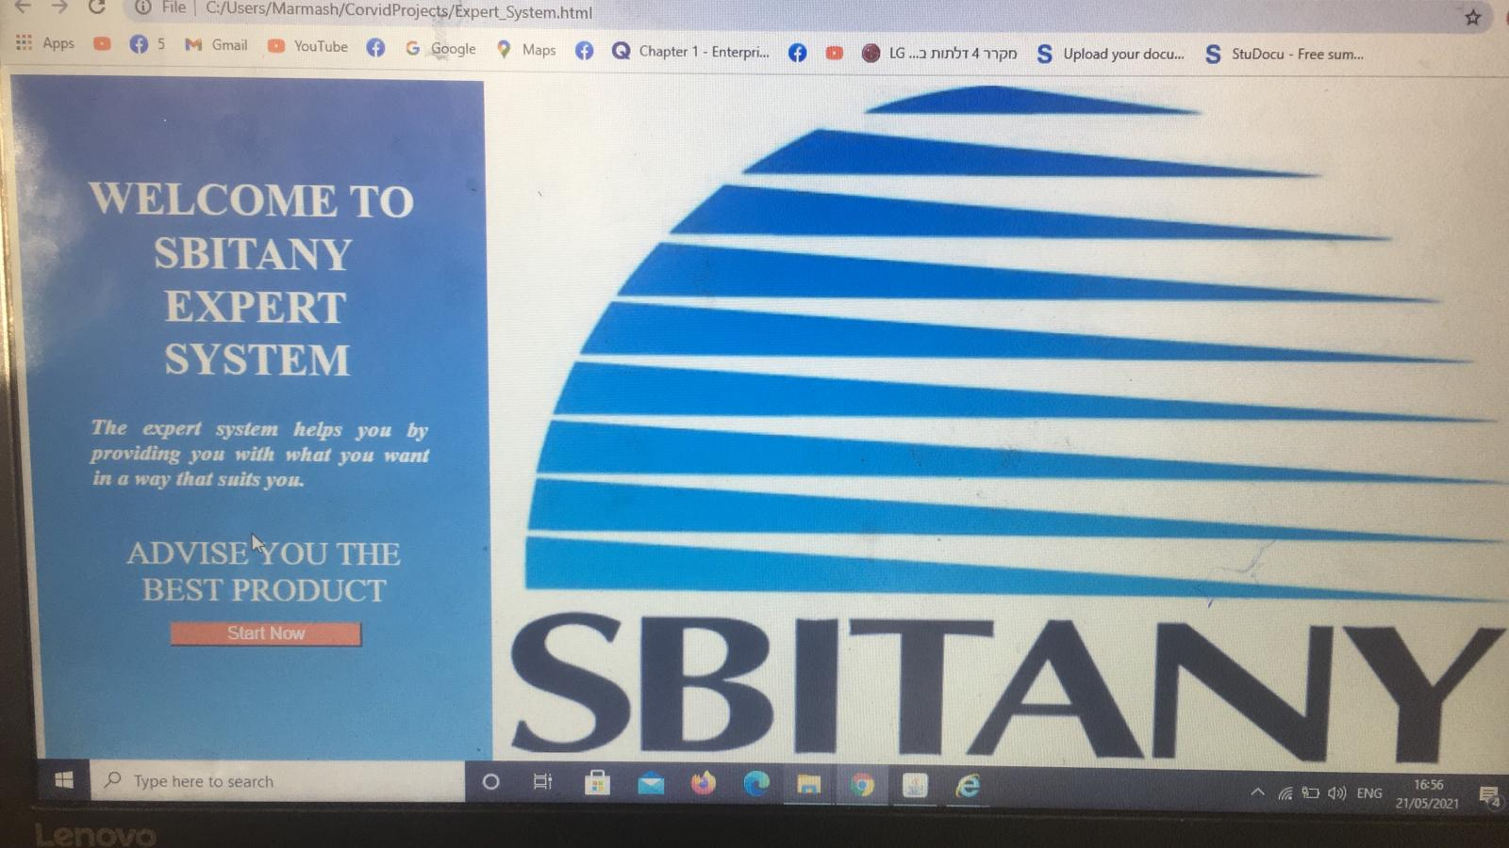
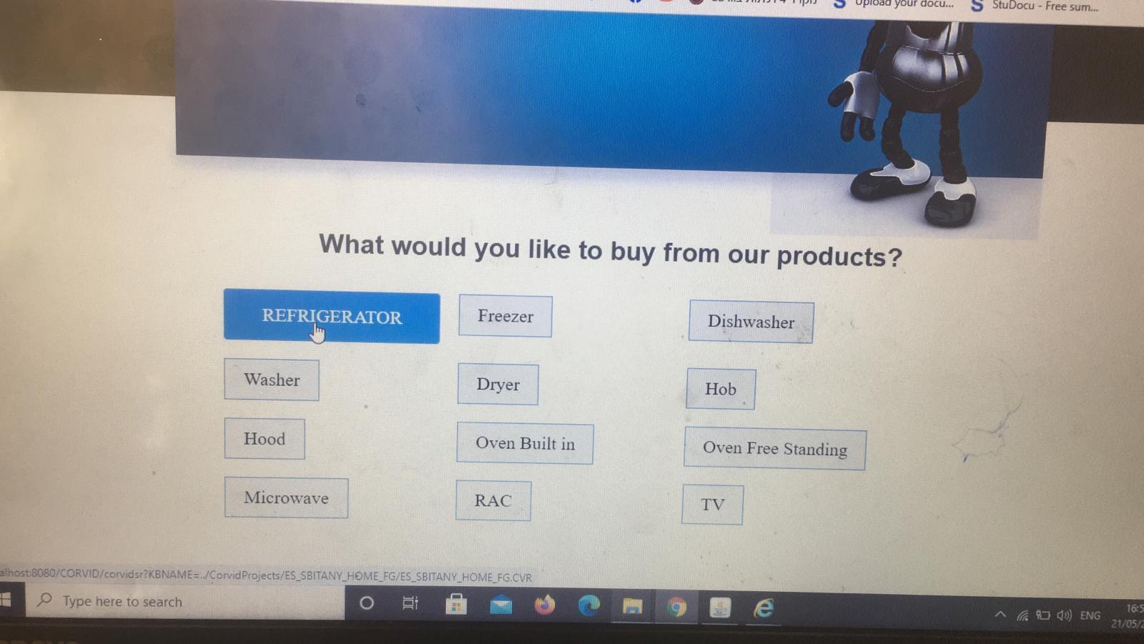
Achievements
Standalone Website for Expert System

Slide 15
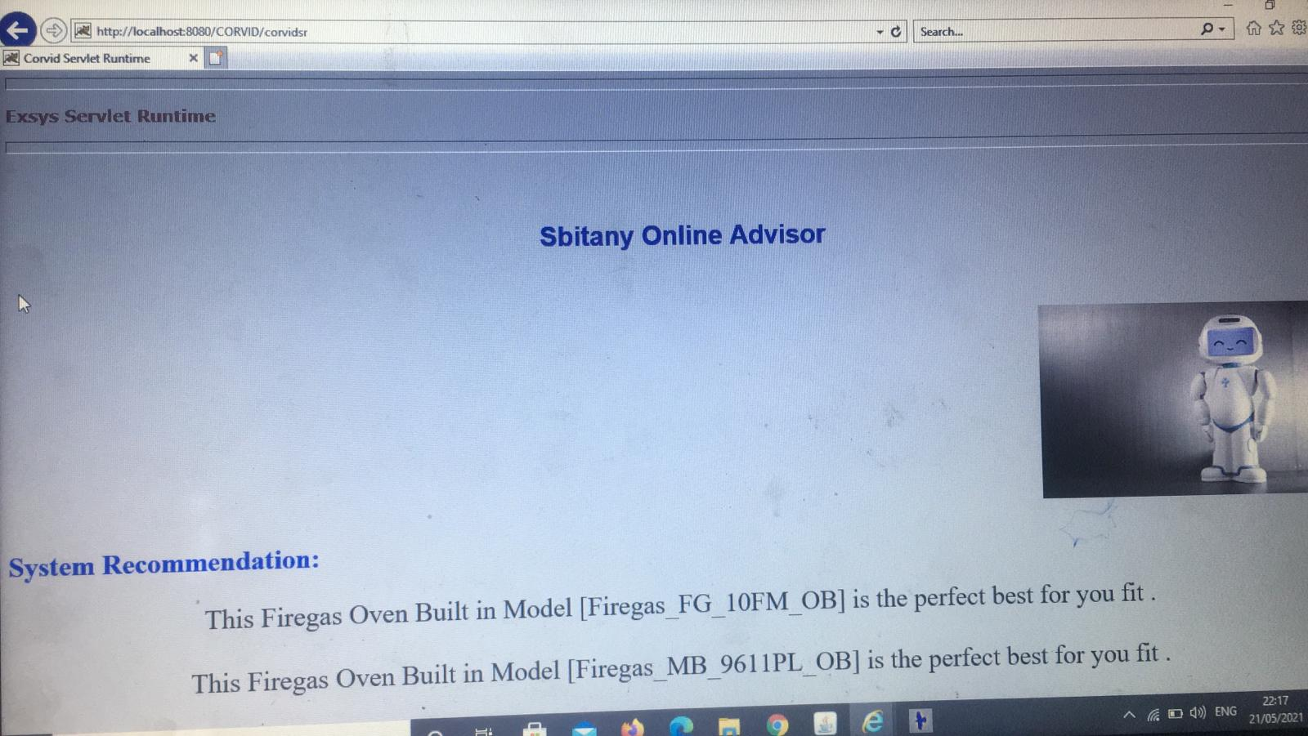
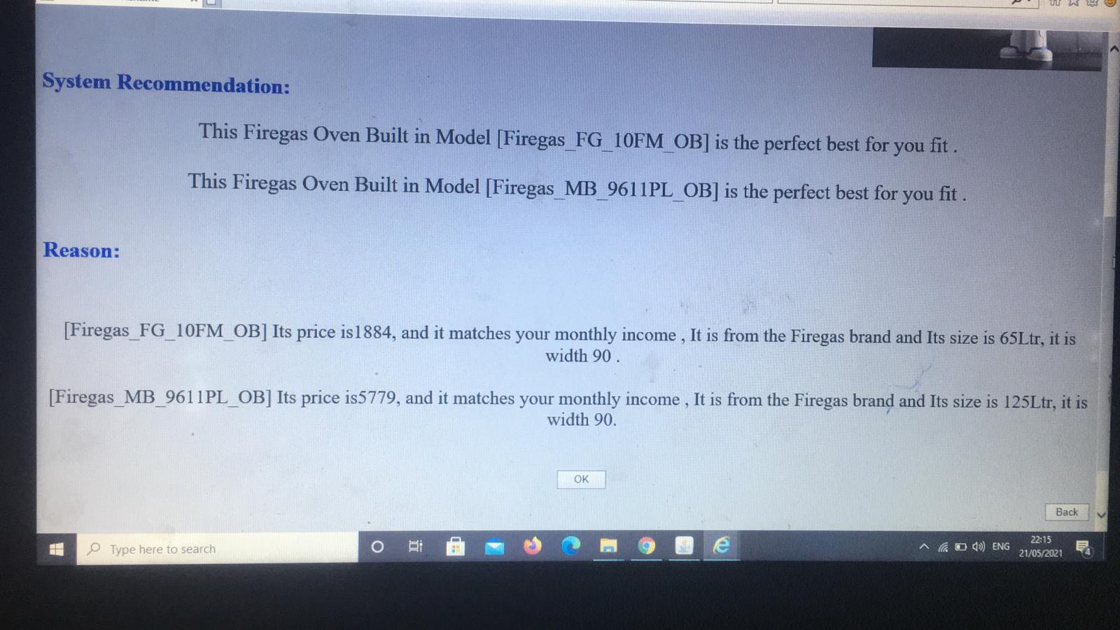
Achievements
Report with result of Expert System with Recommendations

Slide 16
Thank you
Any Question?

