Slide 1
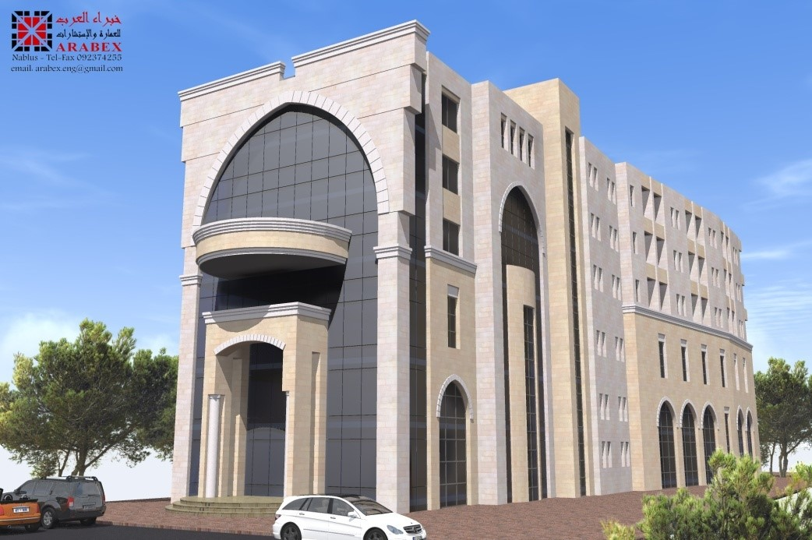
3D Seismic Design Of Ahmad Odeh Hotel
Prepared By : - Yasmeen Bsharat
- Abeer Saleh
Under Supervision of: Dr. Abdul Razzaq Touqan
2016-2017

Slide 2
Outline
1 Project description.
2 Seismic Design Parameters .
3 Structural System Type.
4 Model.
5 Model Check.
6 Slabs & Beams.
7 Special Shear Walls Design.
8 Special Boundary Element Design.
9 Footings Design.

Slide 3
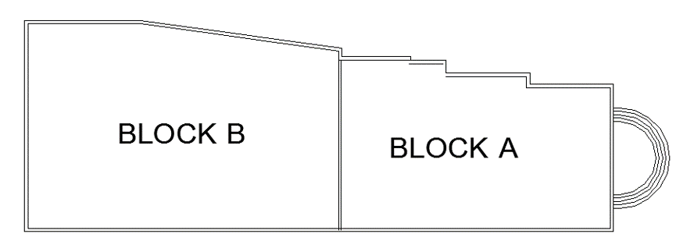
Project Description
The Ahmad Odeh Hotel is located in Beat Wazan in Nablus.
Its consists of two blocks separated by seismic joints.
Block A and Block B consist of six floors and a basement.
Total Building Area = 5400.97m²
We design block A.

Slide 4
The Codes Used in This Project
The Codes used in this project are the following :
1
  ACI 318-14 (American Concrete Institute).
2
  IBC2015 (International Building Code).
3
  ASCE-7 (2010).

Slide 5
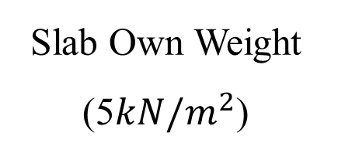
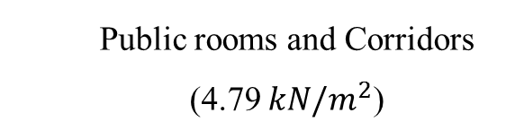
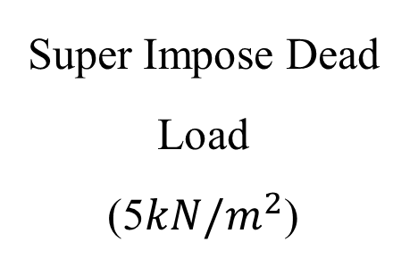

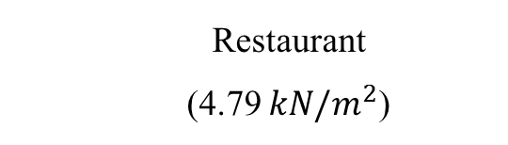
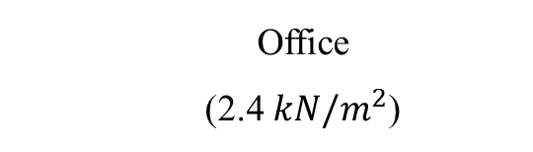
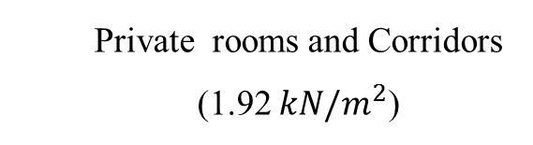
Load Types
Live Load
(5$kN/m^{2}$)
Super Impose Dead Load
(5$kN/m^{2}$)
Public rooms and Corridors
(4.79 $kN/m^{2}$)
Slab Own Weight (5$kN/m^{2}$)
Private rooms and Corridors (1.92 $kN/m^{2}$)
Tiles
Office
(2.4 $kN/m^{2}$)
Mortar & Filling
Plaster
Restaurant
(4.79 $kN/m^{2}$)
Partitions

Slide 6
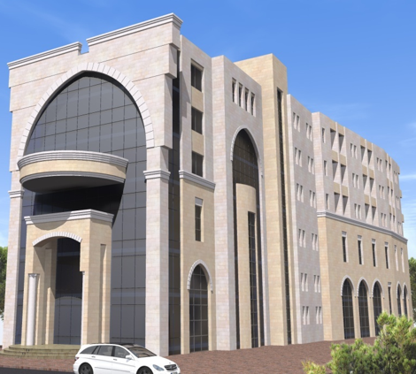
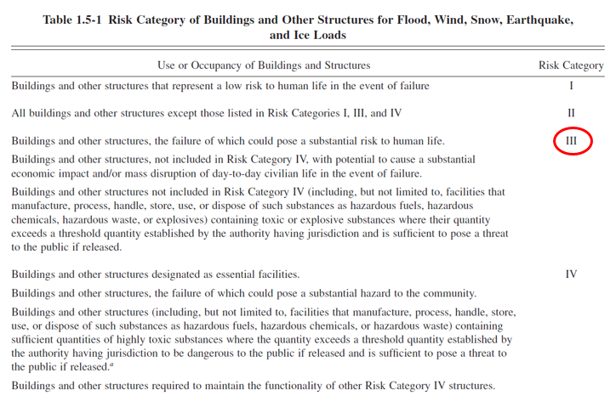
Seismic Design Parameters
Risk Category

Slide 7
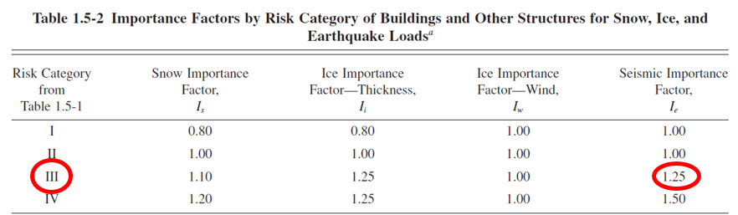
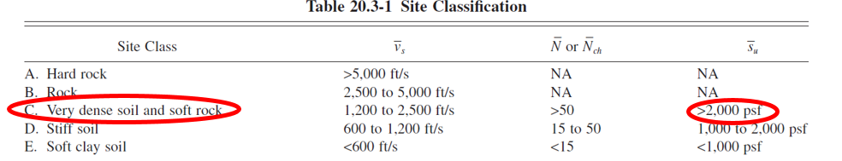
Seismic Design Parameters
Importance Factor, I
Site Class (C)

Slide 8
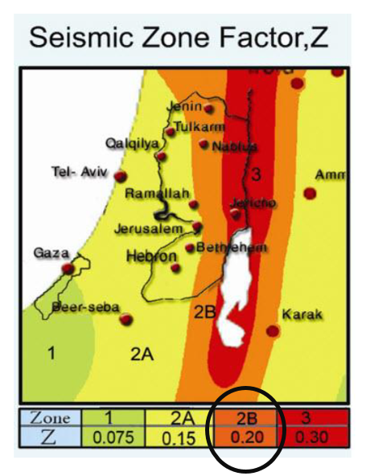
Seismic Design Parameters
Seismic Zone Factor, Z
Seismic Zone for Nablus is 2B
Factor (Z) = 0.20
S_{S} = 2.5 x Z = 2.5 x 0.2 = 0.5
Z = 0.20
S₁ = 1.25 x Z = 1.25 x 0.2 = 0.25

Slide 9
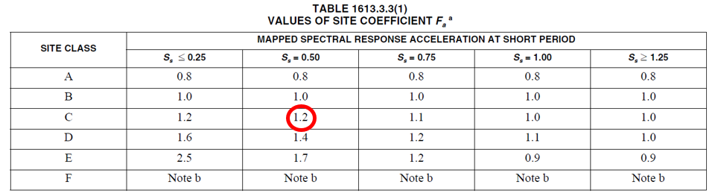
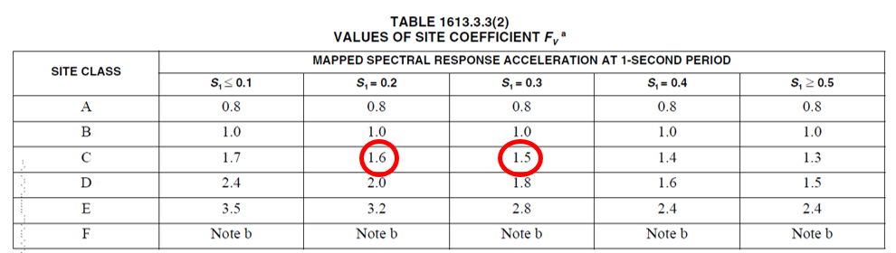
Seismic Design Parameters
Site Coefficients, F_{a ,} F_{v}

Slide 10
Seismic Design Parameters
Spectral response acceleration parameters. S_{DS} , S_{D1}
S_{S}=0.5
F_{a}=1.2
S_{MS} = F_{a} x S_{S} = 0.6
S_{DS}= S_{MS} = 0.6
F_{v}=1.55
S_{M1} = F_{v} x S₁ = 0.3875
S_{D1}= S_{M1} = 0.3875
S₁=0.25

Slide 11
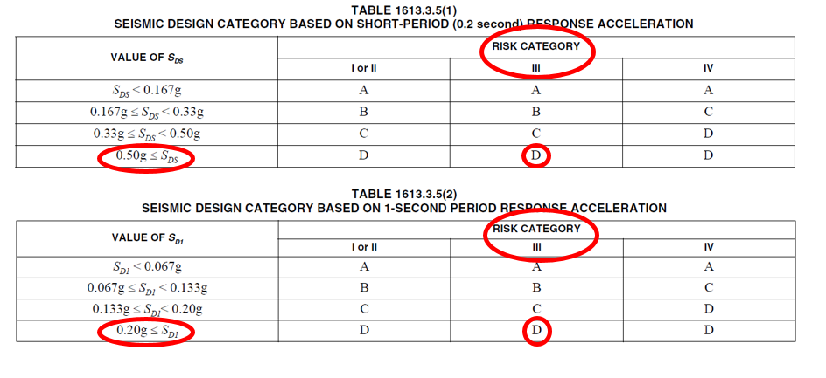
Seismic Design Parameters
Seismic Design Category (D)
Seismic design category is determined based on:
- Risk category
- Values of S_{DS} and S_{D1.}

Slide 12
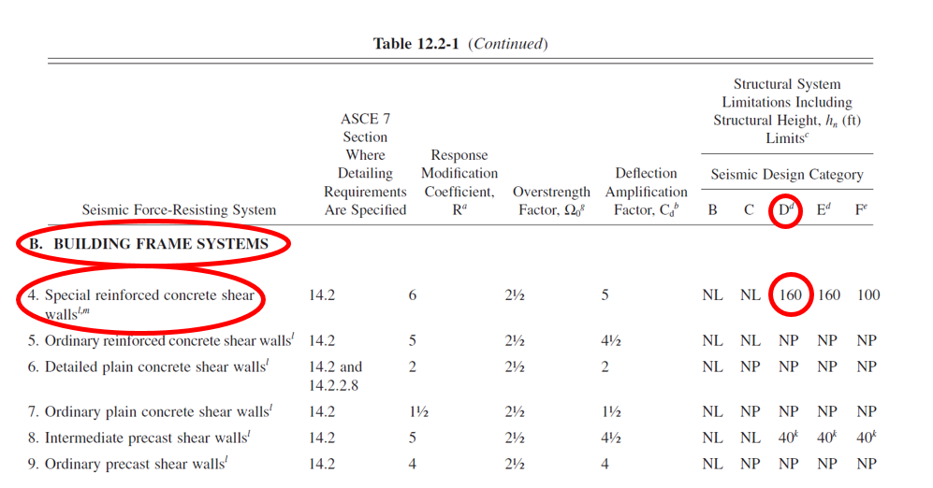

Structural System Type
Building frame system (special concrete shear walls).
R=6
$Ω_{o}$=2.5
Cd=5

Slide 13
Load Combinations
  1.4D
1
  1.2D + 1.6L
2
3
  1.2D + 1.0L + 1.0E
4
  0.9D + 1.0E

Slide 14
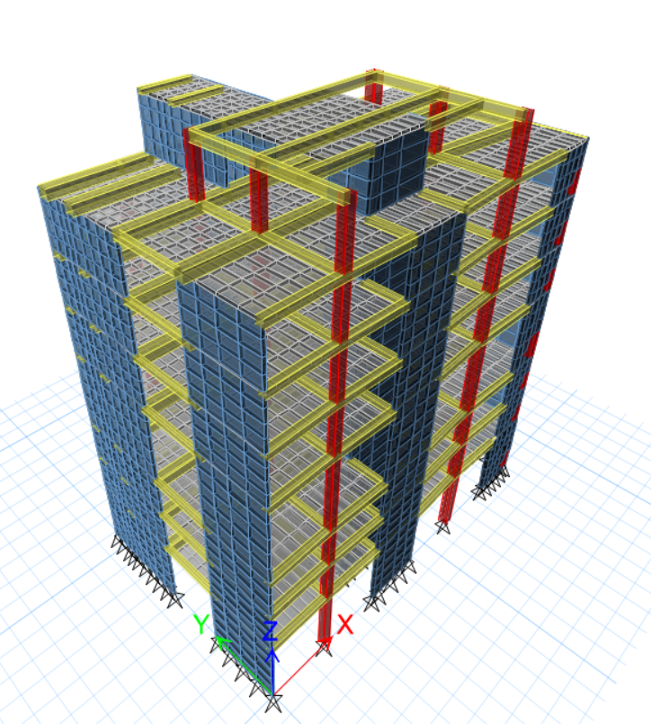
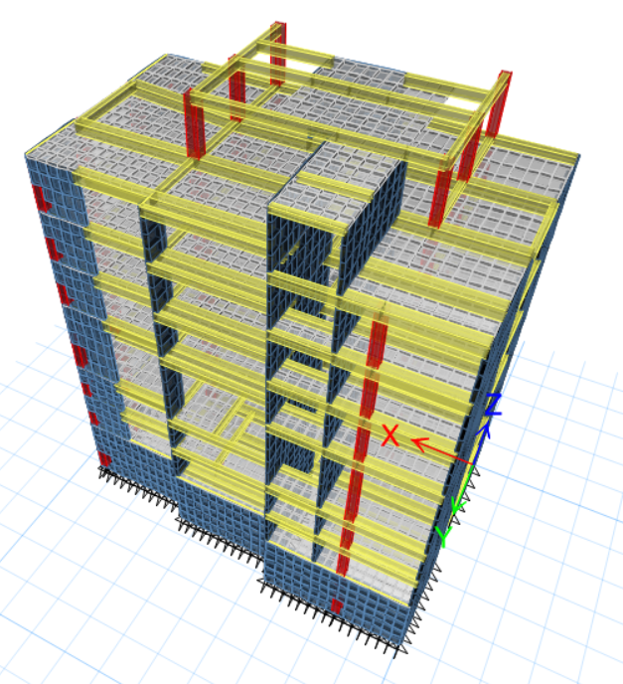
ETABS Model

Slide 15
ETABS Model Checks
Compatibility
Equilibrium
Stress - Strain
Base Shear
Serviceability
Stability
Period
Checks

Slide 16
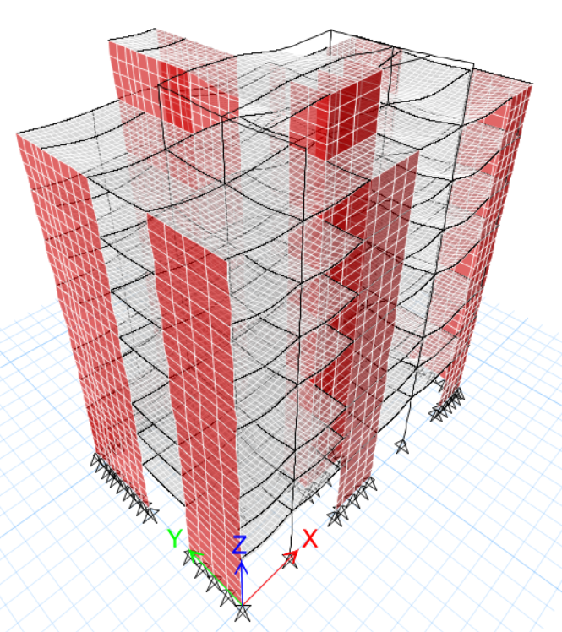
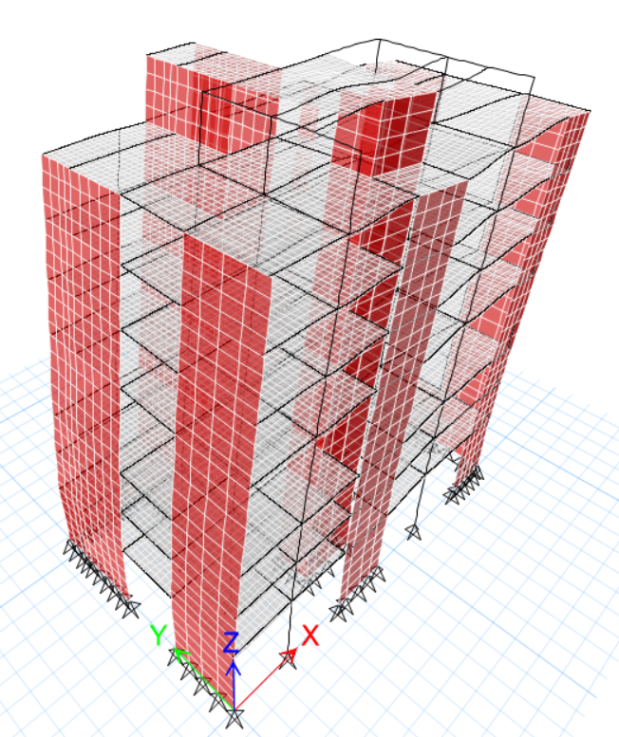
ETABS Model Checks
1 Compatibility

Slide 17
ETABS Model Checks
2 Equilibrium
TABLE: Base Reactions
Load Case | Fz ETABS (kN) | Manually (kN) | %Difference
Dead | 26006.31 | 26198.64 | 0.7
Live | 9155.35 | 9140.70 | 0.16
SID | 8792.16 | 8778.05 | 0.16
Wall | 7809.89 | 7881.30 | 0.9

Slide 18
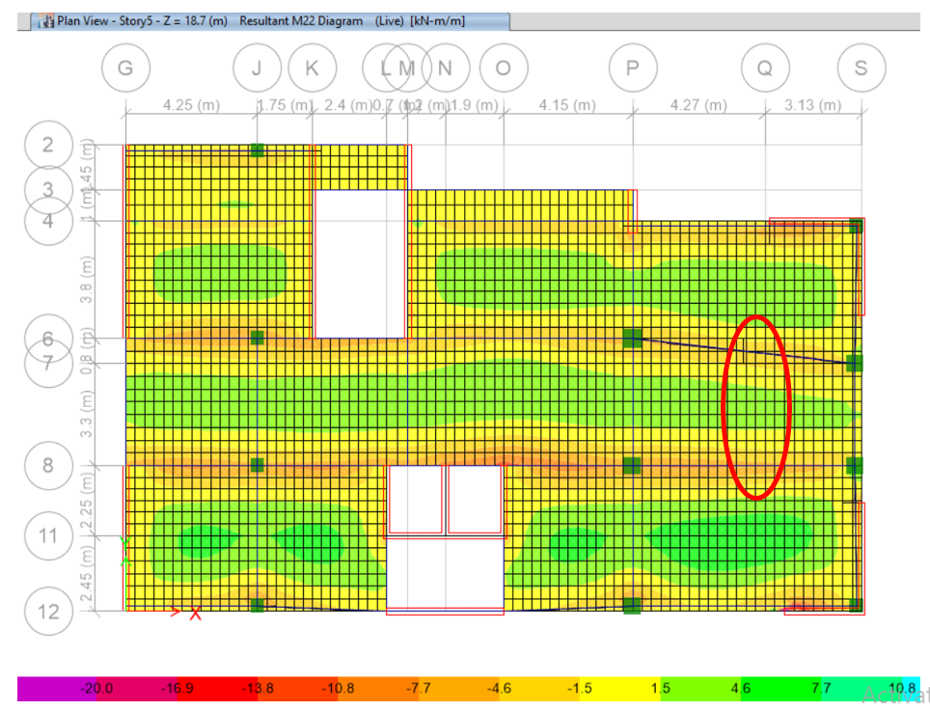
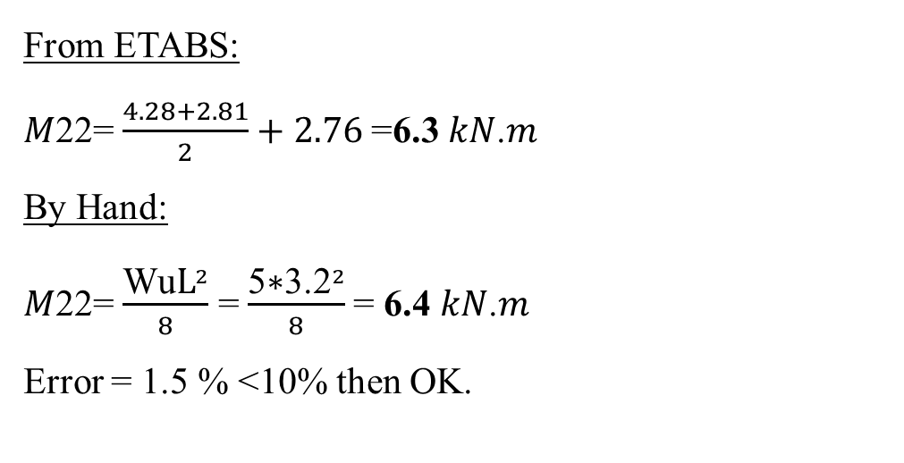
ETABS Model Checks
3 Stress – Strain (For Slab)
Make check on story five (5) at elevation 18.7 for live load.
From ETABS:
𝑀22= $\frac{4.28+2.81}{2}+2.76$=6.3 𝑘𝑁.𝑚
By Hand:
𝑀22= $\frac{{\text{Wu}\text{L}}^{2}}{8}$ = $\frac{{\text{5}\text{∗}\text{3.2}}^{2}}{8}$= 6.4 𝑘𝑁.𝑚
Error = 1.5 % <10% then OK.

Slide 19
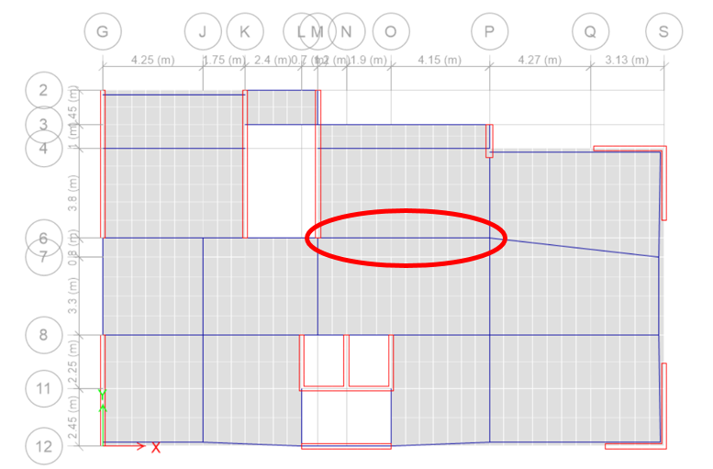
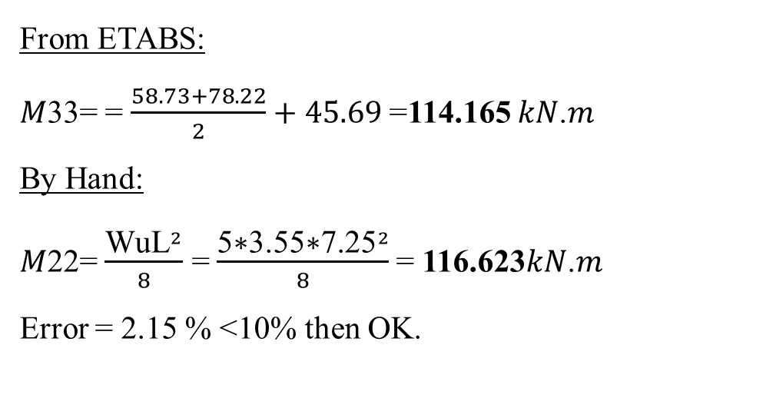
ETABS Model Checks
3 Stress – Strain (For Beam)
Make check on beam (B4) at story 6
span to be checked L=7.25m
From ETABS:
𝑀33= = $\frac{58.73+78.22}{2}+45.69$=114.165 𝑘𝑁.𝑚
By Hand:
𝑀22= $\frac{{\text{Wu}\text{L}}^{2}}{8}$ = $\frac{{\text{5}\text{∗}\text{3.55}\text{∗}\text{7.25}}^{2}}{8}$= 116.623𝑘𝑁.𝑚
Error = 2.15 % <10% then OK.

Slide 20
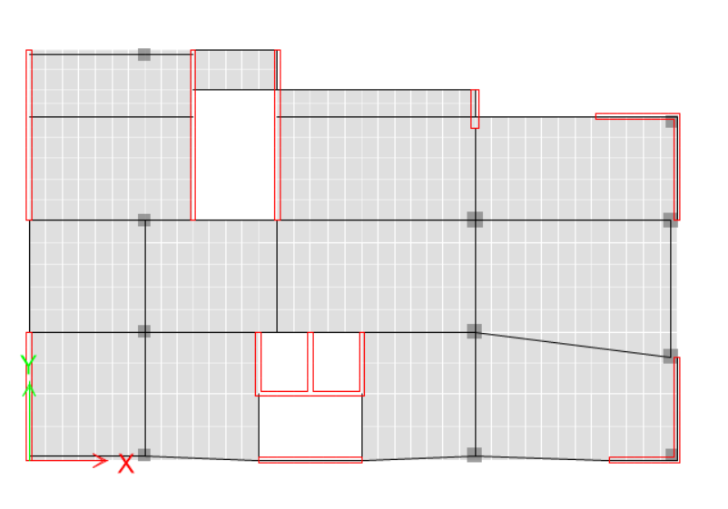
ETABS Model Checks
3 Stress – Strain (For Column)
Make check on column (P6) at story 6
Tributary area= 26.2 m²
From ETABS:
P _{L} = 80.16 kN
By Hand:
P _{L} = L.L*𝐴 = 3*26.2=78.6 𝑘𝑁
Error = 1.9 % <10% then OK.

Slide 21
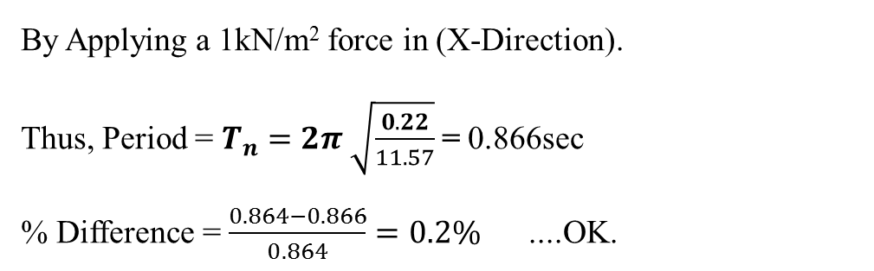
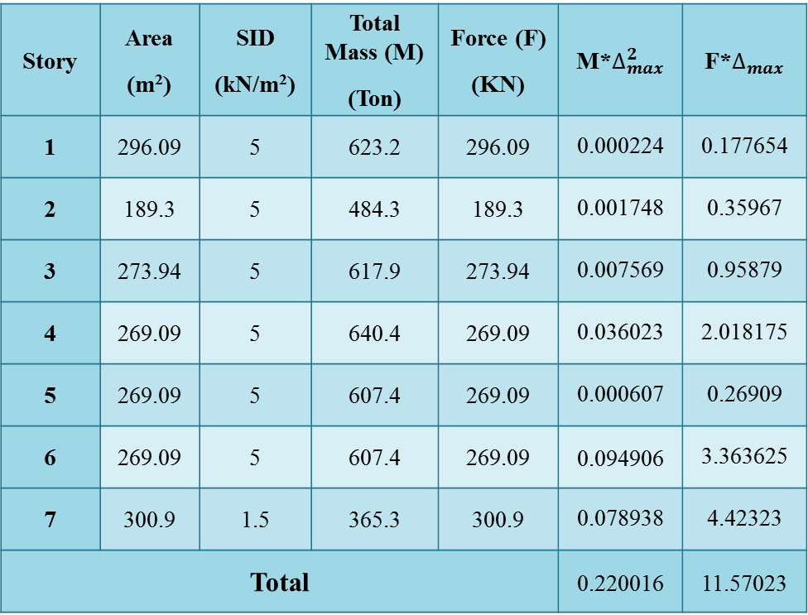


ETABS Model Checks
4 Period
Story | Area (m²) | SID (kN/m²) | Total Mass (M) (Ton) | Force (F) (KN) | M*$∆_{max}^{2}$ | F*$∆_{max}$
1 | 296.09 | 5 | 623.2 | 296.09 | 0.000224 | 0.177654
2 | 189.3 | 5 | 484.3 | 189.3 | 0.001748 | 0.35967
3 | 273.94 | 5 | 617.9 | 273.94 | 0.007569 | 0.95879
4 | 269.09 | 5 | 640.4 | 269.09 | 0.036023 | 2.018175
5 | 269.09 | 5 | 607.4 | 269.09 | 0.000607 | 0.26909
6 | 269.09 | 5 | 607.4 | 269.09 | 0.094906 | 3.363625
7 | 300.9 | 1.5 | 365.3 | 300.9 | 0.078938 | 4.42323
Total |  |  |  |  | 0.220016 | 11.57023
Period Check By (Rayleigh Method):
By Applying a 1kN/m² force in (X-Direction).
Thus, Period = $T_{n}=2π \sqrt{\frac{0.22}{11.57}}$= 0.866sec
% Difference = $\frac{0.864−0.866}{0.864}=0.2\%$ ....OK.
Check if T $≤ C_{u}T_{a}$
T_{a} = C_{t}h_{n}^{x}
= 0.0488*28.3^{0.75} = 0.599 sec
T (0.864) $>(0.839)1.4T_{a}$ , but its acceptable

Slide 22
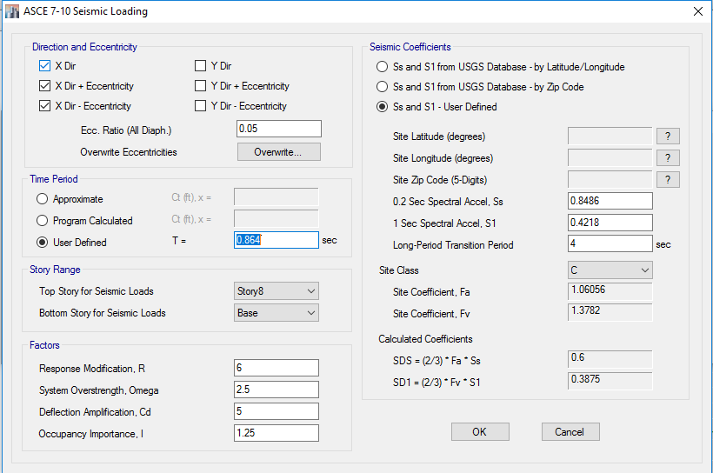
ETABS Model Checks
5 Base Shear
Define Equivalent Static Force
R = 6
I = 1.25
S_{DS} = 0.6
S_{D1} = 0.3875

Slide 23

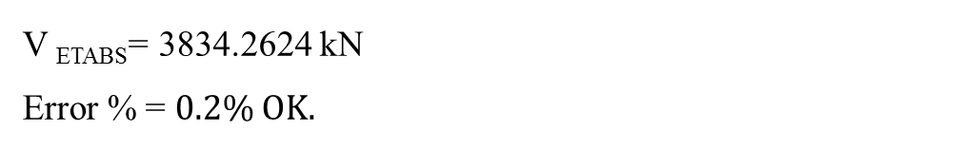
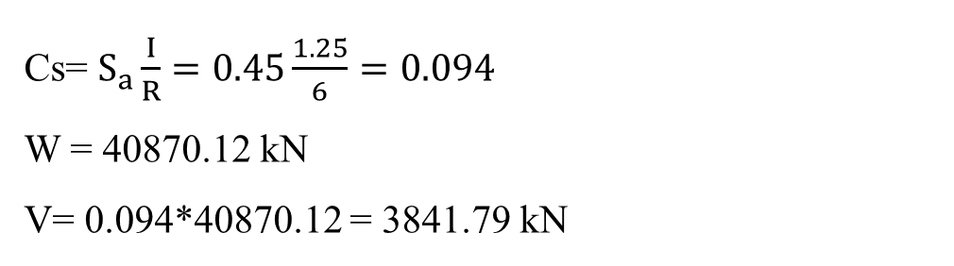
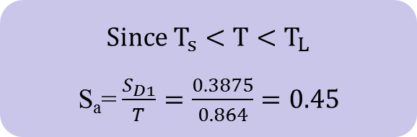


ETABS Model Checks
5 Base Shear
Determine of Base shear using IBC2015
By Hand:
T_{x} = 0.864sec
$T_{s}=0.645sec$
$T_{L}=4sec$
$T_{°}=0.129sec$
V=Cs*W
Cs= $S_{a}\frac{I}{R}=0.45\frac{1.25}{6}=0.094$
W = 40870.12 kN
V= 0.094*40870.12 = 3841.79 kN
From ETABS:
${Since T}_{s}<T<T_{L}$
S_{a}=$\frac{S_{D1}}{T}=\frac{0.3875}{0.864}=0.45$
V _{ETABS}= 3834.2624 kN
Error % = $0.2\% OK.$

Slide 24
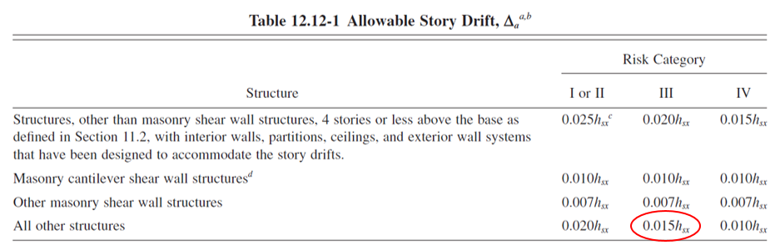
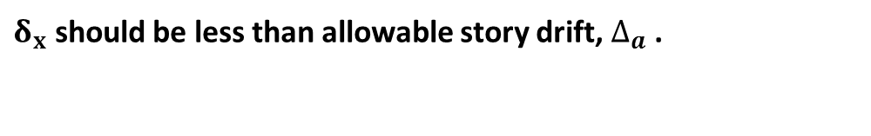
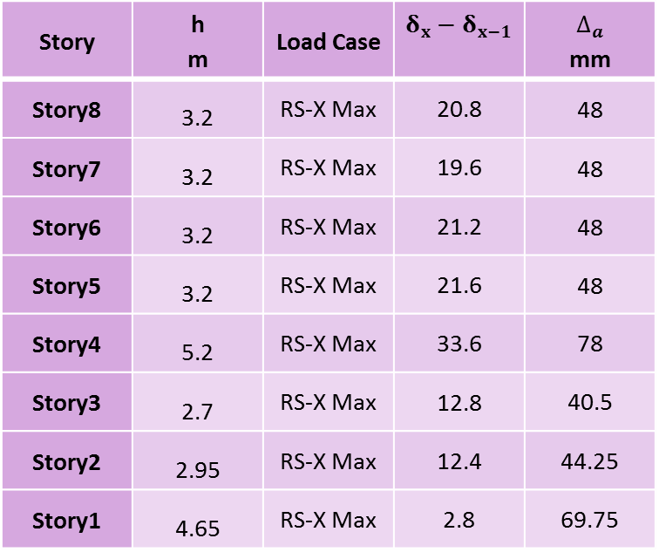


ETABS Model Checks
6 Serviceability
$δ_{x}=\frac{C_{d}δ_{xe}}{I_{e}}$
Story | h m | Load Case | $δ_{x}−δ_{x−1}$ | $$∆_{a}$$ mm
Story8 | 3.2 | RS-X Max | 20.8 | 48
Story7 | 3.2 | RS-X Max | 19.6 | 48
Story6 | 3.2 | RS-X Max | 21.2 | 48
Story5 | 3.2 | RS-X Max | 21.6 | 48
Story4 | 5.2 | RS-X Max | 33.6 | 78
Story3 | 2.7 | RS-X Max | 12.8 | 40.5
Story2 | 2.95 | RS-X Max | 12.4 | 44.25
Story1 | 4.65 | RS-X Max | 2.8 | 69.75
$δ_{x}$ should be less than allowable story drift, $∆_{a}$ .
$δ_{x}$ is less than allowable story drift, $∆_{a}$ ... Ok

Slide 25
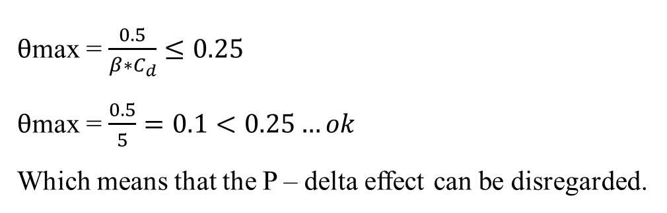
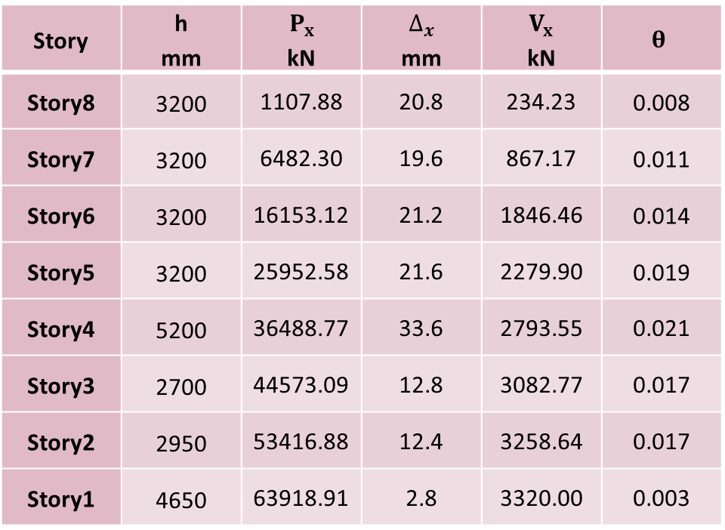
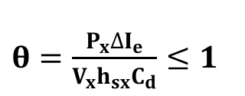
ETABS Model Checks
7 Stability
$θ=\frac{P_{x}∆I_{e}}{V_{x}h_{sx}C_{d}}≤1$
Story | h mm | $$P_{x}$$ kN | $$∆_{x}$$ mm | $$V_{x}$$ kN | $$θ$$
Story8 | 3200 | 1107.88 | 20.8 | 234.23 | 0.008
Story7 | 3200 | 6482.30 | 19.6 | 867.17 | 0.011
Story6 | 3200 | 16153.12 | 21.2 | 1846.46 | 0.014
Story5 | 3200 | 25952.58 | 21.6 | 2279.90 | 0.019
Story4 | 5200 | 36488.77 | 33.6 | 2793.55 | 0.021
Story3 | 2700 | 44573.09 | 12.8 | 3082.77 | 0.017
Story2 | 2950 | 53416.88 | 12.4 | 3258.64 | 0.017
Story1 | 4650 | 63918.91 | 2.8 | 3320.00 | 0.003
$θ$max = $\frac{0.5}{β∗C_{d}}≤0.25$
$θ$max = $\frac{0.5}{5}=0.1<0.25…ok$
Which means that the P – delta effect can be disregarded.

Slide 26
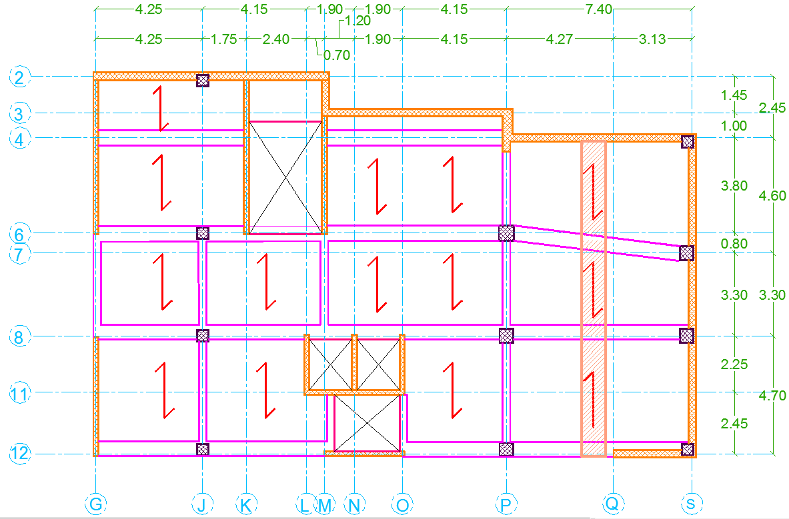
Design and Detailing
Slab Design
One way Solid Slab in Y-direction
Thickness = 200mm.

Slide 27
Design and Detailing
Beam Design
Design The Beam For Flexure
According to calculations from several load combinations we notice that negative M_{u} is occurring due to (1.2D+L+E) combination, where positive M_{u} is occurring due to (1.2D+1.6L) combination.

Slide 28
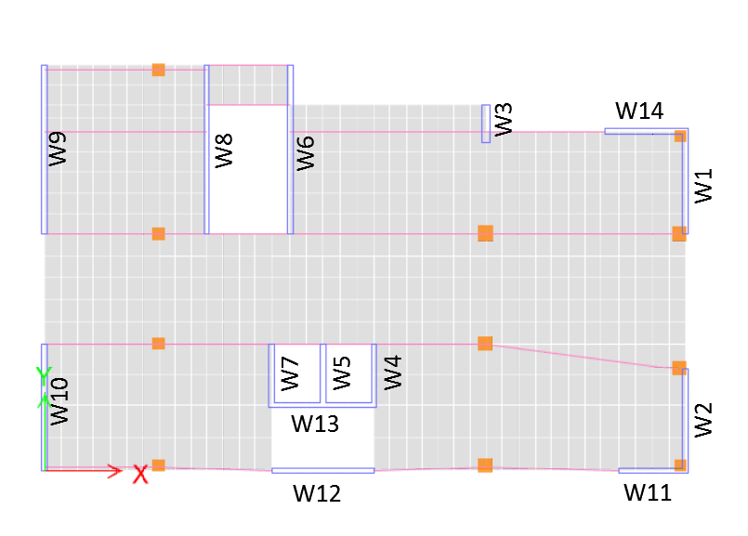
Design and Detailing
Special Shear Wall Design
We selected wall (W1) in the 6th floor to be designed

Slide 29
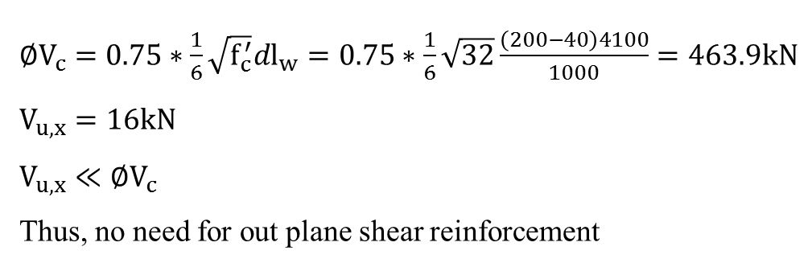
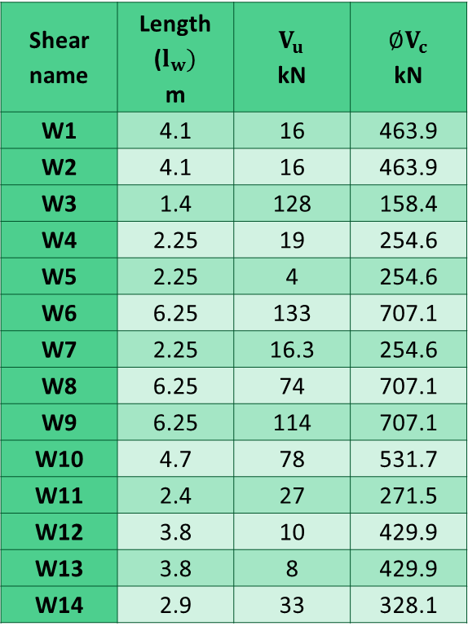
Design and Detailing
Special Shear Wall Design
Shear name | Length ($l_{w})$ m | $$V_{u}$$ kN | $$∅V_{c}$$ kN
W1 | 4.1 | 16 | 463.9
W2 | 4.1 | 16 | 463.9
W3 | 1.4 | 128 | 158.4
W4 | 2.25 | 19 | 254.6
W5 | 2.25 | 4 | 254.6
W6 | 6.25 | 133 | 707.1
W7 | 2.25 | 16.3 | 254.6
W8 | 6.25 | 74 | 707.1
W9 | 6.25 | 114 | 707.1
W10 | 4.7 | 78 | 531.7
W11 | 2.4 | 27 | 271.5
W12 | 3.8 | 10 | 429.9
W13 | 3.8 | 8 | 429.9
W14 | 2.9 | 33 | 328.1
Check shear walls for out plane shear force ($V_{u,x}$)
$∅V_{c}=0.75∗\frac{1}{6}\sqrt{f_{c}^{′}}dl_{w}=0.75∗\frac{1}{6}\sqrt{32}\frac{\left(200−40\right)4100}{1000}=463.9kN$
$V_{u,x}=16kN$
$V_{u,x}≪∅V_{c}$
Thus, no need for out plane shear reinforcement

Slide 30
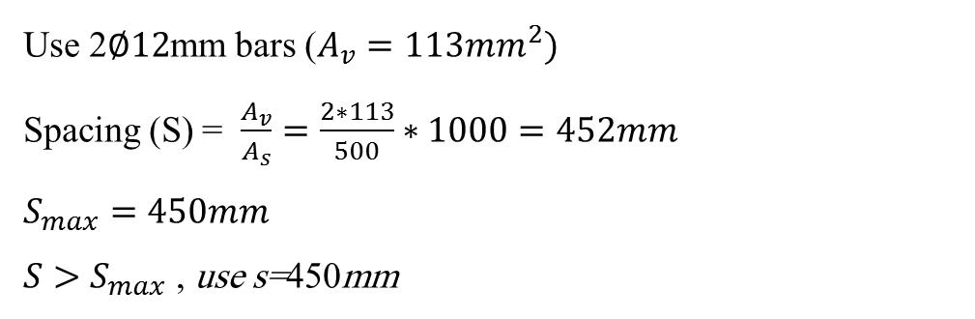
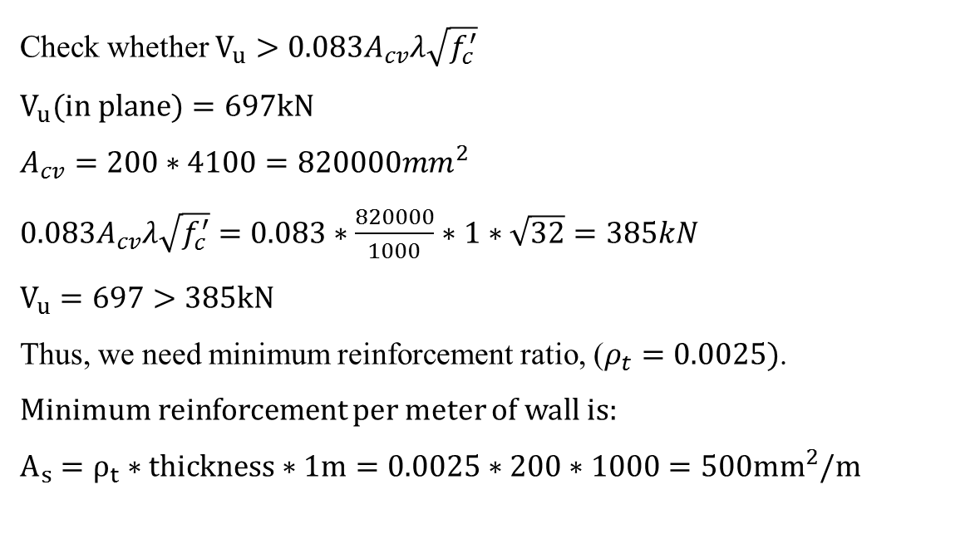
Design and Detailing
Special Shear Wall Design
Design shear wall for in plane shear force
Check whether $V_{u}>0.083A_{cv}λ\sqrt{f_{c}^{′}}$
$V_{u}(in plane)=697kN$
$A_{cv}=200∗4100=820000mm^{2}$
$0.083A_{cv}λ\sqrt{f_{c}^{′}}=0.083∗\frac{820000}{1000}∗1∗\sqrt{32}=385kN$
$V_{u}=697>385kN$
Thus, we need minimum reinforcement ratio, ($ρ_{t}=0.0025)$.
Minimum reinforcement per meter of wall is:
$A_{s}=ρ_{t}∗thickness∗1m=0.0025∗200∗1000=500mm^{2}/m$
Use 2$∅12$mm bars ($A_{v}=113mm^{2})$
Spacing (S) = $\frac{A_{v}}{A_{s}}=\frac{2∗113}{500}∗1000=452mm$
$S_{max}=450mm$
${S>S}_{max}$ , use s=450mm

Slide 31
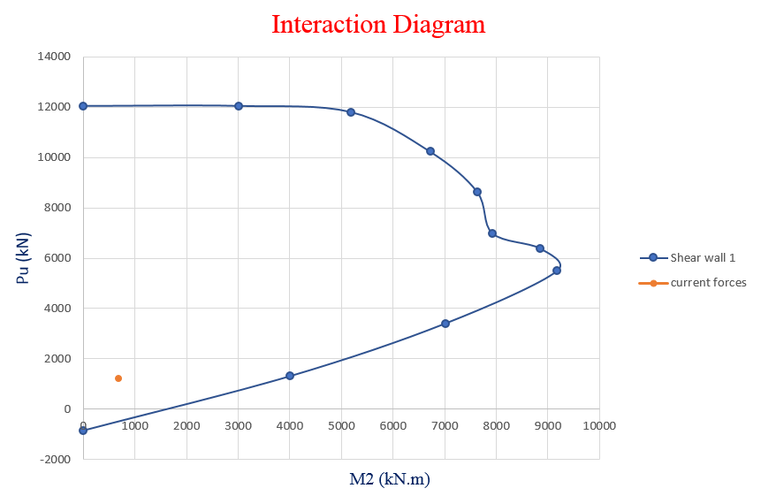
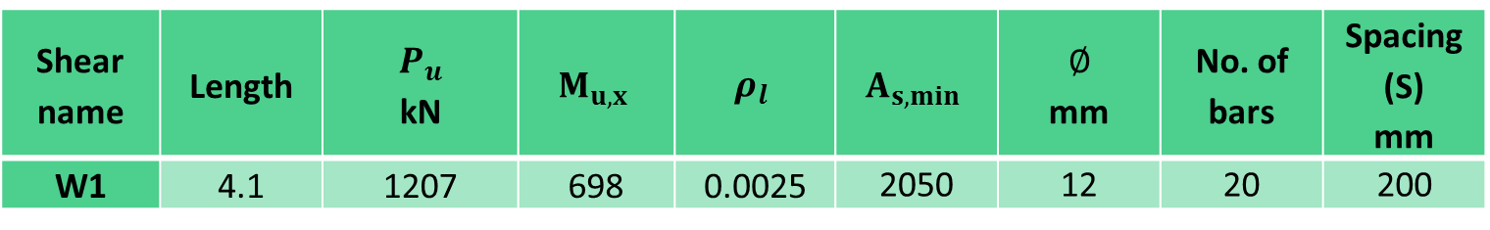
Design and Detailing
Special Shear Wall Design
Design the wall for flexure and axial forces
Shear name | Length | $$P_{u}$$ kN | $$M_{u,x}$$ | $$ρ_{l}$$ | $$A_{s,min}$$ | $$∅$$ mm | No. of bars | Spacing (S) mm
W1 | 4.1 | 1207 | 698 | 0.0025 | 2050 | 12 | 20 | 200
Check for ETABS
As you see the point within the curve, so it’s ok

Slide 32
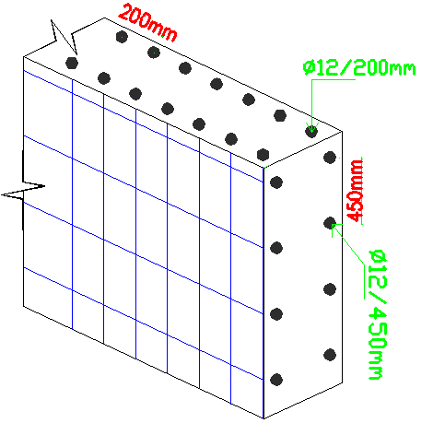
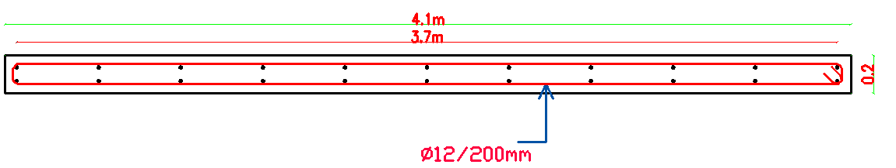
Design and Detailing
Special Shear Wall Design
Reinforcement detailing for shear wall (W1)

Slide 33


Design and Detailing
Special Boundary element Design
Shear name | $$σ_{c,max}$$ | 0.2$f_{c}^{′}$ | Need / not need
W1 | 2.72 | 6.4 | Not
W2 | 2.32 | 6.4 | Not
W3 | 6.61 | 6.4 | Need
W4 | 2.72 | 6.4 | Not
W5 | 1.51 | 6.4 | Not
W6 | 7.38 | 6.4 | Need
W7 | 3.50 | 6.4 | Not
W8 | 7.09 | 6.4 | Need
W9 | 6.73 | 6.4 | Need
W10 | 3.98 | 6.4 | Not
W11 | 3.12 | 6.4 | Not
W12 | 2.77 | 6.4 | Not
W13 | 2.50 | 6.4 | Not
W14 | 3.12 | 6.4 | Not
Check if we need to design a special boundary element
If maximum compressive stress in the wall greater than 0.2$f_{c}^{′}$.
Thus, we need to design a special boundary element for wall.
Maximum compressive stress ($σ_{c,max}= \frac{P_{u}}{A_{g}}+\frac{M_{u}l_{w}}{2I_{g}})$

Slide 34
Design and Detailing
Special Boundary element Design
We selected wall (W6) in the basement floor to be designed

Slide 35







Design and Detailing
Special Boundary element Design
Calculate distance from extreme compression fiber to neutral axis (c)
$c ≥\frac{l_{w}}{600\left(\frac{1.5δ_{u}}{h_{w}}\right)}$
$l_{w}=6.25m$
$δ_{u}=1.5mm$
$$h_{w}=4.45m$$
$$\frac{δ_{u}}{h_{w}}≥0.005$$
$$\frac{δ_{u}}{h_{w}}=0.000337<0.005$$
Use $\frac{δ_{u}}{h_{w}}=0.005$
We find (c) using ETABS and its equal 1.39 $≈1.4m$ …ok
$c=\frac{6.25}{600\left(\frac{1.5∗1.5}{4.45}\right)}= 1.4m$

Slide 36


Design and Detailing
Special Boundary element Design
Find the dimensions of special boundary element
a = max $\left\{\begin{aligned}c−0.1l_{w} \\ \frac{c}{2}\end{aligned}\right.=\left\{\begin{aligned}0.775 \\ 0.7\end{aligned}=0.8m\right.$
b $≥\frac{h_{w}}{16}=0.4m$
Use b=0.4m

Slide 37


Design and Detailing
Special Boundary element Design
Longitudinal reinforcement
Longitudinal reinforcement for the web of the wall
($V_{u}=1160$kN) > $0.083A_{cv}λ\sqrt{f_{c}^{′}}$ =586.9kN
$ρ_{t}=0.0025$
Since ($\frac{h_{w}}{l_{w}}<2)$, $ρ_{l}=ρ_{t}=0.0025$
$$A_{s,min}=0.0025∗200∗6.25∗1000=3125mm^{2} \left(Use 28∅12\right)$$
Longitudinal reinforcement for special boundary element
Reinforce the special boundary element as special column with minimum area of steel.
$A_{s,min}=ρ∗b∗a=0.01∗800∗400=3200mm^{2}.$ (Use 14$∅14$)

Slide 38

Design and Detailing
Special Boundary element Design
Transverse reinforcement
Transverse reinforcement for the web of the wall
($V_{u}=1160$kN) > $0.083A_{cv}λ\sqrt{f_{c}^{′}}$ =586.9kN
$ρ_{t}=0.0025$
$A_{s}=ρ_{t}∗thickness∗1m=0.0025∗200∗1000=500mm^{2}/m$
Spacing (S) = $\frac{A_{v}}{A_{s}}=\frac{2∗113}{500}∗1000=452mm$
$$S_{max}=450mm,$$
${S>S}_{max}$
Use $2∅12$ @ 450mm.

Slide 39




Design and Detailing
Special Boundary element Design
Transverse reinforcement
Transverse reinforcement for special boundary element
$$\frac{A_{sh}}{sb_{c}}=max\left\{\begin{aligned}0.3 \left(\frac{A_{g}}{A_{ch}}−1\right)\frac{f_{c}^{′}}{f_{y}} \\ 0.09\frac{f_{c}^{′}}{f_{y}}\end{aligned}\right.$$
$A_{g}$= a* b = 0.8*0.4 = 0.32 mm²
$A_{ch}$=$a_{1}∗ b_{1}$=$0.76∗0.36=0.27$mm²
$\frac{A_{sh}}{sb_{c}}=max\left\{\begin{aligned}0.3 \left(\frac{0.32}{0.27}−1\right)\frac{32}{420}=0.0042 \\ 0.09\frac{32}{420}=0.007\end{aligned}\right. =0.007$

Slide 40



Design and Detailing
Special Boundary element Design
Transverse reinforcement
Transverse reinforcement for special boundary element
S_{max} = Min $\left\{\begin{aligned}{least boundary element diminsion}/4 \\ 6d_{b } \\ {100+(350−h_{x })}/{3 } \\ 150mm\end{aligned}\right\}≥100mm$
S_{max} = Min $\left\{\begin{aligned}{400}/4=100 \\ 6∗14=84 \\ {100+(350−144)}/{3=168 } \\ 150mm\end{aligned}\right\}≥100mm$
S_{max} = 100mm
$A_{sh1}$ = 0.009*$s∗b_{1}$ = 0.007*$100∗760$=532mm²
Use stirrup $3∅12$ (6 legs)
$A_{sh2}$ = 0.007*$s∗a_{1}$ = 0.007*$100∗360$=252mm²
Use stirrup $2∅12$ (3 legs)

Slide 41


Design and Detailing
Special Boundary element Design
Reinforcement detailing for shear wall (W6)

Slide 42

Design and Detailing
Footings Design
Check if we need to use mat foundation
If$\sum{Area of isolated footing >0.6 of area of buliding }$. Thus, we need to use mat foundation
$\sum{A_{F , isolated }= \frac{\sum{P_{i}}}{q_{all}}}$
From ETABS $\sum{P_{i}}$ =51919 kN
$A_{basment}=296.09 m^{2}$
$$\sum{\begin{aligned}A_{F , isolated }= \frac{51919}{270}= 192 m^{2}>0.6∗296.09=178m^{2} \\ \end{aligned}}$$

Slide 43

Design and Detailing
Footings Design
Check if we need to use mat foundation
If we assume that, we have single footings and wall footings and checks if it is suitable.
We draw calculated dimensions of footings in AutoCAD, and we recognize that assumed footings type not suitable in our structure.
Therefore, we used mat foundation

Slide 44

Design and Detailing
Footings Design
The plan view of mat foundation
We used h = 1200mm

Slide 45

Design and Detailing
Footings Design
Check for deflection
Allowable displacement in the mat foundation is10mm.
The maximum displacement of the footings joints is shown in figure and it is approximant equal 10mm… ok

Slide 46


Design and Detailing
Footings Design
Check for stress
Bearing capacity of the soil ($q_{all}$ ) =270 kN/m²
The maximum stress is shown in figure and it is less than 270 kN/m²
$σ_{max}=262.5\text{kN}\text{/}\text{m}\text{2}<σ_{allowable}OK$

Slide 47


Design and Detailing
Footings Design
Check punching shear
$$∅V_{Cp}=∅\frac{1}{3}\sqrt{f′c} b_{°}d$$
Column name | Column dimensions (cm) | Ultimate shear (kN) | $$b_{°}$$ (mm) | $$∅V_{Cp}$$ (kN)
P6 | 60*60 | 4325.3 | 4(600+1125) = 6900 | 9507 | Ok
P12 | 55*55 | 2436.3 | 2(1112.5)+1675 = 3900 | 5374 | Ok
S12 | 45*45 | 950 | 2*1012.5 = 2025 | 2790 | Ok

Slide 48

Design and Detailing
Footings Design
Check for wide beam shear
$$\text{Shear} \text{values} \text{was} \text{found} \text{by} \text{making} \text{column} \text{strip} \text{in} \text{each} \text{direction}\text{. }$$
$$\text{From} \text{column} \text{strip} \text{in} \text{X}\text{− }\text{direction}\text{, }\text{Vu}\text{ = }\text{1257}\text{kN} \text{at} \text{distanc} \text{d}\text{=}\text{1125}\text{mm} \text{from} \text{face} \text{of} \text{column}$$
Column strip width = 2m
$∅V_{C}=∅\frac{1}{6}\sqrt{f′c} bd$
Wide beam shear capacity of column strip = $∅V_{C}=0.75\frac{1}{6}\sqrt{24}∗2000∗\frac{1125}{1000}=1378 kN$
Capacity is greater than ultimate. Thus, it is ok
And the same for $\text{column} \text{strip} \text{in} \text{Y}\text{− }\text{direction}$

Slide 49


Design and Detailing
Footings Design
Design for flexure
In X-direction, use $A_{s,min}(7∅20/m)$ for both bottom and top reinforcement
In Y-direction, use $A_{s,min}(7∅20/m)$ for both bottom and top reinforcement.

