Slide 1

AQQABA SECONDRY SCHOOL Structural Design.
GP2 - 22/12/2016
Prepared By :
Ameed Asmah
Jameel Nabulsi
Kamal Nouri
Mo’men Hanbali
Submitted to :
Eng. Abbdulhakim Jawhari

Slide 2
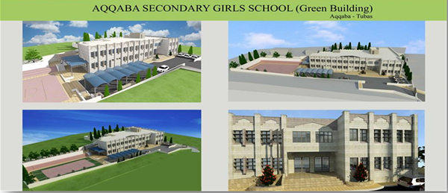
3D Architectural Model of The Project

Slide 3
Project Description
The project is located in AQQABA
The project consists of 2 blocks separated by seismic loads
The project consists of Ground and First floor
Total Area = 1543.30 m²
Ground Floor Area = 635.40 m²
First Floor Area = 745.60 m²

Slide 4
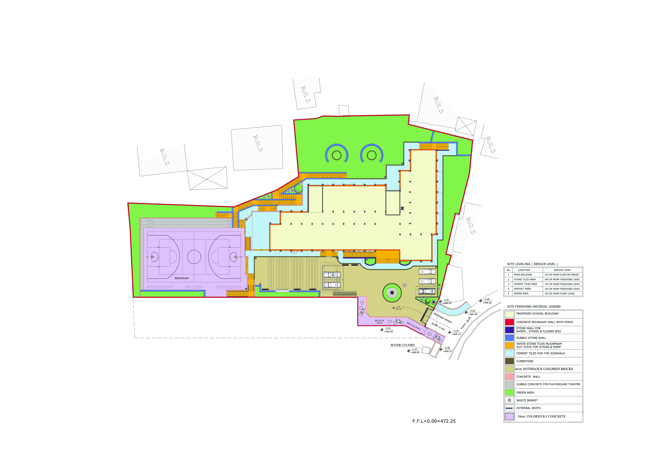
Project Site Plan
Block (2)
Block (1)

Slide 5
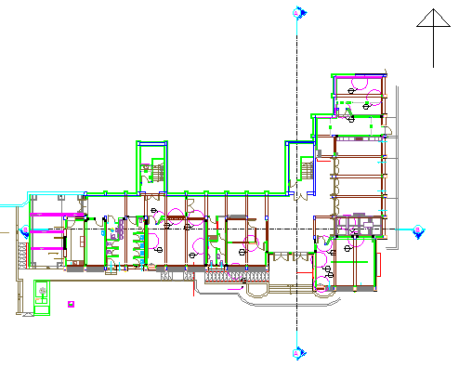
Ground Architectural Plan
Block (2)
Block (1)

Slide 6
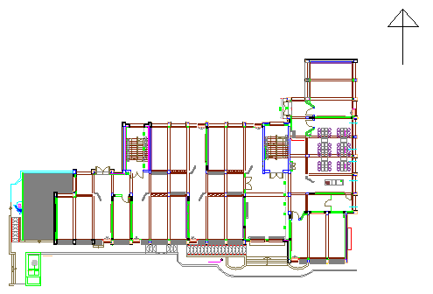
First Floor Architectural Plan
Block (1)
Block (2)

Slide 7
Objectives of Graduation Project (2)
analyze and design the structural members in each block.
To build a 3D model using Etabs 2015 for the project with the verification of the analysis.
Provide complete plans on details of building frames, foundations and shear wall.

Slide 8
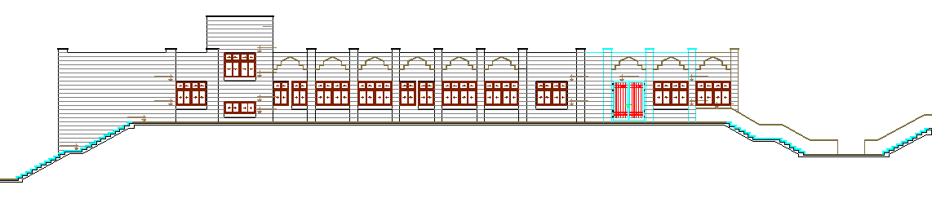
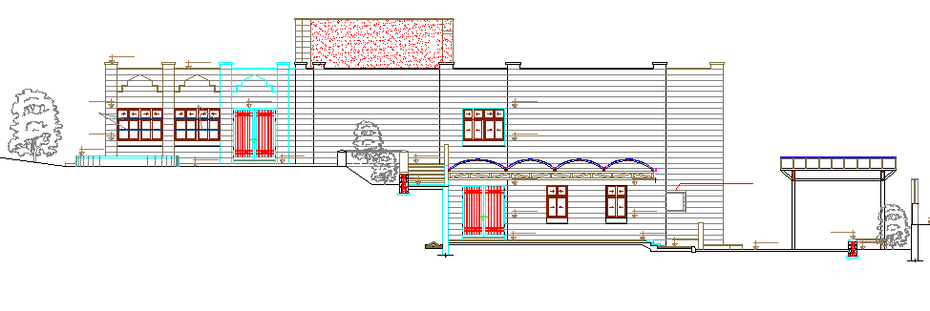
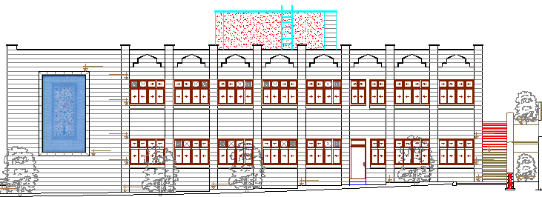
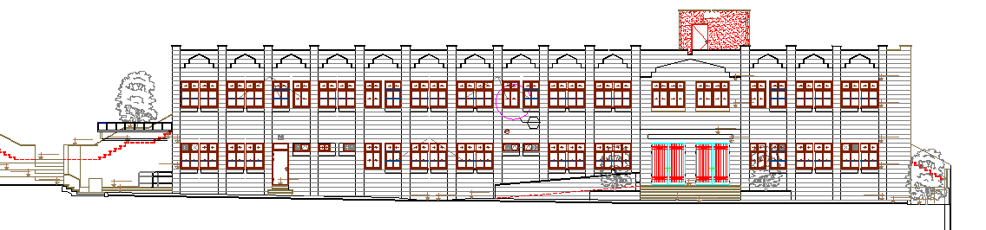
School Elevations
Northern elevation.
Western elevation.
Eastern elevation.
Southern elevation.

Slide 9
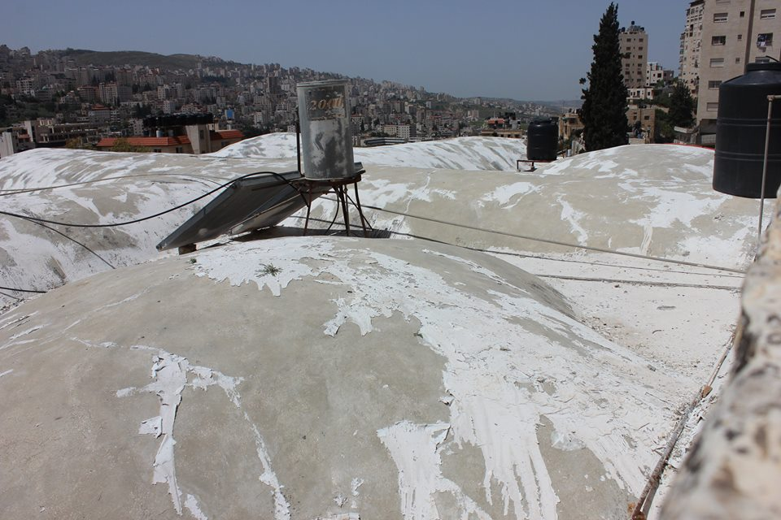
School structural systems
Volts

Slide 10
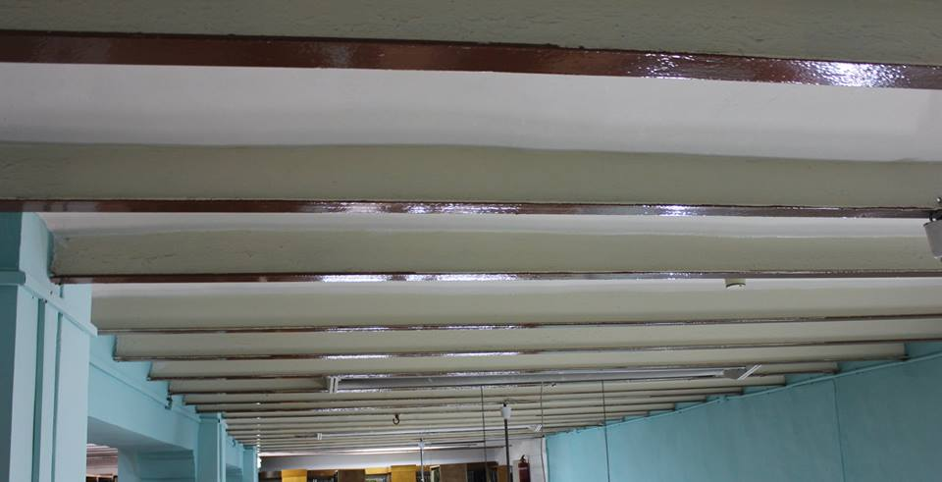
School structural systems
2- composite system (H –section )

Slide 11
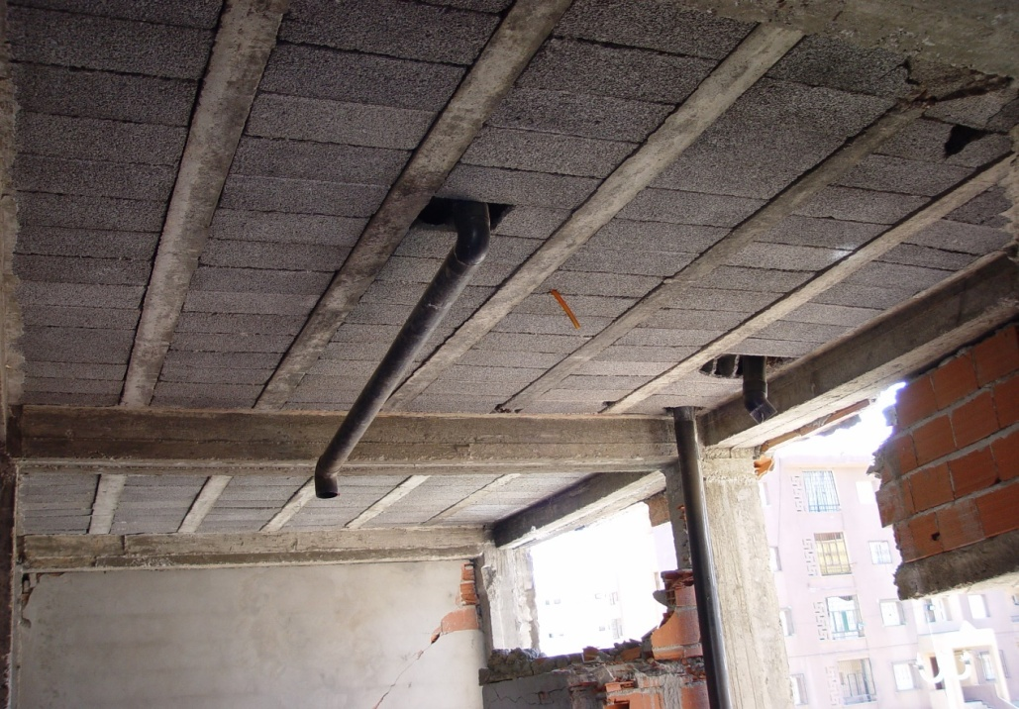
School structural systems
3- Ribbed slab with hidden beams
4- Ribbed slab with dropped beams

Slide 12
Materials
Concrete structural material With:-
  Used Compressive Strength (fc’) for Slabs, Beams, Columns and Footings is 28 MPa.
  Modulus of Elasticity = 24870 MPa
  Unit Weight for used Concrete is 25 kN/m³

Slide 13
Materials
Reinforcing Steel structural material that has :-
  Yielding Stress for used Steel is 420 MPa
  Modulus of Elasticity is 200,000 MPa
  Unit Weight (ɣ) is 77kN/m3

Slide 14
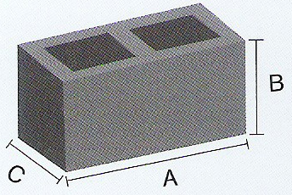
Materials
3) Concrete Blocks
they are non-structural elements composed of a mixture of cement, fine and coarse aggregates, casted in special forms to produce individual units that are used in building external masonry walls, internal partitions, ribbed slabs, and sometimes for the form work of foundations of the structure.

Slide 15
Materials
Building Stones:
  non-structural material Used to cover the external walls, whether it’s a reinforced concrete shear wall, or a masonry wall made from concrete blocks that has an average of density 2700 kg/m3
  The Three main shapes of the used stones are:
    Tobzeh Stone
    Mufajjar Stone
    Matabbeh Stone

Slide 16
Materials
3) Cement Plaster:
  non-structural material used in the coating of internal partitions and external masonry walls, it consists of a mixture of Portland cement, sand, and water applied on the walls to achieve a smooth and flat surface, also to fix the defects
4) Tiles:
  non-structural material that has and average of 2700 kg/m3 density and 3 cm thickness

Slide 17
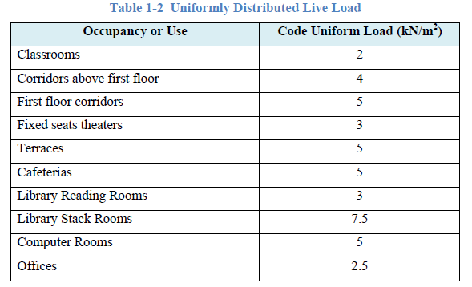
Load Types
1- Live load

Slide 18
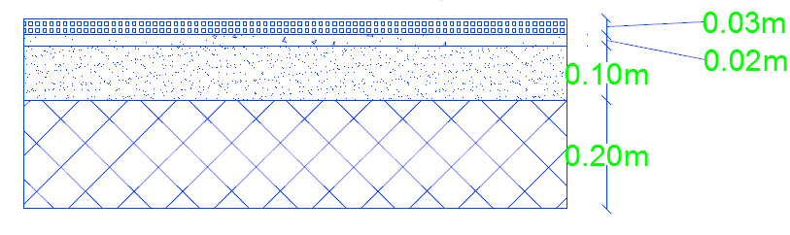
Load Types
2- Dead Load :-
Super imposed Load on slab:-

Slide 19
Load Types
Load on walls (walls height is 3.7 m)
External walls
=
Internal walls
will be taken as line load = 9 KN/m

Slide 20
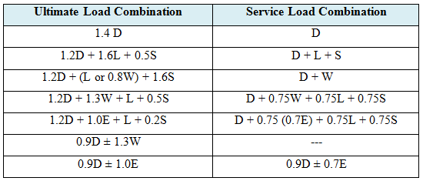
Load Combinations
Using UBC 1997:

Slide 21
Earthquake Forces
Determine horizontal and vertical combination of earthquake effects:
horizontal and vertical combination of earthquake effects:-
E = ρ Eh + Ev
Eh₁ = Ex +0.3 Ey
Eh₂ =0.3 Ex + Ey
Ev = 0.5CaID

Slide 22
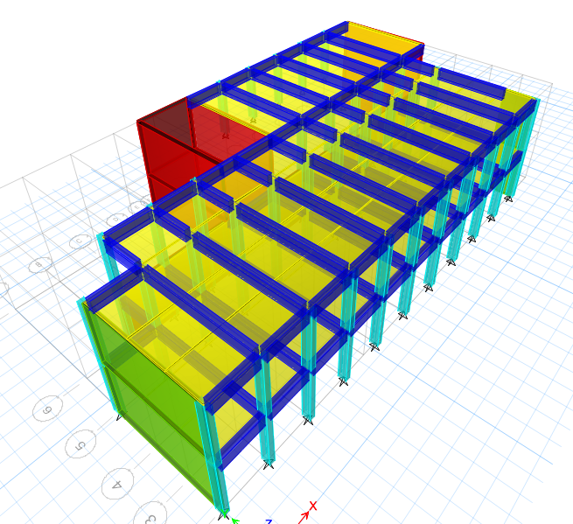
Structural 3D Modeling (Block 1)
The structure is modeled using ETAPS 2015 program

Slide 23
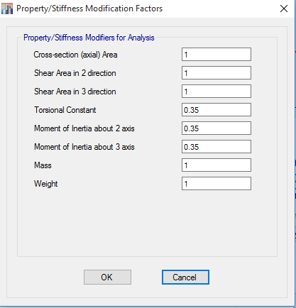
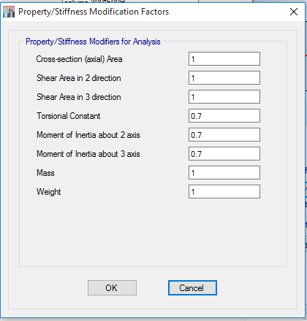
Structural 3D Modeling (Block 1)
For The Beams For The Columns
  Stiffness Modifiers = 0.35 Stiffness Modifiers = 0.70

Slide 24
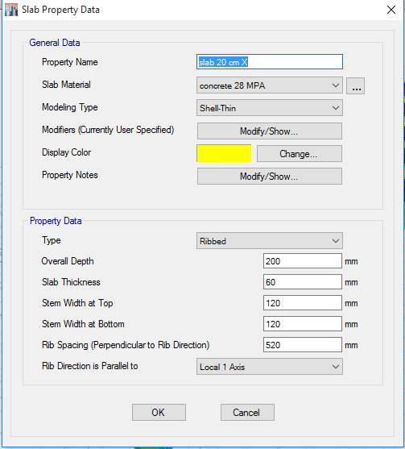
Structural 3D Modeling
For X-Direction slab represented as Ribbed Slab

Slide 25
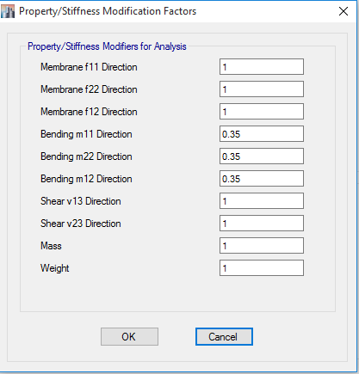
Structural 3D Modeling
Ribbed slab behave as beams
so we have 0.35 modifier

Slide 26
Structural 3D Modeling
Shear wall with 20cm and 30cm thickness
stiffness modifiers

Slide 27
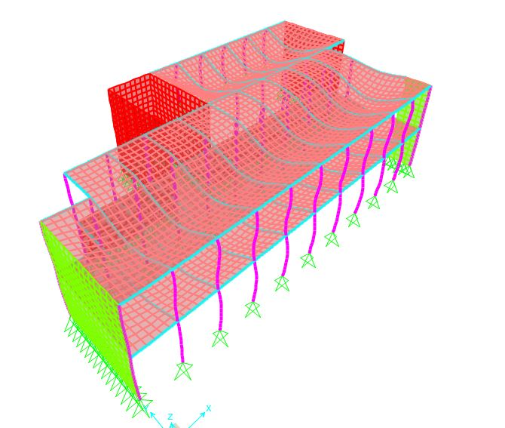
Verification of Structural Analysis
Compatibility Check :
To make sure that all structural elements in 3-D structural model acting as one unit.

Slide 28
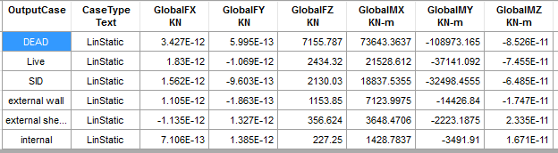
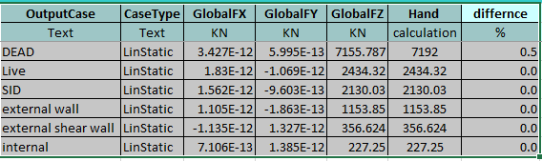
Verification of Structural Analysis
Sap results :-
Hand Calculations :
The difference is
less than 5 % → Its OK

Slide 29
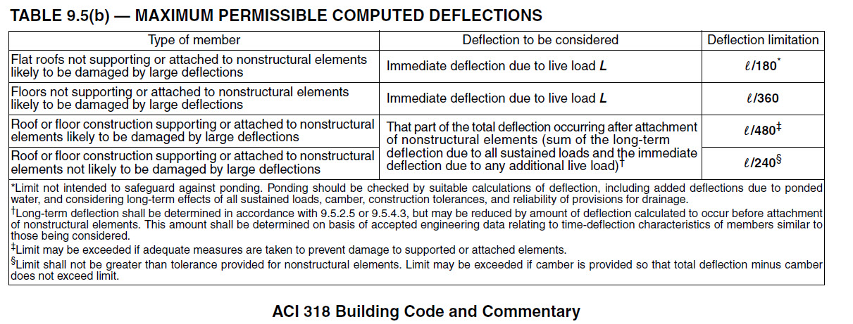
Verification of Structural Analysis
Deflection :-
Allowable deflection
L = 2.4 m
allowable = 2.4 / 240 = 10mm .

Slide 30
Verification of Structural Analysis
Deflection :-
Deflection long term = deflection middle panel - average deflection at support
Average deflection at support = 0.2
Deflection at middle panel = 5.8 mm.
Deflection of long term = 5.8 -0.2 = 5.6 mm
→ Its OK

Slide 31
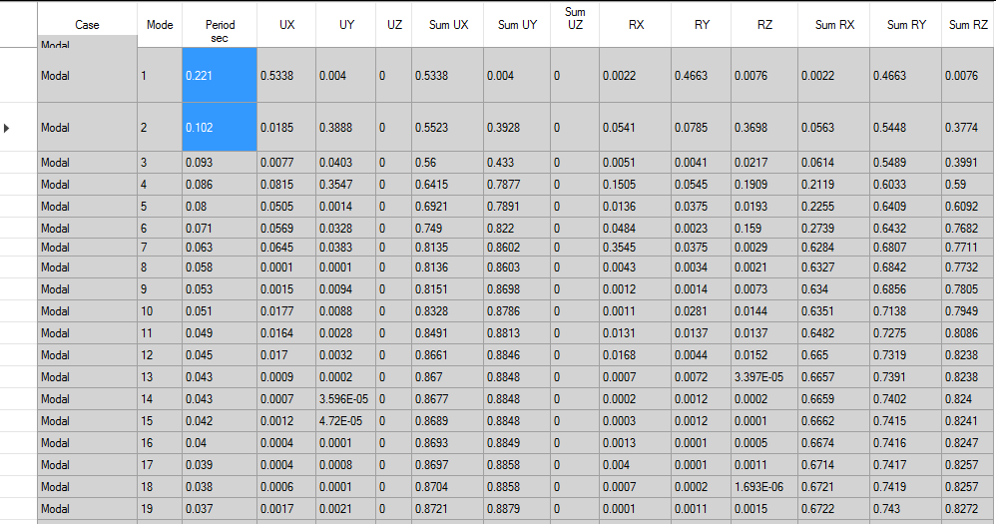
Dynamic analysis according to UBC 97
comparison will be done between the periods (T) of the building, both manually using UBC97 code and by ETAB program from the modal response.
ETABS 2015

Slide 32

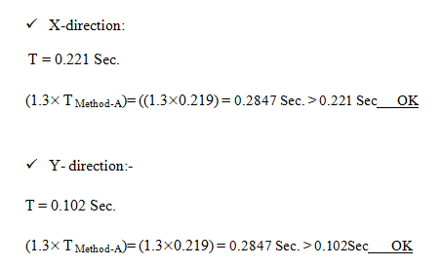
The Value from ETABS must be smaller than (1.3× T _{Method-A})

Slide 33
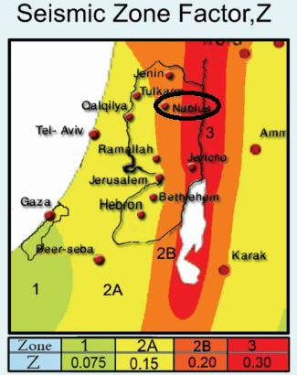
Seismic Zone Requirements (UBC-97)
Seismic Zone Factor (Z) Map Prepared By An-Najah National University is used to determine the seismic zone for Aqqaba.
we are in seismic zone 2B ( z = 0.2)

Slide 34
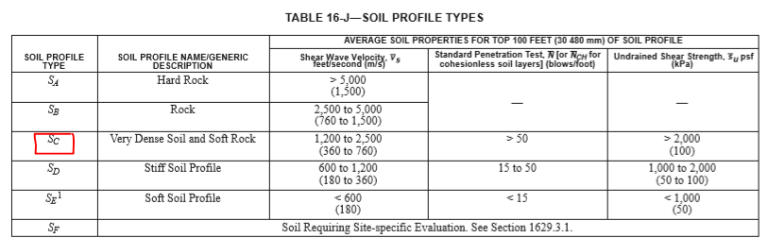
Soil classification
The Soil profile is found to be (SC).

Slide 35
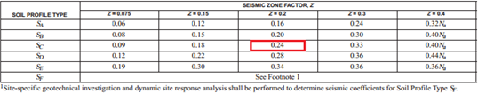
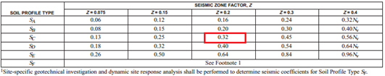
Seismic coefficients (UBC-97)
Seismic coefficients:
Ca = 0.24
Cv = 0.32

Slide 36
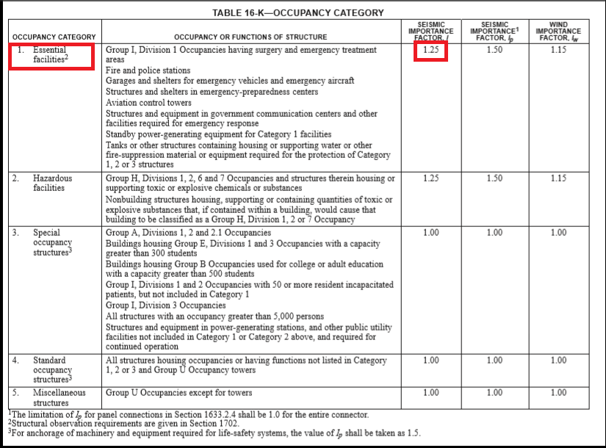
Importance Factor (UBC-97)
I = 1.25 (essential building).

Slide 37
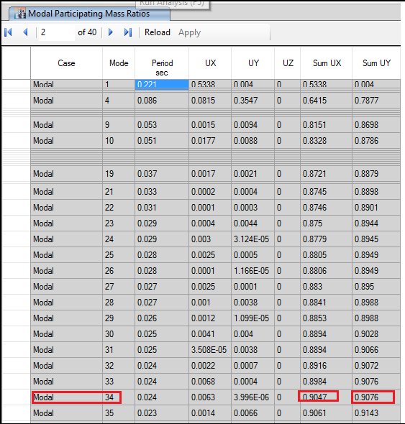
Design using Response spectrum
Modes and Periods

Slide 38
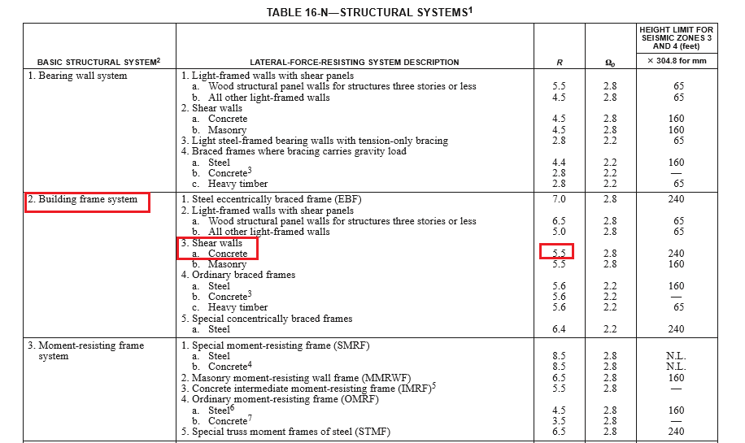
Response modification factor (R)
Response Modification Factor (R): = 5.5
Gravity acceleration g = 9.81 m/s²

Slide 39
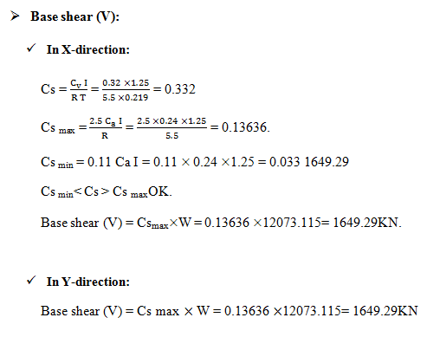
Using response spectrum to determine the design base shear:

Slide 40
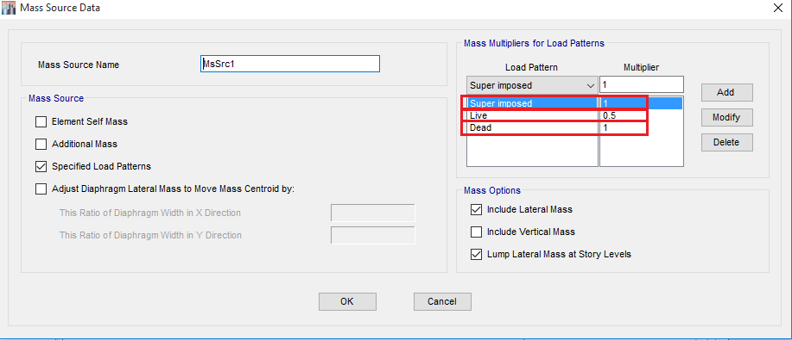
Mass that included = mass of (Dead load + Superimposed dead load + 0.5Live load).

Slide 41
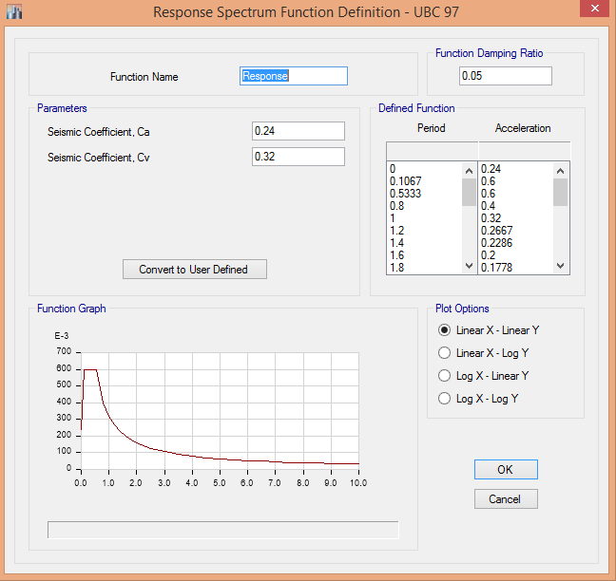
Response Spectrum Analysis on ETABS:

Slide 42
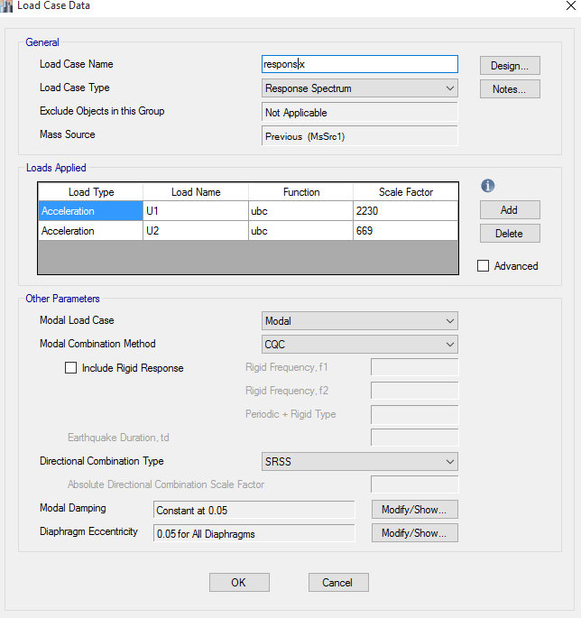

Define modal acceleration in X and Y according to (Eigen value).

Slide 43
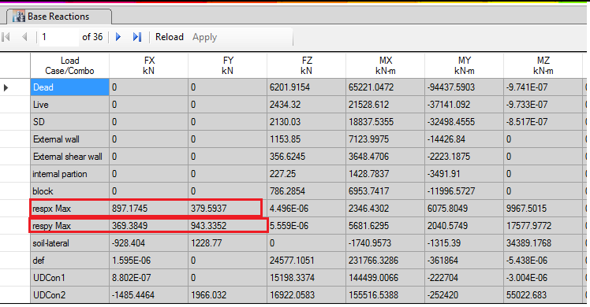
Initial Base Shear
F_{x ETABS} = 897.17 KN.
F_{y ETABS} = 943.33 KN.

Slide 44
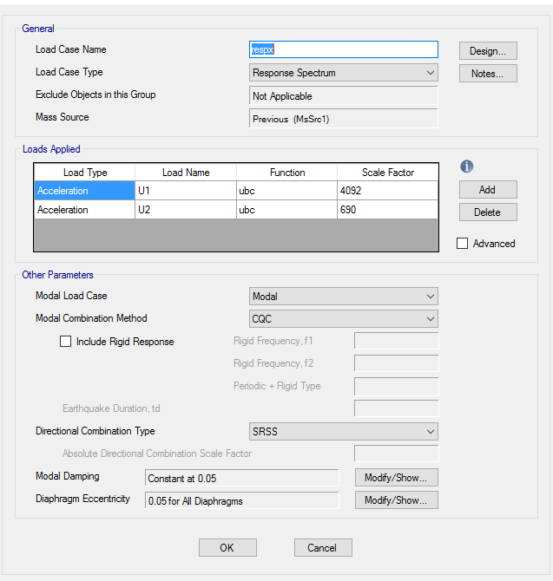
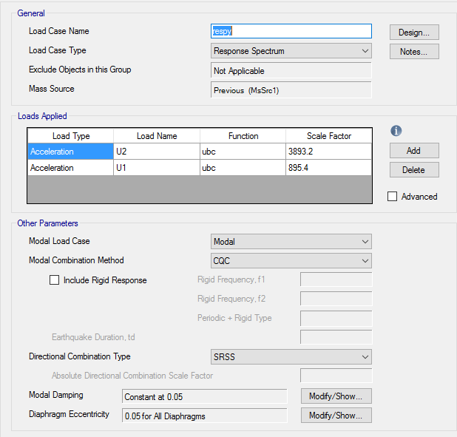
Modified scale factor for X

Slide 45
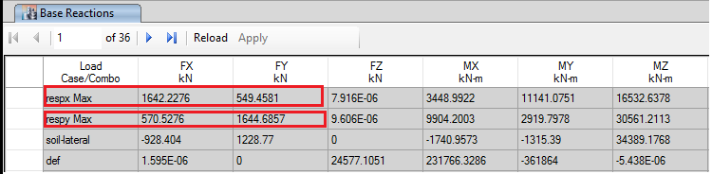
Final Base Reaction

Slide 46
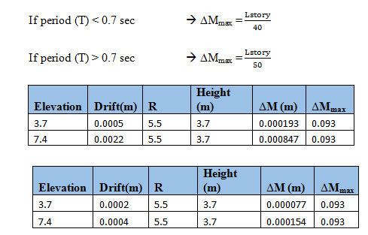
Limits of displacement:

Slide 47
Design of concrete structural elements
The code used for design and detailing is ACI 318-11 regarding seismic and gravity loads.
The structural system is Building Frame System with Special Shear Walls ( Intermediate Frames ).
Provisions were applied to all structural members including:
  Beams
  Slabs
  Shear Walls
  Foundations

Slide 48
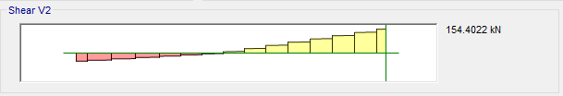
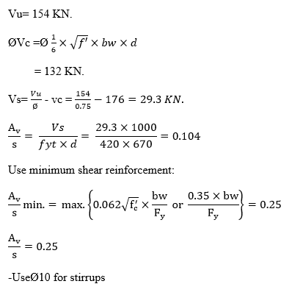
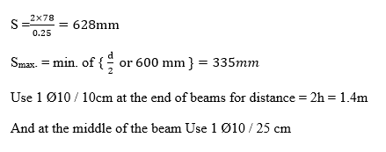
Design of Intermediate Beam

Slide 49
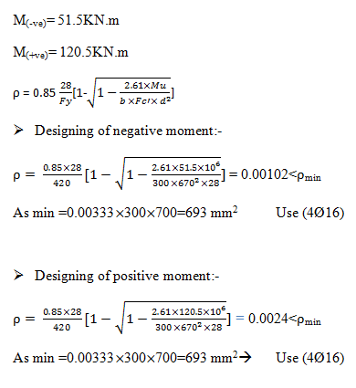
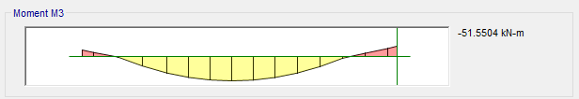
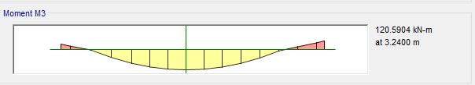
Design of Intermediate Beam

Slide 50
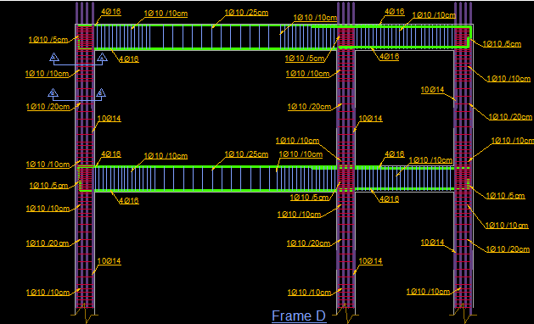
Details for a Beam_Column frame

Slide 51
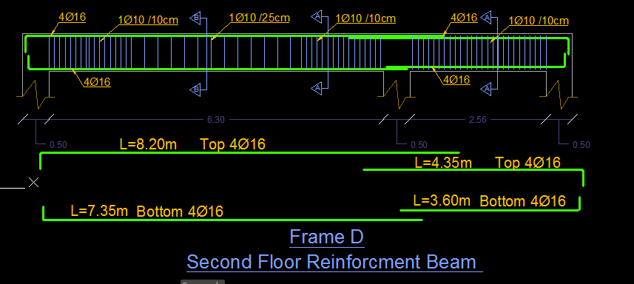
Details for a Beam

Slide 52

Details of Beam_Column Sections

Slide 53


Details for a slab

Slide 54


Design of Shear wall

Slide 55



Design of Shear wall

Slide 56

Design of Shear wall

Slide 57

Details of Shear wall

Slide 58
Design of footing

