Slide 1

Design of Wastewater Collection System for Al-Attarah Village
Graduation Project 2
Prepared by:
ABDALLAH FOUQHA
ANAS HANTOLI
MOHAMMED ABU ASBEH
Under supervision of:
Dr. Sameer shadeed

Slide 2
Outline of the project :
Introduction
Objective
Methodology
Study area
Data collection
Design of Wastewater Collection System
Results of Wastewater Collection System for Design
Cost Estimate For Wastewater Collection System

Slide 3
INTRODUCTION
Water used in the home for flushing, bathing, laundry, cleaning dishes and floor drainage. this produce wastewater so we need to method to disposal from this waste, it called wastewater collection system (WCS).
Many villages in west bank don't have waste water collection system, Al-Attarah is one of this villages.

Slide 4
OBJECTIVE
Design a wastewater collection system for Al-Attarah village for the coming 30 years.

Slide 5
METHODOLOGY
Visiting study area.
Data collection.
Estimate the future Population and Wastewater Generated.
Design of wastewater network using Sewer CAD software.

Slide 6
STUDY AREA

Slide 7
STUDY AREA
Location:
Al-Attarah village is located 21 km the southwest of Jenin.
Climate:
Hot, dry in summer and cool, rainy in winter and average annual rainfall in 492 mm.

Slide 8
STUDY AREA
Population:
The total population of the village was 1683 capita in 2017.
Sewage drainage:
The village does not have wastewater collection system (WCS), As such, people in the village still use cesspits to get rid of wastewater. Once cisterns get full, they are being disposed by tankers to the nearby wadi. Consequently, there exist a serious environmental problem that affects the quality of life in the village.

Slide 9
DATA COLLECTION

Slide 10
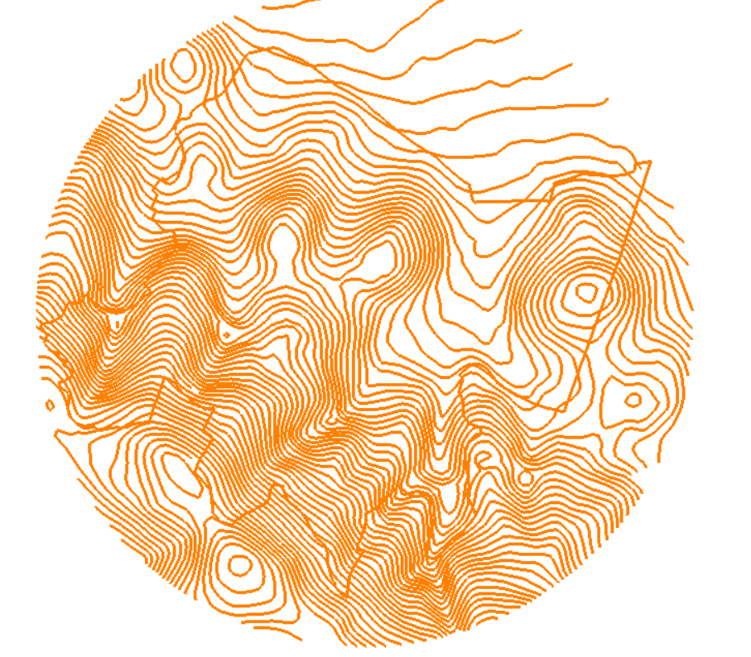
Contour map

Slide 11
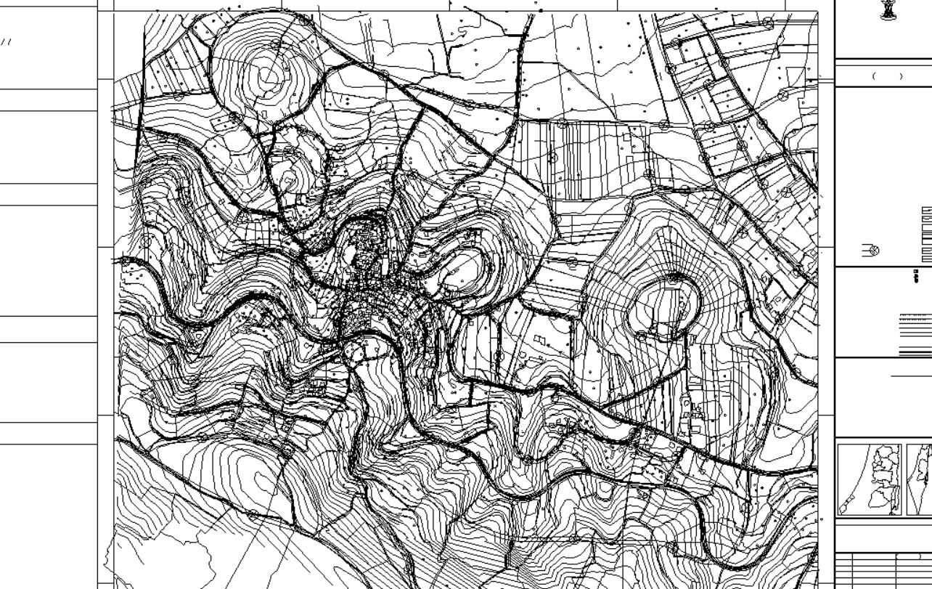
Roads map

Slide 12
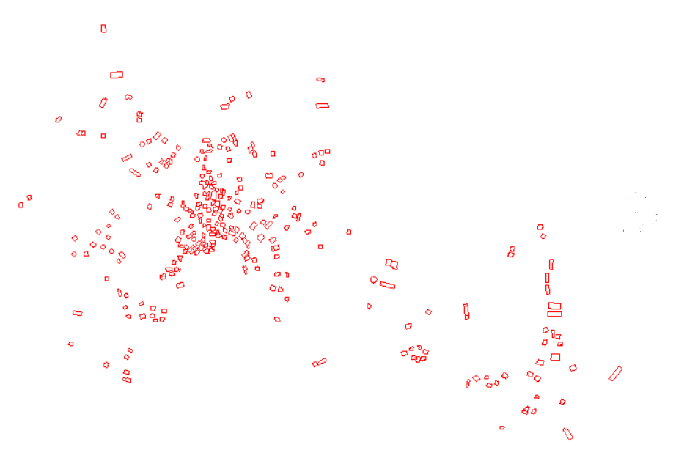
Building map

Slide 13
DESIGN OF WATERWATER COLLECTION SYSTEM

Slide 14

Data Of Future Population
$P_{n}=P_{0}×{\left(1+r\right)}^{n}$
Where:
${ P}_{n}$ = The number of population after (n) years.
${ P}_{0 }$= The number of population now.
r = Growth rate in the country.
n = Number of years.

Slide 15

Data Of Future Population
N = 30 years
R = 0.038
P₂₀₅₀ = P₂₀₃₇ (1 + r)¹³ $=5764 capita$
Community | Population 2007 (Capita) | Population 2017 (Capita) | Population 2037 (Capita) | Population 2050 (Capita)
Al-Atarah | 1,159 | 1,683 | 3,549 | 5,764

Slide 16
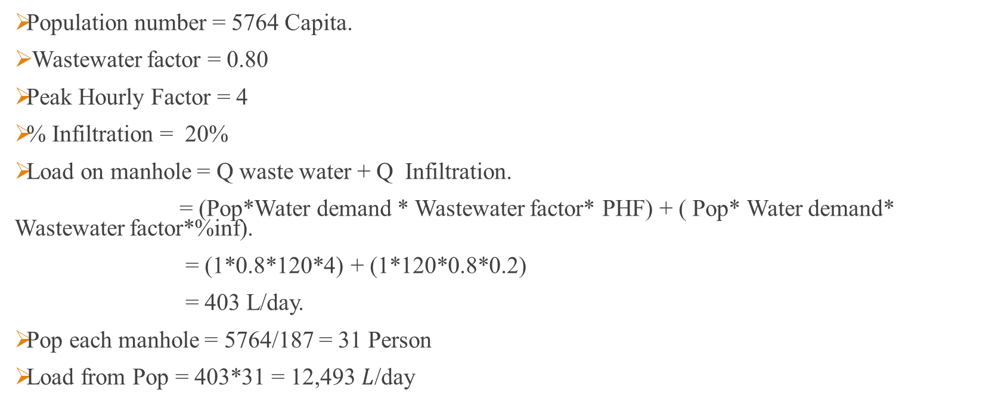
Data Of Wastewater Generated
Population number = 5764 Capita.
Wastewater factor = 0.80
Peak Hourly Factor = 4
% Infiltration = 20%
Load on manhole = Q waste water + Q Infiltration.
= (Pop*Water demand * Wastewater factor* PHF) + ( Pop* Water demand* Wastewater factor*%inf).
= (1*0.8*120*4) + (1*120*0.8*0.2)
= 403 L/day.
Pop each manhole = 5764/187 = 31 Person
Load from Pop = 403*31 = 12,493 $L$/day

Slide 17
Network Design Using The Sewer CAD
We open the required shape files (contours, road network , building map) with Sewer CAD program.
We draw the network.

Slide 18
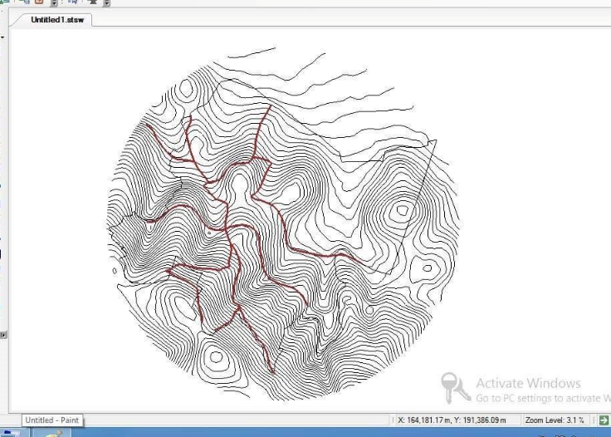
Network Design Using The Sewer CAD

Slide 19
Network Design Using The Sewer CAD
WCS
Conduites
Manholes
Outfalls
Length <=30
Diameter>=8in
Material (PVC)
Diameter
Drop Manhole
Material
Loads
Elevation
Location
Elevation
Slope

Slide 20
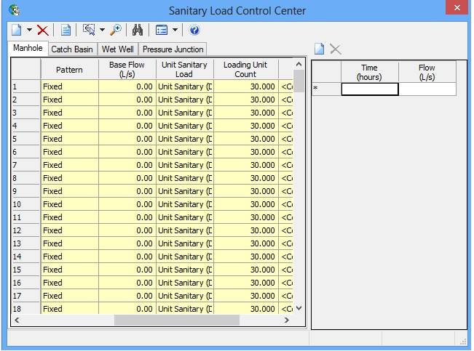
Network Design Using The Sewer CAD

Slide 21
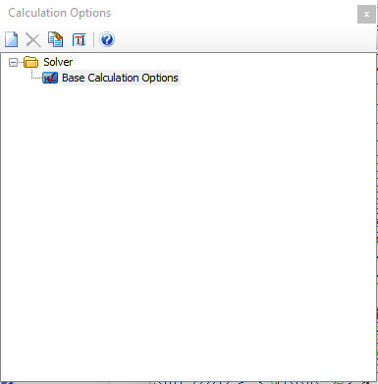
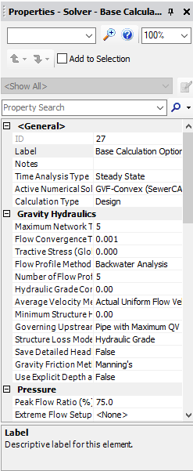
Network Design Using The Sewer CAD

Slide 22
WCS
Number of Elements | Elements
187 | Manhole
188 | Conduit

Slide 23
Design Criteria
Slope criteria from 1 to 12 %.
Velocity criteria from 0.3 to 3 m/sec.
Cover criteria from 0.8 to 5 m.

Slide 24
Results of Wastewater Collection Network for Design

Slide 25
Velocity
Velocity (m/s)
Conduit Number

Slide 26
Slope
Slope (%)
Conduit Number

Slide 27
Cover
Cover (m)
Conduit Number

Slide 28
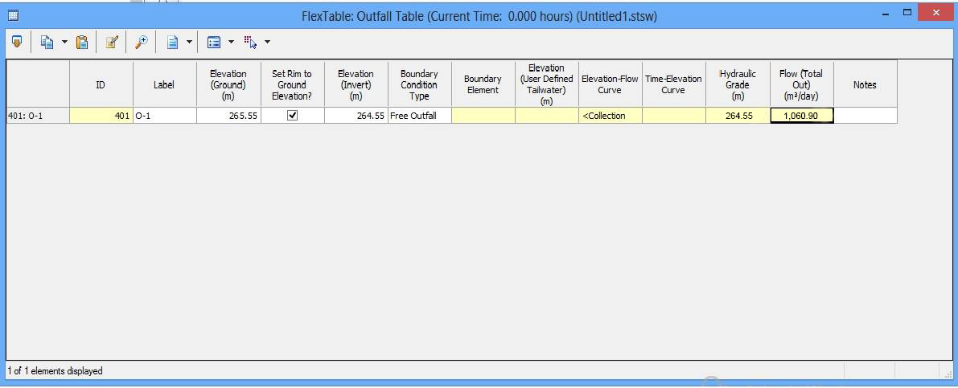
Outfall

Slide 29
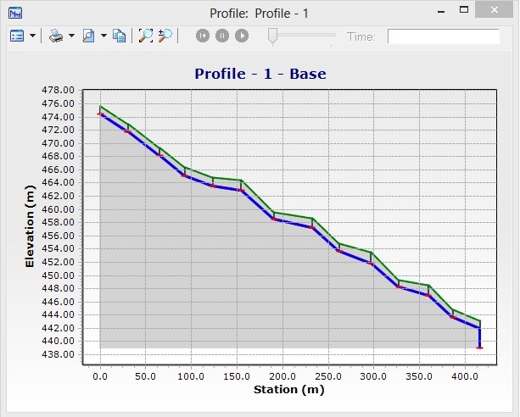
Profile 1

Slide 30
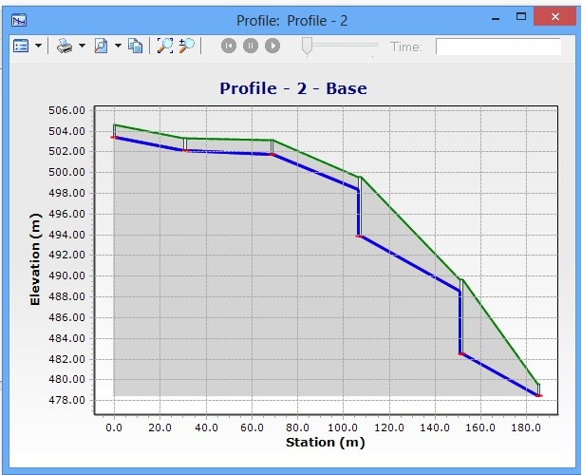
Profile 2

Slide 31
Cost Estimate For WCS
 | Unit | Quantity | Unit price ($) | Total price ($)
conduits cost | m | 6,125 | 40 | 245,000
excavation and filling and paving cost | m | 6,125 | 30 | 183,750
manholes cost | number | 187 | 650 | 121,550
 |  |  | total cost | 550,300

Slide 32


