Slide 1

Graduation Project 2
Structural Analysis and Design of Optical and Nursing College
Under Supervision of:
Eng. Abdalhakeem Aljawhari MSc,CE

Slide 2




Prepared By :-
Adel
Abdalhi
Basel
Nassar
Mohammad
Diab
Tareq
Ziad

Slide 3
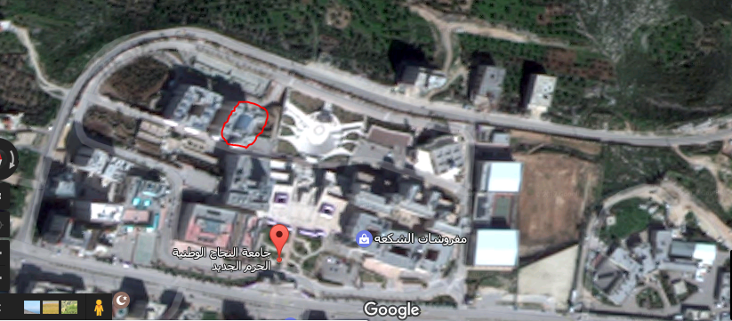
Project Description
The Optical and Nursing College building area covers about 1240 m2 which is located in Najah University new campus – Palestine next to faculty of medicine. The total building height is 28.3 m. The building consists of seven floors, and has two entrances with deferent levels.

Slide 4
Site and geology
Qall=350 Kn/m2
Friction angle (ɸ) = 30⁰
Specific weight (ɣ) = 18 Kn/m3
Type of soil is Loosing Rock
It is recommended to consider isolated and/or continuous footings.

Slide 5
  Design philosophy
1
2
3
A 3D model will be constructed and analyzed using ETABS 2016 program taking into consideration the effects of dynamic Loads.
Columns and Beams will be represented as line elements
Slabs and shear walls will be modeled as area elements.
4
5
The connections between the footings and the column necks will be represented as pin connections.
Ultimate design method will be used for analyzing the structure.

Slide 6
Loading
Dead load
Superimposed dead load
Masonry loads on the shear walls.
Water loads on tanks
Soil load
Live loads
Earth Quick loads

Slide 7



  Computer programs:
ETABS 2016 was used to analyze and design the structural elements.
AutoCAD Was used for Structural detailing.
Safe 2016 was used for Design Footing.
Sap2000 was used for Design Stairs.
ETABS 2016 was used for Design Water Tank.

Slide 8
Dimensions of structural element were used in project :
Slab:
Tow way solid slab 20 cm
Beams:
B400*400 (Width * Depth)
B450*700 (Width * Depth)
Shear Wall:
S 25 cm ( Thickness)
S 20 cm ( Thickness)
Column:
G1 (350 *450 )
G2 (400*500 )
G3 (500*600 )
G4 (400*400 )

Slide 9
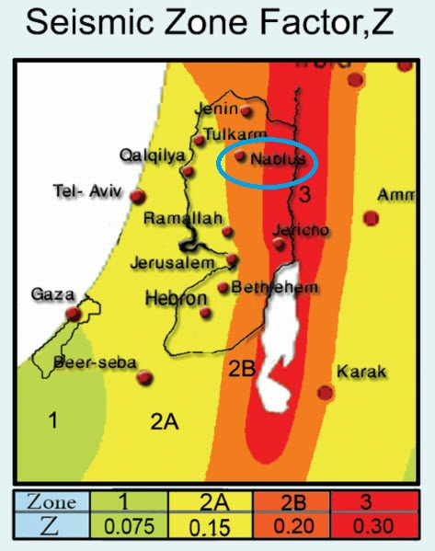
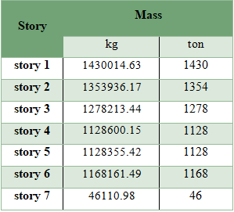
LATERAL LOADS
According to Palestine seismic map in figure and the project location, seismic zone is 2B.
→ Z=0.2 UBC (97) - TABLE 16-I
Site Soil Classification is Sc UBC(97) - TABLE 16-J
Weight of structure:
The effective seismic weight:
W=Wdead+Wsd+0.25W live

Slide 10
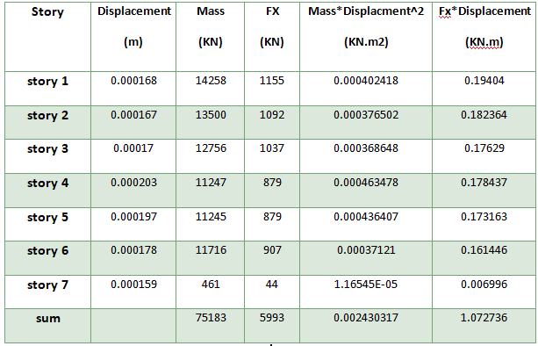

LATERAL LOADS
Determination of structure period:
Using Reloph Method to calculate the period of structure:
Assume 1 kN/m² as Earth Quick in x direction distributed in each floor.

Slide 11
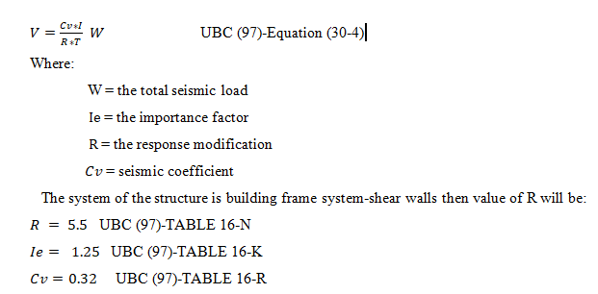
LATERAL LOADS
Determinations of base shear using static lateral force procedure:

Slide 12
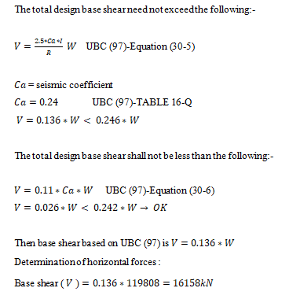
LATERAL LOADS
Determinations of base shear using static lateral force procedure:

Slide 13
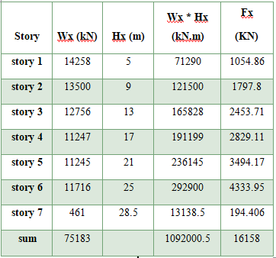
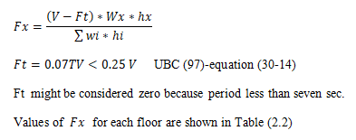
LATERAL LOADS
Horizontal force in each floor from equation 30-15-UBC:-

Slide 14
LATERAL LOADS
Response spectrum that is defined in UBC-97
Response spectrum is an elastic response spectrum for 5 percent equivalent viscous damping used to represent the dynamic effects of the Design Basis Ground Motion for the design of structures.

Slide 15
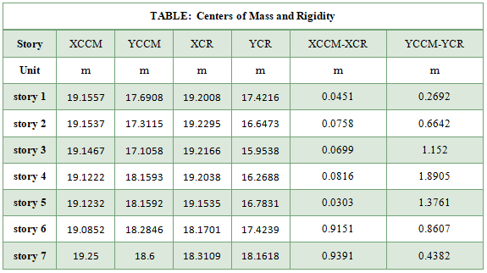
LATERAL LOADS
The center of mass and center of rigidity
An eccentricity equal to 0.25L is acceptable by the code, where L is the total length of the structure at the eccentricity direction.:
values of eccentricity is small than 0.05L for each direction
= 0.05 * 40 = 2

Slide 16
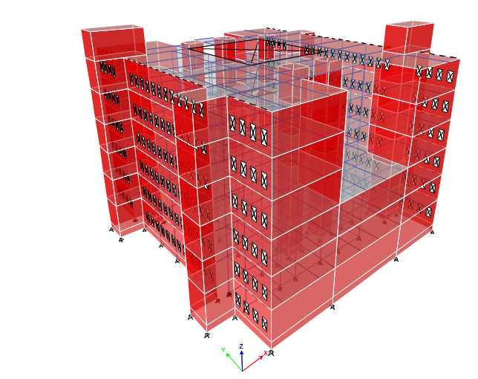
THREE DIMENSIONAL STRUCTURE ANALYSIS
The modeling starts with building each block using ETABS 2016 by first defines: materials, sections as one-dimensional elements (columns and beams) and two-dimensional elements (slabs and shear walls), and loads (gravity and lateral loads), then draws each element relative to specific grid system on ETABS 2016.

Slide 17
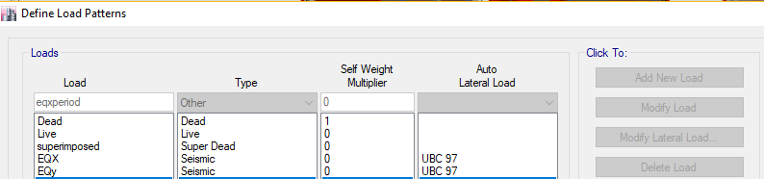
THREE DIMENSIONAL STRUCTURE ANALYSIS
Loads on ETABS
Load pattern

Slide 18
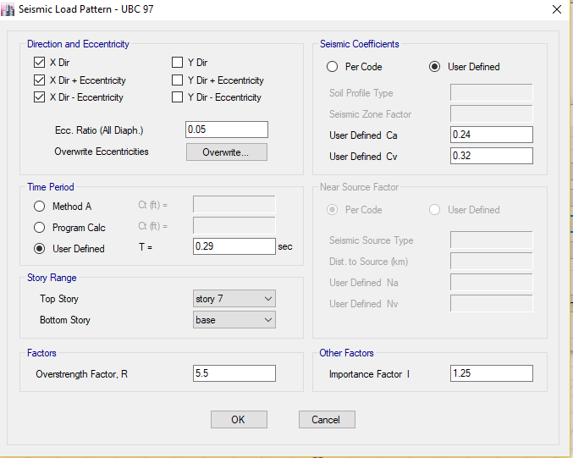
THREE DIMENSIONAL STRUCTURE ANALYSIS
Seismic load:
UBC code was used to define the load using equivalent static method and response spectrum and figure 4.14 shows the definition for UBC-97.

Slide 19
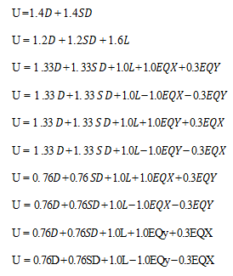
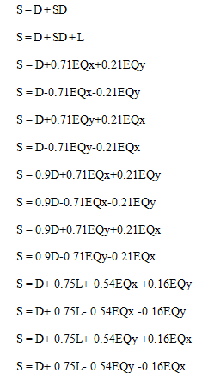
THREE DIMENSIONAL STRUCTURE ANALYSIS
Load Combinations:

Slide 20
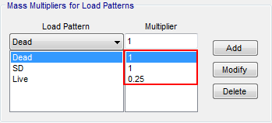
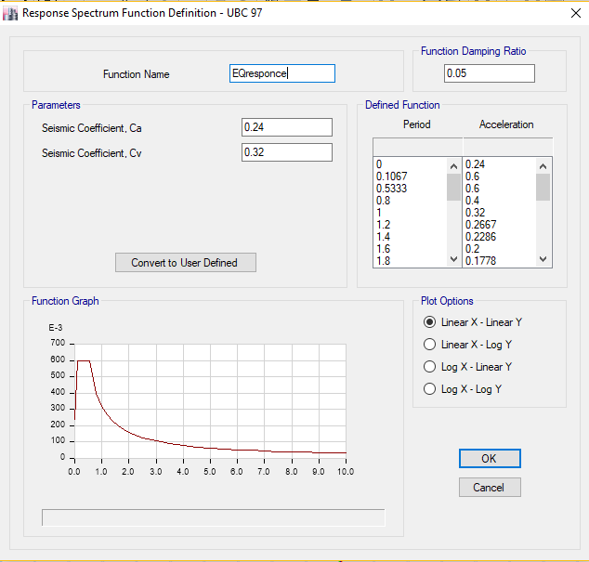
THREE DIMENSIONAL STRUCTURE ANALYSIS
mass source
Definition of response spectrum function

Slide 21
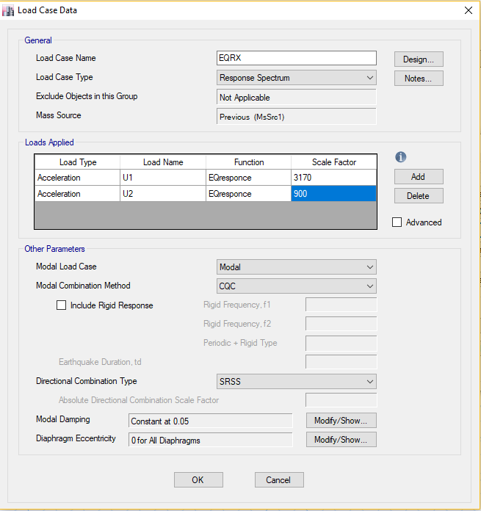
THREE DIMENSIONAL STRUCTURE ANALYSIS
Definition of load cases for response spectrum

Slide 22
Verifications of structural analysis
Strength check
Columns and beams should be checked for shear and torsion. In addition, for columns refer to ACI-318M-11 should be between 1% and 8%but for practical and economic consideration, for Beams ρ is recommended to be less than for singly.
After run and design of the structure, there were no red elements, so there were not any shear or torsion problems that would cause the elements to be over stressed.

Slide 23
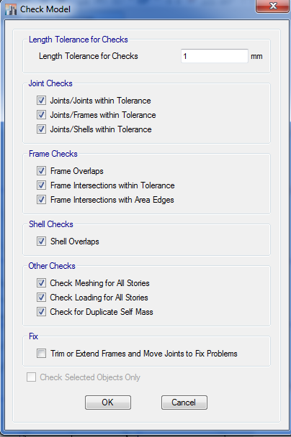
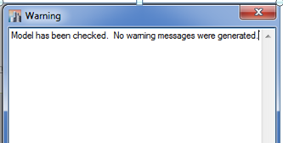
Verifications of structural analysis
Drawing structural model check

Slide 24
Verifications of structural analysis
Drawing structural model check

Slide 25
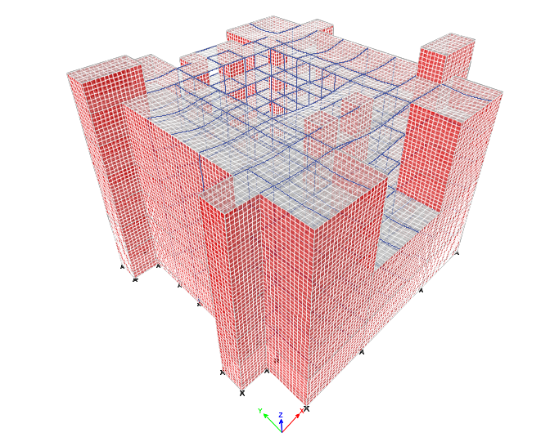
Verifications of structural analysis
Compatibility of structural model
By making start animation for the deformed shape of ETABS model, it can be noticed that the structural elements are compatible and all of them are moving together. Figure 4.20 shows the deformed shape.

Slide 26
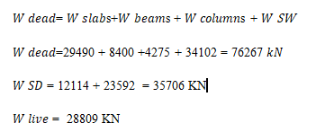
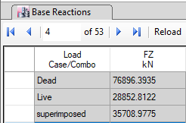
Verifications of structural analysis
Equilibrium

Slide 27
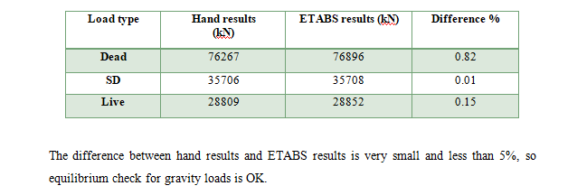
Verifications of structural analysis
Equilibrium

Slide 28
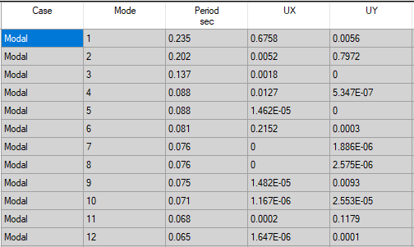
Verifications of structural analysis
Lateral loads check
Periods:
For maximum displacement in X-direction, 𝑈𝑋 = 0.67 mm, 𝑇𝐸𝑇𝐴𝐵𝑆,𝑋 = 0.235 sec For maximum displacement in Y-direction, 𝑈𝑌 = 0.79 mm, 𝑇𝐸𝑇𝐴𝐵𝑆,𝑌 = 0.202 sec From Chapter 2, period from hand calculation, 𝑇ℎ𝑎𝑛𝑑 = 0.29 sec
𝑇𝐸𝑇𝐴𝐵𝑆,𝑋 = 0.235 sec < 1.4×𝑇ℎ𝑎𝑛𝑑
𝑇𝐸𝑇𝐴𝐵𝑆,𝑌 = 0.202 sec < 1.4×𝑇ℎ𝑎𝑛𝑑

Slide 29
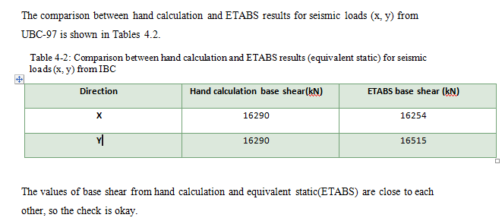
Verifications of structural analysis
Lateral loads check
Seismic load check

Slide 30
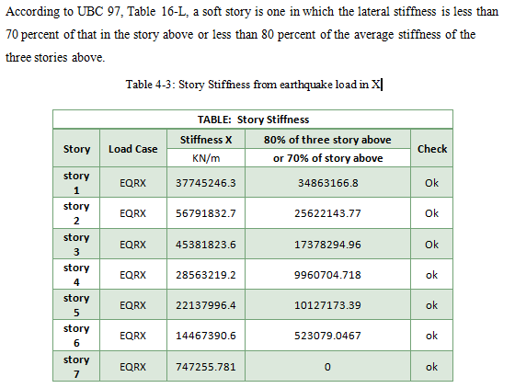
Verifications of structural analysis
Stiffness irregularity – soft story:

Slide 31
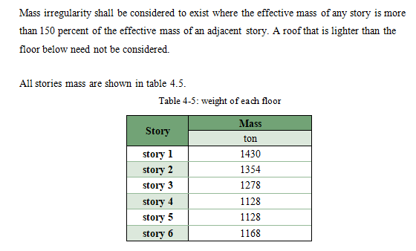
Verifications of structural analysis
Weight (mass) irregularity

Slide 32
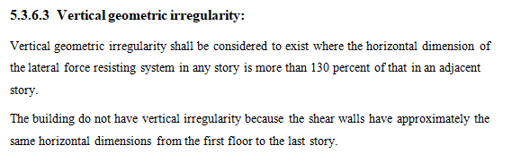
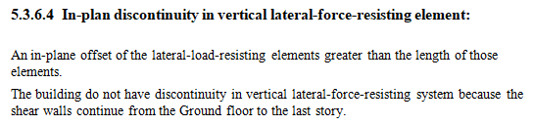
Verifications of structural analysis

Slide 33
Verifications of structural analysis

Slide 34
Verifications of structural analysis

Slide 35
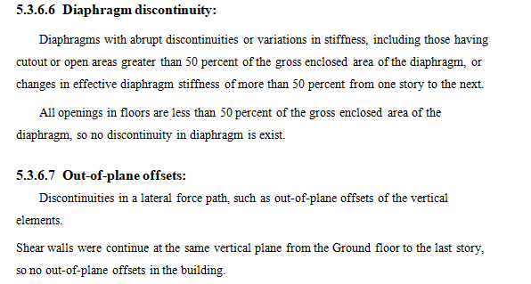
Verifications of structural analysis

Slide 36
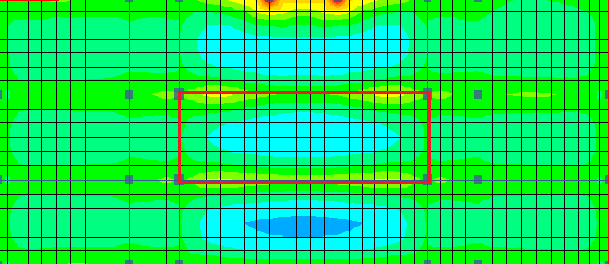
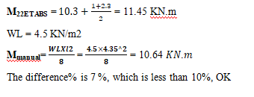
Verifications of structural analysis
Stress Strain relationship (internal equilibrium)

Slide 37
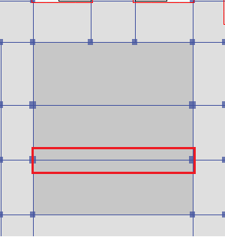
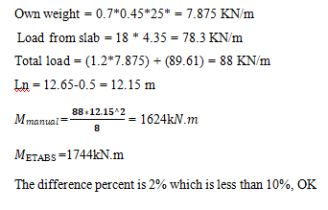
Verifications of structural analysis
Stress Strain relationship (internal equilibrium)

Slide 38
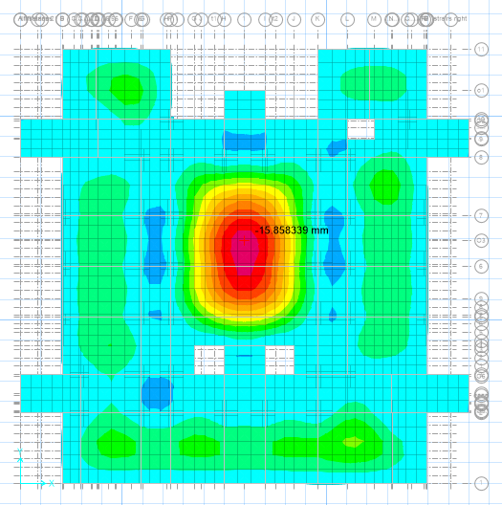
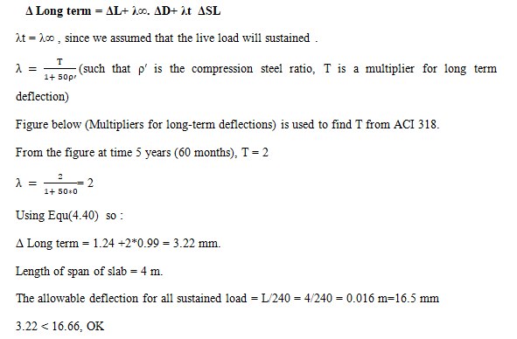
Verifications of structural analysis
Check slab for deflection :

Slide 39
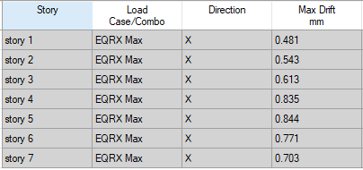
Verifications of structural analysis
Story drift:
∆𝑆 for story 1 = 0.000481 m
∆𝑀= 0.7 × 5.5 × 0.000481 = 0.00185 m
𝑇𝑋 = 0.235 sec < 0.7 sec
0.025𝐻 = 0.025 × 5 = 0.125 m
∆𝑀= 0.00185 m < 0.025𝐻 = 0.125 m → OK
∆𝑆,𝑚𝑎𝑥 for remaining stories = 0.000844 m
∆𝑀= 0.7 × 5.5 × 0.000844 = 0.00325 m
0.025𝐻 = 0.025 × 4 = 0.1 m
∆𝑀= 0.00325 m < 0.025𝐻 = 0.1 m → OK

Slide 40
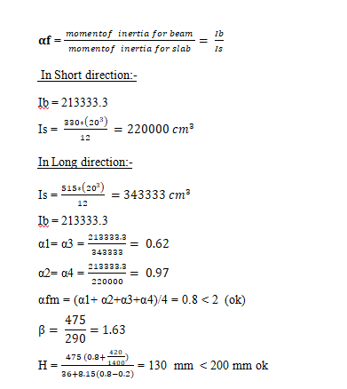
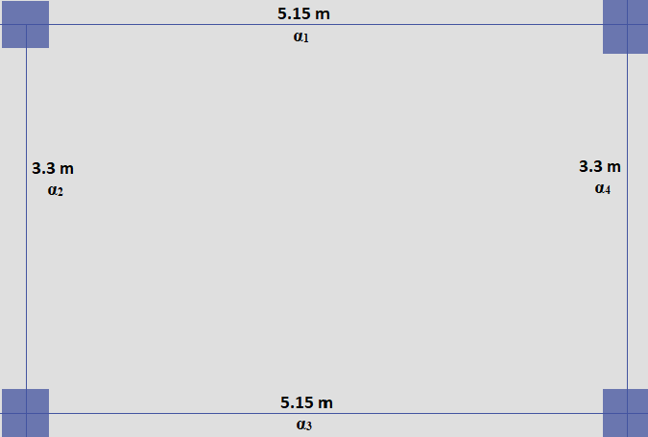
Design of Slab
Assume slab thickness equal 20 cm.
Assume beams of continues spans to be 400 mm width and to have thickness of 400 mm

Slide 41
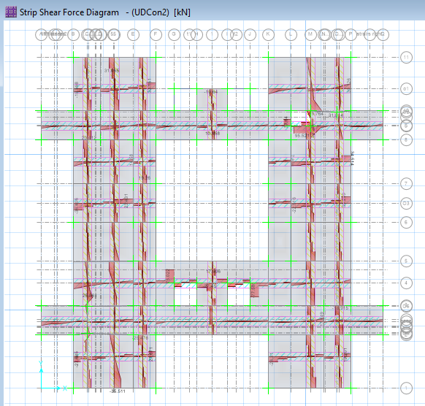

Design of Slab
Wide-beam shear check
From Safe, max Vu = 77 kN ,as shown in figure.
Ok

Slide 42
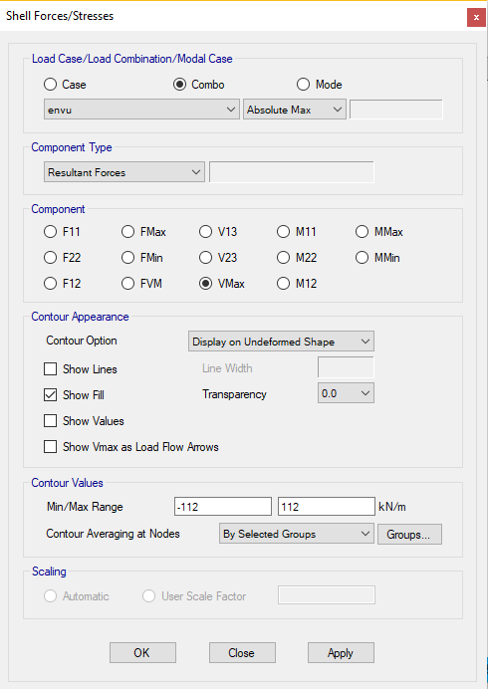
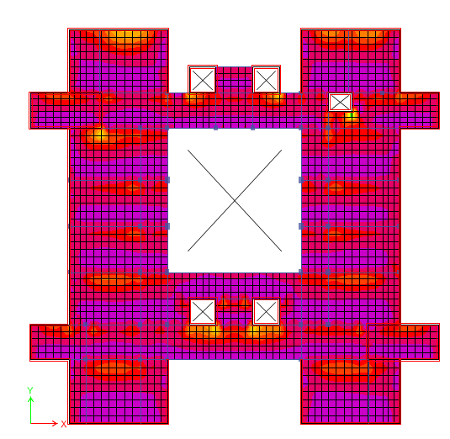
Design of Slab
Wide-beam shear check
Ok

Slide 43
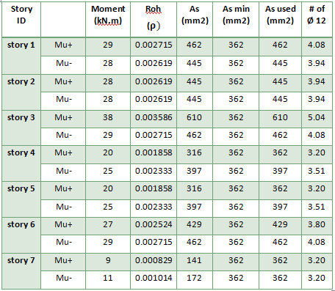
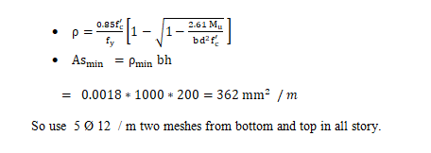
Design of Slab
Design the slab for flexure

Slide 44
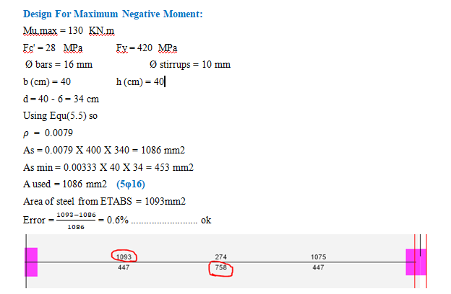
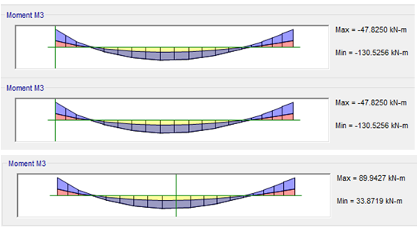
Design of Beams
Design of Beam for flexure
.

Slide 45
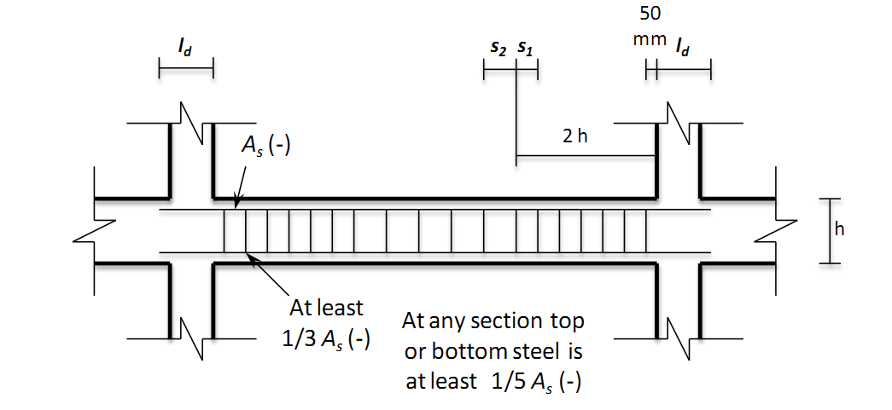
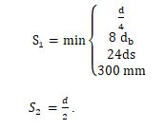
Design of Beams
These rules were followed in shear design of beams for intermediate resisting frames case.
.

Slide 46
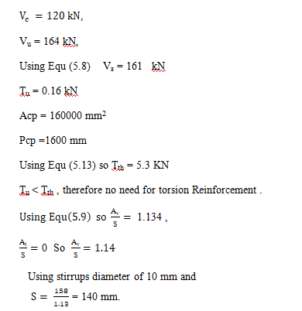
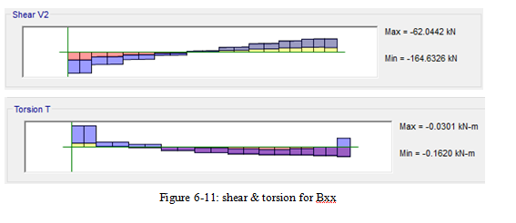

Design of Beams
Design of Beam for shear force
.

Slide 47

Design of Beams
Summary of beams group design
.

Slide 48



Design of Columns
Slenderness check for the columns
.
No slenderness in the column, and can be classified as short column

Slide 49


Design of Columns
.
Ok

Slide 50


Design of Columns
.

Slide 51



Design of Columns
The following rules are followed in shear design of columns for intermediate resisting frame case.
.

Slide 52

Design of Columns
summary of columns
.

Slide 53
Foundation Design.
.
Expected value | Soil Property
350 KN/(m^2) | Bearing Capacity
18 KN/(m^3) | Specific weight (ɣ)
30 degree | Friction angle (Ø)
……. | Stiffness factor for soil (K)

Slide 54

Footing layout .
.

Slide 55
Footing table.
Footing Num | Reinforced concrete |  |  | Blinding concrete |  |  | Bottom Reinforcement in Both Direction(mm) | Top Reinforcement in Both Direction(mm)
 | L(m) | B(m) | H(m) | L(m) | B(m) | H(m)
F1 | 1.80 | 1.80 | 0.4 | 2.0 | 2.0 | 0.5 | Ф14@150mm | ф12@250mm
F2 | 2.00 | 2.00 | 0.5 | 2.20 | 2.20 | 0.6 | Ф14@150mm | ф12@250mm
F3 | 1.70 | 1.70 | 0.4 | 1.90 | 1.90 | 0.5 | ф14@150mm | ф12@250mm
F4 | 1.50 | 1.50 | 0.4 | 1.70 | 1.70 | 0.5 | ф14@150mm | ф12@250mm
F5 | 2.20 | 2.20 | 0.5 | 2.40 | 2.40 | 0.6 | ф16@150mm | ф12@250mm
F6 | 4.00 | 4.00 | 0.5 | 4.20 | 4.20 | 0.6 | ф14@150mm | Ф14@150mm
F7 | 1.20 | 1.20 | 0.4 | 1.40 | 1.40 | 0.5 | Ф14@150mm | ф12@250mm
.

Slide 56
Footing analysis.
Ultimate and surfaces loads on footing.
.
Pu(KN) | Ps(KN) | Footing num
Pu=1375 | Ps=1054 | F1
Pu=1726 | Ps=1313.4 | F2
Pu=1408 | Ps=1005 | F3
Pu=971 | Ps=700 | F4
Pu=2118.5 | Ps=1611 | F5

Slide 57

Footing analysis.
.

Slide 58

Footing analysis.
.

Slide 59

Footing analysis.
.

Slide 60

Footing analysis.
.

Slide 61

Footing design.
.

Slide 62


Footing detailing .
.

Slide 63

Combined footing:
.
Footing Num | Reinforced concrete |  |  | Blinding concrete |  |  | R.Bottom Short (mm) | R.Bottom Long(mm) | R.Top Short(mm) | R.Top Long(mm)
 | L(m) | b(m) | h(m) | L(m) | b(m) | h(m)
CF1 | 4.2 | 3.3 | 0.7 | 4.4 | 3.5 | 0.8 | Ф16@150 | Ф16@150 | Ф16@150 | Ф16@150

Slide 64

Deflection check.
.

Slide 65

Stress check.
.

Slide 66

Punching check:
.

Slide 67

Combined footing design :
.

Slide 68

Combined footing design :
.

Slide 69

Combined footing design :
.

Slide 70

Detailing of Combined footing :
.

Slide 71

Detailing of Combined footing :
.

Slide 72


wall footing design :
.

Slide 73

Deflection check:
.

Slide 74

Stress check:
.

Slide 75

Design of wall footing:
.
long steel
1ф14/150mm

Slide 76

Detailing of wall footing:
.

Slide 77



Design of Stairs
.

Slide 78

Design of Stairs
.

Slide 79


Design of Stairs
.

Slide 80


Design of Stairs
.

Slide 81


Design of Stairs
  Design for flexural:
.

Slide 82

Design of Stairs
  Design for flexural:
.

Slide 83

Design of Water Tank
We assume dimensions for tank 6m × 6m × 4m
So L/h= 6/4 = 1.5 between (1-2), it’s considered as median tank.
.
Allowable stress below the base is 350 KN/m² And fc assumed 45 Mpa and fy=420 Mpa
four 3D model were made for the base ,roof and walls on ETAB with this dimensions.
1) First one : soil without roof
2) Second one: soil with roof
3) Third one : water without roof
4) Fourth one : water with roof

Slide 84


Design of Water Tank
Thickness of water tank:
Thickness of wall = 30 cm
Thickness of base= 35 cm
Thickness of roof = 20 cm
.

Slide 85





Design of Water Tank
.

Slide 86


Design of Water Tank
.
Vertical steel on the middle region from water and soil.
We display M₂₂ and read the max moment. It is shown in the figure below.

Slide 87




Design of Water Tank
.

Slide 88


Design of Water Tank
.
M_{u} = 50 KN.m
ρ = 0.001<0.0033
As =0.00333 *1000*280=924mm²
(5Φ16/m) (1Φ16/200 mm)
Shrinkage steel in the transverse direction of main steel
As_{min}= 0.0018*1000*350=636mm² (6Φ12/1Φ12/ m) (mm)
M_{u} = 16 KN.m
ρ = 0.0022<0.0033
As =0.00333 *1000*175=577.5mm²
(5Φ12/m) (1Φ12/200 mm)
Shrinkage steel in the transverse direction of main steel
As_{min}= 0.0018*1000*200 = 360mm²(5Φ12/m) (1Φ12/200 mm)

Slide 89


Design of Water Tank
.

Slide 90



Design of Shear Wall
Walls loads will be taken from ETABS and designed manually.
.

Slide 91

Design of Shear Wall
.

Slide 92


Design of Shear Wall
check result from ETABS
.

Slide 93



Design of Shear Wall
.

Slide 94


Design of Shear Wall
.

Slide 95

Design of Shear Wall
summary of shear wall
.

Slide 96

.

