Slide 1



AL-NAJAH Market
https://najahstumarket.shop/

Slide 2


Introduction
The “AN-Najah University Market" project is an online platform aimed at the students of An-Najah National University, designed to create an integrated marketplace that meets their academic and daily needs, while providing them the opportunity to sell their personal or used products on our platform for a nominal commission.

Slide 3


About the store
The store offers two main options: first, a dedicated platform for students to showcase and sell their items at reasonable prices; and second, an online store that provides a variety of products including electronics, clothing, cosmetics, university books, and school supplies at competitive prices. The project focuses on providing a comfortable and safe shopping experience for students, while promoting entrepreneurship among them, encouraging a culture of reuse and sustainability for used products, and advocating against their wastefulness.

Slide 4

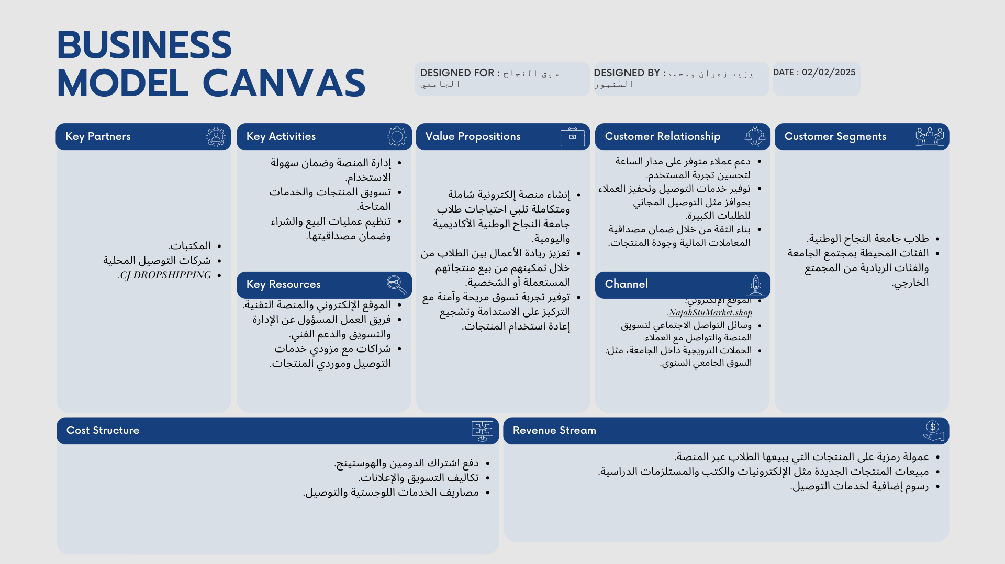

Slide 5






Goals
01
02
03
04
Encouraging the reuse of used products such as books and electronics, which contributes to reducing waste
Encouraging entrepreneurship among students: Motivating students to develop their small projects by providing a platform to showcase their products
Creating a safe e-commerce environment ensuring that financial transactions and displayed products are credible and secure, which builds trust in our platform
Providing a comprehensive marketplace that meets the needs of students in particular and people in general

Slide 6





An overview of our products
Study equipment
Accessories
Electronics
University books
Calculators, engineering rulers, drawing pens, medical lab coats
Phones and headsets for computers
New and used books in good condition for all majors and colleges
Accessories and cosmetics

Slide 7

Revenue
Source | Description | Percentage
Product Sales | Revenue from selling products | 70%
Fees | Fees on the products | 30%

Slide 8

Yazeed Kamel Zahran
Mohamed Rafiq Tanbour
Marketing
Manager

Slide 9





For watching this presentation
https://najahstumarket.shop/
0568226028 0599959585
Nablus, AL-Najah National University
s12039083@stu.najah.edu

