Slide 1


CNC Lath Machine Project
Submitted by
Adnan Hassoneh
Asad Alsebaee
Ayoub Qadoos
Mutasem Essa
Abed Alqader Salameh
Supervised by
Dr. Salameh Abd Alfattah

Slide 2
OUTLINE :
INTRODUCTION.
LATHE MACHINE.
CNC MACHINE.
HARDWARE.
SOFTWARE.

Slide 3
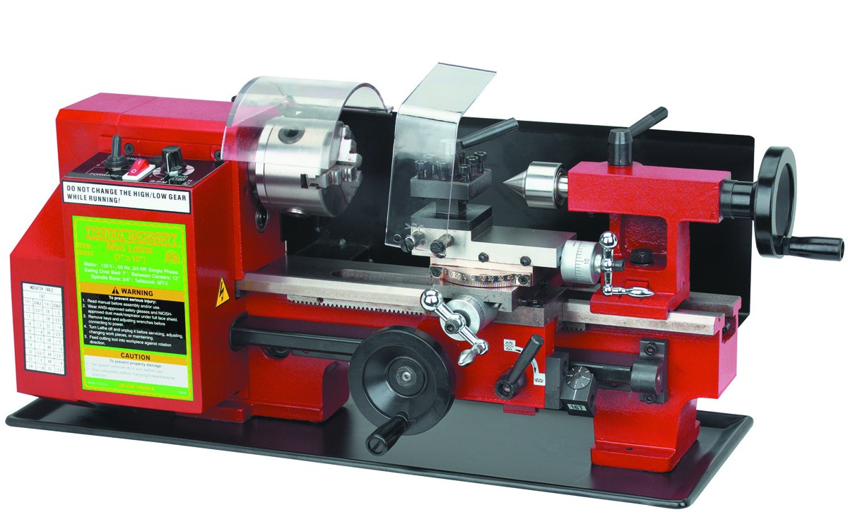
Chapter 1
Introduction :
This project talk about how to convert manual lathe machine to automated one “CNC MACHINE” .

Slide 4
Chapter 2
LATHE MACHINE

Slide 5
DEFINITION :
A Lathe machine is a tool that rotates a work piece on its axis in order to perform various operations.
Tools are applied to the work piece to create an object having a symmetrical axis of rotation in order to perform actions including cutting, sanding, drilling or deformation, facing and turning.

Slide 6
PARTS OF LATHE :

Slide 7
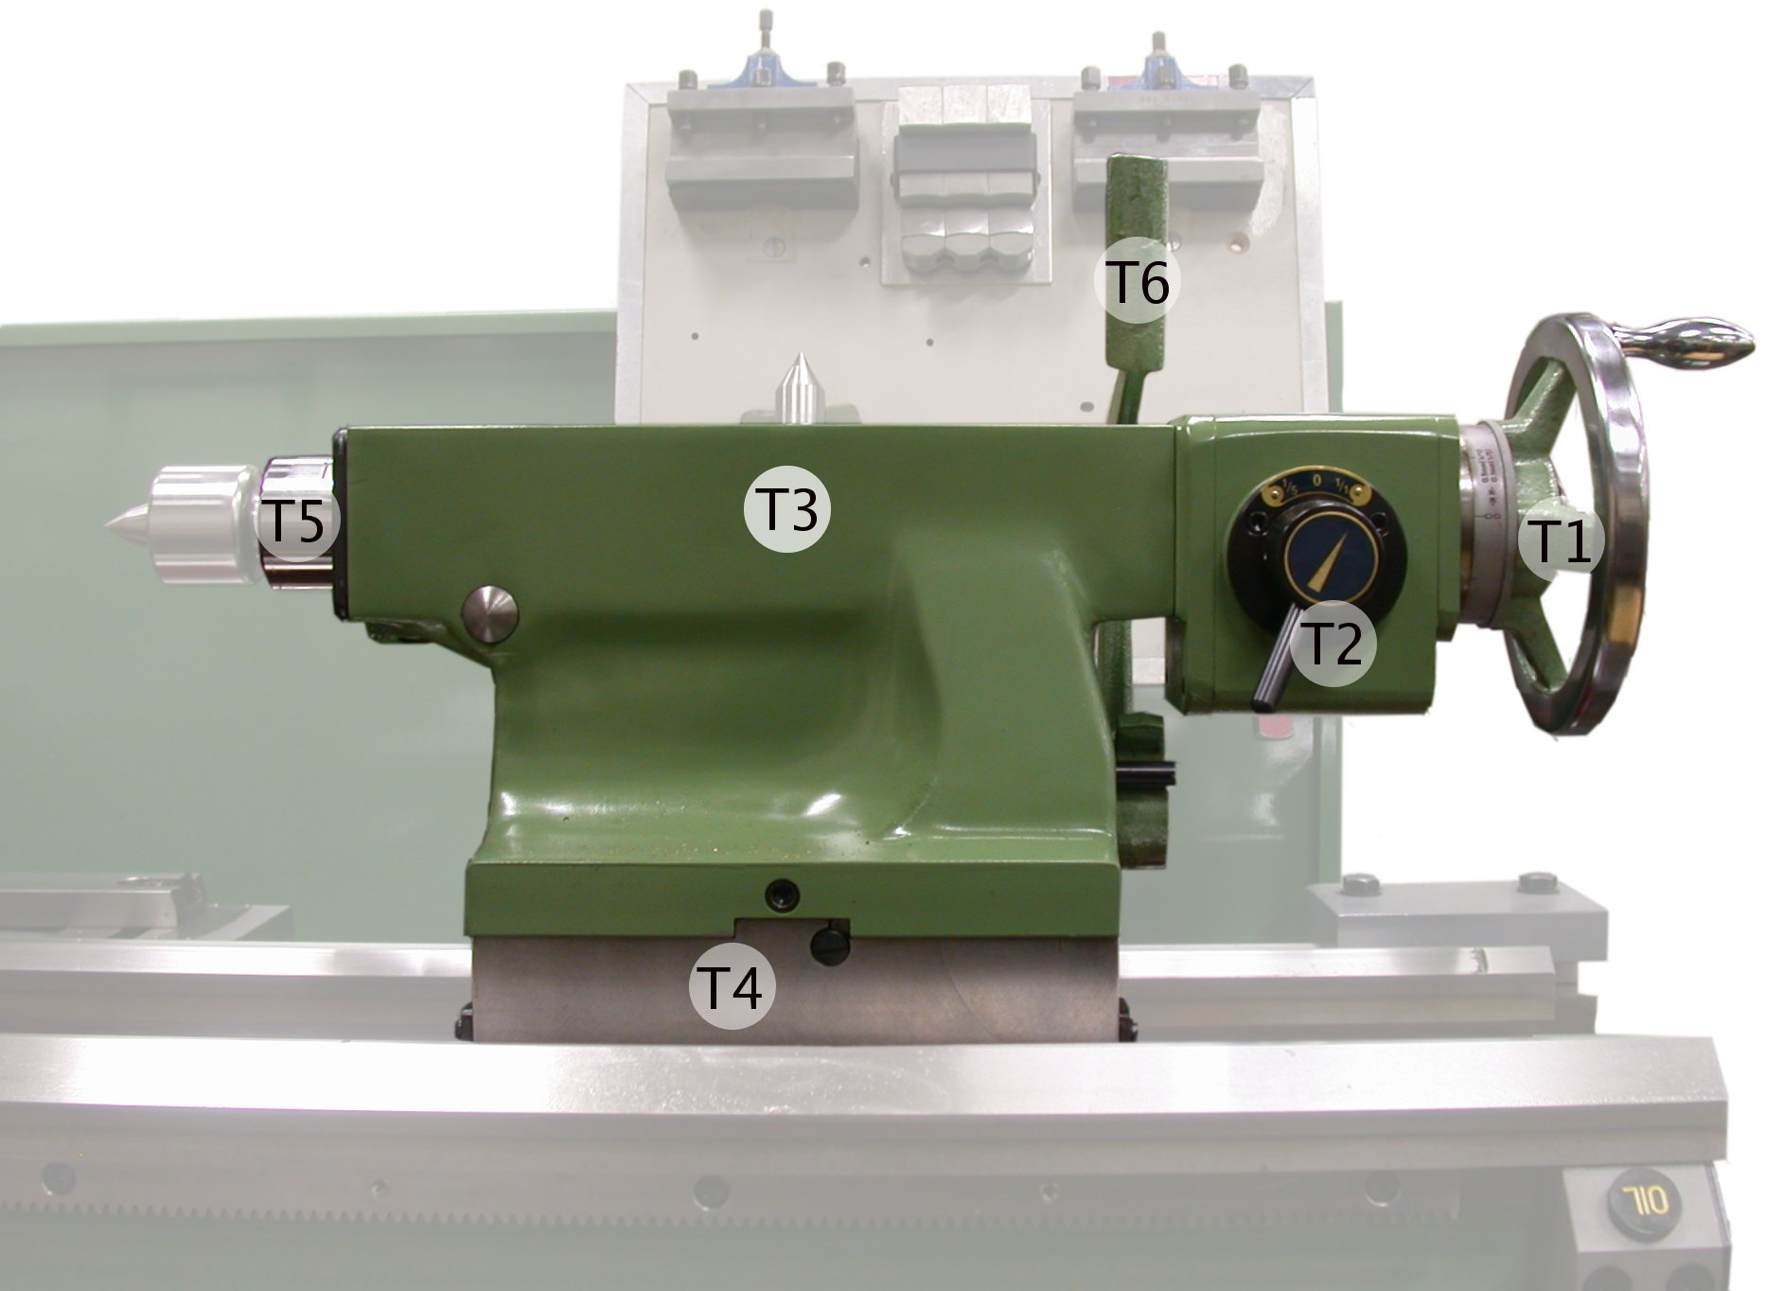
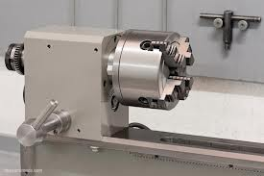
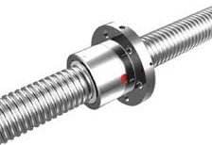
MAIN PARTS OF LATHE :
Tailstock.
Carriage.
Headstock.
Feed rod & lead screw.

Slide 8
Turning process

Slide 9
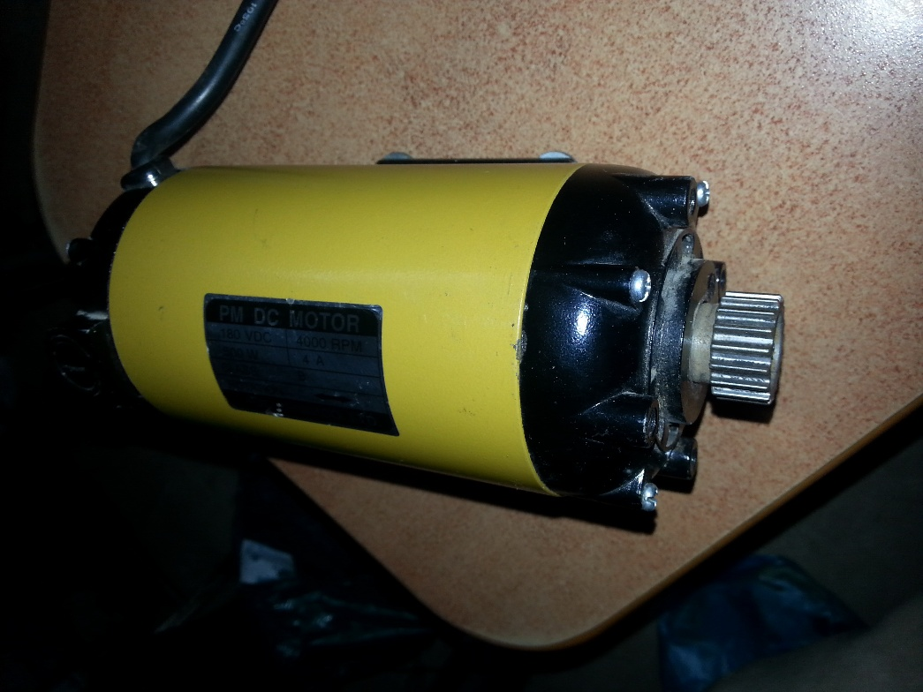
HARDWARE COMPONENT
LATHE MOTOR .
It's a synchronize motor connect with the head of lathe by mechanism.it use to rotation the head .and we can control the speed of it by the power supply.
Motor Characteristic
Volt \ type | 180 VDC
Max.speed | 4000 r.p.m
Amber | 4 A
Power | 500 w
rotation | c.w & cc.w

Slide 10
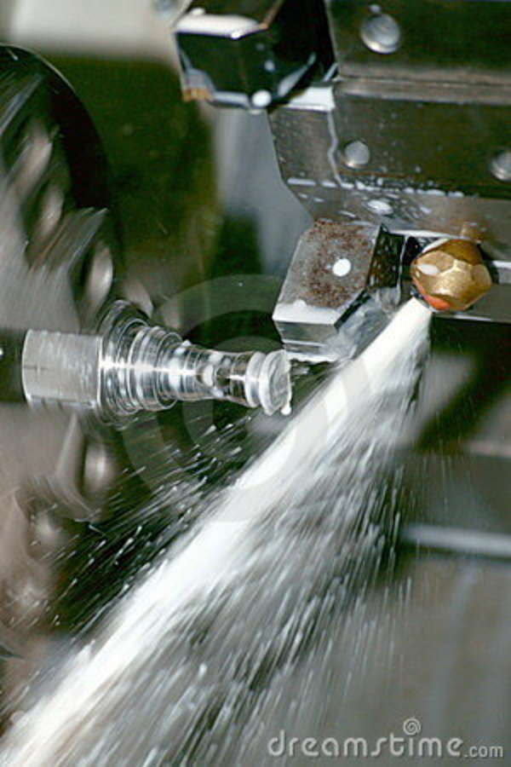
Chapter 3
CNC MACHINE
&
HARDWARE COMPONENT

Slide 11
CNC MACHINE :
What Is CNC?
Computer Numerical Control (CNC) is one in which the functions and motions of a machine tool are controlled by means of a prepared program .
This machine utilizes technology and automation in creating precise designs.
A computer program is customized for an object and the machines are programmed with CNC machining language (called G-code) that essentially controls all features like feed rate, coordination, location and speeds.

Slide 12
CNC MACHINE :
ADVANTEGES:
Using CNC machines effectively reduces cost and time of production.
Need to skilled personnel is reduced.
High accuracy and consistency of production.
Allow for a much safer work environment since workers are almost kept aside.

Slide 13
CNC MACHINE :
DISADVANTEGES:
CNC machines need much more initial investment and running costs than manually operated ones.
High cost of maintenance since it is more complicated.
Need to Skilled personnel is reduced thus unemployment can rise.

Slide 14
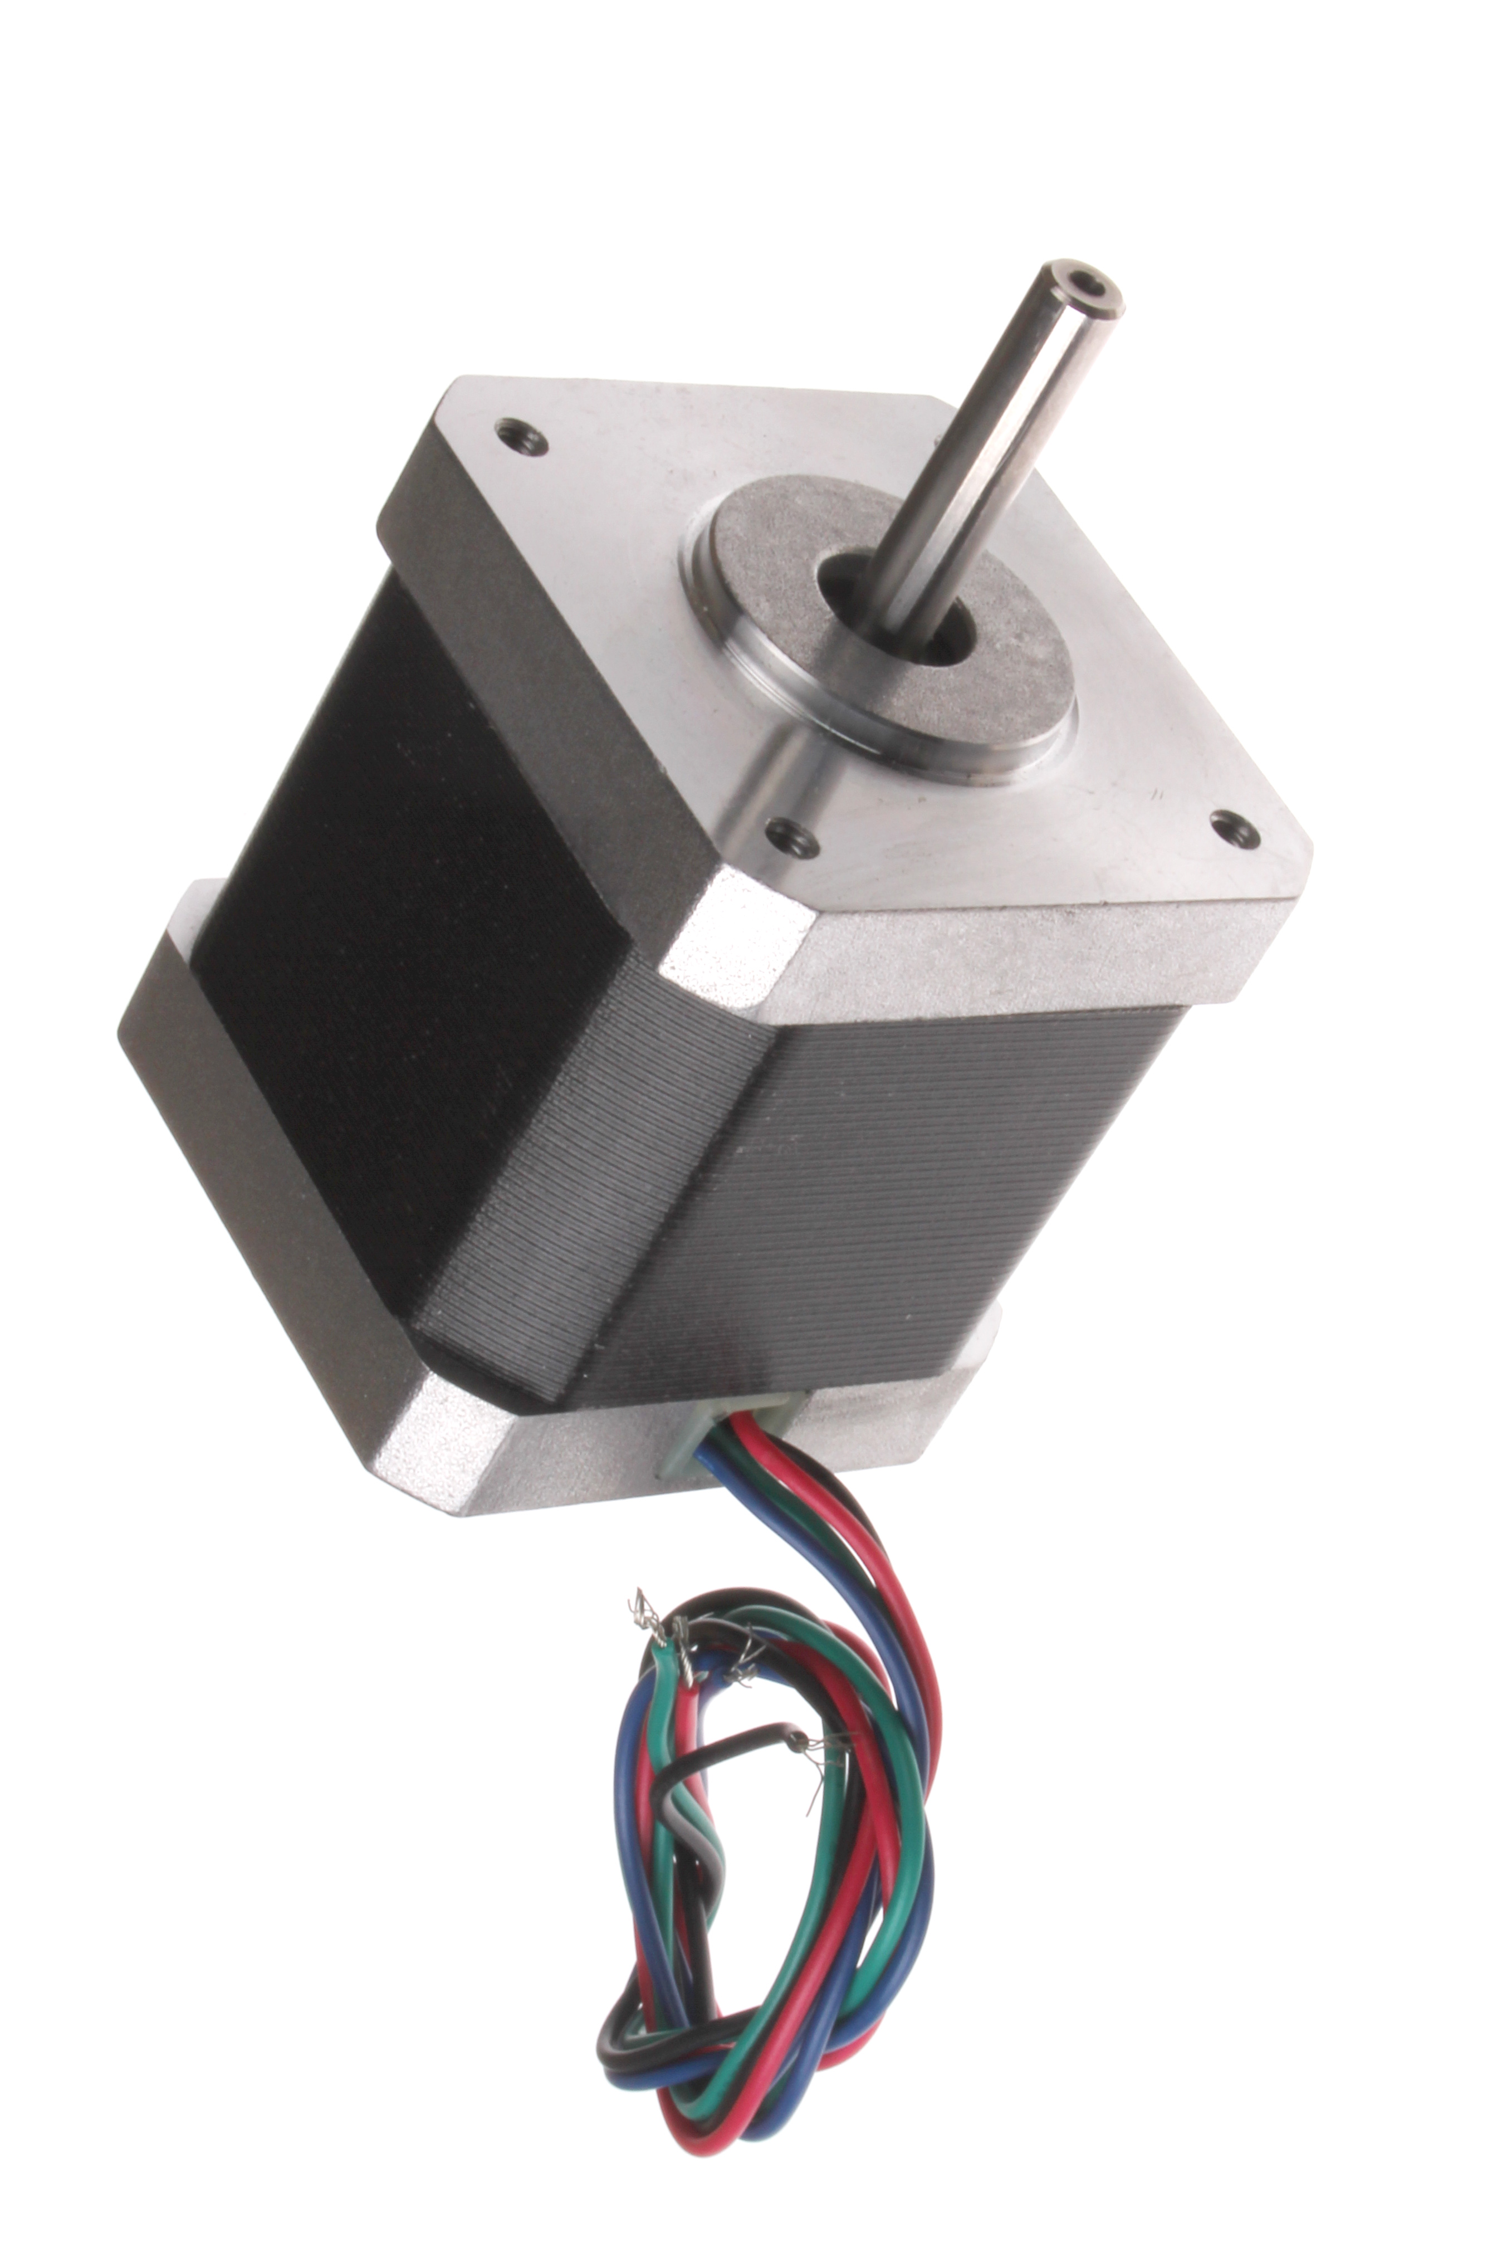
HARDWARE COMPONENT
STEPPER MOTOR
A stepper motor is an electromechanical device which converts electrical pulses into discrete mechanical movements. The shaft or spindle of a stepper motor rotates in discrete step increments when electrical command pulses are applied to it in the proper sequence (divides a full rotation into a number of equal steps)

Slide 15
HARDWARE COMPONENT
STEPPER MOTOR
WHY TO USE STEPPER MOTOR
The rotation angle of the motor is proportional to the input pulse.
The motor has full torque at standstill .
Precise positioning and repeatability of movement since good.
Excellent response to starting/stopping/reversing.
Low cost for control achieved

Slide 16
HARDWARE COMPONENT
STEPPER MOTOR
STEPPER MOTOR ARE USED.
Motor axis/ Characteristic | Amber( A ) | Steep ( deeg.) | Torque( kg )
Z-axis | 3 | 1.8 | 1.5
X-axis | 2 | 1.8 | 1

Slide 17
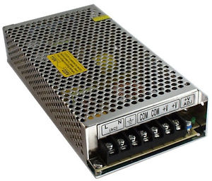
HARDWARE COMPONENT
POWER SUPPLY.
It is a device that supplies electric power to an electrical load.
Power supply | properties
Volt | 12 V
Amber | 12 A

Slide 18
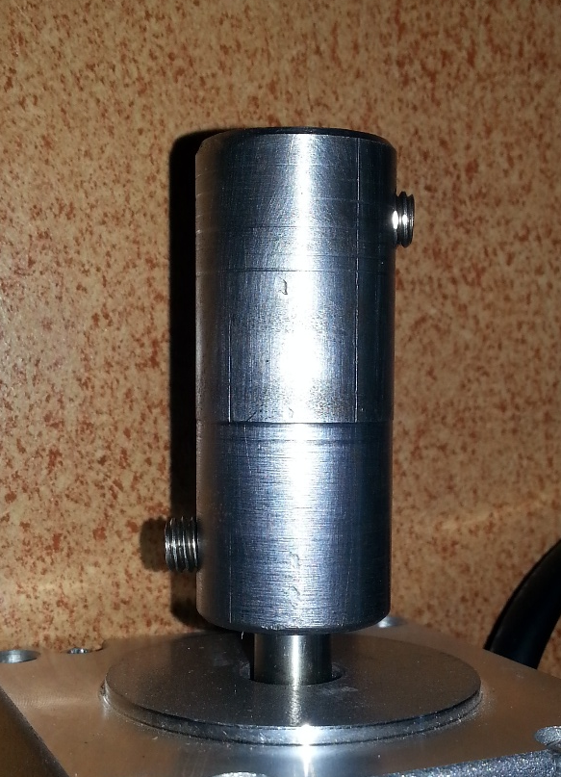
HARDWARE COMPONENT
COUPLING :
Its piece of stainless or steel make in different shape use to connect between the shaft of stepper and the shaft of mechanical part want to move.

Slide 19
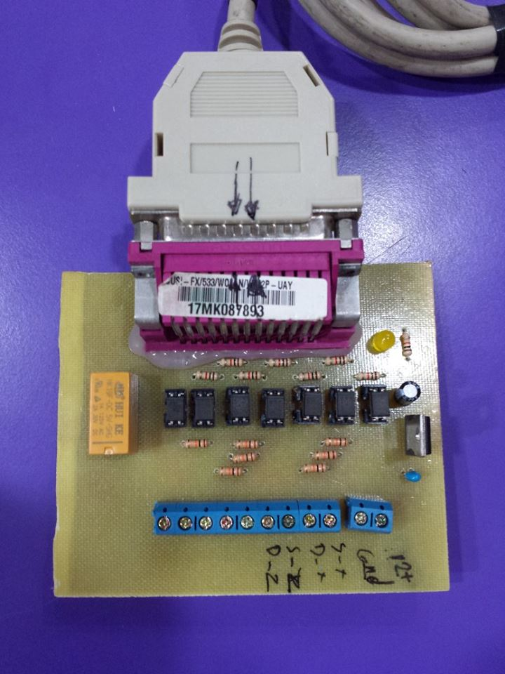
HARDWARE COMPONENT
INTERFACE .
Is an electrical circuit that connects between the computer and driver. So that it receive information from computer and translated it, and then converted into electrical signals understandable for driver.

Slide 20
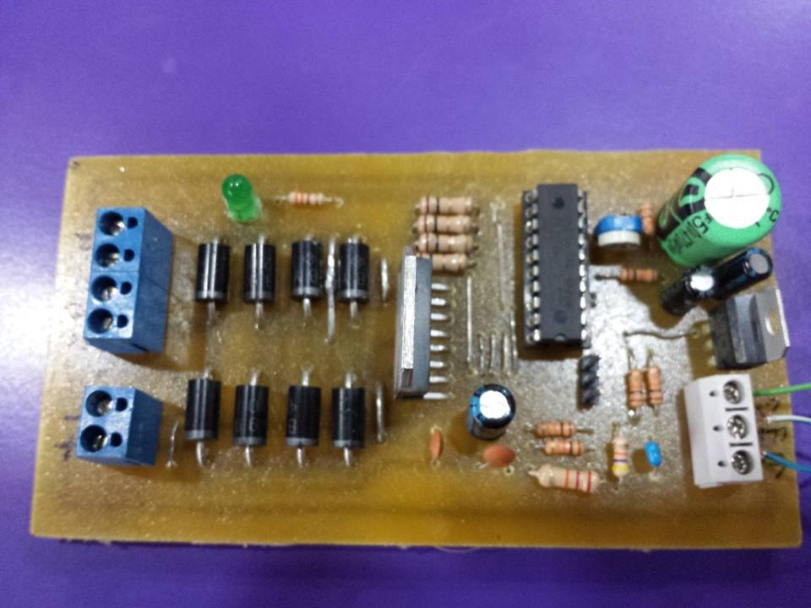
DRIVERS :
The type of motor is used influences the type of drive it use. Think of the drive is an amplifier that allows a computer to control a motor through an interface of low voltage digital signals. The main part of driver is:

Slide 21
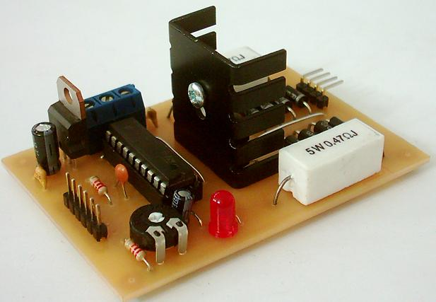
L-297 & L-298
L-297
The L297 chip is designed to make driving stepper motors easy!
We can tell the L297 that we want to click the motor by another step- and the L297 is responsible for telling the motor how to do it .

Slide 22
L-297 & L-298 Circuit
L-298
The L298 is an integrated circuit in a 15-lead Multi watt.
It is a high voltage, high current dual full-bridge driver.
Designed to drive inductive loads such as DC and stepping motors.

Slide 23
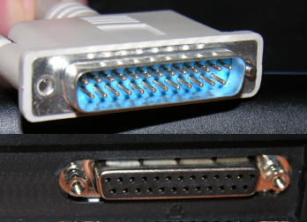
CONNECTIONS
Parallel ports are the most common way of connecting bulk transfer devices to a computer although they are slowly being replaced by USB ports.

Slide 24
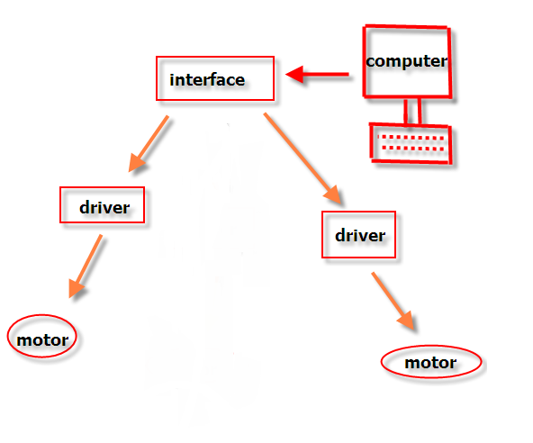
HARDWARE COMPONENT
HOW TO CONECT IN GENERAL

Slide 25
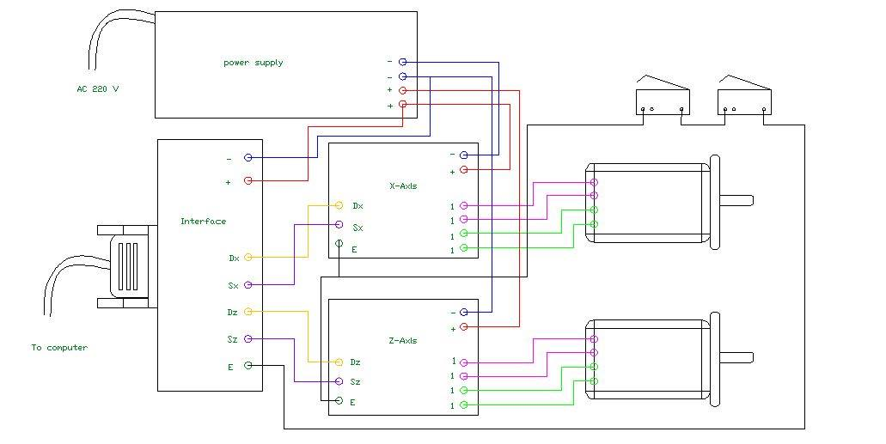
HARDWARE COMPONENT
HOW TO CONECT BETWEEN ELECTRICAL COMP.

Slide 26
Chapter 4
SOFTWARE

Slide 27
SOFTWARE
Introduction :
“ CNC “ stands for computer numerical control, and refers specifically to a computer "controller” that reads G-code , to drives a machine tool .
The Purpose of use the software is to convert the image into orders for control of the machine

Slide 28
SOFTWARE
Mach3
What is Mach3? :
is the software runs on a computer that controls in CNC machine motors.
MACH3 depends on G-Code that get from cad\cam .

Slide 29
MACH3
What Mach3 can do? :
flexible program designed to control machines.
Control of Two or three axes of motion, which are usually at right angles to each other.

Slide 30
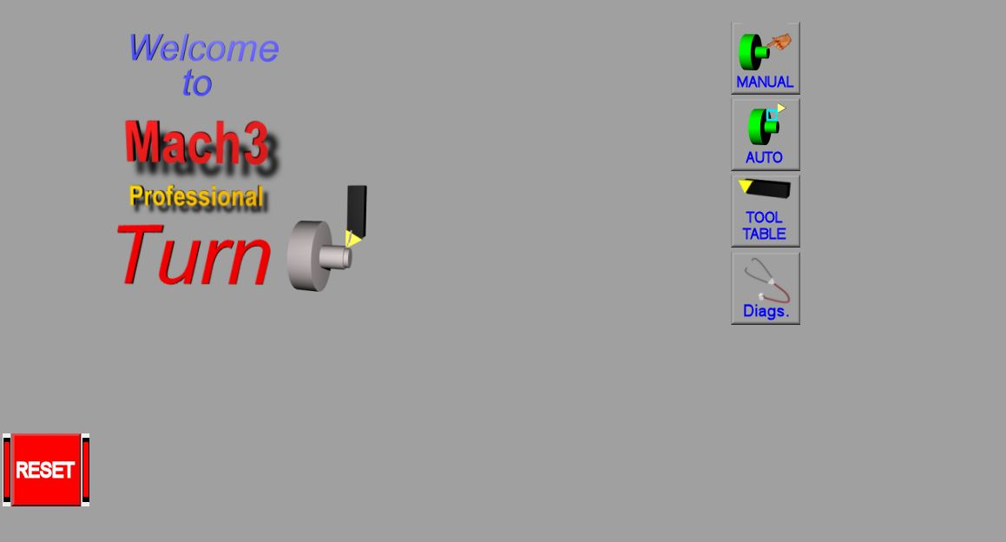
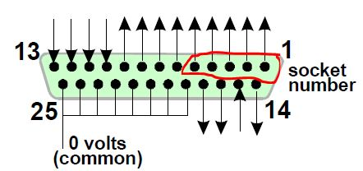
MACH3

Slide 31
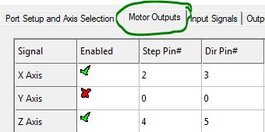
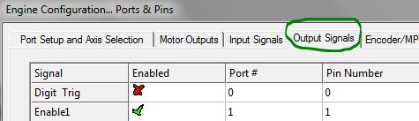
Configuration

Slide 32
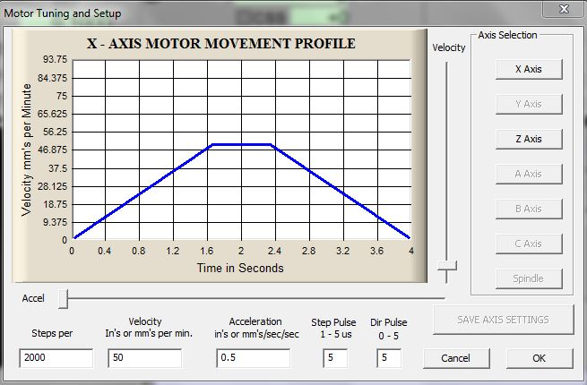
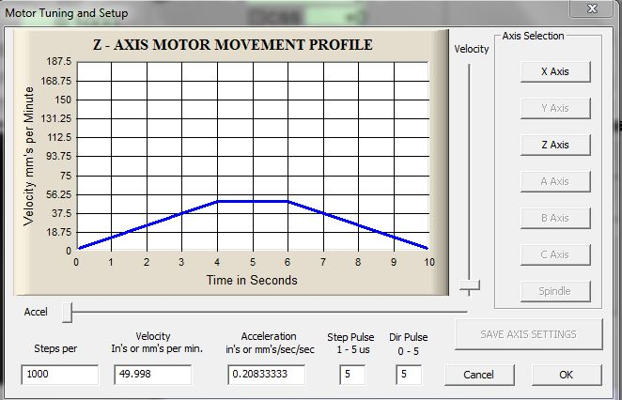
Configuration

Slide 33
G & M CODE
What is G-code:
G-Code is one of computer code languages.
Is the most popular programming language used
for programming CNC machinery.

Slide 34
G & M CODE
G CODE EXAMPLES :
GOO : Rapid Positioning
G00 X1.5 Z5
G00 X5 Z10
G28 , G30 : Return home
This code is responsible for return the axis to starting point .

Slide 35
G & M CODE
WHAT Is M CODE :
M-Codes controls CNC program executions (machine functions).
Examples :
M00 : program stop
M09 : All coolant off
M47 : Repeat program from first line

Slide 36
Conclusion

Slide 37
Thank you

