Slide 1

An-Najah National University
Faculty of Engineering
Chemical Engineering Department
Graduation Project ( 2 )
Effect of processing techniques and conditions on properties of composite polymeric film.
Prepared by:
Ahed Zabadi
Muna Sleem
Salam Sa'ad
We'am Dweikat
Supervisors:
Dr. Hassan Sawalha
Eng. Shadi Sawalha

Slide 2
Outline
Introduction.
About Linear-low density Polyethylene.
Objectives.
Experimental work.
Materials.
Processing techniques.
Characterization.
Results and discussion
Conclusion

Slide 3
Introduction

Slide 4
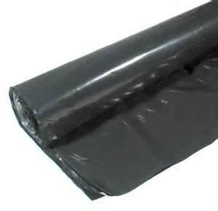
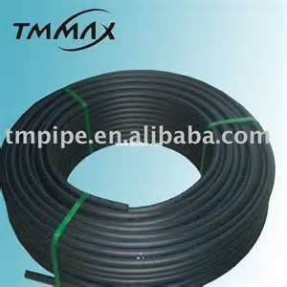
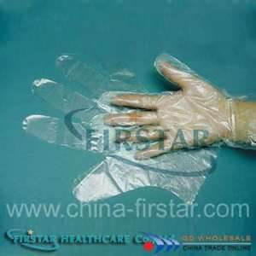
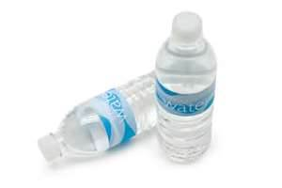
Different types of PE products
Figure (1): polyethylene bags.
Figure (2): polyethylene pipes
Figure (3): polyethylene gloves.
Figure (4): polyethylene terephthalate bottles

Slide 5
  Polyethylene
Polyethylene (PE) is the simplest of all polymers.
Linear low – density polyethylene (LLDPE), is a type of PE has low density and crystallinity, formed under low temperature and pressure polymerization conditions.

Slide 6
  Improvement of the properties
  LLDPE
Optimizing the mechanical and thermal properties by operation conditions (cooling rate and pressing temperature).
Use additive with different concentration and study its effect on the mechanical and thermal properties by measure it.

Slide 7
  Objectives:
The first objective of this project was to study the effect of processing techniques and conditions on the properties of polyethylene film.
Preparation method:
Thermal method.
Cold method.

Slide 8
The second objective was to study the effect of biological food waste –at different concentrations-on the mechanical and thermal properties of composite polyethylene film.

Slide 9
The properties will be measured by using:
Differential Scanning Calorimetry (DSC).
Tensile Testing Machine.
Melt flow index (MFI).

Slide 10
Experimental work

Slide 11
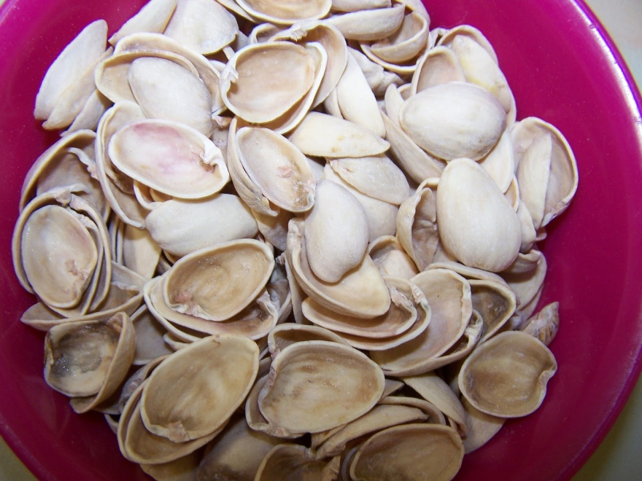
  Material:
Borstar®FB2230 is an enhanced polyethylene. It contains antioxidant and low content anti blocking agent.
Food waste materials:
Figure(5): pistachio shell

Slide 12
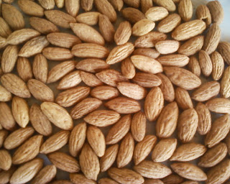
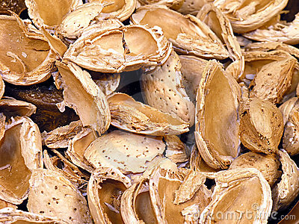
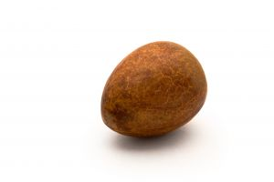
Figure(6): olive kernel
Figure(7): almond shell
Figure(8): avocado seed

Slide 13
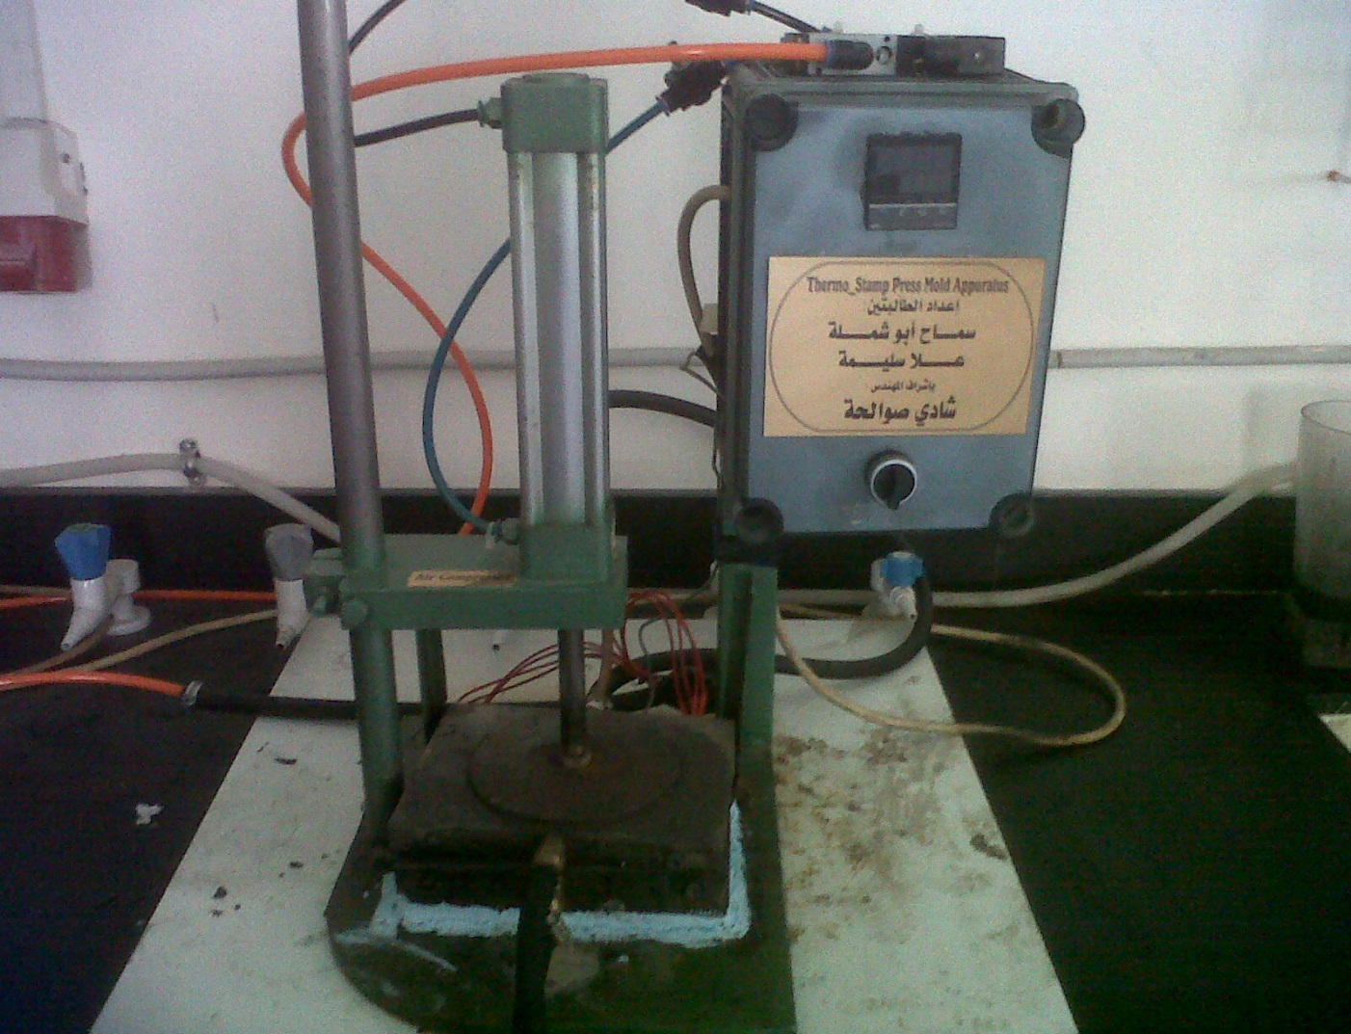
  Processing methods
Thermal press molding.
1-Pressing.
2- Heating.
3- Cooling.
Figure(9): press molding device.

Slide 14
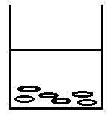
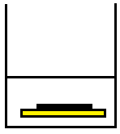

Cold method (polymer dissolution):
xylene
Non-solvent
2. The solution was casted then put in to non-solvent.
xylene
polyethylene
Non-solvent
LLDPE put in xylene with 2% concentration and the solution was heated at hot plate.
Solidification
3. Solidification for the polymer film.

Slide 15
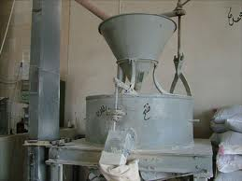
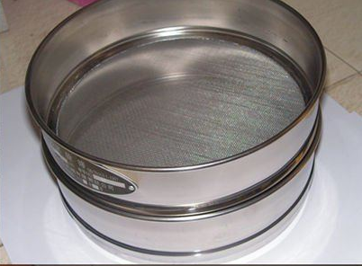
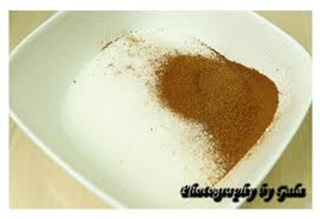
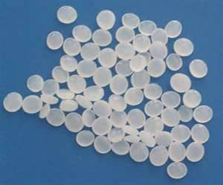

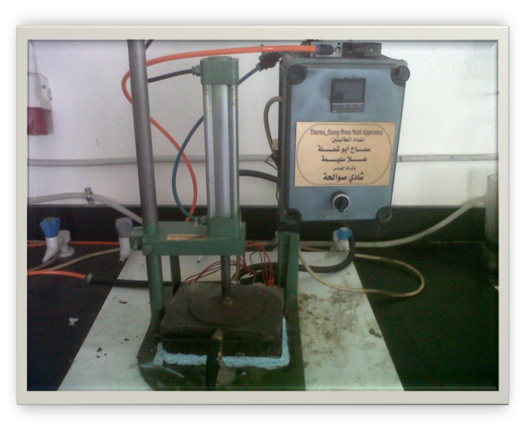
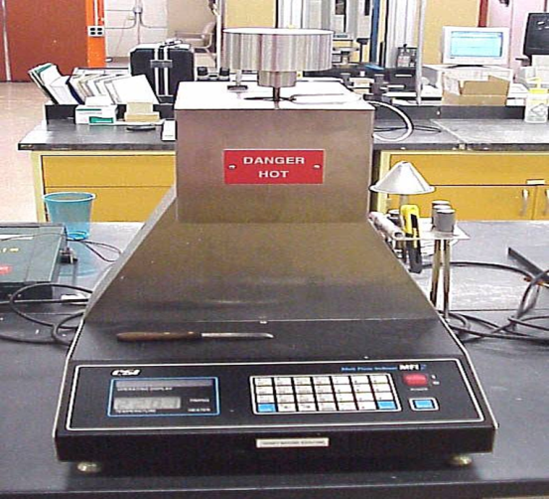
Preparation of composites film:
Screening
Blending the polymer with the flour
Grinding
Press molding
extrusion

Slide 16
  Characterization
Mechanical Properties:
The modulus of elasticity, yield and ultimate strength and elongation at break of the films were measured using Universal Material Tester 50 kN.
Samples were cut from the films into a dog-bone shape.

Slide 17
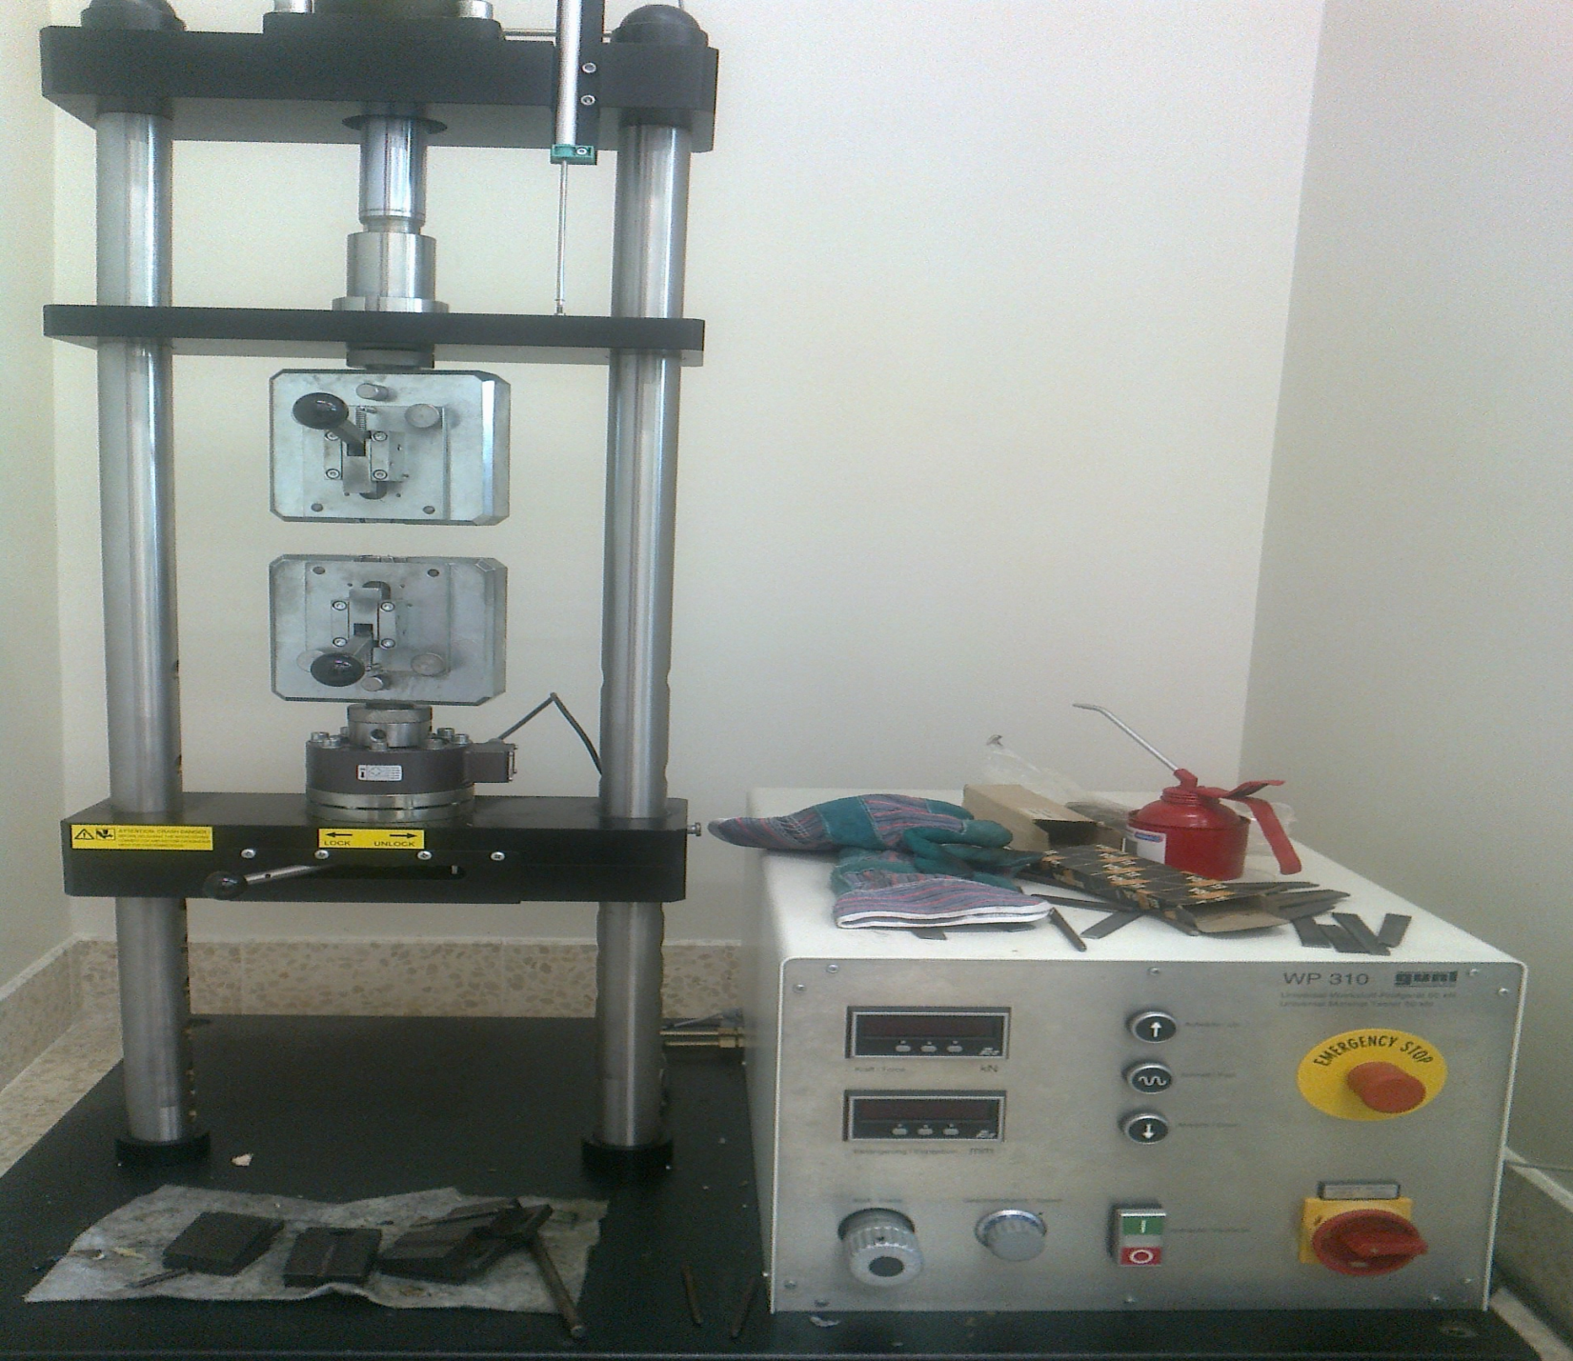

Figure (10): Universal Material Tester 50 kN
Notes:
لما نحكي عن طريقة عمل الجهاز لازم نحكي السرعة =50 mm/min

Slide 18
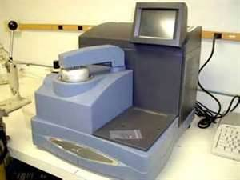
Thermal Properties:
Range of melting temperature and enthalpy of melting were measured using differential scanning calorimetry.
Figure(11): differential scanning calorimetry.

Slide 19

Chemical Properties:
Melt flow index was measured using melt flow indexer.
Figure(12): melt flow indexer.
Notes:
Film samples were cut into small pieces and tested using melt flow index device with a capacity of 6 g. The test was done under loud of 5000g and 190 °C. After the sample processed in the device the material was taken after a period of 10min and weighted.

Slide 20
Results and discussion

Slide 21
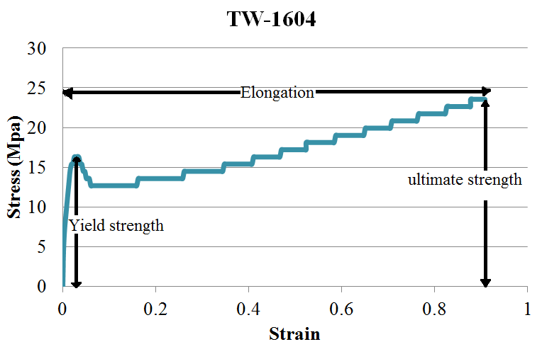
Analysis of stress-strain diagram
Modulus = Stress /Strain (0.001)
Notes:
نحط stree-strian diagram من الرسمة القديمة تطبيق على السامبل اللي بالمشروع

Slide 22
Results of mechanical properties:
Figure (13): Elastic modulus at different cooling rate for temperatures 160 and180 °C.

Slide 23
Figure (14): Ultimate strength at different cooling rate for temperatures 180, 200°C.

Slide 24
Figure (15): maximum yield strength at different cooling rate for temperatures 180, 200°C.

Slide 25
Figure (16): Elongation at different cooling rate for temperatures 160, 200°C.

Slide 26
Figure (17): Elastic modulus at different temperatures cooled by air.

Slide 27
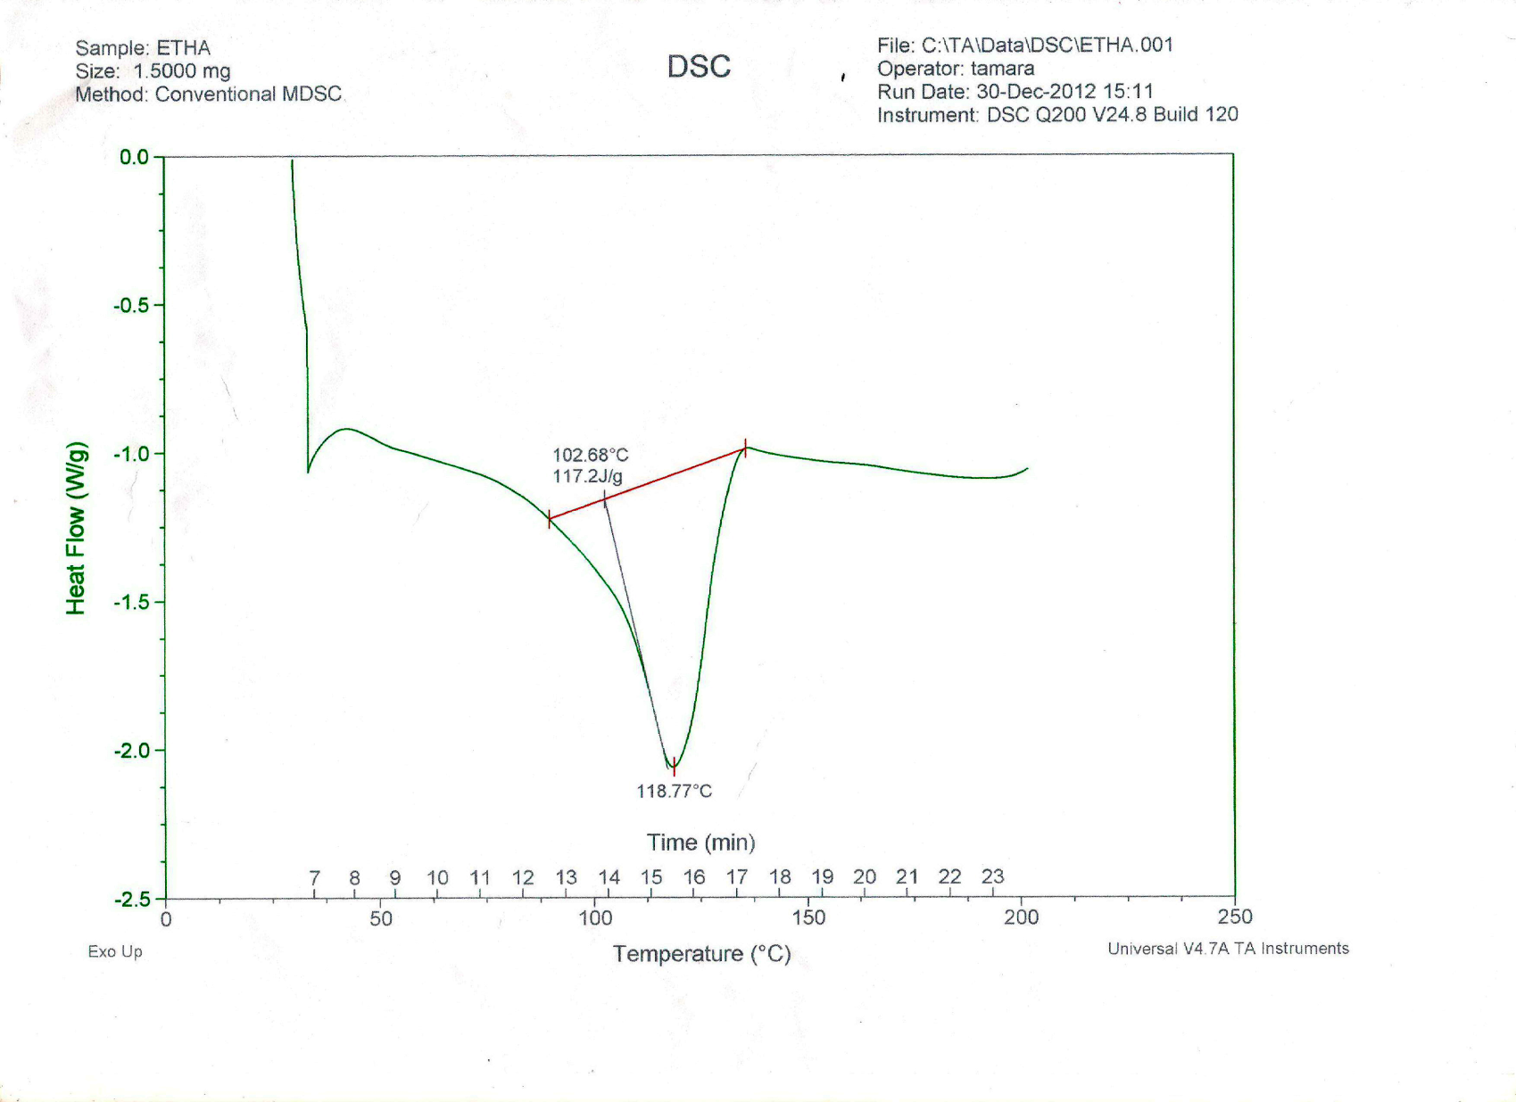
Analysis of DSC diagram:
Figure(18): results of DSC device.

Slide 28
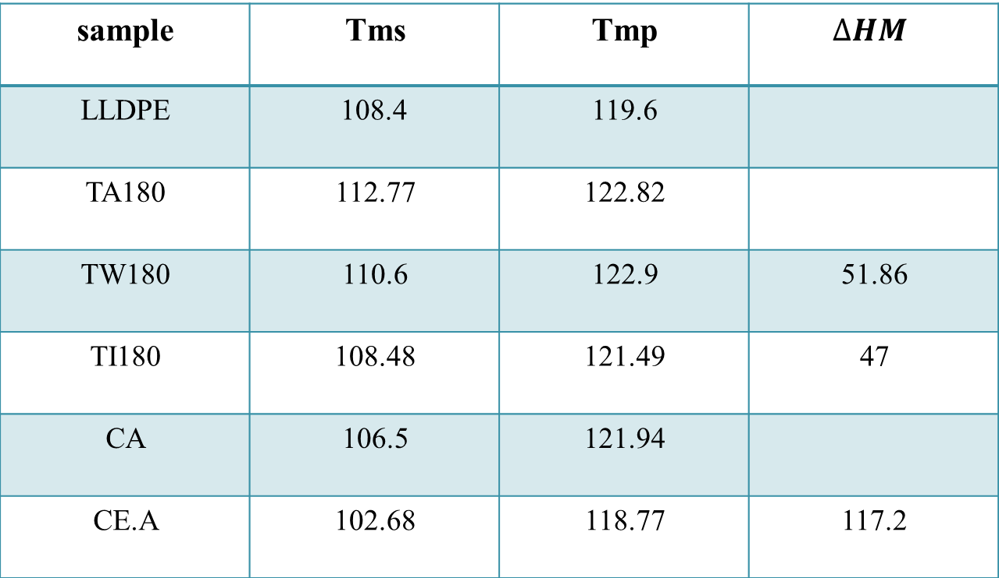
DSC results
Table (1): comparison between processing method.
$$∆HM$$ | Tmp | Tms | sample
 | 119.6 | 108.4 | LLDPE
 | 122.82 | 112.77 | TA180
51.86 | 122.9 | 110.6 | TW180
47 | 121.49 | 108.48 | TI180
 | 121.94 | 106.5 | CA
117.2 | 118.77 | 102.68 | CE.A
20.31
43.01
106.1

Slide 29
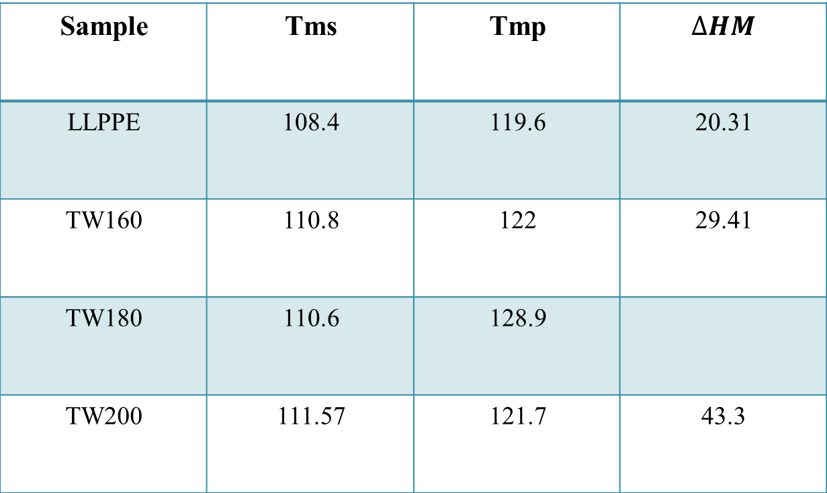
Table (2): comparison between different pressing temperatures.
$$∆HM$$ | Tmp | Tms | Sample
20.31 | 119.6 | 108.4 | LLPPE
29.41 | 122 | 110.8 | TW160
 | 128.9 | 110.6 | TW180
43.3 | 121.7 | 111.57 | TW200
51.86

Slide 30
Melt flow index results:
Thermal method: no change in the melt flow index.
Cold method:
Table (3): Melt flow index for Cold method samples.
Melt flow index g/10 min | Sample
1.23 | Ethyl acetate
1.08 | Ethanol
1.38 | Air

Slide 31
Part two:
Composite films

Slide 32
Results of mechanical properties.
Figure (19): Elastic modulus for composite films.

Slide 33
Figure (20): Maximum yield strength for composite films.

Slide 34
Figure (21): Ultimate strength for composite films.

Slide 35
Figure (22): Elongation for composite films.
Notes:
elongation

Slide 36
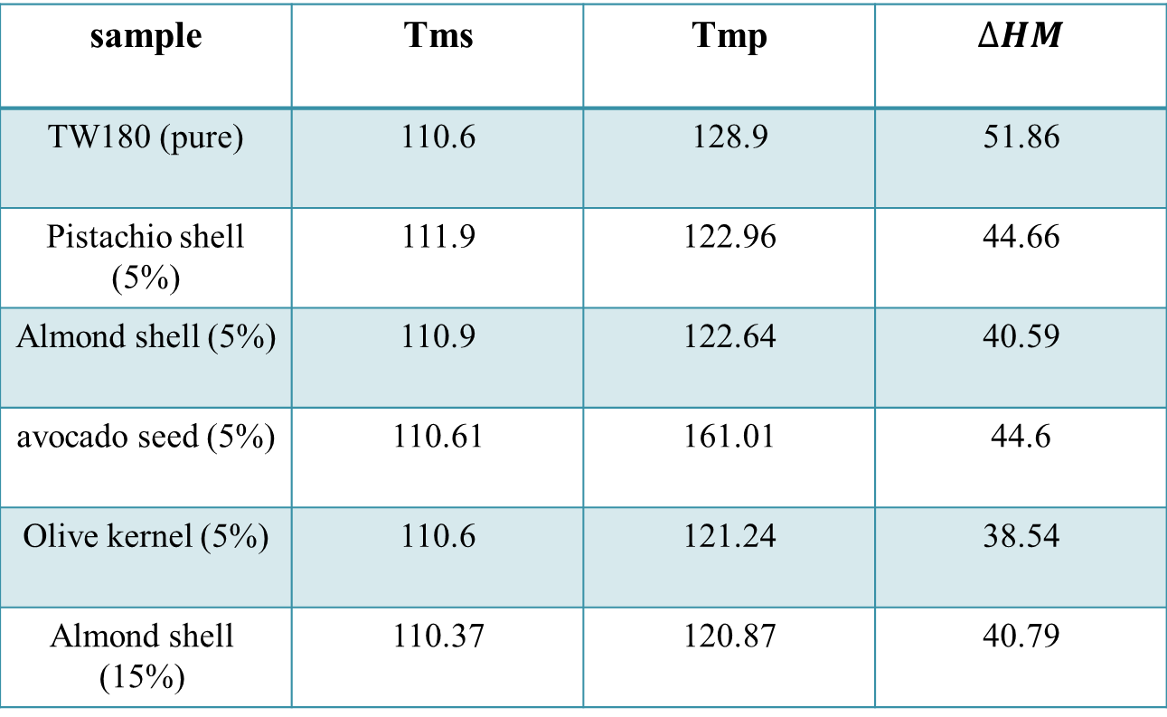
DSC results.
Table (4): comparison between pure and composite films.
$$∆HM$$ | Tmp | Tms | sample
51.86 | 128.9 | 110.6 | TW180 (pure)
44.66 | 122.96 | 111.9 | Pistachio shell (5%)
40.59 | 122.64 | 110.9 | Almond shell (5%)
44.6 | 161.01 | 110.61 | avocado seed (5%)
38.54 | 121.24 | 110.6 | Olive kernel (5%)
40.79 | 120.87 | 110.37 | Almond shell (15%)

Slide 37
Melt flow index results.
Table (5): Melt flow index for composite samples (g/10 min).
5% | 15% | samples
No result | 0.97 | Olive kernel
0.92 | 1.12 | Pistachio shell
0.499 | 0.36 | Almonds shell
0.91 | 1.09 | Avocado seed

Slide 38
Conclusion
The films cooled by quenching in ice have the lowest elastic modulus, maximum yield and ultimate strength.
Increasing the pressing temperature increases the elastic modulus.

Slide 39
MFI of solution-casting samples have higher MFI values than those prepared with thermal press-molding.
The pistachio shell (with 5% concentration) showed better mechanical properties than other food additives.

Slide 40


