Slide 1
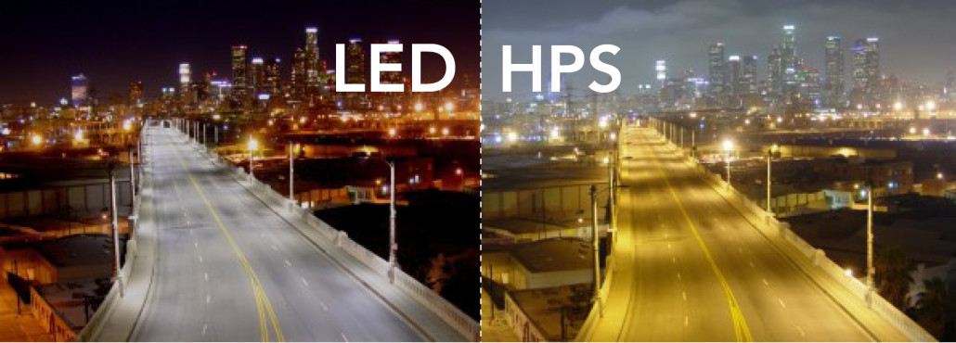
Comparative Life Cycle Assessment of Street lighting

Slide 2
Outlines
Introduction.
LCA Methodology.
Life Cycle Inventory Analysis (LCI).
HPS technology & LED technology.
Results .
Life Cycle Cost Analysis (LCI).
Conclusion.

Slide 3
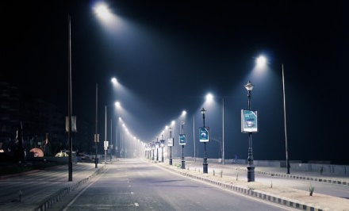
Introduction
Interest in environmental impacts has increased over the last few decades. The concern has widened from local environmental impacts, such as oil spills and the use of chemicals, to a more global perspective including issues such as the acceleration of climate change. Lighting is one of the areas where environmental concern has risen ,almost 20 % of electricity consumption worldwide is used-up by lighting applications.
Objectives
Current situation in Nablus streets!
Scope of the work.
Significance of the work.
Constraints.

Slide 4
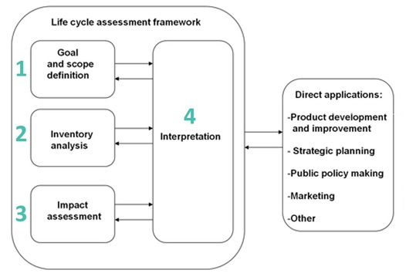
LCA Methodology

Slide 5
Life Cycle Inventory Analysis (LCI)
The total electricity consumption of street lighting lamps for 2016 was obtained from NEDCO.
The illumination (lux) of HPS & LED lamps was obtained by direct measurements.
Information about the components of HPS & LED lamps was obtained from previous papers .

Slide 6
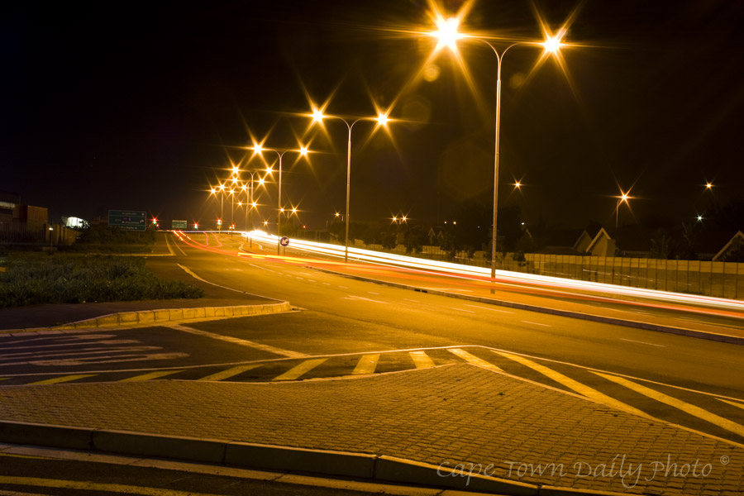
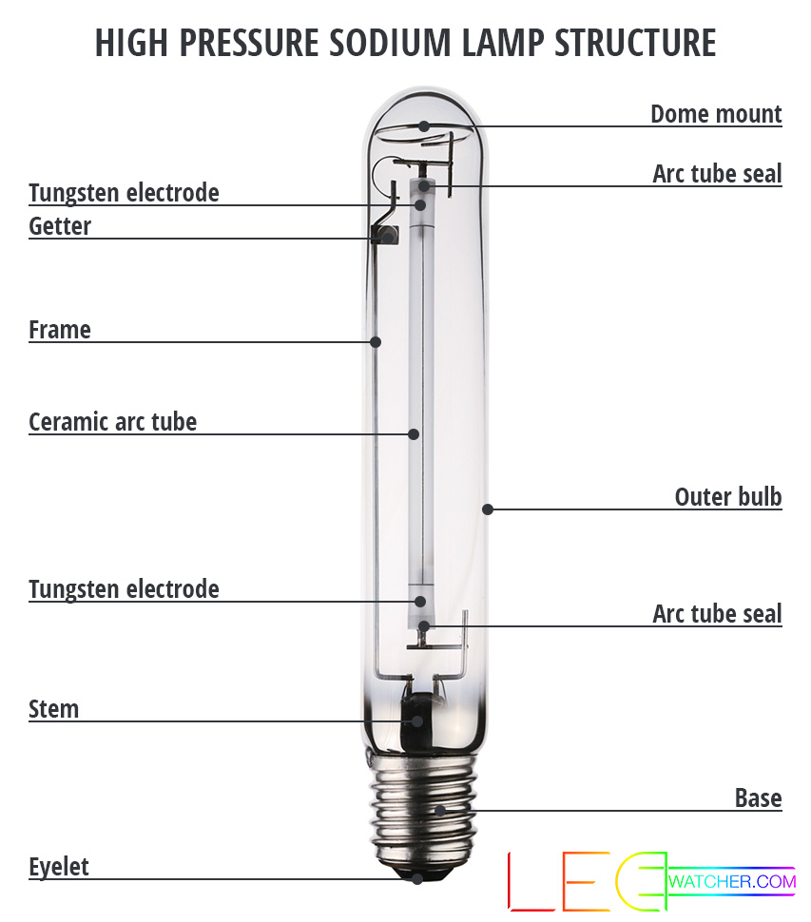
HPS Technology

Slide 7
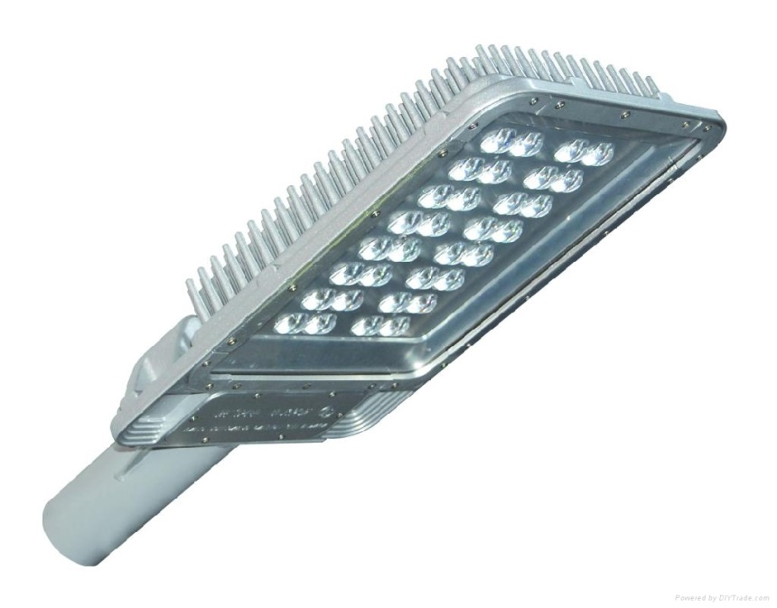
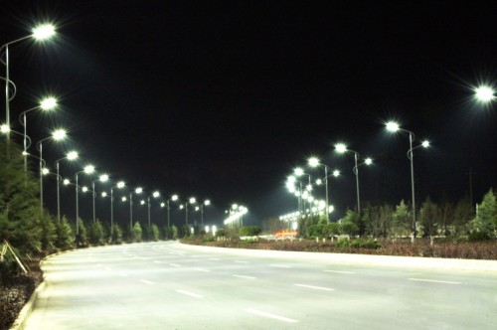
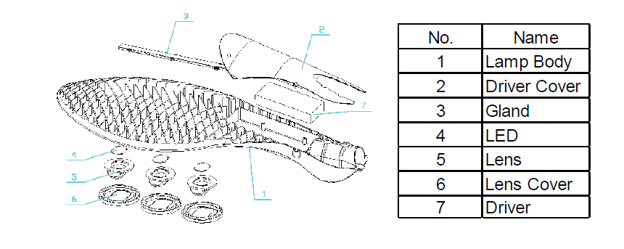
LED Technology

Slide 8
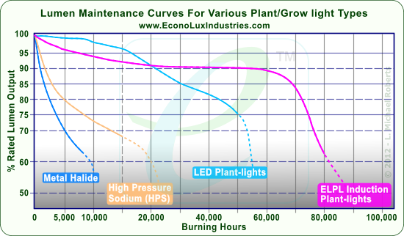
lamp depreciation through operating hours (HPS&LED)

Slide 9
Results
In order to evaluate the environmental impacts of LED & HPS manufacturing and make a comparison , the manufacturing and disposal process of their main components of their bulb was modeled using Open LCA to compare the environmental impacts of the both technology.
Environmental Categories
Global Warming (GW).
Ozone Layer Depletion.
Human Toxicity.

Slide 10
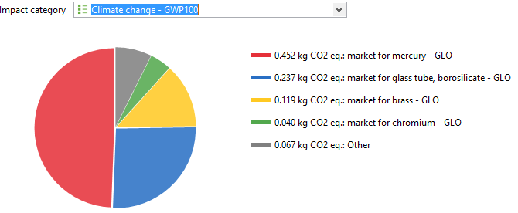
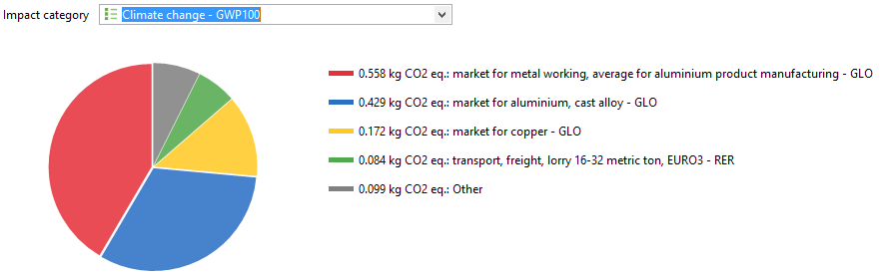
Manufacturing
HPS manufacturing environmental impacts
LED manufacturing environmental impacts

Slide 11
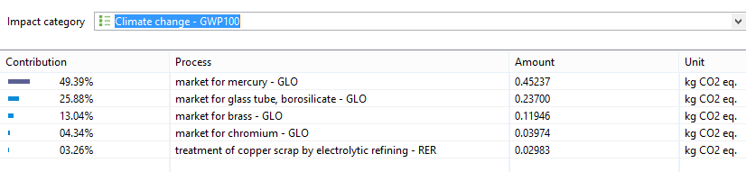
process contributions percentages on the climate change for HPS lamps

Slide 12
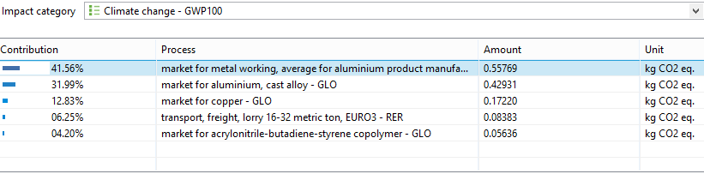
Process contributions percentages on the global warming for LED lamps

Slide 13
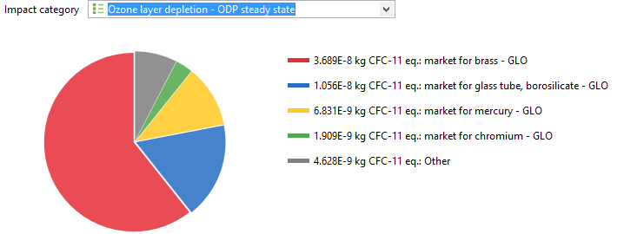
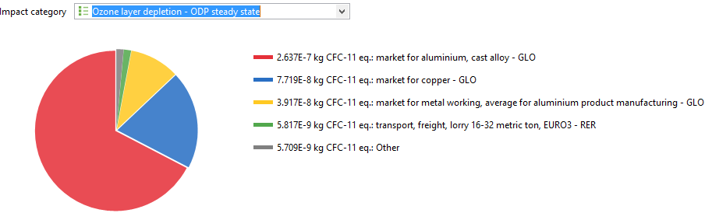
Ozone layer depletion
HPS
LED

Slide 14
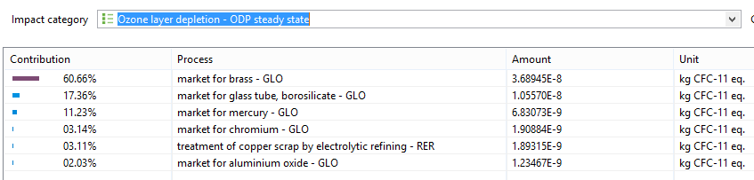
Process contributions percentages on the ozone layer depletion for HPS lamps

Slide 15
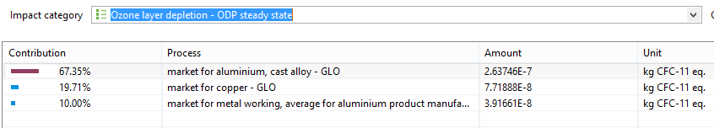
Process contributions percentages on the ozone layer depletion for LED lamps

Slide 16
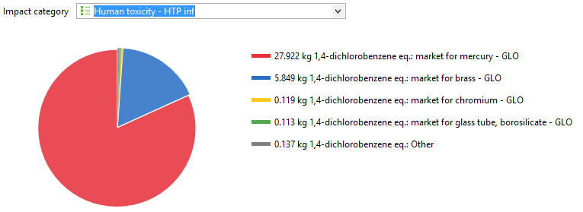
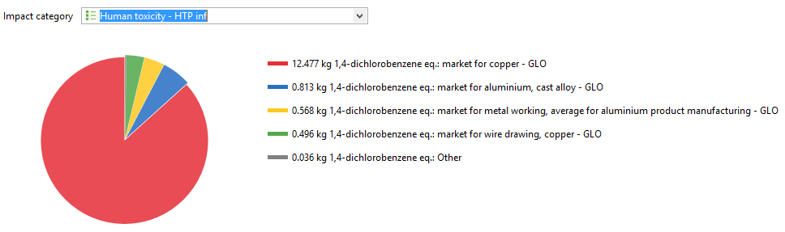
Human Toxicity
HPS
LED

Slide 17
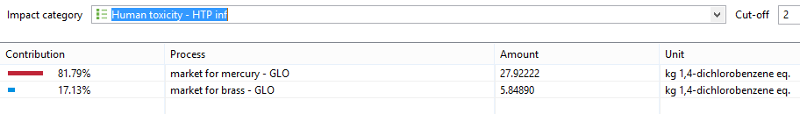
Process contributions percentages on the human toxicity for HPS lamps

Slide 18
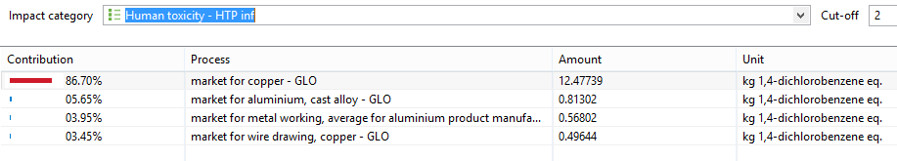
Process contributions percentages in the Human toxicity for LED lamps

Slide 19
Use Stage
The emissions during use phase of HPS
Month | Consumption(KWh) | Ton CO2 | Ton SO2 | TonN(O)x
January | 642840.411 | 498.2013185 | 12.21396781 | 1.285680822
February | 595644.863 | 461.6247688 | 11.3172524 | 1.191289726
March | 570475.8676 | 442.1187974 | 10.83904148 | 1.140951735
April | 585994.5205 | 454.1457534 | 11.13389589 | 1.171989041
May | 487595.5479 | 377.8865497 | 9.264315411 | 0.975191096
June | 476837.6712 | 369.5491952 | 9.059915753 | 0.953675342
July | 496127.0548 | 384.4984675 | 9.426414041 | 0.99225411
August | 409211.3014 | 317.1387586 | 7.775014726 | 0.818422603
September | 504321.5753 | 390.8492209 | 9.582109932 | 1.008643151
October | 608124.6575 | 471.2966096 | 11.55436849 | 1.216249315
November | 612546.5753 | 474.7235959 | 11.63838493 | 1.225093151
December | 621966.7808 | 482.0242551 | 11.81736884 | 1.243933562
Total |  | 5124.057291 | 125.6220497 | 13.22337365

Slide 20
The emissions after five years of the modification with LED lamps.
After Modificaton | 2021
Month | Consumption (KWh) | Ton CO2 | Ton SO2 | TonN(O)x
January | 352421.64 | 273.126771 | 6.69601116 | 0.70484328
February | 312984 | 242.5626 | 5.946696 | 0.625968
March | 298037.565 | 230.9791129 | 5.662713735 | 0.59607513
April | 283424.4 | 219.65391 | 5.3850636 | 0.5668488
May | 246605.31 | 191.1191153 | 4.68550089 | 0.49321062
June | 234365.4 | 181.633185 | 4.4529426 | 0.4687308
July | 237749.85 | 184.2561338 | 4.51724715 | 0.4754997
August | 207397.44 | 160.733016 | 3.94055136 | 0.41479488
September | 246123 | 190.745325 | 4.676337 | 0.492246
October | 274348.14 | 212.6198085 | 5.21261466 | 0.54869628
November | 262628.6625 | 203.5372134 | 4.989944588 | 0.525257325
December | 275503.2 | 213.51498 | 5.2345608 | 0.5510064
 |  | 2504.481171 | 61.40018354 | 6.463177215
1 KWh electricity = 0.000775 CO2 ,0.000019 SO2,0.000002 NOX

Slide 21
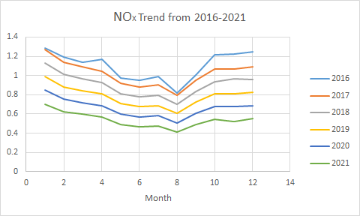

Slide 22
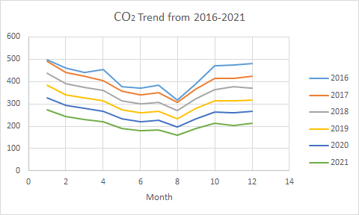

Slide 23
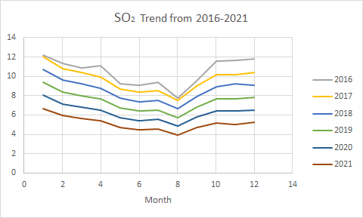

Slide 24
Reduction in GHG emissions
A reduction in GHG emissions year by year is observed with the replacement process, where 183.8 ton of SO2, 19.35 NOx, and 7497 ton CO2 are saved in the 5 years.

Slide 25
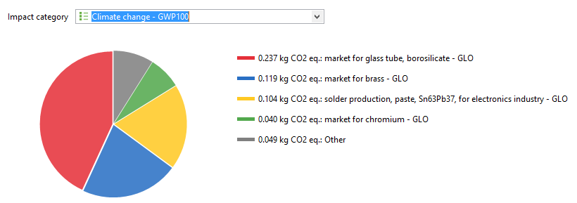
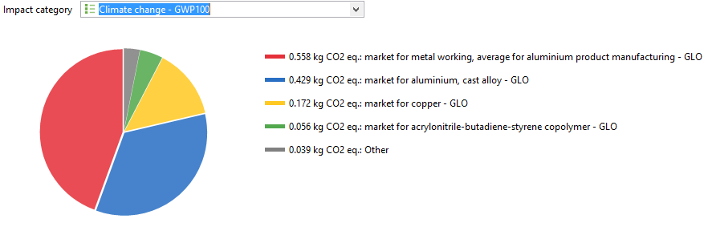
End Of Life &Disposal :
Global Warming (GWP):
HPS Disposal impacts in the global warming
LED Disposal impacts in the global warming

Slide 26
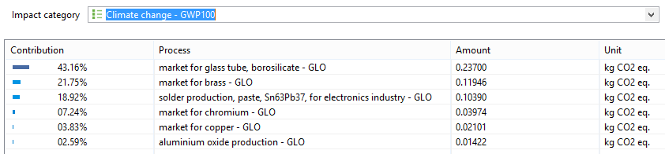
Process contributions percentages in the global warming for HPS lamps

Slide 27
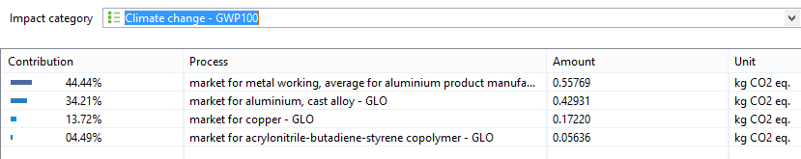
Process contributions percentages in the global warming for LED lamps

Slide 28
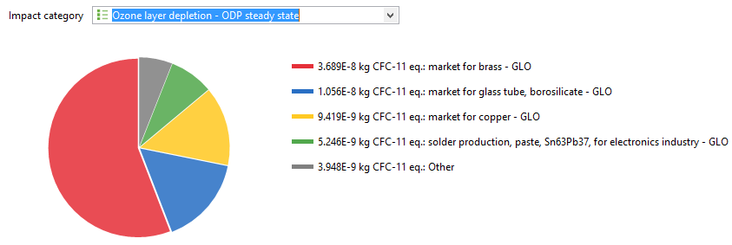
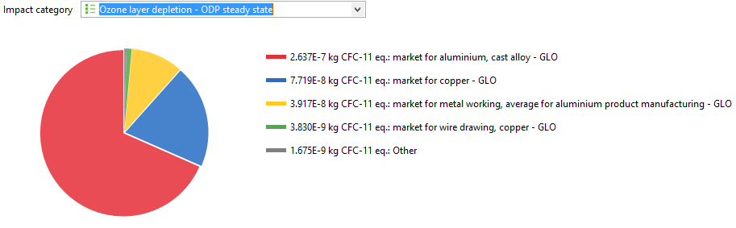
Ozone Layer Depletion
The HPS Disposal impacts in the ozone layer depletion
The LED Disposal impacts in the ozone layer depletion

Slide 29
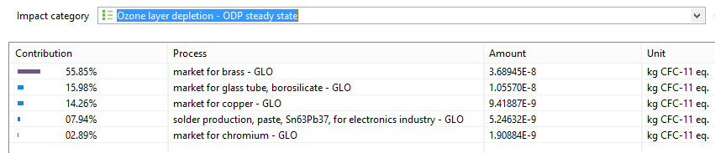
Process contributions percentages in the ozone layer depletion for HPS lamps

Slide 30
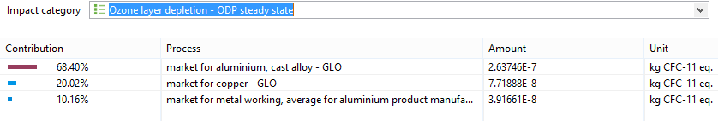
Process contributions percentages in the ozone layer depletion for LED lamps

Slide 31
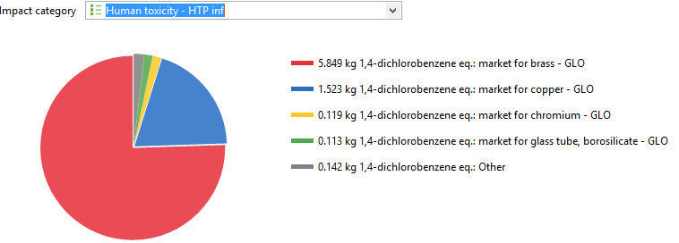
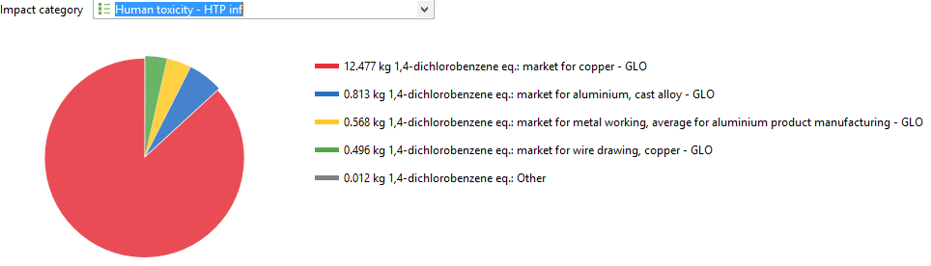
Human Toxicity
The HPS Disposal impacts in the human toxicity
The LED Disposal impacts in the Human toxicity

Slide 32
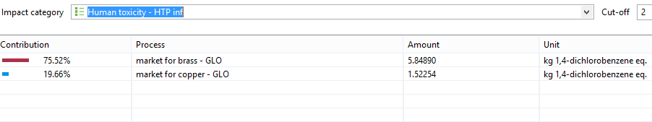
Process contributions percentages in the human toxicity for HPS lamps

Slide 33
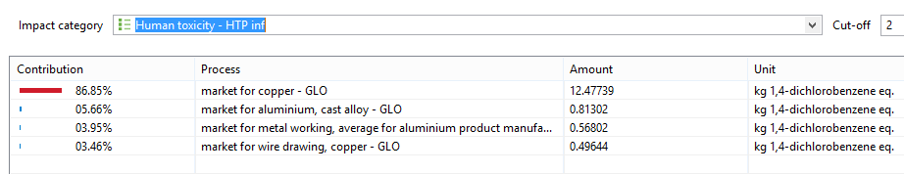
Process contributions percentages in the Human toxicity for LED lamps

Slide 34
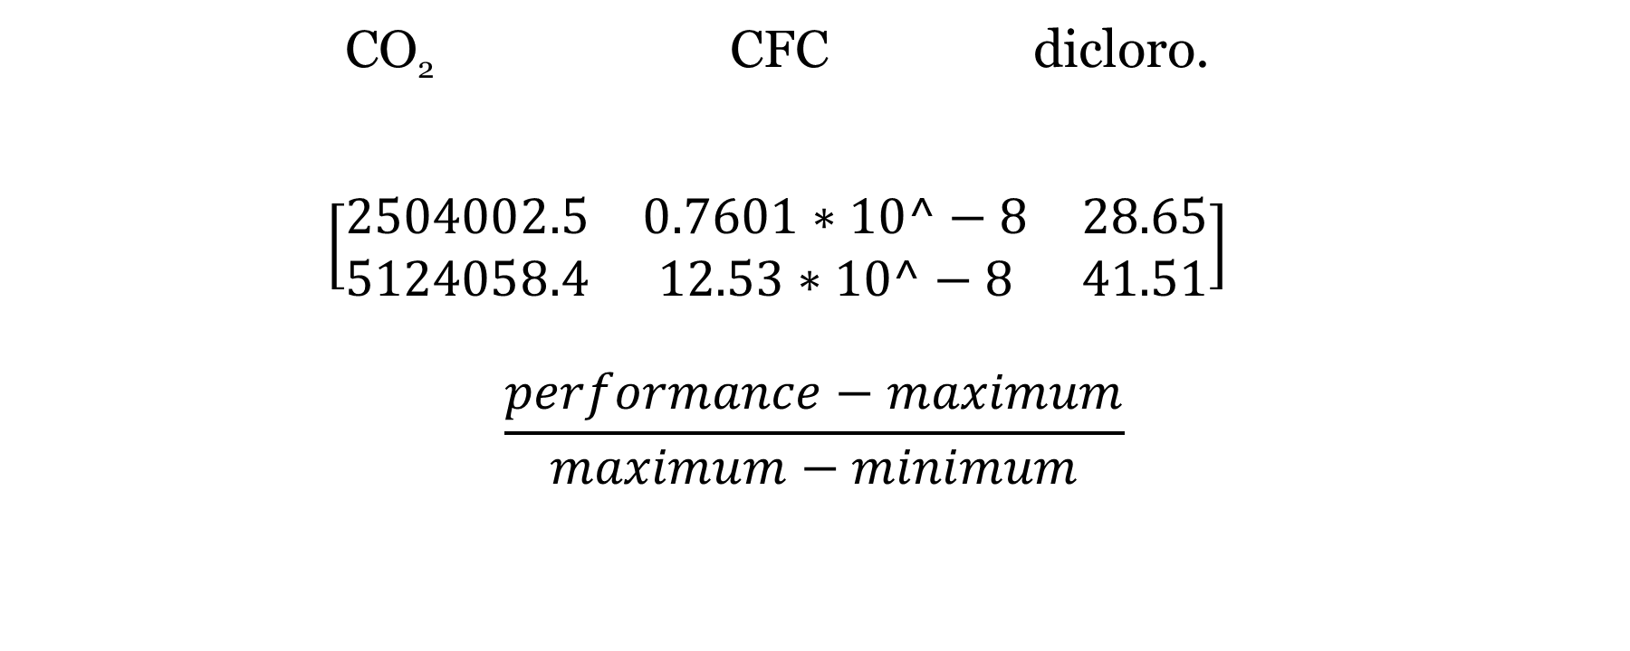
By using weighted sum method:
CO₂ CFC dicloro.
$\left[\begin{matrix}2504002.5 & 0.7601∗10^−8 & 28.65 \\ 5124058.4 & 12.53∗10^−8 & 41.51\end{matrix}\right]$
$$\frac{performance−maximum}{maximum−minimum}$$
0.7
0.1
0.2
LED A1
HPS A2

Slide 35
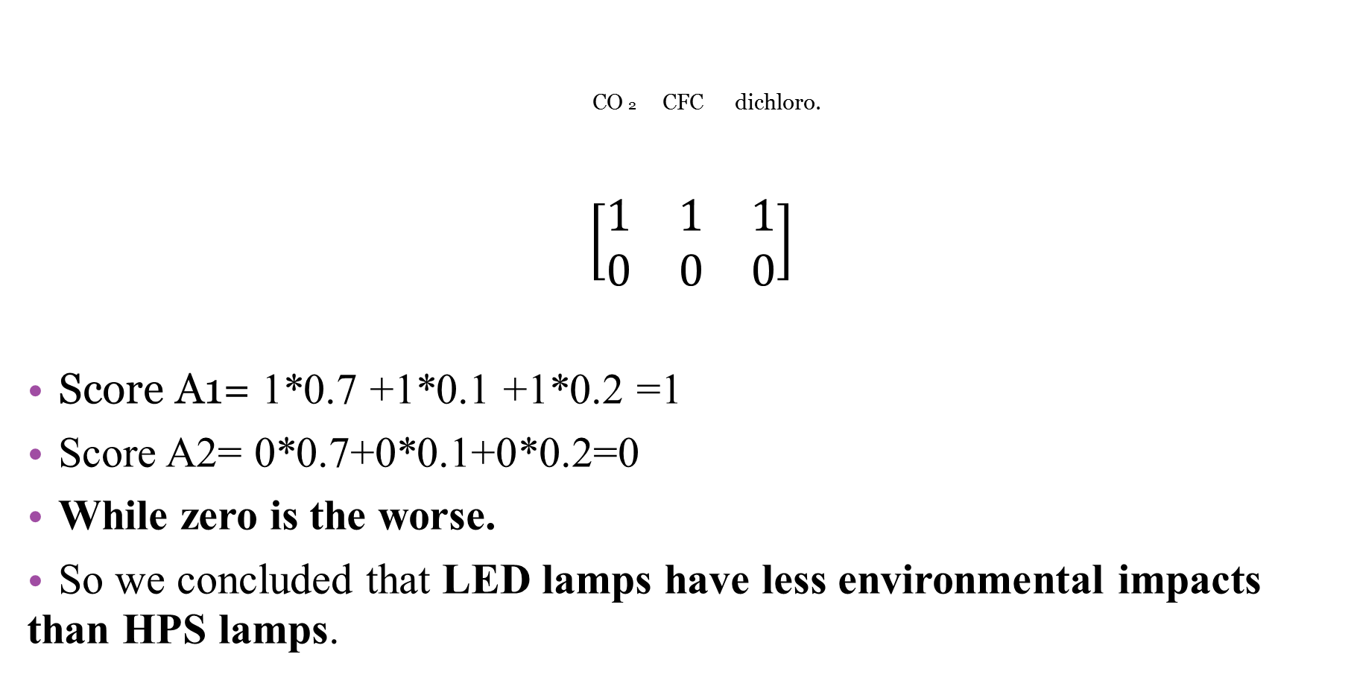
CO 2 CFC dichloro.
$\left[\begin{matrix}1 & 1 & 1 \\ 0 & 0 & 0\end{matrix}\right]$
Score A1= 1*0.7 +1*0.1 +1*0.2 =1
Score A2= 0*0.7+0*0.1+0*0.2=0
While zero is the worse.
So we concluded that LED lamps have less environmental impacts than HPS lamps.
0.7
0.1
0.2
LED A1
HPS A2

Slide 36

Life Cycle Cost Analysis (LCCA)
LCCA is applied when it is required to determine the lowest life-cycle cost means to accomplish the projects' objectives. LCCA enables the analyst to make sure that the selection of a design alternative is not based on solely the lowest initial costs, but also considers all the future costs over the projects' usable life.

Slide 37
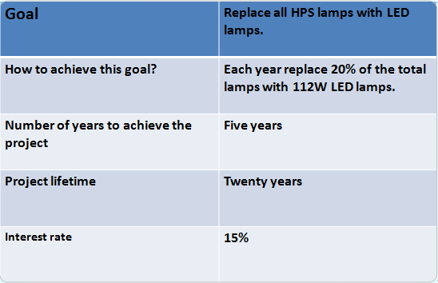
Life Cycle Cost Analysis (LCCA)

Slide 38
Life Cycle Cost Analysis (LCCA)
Important Numbers
6,435,357 KWh
2,818,695 NIS/year
Tariff 0.48 NIS/KWh
10.5 Operation hours
112W LED
388NIS/fixture
250W HPS
40 NIS/fixture

Slide 39
Estimation of the total number of lamps in Nablus
Energy consumption= Number of lamps x wattage x operation hours.
So,
N= 6900 lamps approximately.
And 1380 lamp HPS need to be changed yearly

Slide 40
Expected Savings
Monthly replacements of HPS lamps in 2017
Month | HPS | LED
January | 6785 | 115
February | 6670 | 230
March | 6555 | 345
April | 6440 | 460
May | 6325 | 575
June | 6210 | 690
July | 6095 | 805
August | 5980 | 920
September | 5865 | 1035
October | 5750 | 1150
November | 5635 | 1265
December | 5520 | 1380

Slide 41
Expected Savings (KWh)

Slide 42
Expected Savings (NIS)

Slide 43
Pay back Period with no bank involved
Cost of 1380 LED lamp 535,440 NIS/year
Initial investment = 2,677,200 NIS
Pay back period = 5.5 years

Slide 44
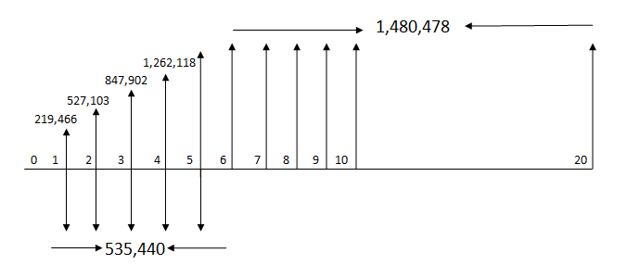
Pay back period with bank involved
Interest rate = 15%.

Slide 45

Pay back period with bank involved
Cost of 1380 LED lamp 535,440 NIS/year
Present worth = 3,726,841 NIS.
Pay back Period = 6.5 years

Slide 46
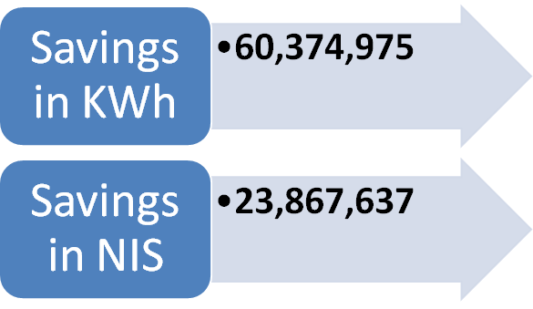
Total Savings

Slide 47
Instructions to dispose HPS lamps.
Turn off the light several minutes before removing it, as the bulbs get very hot.
Once the bulb is cool, remove any outer light fixture and then carefully unscrew the bulb.
Place the bulb in a padded container where it cannot break.
Look up for local hazardous waste recycling facilities.

Slide 48
Conclusion
This study presented an overview of life cycle assessment (LCA) of two street-lighting technologies.
The two technologies were compared from cradle to grave based on their environmental impact as well as their economic performances.
Accumulated savings during the use phase are: 60,374,975 in KWh & 23,867,637 in NIS.
Reduction in GHG emissions: 46,790 ton CO2, 1,147 ton SO2 and 120.75 ton NOx .
Some serious actions should be made in order for LED and HPS makers to reduce the concentrations of heavy metals and gases to reduce the environmental impacts during the manufacturing and end-of-life phases.
Nablus has the opportunity to join smart cities if it chooses LED technology.

Slide 49
Future work
Focus more on the maintenance of the bulbs in order for our system to operate more efficiently, . This means that there should be regular inspections for failed lamps, and replacement of defective equipments as well as cleaning different components.
Carry out public surveys to ensure safe, reliable and efficient working process.
Raise awareness about the importance of adopting LED technology in the cities and recycling LED and HPS lamps. Recycling can be done by collecting and shipping burned out LED bulbs to online recycling programs.

Slide 50


