Slide 1

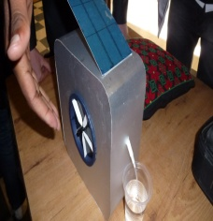


Design of cooling system for extracting water from humid air
AN –NAJAH NATIONAL UNIVERCITY
FACULTY OF ENGINEERING
DEPARTMENT OF MECHANICAL ENGINEERIG
Prepared by:
Afeef Nabulsi
Oday Amouri
Oday Humaid
Said Ahmad
Supervisor:
Dr.Abd-Alrahim Abusafa

Slide 2
Contents
1
General background
2
Problem definition
2
3
What is our project ?
3
4
System objective and target area
4
5
Design of the system
6
Design of prototype
6

Slide 3

General background
Made from water every living thing.
Water is a liquid at standard ambient temperature and pressure, but it often co-exists on Earth with its solid state, ice, and gaseous state, steam
(water vapor).

Slide 4
General background
Water covers 71% of the Earth's surface
Only 2.5% of the Earth's water is freshwater, and 98.8% of that water is in ice and groundwater deep to 2000 m under ground
approximately one billion people still lack access to safe water
By 2025, 1.8 billion people will be living in countries or regions with absolute water scarcity.
In 2030, 47% of world population will be living in areas of high water stress.

Slide 5
Problem definition
Our world suffering water deficiency because of increasing in population, and depletion of the natural resources.
dryness in Middle East , because of water pollution, and lack in water resources
Israeli occupation prevents Palestinian people from their water resources

Slide 6
Problem definition
Consumption
Settlers : Palestinians
4 .5 : 1
Israel pumps around 500
600 MQM/year
100 MQM remains for Palestinians

Slide 7
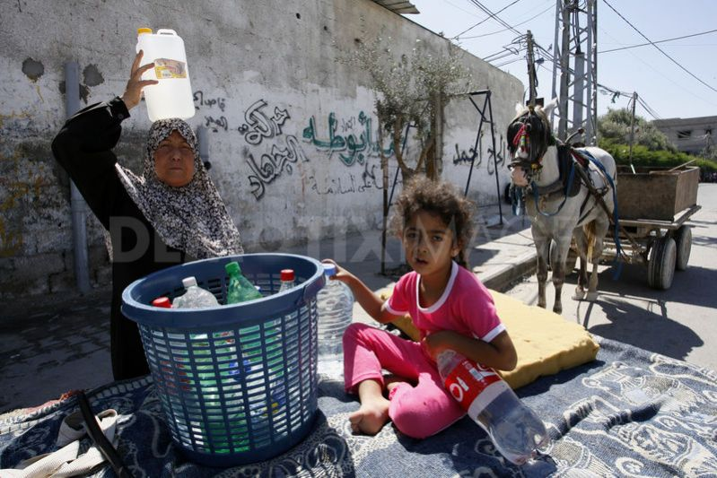
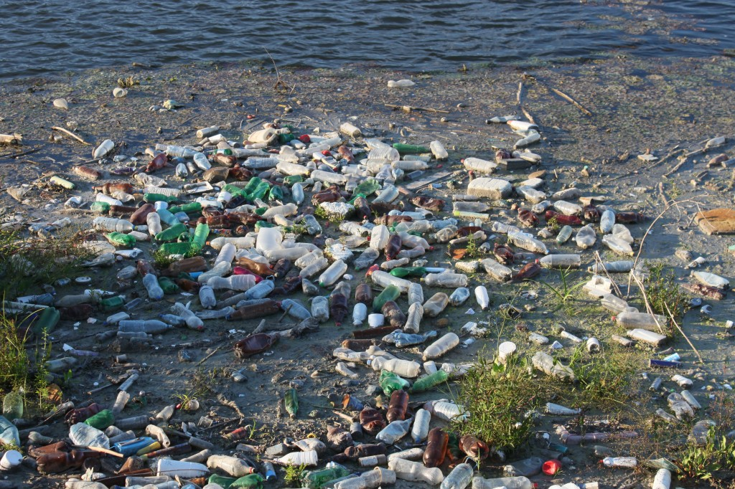
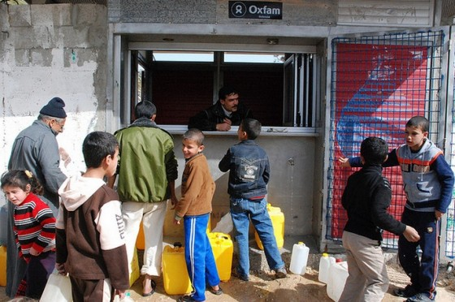
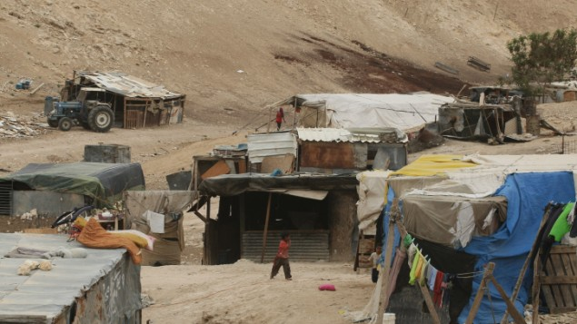

Slide 8
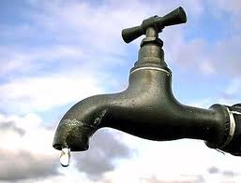
Problem definition
Because there is a continuous decrease in the water-generating sources
it was necessary to create the water from another way,
and this is what will be explained through this project.

Slide 9
What is our project ?
system which can solve the problem in loses water, and find other resources which can give us more liters of water
A device that extract water from humid air.

Slide 10
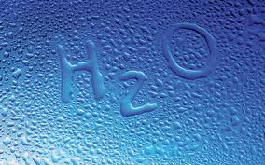
What is our project
Its an environmental project, because the system powered by Renewable energy, we use solar energy to operate the device.

Slide 11
System objectives
* Design advice that extracts water from humid air.
Calculate and optimize the required PV-battery system to provide the necessary energy from a renewable source.
Minimize the power required for the operation by designing a series of energy recovery equipment such as heat exchangers.
Operate the system after construction to provide water with quality of water according to the specifications of the World Health Organization.

Slide 12
Design
Design
Temperature
Humidity
Solar radiation
Depend on

Slide 13
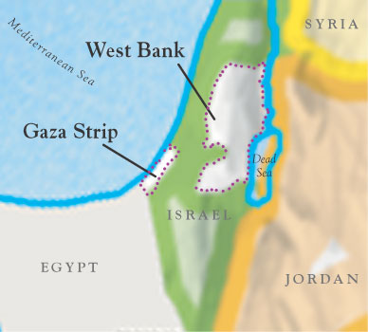
Target Area
useful Geographical location for project humidity, temperature
has a problems with water
Gaza strip

Slide 14
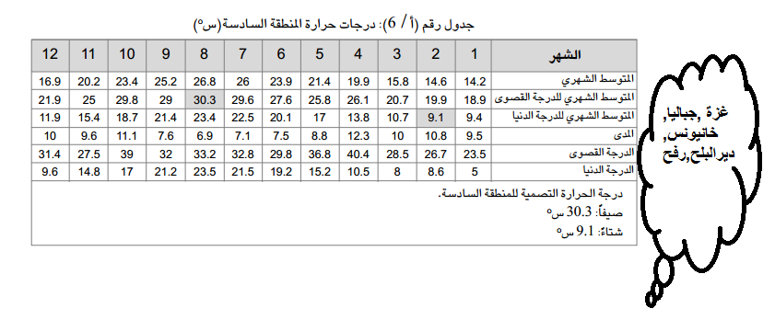
Target Area
average temperature is around 25ºC.

Slide 15
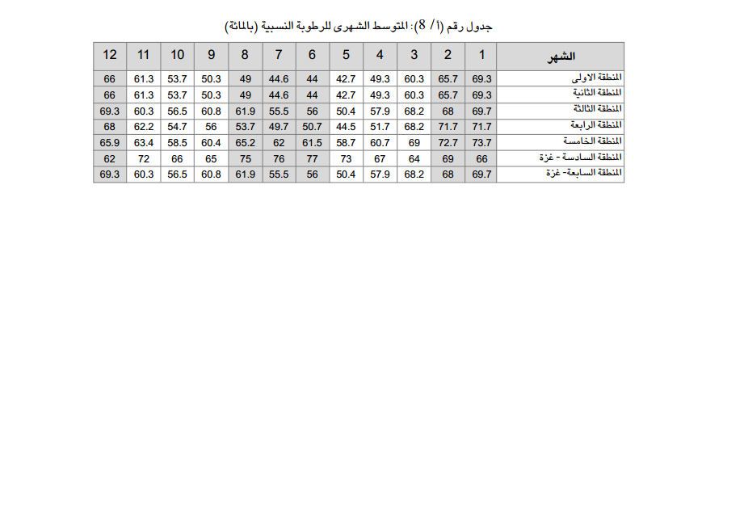
Target area
average humidity ratio is around 70 %.

Slide 16

What is our goals ?
is to produce 400 liter/day
After design the project

Slide 17

What is our goal ?
Mass flow rate of air :
Depend on cooling the air from 25ºC to 5ºC
m_{W}=m_{a}(h₁-h₂)

Slide 18
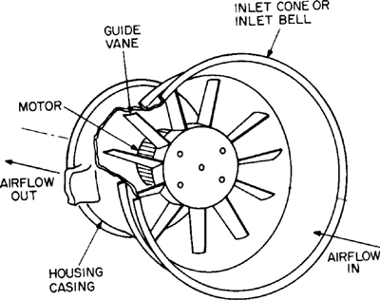
Parts of device
Design of fan
1
Air flow 1 m³/s
2
Axial Blower fan

Slide 19
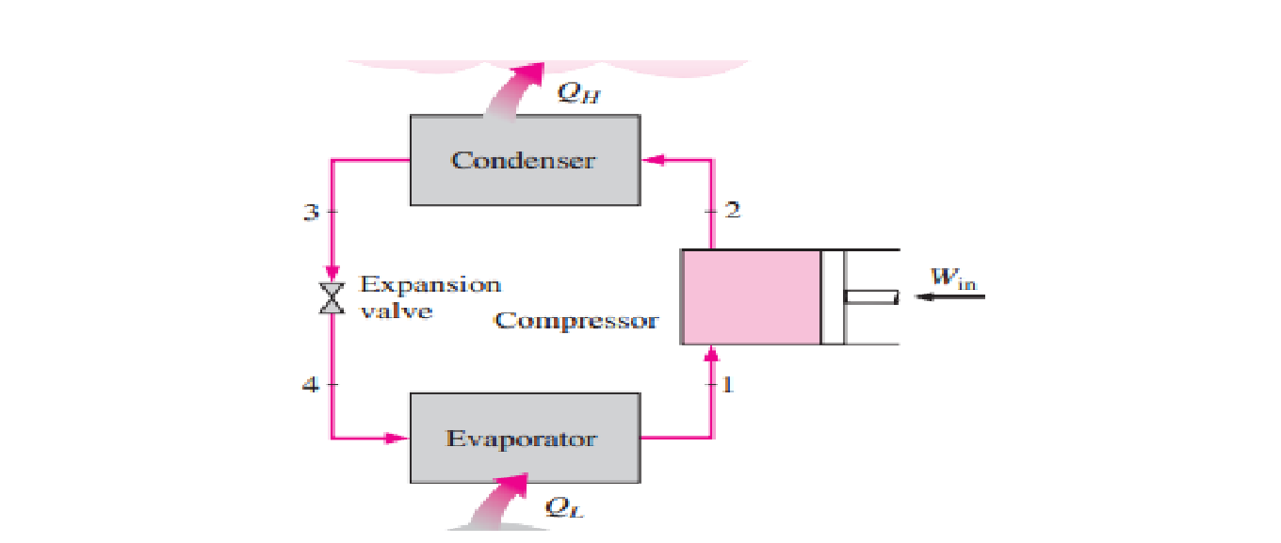
Parts of the system
Basic refrigeration cycle
Power that Refrigeration cycle need
Wc =15 Kw depending on suppose C.O.P =3.5

Slide 20
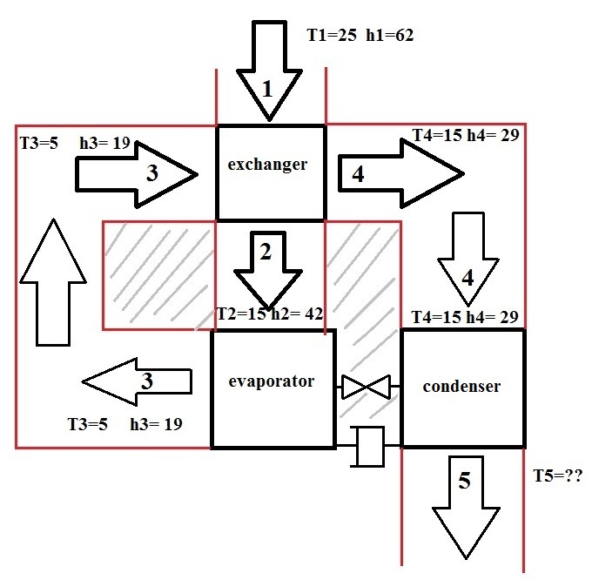
Parts of the system
steps we followed to design the system

Slide 21
Parts of the system
Heat exchanger design
How the heat exchanger reduce the power consumed by the Refrigeration cycle ?
Shell tube Heat exchanger .
Plate Heat exchanger.
Rotating wheel Heat exchanger.
21

Slide 22
Parts of the system
Heat exchanger
 | Rotating wheel | Plate | Shell tube
Pressure drop | low | medium | medium
Parts movement | Rotate | fixed | fixed
size | medium | Large volume | Very long tubes
recovery efficiency | 75 % Heat storage core | 60 % | 50 %
22

Slide 23
Parts of the system
Refrigeration cycle with heat exchanger
Wc= 8 KW
23

Slide 24
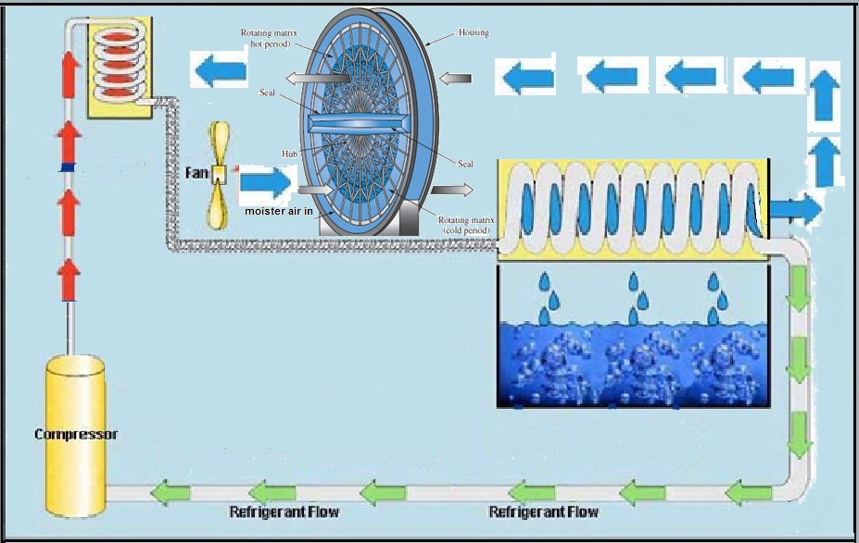

Slide 25
Parts of the system
Wc =2.288 KW
After allowing the cold air to Passes through the condenser
25

Slide 26
Parts of the system
Evaporator & condenser Design
The main factor s affect the design are:
mean temperature difference between the fluids (K).
cooling capacity (W).
overall heat transfer coefficient (W/(m² K)).

Slide 27
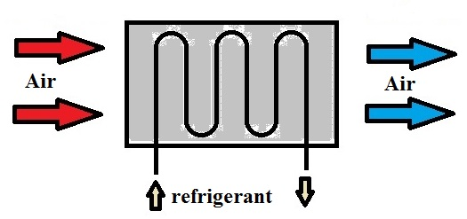
Parts of the system
the length of evaporator 35.4 m at diameter 1cm
The length of condenser 21.1 m at diameter 1cm

Slide 28
Parts of the system
1
2
3
The total energy that the system need 3.018Kw
2.288 Kw compressor, 0.55 KW Fan, 0.18KW
Rotating wheel
more advanced research could handle Power generation and refrigerator cycle by renewable energy

Slide 29
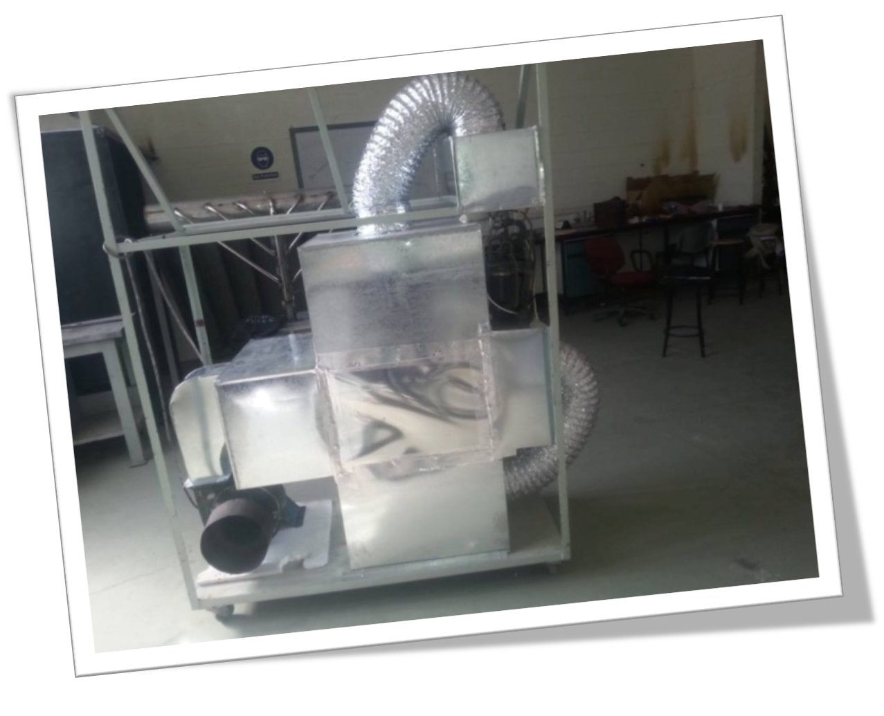
Prototype Design

Slide 30
Parts of the device

Slide 31
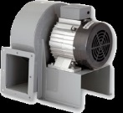
Parts of device
Design of fan
1
Air flow ? m³/s
2
centrifugal fan

Slide 32
What is our goal ?
Mass flow rate of air :
Four levels
89 CFM
115CFM
139CFM
252CFM
Depend on cooling the air from 25ºC to 17ºC

Slide 33
temperatures

Slide 34
Refrigeration cycle
 | Vapor Compression Cycle
Refrigeration gas | R410-a
coefficient of performance | medium 3
Parts Cost | simple
Source of energy | electrical

Slide 35
Parts of the system
Heat exchanger design
Plate Heat exchanger
35

Slide 36
Parts of the system
Heat exchanger
 | Plate
Made from | Tin Alloy
Pressure drop | medium
Parts movement | fixed
size | 11 m²
recovery efficiency | 35 %
36

Slide 37
flow | Heat capacity (k Watt)
At full flow | 2.038
At Three-quarters full flow | 1.669
At half full flow | 1.436
At quarter full flow | 1.514

Slide 38
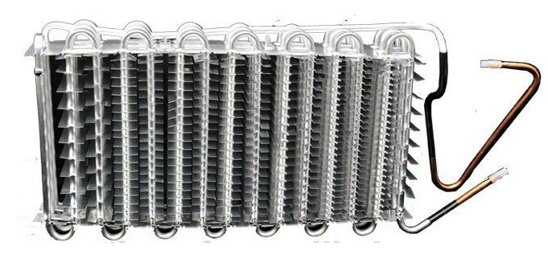
Parts of the system
Evaporator & condenser Design
flow | Evaporator heat capacity (k Watt)
At full flow | 0.99156816
At Three-quarters full flow | 1.31098604
At half full flow | 1.0702692
At quarter full flow | 1.05248
Condenser heat capacity(kW)
0.29423064
1.15786944
1.1156805
1.136982

Slide 39
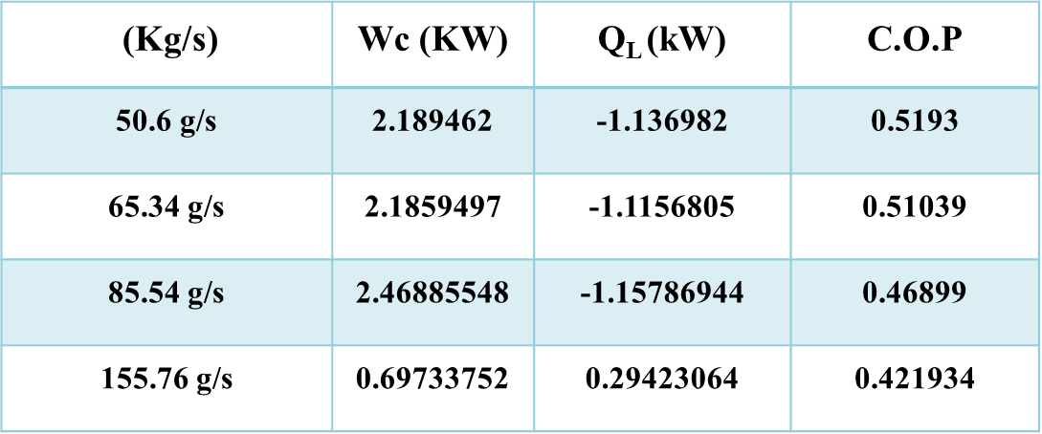
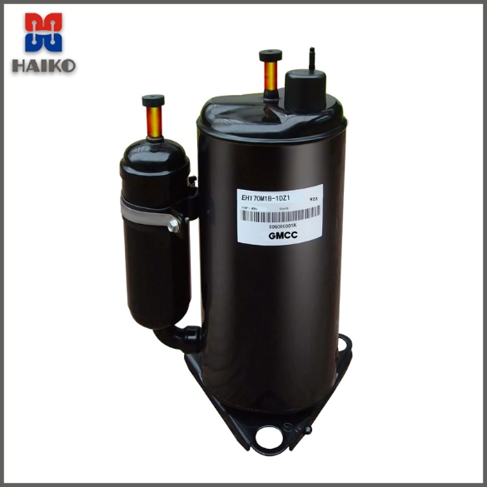
Energy efficiency ratio
0.5

Slide 40

Parts of the system
Basic refrigeration cycle
Power that Refrigeration cycle need
W_{C} 0.57 kw with C.O.P 0.5

Slide 41
Parts of the system
2
1
0.572 Kw compressor, 0.5 KW Fan
The total energy that the system need 1.078kW

Slide 42


Why We design a prototype for the project wasn't in conformity with
the original design
lack of some of the required pieces in the local market
Lack of
Funding
&

Slide 43
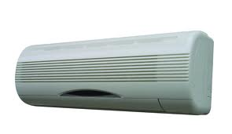
The cooling cycle that we have used is a cycle of a normal air conditioner
so the lowest possible temperature we can get here is
16 degree
5 degree
Whereas the required temperature is

Slide 44
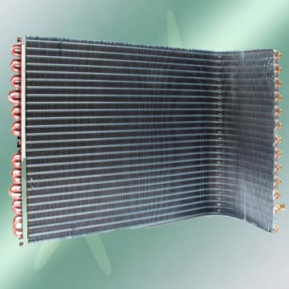
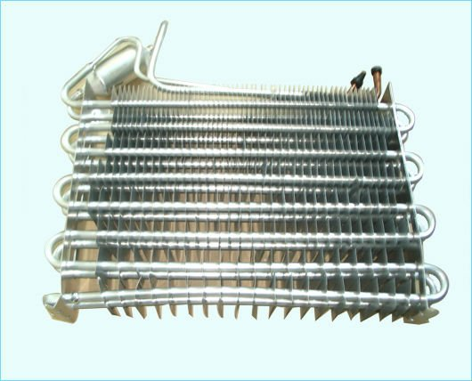
The original evaporator of the cycle was changed because of the Inconvenience with the design ,
So that reduced the circuit’s ability in refrigerating.

Slide 45
As a result of decreasing the cycle ability in refrigerating, we had to minimize the air flow into the cycle by using a mechanical gate which was placed on the blower’s suction instead of using an inverter –because of the high cost of the last one- in order to control the flow.

Slide 46
The area of the heat exchanger we have used is small and the distances between each plate and the other is large because the manufacturing capacity is limited in the market .This heat exchanger is not available in the local market as well as the required specifications , while importing from abroad is difficult due to the costs.

Slide 47
Heat exchanger was manufactured from tin alloy which is considered to be a low-conductivity material respect to the conductivity of the materials that the exchanger is always made from, but the selection of tin alloy was due to its low price. Unfortunately that affected the results, so we didn’t get the exact desired results.

Slide 48
Finally, as a result of using the centrifugal blower, we have obliged to design a duct that led to high pressure drop, and thus reduced the flow volume of 1480CFM to 252CFM, then increasing the motor burden leading to increase the consumed energy too.

Slide 49
Recommendation
The results that we reach were not already achieved theory, to be:
At the first, axial blower recommended using to decrease pressure drop to minimum, and the duct forms should be funnel-shaped not square shape.

Slide 50
On the other hand, the alloy used to manufacturing heat exchanger should be copper alloy its better than tin alloy to rise the efficiency of heat exchanging, but the rotary wheel heat exchanging is much better than the plate one, it has more efficiency and smaller size.

Slide 51
The evaporator should replace with a large one and use a different refrigeration cycle using R-134a refrigerant that will make the temperature drop to 5°C to condensate the maximum amount of water.

Slide 52
Thank You !

