Slide 1
Hardware Store Locator
Supervised by Dr.Fadi Draidi

Slide 2
OUR TEAM
Feras Hamad
Hakam Khalili

Slide 3
TABLE OF CONTENTS
01
02
03
04
05
06
Introduction
Problems
Solutions & features
Methods & Technology
Design
Future work

Slide 4
In these modern days, the numbers of technology stores are increasing, and a lot of them get unnoticed especially ones that are a small store, and are located in suburban areas in which that they can only attract local customers.
Also, as a customer finding the store that contains the item you need can waste a lot of time, money and effort, especially if you live in a rural area.
01
Introduction

Slide 5
Customers
Owners
02
Time wasted finding a store: if you don’t know the nearby hardware store, it may take time, and perhaps miss a deal.
Time wasted finding the needed item: if you didn’t find the item you need in any store, you have wasted a lot of time already.
Problems
Advertising: your small business can be hard, and would take consume a lot of money that you could have preserved for your business.

Slide 6
03
Finding Store
Finding Items
Advertising Store
Solutions & features
An app that has a way to search for items, and display stores that have that item available
An app that has a way to register stores and display them to customers, with details
An app that has a map containing all nearby stores, and displays the nearest

Slide 7
04
A web application consisting of the most popular frameworks, and follows the structure of :
Front-End
Back-End
Database
Would be the method of executing the solutions
Methods & Technology

Slide 8





Data Base
Back-End
Back-End
Front-End
MAP
MySQL
Node
Express
React
TomTomMap

Slide 9
05
Map System (Feras Hamad)
Search Engine (Feras Hamad)
Registration System (Hakam Khalili)
Inventory System (Hakam Khalili)
Design

Slide 10
Map System:
Request Geolocation for current location
Adds Markers for current location, and available hardware stores.
Calculates and Draws a path towards the nearest hardware store.

Slide 11
Search Engine:
Search Bar with Autocomplete.
Displays available items as cards after entering text (from Database).
Retrieve search results from Database, after clicking on a card.

Slide 12
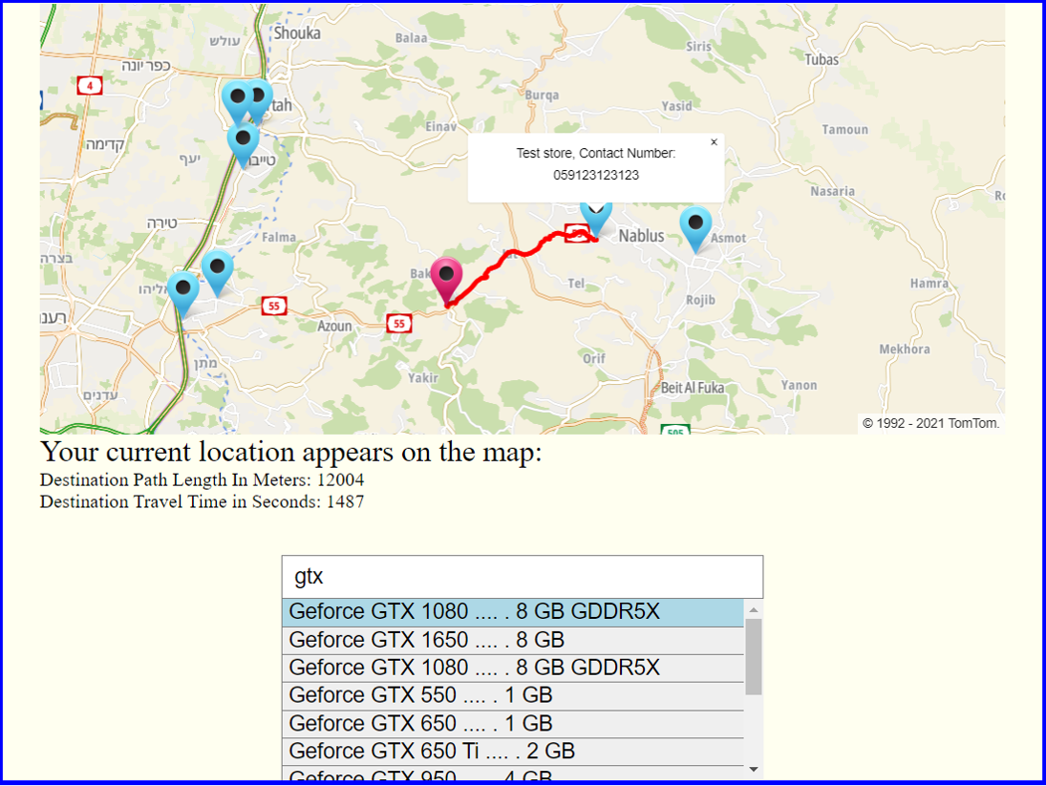
Map System (Feras Hamad)
Search Engine (Feras Hamad)
1
2

Slide 13
06
Future work
Monetization ( ADs / Commission )
Adding more features ( Better UX / Details )

Slide 14
Thank You
The End

