Slide 1
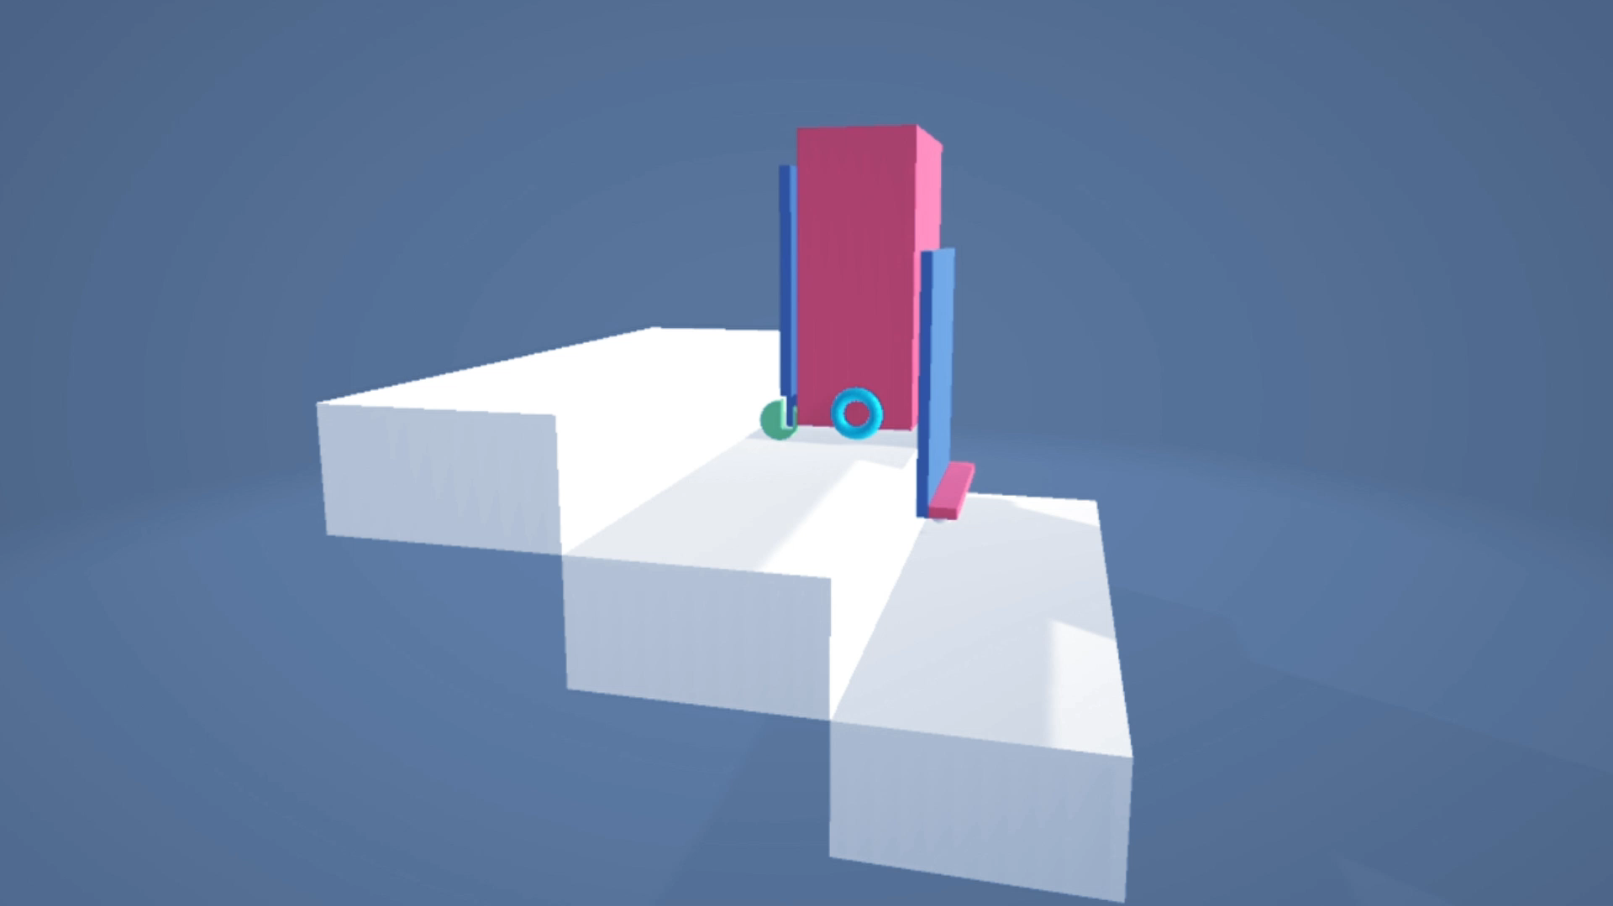
SPEED
SweepUp Stairs
- Jood Hamdallah & Saleh Sawalha
- Dr.Manar Qamhieh

Slide 2
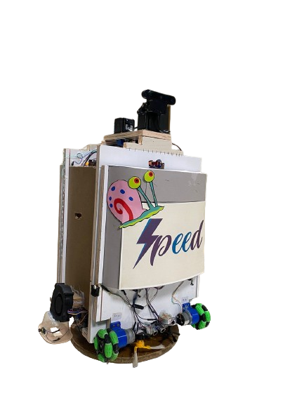
Why Speed ?
Never done before.
Climbing the stairs pattern .
Sweeping the stairs

Slide 3
Table of contents
01
02
03
04
Technique & Movement
Challenges & Design
Constraints
Future work

Slide 4
01
Technique & Movement

Slide 5
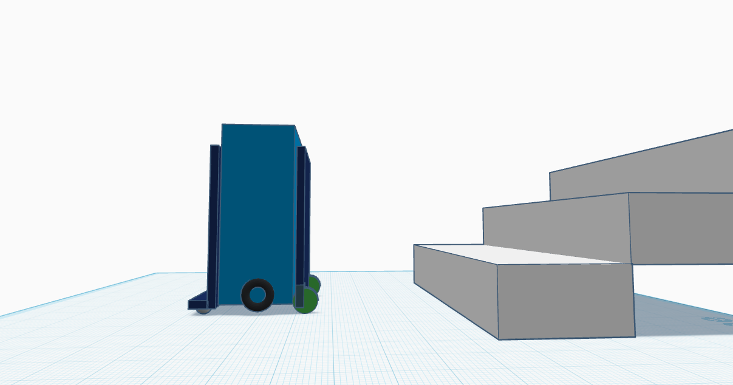
Part B
Main part
Part A

Slide 6
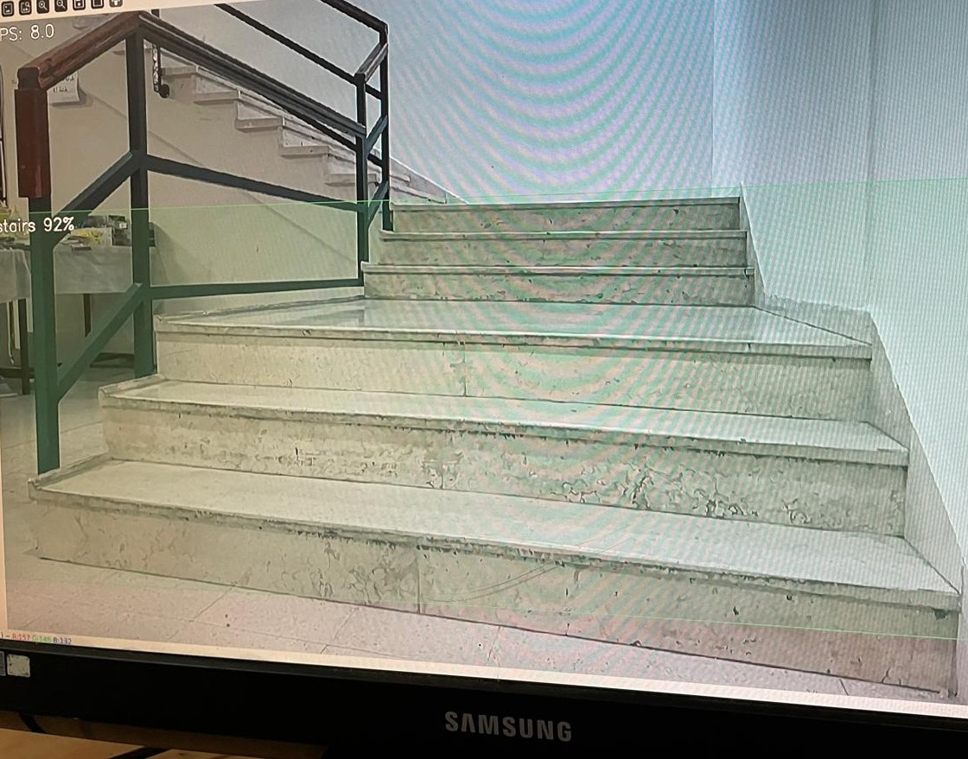
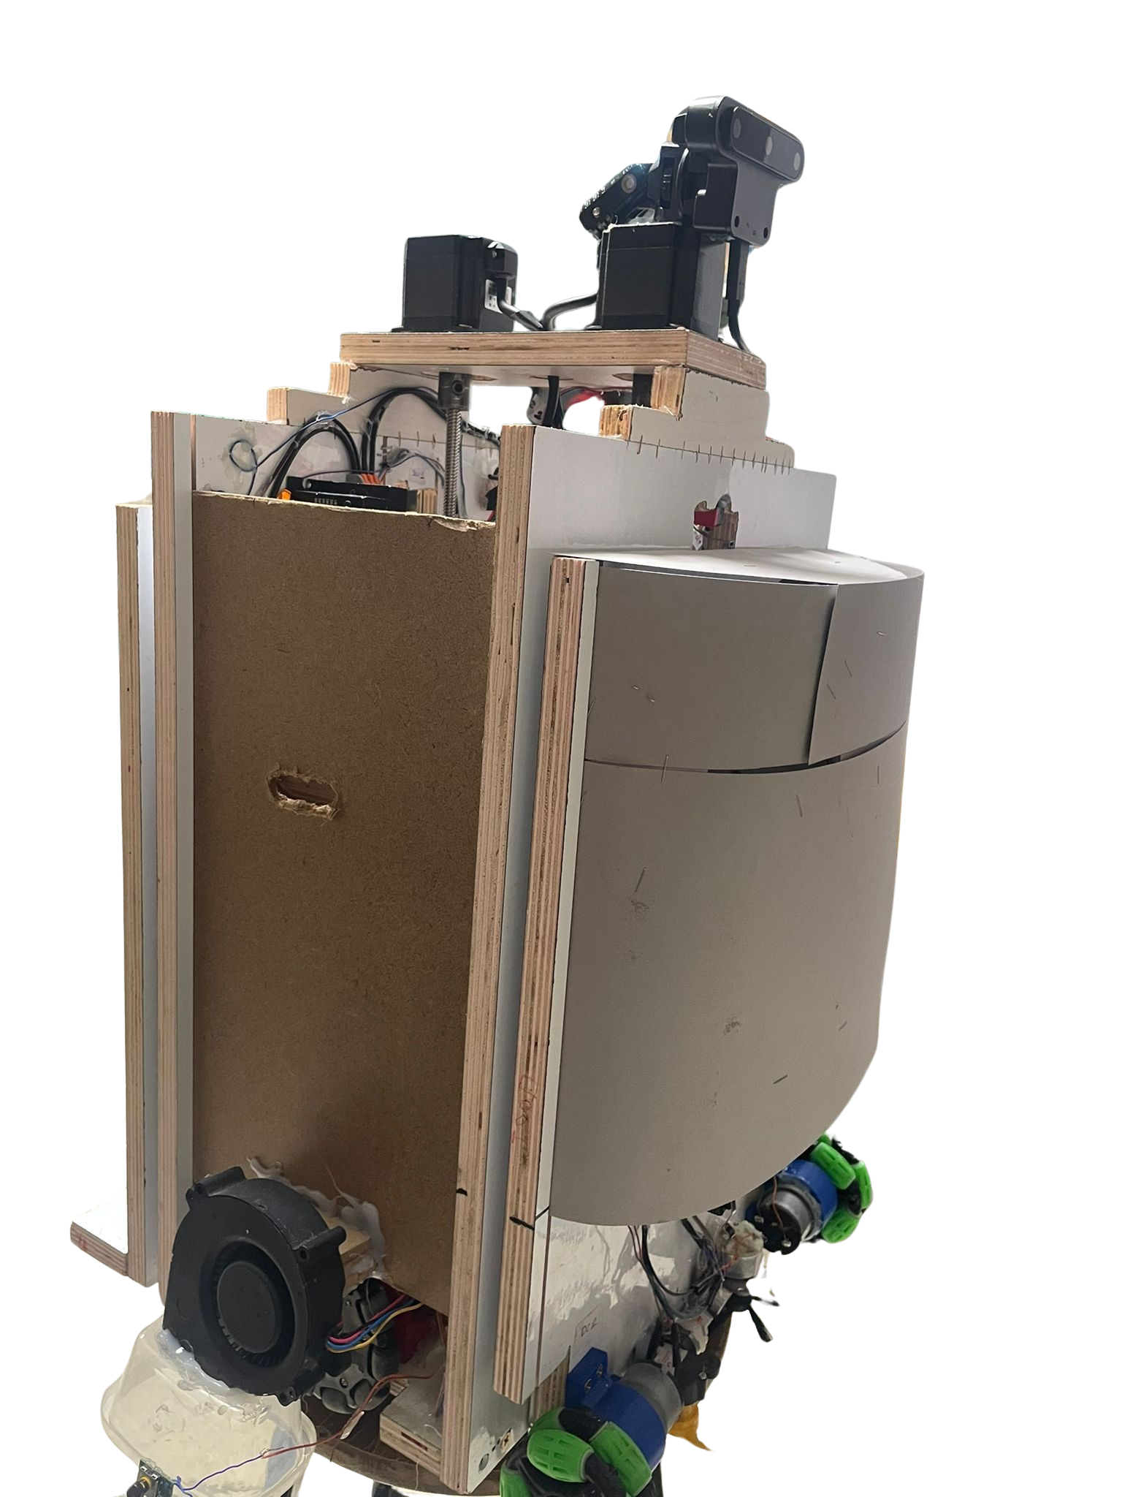
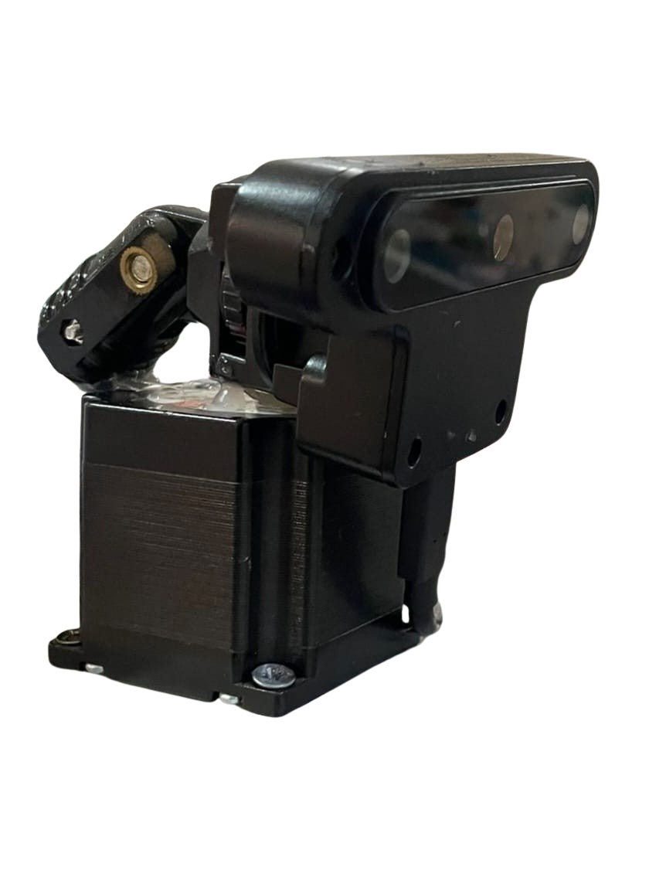
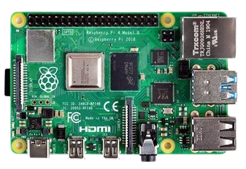
Camera
OAK-d Full HD Camera
The camera is connected with raspberry pi 4 model B .
Using AI Model for stairs detection.

Slide 7
Movement steps
1st step
2nd step
3rd step
4th step
5th step
Moving
right & left
Moving
Part B up
Moving
forward
Moving
Part A up
Moving Main part up

Slide 8
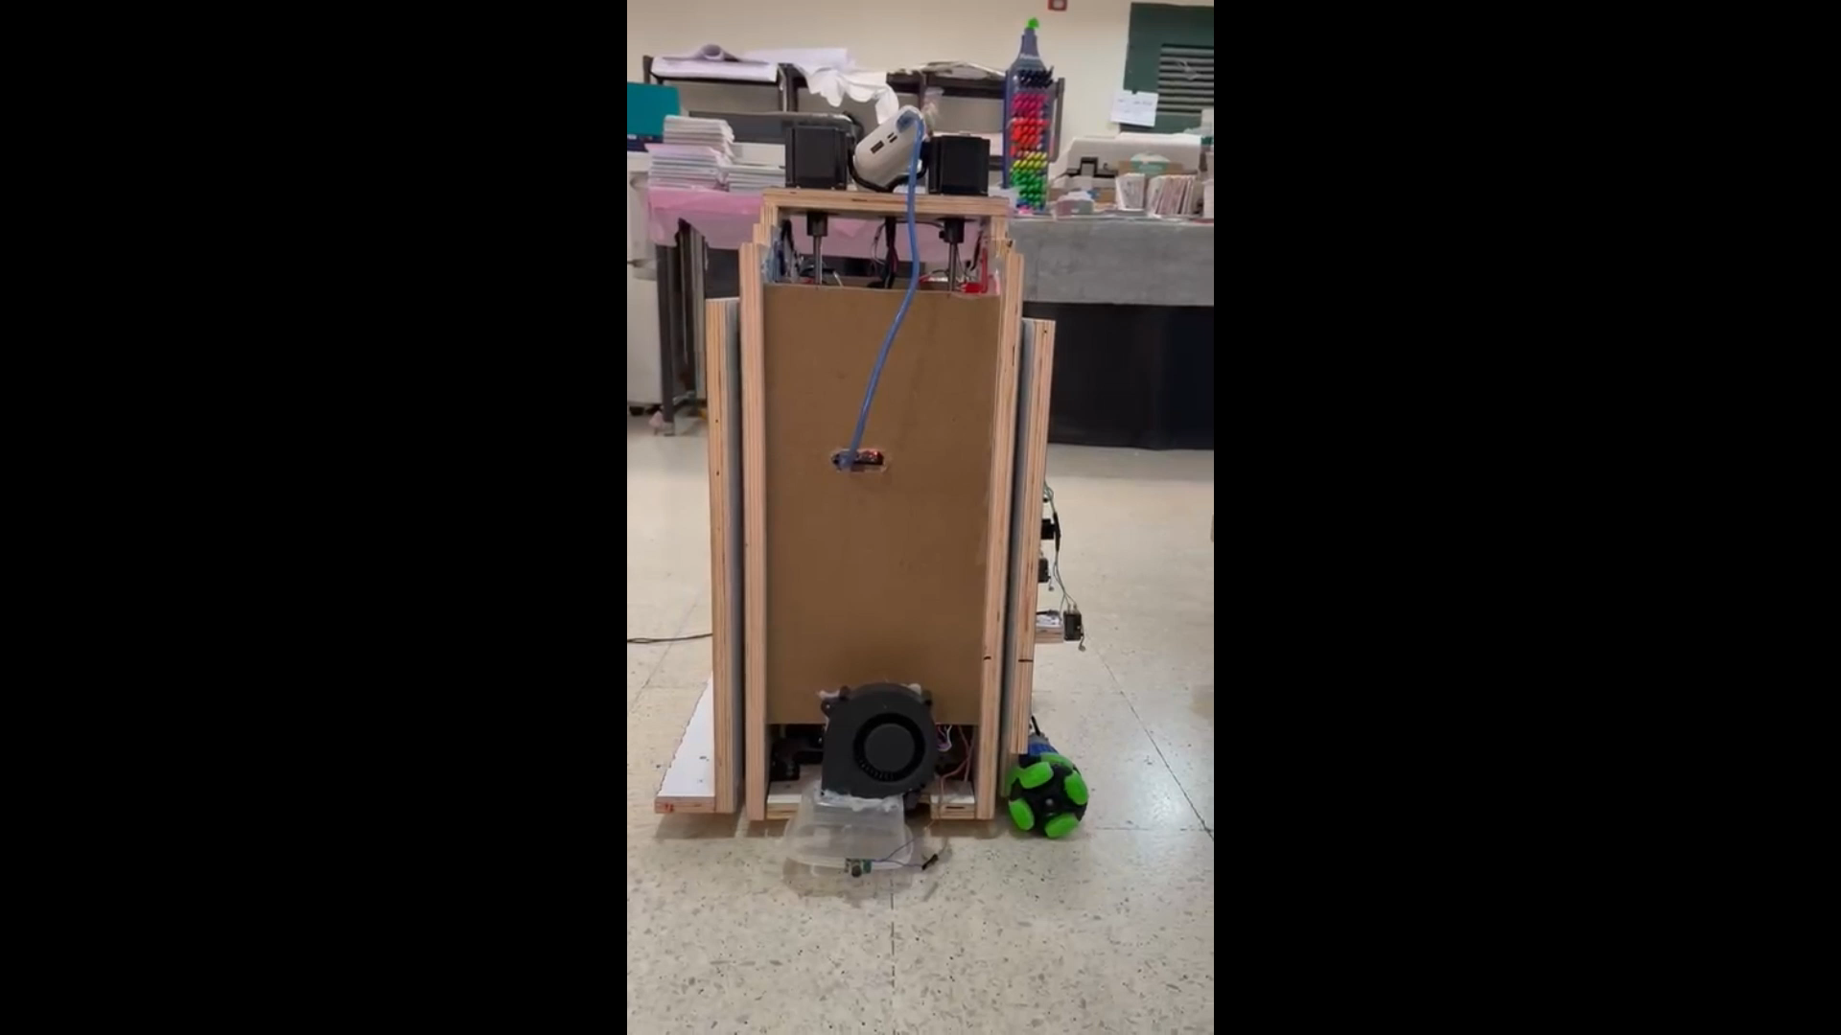
Moving forward
01
Stepper & DC motors are used for moving forward.
Navigation System: Limit Switches, IR sensors, & Camera were implemented to detect stairs.

Slide 9
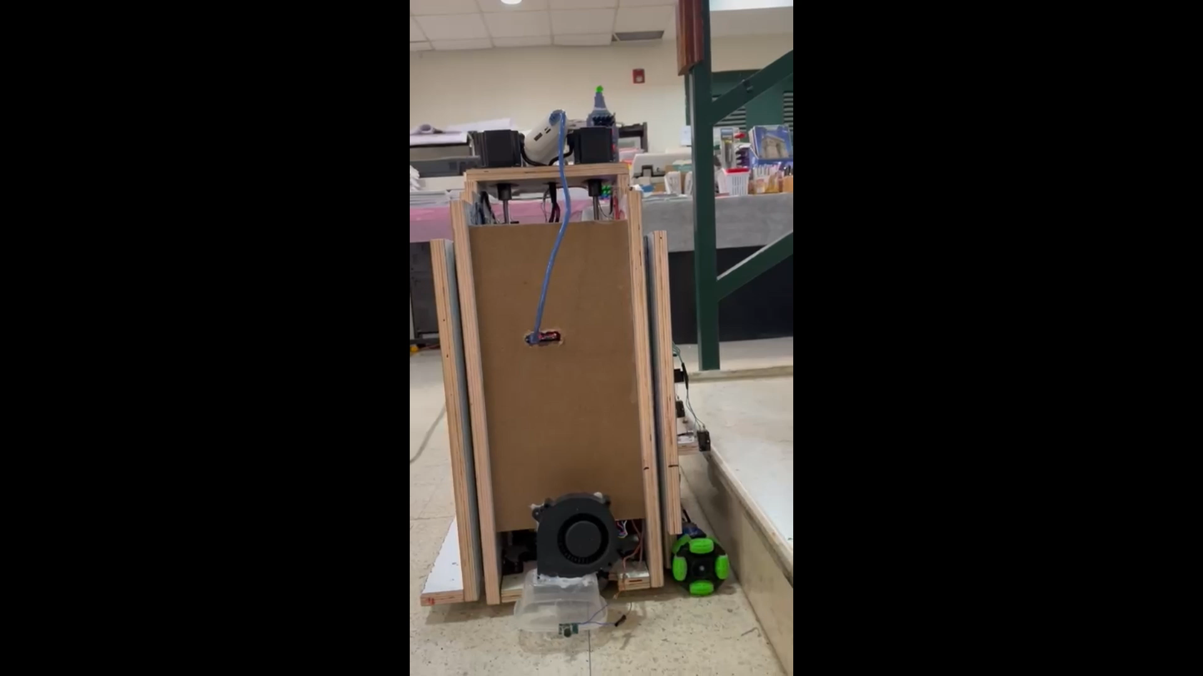
Moving Part A up
02
If ( 2 Limit Switches Pressed) {
While (Height != 19 cm) {
Part A UP
}
}
A

Slide 10
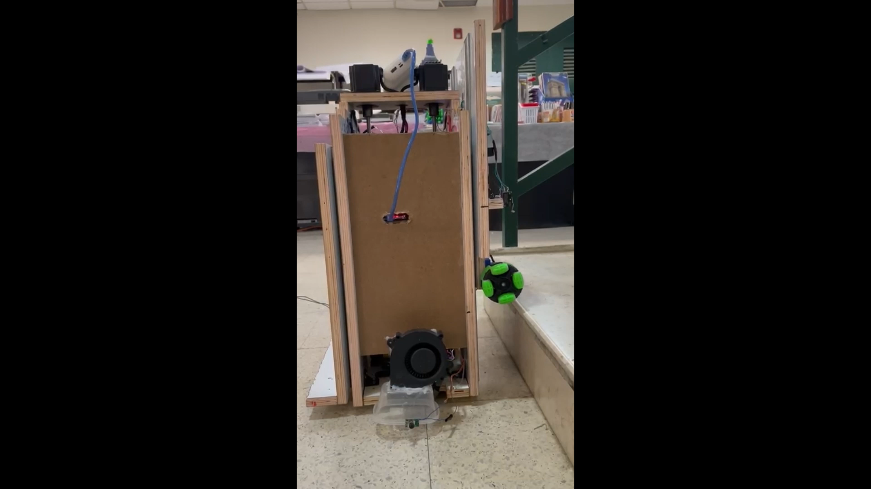
Moving forward
03
Move forward again until all of
Part A is on the first stair.

Slide 11
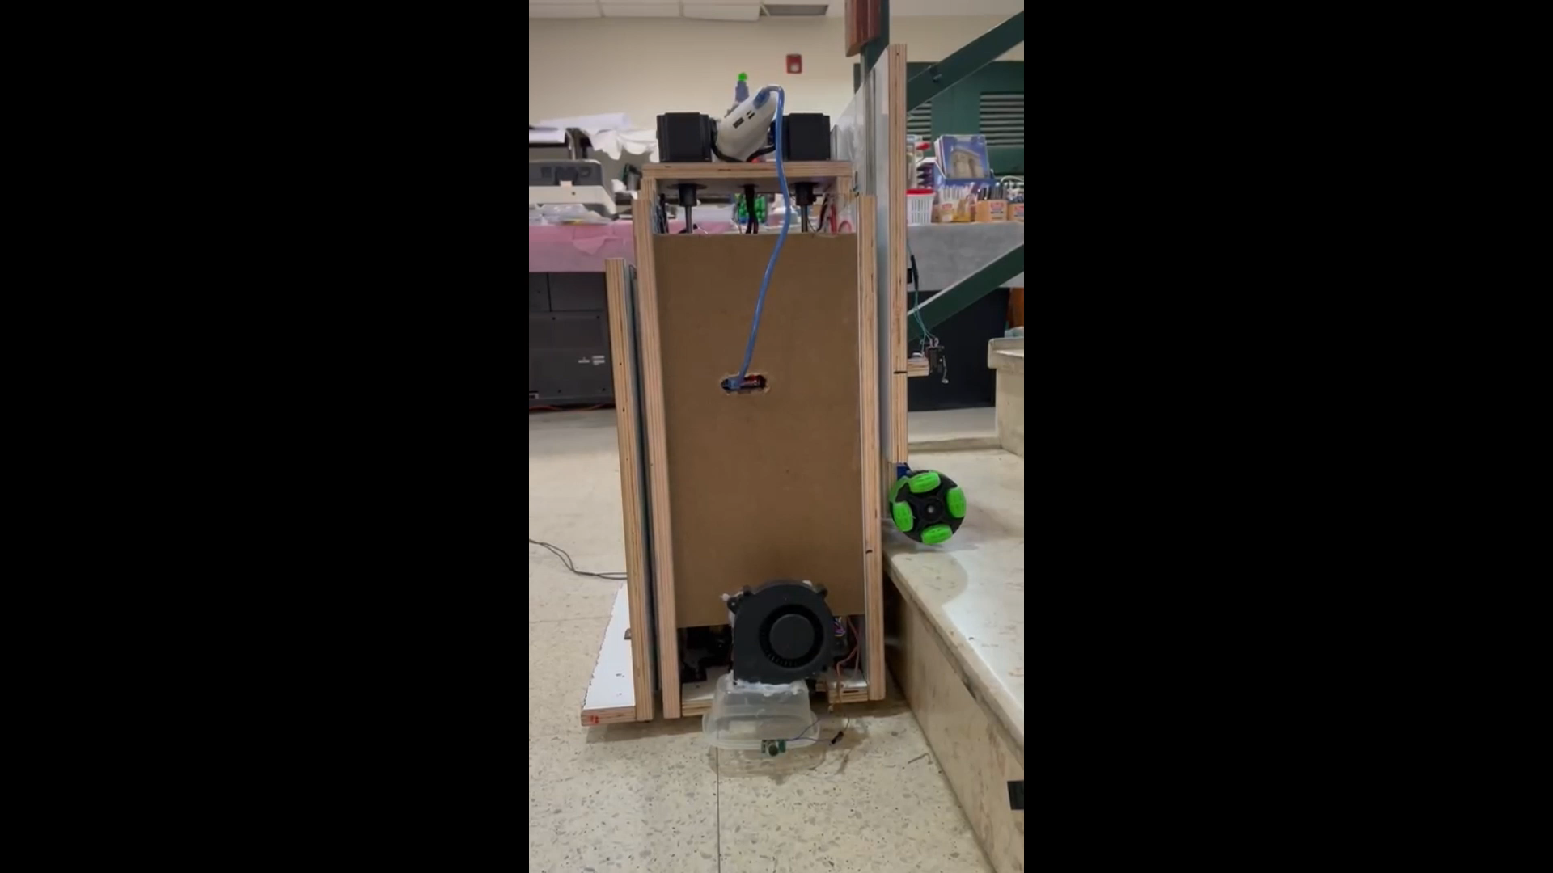
Moving main part up
04
B
A
Parts A & B moving down to
raise the main part.
Part A back to the same position
Part B goes down until reach the
Limit switch

Slide 12
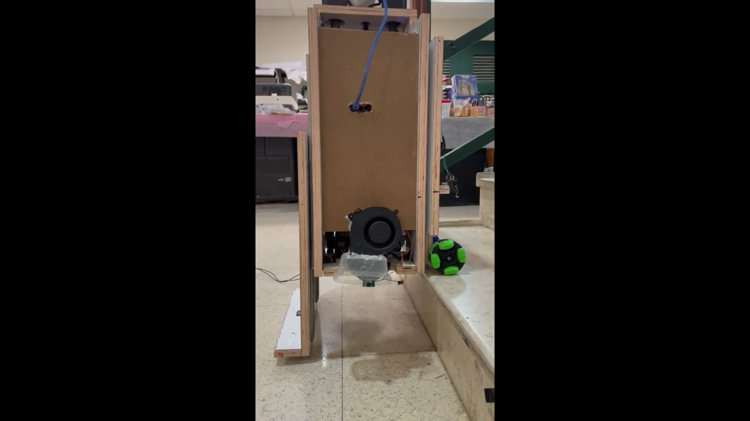
Moving forward
05
After the last move forward,
the two parts that responsible
for sweeping will be on the
first stair.

Slide 13
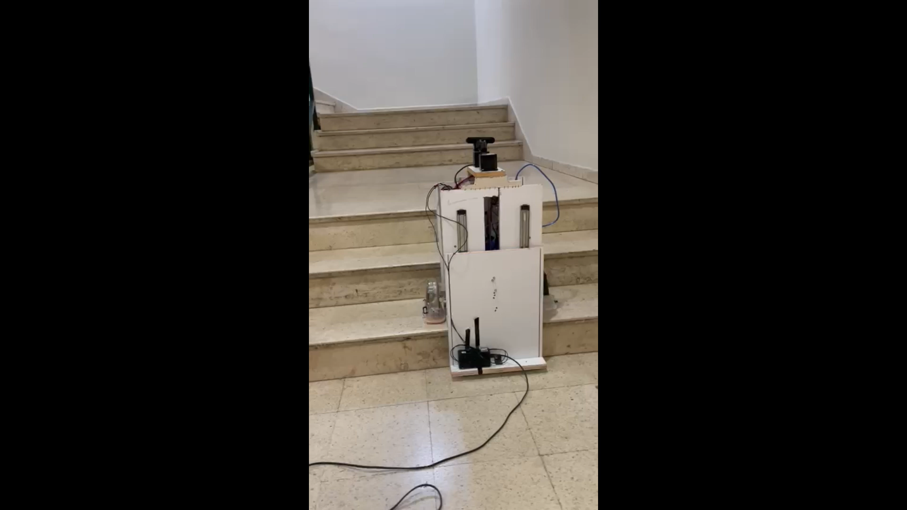
Moving right & left
06
At this stage the robot starts
moving right and left to sweep
the stairs.
The robot toggles the direction
in two cases: if one of the two
switches is hit or the IR
did not detect object

Slide 14
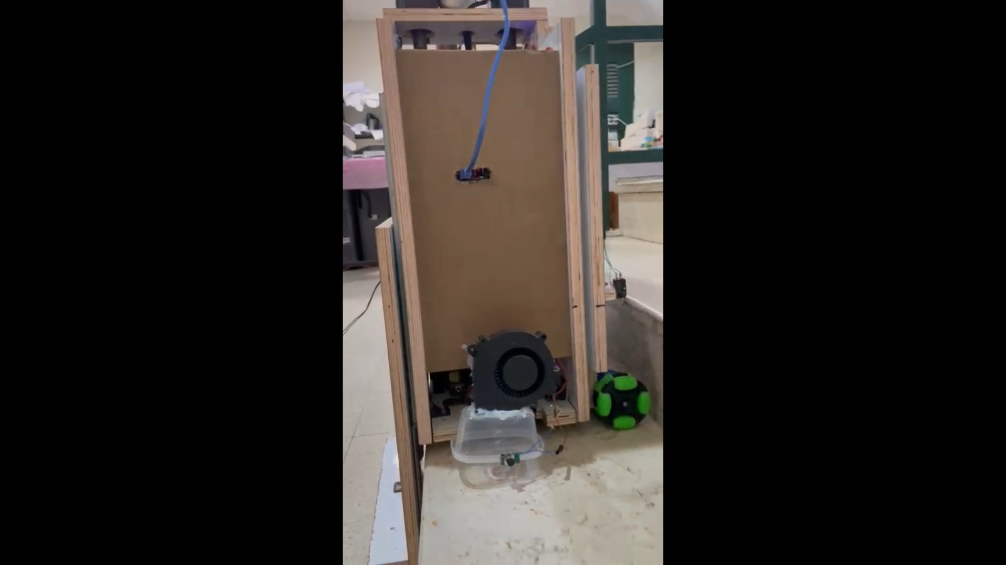
Moving
Part B up
07
At this stage all the parts of
the robot are on the first stair.
B

Slide 15
02
Challenges & Design

Slide 16
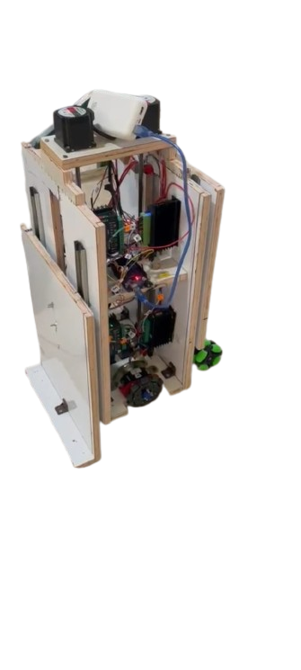
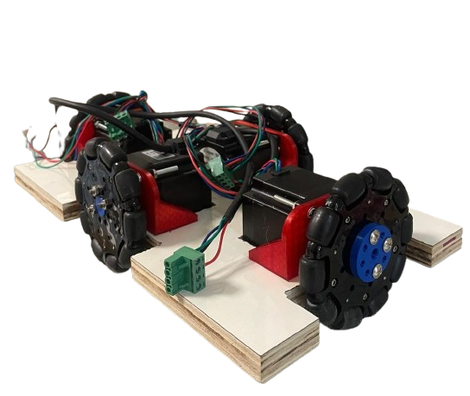
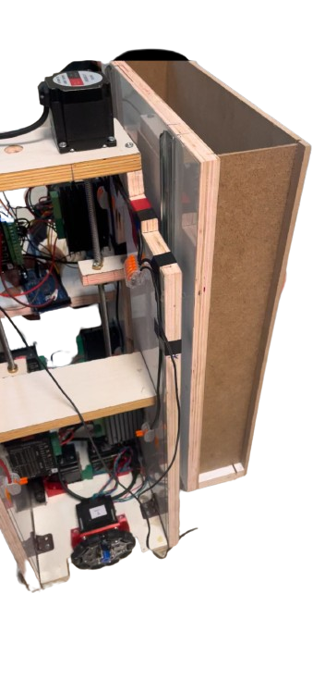
First challenge:
Limit of stair width
Vertical design
Bi-directional wheels
Up and down movement

Slide 17
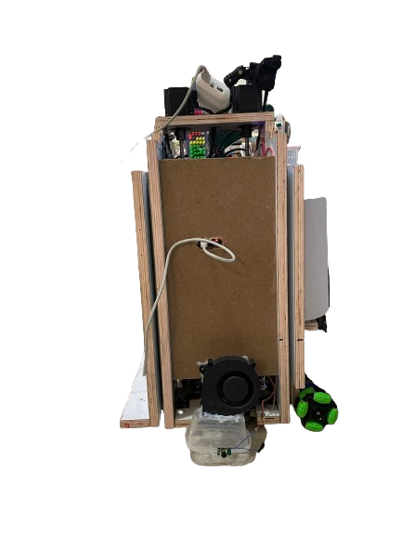
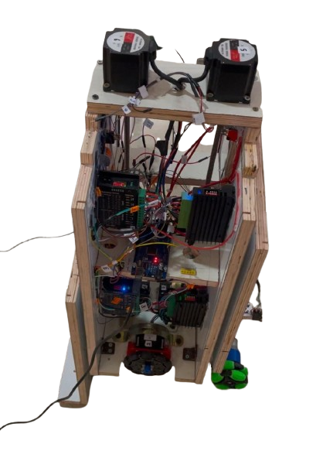
Vertical design
Drivers
57cm
Micro Controllers
Motors
35cm

Slide 18
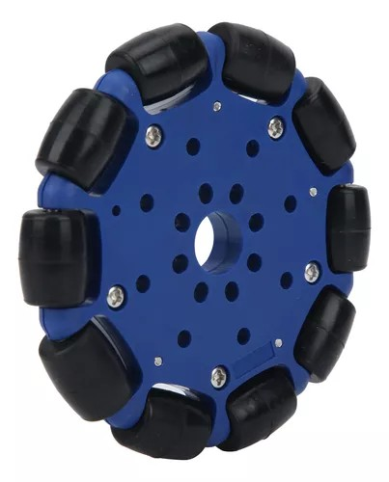
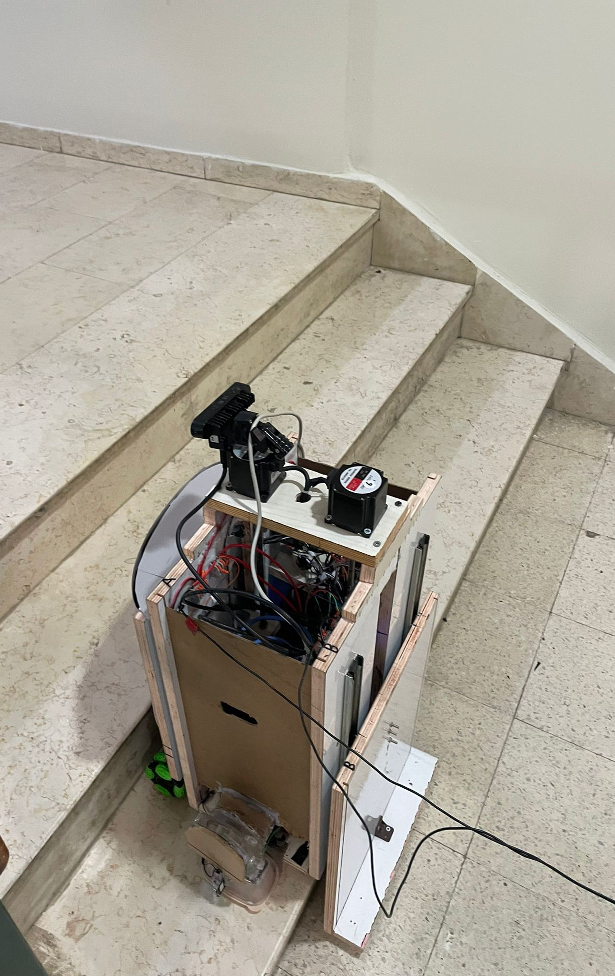
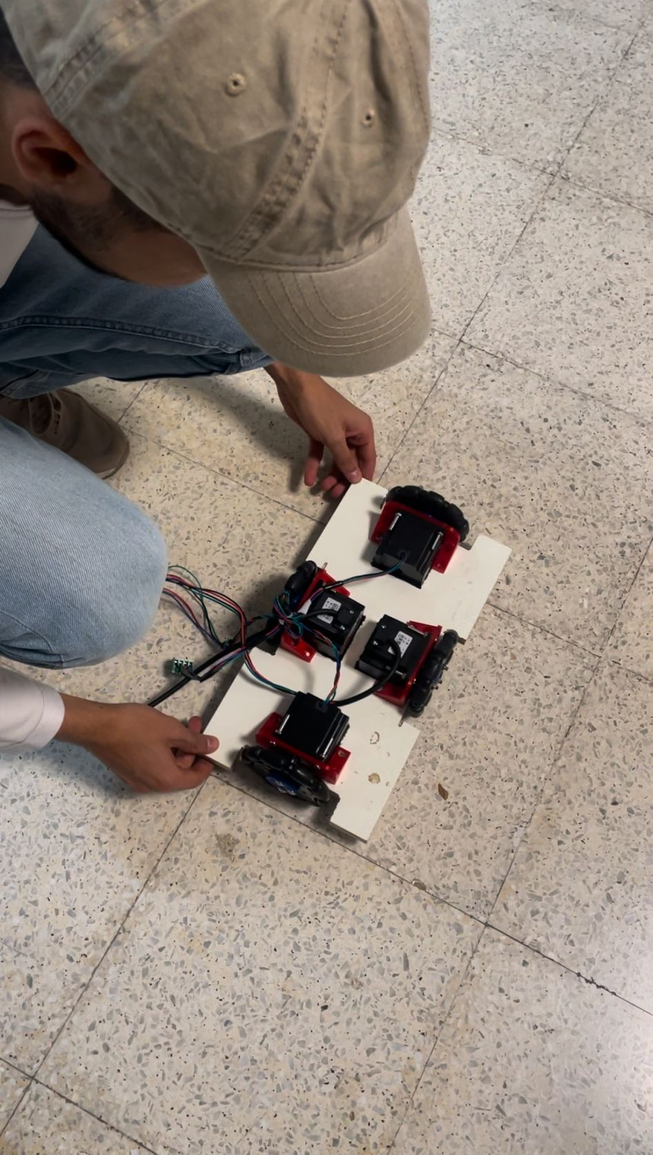
Bi-directional wheels
Difficult to turn wheels on stairs.
Using the OMNI wheels.
Main base of the robot speed.

Slide 19
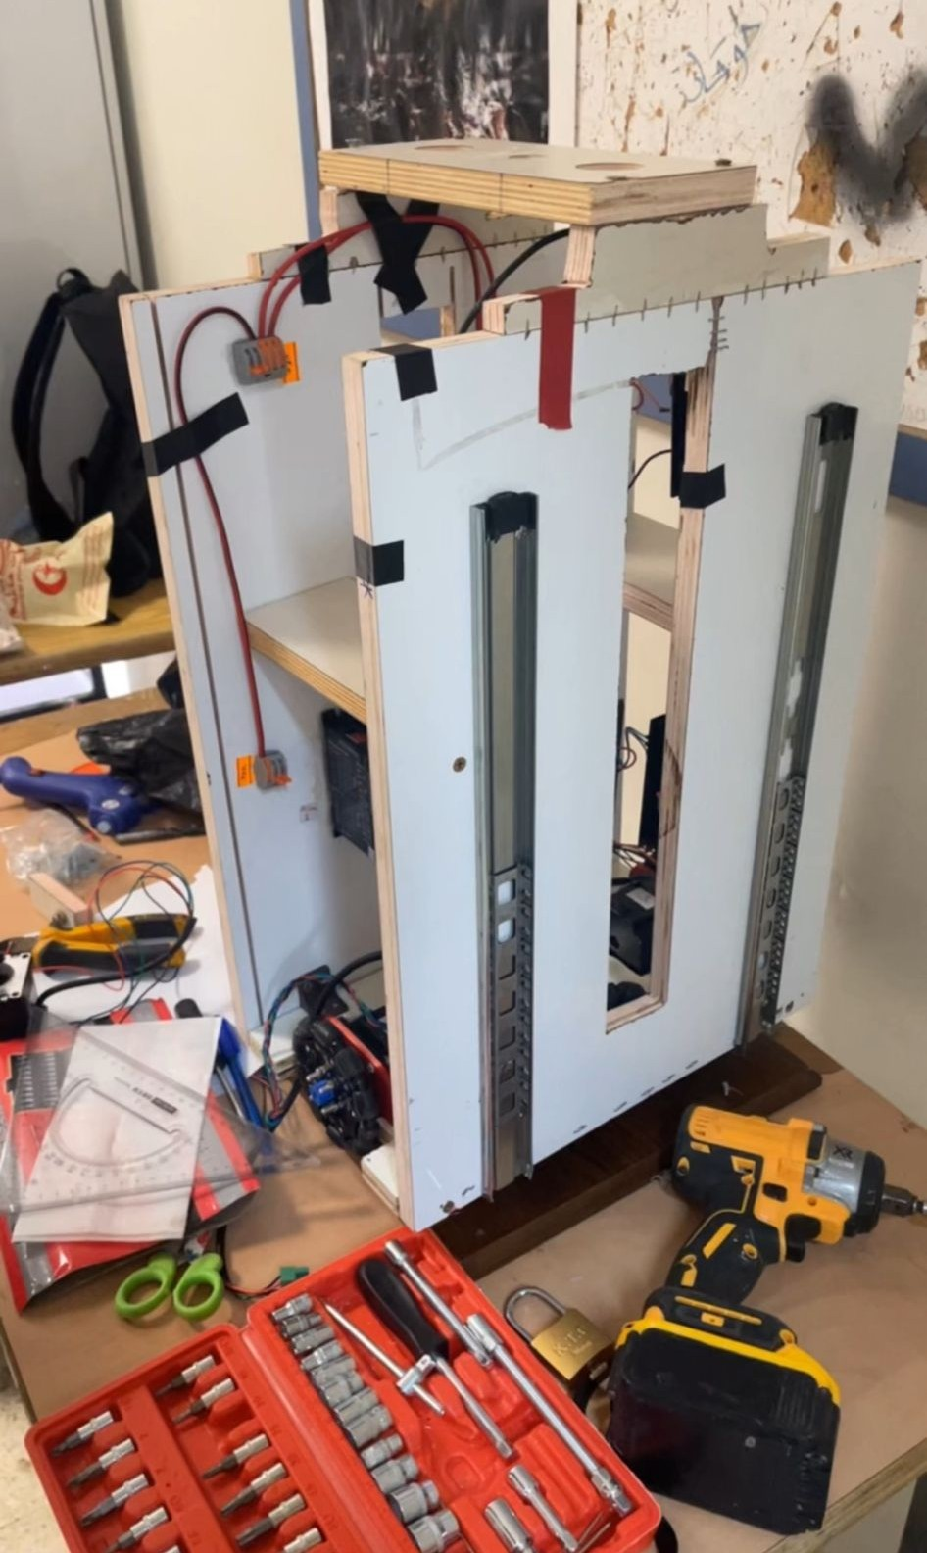
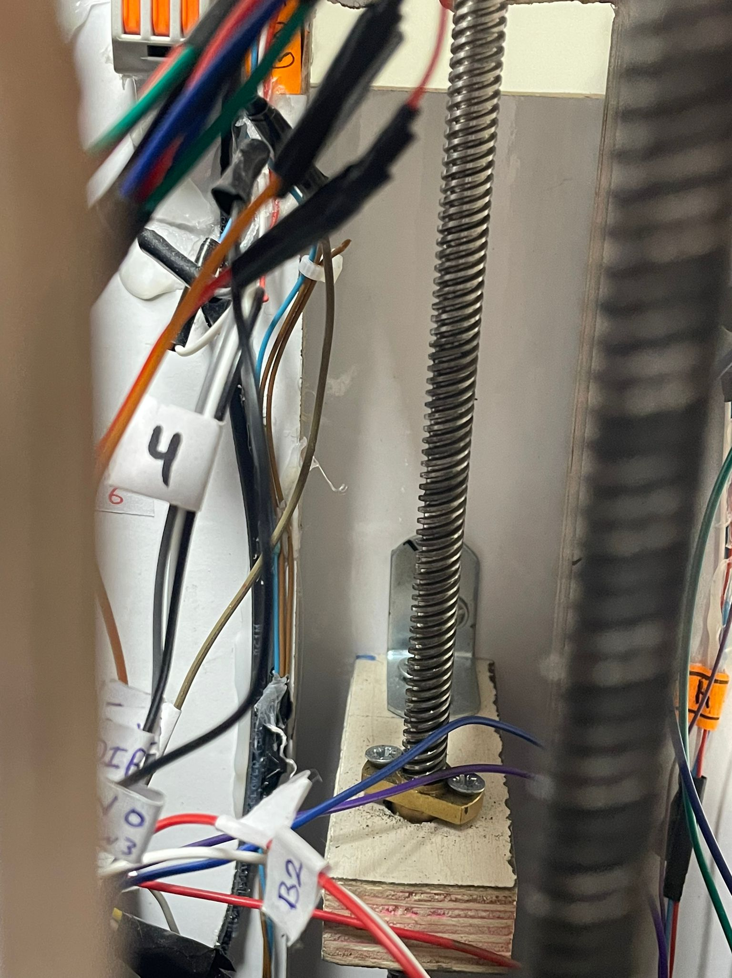
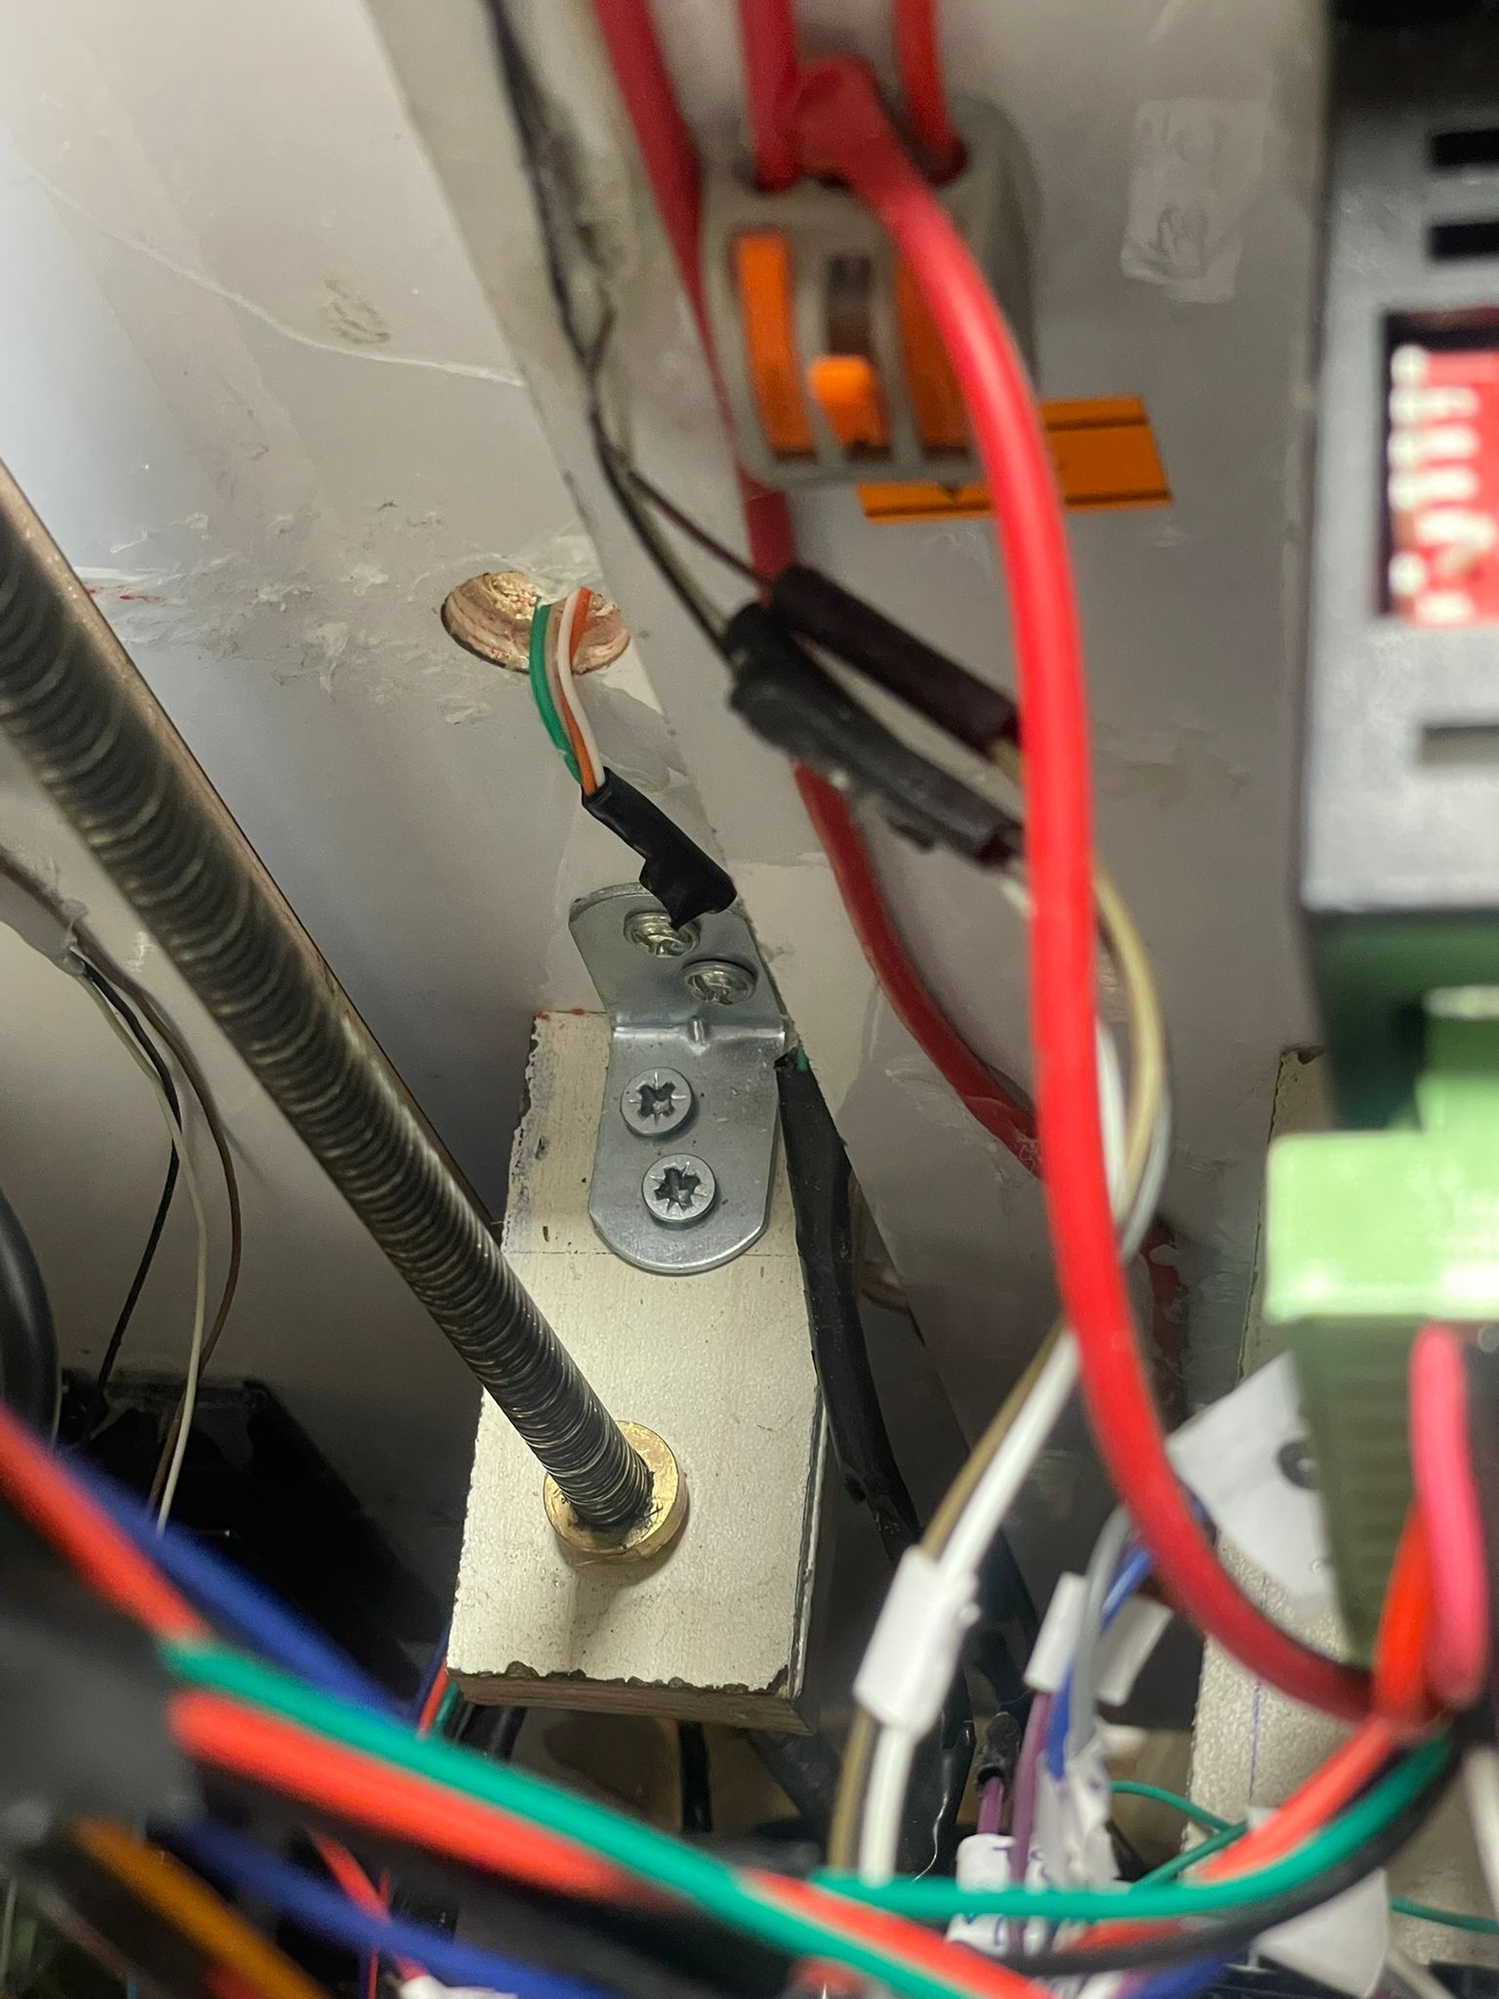
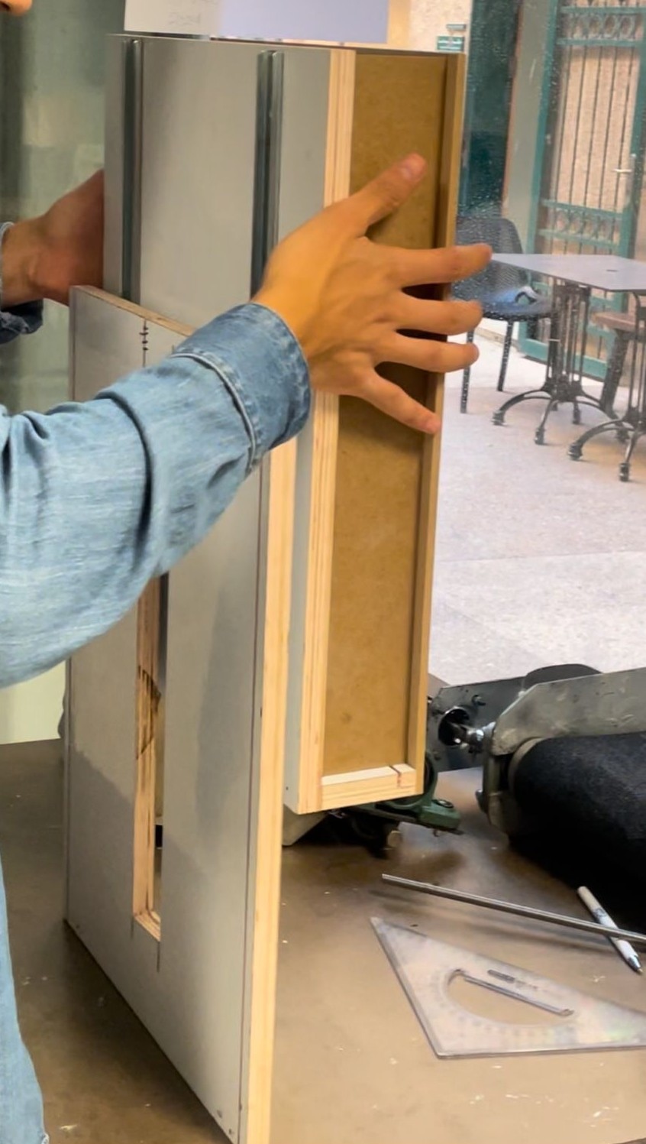
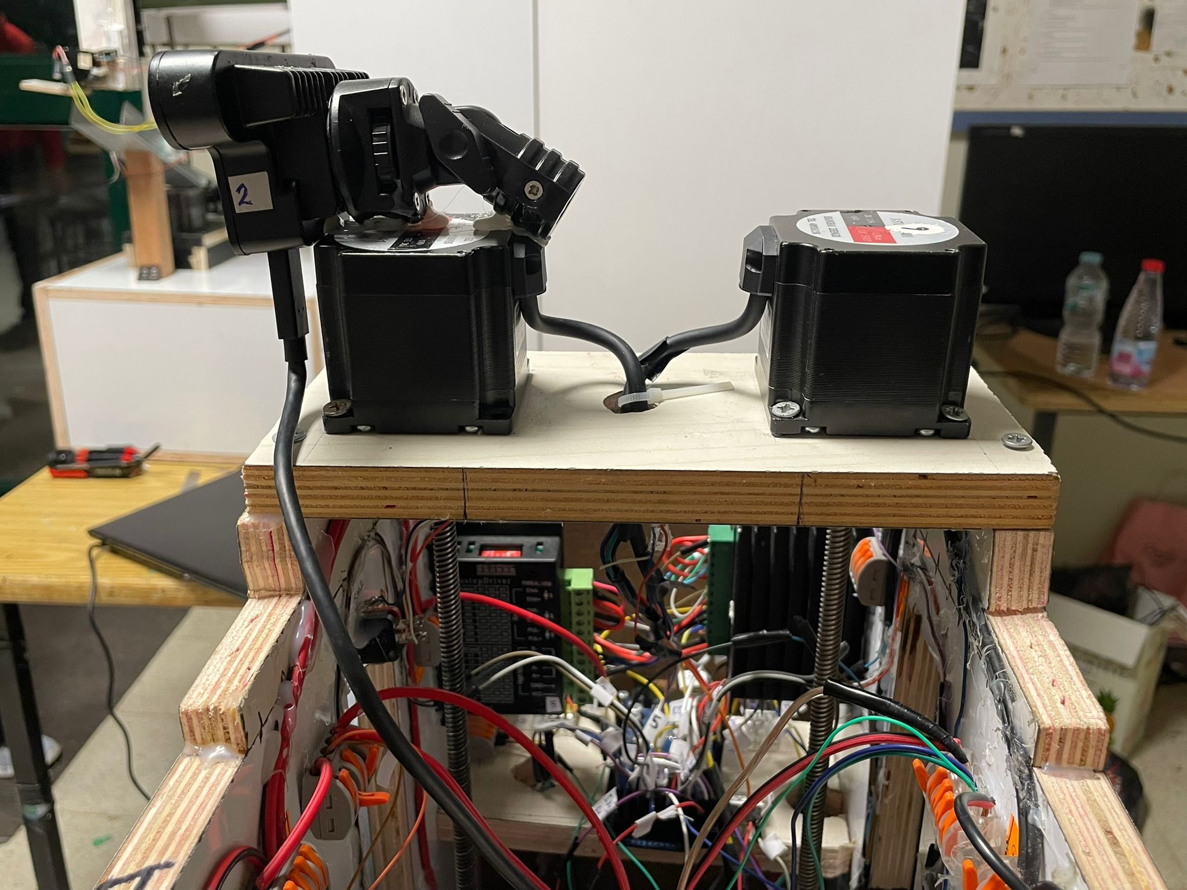
Up & down movement
Two Nema 23 connected with lead screw
Lead screws connected with both parts A & B
Part A & B connected to main part with sliders

Slide 20
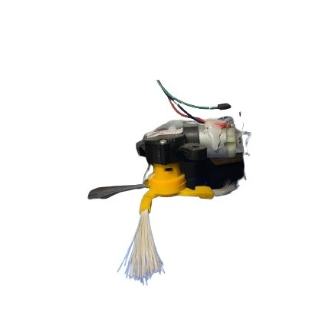
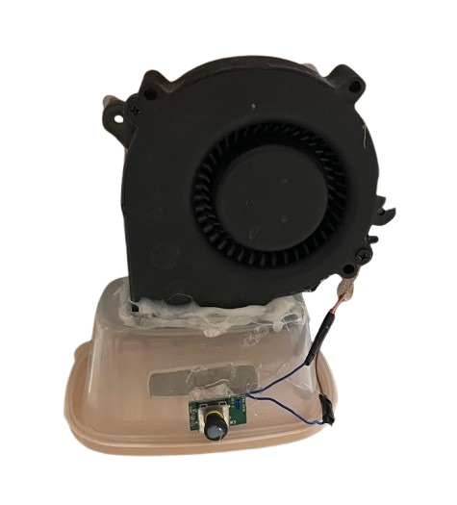
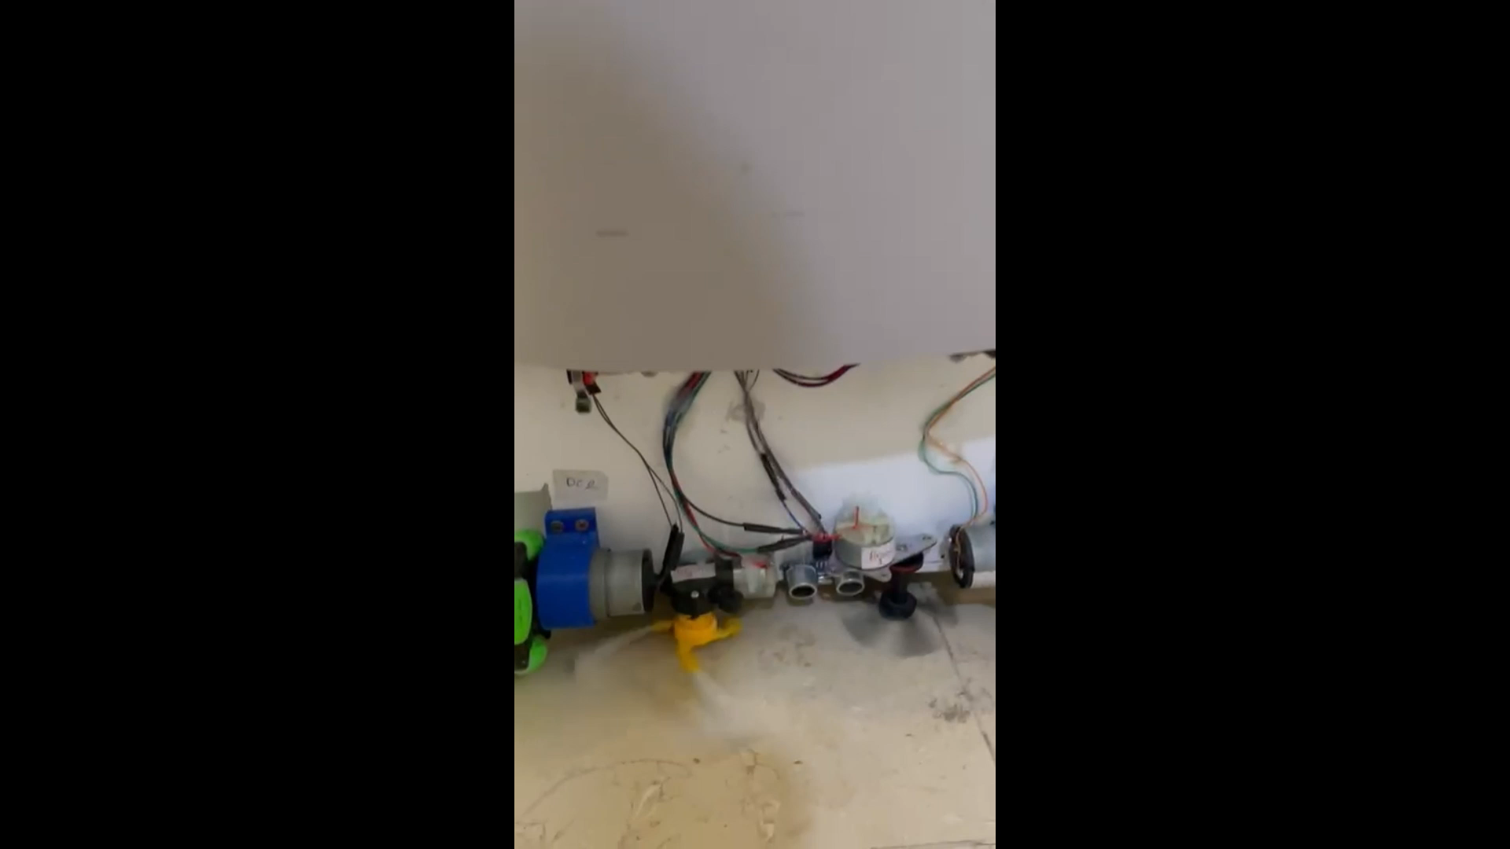
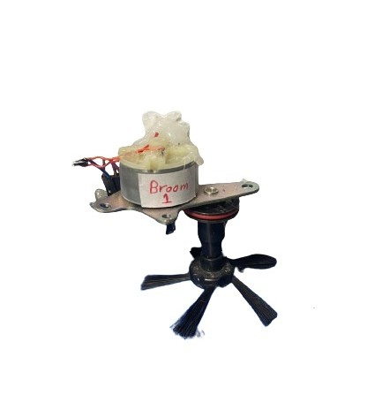
Second challenge:
Cleaning

Slide 21
03
Constraints

Slide 22
Constraints
Cost Limitations
High Power Consumption
Heavy Weight

Slide 23
04
Future work

Slide 24
Future work
Smart Stair Navigation
Enhancing Cleaning System
Self-Emptying and Maintenance Features
Advanced AI Model for Obstacle Avoidance & Stair Recognition

Slide 25
Thanks!
Speed wake up we finished ! !
Do you have any questions?
💤💤💤💤

