Slide 1

Al-Najah National University
Building Engineering department
Design Of Cancer Center
Prepared by:-Asma Atout, Najah Zadah and Rana Johary
Supervisor: Dr.Monther Dwaikat

Slide 2
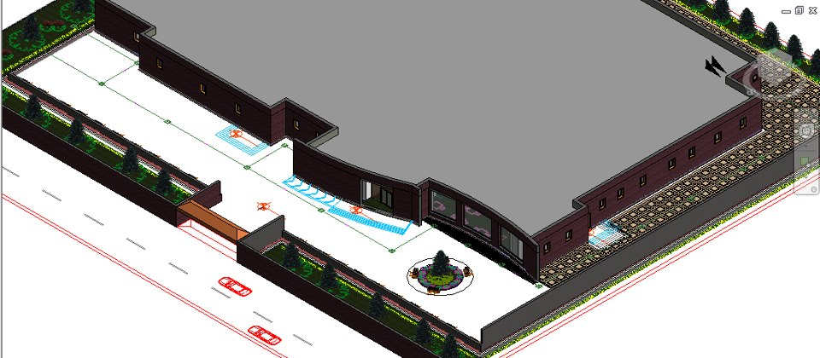
CANCER CENTER

Slide 3
Table of contents:
Introduction
Architectural design
Structural design
Environmental design
Mechanical design
Electrical design
Safety
Material Cost

Slide 4
Introduction
our project presents an integrative design for a cancer Center in the western region of Nablus city.
The design of the center depends on the plans of cancer hospital in Qatar by taking into consideration the new location conditions and the new area of the project to cover the demand of Nablus and its environs

Slide 5
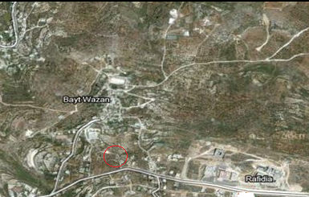
Proposed location:
The location of the project is on the road between Nablus and Qalqelia near Beitwazan.

Slide 6
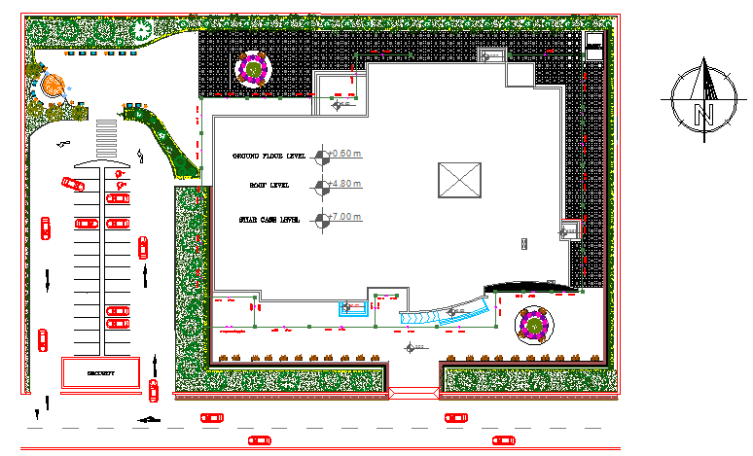
Site Plan

Slide 7
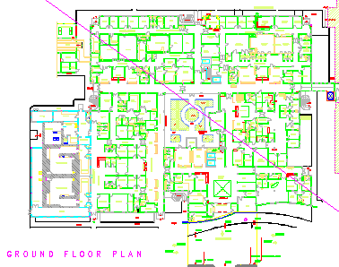
Original PROJECT

Slide 8
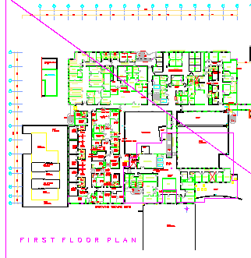
ORIGINAL project

Slide 9
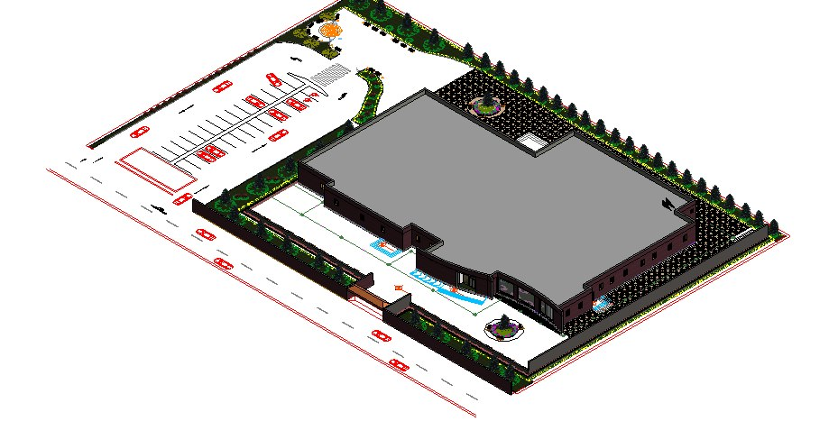
Proposed project:
The project consists of one floor .
The area of the project equals 2850m².
The structure designed with the possibility of future expansion in case of increased demand .

Slide 10
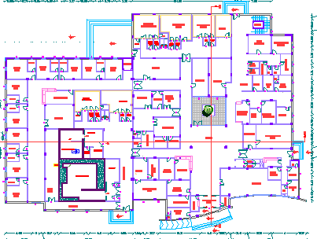
Architectural plan

Slide 11
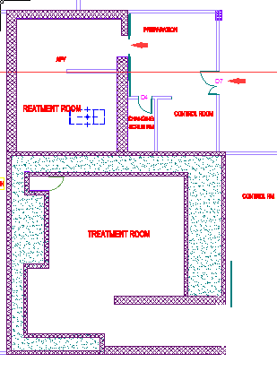
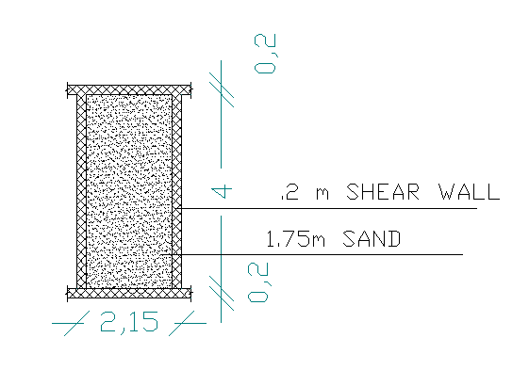
Radiotherapy room

Slide 12
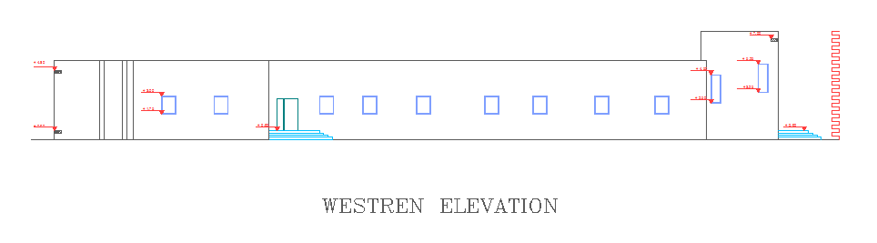
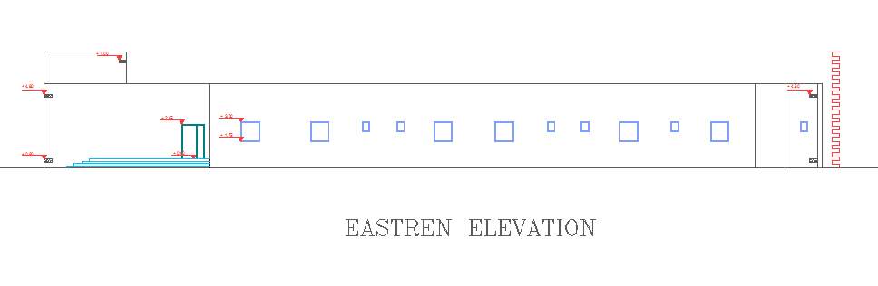
West elevation
East elevation

Slide 13
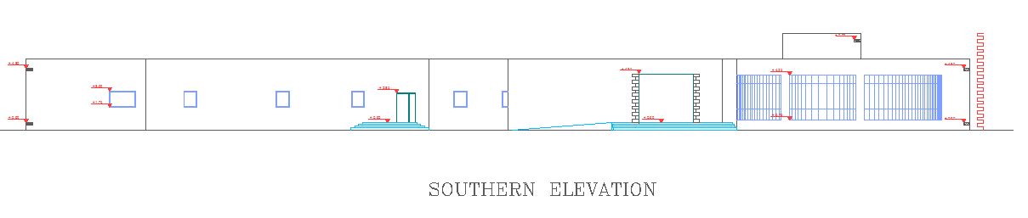
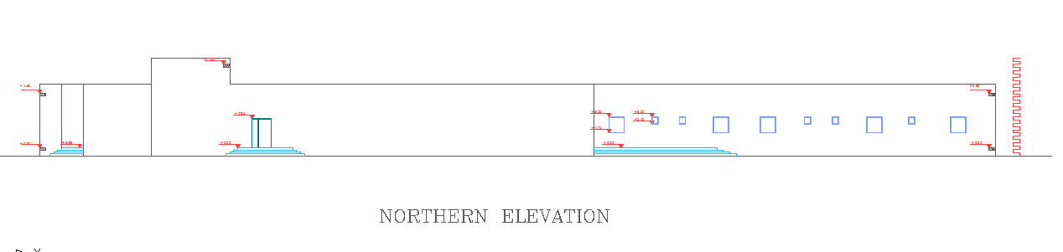
South elevation:
North elevation

Slide 14
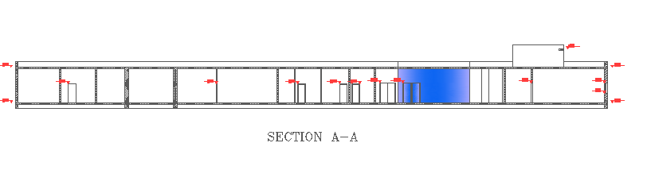
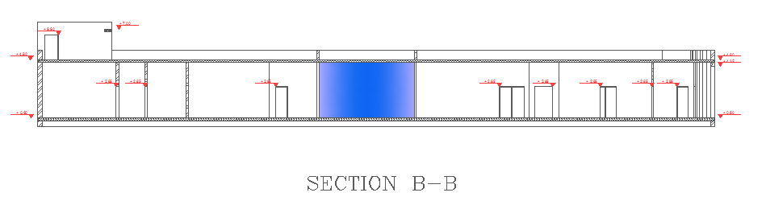
Sections

Slide 15
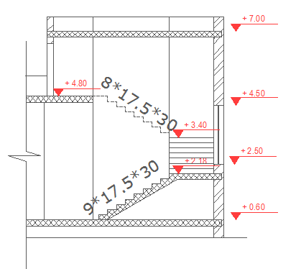
Section in stair

Slide 16
Structural design
Codes and specifications:
ACI -318-08
UBC (1997)
ASCE 07 (2010)
Software:
SAP 2000, V14.2.2

Slide 17
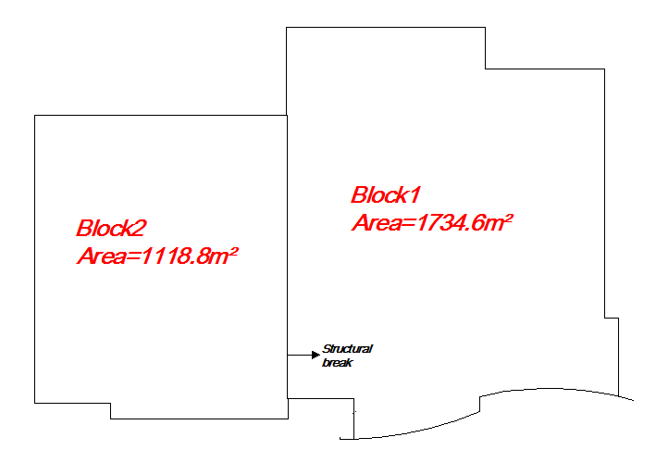
Project description:
-The project consists of two block separated by 5cm structural joint.
  -Structural system→Two way solid slab with drop beams

Slide 18
Materials Properties
Soil bearing capacity is 300kN/m²
Soil Type is SB
Reinforcement Steel Yielding Stress fy = 420 MPa
Concrete Compressive Strength f’c = 28 Mpa

Slide 19
LOADS:
1- Dead load consist :
  Own weight for building come from weight of (beams, columns , slabs, wall).
  Superimposed come from a weight of back fill and tiles = 5KN/m².
2- Live load equal 4Kn/m² .
3- Seismic design load:
Importance factor=1.2
Soil class: SB
Seismic coefficient Cv=0.2
Seismic coefficient Ca=0.2
R=4.5

Slide 20
DESIGNED ELEMENTS
Footings (Isolated, strap, Shear wall footing,).
Columns.
Beams.
Slabs.
Shear wall.
Stairs.

Slide 21
Preliminary design
Slab:
L/B < 2 → Two way slab
By using the Direct design method we found that the thickness of slab equals 20cm.
Solid slab.
Columns:
We calculated Ag of the columns by using the following equation:
Ag= Pu/0.65*0.8* (0.85*F’c*(1-ƿ) + (ƿ+fy)
All columns have the same dimensions 30*60cm.

Slide 22
Preliminary design
3- Beams:
Drop beams.
Width=30cm
Depth=60cm
4- Tie beams:
Width=35cm
Depth=50cm

Slide 23
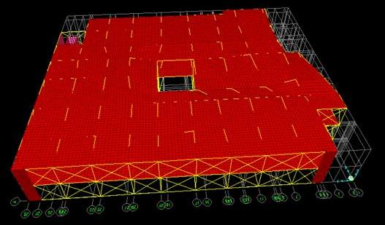
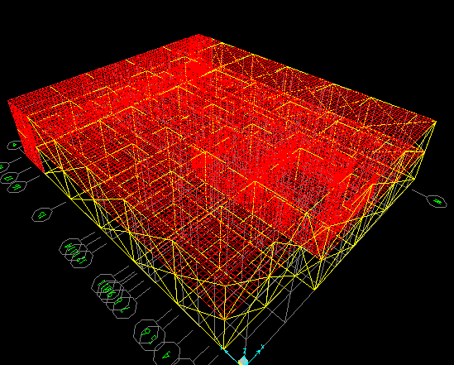
3d Sap model
Block 1
Block2

Slide 24
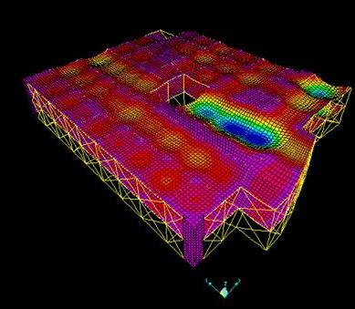
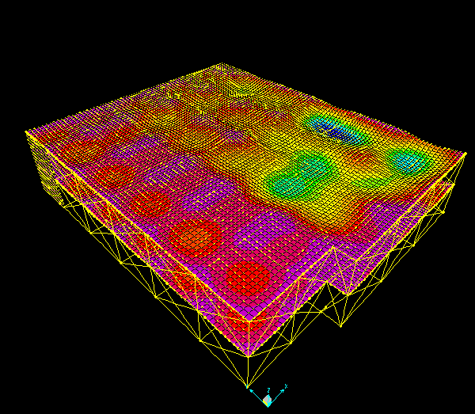
Model validation
Compatibility check
Block 1
Block2

Slide 25
Model Validations
2-Equilibrium check:
For block 1:
Loads | SAP | Manual | Error%
Dead Load | 55357.8 KN | 56439.4 KN | 1.9%
Live Load | 13953.5 KN | 13962.9 KN | 2.7%
And we did the same check for block2 and it was ok the error less than 5%.

Slide 26
Model Validation
3- Local equilibrium check (internal loads):
Columns:
The difference between SAP and manual loads on columns:
Columns no. | Load from SAP | Manual load | Difference
6 | 1104 | 1156 | 4.7%
Beams:
Beam no. | Moment from SAP(KN.m) | Manual moment | Difference
59 | 279 | 275 | 7.7%

Slide 27
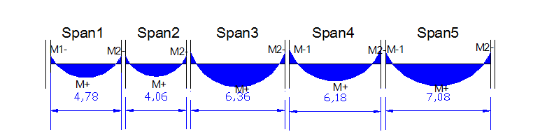
Model Validation
Slab:
Span 2 | SAP moment | Manual moment | Difference
C.S | 128 | 116 | 10%
M.S | 11 | 35 | 60%

Slide 28
Dynamic model checks
T(manual)=ct* h(3/4) Where: Ct =0.0488 &h=8m
V= (Cv*I/R*T)*W
 | Period | Earthquake forec (V)
SAP | 0.29 sec | 7900
Manual | 0.23 sec | 9900

Slide 29
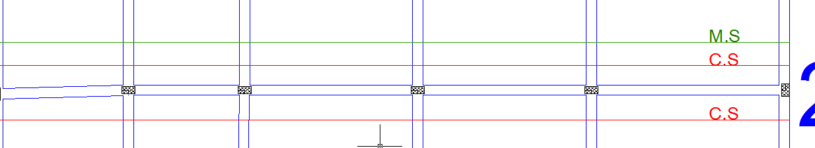
Design
Slab design:
The slab is two way solid slabs with 20cm thickness and we designed the slabs in two directions (X and Y direction) for each column strip and middle strip, we took the values of moments from SAP then we calculated the area of steel required and the number of bars.

Slide 30
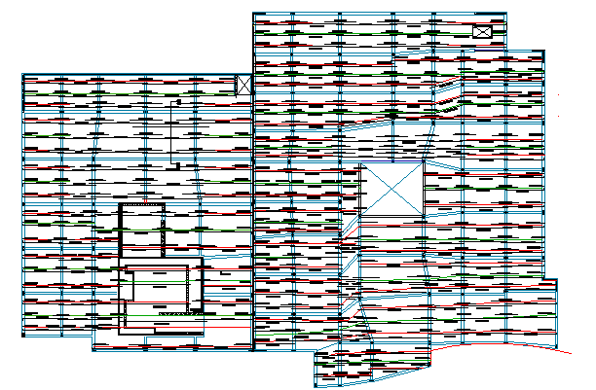
Slab reinforcement in X-direction

Slide 31
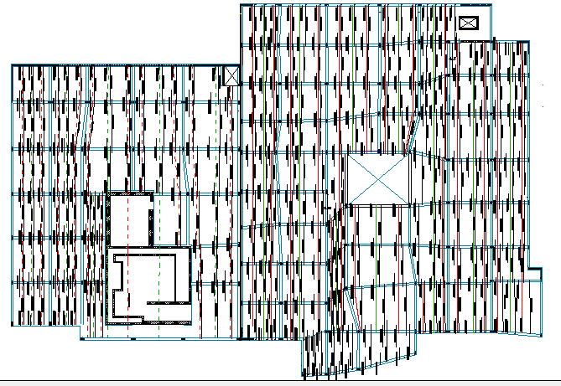
Slab reinforcement in Y direction

Slide 32
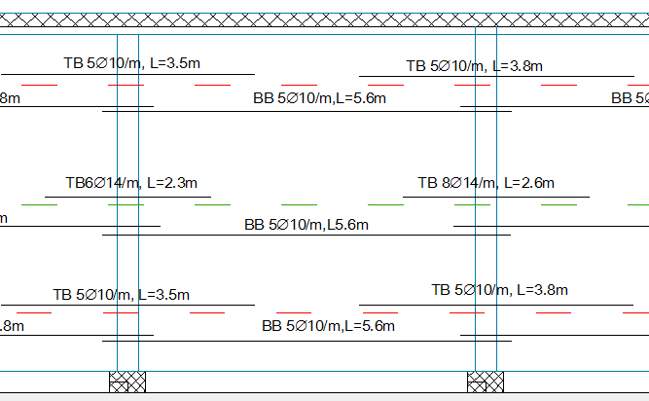

Slide 33
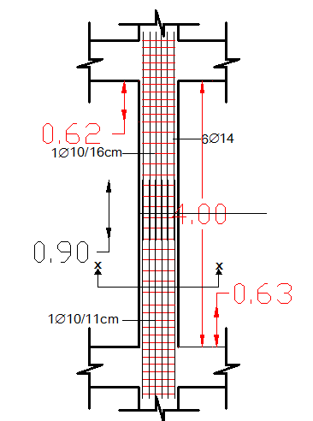
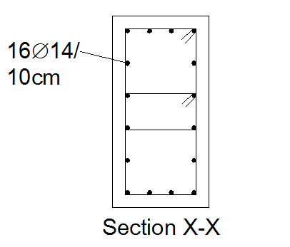
Design
Column | Dimensions | Long reinforcement | Stirrup at edge | Stirrups at middle
C1 | 30*60cm | 16Ø14 | 1Ø10/11cm | 1Ø10/16cm

Slide 34
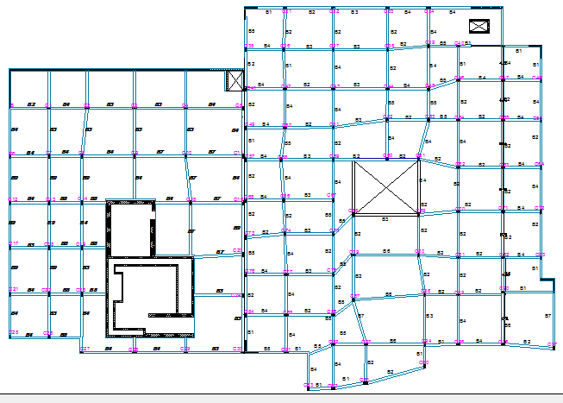
Beams plan

Slide 35
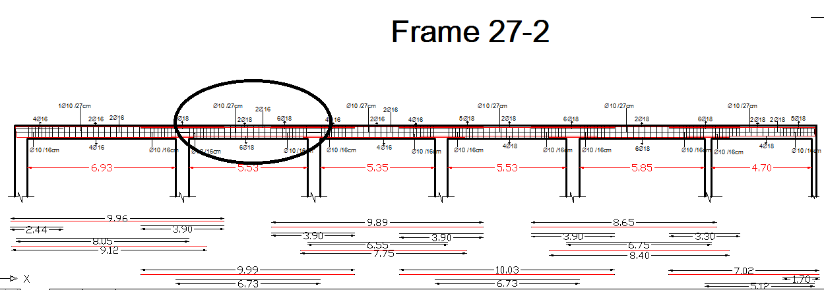
Beams reinforcement

Slide 36
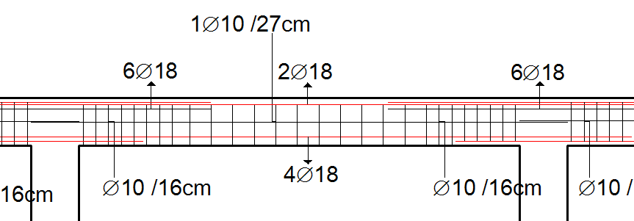
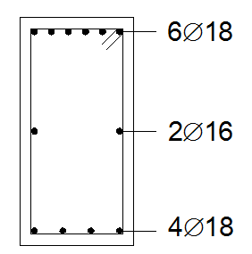

Slide 37
Footings design
Footing | Type | Dimensions (m) | Depth(m) | Short direction steel | Long direction steel
F1 | Isolated | 1.5*2 | 0.65 | 6Ø16/m | 6Ø16/m
F2 | Isolated | 2*2 | 0.65 | 6Ø16/m | 7Ø16/m
F3 | Isolated | 2*2.5 | 0.65 | 6Ø18/m | 6Ø20/m
F4 | Isolated | 1*2 | 0.65 | 8Ø22/m | 6Ø16/m
F5 | Strap | - | 0.65 | - | -
F6 | Wall Footing | - | 0.6 | 10Ø20/m | 7Ø20/m
F7 | Wall Footing | - | 0.6 | 10Ø20/m | 7Ø20/m
F8 | Wall Footing | - | 0.25 | 4Ø16/m | 8Ø18/m
F9 | Wall Footing | - | 0.25 | 5Ø12/m | 5Ø12/m

Slide 38
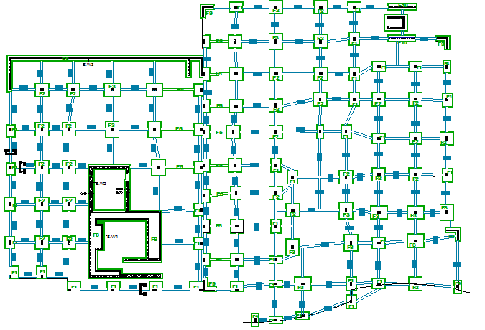
Footings

Slide 39
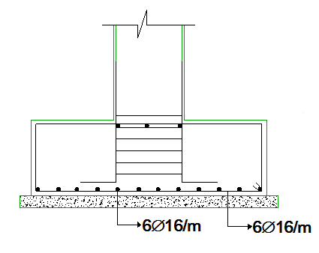
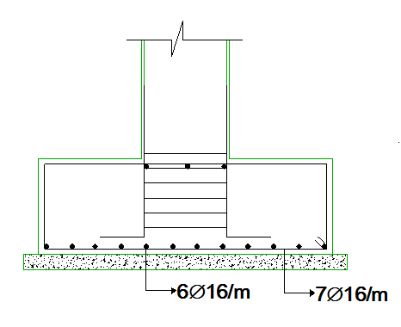
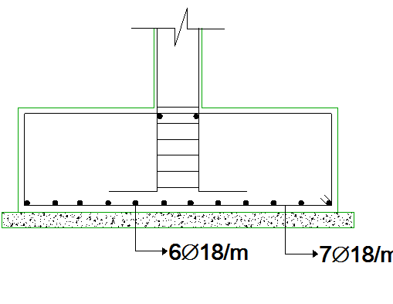
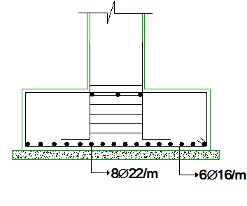
Footings
F1
F2
F3
F4

Slide 40
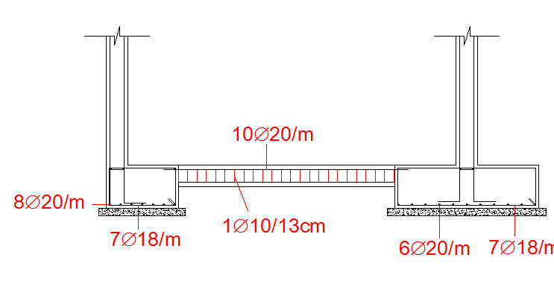
Footings
F5

Slide 41
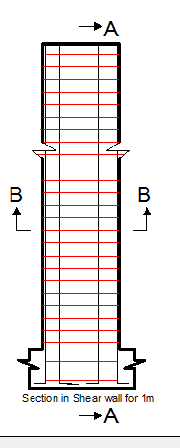
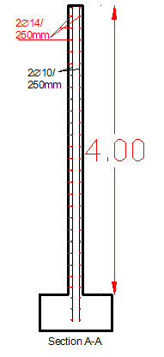
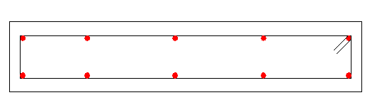
Shear wall
Sec A-A
Sec B-B

Slide 42
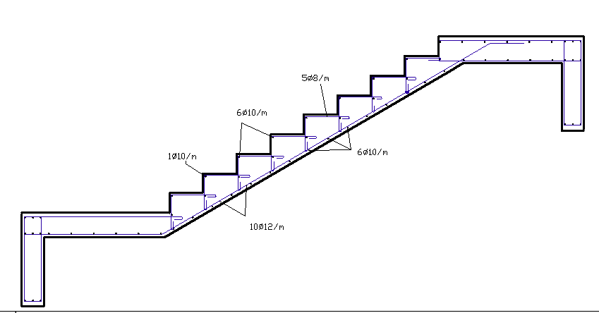
Stair

Slide 43

Environmental Design
Codes and specifications:
Energy Efficient Palestinian Building Code
Software:
Autodesk Ecotect Analysis, 2011

Slide 44
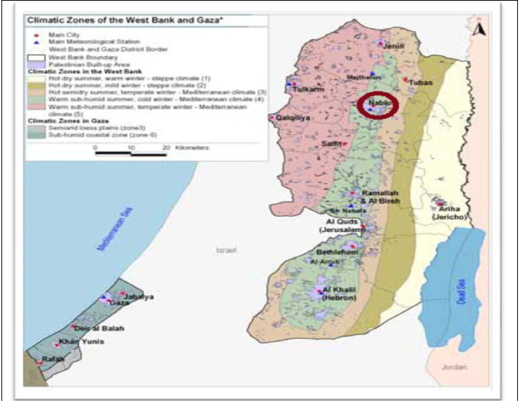
Project climate zone
The project located in Nablus ‘’Zone3’’

Slide 45
Climate data for Nablus
Month | Jan | Feb | Mar | Apr | May | Jun | Jul | Aug | Sep | Oct | Nov | Dec | Yearly
Average High C◦ | 11.7 | 13.3 | 16.1 | 21.1 | 25 | 27.8 | 28.9 | 28.9 | 27.8 | 25 | 18.9 | 13.9 | 21.5
Average low C◦ | 3.9 | 4.4 | 6.1 | 9.4 | 12.2 | 15 | 17.2 | 17.2 | 16.1 | 13.9 | 9.4 | 5.6 | 10.8
Precipit-ation (mm) | 142.2 | 114.3 | 99.1 | 30.5 | 2.5 | 0 | 0 | 0 | 0 | 22.9 | 68.6 | 109.2 | 580

Slide 46
Facilities Used to Achieve Environmental Design
We have a core in our building give the intermediate region natural lighting and ventilation .
In the southern facade there is a glass part, so we use a pergola permit to enter the winter sunlight and prevent it from entering summer.

Slide 47
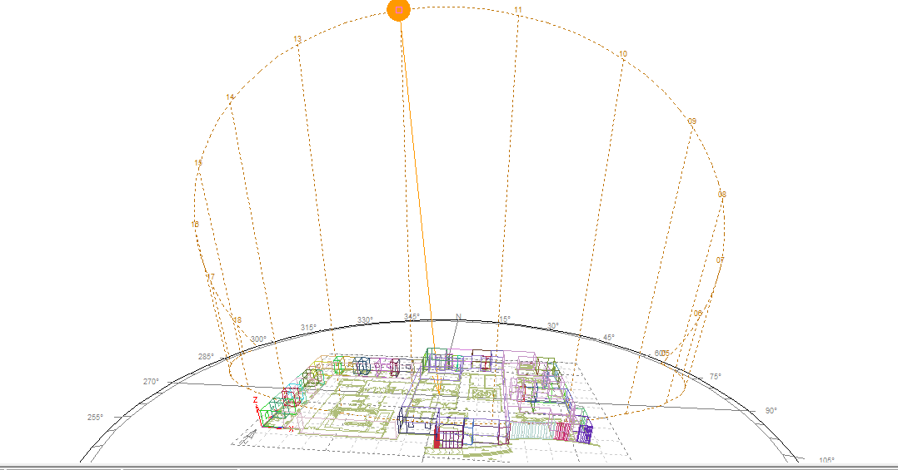
Sun path on the building at 21 July

Slide 48
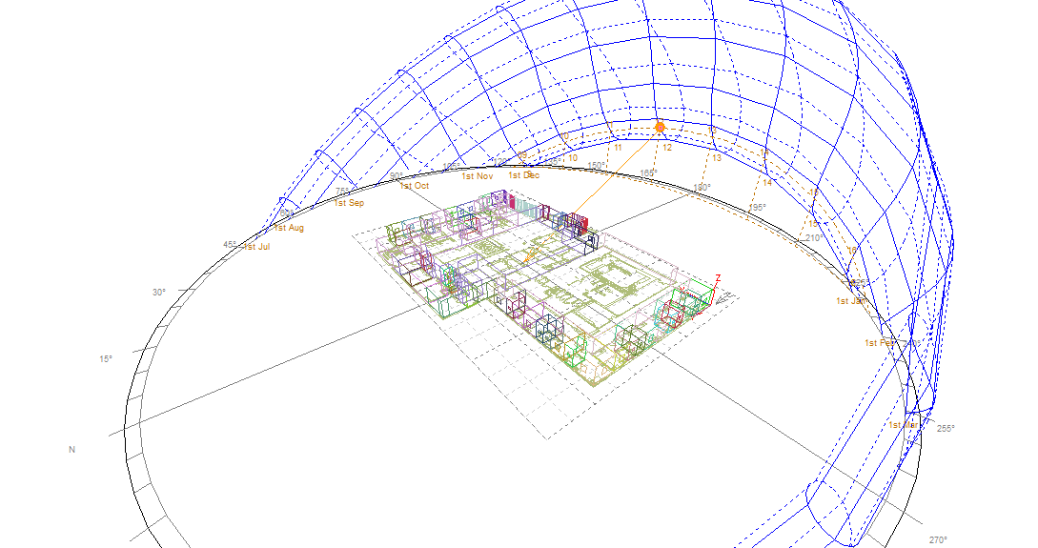
Sun path on the building at 21 January

Slide 49
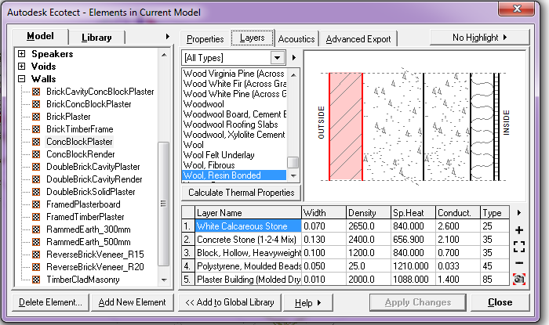
Thermal insulation
The external wall section:

Slide 50
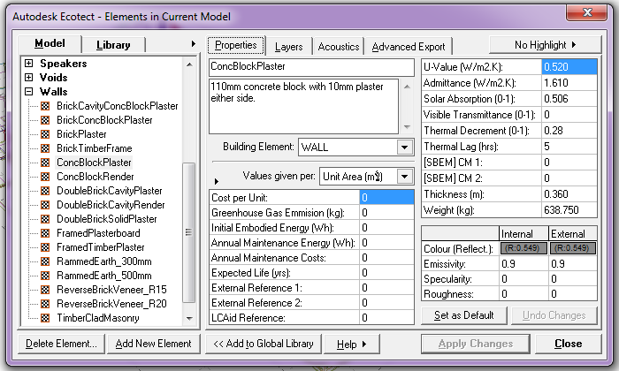
Thermal insulation
U value of external wall section:

Slide 51
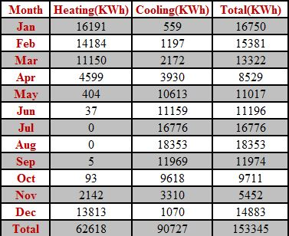
Thermal Insulation
Simulation the Model with insulation:
1.Heating and Cooling Loads With Insulation

Slide 52
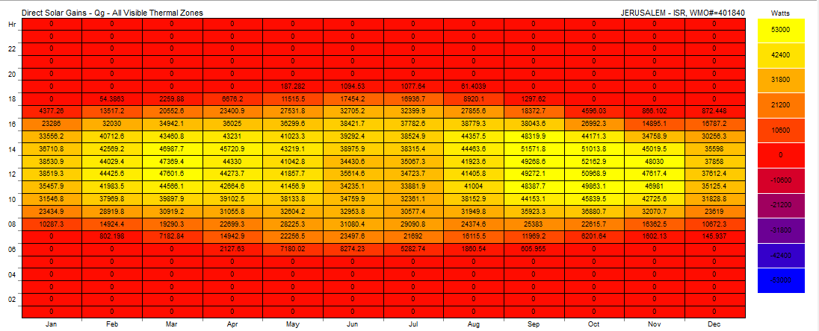
Thermal Insulation
Simulation the Model with insulation:
2. Direct Solar Gain With Insulation

Slide 53
Acoustical design
Performance requirements for airborne sound insulation range from 43 dB Rw to 53 dB Rw depending on the location of the rooms within the building.
We designed the center by taking into account two soundproofing problems which are:1- improve the sound within a room, and 2- reduce sound leakage to /or from adjacent rooms or outdoors.

Slide 54
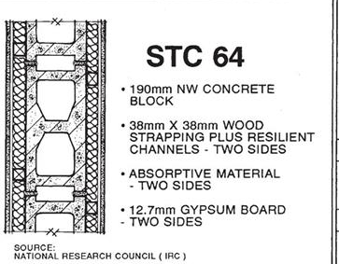
Section in partition

Slide 55
Mechanical design
Content:
Code & Specifications:
Water Supply system.
Rain water
Drainge system
HVAC system
ASHREA 2009

Slide 56

Water supply system

Slide 57

Water supply network

Slide 58

Water supply
Water pumping system

Slide 59


Rain water

Slide 60

Drainge system

Slide 61

Drainge system
For One zone:

Slide 62

HVAC system

Slide 63
Electrical design
Codes and specifications:
NEC 2008
Software:
Ecotect
Dialux

Slide 64
Electrical design
Lighting Design.
power Design
Distribution board calculation.

Slide 65
Artificial lighting:
Luminance needed for some functional room at work plane in the center:
Type of room | Luminance at work plane (lux)
Treatment rooms | 1000
Offices | 500
Reception | 500
Waiting areas | 200
Corridors | 150
Surgeries rooms | 500
Examination rooms | 300
Laundry | 300
Cafeteria | 100
Bathrooms & WC’s | 100
Conference rooms | 750
Stores | 100
Stairs | 100

Slide 66

Lighting plan

Slide 67


Lighting
Patient room
Cafeteria

Slide 68

Sockets distribution:

Slide 69

Main distribution board

Slide 70



Slide 71


Safety DESIGN
Fire protection:
Types of systems that are warning to a fire:
Smoke-detection alarm.
Heat-actuated alarm.
Automatic water-sprinkler.
Automatic chemical extinguishing.

Slide 72


Manual Fire Alarm Automatic Fire Alarm
Fire Protection

Slide 73

Design of Fire Protection
Sprinklers for rooms.
Fire Extinguishers and Fire Hoses for corridors and halls.

Slide 74

Sprinklers distribution

Slide 75

materials cost – Structural design

Slide 76

1200000

Slide 77


