Slide 1

Real Estate
Khawla jayousi
Dr. Husaam A. Halim

Slide 2
Motivation
Nowadays all the world's trends towards modern technology are growing every day, including many topics, the most popular topic is the display and sale of goods.

Slide 3
Outline
Objective.
Introduction.
What we are used.
Features.
Stages.
Project Scope.
System diagrams.
Future work.

Slide 4
Objectives
Real estate information organization
View all properties
Ease of searching for a property
Show different options

Slide 5
Introduction
The Real Estate system includes different types of real estate and their details and facilitates the communication process between the owner of the real estate office, the seller and the buyer.

Slide 6
What we are used
React framework code.
HTML/CSS.
SQLite Studio Database.
Express js.

Slide 7
Features
Types of real estate
Real estate office owner details
Property details
Real estate search
Contact the owner of the real estate office

Slide 8
Stages
Data collection.
Define the system requirement.
Design interface for the system.
Implementation.
Testing.

Slide 9
Project Scope
The real estate system includes two main types of users :
    1. the owner of the real estate office
    2. customers

Slide 10
System diagrams
System architecture
System diagram.
Sequence diagram.
Data flow diagram.

Slide 11
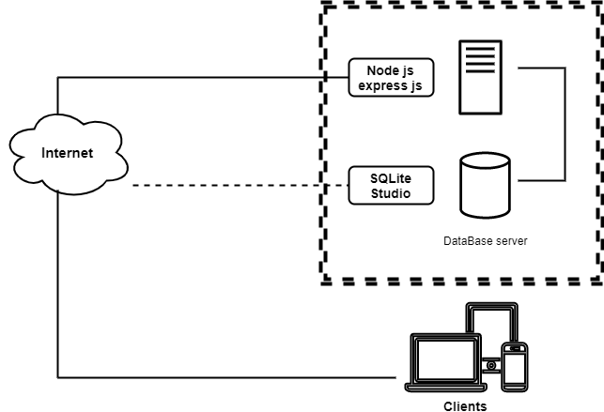
System architecture

Slide 12
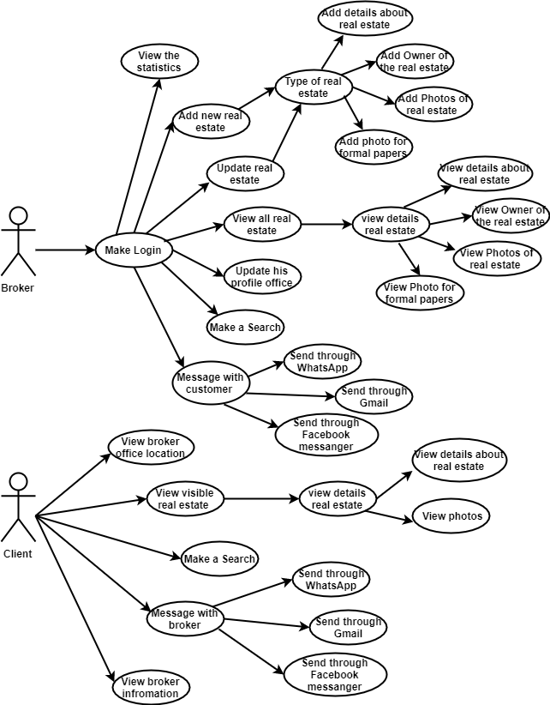
    Use Case Diagram

Slide 13
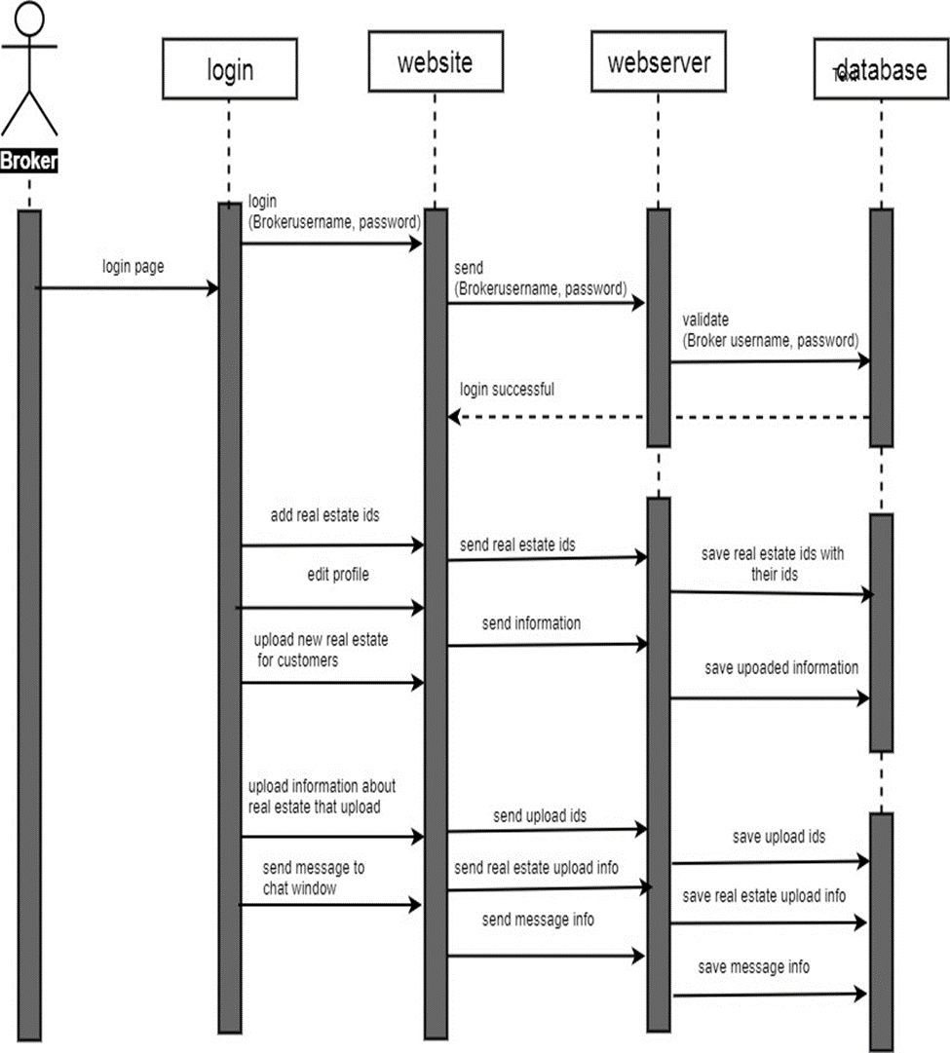
        Sequence Diagram
Sequence for Broker

Slide 14
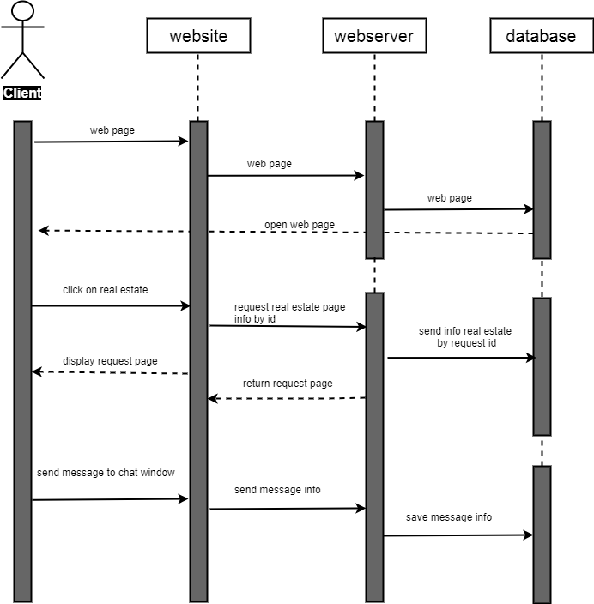
Sequence for Clients

Slide 15
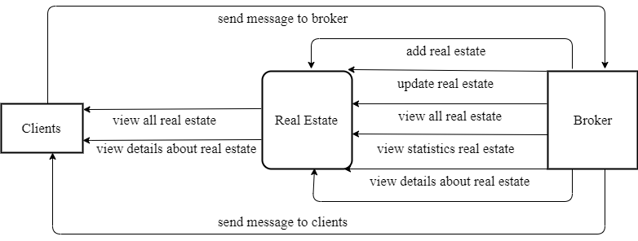
Data flow diagram

Slide 16
Conclusion
The Real Estate is designed to cover the needs of Broker and Clients that do not present in the current system.
depending on the broker' needs and in a way that facilitates the sale and buys process and communication between broker and customer.

Slide 17
Future Work
accepts a number of real estate office owners.
Merging a group of offices with the application and displaying their properties.
Add some data and corrections to the problems that appear when using the program.
The ability to reset the password when it is lost.

Slide 18
Thank you

