Slide 1

An-Najah National University
Chemical Engineering Department
Graduation Project
Modification and Testing the Performance of Floor Surface Cleaning Gel
Prepared by:
Azza Abu-Asab
Doaa’ Al-Shiekh
Ola Abdelhadi
Supervisor:
Prof.Amer El-Hamouz

Slide 2

Contents
1
Introduction
2
Goals and objectives
3
Methodology
4
Experimental Work
5
Results and Discussion
6
6
Conclusions and Recommendations

Slide 3

Introduction
This project is based on a previous project “ The Preparation of Palestinian Standard for Floor Cleaning Gel”.
The actual market volume is approximately 6700 tons per year.
Study Problem
The rapid increase in the cost of the pine oil.
There's no practical scientific method to test the performance of the gel.

Slide 4
Main Goals
Can we produce a cleaning gel with low cost and higher efficiency?!
Testing the performance of the gel using surface activity concept and standard tests

Slide 5
Objectives
1
Production of a gel in the lab by different pine oil concentration.
2
Modification of floor cleaning gel by adding abrasive materials and modifying the formula.
3
Finding and using a method to evaluate the cleaning efficiency and performance of the gel by using contaminated soil and determine the amount of contamination absorbed for each
Evaluate the cleaning efficiency and performance of the gel for contaminated soil tile using a straight line apparatus and the surface tension of cleaning gel solution.

Slide 6
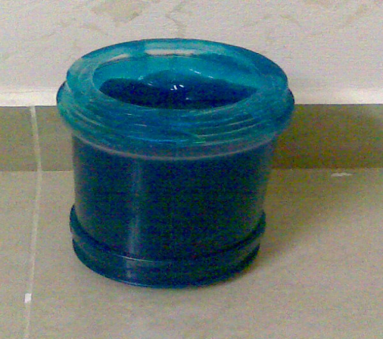
1
Questionnaire
5
Designing an apparatus to evaluate the cleaning efficiency
Txt in here
2
Methodology
Performing gel samples with abrasive material.
ThemeGallery is a Design Digital Content & Contents mall developed by Guild Design Inc.
4
New formula of cream cleaning product
3
Standard quality tests

Slide 7
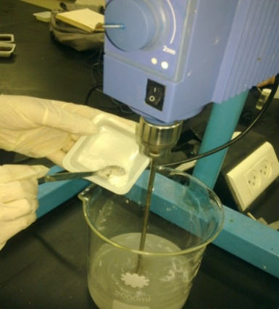
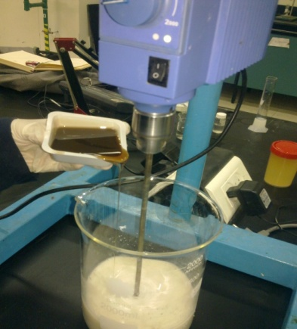
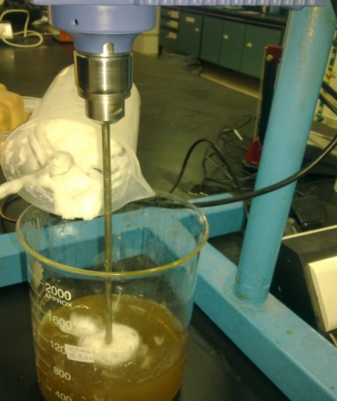
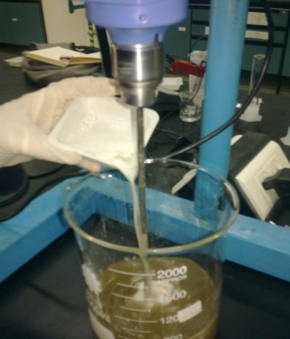
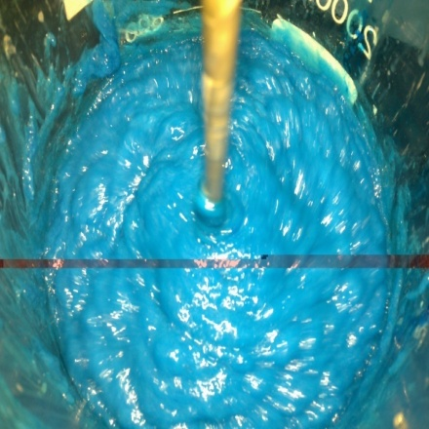
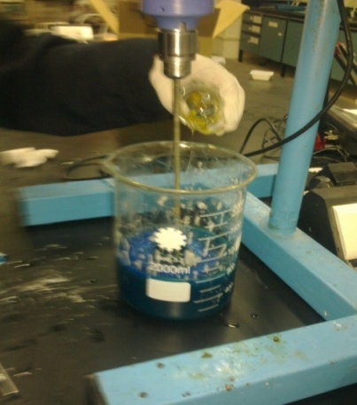
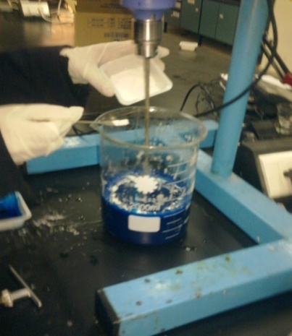
Experimental Work
Materials

Slide 8
Customer Concern
The results of the survey

Slide 9

The characteristics of the gel preferred by the consumer were in the following order :
High cleaning efficiency
1
2
Moderate to high foam volume
Moderate viscosity
3
4
Acceptable fragrant smell
5
Mild to the skin.

Slide 10
Results
Gel Preparation
Minimum number of experiments needed were 12 to get the most acceptable gel sample.The most important ones are as in the following table
Sample No. | Pine oil (Wt%) | Abrasive (Wt%) | CMC (Wt%) | Texapone (ETA) (Wt%)
1 | 5 | - | - | -
4 | 3 | 10 Sand | - | -
6 | 3.5 | 5 CaCO₃ | - | -
12 | 2.5 | 2.85 CaCO₃ | 0.5 | 1

Slide 11
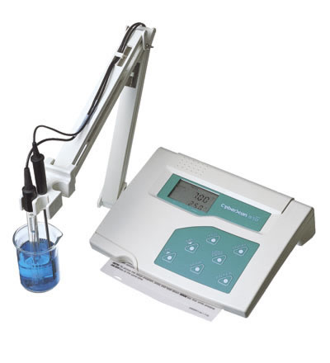
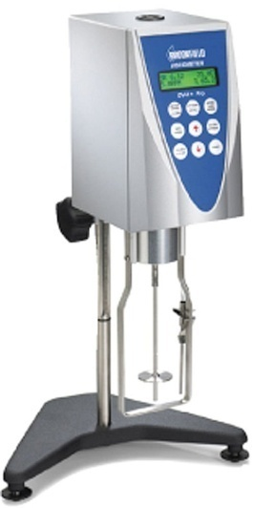

Standard tests
pH
viscosity
foam volume (shake volume test)

Slide 12
Results of measured viscosity, foam and pH tests
Results
Standard tests
Sample no. | Viscosity (cp) | Foam volume (mm) | pH
1 | 26000 | 40 | 6.5
4 | 25261 | 30 | 7.24
6 | 25219 | 30 | 6.88
12 | 32600 | 70 | 6.92
13(commercial) | 25712 | 65 | 6.85

Slide 13
Cost of the best sample in this project and in the a previous project
Results
Ingredient | Cost of one Kg of the ingredient (NIS) | Weight of ingredient of 1L sample of the previous project (g) | Weight of ingredient of 1L sample of this project (g) | Cost of 1L sample of the previous project (NIS) | Cost of 1L sample of this project (NIS)
LABS | 10 | 120 | 120 | 1.2 | 1.2
NaOH | 4 | 15 | 15 | 0.06 | 0.06
Pine oil | 35 | 25 | 50 | 0.87 | 1.75
CaCO₃ | 8 | 28.5 | - | 0.23 | -
CMC | 12 | 5 | - | 0.06 | -
ETA | 9 | 10 | - | 0.09 | -
Total cost |  |  |  | 2.51 | 3.01
The percentage of saving is about 17%

Slide 14


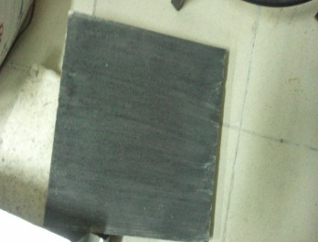
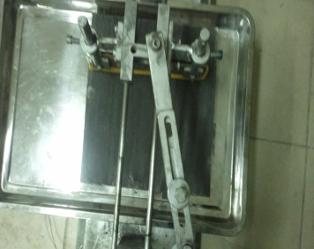
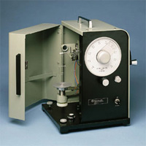
Testing the performance of gel using surface activity concept:
It was done according to the American Standard Testing Method (ASTM), ASTM D4488-95
Soil preparation
The soil was prepared by blending a melt vegetable oil, animal grease, and carbon black
.
Soil application
left for 24 hours at ambient temperature.
Cleaning test
Surface tension measurements

Slide 15
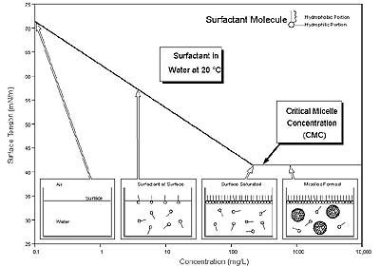
Results
Finding the “cmc” of the gel

Slide 16
In order to find the critical micelle concentration “cmc” of the gel, 14 samples of gel with different diluted concentrations in the range between 4*10⁻⁴ to 4 ml gels in 125 ml water were prepared

Slide 17

Pine oil concentration
commercial
1%
3.5%
2.5%
0.002:125
0.004:125
0.06:125
0.25:125
1:125

Slide 18
Results
Effect of time (cleaning cycles) on surface tension
Effect of time (cleaning cycles) on surface tension for the 2.5% pine gel/soil solution at different concentrations of gel

Slide 19
Results
Effect of pine oil concentration on surface tension
For a 5 cycles cleaning application

Slide 20
Results
Effect of pine oil concentration on surface tension
For 10 cycles cleaning application

Slide 21
Results
Effect of pine oil concentration on surface tension
For 15 cycles cleaning application

Slide 22



Conclusions and Recommendations
The concentration of the pine oil was reduced to a half of its value in the previous project (from 5wt% to 2.5 wt% )
.
A measurement of the critical micelle concentration ‘cmc’ of the gel was found to be 310 ppm
This work result of pine oil concentration is in line with the published data. Pine oil preferably in amount of up to( 0.01-2.5% by weight),
but most preferably in amount of between (0.75-1.5%) pine oil by weight
Germicidal Pine Oil Composition

Slide 23
Comparison of surface tension of prepared sample with a commercial gel sample was carried out. Results show that the surface tension measurements of the commercial one were less than that of other samples. Although, the commercial gel sample contains concentration of LABS lower than that used of our work.
What pine oil and other constituents’ concentration in the commercial sample is?

Slide 24
Recommendations
The New Recommended Recipe should include:
pine oil concentration of 1.5%.
New Recommended Recipe
pine oil solubilizing agent (5%)
viscosity promoter

Slide 25
Thank You!

