Slide 1
PV-Diesel Hybrid system with energy storage batteries: design, configurations and performance evaluation
Supervisor :Dr .Moien Omar
Prepared by:
Osama Salameh
Mohammad Ata

Slide 2
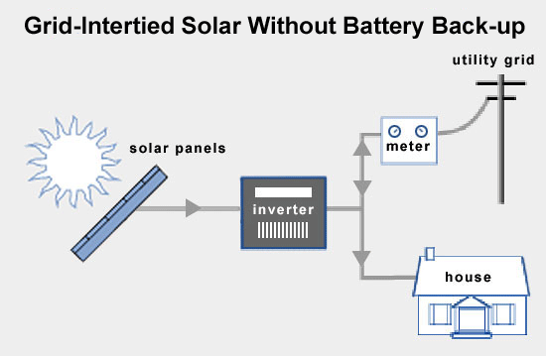
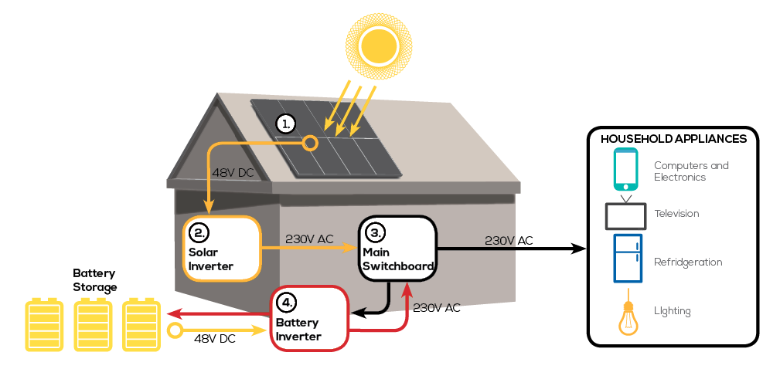
On Grid / Off Grid

Slide 3
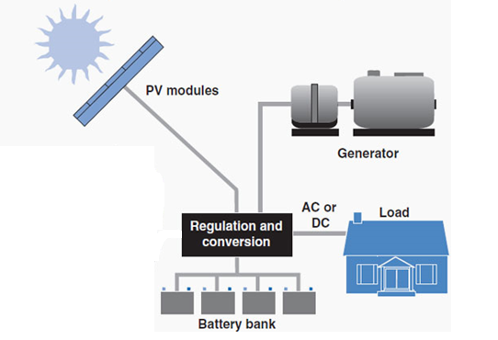
Hybrid System
As an off-grid power generation, the hybrid system offers clean and efficient power that will in many cases be more cost-effective than sole diesel systems. The renewable energy options have increasingly become the preferred solution for off-grid power generation .

Slide 4
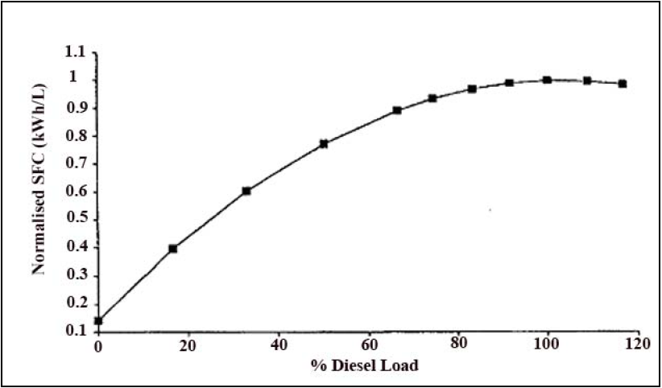
Diesel Generator
During periods of low loads, the diesel generator will be poorly loaded with the consequences of poor fuel efficiency and low combustion temperatures. The low temperatures cause incomplete combustion and carbon deposits (glazing) on the cylinder walls, causing premature engine wear. Therefore to avoid glazing we operate the diesel generator near its full rated power.

Slide 5
Sizing Off-Grid Systems

Slide 6
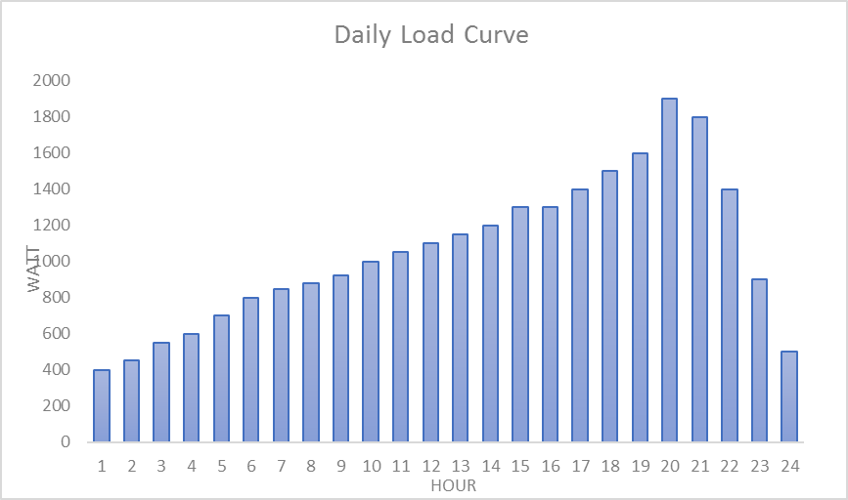
Daily Load Curve
The daily load curve describes the load behavior over 24 hours over the day, which will indicate the energy over the day that have to be covered from the PV system.
This case study was done for 4 houses (residential load), it describes the energy consumption per day for the houses.

Slide 7
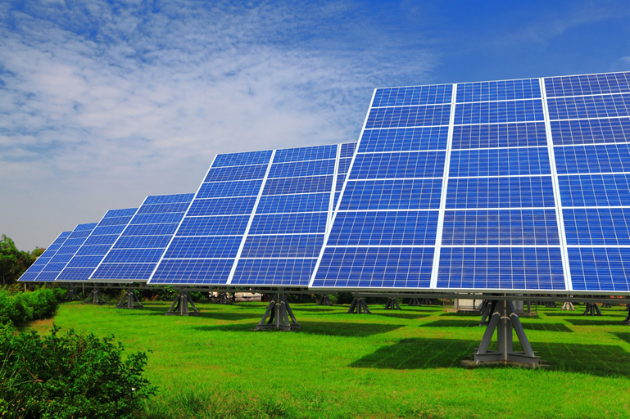
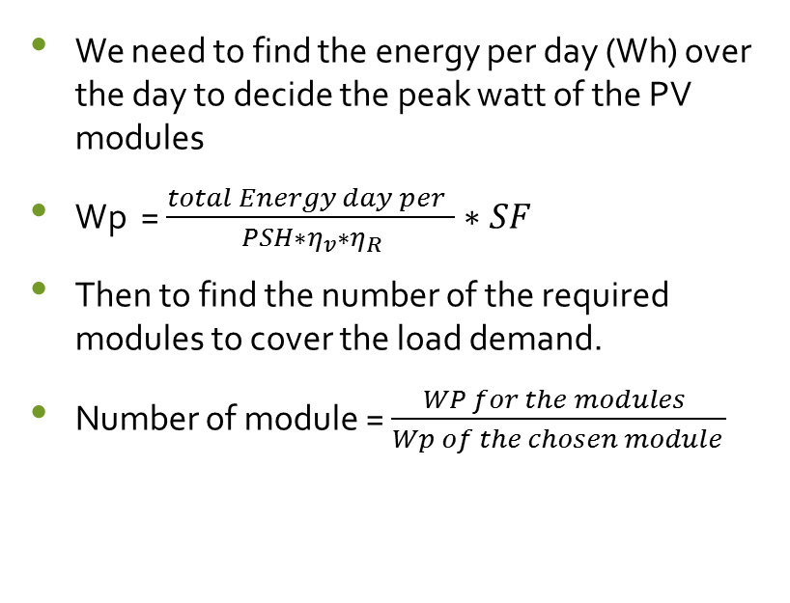
Solar Photo Voltaic Modules
We need to find the energy per day (Wh) over the day to decide the peak watt of the PV modules
Wp =$\frac{total Energy day per }{PSH∗η_{v}∗η_{R}}∗SF$
Then to find the number of the required modules to cover the load demand.
Number of module =$\frac{WP for the modules }{Wp of the chosen module }$

Slide 8
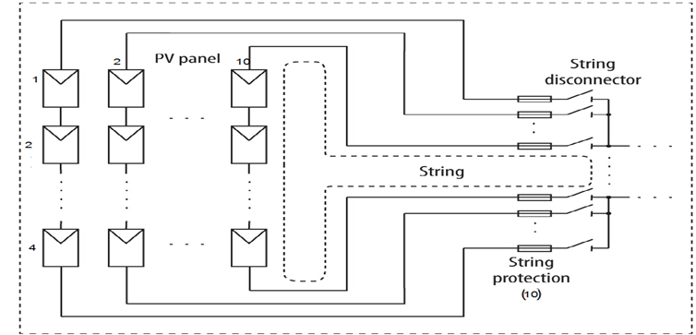
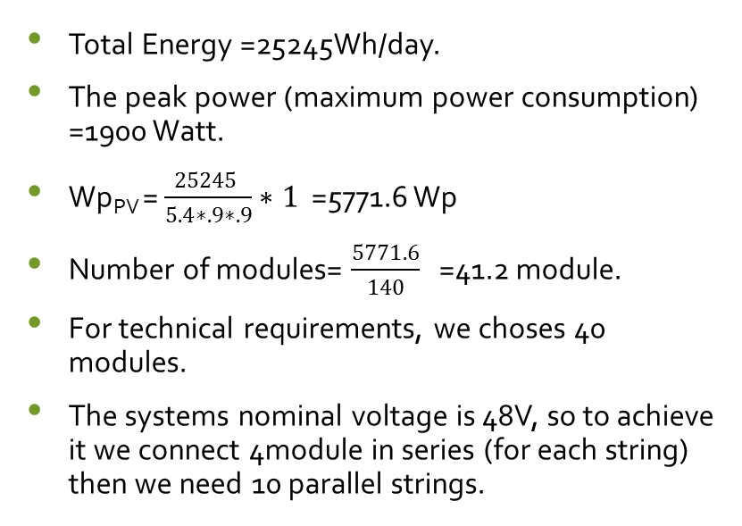
Solar Photo Voltaic Modules
Total Energy =25245Wh/day.
The peak power (maximum power consumption) =1900 Watt.
Wp_{PV} = $\frac{25245 }{5.4∗.9∗.9}∗1$ =5771.6 Wp
Number of modules= $\frac{5771.6}{140}$ =41.2 module.
For technical requirements, we choses 40 modules.
The systems nominal voltage is 48V, so to achieve it we connect 4module in series (for each string) then we need 10 parallel strings.
Voc system =88.4V.
Isc=83.5 A

Slide 9
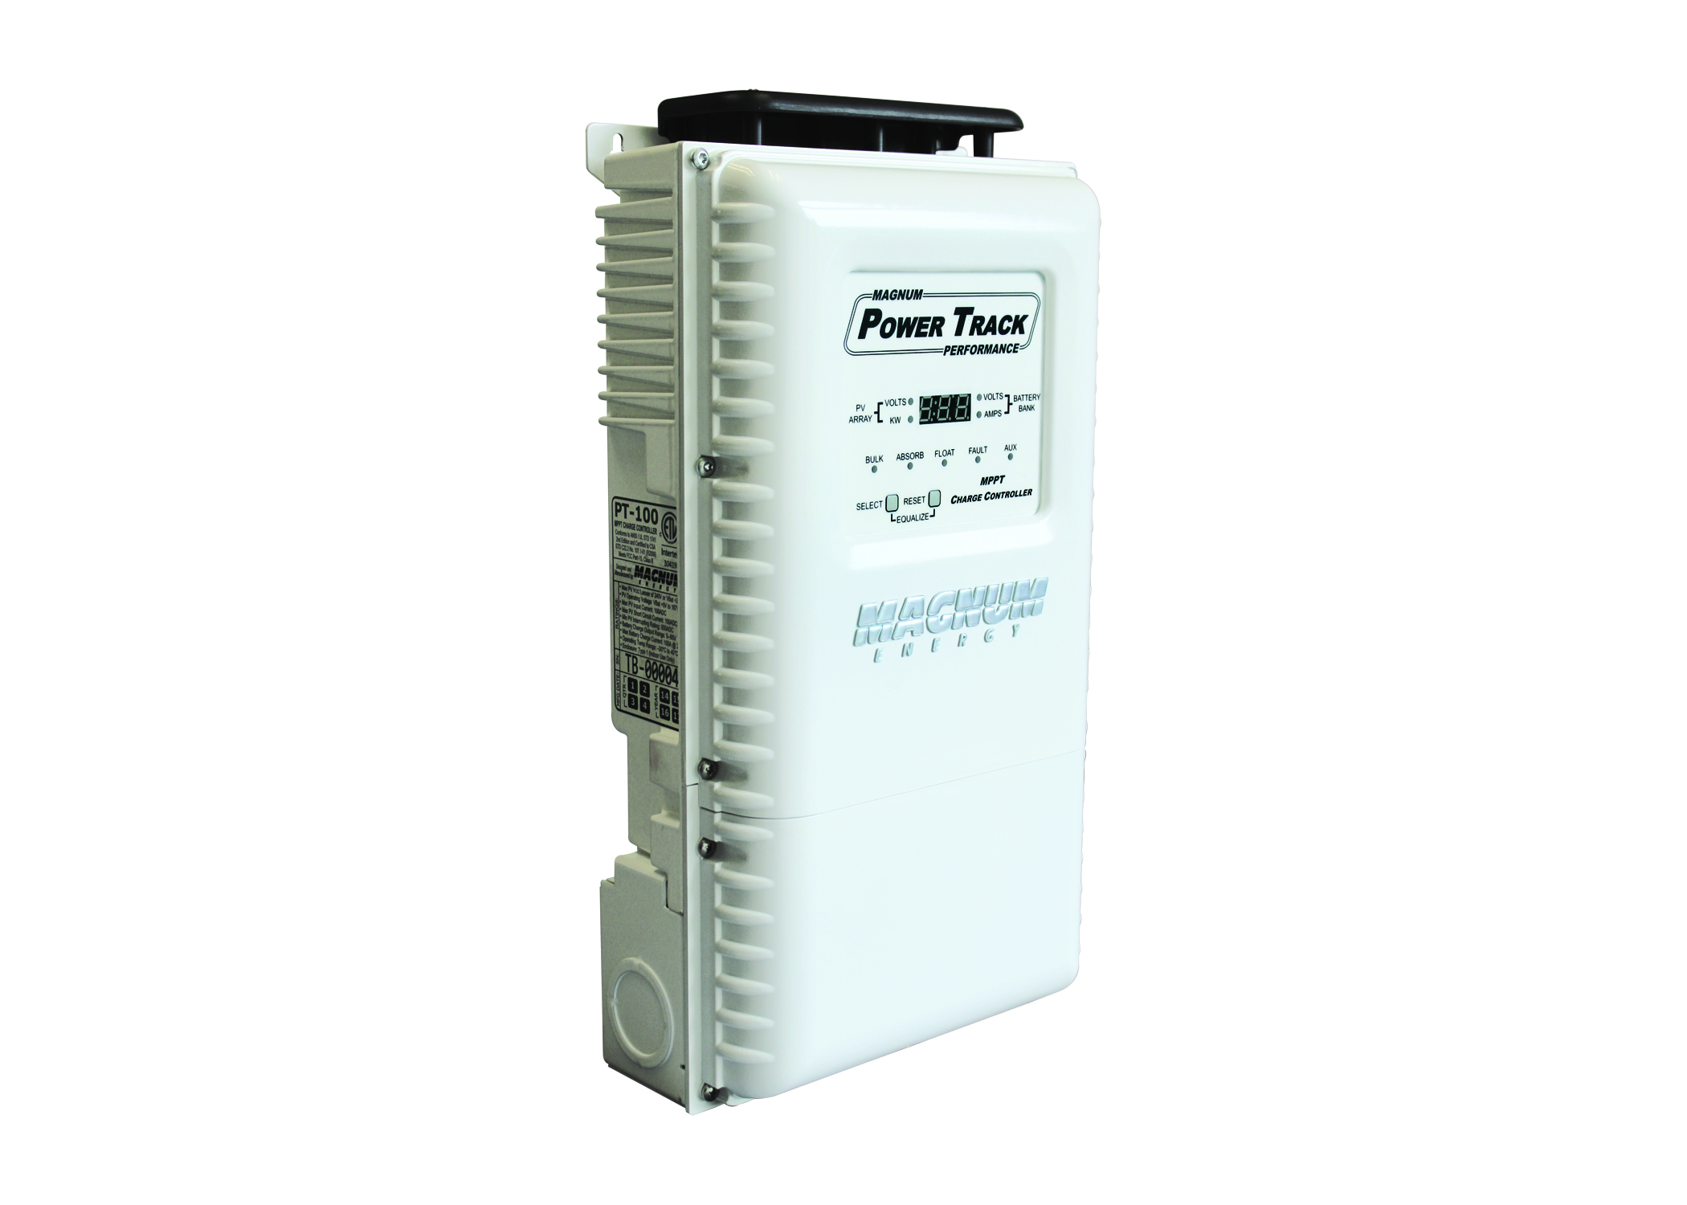
Charge Regulator Sizing
The charge regulator (DC -DC convertor) protect the battery from the deep discharge and overcharging that may protect against overvoltage. (PWM)and (MPPT), so to choose the appropriate regulator, you have to choose the type of regulator ,in fact the MPPT has 30% efficiency mare than PWM.
The charge regulator has to deal with currents until 100A DC(1.3*ISC ), this regulator has to has a 48 VDC output (to match the battery voltage.

Slide 10
Inverter Sizing
(DC -AC convertor), it converts the DC power generated from the PV or from the battery bank plant to the load. the voltage level (typically 230V-AC /50,60 Hz pure sine wave) as output voltage, and for the input voltage (typically the invertor coming with different DC level voltage 12,24,48V DC) which must match the nominal battery voltage used in the PV system. the rated power of the investor should be 1.25-1.3 times maximum load in the load curve for the most appliances exclude the motor or the bumping.

Slide 11
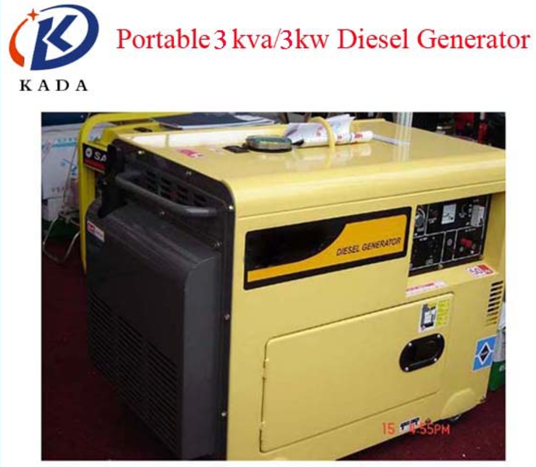
Diesel Generator Sizing
For the generator, it will be used as a reserve so you have to size it carefully to guarantee that it wouldn’t be oversized because it will case a lot of losses and limitation on the generator life’s hours. so, in our design the peak load 1900Watt and if we use the safety factor of 1.3 we get 2470W and we can approximate it for 3KW

Slide 12
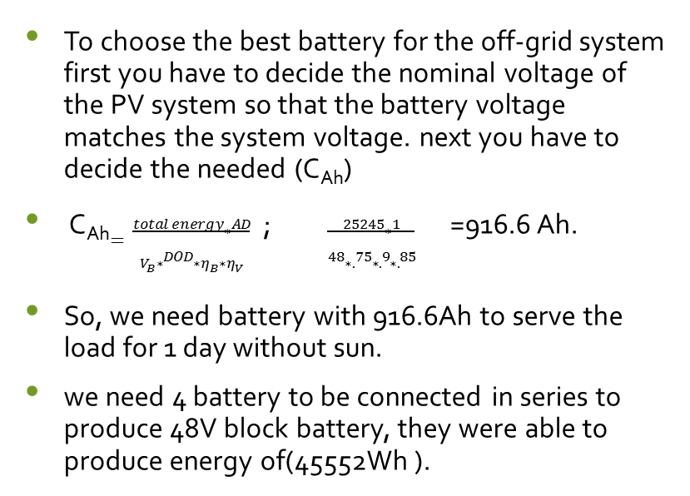
Battery Sizing
To choose the best battery for the off-grid system first you have to decide the nominal voltage of the PV system so that the battery voltage matches the system voltage. next you have to decide the needed (C_{Ah})
C_{Ah}$=\frac{total energy∗AD}{V_{B}∗DOD∗η_{B}∗η_{V}}$; $\frac{25245∗1}{48∗.75∗.9∗.85}$ =916.6 Ah.
So, we need battery with 916.6Ah to serve the load for 1 day without sun.
we need 4 battery to be connected in series to produce 48V block battery, they were able to produce energy of(45552Wh ).

Slide 13
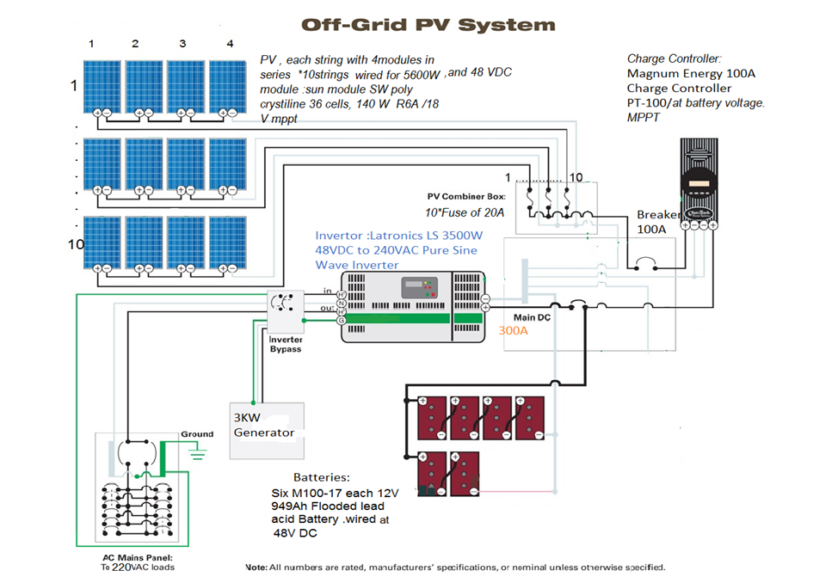
Schematic Diagram for the PV System

Slide 14
Simulation

Slide 15


Slide 16
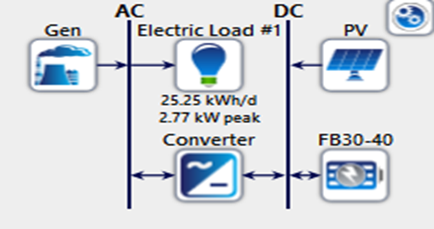
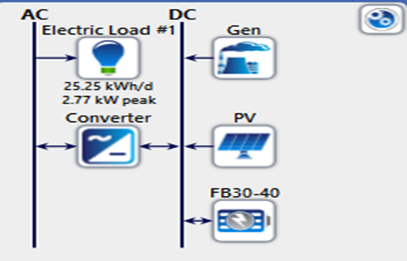
AC / DC - Bus Connected Generator PV System

Slide 17
Controller
1- Load Following Strategy: The load following strategy is a dispatch strategy whereby whenever a generator operates, it produces only enough power to meet the primary load. Lower-priority objectives such as charging the storage bank or serving the deferrable load are left to the renewable power sources. The generator may still ramp up and sell power to the grid if it is economically advantageous.
2- Cycle Charging Strategy: The cycle charging strategy is a dispatch strategy whereby whenever a generator needs to operate to serve the primary load, it operates at full output power. Surplus electrical production goes toward the lower-priority objectives such as, in order of decreasing priority: serving the deferrable load, charging the storage bank, and serving the electrolyzed.

Slide 18
Diesel Generator
LF
AC
CC
DC
AC
DC

Slide 19
Results and Analysis for the Load Flow

Slide 20
Load Following Strategy

Slide 21
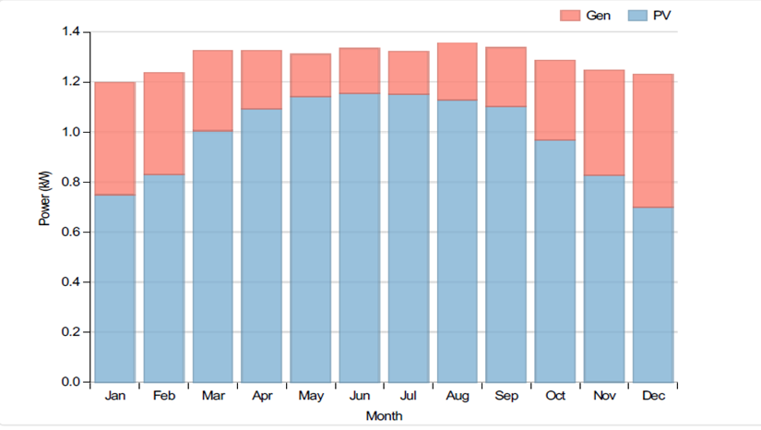
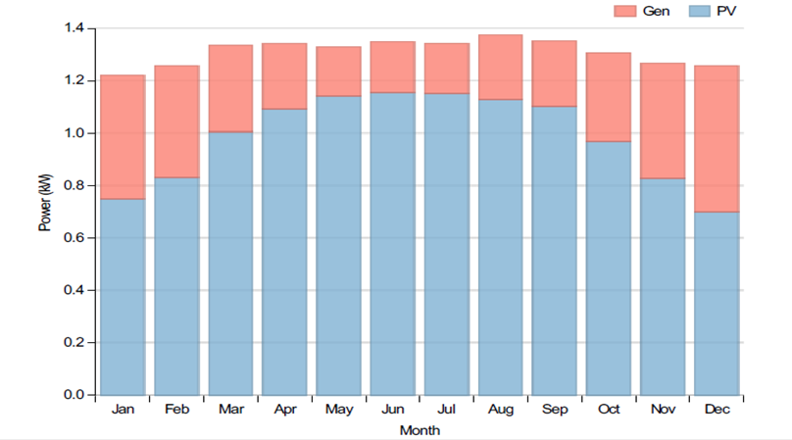
Power sharing between Generator and The PV generator
AC Load Following
DC Load Following

Slide 22
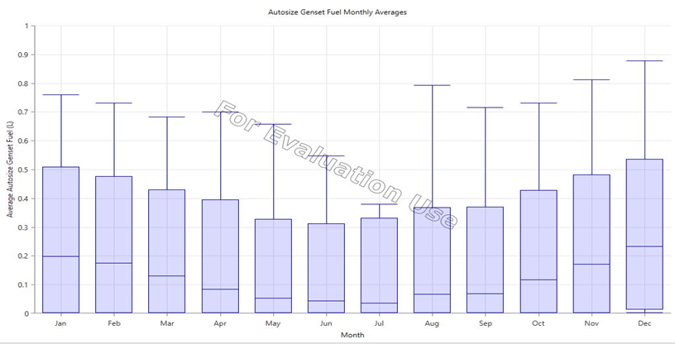
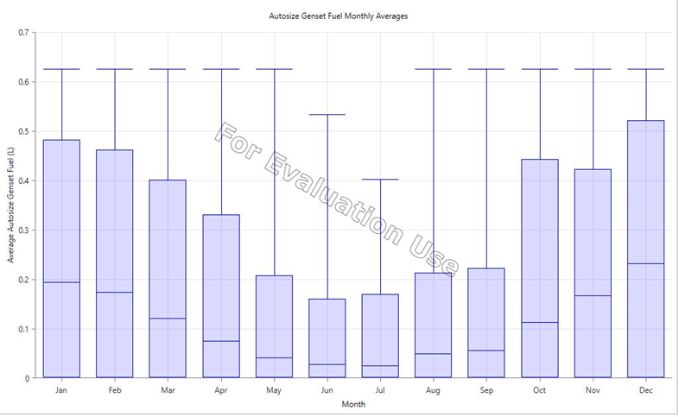
Generator Fuel
AC Load Following
DC Load Following

Slide 23
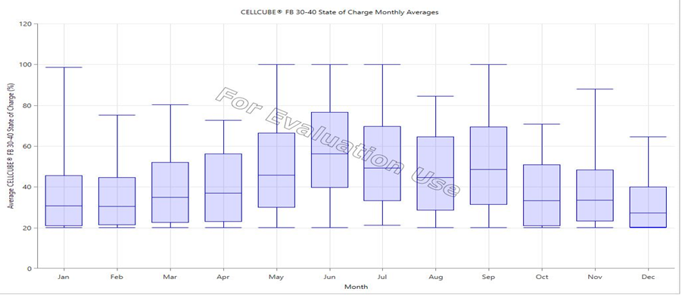
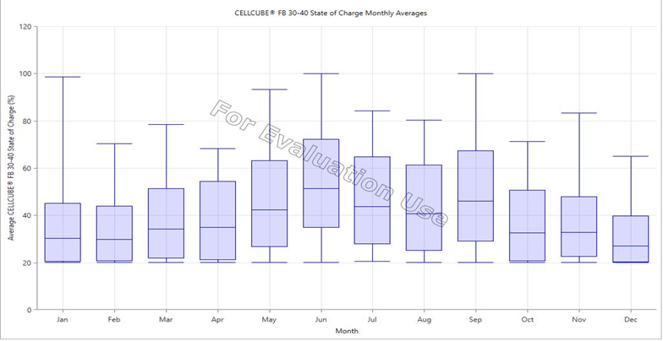
State of Charge of the Battery(SOC)
AC Load Following
DC Load Following

Slide 24
Cycle Charging Strategy

Slide 25
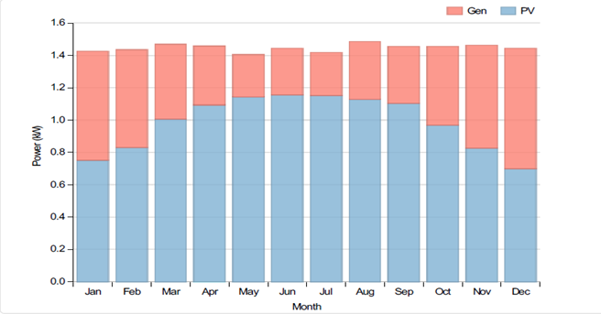
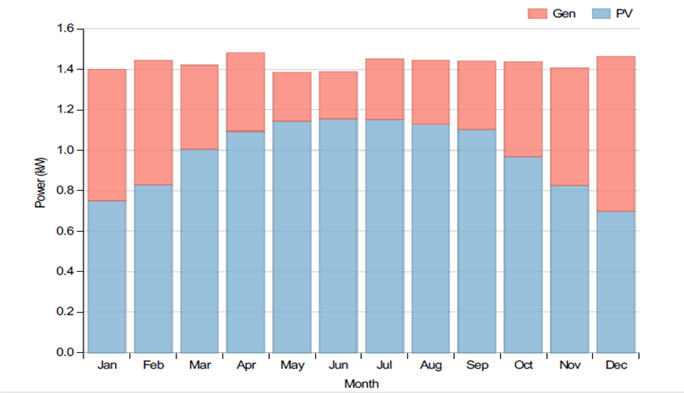
Power sharing between Generator and The PV generator
AC Cycle Charging
DC Cycle Charging

Slide 26
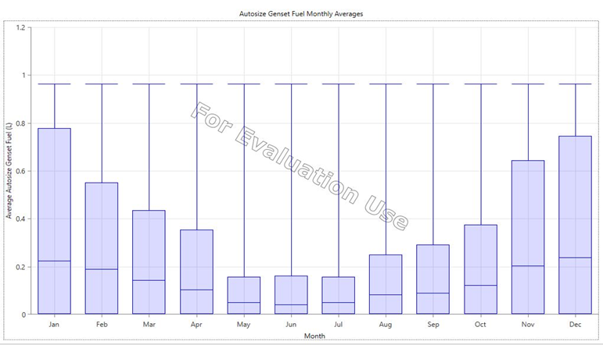
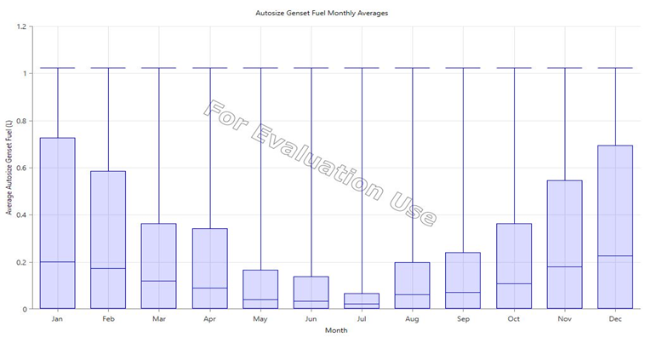
Generator Fuel
AC Cycle Charging
DC Cycle Charging

Slide 27
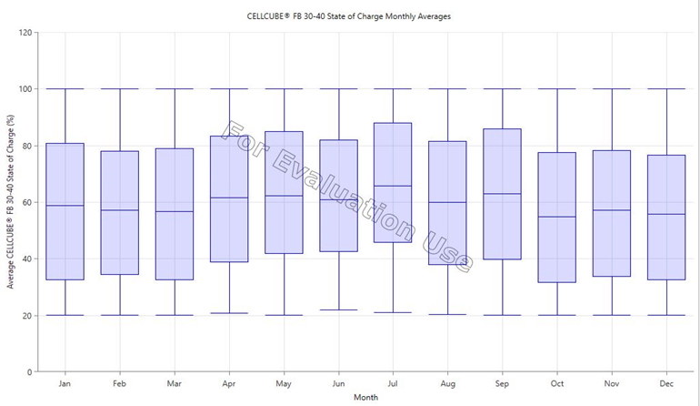
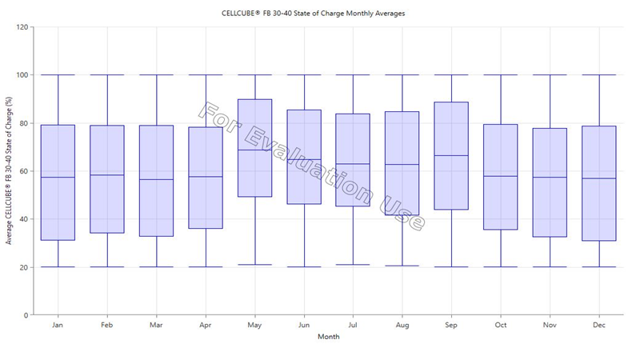
State of Charge of the Battery(SOC)
AC Cycle Charging
DC Cycle Charging

Slide 28
Type of connected Compression | Load Following |  | Cycle Charging
 | AC/LF | DC/LF | AC/CC | DC/CC
Hours of operation(h/year) | 3015 | 2931 | 1330 | 1205
Number of starts (starts/year) | 722 | 636 | 94 | 89
Electrical production(kWh/year) | 2660 | 2819 | 4007 | 3859
Mean electrical output(KW) | 1 | 1 | 3 | 3
Min. electrical output(KW) | 1 | 1 | 1 | 1
Max. electrical output(KW) | 3 | 3 | 3 | 3
Fuel consumption(L/year) | 1228 | 1282 | 1253 | 1205
Specific fuel consumption(L/KWh) | 0.46 | 0.45 | 0.31 | 0.31

Slide 29
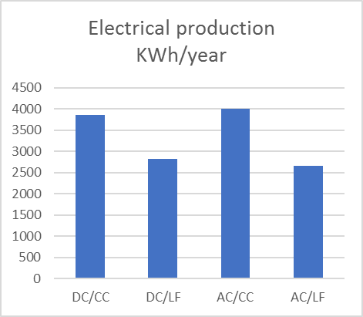
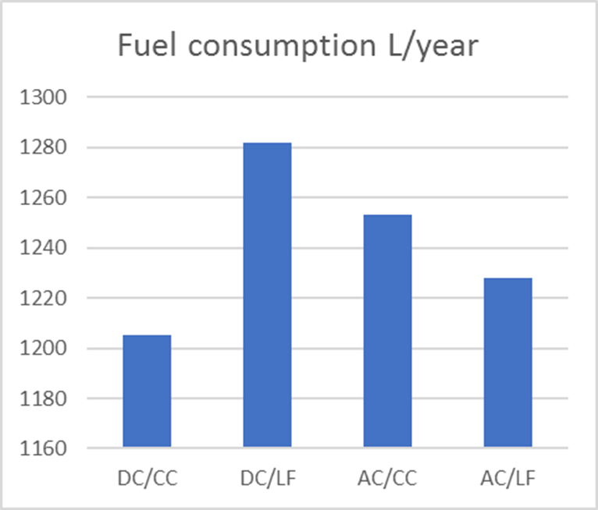

Slide 30
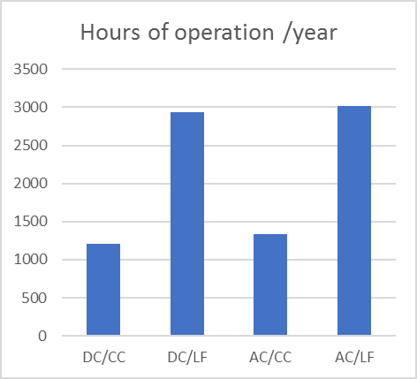
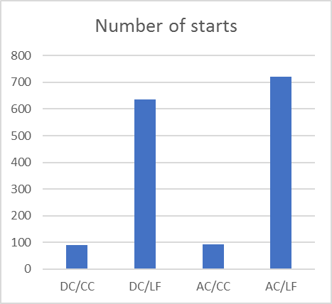

Slide 31
END

