Slide 1
Feasibility Study for Establishing an Automatic Facility for Furniture Components
Prepared by: Supervised by:
Izzat Yasin Dr. Ahmad AL-Ramahi
Mohammad Taha
Naef Jomaa
Wqqas Abbas

Slide 2
Introduction
Problem statement
Furniture parts sources.
The need for project idea.

Slide 3
Introduction
Objectives
Conduct a proper and sufficient market study.
Perform relevant technical study covering machinery, layout, etc.
Perform the necessary financial analysis to judge on the feasibility of such industry.
To support in providing Palestinian furniture industry with needed furniture components.
To improve the project team skills in conducting feasibility studies.

Slide 4
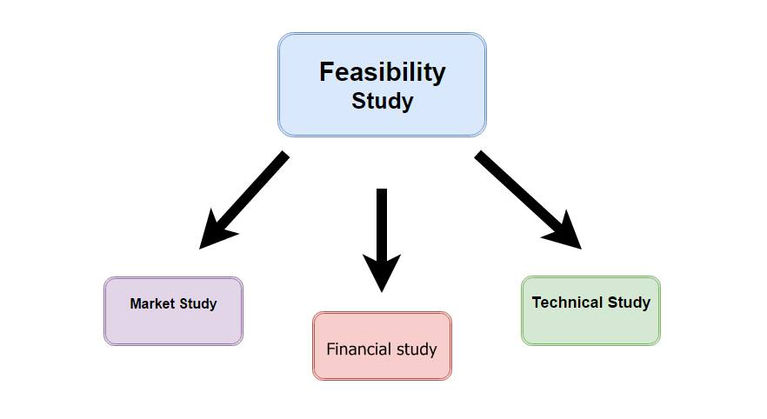
Introduction
Scope of the work
The feasibility study consists mainly of market study, technical study and financial study as shown below

Slide 5
Literature Review
There are two main subjects we studied about:
CNC Machines
How to prepare an industrial feasibility study

Slide 6
Methodology
Market study
Technical study
Financial study

Slide 7
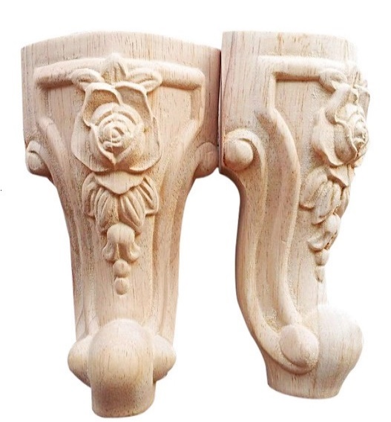
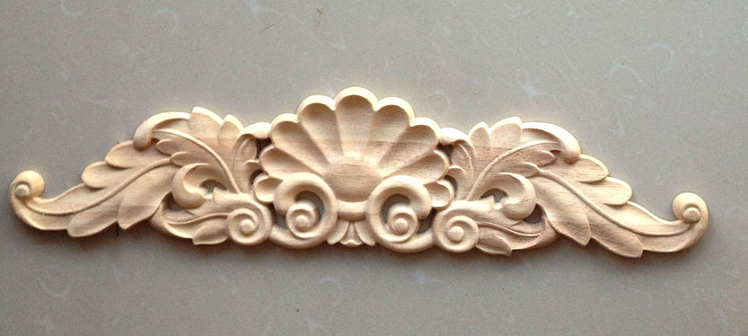
Market study
Product identification

Slide 8
market study
Primary research
Secondary research

Slide 9
Market study Results
Number of facilities and workers in the furniture industry
City | Number of facilities | Number of workers
Nablus | 390 | 1434
Salfeet | 103 | 547
Jenin | 149 | 331
Qalqilya | 83 | 340

Slide 10
Market study Results
Total production volume

Slide 11
Market study Results
Furniture products market

Slide 12
Market study Results
Complementary furniture parts resources

Slide 13
Market study Results
Quality of existing complementary parts

Slide 14
Market study Results
Cost of complementary parts analysis

Slide 15
Market study Results
Satisfaction of complementary parts prices

Slide 16
Market study Results
Monopolization in complementary parts analysis

Slide 17
Market study Results
Level of technology used in local complementary parts industry analysis

Slide 18
Market study Results
Level of technology needed to make each product

Slide 19
Market study Results
Average time to produce complementary part analysis

Slide 20
Market study Results
In this market study, we identified what the market needs of this sector and we have collected information by more than one way and then the analysis of this information shows us that the market needs for such a facility to meet the needs and this is what encourages us to complete the feasibility study.

Slide 21
technical study
Production processes Stages
Raw material needed
Machines and Equipment
Human resources
Facility Location

Slide 22
Stages of Production processes
Cutting and Preparation of raw material.
Installation of work part on the machine.
Form the pieces to the desired shape.
Remove the piece from the machine.
Packaging process: do packaging for the manufactured products.

Slide 23
Raw material needed for the plant
Raw material is considered one of the main components of the technical study, in this industry, the wood is the main component of the raw materials that is necessary for manufacturing the products
The main two types of wood are to be used :
1- Beech
2- Beech pine

Slide 24
Machines and Equipment Required
Sliding table saw
Band saw
Planer
CNC Router (3D)
Axis Linkage CNC Router

Slide 25
Human resources needed in the factory
General Manager
Secretary
Quality control, Production and inventory Manager .
Designer
Accountant
Purchasing, Sales and Marketing supervisor
Workers
Driver
Security

Slide 26
Facility Location
Factor | weight |  | Nablus |  | Salfeet |  | Jenin |  | Qalqilya
 |  |  | score | Weighted score | score | Weighted score | score | Weighted score | score | Weighted score
Cost of land* | 50 | 0.25 | 5 | 1.25 | 5.71 | 1.42 | 6.6 | 1.65 | 10 | 2.5
Proximity to raw materials | 70 | 0.35 | 6 | 2.1 | 9 | 3.15 | 4 | 1.4 | 7 | 2.45
Proximity to markets | 80 | 0.4 | 9 | 3.6 | 8 | 3.2 | 5 | 2 | 6 | 2.4
Total | 200 | 1 |  | 6.95 |  | 7.77 |  | 5.05 |  | 7.35
From result in table above we choose Slafeet as the best location for our facility

Slide 27
Facility Planning and Plant layout
For any company or manufacturing plant, facility planning and plant layout is an important stage to facilitate the production and reduce unneeded activities.
The most suitable layout style is process layout where the processes are segregated and the machines of each process are kept together while each process is kept separately.

Slide 28
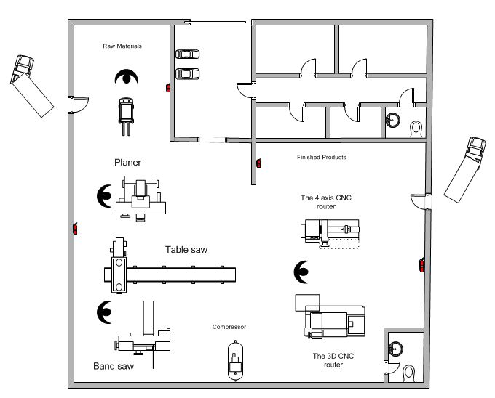
Facility Layout
Raw Material
Planing
CNC
Sawing
Finished Product

Slide 29
financial study
A financial feasibility study is an assessment of the financial aspects of an investment.
financial study includes :
start-up capital, expenses, revenues, and investor income and disbursements.
ROR, Payback period.

Slide 30
Start-up Capital
Land Price(273000 NIS)
Total Construction Cost(518,728 NIS).
Electricity Cost (56,000 NIS)
Water System cost(5000 NIS)

Slide 31
Start-up capital
Production Equipment cost
Machine | Number | Price in NIS
Planer | 1 | 20,000
Band Saw | 1 | 25,000
Table saw | 1 | 50,000
Compressors | 1 | 7400
Carpentry tools |  | 2000
3D CNC | 1 | 92,000
4D CNC | 1 | 110,000
Computers | 5 | 13000
Printer | 2 | 600
Truck | 1 | 150,000
Forklift | 1 | 30,000
Total cost | 500,000

Slide 32
Start-up capital
furniture cost
Type of furniture | Quantity | Unit Cost | Total Cost in NIS
Manager Desk | 1 | 3,000 | 3000
Manager furniture | 1 | 8,000 | 8000
Chairs for the Manager’s office | 4 | 150 | 600
Desks for the employees | 6 | 500 | 3000
Chairs for the employees | 6 | 400 | 2400
Chairs for the employees' offices | 8 | 150 | 1200
Desk for Secretaries | 1 | 500 | 500
Chairs for secretaries | 1 | 300 | 300
Chairs for the secretaries’ office | 2 | 150 | 300
Total cost of furniture |  |  | 19,300

Slide 33
Total Capital cost
Startup-Capital Element | Cost in NIS
Land price | 273,000
Construction Cost | 518,728
Electricity cost | 56,000
Water System cost | 5000
Production Equipment | 500,000
Furniture | 19,300
Total | 1,372,028

Slide 34
Operational Cost
Raw Material
Type | Price
Beech Pine (الموسكي) | 2500 NIS/cup
Beech (الزان) | 3500 NIS/cup

Slide 35
Operational Cost
Energy Consumption
Total cost of consumption of electricity\day | 153.6
Total cost of consumption of fuel\day | 254.4
Total Energy Cost/month | 408

Slide 36
Operational Cost
Salaries
Categories | Number | Salary (NIS/ month)
Manager | 1 | 5000
Secretary | 1 | 2000
Quality control, Production and inventory Manager | 1 | 3500
Designer | 1 | 3000
Accountant | 1 | 3000
Purchasing, Sales and Marketing supervisor | 1 | 3000
Workers | 4 | 10000
Driver | 1 | 3000
Security | 1 | 1500
Total | 12 | 34000

Slide 37
Operational Cost
Depreciation cost
Components | Price (NIS) | Depreciation rate (Nibal, 2012) | Depreciation value (NIS)\year **
Production machines | 320,000 | 0.1 | 32,000
Vehicles | 180,000 | 0.1 | 18,000
Building and offices | 599,028 | 0.04 | 23,962
Total | 1,099,028 |  | 73,962

Slide 38
Operational Cost
Insurance Cost
Human Resources Insurance
High level: Management and engineers with insurance rate of 1.5 %
    Low level: Technical workers with insurance rate of 3.5 %
Category | Total salaries (NIS/ year) | Insurance rate (%) | Insurance Cost (NIS/ year)
High level | 234,000 | 1.5 | 3510
Low level | 174,000 | 3.5 | 6090
Total |  |  | 9600

Slide 39
Anti-Fire Insurance
Categories | percentage of insurance | Initial cost (NIS) | Insurance cost (NIS/ year) **
Production equipment | 0.018 | 320,000 | 5760
Buildings | .007 | 599,028 | 4194
Vehicles | 0.05 | 180,000 | 9,000
Total |  |  | 18,954
Total insurance cost = Human Recourses Insurance Cost + Anti-Fire Insurance Cost = 9600 + 18,954
= 28,554 NIS

Slide 40
Operational cost
Other Running Cost
Internet, water consumption, telephones, advertisement and other related hidden cost is about 3000 NIS/year

Slide 41
Total operational cost
Types of Cost | Cost (NIS /month)
Salaries | 34,000
Depreciation | 6,163.5
Insurance | 2,379.5
Electric energy and fuel | 10,608
Other cost | 250
Total | 53,401NIS/month

Slide 42
Financial Analysis
We assumed that the factory would be operated for 312 days per year. Quantities to be produced from table legs, sofa legs, sofa hands, crowns, and chair legs equal to 105831 part per year.

Slide 43
production percentage
Identified Product | Production Proportion | Quantity per year
Sofa legs | 0.567 | 60,006
Sofa arms | 0.258 | 27,304
Dining table legs | 0.0173 | 1831
Table legs | 0.0467 | 4942
Crowns | 0.011 | 1165
Chairs legs | 0.1 | 10583
Total | 1 | 105831

Slide 44
Sofa legs details
Sofa legs details / month
Fixed cost (NIS) | 30,278
Quantity of row material (Cup) | 5
Raw material Cost (NIS) | 12500
Cost of 1 part (NIS) | 8.55
Selling price (NIS) ¹ | 16
CM | 7.44
Production volume (unit/month) ³ | 5000.48
Gross profit / month (VAT excluded) ⁴ | 37229.49
Net Profit / month (including tax) ⁵ | 31272.77
Profit per unit (NIS) ⁶ | 6.25
Breakeven point (unit)/month ⁷ | 4841.46

Slide 45
Sofa arms details
Sofa arms details / month
Fixed cost (NIS) | 13,777
Quantity of row material (Cup) | 24
Raw material Cost (NIS) | 60,000
Cost of 1 part (NIS) | 32.42459624
Selling Price (NIS) | 53
CM | 20.57540376
Production volume (unit/month) | 2275.3536
Gross profit / month (VAT excluded) | 46816.31901
Net Profit / month (including tax) | 39325.70797
Profit per unit (NIS) | 17.28333915
Breakeven point (unit)/month | 797.1504621

Slide 46
Dining table legs details
Dining table legs details / month
Fixed cost (NIS) | 924
Quantity of row material (Cup) | 3
Raw material Cost (NIS) | 10500
Cost of 1 part (NIS) | 74.87
Selling Price | 120
CM | 45.12
Production volume (unit/month) | 152.57
Gross profit / month (VAT excluded) | 6884.82
Net Profit / month (including tax) | 5783.25
Profit per unit (NIS) | 37.90
Breakeven point (unit)/month | 24.37

Slide 47
Table legs details
Table legs details / month
Fixed cost (NIS) | 2,494
Quantity of row material (Cup) | 5
Raw material Cost (NIS) | 12500
Cost of 1 part (NIS) | 36.40543502
Selling price | 45
CM | 8.594564977
Production volume (unit/month) | 411.85664
Gross profit / month (VAT excluded) | 3539.728654
Net Profit / month (including tax) | 2973.372069
Profit per unit (NIS) | 7.21943458
Breakeven point (unit)/month | 345.4315042

Slide 48
Crowns details
Crowns details / month
Fixed cost (NIS) | 587
Quantity of row material (Cup) | 5
Raw material Cost (NIS) | 8750
Cost of 1 part (NIS) | 96.25
Selling price | 120
CM | 23.74
Production volume (unit/month) | 97.01
Gross profit / month (VAT excluded) | 2303.93
Net Profit / month (including tax) | 1935.30
Profit per unit (NIS) | 19.94
Breakeven point (unit)/month | 29.44

Slide 49
Chair legs details
Chair legs details / month
Fixed cost (NIS) | 5,340
Quantity of row material (Cup) | 5
Raw material Cost (NIS) | 14000
Cost of 1 part (NIS) | 21.92952418
Selling price | 30
CM | 8.070475818
Production volume (unit/month) | 881.92
Gross profit / month (VAT excluded) | 7117.514033
Net Profit / month (including tax) | 5978.711788
Profit per unit (NIS) | 6.779199687
Breakeven point (unit)/month | 787.7162812

Slide 50
Project Evaluation
In projects evaluation, there are many criteria used to evaluate the feasibility of project in terms of money. In this project, we would use four types of criteria which are payback period, net present value, rate of return and benefits/ cost analysis.

Slide 51
Payback period
Payback period = Cost of investment \ Annual cash flow.
Cost of investment =2,791,028 NIS
Annual cash flow = 1,047,229.501 NIS
Payback period = 2.665154103 years

Slide 52
Rate of Return
Rate of return = Annual profit \ Cost of investment.
ROR = 1,047,229.501 / 2,791,028= 37.5 %
This is mean that investing money in creating this furniture plant will yield a profit of 37.5 % from the amount of money invested

Slide 53
Conclusion
      Constructing furniture parts factory is possible and feasible, based on different financial indicators such that rate of return (ROR =37.5%), (Payback period = 2.66 year), and all these factors are positive for constructing the factory.
      Constructing this factory requires an approximate budget of (2,791,028 NIS) and gives approximate annual profit of (1,047,229.501 NIS).
Land, constructing costs, and cost of equipment’s are most important cost components that should be considered in factory construction

Slide 54
Con’t
      Development is possible because the financial study is based on the maximum capacity of the CNC machines, which can be increased by increasing the number of machines.
      Constructing this kind of factories is very important and feasible for several reasons such as the large volume of imported products in the market which still can't be made locally, also the availability of raw materials, and the ability to export the products.
      The technology used in the factory can be used to make special orders at special prices.

Slide 55

Thank you

