Slide 1
Design of Automatic Hinge-Manufacturing Machine
Supervisor
Dr. Ahmad Ramahi
By:
Ma’moon Ataallah
Mohammed Abdel Karim
Mohammed hussein
Baha Khaldi
2017
Project name

Slide 2

Outlines
Introduction
problem
Objectives
Methodology
Operation and Result
Feasibility study
Future work

Slide 3
Introduction
A hinge is a mechanical components that connects two solid objects, typically allowing only a limited angle of rotation between them.
Which type of hinges will be produced ?

Slide 4
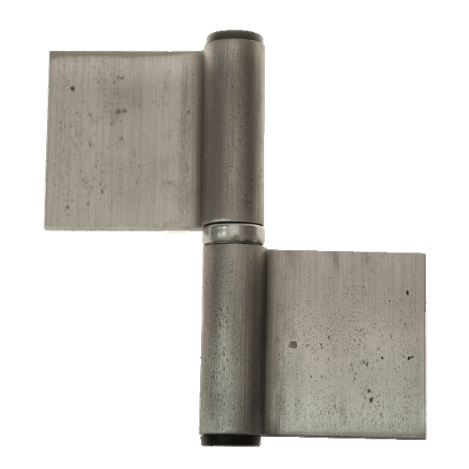
Introduction
Flag Hinge

Slide 5
problem
In the local market of Palestine, hinges are produced by using traditional unsafe ways.

Slide 6
Objectives
Safety
Easiness of use
Low cost

Slide 7
Methodology
We make kinematic and stress analysis.
Draw the production line on solid work program
A feasibility study and operating manual was prepared

Slide 8
Operation and Result
Flat bars will be added manually to autoloader machine then it will be added automatically to conveyer by pneumatic cylinder

Slide 9
Bar
material | length | width | thickness
1010 CD | 3 m | 0.5 cm | 4 cm

Slide 10
Stand
Material stand | Θ | time
1006 CD | 45 | 0.6

Slide 11
Operation and Result
In the feeding process, a conveyor will pass bars received from the loader to the cutting machine

Slide 12
Conveyer
Chain velocity | Length of Chain | Allowable power | C-C
0.346 | 6.41 | 0.21283 | 3

Slide 13
Operation and result
  An automatic saw cutting machine will cut the bar to small flat parts

Slide 14
Blade
diameter | width | No. teeth | RPM | F/T | Cutting velocity
200mm | 2mm | 64 HZ | 80 | 0.06m/t | 0.48 ( m/s)

Slide 15
forces for blade
Cutting force | Shear force | Thrust force | Power
255.6N | 36.67N | 154.8N | 0.28832hp

Slide 16
Operation and Result
After the cutting process, a sliding feeder that has a specific shape and direction will lead the cut parts to a bending machine

Slide 17
Sliding
Material stand | Θ | time
1006 CD | 39 | 1

Slide 18
Eccentric press
Eccentric press will form by bending each part to its desired shape

Slide 19
Eccentric press
Torque | Angular velocity for crank | Power | Bending Force | Stroke
700 J | 0.521 rad/s | 0.75 hp | 29.1 KN | 4.71 cm

Slide 20
Operation and Result
After the bending process, the flexed piece is removed by scotch yoke mechanism

Slide 21
scotch yoke
The scotch yoke is a mechanism for converting the linear motion of a slider into rotational motion or vice-versa to push the part from die.

Slide 22
feasibility study
A cost benefit analysis is used to evaluate the total anticipated cost of a project compared to the total expected benefits in order to determine whether the proposed implementation is worthwhile for a company or project team.

Slide 23
Initial cost | Running cost | Depreciation | Benefit | Back pay period | profit
15000 | 132819 | 1500 | 181852 | 1 year | 47433

Slide 24
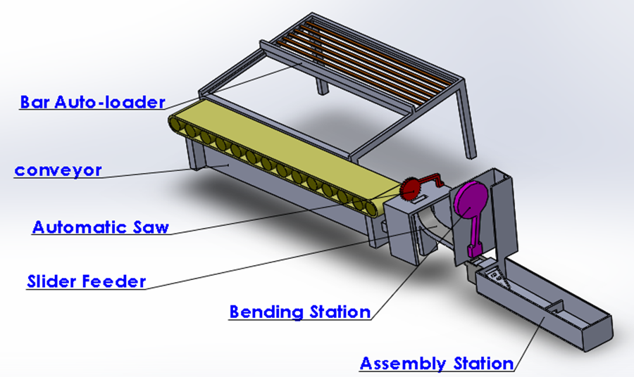
Project’s Schematic Drawing for the Whole System

Slide 25
Future work
Find a proper way to assemble the whole parts together
Animation for whole system
Enhancing production line

Slide 26

Thank
You

