Slide 1
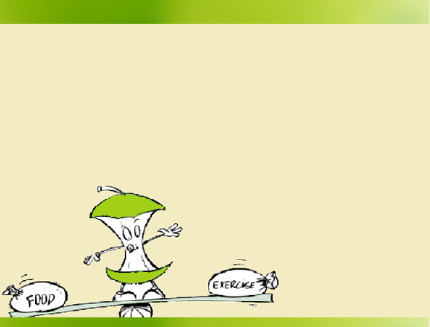
Graduation Project Seminar
Intelli-Diet
Students: Dalal I. Mughrabi & Jumanah H. Qasrawi
Supervisors: Dr. Raed Al-Qadi & Dr. Ashraf Armoosh

Slide 2
Motivation
Lose weight and keep fit.
Challenge to stick with healthy diet and regular exercises.
Self control.
Notes:
1. According to the increasing desire of Lose weight and keep fit
2. Despite knowing that a healthy diet and regular exercise are good for you and have many benefits
Its almost always a Challenge to stick with them,
3.self control and avoid temptation to slip into negative habits
4. The motivation to continue will wane and you will need some help to recapture that feeling
Can Money Motivate You · To Lose Weight? No

Slide 3
Solution….
Here it is the INTELLI-DIET ……
Easy way to keep you motivated
Notes:
So we developed a new application for you , the INTELLI-DIET
Mobile application Wrote by java using android platform
using this application will be on always track of your needed calories
at any given time whether you are on track to lose weight, gain weight or stay the same, so that you can make the right choices to reach your goal.

Slide 4

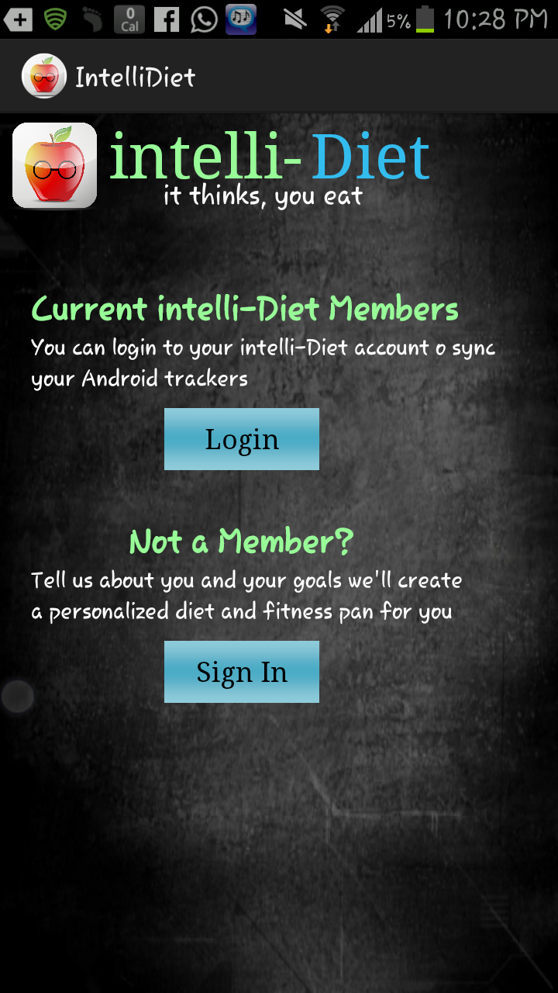
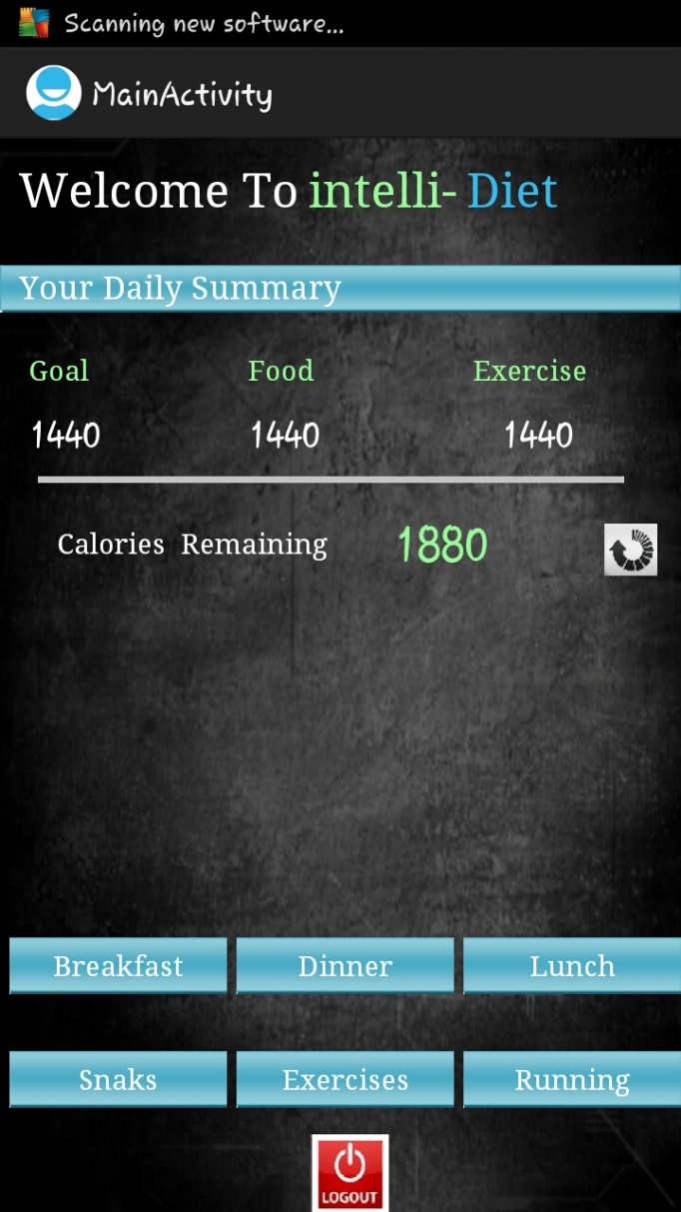
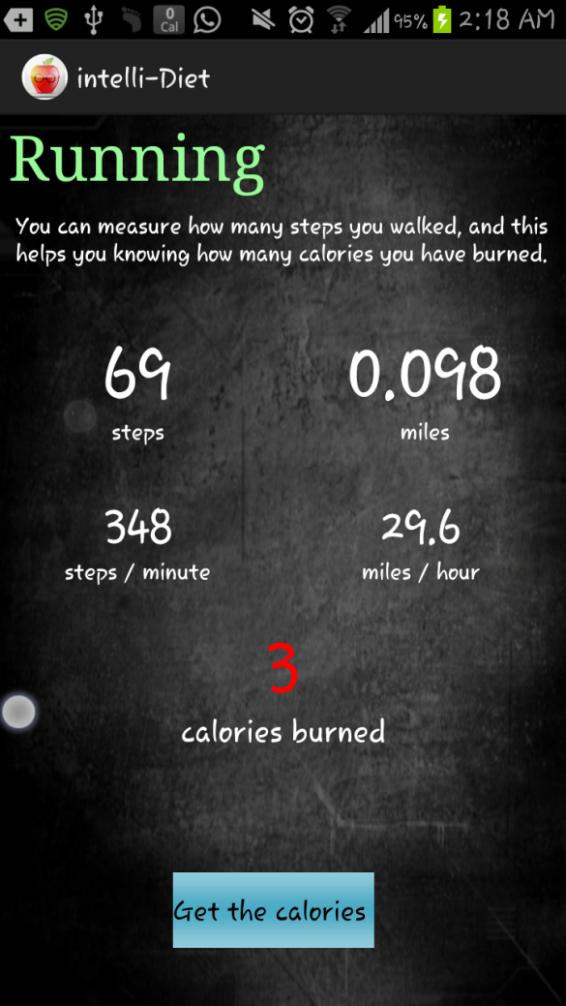
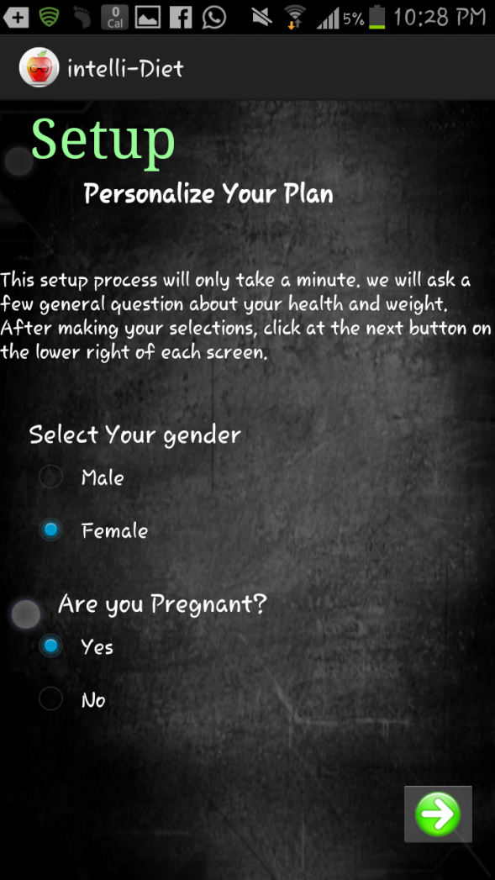

Slide 5
Features
Graphical interface
Calories needed daily
Large database
Net calories
BMI
Pedometer
Log out and in any time with keeping you data saved
Notes:
An easy to use graphical interface
2. No need to calculate how many calories you need daily , the app can inform you with ur daily needed of calories
Nutritional analyses of food consumption against daily targets
The ability to quickly search and log many food items and activities
No need to write down what you eat and how many exercises you do to compare and see how much you gained calories the app Compare your intake and daily burn expenditure using our net calorie
Easy way to calculate ur BMI
Using accelerometer sensor it can detect how many steps you walked, dependently it calculate how many calories you burned according to that activity which is the pedometer
Log out and in any time with keeping you data saved

Slide 6
Methodology
SDK – ANDROID 2.2
Android database SQLite
Sensor manager
Notes:
1. DONWLOAD the SDK A software development kit (SDK or "devkit") is typically a set of software development tools that allows for the creation of applications for a certain software package, software framework, hardware platform, computer system, video game console, operating system, or similar platform.
API 8(application programming interface) Android 2.2 is a minor platform release including user features, developer features, API changes, and bug fixes.
For developers, the Android 2.2 platform is available as a downloadable component for the Android SDK. The downloadable platform includes an Android library and system image, as well as a set of emulator skins and more. To get started developing or testing against Android 2.2, use the Android SDK Manager to download the platform into your SDK.
2. Using the database for android SQLite
With the package com.androidhive.androidsqlite
with three tables
SensorManager lets you access the device's sensors we use the (type_accelerometer) sensor

Slide 7
Database
Explore data returned through a content provider.
Created and opened
Requests through content providers
Notes:
1.Database Contains classes to explore data returned through a content provider.
2. In order to deal with the databasecreat , open it, using openOrCreateDatabase class
3. access the tables and modify them using class called DatabaseHandler.java which extends the SQLiteOpenHelper
4. if I need anything from the database(requests through content providers) we use using openOrCreateDatabase class

Slide 8

Logics and Implementations
Create Account
Age
Weight
Height
Gender
Notes:
Once you create your account you enter your age,gender, weight and height.
these parameter be stored at the database using( user table).

Slide 9
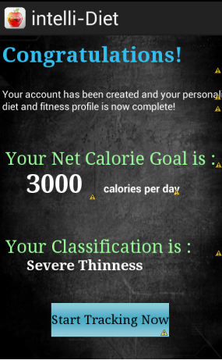

Logics and implementations
Calculate BMI
BMI is the Body Mass Index
Notes:
BMI is the Body Mass Index is use to assess how much an individual's body weight departs from what is normal or desirable for a person of his or her height
The BMI will be generated as soon as you create your account it will calculate it usingyour weight and height as follow:

Slide 10
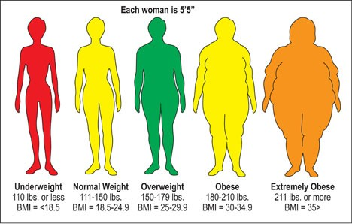
Logics and Implementations
BMI Categories
Notes:
Here it is the classification of the BMI depending on the age and gender
You may be underweight, normal, overweight, obese or extremely obeses.
So according to ur BMI you will decide wither to lose weight, gain weight or keep maintain.

Slide 11
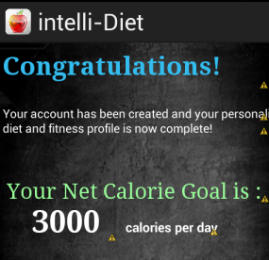
Logics and implementations
Calories Counter
Every person's need of calories per day vary from one to another.
Notes:
Every person's need of calories per day vary from one to another; this is because the calories needed per day are based on age and gender basically.
when you create your account. Depending on precise calculations and asking some doctors we calculate the calories needed , Once you create ur account it will inform you by ur needed calories per day

Slide 12
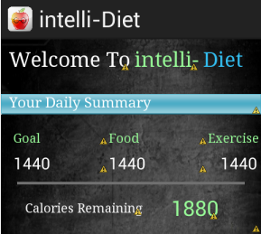
Logics and Implementations
Calories Tracker
Compare calories in and calories out
Notes:
We believe — and medical studies prove — that the best way to lose weight and keep it off forever is to simply keep track of the foods you eat. our application makes calories counting, food and activity tracking so easy
It can help you track how many calories you've burned during any activity, how many calories in the food you eat, compare it by your daily needed of calories and display the reaming of your calories day by day, so you will be aware of your net daily calories.

Slide 13
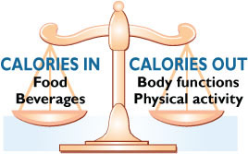
Logics and Implementations

Slide 14
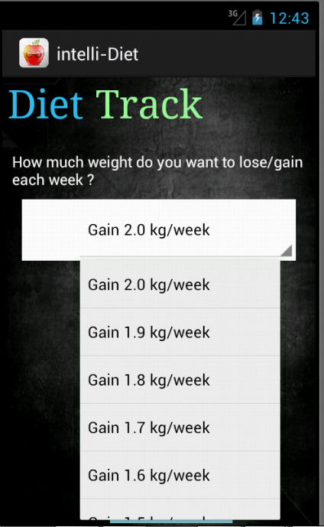
Logics and Implementations
Weight Goal
Whether you need to lose, gain or maintain weight it can help you.
Notes:
Whether you need to lose, gain or maintain weight it can help you. By telling how many kilograms you decide to lose , gain or maintain per week. Just select what you want and it will tell you how many calories you need per day and track you with them.
If you are maintaining your current body weight, you are in caloric balance. If you need to gain weight or to lose weight, you'll need to tip the balance scale in one direction or another to achieve your goal.

Slide 15
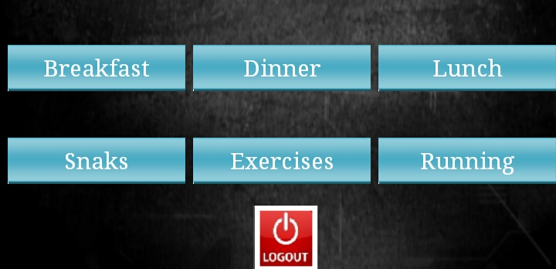
Logics and Implementations
Food tracker
Breakfast
Lunch
Dinner
Snacks
Notes:
a large Database table which include many different kinds of meals with related calories is availabe , you have the ability to add whatever meal you eat; breakfast, lunch, dinner and snacks
So this app helps you keep track of the foods you eat,
At each page of these there's a list which includes many different kinds of food,

Slide 16
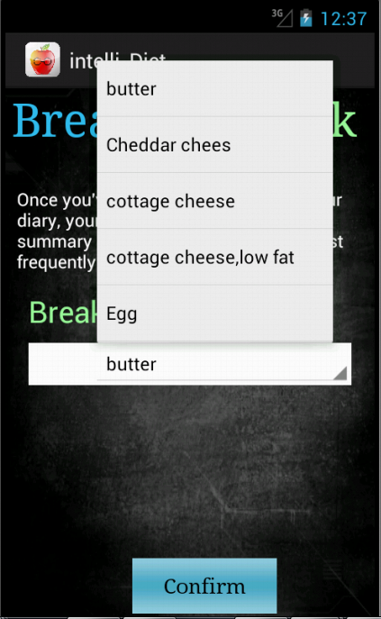
Logics and Implementations
Notes:
At each page of the breakfast, dinner lunch and snacks there's a list which includes many different kinds of food,

Slide 17
Logics and Implementations
Exercises Tracker
Opportunity to choose between many different kinds of activities you may do.
Notes:
The same, a large database which includes many exercises with the related calories
This app give you the opportunity to choose between many different kinds of activities you may do

Slide 18
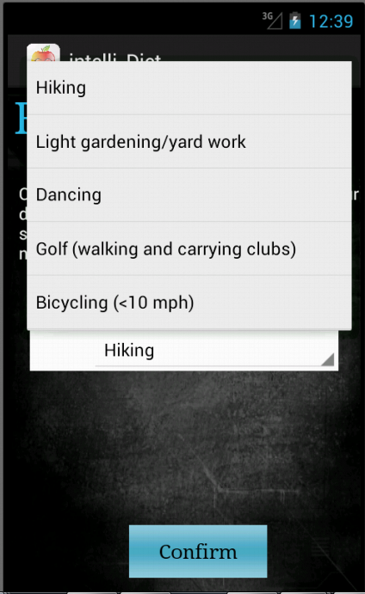
Logics and Implementations
Notes:
Choosing any of these food or activity will dynamically added the numbers of calories related to that food or activity to the main page of calories and comparing them to the daily needed of calories as shown above.

Slide 19
Logics and Implementations
Pedometer
Count each step a person takes.
Number of calories burned
Notes:
At this part of the application, we can count each step a person takes by detecting the motion of the person's hips.
according to the number of steps detected we can measure this distance by kilometers or miles (distance = number of steps × step length). Step counters can give encouragement to compete with oneself in getting fit and losing weight, and this can be done by calculating the number of calories burned according to that walked distance using some calculation which depends on the walked distance and the weight, so that you can enter your weight in order to complete the calculation.

Slide 20

Logics and Implementations
We use the accelerometer sensor
Notes:
Android devices have built-in sensors that measure motion, orientation, and various environmental conditions. These sensors are capable of providing raw data with high precision and accuracy, and are useful if you want to monitor three-dimensional device movement or positioning,
You can access the device’s sensors by using the manager sensor. Get an instance of this class by calling Context.getSystemService() with the argument SENSOR_SERVICE. In order to access the sensor and get the value.
public SensorActivity() {
mSensorManager = (SensorManager)getSystemService(SENSOR_SERVICE);
mAccelerometer = mSensorManager.getDefaultSensor(Sensor.TYPE_ACCELEROMETER)
library
import android.content.SharedPreferences;
import android.preference.PreferenceManager;
import android.hardware.Sensor;
import android.hardware.SensorEvent;
import android.hardware.SensorEventListener;
import android.hardware.SensorManager;

Slide 21
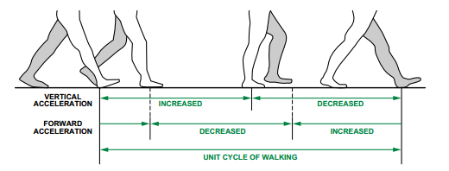
Logics and Implementations
Step Detector
Notes:
Every time you walk, your body tilts to one side and you swing a leg forward. Then your body tilts the other way and you swing the other leg forward too. Each tilt of the hips and shift of the legs is a step. Assuming each step is pretty much the same length, all we need to do is count the number of steps we make in a day, by counting the number of times our body tilts from side to side. We can then multiply the number of steps by the length of each one to figure out the overall distance walked. This is pretty much how a pedometer works.
The value return from the accelerometer based on x y and z axis
If the current value returned from the accelerometer is larger than the last value then the movement is toward (1), if its equal then there no movement(0), of it smaller this means the movement is backward(-1) but we take absolute in order to count the backward step as step
If it return 0 there no movement and it will not save the last value
If it return 1 there is a movement and will save the last value
Substract the current value by the last value in order to get the size
We can say that there a step in the next and previous step is as large as the current steps else there is no new step

Slide 22
Logics and Implementations
Distance Parameter
Distance = number of steps × Step length
Notes:
After computing the step parameter according to the algorithm above, we can use the Equation below to get the distance parameter.
Distance = number of steps × Step length
It will keep sum the step length at every step (using loop)

Slide 23
Logics and Implementations
Pace parameter
Number of steps per minutes.
Notes:
In order to calculate the speed which we need it in calculating the calories burned we need to measure the pace which is number of steps per minutes.
It takes the current time and the last time fro a step and see how much times each step takes, take the average
1step >> 5 second (scale with min ) see how many step each min .

Slide 24
Logics and Implementations
Speed parameter
Speed= Distance / Time
Or
Speed = Pace * step_lenght
Notes:
we can measure the speed by using the pace parameter (steps/min) and multiply by the stepLenght to get the distance. (Distance/Time)

Slide 25
Logics and Implementations
Calories Burned
Calories burned= weight*step_length* P*steps
P is walking vector=0.708
Notes:
Here is the point of using the parameter, from the distance walked and the weight we can calculate how many calories you burned during this activity by using this equation.
Depending on medical studies

Slide 26
Logics and Implementations
Accuracy
Assume that it's in error by least 10 percent.
Notes:
Counting steps with a pedometer sounds super-scientific, but you need to remember that it's only an approximate measurement. Not all your steps will be correctly counted and some false movements (jolts in the road as you ride in a car, for example) might be counted as steps too. Don't take the count too seriously; assume that it's in error by least 10 percent

Slide 27
Thanks
First, we present our thanks for computer engineering department in AN-Najah National University.
Thanks to our supervisors:
Dr. Raed Al-qadi
Dr. Ashraf Armoosh
Thanks to the Committee discussion members:
Dr. Luai Malhis
Dr. Haya Samaneh

Slide 28
>> Now we move to the Demo ……

