Slide 1


Slide 2

Serious Educational Game
Students:
Majdoleen Saadeh
Aseel Ghanim
Supervisor:
Dr. Aladdin Masri

Slide 3





Slide 4

Outline

Slide 5
Outline
Introduction
Why serious educational game
Objectives
Future work
Methodology
Result
Constraints

Slide 6
Introduction

Slide 7
Introduction
Games
Action games
Adventure game
Educational
game
Simulation
game
Serious
game
Serious
educational
game

Slide 8
What is serious educational game :
serious educational game :
The game that are used for learning ,the entertainment is not the main purpose .

Slide 9
Constraints

Slide 10
Constraints
quarantine because of corona virus (coved 19 ).
The assets we need are not available at Unity Assets.

Slide 11
Why serious educational game

Slide 12
Why serious educational game :
COVID-19
Children use mobile phones
for long periods
educational electronic games
are not used in schools

Slide 13
Objectives

Slide 14




Objectives:
innovation
learning
Entertainment
Challenge
Helping tool for teachers in school

Slide 15
Methodology

Slide 16
Methodology:
Design
Assets & voices & Animation
TOOLS

Slide 17
Methodology
Design:

Slide 18
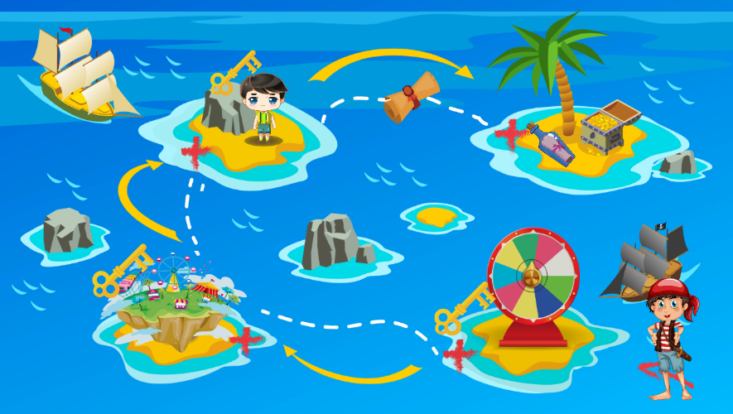
Design
The Treasure Map:

Slide 19
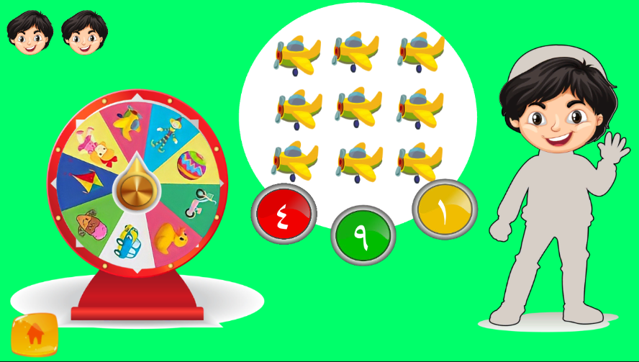
Design
Island one: The wheel game .

Slide 20
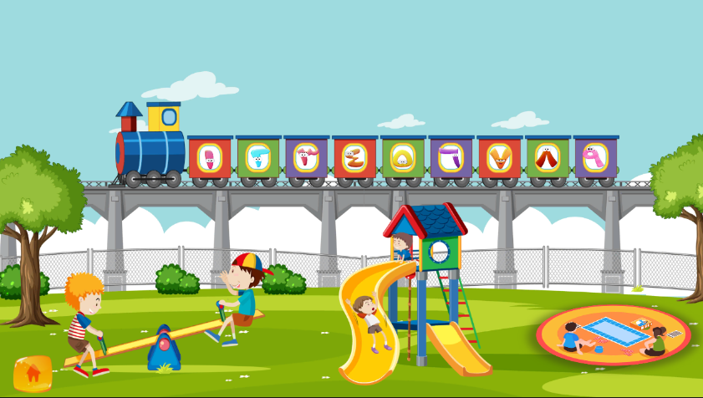
Design
Island Two: Amusement Island

Slide 21
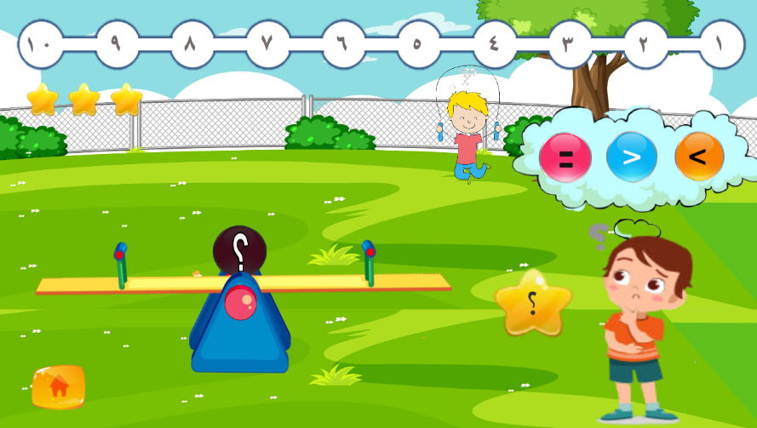
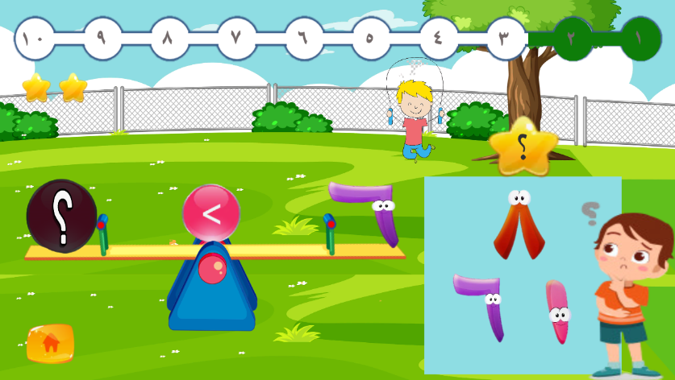
Design
Island Two: Seesaw Game

Slide 22
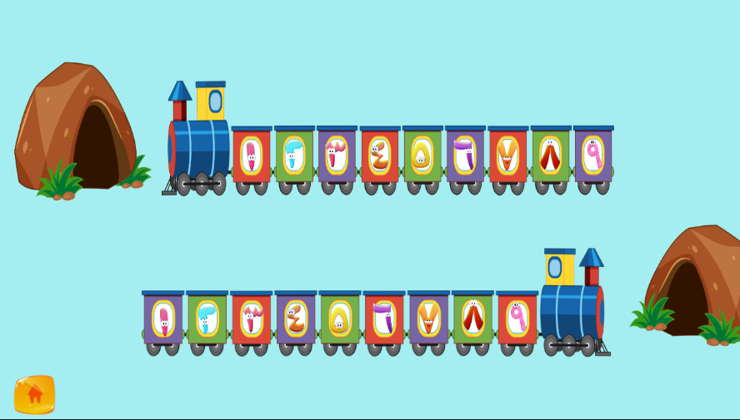
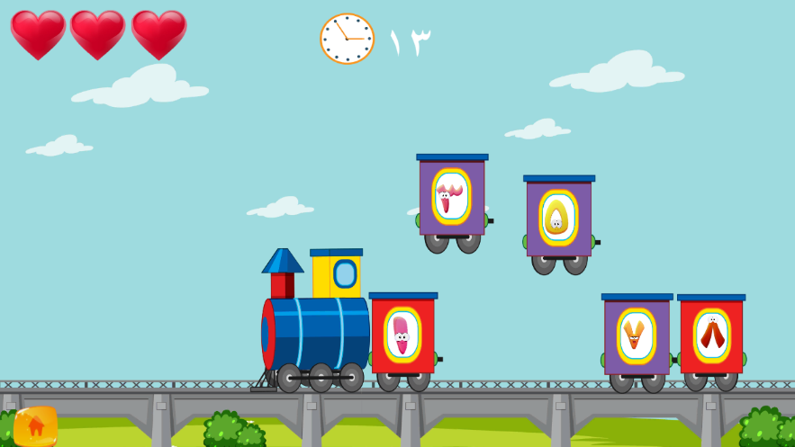
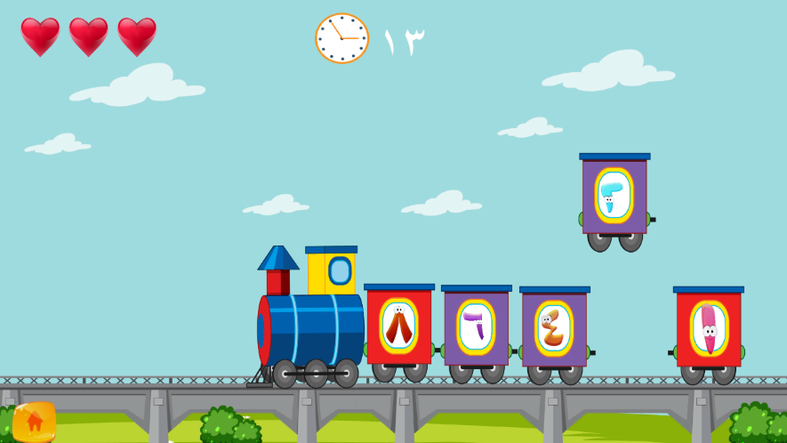
Design
Island Two: Train Game

Slide 23
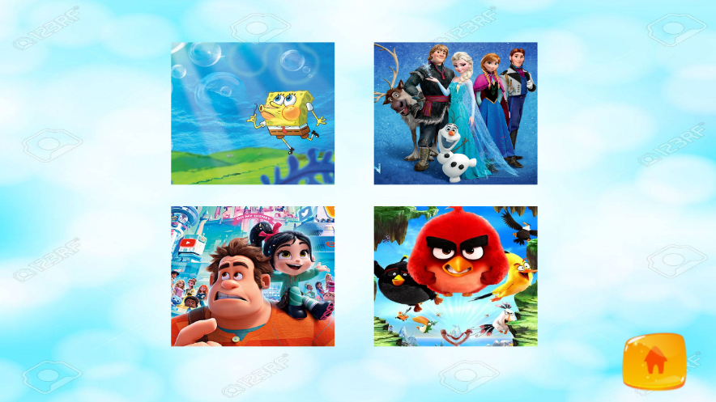
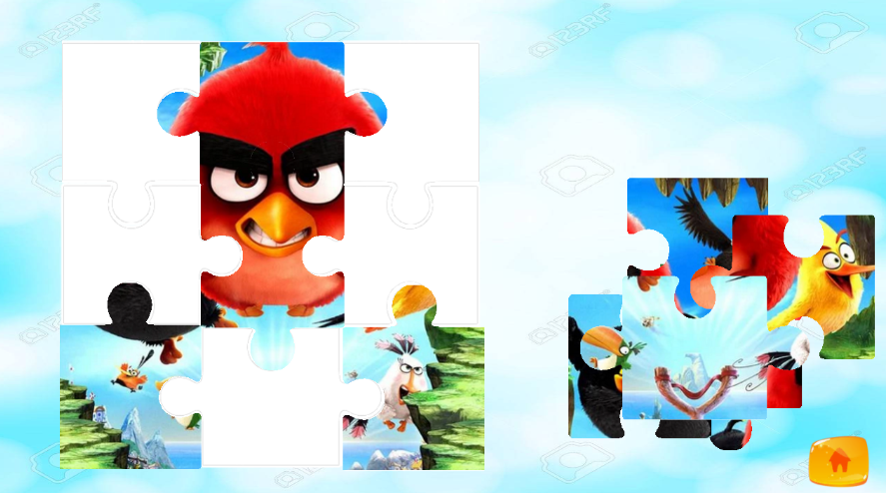
Design
Island Two: Puzzle Game

Slide 24

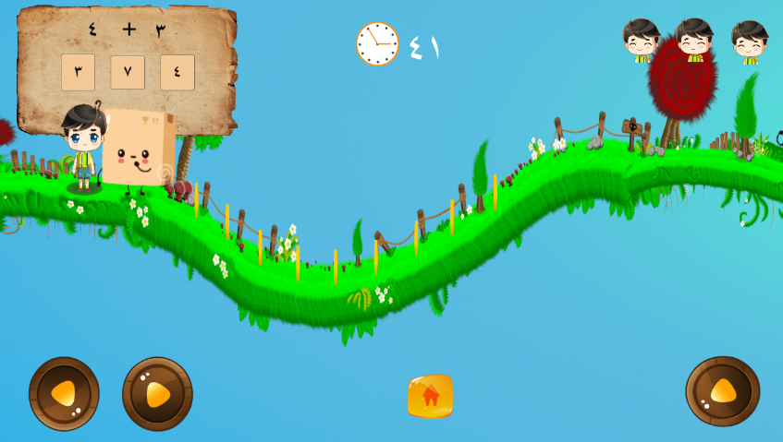
Design
Island Three

Slide 25

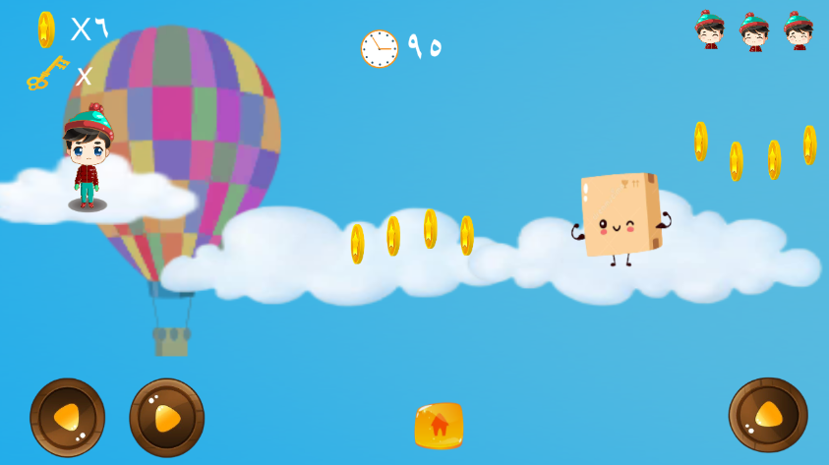
Design

Slide 26
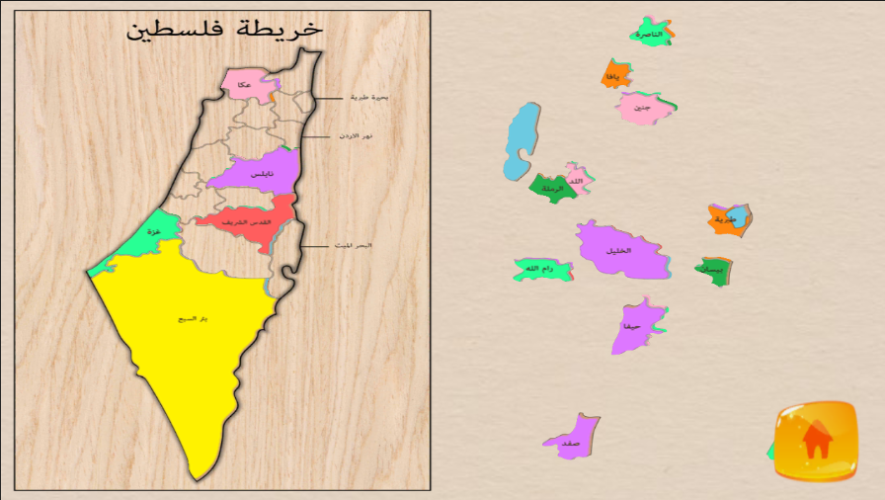
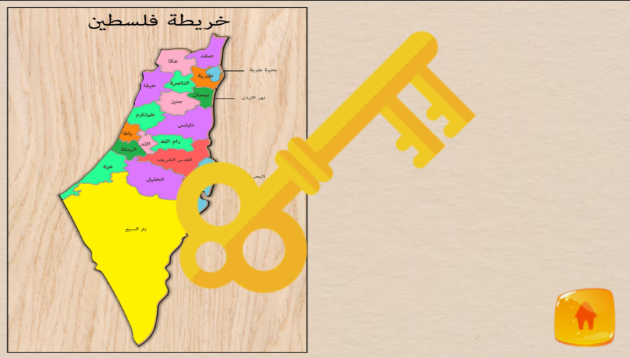
Design
Palestine Map Puzzle:

Slide 27
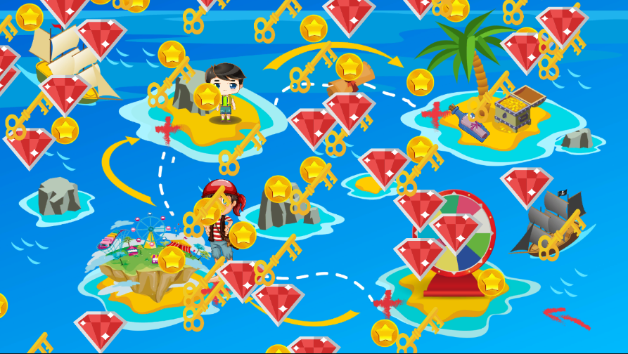
Design
Island Four: fined the treasure

Slide 28
Methodology
Assets & voices & Animation

Slide 29
Assets & voices & Animation
Background and motivation voices
Assets and colors that suits the kids
Animations to attract kids

Slide 30
Methodology
Tools:

Slide 31
Tools

Slide 32
Results:

Slide 33
Results
contribute to the education and training of children in mathematics.
The specialists and kids have reacted positively.

Slide 34
Future work

Slide 35
Future work
make an English version of the game.
include different topics for different age groups.
teachers will be able to change entries or questions.
Add dashboard.

Slide 36
Contact us
magdoleensaadeh@gmail.com
aseelghanim0@gmail.com
Thank You for Watching

