Slide 1

Studying Geothermal Heat Pump in Palestine

Slide 2
Prepared By :
Ahmad Khaled- Mohanad Khalelia- Nedal Saleh
Graduation Project
Supervised By :
Miss. Hala Hadad

Slide 3
Presentation Outline
Site Analysis.
Architectural Design..
Structural Design.
Geothermal system design.
Cost Estimation

Slide 4
Project Information
General Overview
This Graduation Project Interested in designing Geothermal heating and cooling system for residential building, and compare with traditional HVAC system.

Slide 5
Site Analysis
Site Location.
Soil Analysis and topography.
Climate.
Temperature.
Wind.
Shadows.

Slide 6
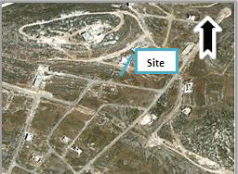
Site Location

Slide 7
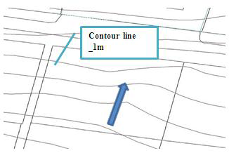
Soil Analysis and topography.

Slide 8
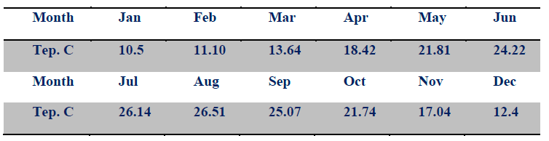
Temperature

Slide 9
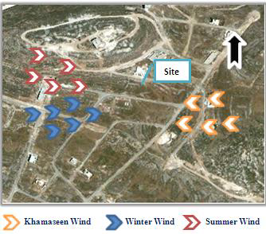
Wind

Slide 10
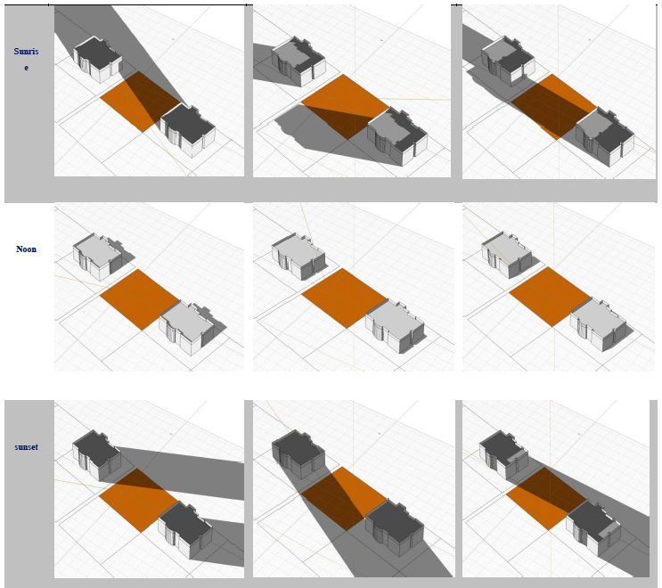
Shadows

Slide 11
Architectural Design
Site plan.
Ground floor.
Elevations.
Sections.
Environmental analysis.
Sun path and shadows.
Natural lighting.
Insolation analysis.

Slide 12
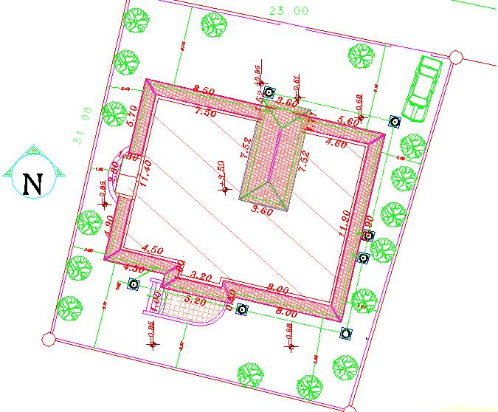
Site Plan

Slide 13
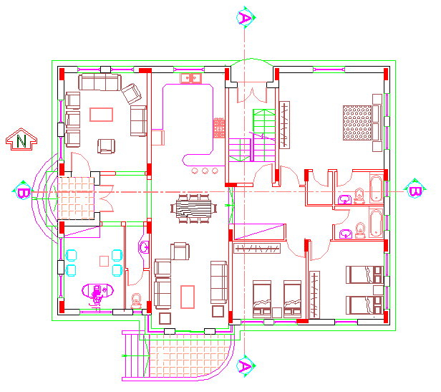
Ground floor

Slide 14
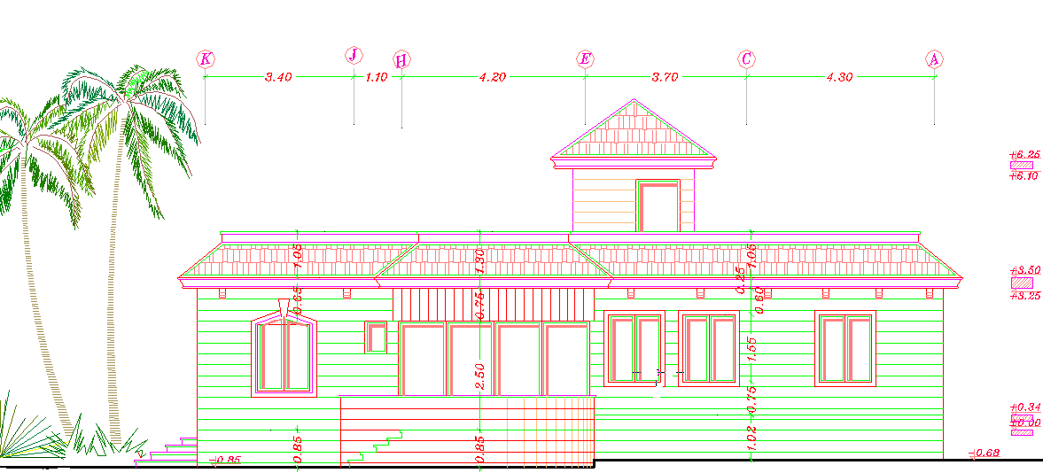
South elevation

Slide 15
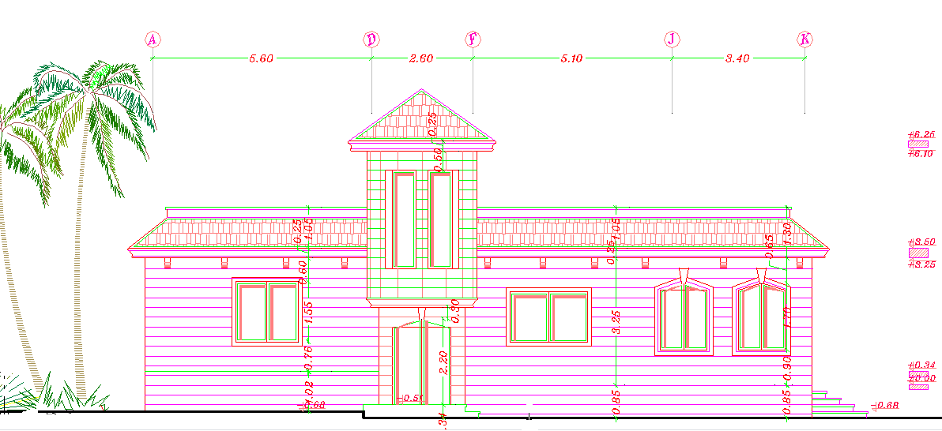
North elevation

Slide 16
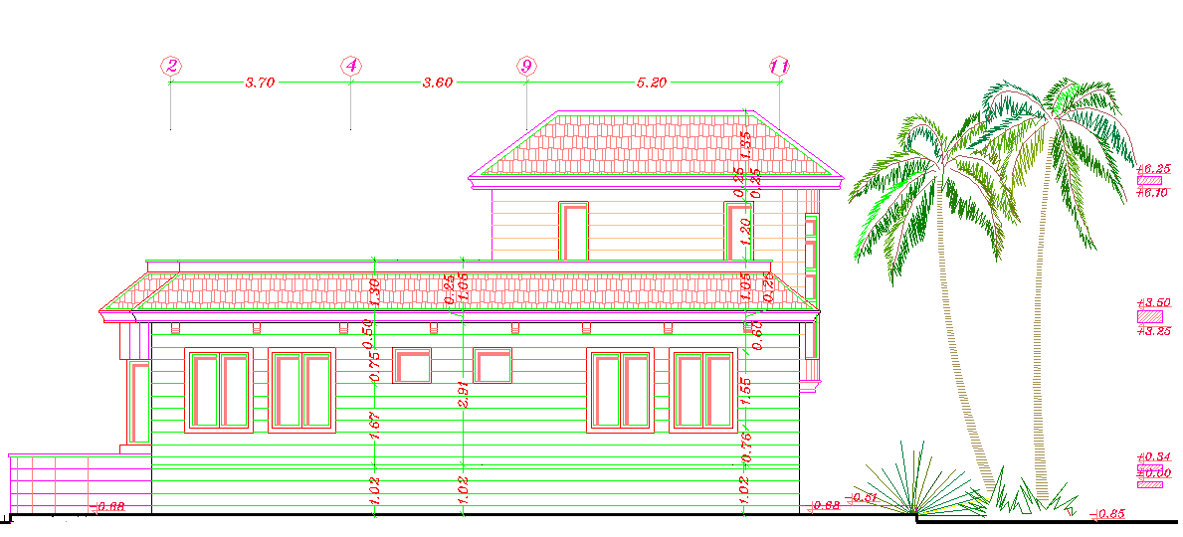
East elevation

Slide 17
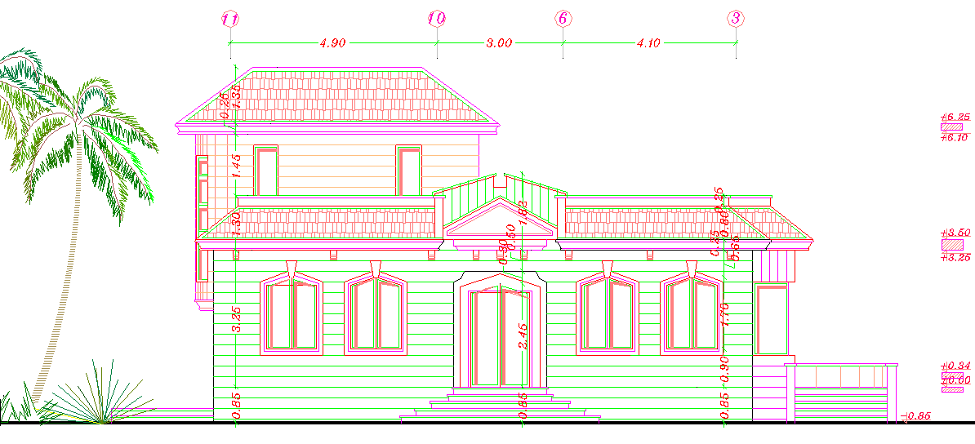
West elevation

Slide 18
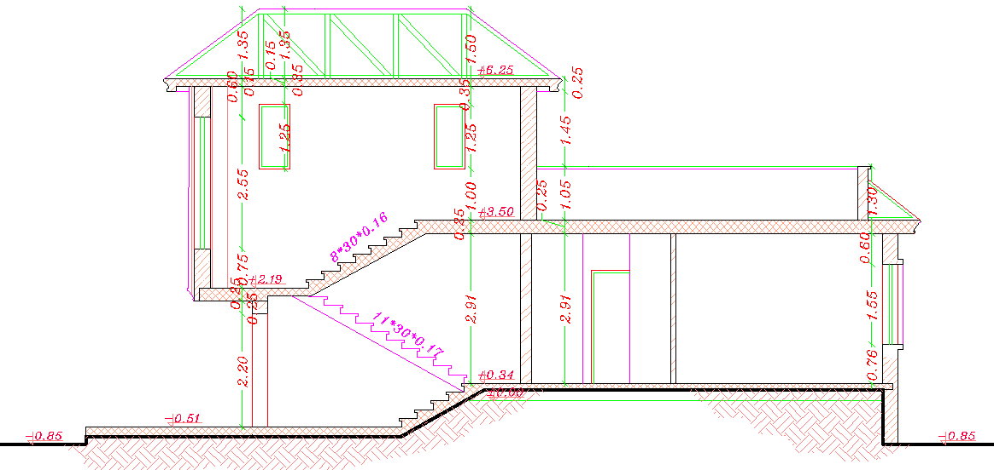
Section A-A

Slide 19
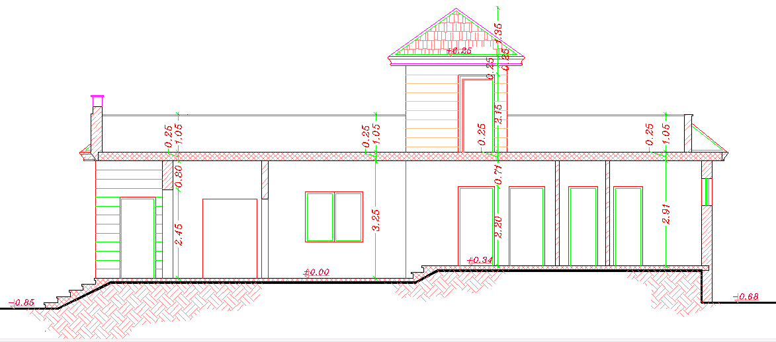
Section B-B

Slide 20
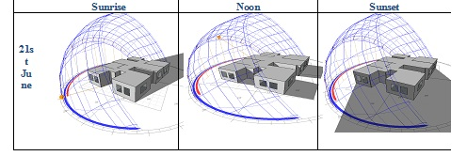
Sun path and shadows
Summer

Slide 21
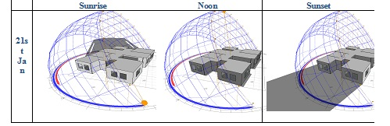
Sun path and shadows
Winter

Slide 22
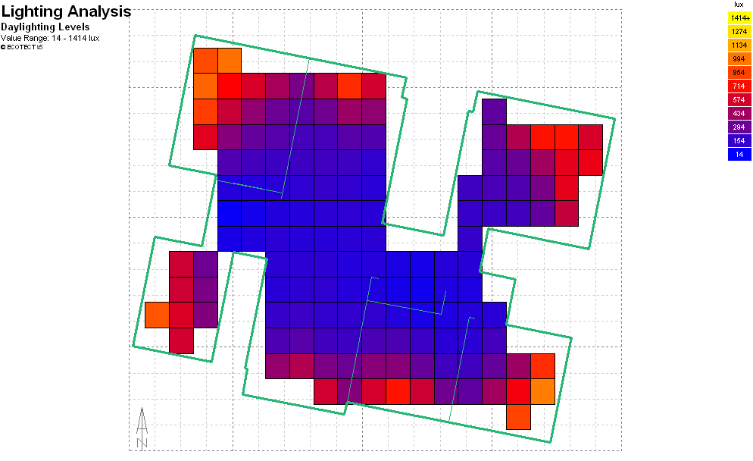
Daylight level

Slide 23
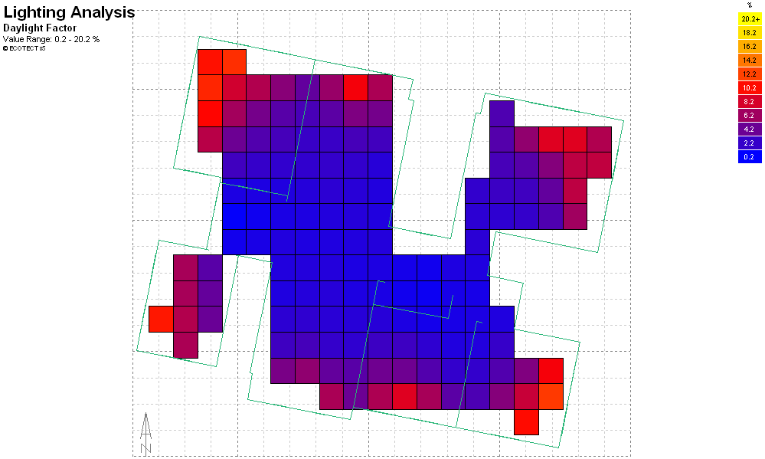
Daylight factor

Slide 24
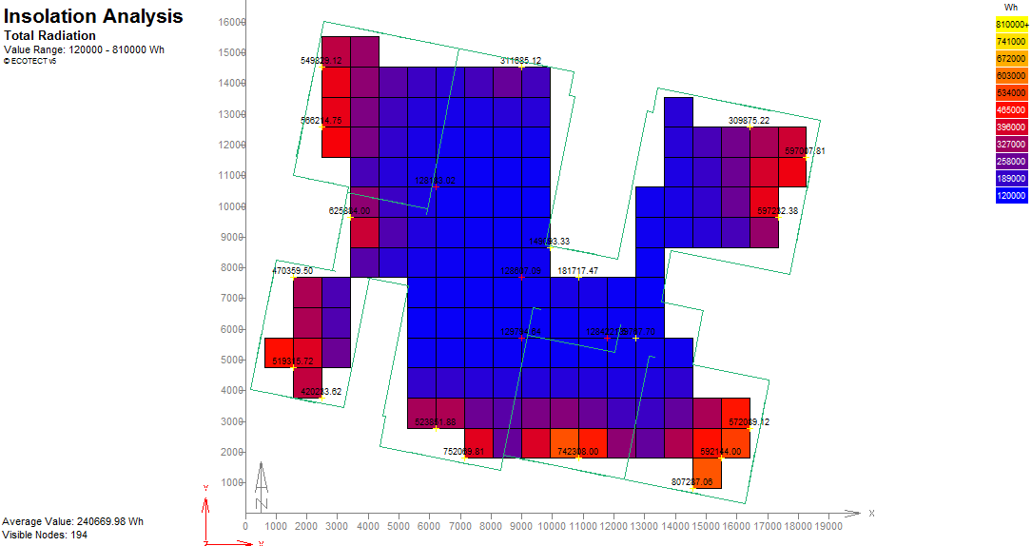
Insolation Analysis

Slide 25
Structural Design
Design data .
Slab design.
Beam design.
Column design.
Footing design.

Slide 26
Design data
Compressive strength of concrete (f'c): The compressive strength of concrete for beams, columns, slabs and footing was chosen as =280 Kg/cm².
Yielding strength of steel (Fy ): The yield strength of steel for flexure equal = 4200 Kg/ cm² and for shear reinforcement equal = 4200 Kg/ cm² .
Unit weights of materials: Concrete = 2500 Kg/ m³, Block=1000 Kg/ m³.
Superimposed dead load=300Kg/ m² , Live load=250Kg/ m²

Slide 27
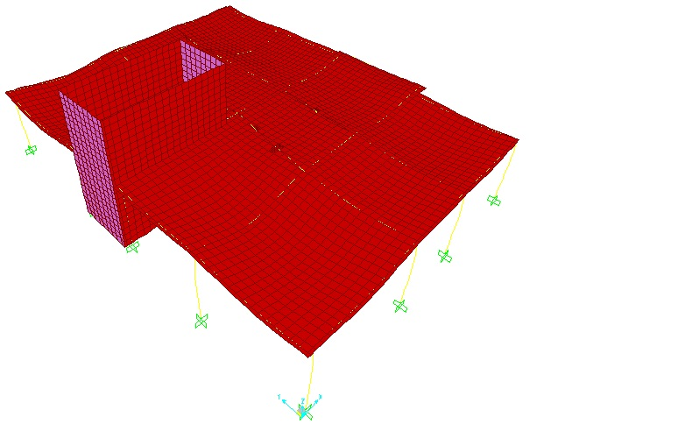
Slab design
Compatibility check

Slide 28
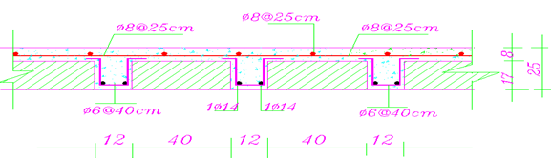
Reinforcement Details
Slabs are designed as one way ribbed slab with thickness =25cm

Slide 29
Beam Design
حديد مكسوح | Bottom reinforcement | Upper reinforcement | Beam#
3 ɸ16 | 7 ɸ14 | 4 ɸ12 | 4
حديد مكسوح | Bottom Steal | Upper Steel | Beam#
3 ɸ14 | 6 ɸ14 | 4 ɸ12 | 1,5
3 ɸ16 | 7 ɸ16 | 4 ɸ12 | 2,3
3 ɸ12 | 3 ɸ12 | 3 ɸ12 | 6,8,9(secondary beams)
3 ɸ16 | 3 ɸ14 | 3 ɸ12 | 7

Slide 30
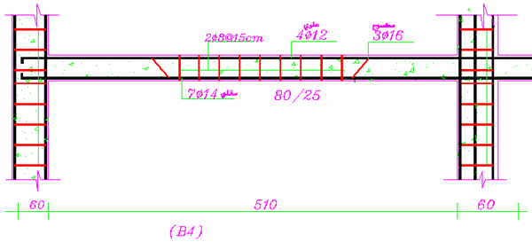
Beam Design

Slide 31
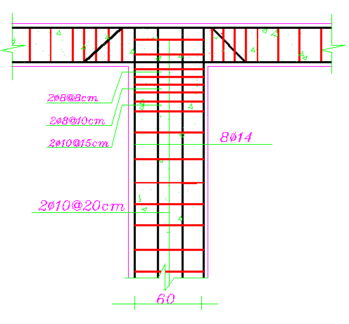
Column design

Slide 32
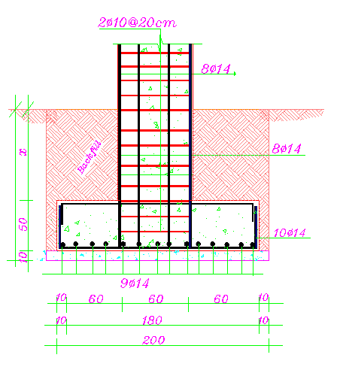
Footing design

Slide 33
Geothermal system design.
Introduction.
Design step.
Choose geothermal system type.
Building load.
Heat pump selection.
Pipe size and length.
Properties of trenches.
Land required.

Slide 34
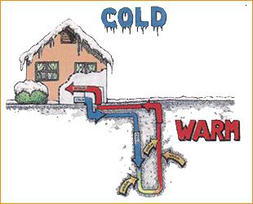
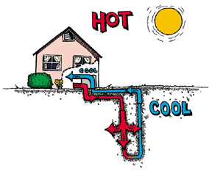
Introduction

Slide 35
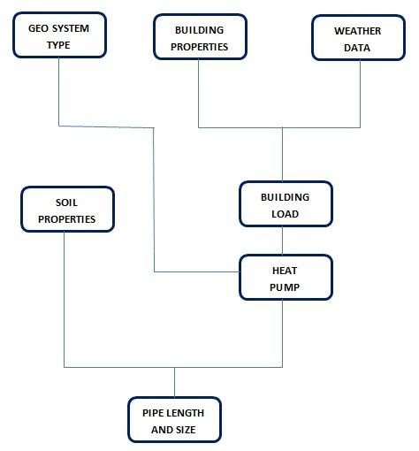
Design step

Slide 36
Choose geothermal system type
The determination of geothermal heat pump system for heating and cooling type depend on many factor:
Site properties
Geology
Hydrology
Land Availability
Topography
Building type
Natural resource
So we choose the horizontal close loop system

Slide 37
Building load
Building properties
External wall Internal wall
Layer name | Width | Density
Stone | 0.07 | 2300
Concrete | 0.1 | 2300
Polystyrene | 0.02 | 46
Block | 0.1 | 1040
Plaster | 0.007 | 1250
Layer name | Width | Density
Plaster | 0.007 | 1250
Block | 0.1 | 1040
Plaster | 0.007 | 1250

Slide 38
Celling Floor
Layer name | Width | Density
Concrete | 0.25 | 2300
Polystyrene | 0.02 | 46
Air gap | 0.05 | 1.3
Gipson board | 0.007 | 1250
Layer name | Width | Density
Soil | 1.5 | 1300
Concrete | 0.15 | 2800
Concrete screed | 0.005 | 2000
Ceramic tiles | 0.01 | 1900

Slide 39
Window Door
Layer name | Width | Density
Glass standard | 0.006 | 2300
Air gap | 0.03 | 1.3
Glass standard | 0.006 | 2300
Layer name | Width | Density
Wood pine | 0.04 | 550

Slide 40
Weather data
Weather data as we describe before.

Slide 41
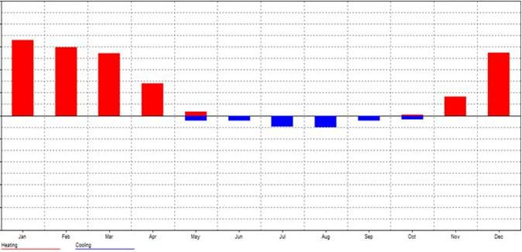
Heating & Cooling Load
Max Cooling: 15518 W Max Heating: 23576 W

Slide 42
Heat pump selection
The selection of heat pump depend on:
Geothermal system type
Project system is used a closed horizontal system.

Slide 43
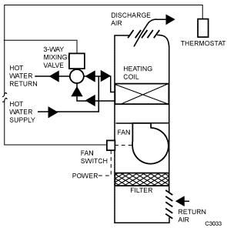
Assistant HVAC system
Assistant HVAC system used is Fan coil with two pipe heating/cooling, single coil system.

Slide 44
Assistant HVAC system
Assistant HVAC system used is Fan coil with two pipe heating/cooling, single coil system.

Slide 45
Building load
Heating load is 23.576 KW, and the cooling load is 15.518 KW
Pump properties
The Assistant HVAC system used is Fan coil, so we choose water to water ground heat pump.

Slide 46
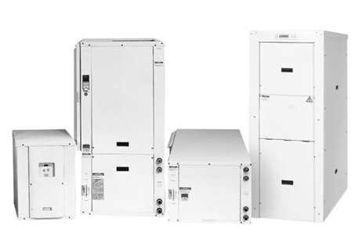
From this data the selected type of heat pump is
RW Series: Commercial Reversible Chiller - 60 Hz (8-50 Tons).
AHRI/ASHRAE/ISO 13256-2 Water-to-Water Ratings
Model | Capacity Modulation | Flow rate |  |  | Ground Loop Heat Pump
 |  |  |  |  | Cooling Full EST 25°C Part EST 20°C ELT 12°C |  | Heating Full EST 0°C Part ELT 5°C ELT 40°C
 |  | Source L/S |  | Load L/S | Capacity Watts | EER | Capacity Watts |  | COP
096 | Full | 1.5 | 1.5 |  | 29,894 | 5.0 | 24,619 | 3.1
 | Part | 1.5 | 1.5 |  | 16,706 | 6.6 | 14,361 | 3,5

Slide 47
Pipe length and size
Pipe size
The table below shown the pipe size and the maximum and minimum flow rate in Schedule 40 pipe for water
Pipe size (in) | Min Flow rate (gpm) | Max Flow rate (gpm)
3/4 | 1 | 20
1 | 2 | 30
1 1/4 | 2 | 50
From heat pump the flow rate is 1.5 L/S which is equal 23.77 gpm, then the pipe size is 1 in.

Slide 48
Pipe length
The not enough date about soil thermal resistance and ground temperature in Nablus city, we used method two to determine the pipe length.
For horizontal (Two pipes per trench): L=44m/KW (155.5m/ton).
Lc = 683m Lh = 1038m
Because we used the same pipe for both heating and cooling we take the max. length that is 1038m.

Slide 49
Properties of trenches
Number | depth | length | width | Area
17 | 2 | 31 | 0.7 | 21.7
Total |  | 527 |  | 368.9

Slide 50
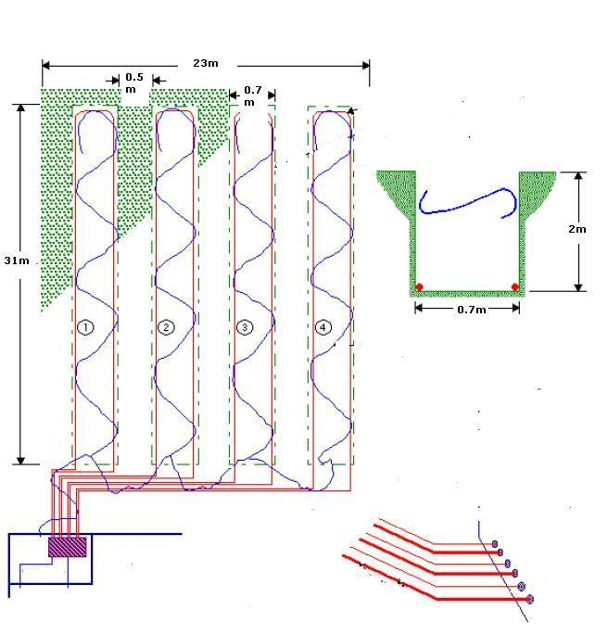
Land required

Slide 51
Cost estimation
Traditional HVAC System Cost
Geothermal System Cost

Slide 52
Traditional HVAC System Cost
Initial Cost
The max. building load is 23.576 KW (7 ton), and the building has the 6 zones to heat and cool, So split unit used is:
Room | Number | Capacity of split unit ( ton) | Price ( $)
Bedroom | 3 | 1 | 1500
Office room | 1 | 1 | 500
Living room | 1 | 1.5 | 700
Guest room | 1 | 1.5 | 700
Total | 6 | 7 | 3400

Slide 53
Running Cost
The table below show the average properties of deferent type of split unit
Capacity ( ton) | Capacity (KW) |  | Power (KWh)
 | Heating | Cooling
1 | 3.81 | 3.51 | 1.3
1.5 | 5.87 | 5.27 | 2
2 | 7.92 | 7.02 | 3.74

Slide 54
Geothermal System Cost
Initial cost
The initial cost depend on
Drilling Machine cost
Labor installation cost
Assistants fan coil unit
Maintenance cost
Running Cost
The running cost depend on the performance and the capacity of heat pump

Slide 55
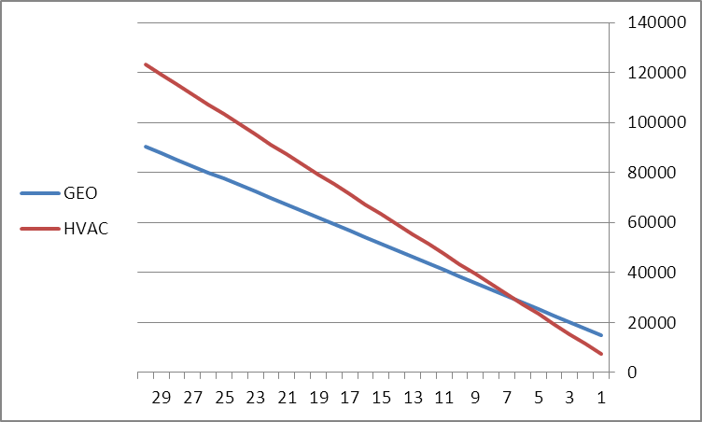
Summery
System | Initial cost ($) | Running cost ($) | Maintenance cost ($) | Total cost ($)
HVAC | 3400 | 3709.5 | 285 | 7394.5
Geothermal | 12354 | 2459.5 | 145 | 14958.5

Slide 56
From this figure we can see that after 7 year, geothermal system cost is equal to HVAC system cost.
So is considered as a good system in Palestine.
because
High initial cost of the geothermal system and low initial cost of the traditional system.
low running cost of the geothermal system and high running cost of the traditional system.
The running cost of the geothermal system is almost 20% less than the HVAC system
The main disadvantage of this geothermal system is the high initial cost, on the other hand it consider as environmentally friendly.
High maintenance cost of traditional system, and low maintenance cost of geothermal system.

