Slide 1
Incorporating Nano Titanium Dioxide in Water Based Emulsion for
Photo-Degradation of VOCs
Prepared by:
Jenan Kamal
Mariam Harah
Remaa` Yasser
Thar`a Mabrouk
Supervisor: Eng. Maryam Hmoudah

Slide 2
Outline:
Brief introduction about( VOCs, Naphthalene, TiO2)
Preparation of water-based emulsion and tests.
Synthesis of in -houseTiO₂ NPs.
Characterization of TiO₂ NPs.
Incorporation TiO₂ NPs with paint and tests.
Set up of photo-degradation of naphthalene.
Photo-degradation of naphthalene solution.
Conclusion

Slide 3
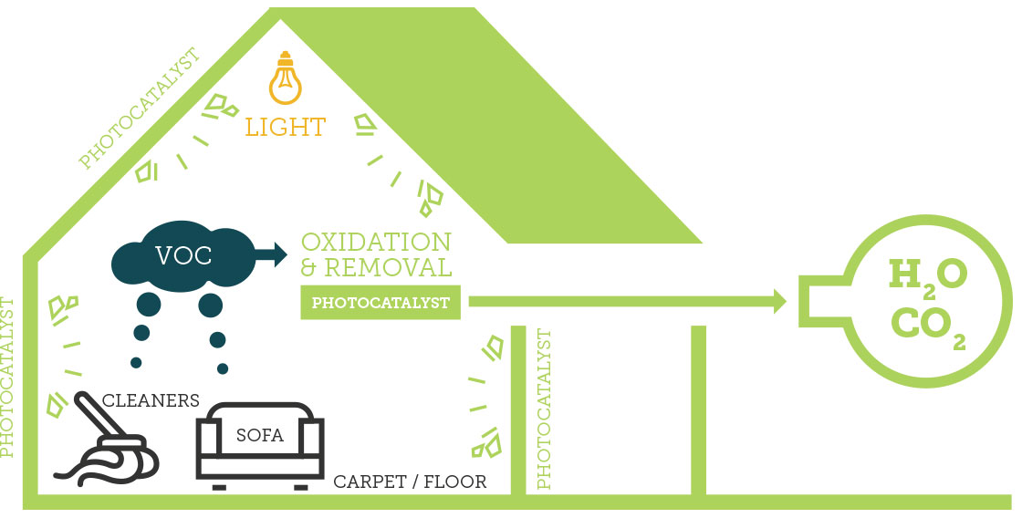

Slide 4
Brief introduction:
Volatile organic compounds (VOCs) are emitted as gases from certain solids or liquids. VOCs include a variety of chemicals, some of which may have short- and long-term adverse health effects. Concentrations of many VOCs are consistently higher indoors (up to ten times higher) than outdoors.

Slide 5
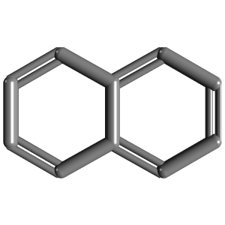
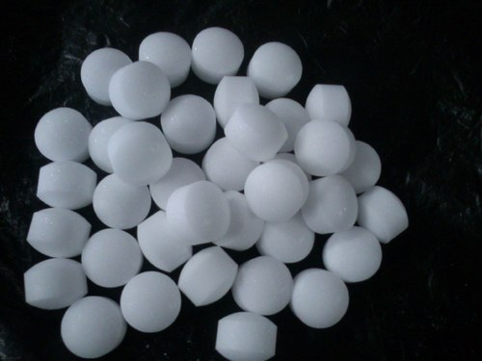
Naphthalene

Slide 6
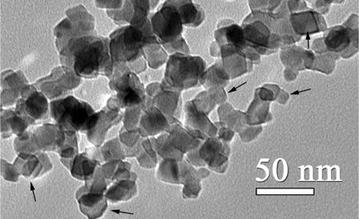
Nano titanium dioxide
Titanium nanoparticles are particles of titanium dioxide (TiO2) with diameters less than 100 nm.

Slide 7
Preparation of water-based emulsion
The raw materials of P2
 | Ingredients | Percentage (wt. %)
1 | Water | 34.0
2 | Cellulosic thickener | 0.4
3 | Dispersing agent | 0.6
4 | Bactercide | 0.45
5 | Titan | 12.0
6 | Carbonate | 20.0
7 | Talc | 4.0
8 | Styrene acrylic | 16.0
9 | Coalescent agent | 0.6
10 | Anti-foaming agent | 0.7
11 | Wetting agent | 0.5
12 | Silicate | 4.0
 | Total | 93

Slide 8
Result of P2 before storage.
Acceptance | Permitted Limit (Palestinian Standards Institution) | Result | The test
√ | 25◦C | 24 ◦C | Temperature
√ | 5-22 poise | 15 poise | Viscosity
√ | 1.4-1.6g/ml | 1.38 g/ml | Density
√ | 7-10 | 8 | pH
√ | 55-70 % | 58.5% | Solid content
√ |  | 4.5 | Gloss
√ |  | 0.949 | Opacity

Slide 9
Result of P2 after storage.
Acceptance | Permitted Limit (Palestinian Standards Institution) | Result | The test
√ | 25◦C | 24 ◦C | Temperature
√ | 5-22 poise | 16 poise | Viscosity
√ | 1.4-1.6g/ml | 1.41 g/ml | Density
√ | 7-10 | 8 | pH
√ | 55-70 % | 58.5% | Solid content
√ |  | 4.5 | Gloss
√ |  | 0.949 | Opacity

Slide 10
Synthesis of TiO₂ NPs by sol-gel method
There are many different synthetic routs of TiO2 NPs.
Sol-gel method is widely used to assemble various metal oxides due to many reasons, so sol-gel is the simplest and most developed method among different methods.

Slide 11
Synthesis process:
After 20min of stirred DIW will be added
Heating 80˚C,5hr
1 day,25°C
NaOH
TTIP
Isopropyl alcohol
Cooled at room temp.
Sol
Gel
pH
Drying @100°C,12hr
Rinse with ethanol
Filtering and washing
Calcination @800,2hr

Slide 12
Characterization of TiO₂ NPs
The main devices used to characterize TiO₂ NPs:
X-ray diffraction (XRD): is a rapid analytical technique primarily used for phase identification of a crystalline material and can provide information on unit cell dimensions.
Scanning electron microscopy (SEM): was performed to study the surface morphology of TiO₂ NPs . To view the morphology of the samples. A very small quantity of each powdered sample was placed over a carbon tape sample holder and it was tapped to release the excess and loose particles

Slide 13
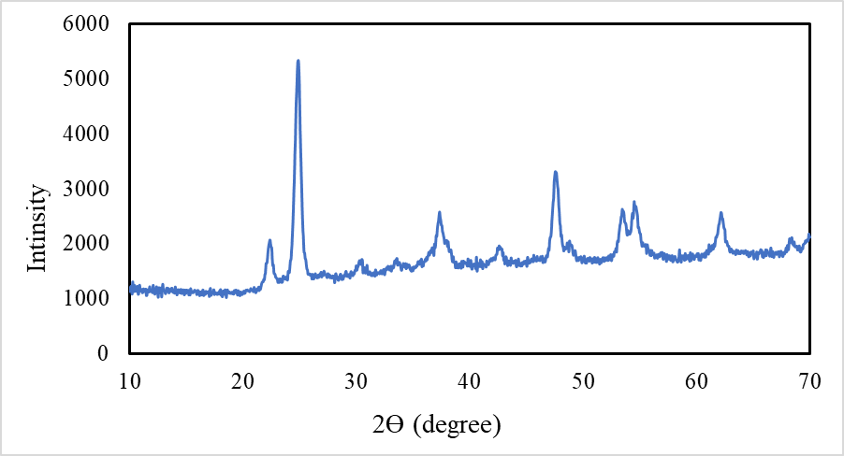

XRD analysis
$D=\frac{(K×ʎ)}{(β×COSΘ)}$

Slide 14
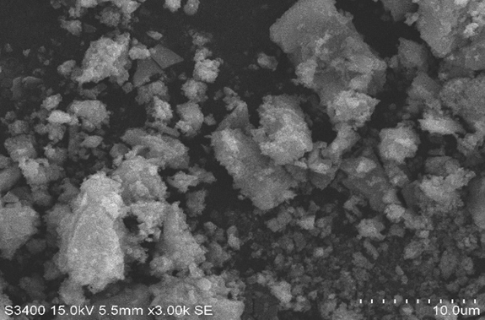
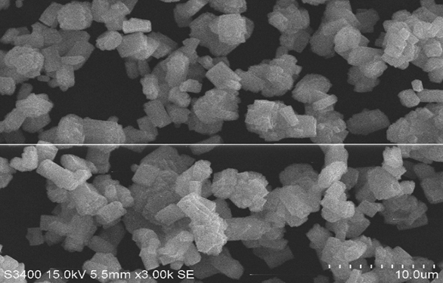
SEM analysis
(a)
(b)
a) SEM image for in-house nano by sol gel method. b) SEM image for purchase

Slide 15
Incorporation TiO₂ NPs with paint
incorporated with paint at the last stage of paint manufacturing.
The ratio of TiO2 NPS to paint equally 1%.
Speed of mixer approximately 166 rpm for 15 min.

Slide 16
Result of incorporating 6g TiO₂ NPs with 600g P2.
Acceptance | Permitted Limit (Palestinian Standards Institution) | Result | The test
√ | 25◦C | 24 ◦C | Temperature
√ | 5-22 poise | 17 poise | Viscosity
√ | 1.4-1.6g/ml | 1.38 g/ml | Density
√ | 7-10 | 8.7 | pH
√ | 55-70 % | 60.7 % | Solid content
√ |  | 4.5 | Gloss
√ |  | 0.949 | Opacity

Slide 17
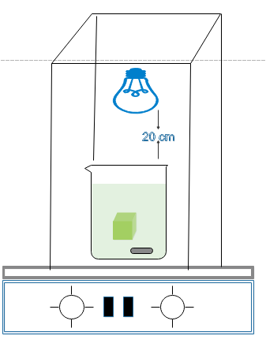
Set up of photo-degradation of naphthalene
Wooden box
Led light
Painted cube
Magnetic
Hotplate

Slide 18
calibration curve
  AfterPhoto-degradation of naphthalene experiment, quantitative analysis was established by UV-Vis spectrophotometer then a calibration curve was constructed and then used to determine the final concentration values of naphthalene solution after photo degradation.
Calibration curve of naphthalene solutions

Slide 19
final concentrations for the S1 (in-house TiO2 NPs ), S2 (pure paint) and S3 (purchased TiO2 NPs) effectiveness on naphthalene solution of 0.28M in first trial .
Trial 1 with LED | Concentration [M] | % of remove the naphthalene
Original solution 0.28M | 0.318 | -
S1 | 0.314 | 1.26%
Re-generation S1 | 0.311 | 2.2%
S2 | 0.324 | -
S3 | 0.322 | -

Slide 20
final concentrations for the S1(TiO2 NPs ), S2 (pure paint) and S3(purchased TiO2 NPs) effectiveness on naphthalene solution of 0.28M in second trial.
Trial 2 with LED | Concentration [M] | % of remove the naphthalene
S1:in-house TiO₂ NPs | 0.299 | 5.97%
S2 :pure paint | 0.306 | -
S3 :purchased TiO₂ NPs | 0.304 | 4.4%

Slide 21
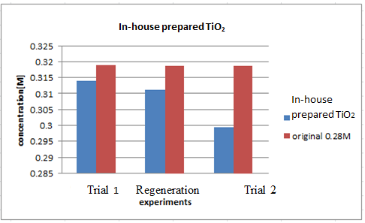
Effectiveness of in-house TiO₂ NPs compared with the original solution

Slide 22
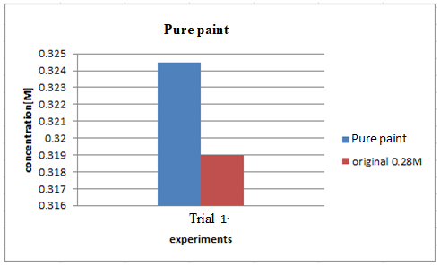
Effectiveness of pure paint compared with original solution

Slide 23
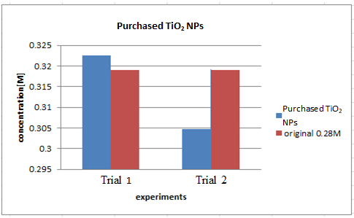
Effectiveness of purchased TiO₂ NPs compared with original solution

Slide 24
conclusion
TiO₂ NPs have been synthesized by the sol-gel method producing anatase phase. TiO₂ has been successfully applied as a catalyst for photo-degradation of naphthalene by using led light. The led light has also improved the photo-catalytic properties of the paint and through the re-generation TiO₂ NPs. In-houseTiO₂ NPs were characterized by two methods X-RD and SEM, the crystal size of the TiO₂-anatase-phase was determined to be 3.1 nm, the surface structure and morphology of TiO₂ NPs were cubic and agglomerated surface.
. The efficiency of photo degradation of naphthalene were compered between in-house TiO₂ NPs and the purchased TiO₂ NPs, the results as %removal of naphthalene for purchased after regeneration it was 4.4%. However, the %Removal of naphthalene with the in-house TiO₂ NPs was 1.26% and after regeneration it was 5.97%. These results indicate the in-house TiO₂ NPs more effective than the purchased TiO₂ NPs

