Slide 1

The Devoted
Caregiver
HardwareProject

Slide 2
Supervisor:
Emad Natsheh.
Students:
Laila Abu Safiya.
Sojod Jamous.

Slide 3
Table of Content:
Research.
IDEA.
System Architecture.
Processing Units and Used Devices.
Operation Process.
Conclusion and future work

Slide 4
Research
Cerebral palsy is a challenging medical condition with no known cure. The sole form of treatment available for individuals with cerebral palsy is physical therapy.

Slide 5
IDEA
Our idea introduces an innovative mobility chair that not only provides much-needed comfort and assistance but also incorporates essential aspects of physical therapy into the daily routine of these patients.

Slide 6
Operation Process

Slide 7
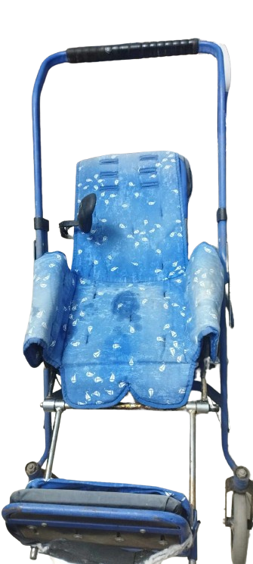
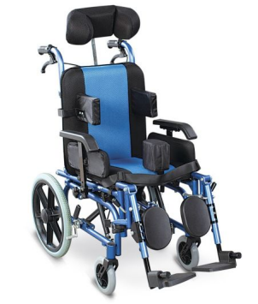
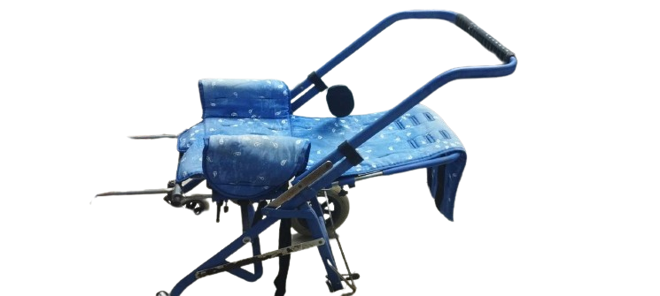
Full body
We use the chair for patients with cerebral palsy as a basic part to stabilize the moving parts and gears for the massage and to place the head support part on it.

Slide 8
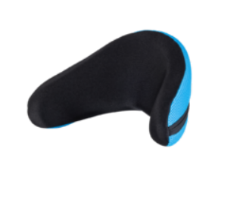
Headrest process
A headrest sensor is utilized to maintain the correct head position, preventing any potential discomfort or risk of choking for the patient.

Slide 9
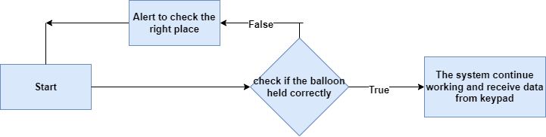
Headrest process

Slide 10
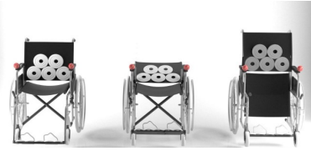
Massages therapy process
Massages vary in speed and technique to improve blood circulation, effectively addressing a common issue for patients with limited mobility.

Slide 11
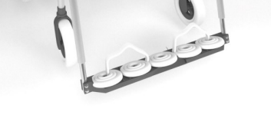
Massages therapy process
Foot massage therapy employs specialized foot wraps, particularly targeting the heel area based on Chinese foot mapping principles

Slide 12
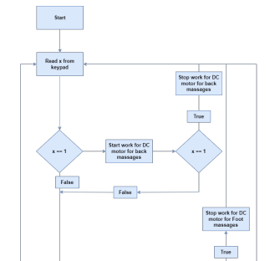
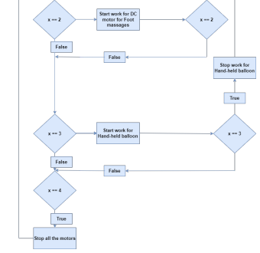
Massage therapy process

Slide 13
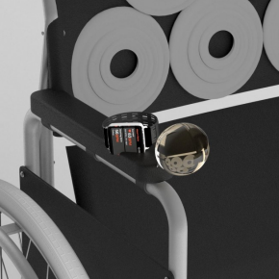
Hand-held Balloon Alerts
The chair incorporates a handheld balloon that gently expands and contracts, alleviating tension in the hands and effectively easing muscle spasms.

Slide 14
Hand-held Balloon Alerts

Slide 15
Massage therapy process

Slide 16
Wristwatch process
It monitors both temperature and heart rate, offering routine reports to the patient’s family and emergency calls to parents in case of any irregular readings.

Slide 17
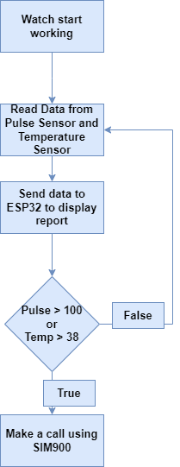
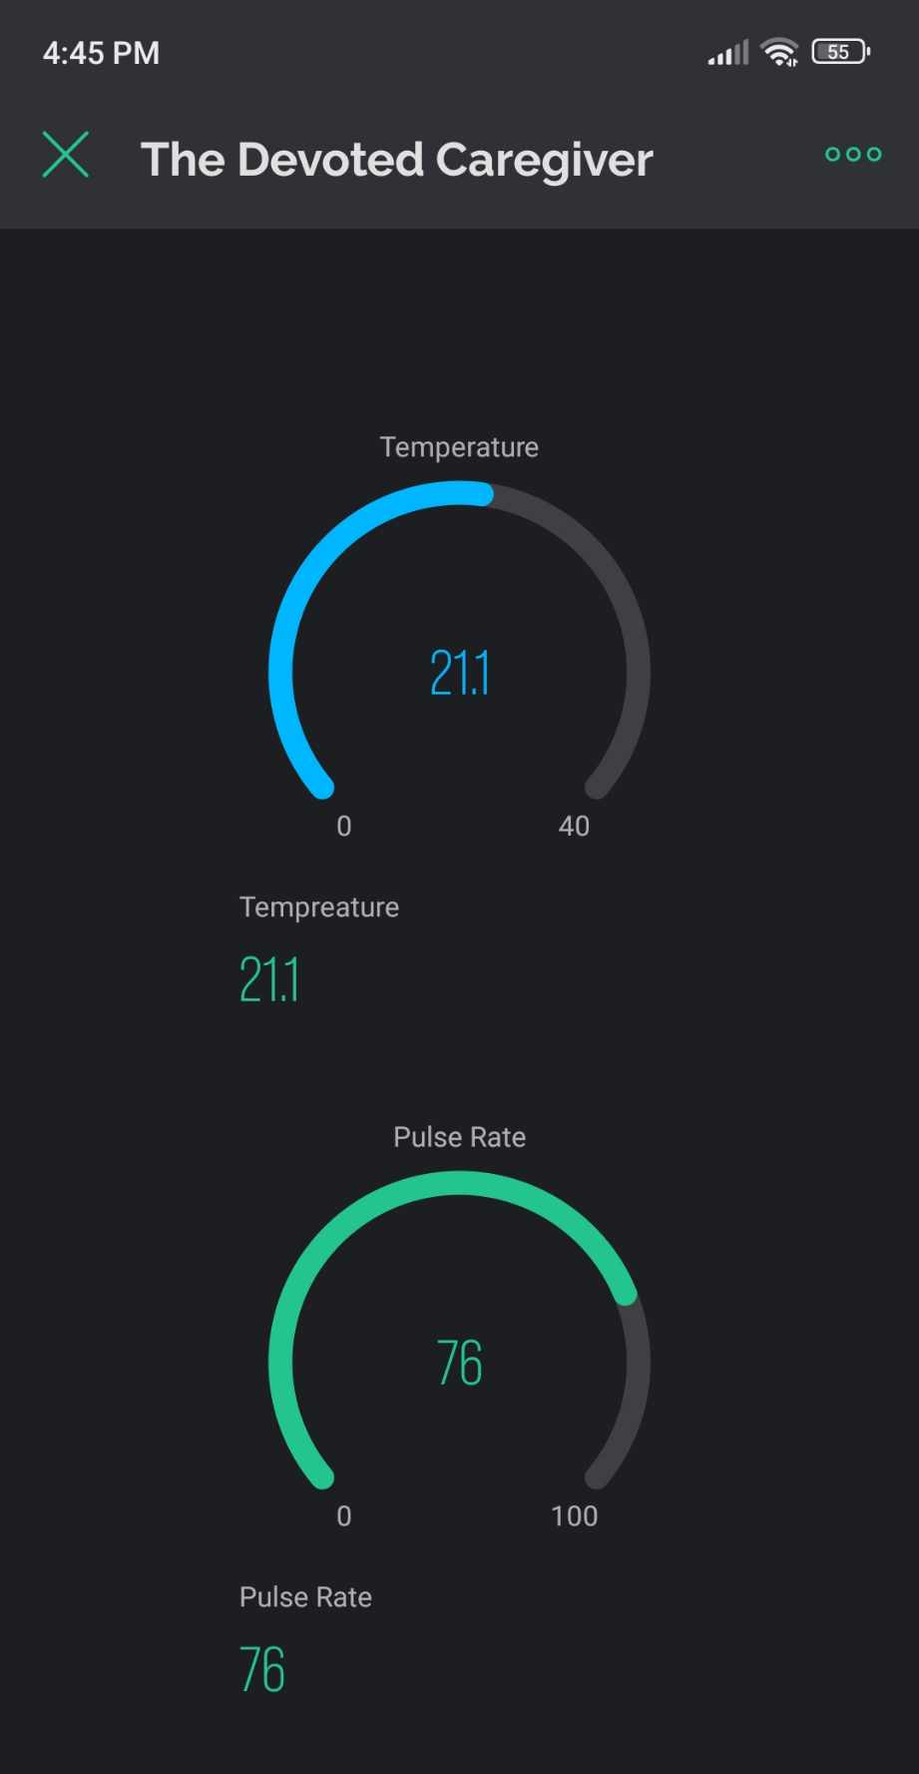
Wristwatch process

Slide 18
Processing Units and Used Devices

Slide 19
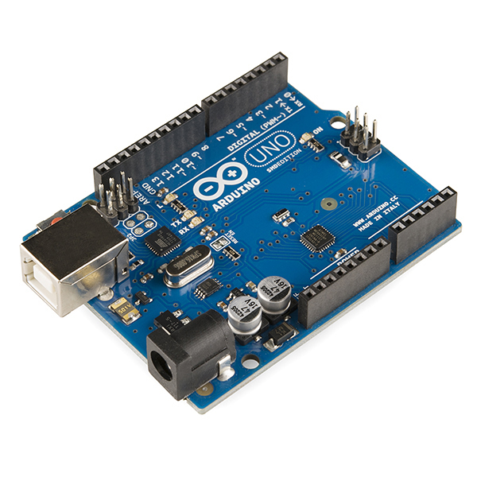
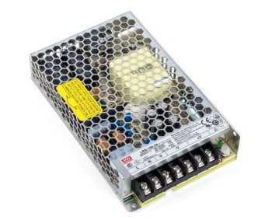
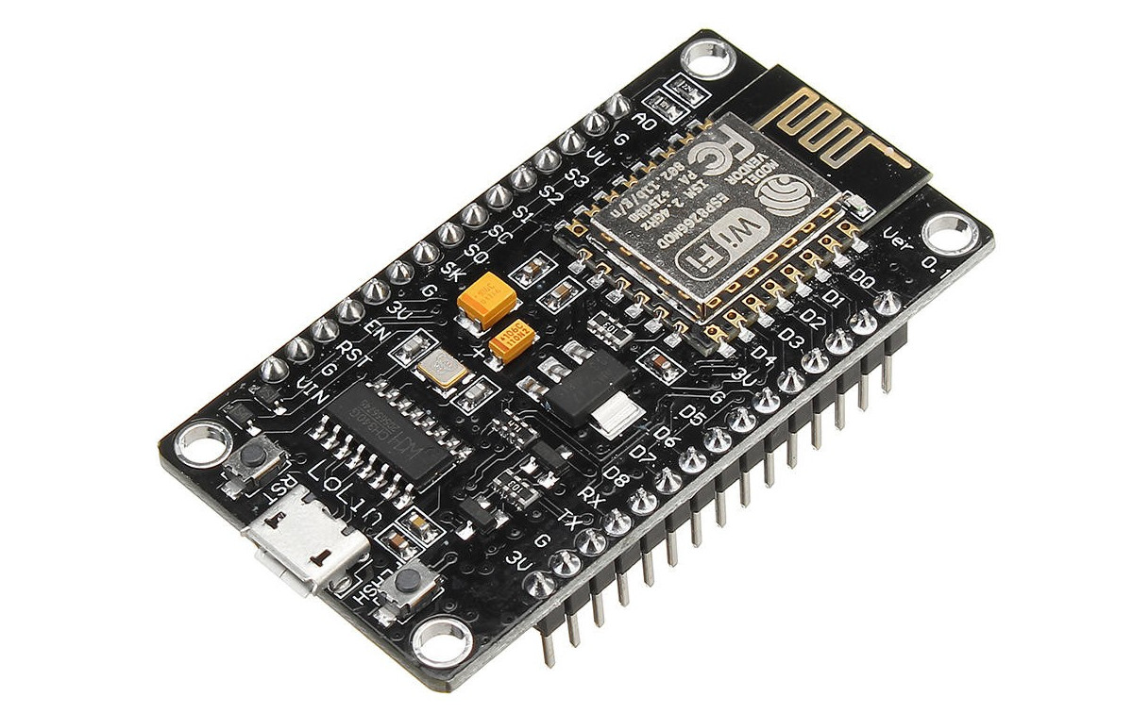
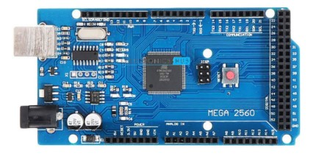
Processing Units and Used Devices
Arduino MEGA
Arduino UNO
POWER SUPPLY
ESP32

Slide 20
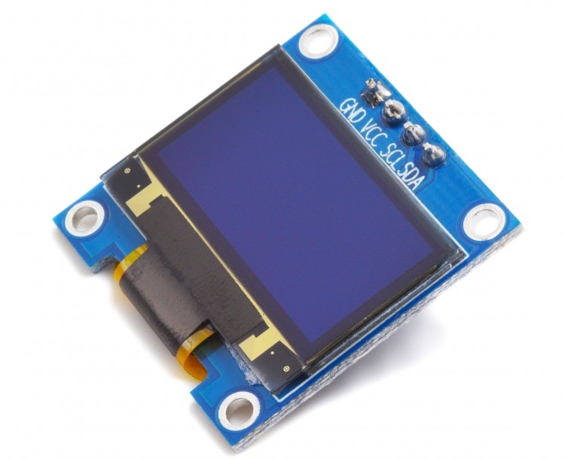
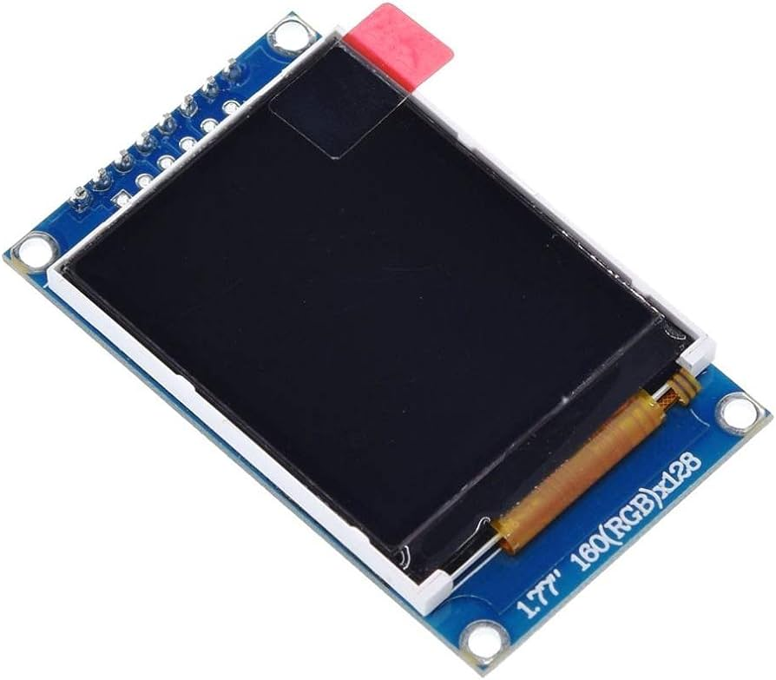
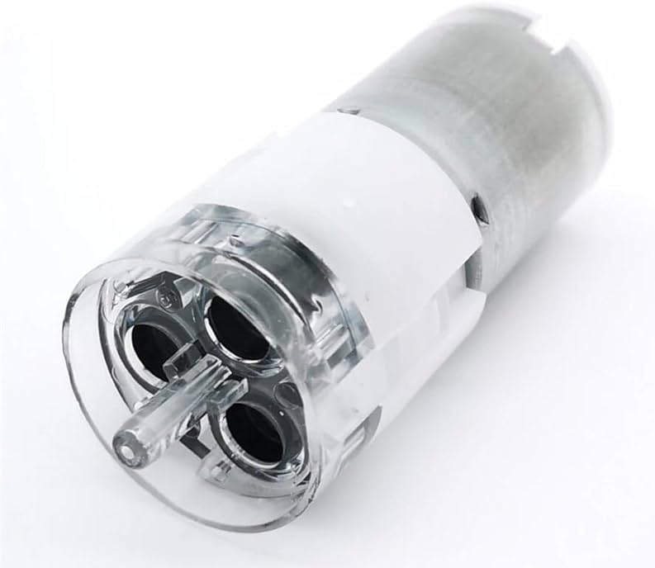
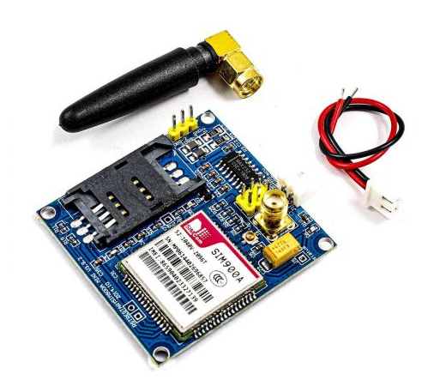
Processing Units and Used Devices
Afficheur TFT1.7
0.96 OLED Display
Micro air Pump
SIM900A

Slide 21
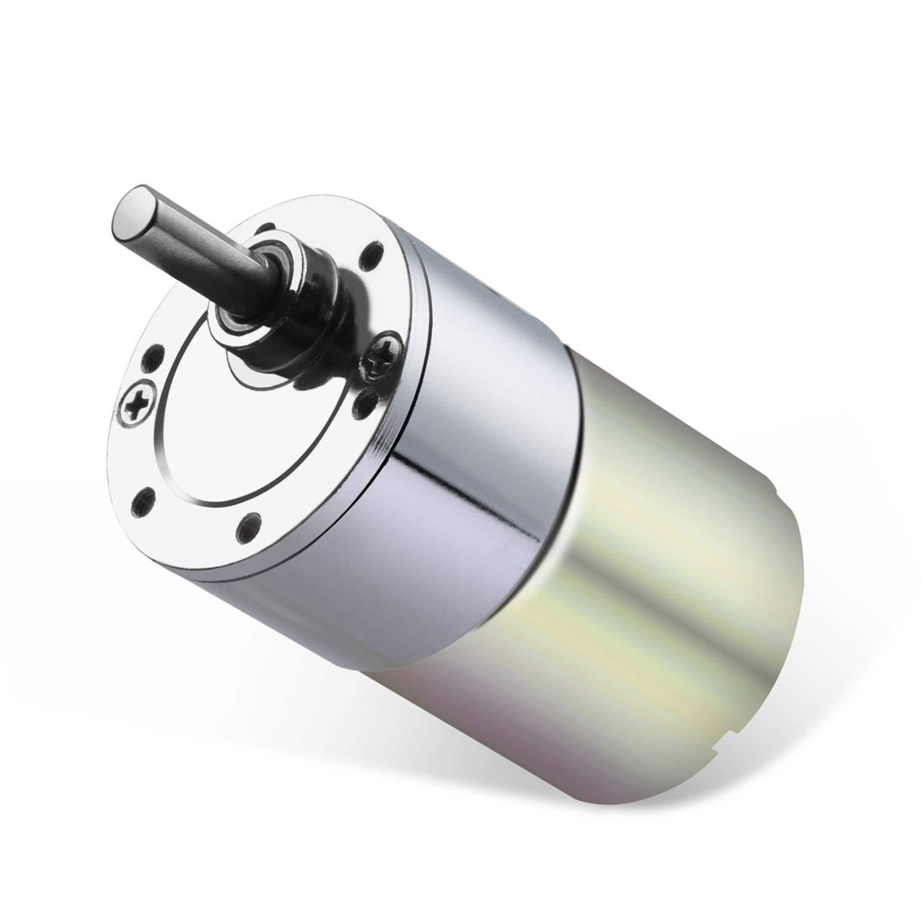
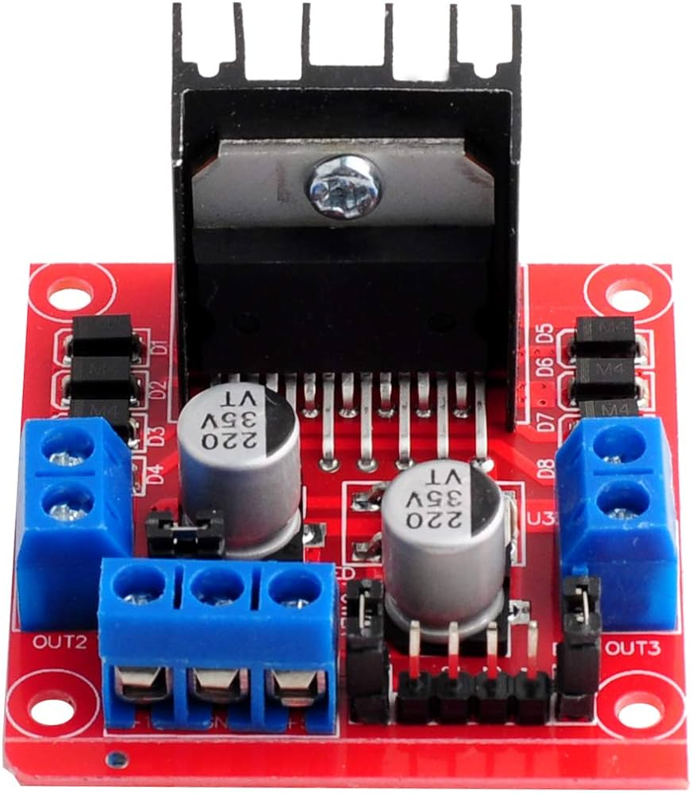
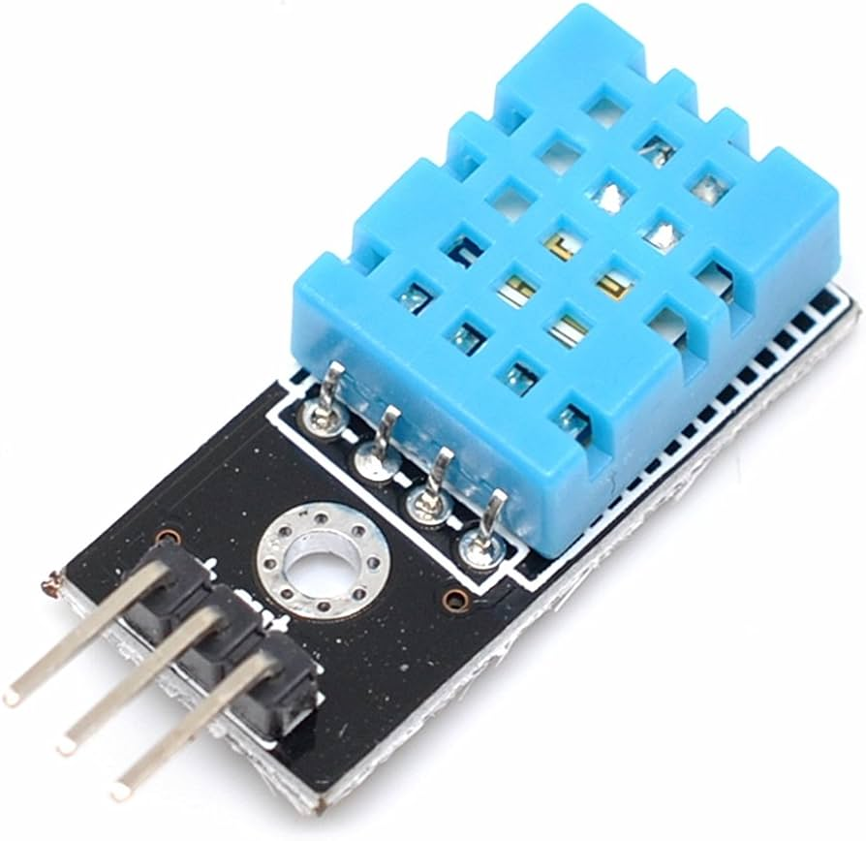
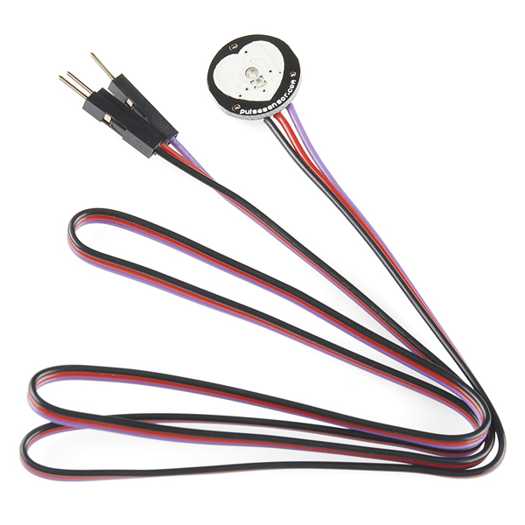
Processing Units and Used Devices
DC Motors
H-Bridge
Pulse Sensor SEN11574
Temperature Sensor DHT11

Slide 22
Conclusion and future work

Slide 23
Conclusion and future work
The system introduces novel and advanced features, departing from conventional approaches.
Future Work:
1− The chair converts to many positions:
a. wheelchair.
b. position bed.
c. standing position (assisting in the physiotherapy process).
2− Control the system via phone.
3− Using more advanced technological systems

Slide 24
Thank You

