Slide 1
Pyrolysis Plastic of Cupper Wire to Oil
Supervisor :
Adel Juaidi
Prepared by
Ahmad Saleh Abu Jazar
Osama Mohsen Atari
Osaid Abu Aseeda

Slide 2
Outline
Introduction
Literature Review
Methodology
Future Progress

Slide 3
Introduction
Introduction

Slide 4
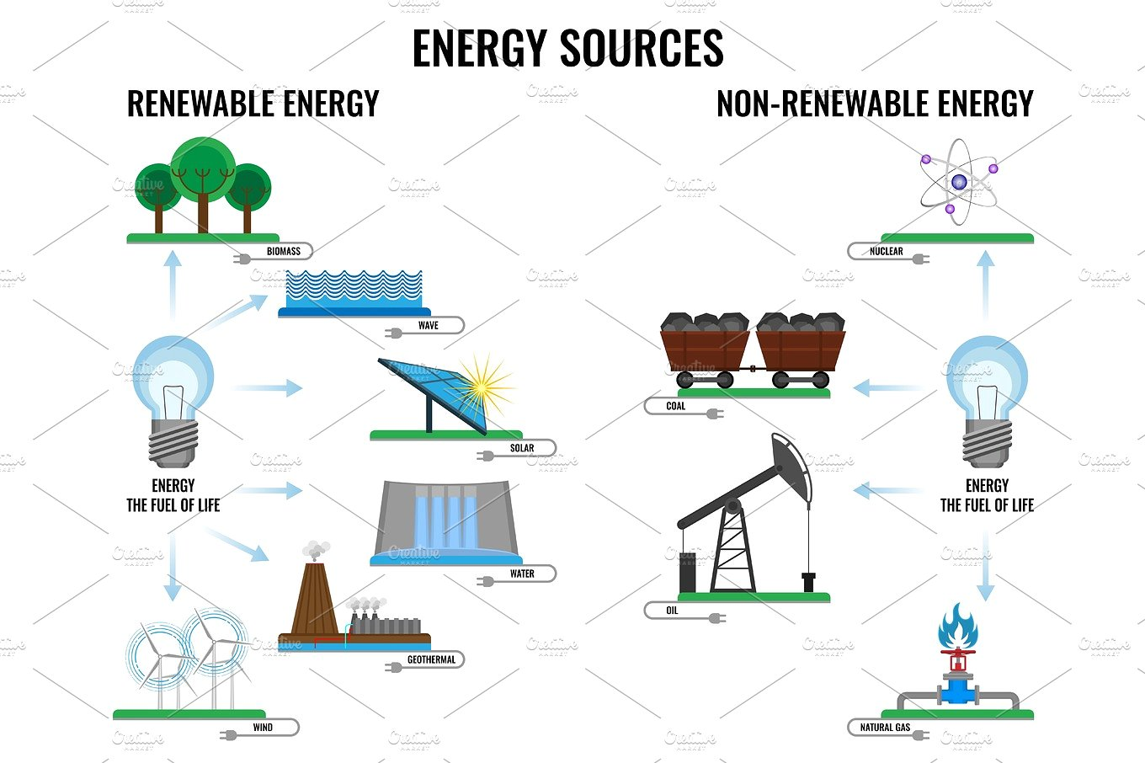

Slide 5
Reducing Pollution Methods
Practice Conservation at Home
Use Alternate Transportation
Use Alternative Energy

Slide 6
Pyrolysis
Advantages
Disadvantages
Products

Slide 7
Material
WOOD
MSW
Plastic
Rubber
Organic Waste
.
Textiles
WEEE

Slide 8
Rotary Kiln Reactor
Fluidized Bed Reactors
Microwave Assisted Reactors
Plasma Reactors
Solar Reactors
Spouted Bed Reactor
Fixed Bed Reactors and Batch Reactors

Slide 9
Pyrolysis
products
Oil
Gas
Char

Slide 10
Enhancing the Pyrolysis Process
Biomass and Plastic Mixtures
HZSM-5
Chlorinated Oil
MCM-41
ZSM-5
PVC
HCL

Slide 11
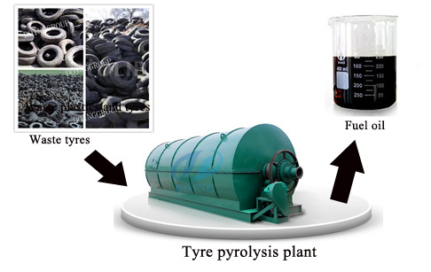
Pyrolysis in Palestine

Slide 12
The Previous Studies of Some Countries
UK
Indonesia
Palestine

Slide 13
Methodology

Slide 14


Slide 15
Methodology
Future Solutions
Machines and Tools
Future Prospects

Slide 16
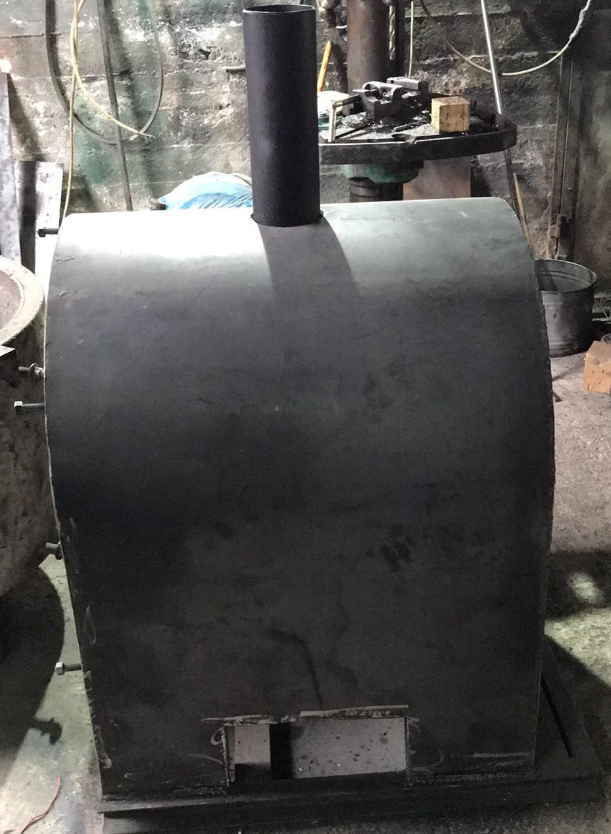

Slide 17
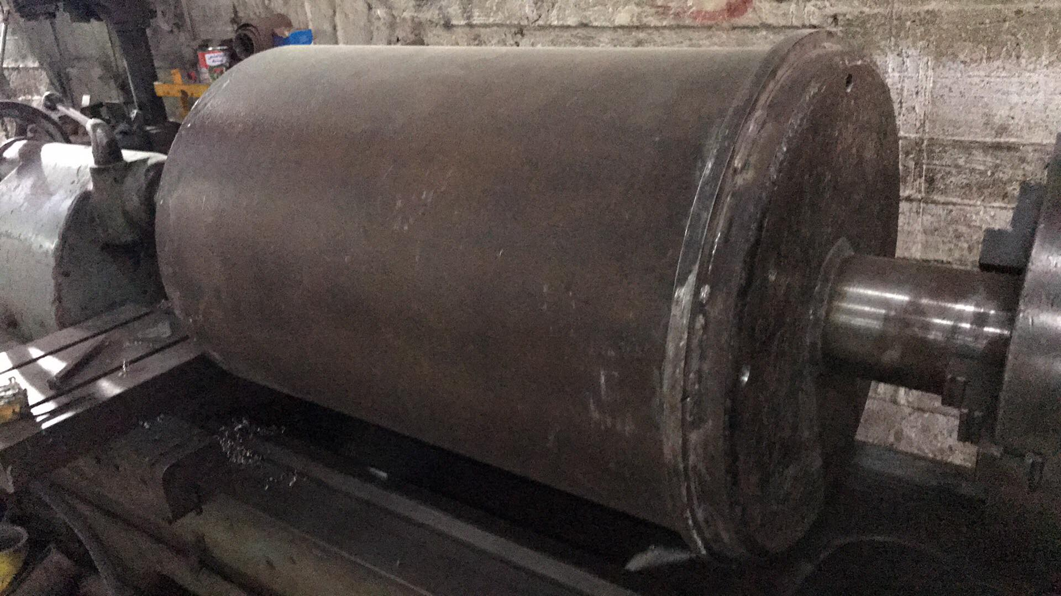

Slide 18
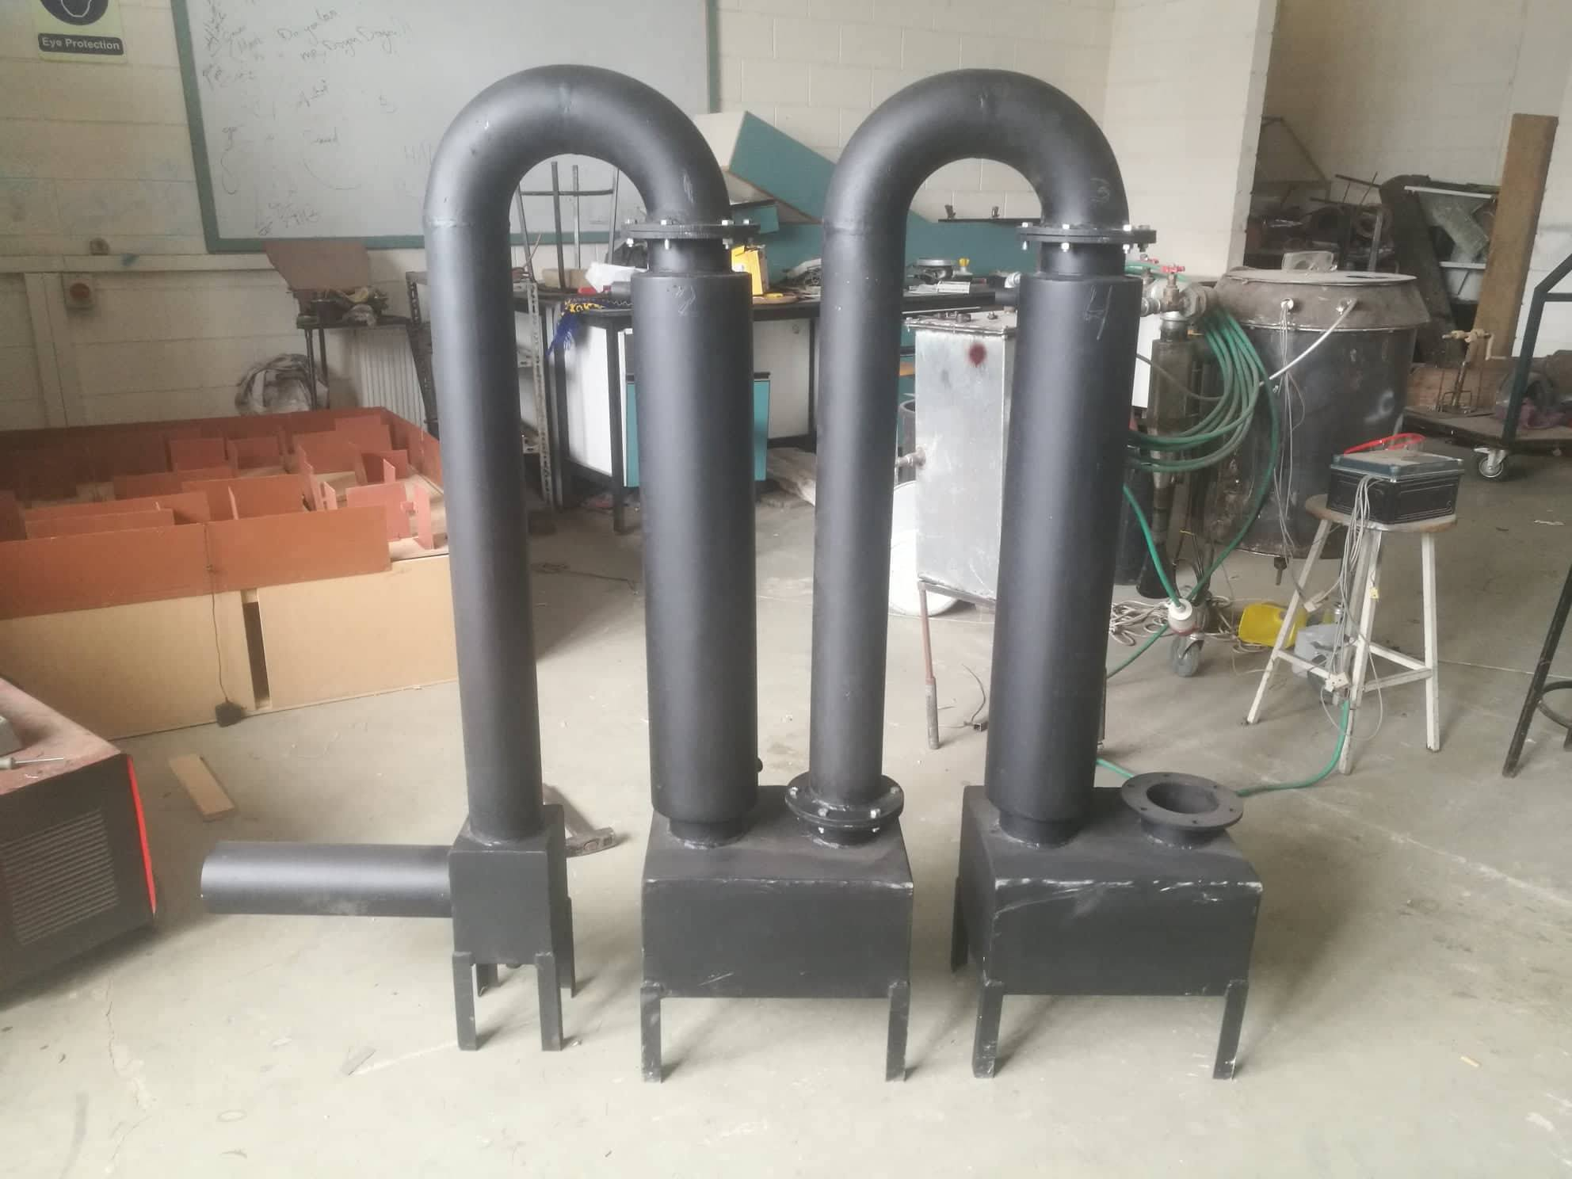

Slide 19
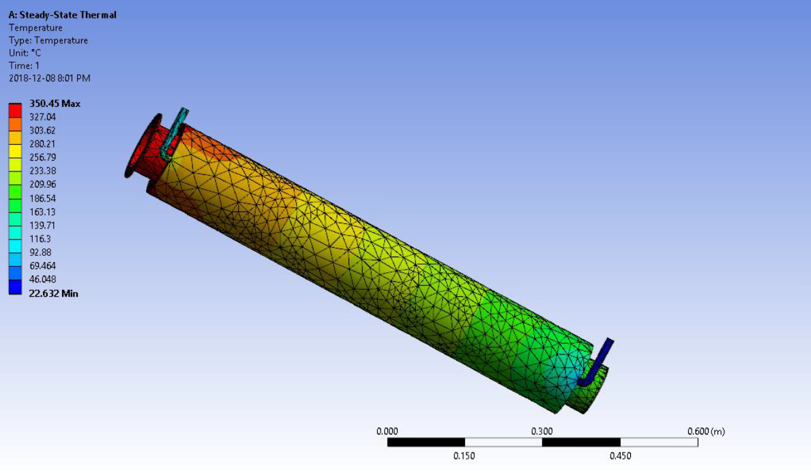
Figure 5: The First Heat Exchanger Thermal Analysis

Slide 20
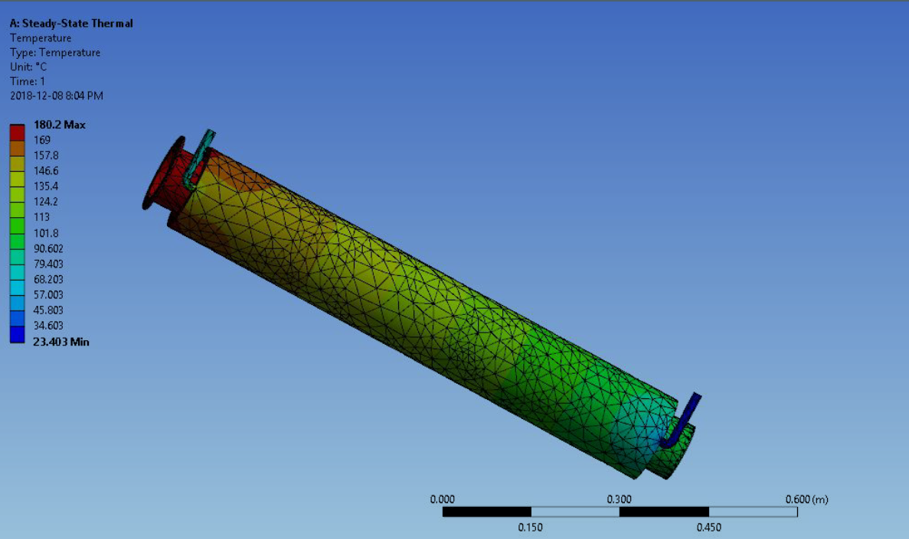
Figure 6: The Second Heat Exchanger Thermal Analysis

Slide 21


